Slide 1



Organizational Behavior
and Projects
PMG421
Lecture 10
Organizational Culture
Prepared by
Dr. Mumen Thabet

Slide 2

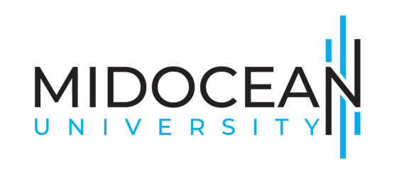


Understanding the organizational culture
Main streams related to organizational culture
Compare the functional and dysfunctional effects of organizational culture
Organizational culture and change management
Artificial Intelligence and organizational culture

Slide 3
Learning Objectives
Describe the common characteristics of organizational culture.
Show how culture is transmitted to employees.
Identify the factors that create and sustain an organization’s culture.
Compare the functional and dysfunctional effects of organizational culture on people and the organization.
Describe the similarities and differences in creating positive, ethical, and innovative cultures.
Describe the role of Artificial Intelligence in organizational culture.

Slide 4
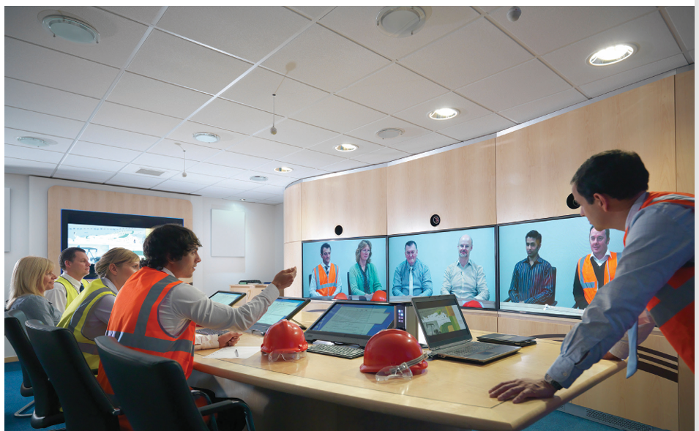
Concept of organizational culture
Organizational culture can have a profound effect on organizational effectiveness.
Notably, 88 percent of millennials surveyed by Gallup (a polling company) stated that they would remain in their jobs for more than five years if they were satisfied with the company’s purpose, or mission.

Slide 5
Concept of organizational culture
And when culture becomes “toxic” it is very hard to change.
It is not as easy as changing the organization’s executives either.
For instance, many of Boeing’s CEOs are positioned to take on its cost-cutting culture but end up meeting the same fate as prior CEOs who have failed to realize the change.

Slide 6
Concept of organizational culture
As Larry Light, CEO of Arcature, notes: “CEO changes without culture change do not produce the outcomes stakeholders would like.
In fact, in many cases, changing management without changing the culture is tantamount to merely rearranging the deck chairs on a slowly sinking cruise ship.”

Slide 7
Definition of Organizational Culture
Organizational culture refers to a system of shared meaning held by members that distinguishes the organization from other organizations.
This system of shared meaning includes values, beliefs, and assumptions that characterize the organization.

Slide 8
Definition of Organizational Culture
These values, beliefs, and assumptions, when put into practice,
(1) filter what employees pay attention to,
(2) are physically manifested as mate rial symbols (for example, uniforms, statues, etc.) and stories, and
(3) form the foundation for shared meaning among members of an organization.

Slide 9
Definition of Organizational Culture – Cont.
Organizational culture shows how employees perceive the essence of an organization, not whether they like them—that is, it is a descriptive term.
Research on organizational culture has sought to measure how employees see their organization:
Does it encourage teamwork?
Does it reward innovation?
Does it stifle initiative?
In contrast, job satisfaction is an evaluative term:
It seeks to measure how employees feel about the organization’s expectations, reward practices, and the like

Slide 10
Definition of Organizational Culture – Cont.
Organizational cultures are extremely difficult to define and characterize, and over the years many people sought to understand the meaning of culture in organizations.
Many have asked, do organizations have cultures? These researchers have tried to figure out what makes cultures different from one another.
Still others have asked, what are organization’s cultures? These researchers are more concerned with describing specific cultures and under standing what makes one particular organization tick.

Slide 11
Contrasting Organizational Cultures
Organization A
This organization is a manufacturing firm. Managers are expected to fully document all decisions, and “good managers” are those who can provide detailed data to support their recommendations.
Creative decisions that incur significant change or risk are not encouraged.
Because managers of failed projects are openly criticized and penalized, managers try not to implement ideas that deviate much from the status quo.

Slide 12
Contrasting Organizational Cultures
One lower-level manager quoted an often-used phrase in the company: “If it ain’t broke, don’t fix it.”
There are extensive rules and regulations in this firm that employees are required to follow.
Managers supervise employees closely to ensure there are no deviations.
Management is concerned with high productivity, regardless of the impact on employee morale or turnover. Work activities are designed around individuals.

Slide 13
Contrasting Organizational Cultures
There are distinct departments and lines of authority, and employees are expected to minimize formal contact with other employees outside their functional area or line of command.
Performance evaluations and rewards emphasize individual effort, although seniority tends to be the primary factor in the determination of pay raises and promotions.

Slide 14
Types of Culture
There are many ways of conceptualizing varying “types” of culture by values or beliefs, one of the most common frameworks describes organizational cultures as possessing several competing values.
(1) “The Clan.” A culture based on human affiliation. Employees value attachment, collaboration, trust, and support.
(2) “The Adhocracy.” A culture based on change. Employees value growth, variety, attention to detail, stimulation, and autonomy.

Slide 15
Types of Culture
(3) “The Market.” A culture based on achievement. Employees value communication, competence, and competition.
(4) “The Hierarchy.” A culture based on stability. Employees value communication, formalization, and routine.

Slide 16
Difference between Cultures
The differences between these cultures are reflected in their internal versus external focus and their flexibility and stability.
For instance, clans are internally focused and flexible, adhocracies are externally focused and flexible, markets are externally focused and stable, and hierarchies are internally focused and stable.
Reviews of hundreds of studies have helped summarize the findings on the cultures from the competing values framework.

Slide 17
Difference between Cultures
the various cultures differ regarding how they influence organizational outcomes.
Although we note that many of these outcomes are also heavily influenced by leadership and organizational structure, culture adds more to the picture than leadership or structure.
A strategic approach to culture would suggest that cultures would ideally match one’s objectives.

Slide 18
Difference between Cultures
Although most cultures have a positive effect on employee attitudes, performance, innovation, product/service quality, and operational efficiency, it is clear that a clan or market culture is perhaps best aligned with customer-oriented outcomes and that a hierarchical culture is best for profitability and revenue growth.

Slide 19
Organizational Culture Cont.
Although the competing values approach is one of the most frequently studied ways of examining organizational culture, other frameworks have been introduced.
For example, the Organizational Culture Inventory groups cultures into three categories:
(1) constructive cultures that value affiliation, encouragement, and achievement;

Slide 20
Organizational Culture Cont.
(2) passive-defensive cultures that avoid accountability, seek validation and approval from others, and are conventional; and
(3) aggressive-defensive cultures that are competitive, perfectionist, and power- oriented.
Another widely used framework is the Organizational Culture Profile (OCP).

Slide 21
Organizational Culture Cont.
The OCP draws upon a novel survey method in which employees sort a set of values based on how closely they represent their organization.
The OCP suggests an organizational culture can be described by eight dimensions:
(1) innovation, (2) attention to detail, (3) decisiveness, (4) team-orientation, (5) outcome orientation, (6) aggressiveness, (7) supportiveness, and (8) rewards-emphasis.

Slide 22
Do Organizations Have Uniform Cultures?
Organizational culture represents a perception that the organization’s members hold in common.
Statements about organizational culture are valid only if individuals with different backgrounds or at different levels in the organization describe the culture in similar terms.
The dominant culture expresses the core values most members share and that give the organization its distinct personality.

Slide 23
Do Organizations Have Uniform Cultures?
Subcultures tend to develop in large organizations in response to common problems or experiences that a group of members face in the same department or location.
Most large organizations have a dominant culture and numerous subcultures.
Sometimes the subcultures can be so strong, however, that they subtly reject the “official” culture and do not conform.

Slide 24
Do Organizations Have Uniform Cultures?
If organizations were composed only of subcultures, the dominant organizational culture would be significantly less powerful.
It is the “shared meaning” aspect of culture (in both dominant and subcultures) that makes it a potent device for guiding and shaping behavior.
Subcultures have even been detected at the country or nation level, forming because of immigration, assimilation of new immigrants, or class differences among the people.

Slide 25
Strong Versus Weak Cultures
It is possible to differentiate between strong and weak cultures.
If most employees have the same opinions about the organization’s mission and values, the culture is strong; if opinions vary widely, the culture is weak.
In a strong culture , the organization’s core values are both intensely held and widely shared.
The more members who accept the core values and the greater their commitment, the stronger the culture and the greater its influence on member behavior.

Slide 26
Strong Versus Weak Cultures
David Rodriguez, executive vice president and chief human resources officer at Marriott hotels, emphasizes that it really is the people who forge a strong culture:
“If you don’t have the courage and wisdom to release control of the culture to your associates and employees, it won’t work.”
Instead, Marriott enlists the help of over 15,000 volunteer employees to champion the company’s culture.

Slide 27
Strong Versus Weak Cultures
A strong culture should more directly affect organizational outcomes because it demonstrates high agreement about what the organization represents.
Such unanimity of purpose builds cohesiveness, loyalty, meaning, and organizational commitment. These qualities, in turn, lessen employees’ propensity to leave.

Slide 28
Strong Versus Weak Cultures
A study of nearly ninety thousand employees from organizations found that culture strength or consistency was related to numerous financial outcomes when there was a strong sense of mission and high employee involvement.
A strong culture has enabled companies like Ace Hardware to thrive in an extremely competitive market, a market in which many other companies have folded or declared bankruptcy.

Slide 29
How Employees Learn Culture?
Culture is transmitted in several forms, the most potent being stories, rituals, material symbols, and language.

Slide 30
(1) Stories
When Henry Ford II was chair of Ford Motor Company, you would have been hard-pressed to find a manager who had not heard how he reminded his executives, when they got too arrogant, “It’s my name that’s on the building.”
The message was clear: Henry Ford II ran the company. As another example, several senior Nike executives spend much of their time serving as corporate storytellers.

Slide 31
(1) Stories
When they tell how cofounder (and Oregon track coach) Bill Bowerman went to his workshop and poured rubber into a waffle iron to create a better running shoe, they are talking about Nike’s spirit of innovation.
The elderly man running in their first commercial in 1988 marks the first use of their slogan “just do it” and continues the story that anyone, despite their differences, can strive for and achieve their athletic goals.

Slide 32
(1) Stories
Stories such as these circulate through many organizations, anchoring the present in the past and legitimizing current practices.
They typically include narratives about the organization’s founders, rule breaking, rags-to-riches successes, workforce reductions, relocations of employees, reactions to past mistakes, and organizational coping.

Slide 33
(1) Stories
Employees also create their own narratives about how they came either to fit or not to fit with the organization during the process of socialization, including first days on the job, early interactions with others, and first impressions of organizational life.
Evidence suggests that these emotionally charged, often inspirational stories are incredibly transformational, persuasive, and motivational—driving employees to adopt and perpetuate the culture.

Slide 34
(2) Rituals
Rituals Repetitive sequences of activities that express and reinforce the key values of the organization, which goals are most important, which people are important, and which are expendable.

Slide 35
(3) Material Symbols
Material symbols Physical objects, or artifacts, that symbolize values, beliefs, or assumptions inherent in the organization’s culture.

Slide 36
(4) Language
Many organizations and subunits within them use language to help members identify with the culture, attest to their acceptance of it, and help preserve it.
Unique terms describe equipment, officers, key individuals, suppliers, customers, or products related to the business.
New employees may be over whelmed at first by acronyms and jargon that, once assimilated, act as a common denominator to unite members of a given culture or subculture.

Slide 37
Influencing Organizational Culture
Positive organizational culture:
A culture that emphasizes building on employee strengths, rewards more than punishes, and emphasizes individual vitality and growth.

Slide 38
Influencing Organizational Culture
Building on Employee Strengths Although a positive organizational culture does not ignore problems, it does emphasize showing workers how they can capitalize on their strengths.

Slide 39
Rewarding More Than Punishing
Although most organizations are sufficiently focused on extrinsic rewards such as pay and promotions, they often forget about the power of smaller (and cheaper) rewards such as praise.

Slide 40
Encouraging Vitality and Growth
No organization will get the best from employees who see themselves as mere cogs in the machine.
A positive culture recognizes the difference between a job and a career.

Slide 41

Artificial Intelligence and Organizational Culture
The integration of artificial intelligence (AI) stands as a revolutionary force in the ever-changing landscape of the modern workplace, redefining the dynamics of organizational structures and processes [1].
As organizations embark on a technological journey, it is critical to consider not only the technical consequences of AI adoption, but also its profound impact on organizational culture [2].

Slide 42

Artificial Intelligence and Organizational Culture
The road towards a future where AI and culture are seamlessly integrated is ongoing, but organizations can embrace the opportunities and handle the obstacles of this exciting period with the appropriate strategy and a commitment to cultural adaptation.

Slide 43

Artificial Intelligence and Organizational Culture
Organizational culture, typically defined as the common values, beliefs, and practices that constitute an organization, is critical in defining workplace identity and character [3].
The introduction of AI technology into this cultural landscape adds a new dimension, altering not only how work is done, but also the fundamental nature of how individuals cooperate, communicate, and contribute to the organizational ethos.

Slide 44

Artificial Intelligence and Organizational Culture
Artificial intelligence (AI) integration into organizational culture is a transformative and ongoing endeavor.
This study has thrown light on the problems and opportunities that organizations confront as they negotiate this transformation, providing vital insights into the complicated interplay between AI and culture.

Slide 45
Artificial Intelligence and Organizational Culture
The findings highlight culture's dynamic nature and adaptability in the face of technological advancement.
As AI advances, organizations must recognize the need of aligning their culture with these changes.
Successful integration necessitates a delicate balance of innovation and tradition, with an emphasis on cultivating a culture of collaboration, adaptability, and a dedication to lifelong learning.

Slide 46



Thank You

