Slide 1


Slide 2


Slide 3


Learning Objectives
Balance the appropriate costs to choose the optimal lot size and cycle inventory in a supply chain.
Understand the impact of quantity discounts on lot size and cycle inventory.
Devise appropriate discounting schemes for a supply chain.
Understand the impact of trade promotions on lot size and cycle inventory.
Identify managerial levers that reduce lot size and cycle inventory in a supply chain without increasing cost.
www.midocean.ae

Slide 4

Role of Cycle Inventory in a Supply Chain
Lot or batch size is the quantity that a stage of a supply chain either produces or purchases at a time
Increasing the lot size or cycle inventory often decreases the cost incurred by different stages of a supply chain.
Cycle inventory is the average inventory in a supply chain due to either production or purchases in lot sizes that are larger than those demanded by the customer
Q: Quantity in a lot or batch size
D: Demand per unit time
Cycle inventory exists in a supply chain because different stages exploit economies of scale to lower total cost.
www.midocean.ae

Slide 5
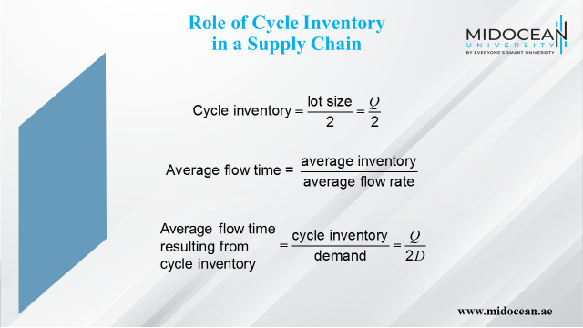

Slide 6
Role of Cycle Inventory in a Supply Chain
Lower cycle inventory has
  Shorter average flow time
  Lower working capital requirements
  Lower inventory holding costs
Cycle inventory is held to
  Take advantage of economies of scale
  Reduce costs in the supply chain
www.midocean.ae

Slide 7
Role of Cycle Inventory in a Supply Chain
Average price paid per unit purchased is a key cost in the lot-sizing decision
Material cost = C
Fixed ordering cost includes all costs that do not vary with the size of the order but are incurred each time an order is placed
Fixed ordering cost = S
Holding cost is the cost of carrying one unit in inventory for a specified period of time
Holding cost = H = hC
www.midocean.ae

Slide 8
Role of Cycle Inventory in a Supply Chain
Primary role of cycle inventory is to allow different stages to purchase product in lot sizes that minimize the sum of material, ordering, and holding costs
Ideally, cycle inventory decisions should consider costs across the entire supply chain
In practice, each stage generally makes its own supply chain decisions
Increases total cycle inventory and total costs in the supply chain
A key to reducing cycle inventory is the reduction of lot size
www.midocean.ae

Slide 9
Role of Cycle Inventory in a Supply Chain
Economies of scale exploited in three typical situations
  A fixed cost is incurred each time an order is placed or produced
  The supplier offers price discounts based on the quantity purchased per lot
  The supplier offers short-term price discounts or holds trade promotions
www.midocean.ae

Slide 10
Economies of Scale to Exploit Fixed Costs
Lot sizing for a single product (EOQ)
D = Annual demand of the product
S = Fixed cost incurred per order
C = Cost per unit
H = Holding cost per year as a fraction of product cost
Basic assumptions
  Demand is steady at D units per unit time
  No shortages are allowed
  Replenishment lead time is fixed
www.midocean.ae

Slide 11
Economies of Scale to Exploit Fixed Costs
Minimize
  Annual material cost
  Annual ordering cost
  Annual holding cost
www.midocean.ae

Slide 12
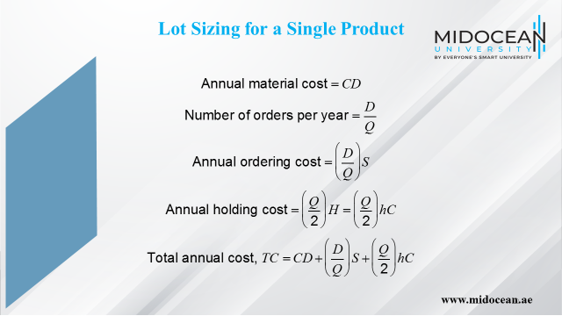

Slide 13
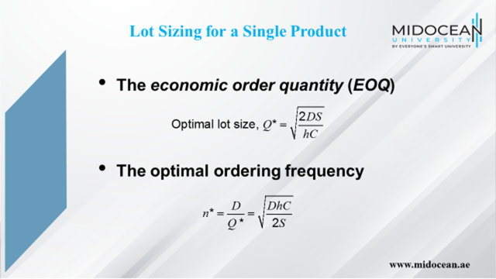

Slide 14
EOQ Example
Annual demand, D = 1,000 x 12 = 12,000 units
Order cost per lot, S = $4,000
Unit cost per computer, C = $500
Holding cost per year as a fraction of unit cost, h = 0.2
www.midocean.ae
Notes:
Notes:

Slide 15
EOQ Example
www.midocean.ae
Notes:
Notes:

Slide 16
EOQ Example
Lot size reduced to Q = 200 units
www.midocean.ae
Notes:
Notes:

Slide 17
Lot Size and Ordering Cost
If the lot size Q* = 200, how much should the ordering cost be reduced?
Desired lot size, Q* = 200
Annual demand, D = 1,000 × 12 = 12,000 units
Unit cost per computer, C = $500
Holding cost per year as a fraction of inventory value, h = 0.2
www.midocean.ae

Slide 18
EOQ Example
www.midocean.ae

Slide 19
EOQ Example
www.midocean.ae

Slide 20
Production Lot Sizing
The entire lot does not arrive at the same time
Production occurs at a specified rate P
Inventory builds up at a rate of P – D
Annual setup cost
Annual holding cost
www.midocean.ae

Slide 21
Aggregating Multiple Products in a Single Order
Aggregating across products, retailers, or suppliers in a single order allows for a reduction in lot size for individual products because fixed ordering and transportation costs are now spread across multiple products, retailers, or suppliers.
Savings in transportation costs
  Reduces fixed cost for each product
  Lot size for each product can be reduced
  Cycle inventory is reduced
Single delivery from multiple suppliers or single truck delivering to multiple retailers
Receiving and loading costs reduced
www.midocean.ae

Slide 22
Lot Sizing with Multiple
Products or Customers
Ordering, transportation, and receiving costs grow with the variety of products or pickup points
Reduction of fixed cost may be achieved by aggregating lots across multiple products, customers, or suppliers.
Lot sizes and ordering policy that minimize total cost
D_{i}: Annual demand for product i
S: Order cost incurred each time an order is placed, independent of the variety of products in the order
s_{i}: Additional order cost incurred if product i is included in the order
www.midocean.ae

Slide 23
Lot Sizing with Multiple
Products or Customers
Three approaches
  Each product manager orders his or her model independently
  The product managers jointly order every product in each lot
  Product managers order jointly but not every order contains every product; that is, each lot contains a selected subset of the products
www.midocean.ae

Slide 24
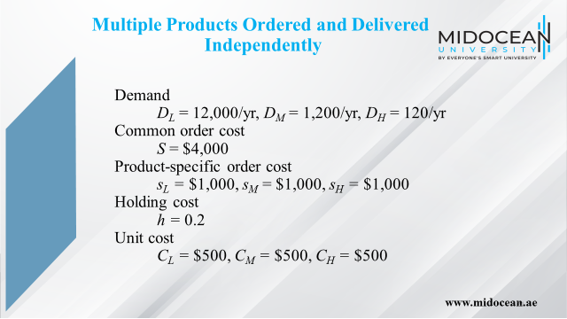

Slide 25
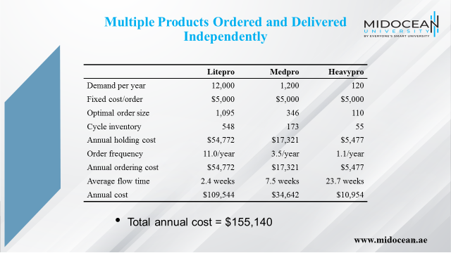

Slide 26
Economies of Scale to
Exploit Quantity Discounts
Lot size-based discount – discounts based on quantity ordered in a single lot
Volume based discount – discount is based on total quantity purchased over a given period
Two common schemes
  All-unit quantity discounts
  Marginal unit quantity discount or multi-block tariffs
For commodity products where price is set by the market, manufacturers can use lot size based quantity discounts to achieve coordination in the supply chain and decrease supply chain cost.
www.midocean.ae

Slide 27
Quantity Discounts
Two basic questions
What is the optimal purchasing decision for a buyer seeking to maximize profits? How does this decision affect the supply chain in terms of lot sizes, cycle inventories, and flow times?
Under what conditions should a supplier offer quantity discounts? What are appropriate pricing schedules that a supplier seeking to maximize profits should offer?
www.midocean.ae

Slide 28
All-Unit Quantity Discounts
Pricing schedule has specified quantity break points q₀, q₁, …, q_{r}, where q₀ = 0
If an order is placed that is at least as large as q_{i} but smaller than q_{i+1}, then each unit has an average unit cost of C_{i}
Unit cost generally decreases as the quantity increases, i.e., C₀ > C₁ > … > C_{r}
Objective is to decide on a lot size that will minimize the sum of material, order, and holding costs
www.midocean.ae

Slide 29
All-Unit Quantity Discounts
Step 1: Evaluate the optimal lot size for each price C_{i},0 ≤ i ≤ r as follows
www.midocean.ae

Slide 30
All-Unit Quantity Discounts
Step 2: We next select the order quantity Q*_{i} for each price C_{i}
1.
2.
3.
Case 3 can be ignored as it is considered for Q_{i+1}
For Case 1 if , then set Q*_{i} = Q_{i}
If , then a discount is not possible
Set Q*_{i} = q_{i} to qualify for the discounted price of C_{i}
www.midocean.ae

Slide 31
All-Unit Quantity Discounts
Step 3: Calculate the total annual cost of ordering Q*_{i} units
www.midocean.ae

Slide 32
All-Unit Quantity Discounts
Step 4: Select Q*_{i} with the lowest total cost TC_{i}
Cutoff price
www.midocean.ae

Slide 33
All-Unit Quantity Discount Example
Order Quantity | Unit Price
0–4,999 | $3.00
5,000–9,999 | $2.96
10,000 or more | $2.92
q₀ = 0, q₁ = 5,000, q₂ = 10,000
C₀ = $3.00, C₁ = $2.96, C₂ = $2.92
D = 120,000/year, S = $100/lot, h = 0.2
www.midocean.ae

Slide 34
Why Quantity Discounts?
Quantity discounts can increase the supply chain surplus for the following two main reasons
  Improved coordination to increase total supply chain profits
  Extraction of surplus through price discrimination
www.midocean.ae
Notes:
Notes:

Slide 35
Two-Part Tariff
Manufacturer charges its entire profit as an up-front franchise fee ff
Sells to the retailer at cost
Retail pricing decision is based on maximizing its profits
Effectively maximizes the coordinated supply chain profit
For products where the firm has market power, two-part tariffs can be used to achieve coordination in the supply chain and maximize supply chain profits.
www.midocean.ae
Notes:
Notes:

Slide 36
Volume-Based Quantity Discounts
A discount is volume-based if the discount is based on the total quantity purchased over a given period, regardless of the number of lots purchased over that period
Design a volume-based discount scheme that gets the retailer to purchase and sell the quantity sold when the two stages coordinate their actions
www.midocean.ae
Notes:
Notes:

Slide 37
Lessons from Discounting Schemes
Quantity discounts play a role in supply chain coordination and improved supply chain profits
Discount schemes that are optimal are volume based and not lot size based unless the manufacturer has large fixed costs associated with each lot
Even in the presence of large fixed costs for the manufacturer, a two-part tariff or volume-based discount, with the manufacturer passing on some of the fixed cost to the retailer, optimally coordinates the supply chain and maximizes profits
www.midocean.ae

Slide 38
Lessons from Discounting Schemes
Lot size–based discounts tend to raise the cycle inventory in the supply chain
Volume-based discounts are compatible with small lots that reduce cycle inventory
Retailers will tend to increase the size of the lot toward the end of the evaluation period, the hockey stick phenomenon
With multiple retailers with different demand curves optimal discount continues to be volume based with the average price charged to the retailers decreasing as the rate of purchase increases
www.midocean.ae

Slide 39
Price Discrimination to Maximize Supplier
Profits
Firm charges differential prices to maximize profits
Setting a fixed price for all units does not maximize profits for the manufacturers
Manufacturer can obtain maximum profits by pricing each unit differently based on customers’ marginal evaluation at each quantity
Quantity discounts are one mechanism for price discrimination because customers pay different prices based on the quantity purchased
www.midocean.ae

Slide 40
Short-Term Discounting:
Trade Promotions
Trade promotions are price discounts for a limited period of time
Key goals
  Induce retailers to use price discounts, displays, or advertising to spur sales
  Shift inventory from the manufacturer to the retailer and the customer
  Defend a brand against competition
www.midocean.ae

Slide 41
Short-Term Discounting:
Trade Promotions
Impact on the behavior of the retailer and supply chain performance
Retailer has two primary options
  Pass through some or all of the promotion to customers to spur sales
  Pass through very little of the promotion to customers but purchase in greater quantity during the promotion period to exploit the temporary reduction in price (forward buy)
www.midocean.ae

Slide 42
Forward Buy
Costs to be considered – material cost, holding cost, and order cost
Three assumptions
  The discount is offered once, with no future discounts
  The retailer takes no action to influence customer demand
  Analyze a period over which the demand is an integer multiple of Q*
Although a forward buy is often the retailer's appropriate response and increases their own profits, it usually increases demand variability with a resulting increase in inventory and flow times within the supply chain.
www.midocean.ae

Slide 43
Forward Buy
Optimal order quantity
Retailers are often aware of the timing of the next promotion
www.midocean.ae

Slide 44
Trade Promotions
Trade promotions generally increase cycle inventory in a supply chain and hurt performance
Trade promotions lead to a significant increase in lot size and cycle inventory because of forward buying by the retailer.
Counter measures
  EDLP (every day low pricing)
  Discount applies to items sold to customers (sell-through) not the quantity purchased by the retailer (sell-in)
  Scan based promotions
www.midocean.ae
Notes:
Notes:

Slide 45
Managing Multiechelon
Cycle Inventory
Multi-echelon supply chains have multiple stages with possibly many players at each stage
Lack of coordination in lot sizing decisions across the supply chain results in high costs and more cycle inventory than required
The goal is to decrease total costs by coordinating orders across the supply chain
www.midocean.ae

Slide 46
Integer Replenishment Policy
Divide all parties within a stage into groups such that all parties within a group order from the same supplier and have the same reorder interval
Set reorder intervals across stages such that the receipt of a replenishment order at any stage is synchronized with the shipment of a replenishment order to at least one of its customers
For customers with a longer reorder interval than the supplier, make the customer’s reorder interval an integer multiple of the supplier’s interval and synchronize replenishment at the two stages to facilitate cross-docking
www.midocean.ae

Slide 47
Integer Replenishment Policy
For customers with a shorter reorder interval than the supplier, make the supplier’s reorder interval an integer multiple of the customer’s interval and synchronize replenishment at the two stages to facilitate cross-docking
The relative frequency of reordering depends on the setup cost, holding cost, and demand at different parties
These polices make the most sense for supply chains in which cycle inventories are large and demand is relatively predictable
www.midocean.ae

Slide 48
Summary of Learning Objectives
Balance the appropriate costs to choose the optimal lot size and cycle inventory in a supply chain.
Understand the impact of quantity discounts on lot size and cycle inventory.
Devise appropriate discounting schemes for a supply chain.
Understand the impact of trade promotions on lot size and cycle inventory.
Identify managerial levers that reduce lot size and cycle inventory in a supply chain without increasing cost.
www.midocean.ae

Slide 49
Essential Reference
Chopra, S., & Meindl, P. (2016). Global Edition. Pearson Education Limited
Chapter 11.
www.midocean.ae

Slide 50



Thank You

