Slide 1

CCNA (200-301) Cisco Certified Network Associate
Prepared by Eng. Taghreed Elsayed
Lecture 6
OSPF

Slide 2

Chapter
03
OSPF (open shortest path first)
Default Route
Default routes
  Packets that are not defined specifically in a routing table will go to the specified interface for the default route
  Example: Customer routers use default routes to connect to an ISP router.
  Command used to configure a default route is
  ip route 0.0.0.0 0.0.0.0 s0/0/1

Slide 3
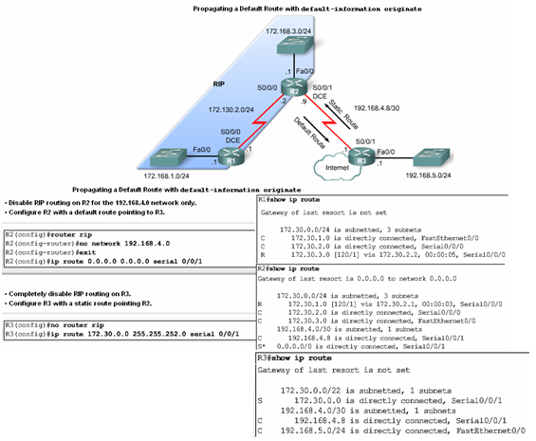
Chapter
03
OSPF (open shortest path first)
Default Route

Slide 4
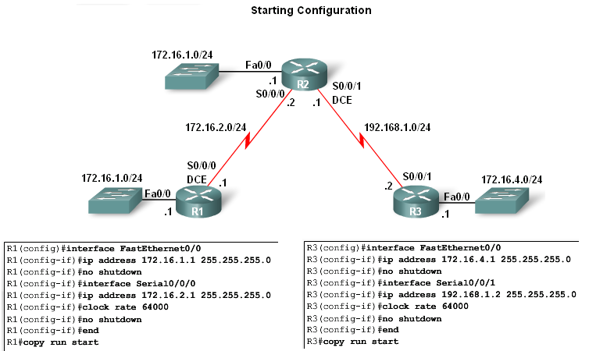
Chapter
03
OSPF (open shortest path first)
Lab Topology
3 router setup
  -R1 and R2 share a common 172.16.0.0/16 network with 172.16.0.0/24 subnets.
  -R2 and R3 are connected by the 192.168.1.0/24 network.
  -R3 also has a 172.16.4.0/24 subnet, which is disconnected, or
  dis contiguous, from the 172.16.0.0 network that R1 and R2 share.

Slide 5
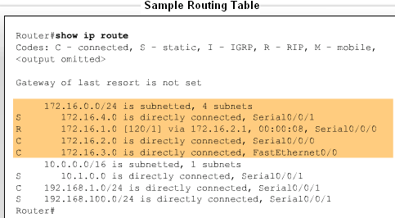
Chapter
03
OSPF (open shortest path first)
Routing table entries come from the following sources
  -Directly connected networks
  -Static routes
  -Dynamic routing protocols

Slide 6
Chapter
03
OSPF (open shortest path first)
Link-State Routing protocols Characteristics
OSPF :(Open Shortest Path First)
Integrated(IS-IS) : Intermediate system to Intermediate System
1.Use partial update
The routers share all information with each other , then when changes occurs only the changed information sent immediately .
Fast convergence time
Need more hardware resources (processor &RAM)

Slide 7
Chapter
03
OSPF (open shortest path first)
The routers is Link-State protocols keep three important tables:
1.Neighbours table: contains all direct connected routers satisfy neighbors' relationship conditions.
2. Topology table: contains detailed information about all routers and routes on OSPF domains.
3. Routing table : contain all best routes calculated from topology table.

Slide 8
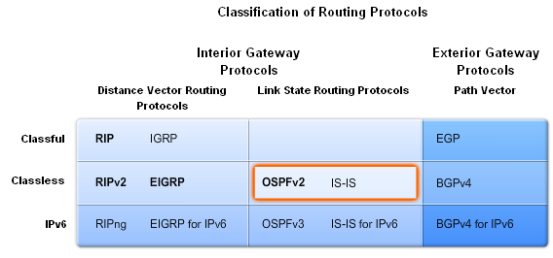
Chapter
03
OSPF (open shortest path first)
Link-State Routing
Link state routing protocols
  -Also known as shortest path first algorithms
-These protocols built around Dijkstra’s (SPF)
To Calculate the best routes from topology table and install them into routing table .
All link state protocols use Hello packets to establish neighbor relationship

Slide 9
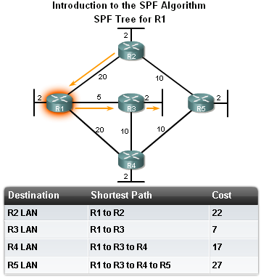
Chapter
03
OSPF (open shortest path first)
Link-State Routing
The shortest path to a destination is not necessarily the path with the least number of hops

Slide 10
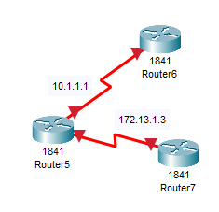
OSPF Router ID
Chapter
03
OSPF (open shortest path first)
Router ID (identification number) is 32 bits
Used to identify router on other router’s neighbors and topology table
Written in IPV4 format
Electing router IP
A)Selecting the highest ip address on physical
operational port.

Slide 11

Chapter
03
OSPF (open shortest path first)
This method for auto selecting router-id is not recommended because it makes OSPF domain unstable
B)Using Virtual Interface called (Loop Back) to identify router on other router’s neighbors and topology table
Loop back interface usually up so make the topology stable

Slide 12

Chapter
03
OSPF (open shortest path first)
This method for auto selecting router-id is not recommended because it makes OSPF domain unstable
c)Configuring router- id manually , there is the most recommended way
If router select id using A OR B before writing this command the router change its id by two ways :

