Slide 1


Natural Language
Processing (AI615)
Prepared by Dr. Ashraf Elsayed
Lecture 5

Slide 2


Text Classification
Lecture 5
Prepared by
Dr. Ashraf Elsayed
www.midocean.ae

Slide 3
The objectives of this lecture is to:
Understand Text Classification
Define and explain Text Classification and Naïve Bayes
Understand the bag of words representation
Understand Multinomial Naïve Bayes Classifier
www.midocean.ae

Slide 4
Text Classification
Assigning subject categories, topics, or genres
Spam detection
Authorship identification
Age/gender identification
Language Identification
Sentiment analysis
…
www.midocean.ae

Slide 5
Text Classification: definition
Input:
  a document d
  a fixed set of classes C = {c₁, c₂,…, c_{J}}
Output: a predicted class c ∈ C
www.midocean.ae

Slide 6
Classification Methods:
Hand-coded rules
Rules based on combinations of words or other features
  spam: black-list-address OR (“dollars” AND“have been selected”)
Accuracy can be high
  If rules carefully refined by expert
But building and maintaining these rules is expensive
www.midocean.ae

Slide 7
Classification Methods:
Supervised Machine Learning
Input:
  a document d
  a fixed set of classes C = {c₁, c₂,…, c_{J}}
  A training set of m hand-labeled documents (d₁,c₁),....,(d_{m},c_{m})
Output:
  a learned classifier γ:d → c
www.midocean.ae

Slide 8
Classification Methods:
Supervised Machine Learning
Any kind of classifier
  Naïve Bayes
  Logistic regression
  Support-vector machines
  k-Nearest Neighbors
  …
www.midocean.ae

Slide 9
Text Classification and Naïve Bayes
Naïve Bayes (I)
www.midocean.ae

Slide 10
Naïve Bayes Intuition
Simple (“naïve”) classification method based on Bayes rule
Relies on very simple representation of document
  Bag of words
www.midocean.ae

Slide 11


The bag of words representation
I love this movie! It's sweet, but with satirical humor. The dialogue is great and the adventure scenes are fun… It manages to be whimsical and romantic while laughing at the conventions of the fairy tale genre. I would recommend it to just about anyone. I've seen it several times, and I'm always happy to see it again whenever I have a friend who hasn't seen it yet.
γ(
)=c
www.midocean.ae

Slide 12
The bag of words representation
I love this movie! It's sweet, but with satirical humor. The dialogue is great and the adventure scenes are fun… It manages to be whimsical and romantic while laughing at the conventions of the fairy tale genre. I would recommend it to just about anyone. I've seen it several times, and I'm always happy to see it again whenever I have a friend who hasn't seen it yet.
γ(
)=c
www.midocean.ae

Slide 13
The bag of words representation: using a subset of words
x love xxxxxxxxxxxxxxxx sweet xxxxxxx satirical xxxxxxxxxx xxxxxxxxxxx great xxxxxxx xxxxxxxxxxxxxxxxxxx fun xxxx xxxxxxxxxxxxx whimsical xxxx romantic xxxx laughing xxxxxxxxxxxxxxxxxxxxxxxxxxxxxxxxxxxxxxxxxxxx recommend xxxxx xxxxxxxxxxxxxxxxxxxxxxxxxxxxxxxx several xxxxxxxxxxxxxxxxx xxxxx happy xxxxxxxxx again xxxxxxxxxxxxxxxxxxxxxxxxxxxxxxxxxxxxxxxxxxxxxxx
γ(
)=c
www.midocean.ae

Slide 14
The bag of words representation
great | 2
love | 2
recommend | 1
laugh | 1
happy | 1
... | ...
γ(
)=c
www.midocean.ae

Slide 15
Bag of words for document classification
?
Test
document
Machine Learning
NLP
Garbage
Collection
Planning
GUI
parser
language
label
translation
…
learning
training
algorithm
shrinkage
network...
parser
tag
training
translation
language...
garbage
collection
memory
optimization
region...
planning
temporal
reasoning
plan
language...
...
www.midocean.ae

Slide 16
Text Classification and Naïve Bayes
Formalizing the Naïve Bayes Classifier
www.midocean.ae

Slide 17
Bayes’ Rule Applied to Documents and Classes
For a document d and a class c
www.midocean.ae

Slide 18
Naïve Bayes Classifier (I)
MAP is “maximum a posteriori” = most likely class
Bayes Rule
Dropping the denominator
Likelihood
Prior probability
www.midocean.ae

Slide 19
Naïve Bayes Classifier (II)
Document d represented as features x1..xn
…
www.midocean.ae

Slide 20
Naïve Bayes Classifier (III)
…
  O(|X|^{n}•|C|) parameters
How often does this class occur?
  Could only be estimated if a very, very large number of training examples was available.
We can just count the relative frequencies in a corpus
www.midocean.ae

Slide 21
Multinomial Naïve Bayes Independence Assumptions
…
Bag of Words assumption: Assume position doesn’t matter
Conditional Independence: Assume the feature probabilities P(x_{i}|c_{j}) are independent given the class c.
…
www.midocean.ae

Slide 22
Multinomial Naïve Bayes Classifier
…
www.midocean.ae

Slide 23
Applying Multinomial Naive Bayes Classifiers to Text Classification
positions ← all word positions in test document
www.midocean.ae

Slide 24
Problems with multiplying lots of probs
There's a problem with this:
Multiplying lots of probabilities can result in floating-point underflow!
.0006 * .0007 * .0009 * .01 * .5 * .000008….
Idea: Use logs, because log(ab) = log(a) + log(b)
We'll sum logs of probabilities instead of multiplying probabilities!
www.midocean.ae

Slide 25
We actually do everything in log space
Instead of this:
This:
Notes:
  1) Taking log doesn't change the ranking of classes!
  The class with highest probability also has highest log probability!
  2) It's a linear model:
  Just a max of a sum of weights: a linear function of the inputs
  So naive bayes is a linear classifier
www.midocean.ae

Slide 26
Text Classification and Naïve Bayes
Naïve Bayes: Learning
www.midocean.ae

Slide 27
Learning the Multinomial Naïve Bayes Model
First attempt: maximum likelihood estimates
  simply use the frequencies in the data
www.midocean.ae

Slide 28
Parameter estimation
fraction of times word w_{i} appears
among all words in documents of topic c_{j}
Create mega-document for topic j by concatenating all docs in this topic
  Use frequency of w in mega-document
www.midocean.ae

Slide 29
Problem with Maximum Likelihood
What if we have seen no training documents with the word fantastic and classified in the topic positive (thumbs-up)?
Zero probabilities cannot be conditioned away, no matter the other evidence!
www.midocean.ae

Slide 30
Laplace (add-1) smoothing for Naïve Bayes
www.midocean.ae

Slide 31
Multinomial Naïve Bayes: Learning
From training corpus, extract Vocabulary
Calculate P(c_{j}) terms
  For each c_{j} in C do
    docs_{j} ← all docs with class =c_{j}
Calculate P(w_{k} | c_{j}) terms
  Text_{j} ← single doc containing all docs_{j}
  For each word w_{k} in Vocabulary
    n_{k} ← # of occurrences of w_{k} in Text_{j}
Number of words in Text_{j}
www.midocean.ae

Slide 32
Unknown words
What about unknown words
  that appear in our test data
  but not in our training data or vocabulary?
We ignore them
  Remove them from the test document!
  Pretend they weren't there!
  Don't include any probability for them at all!
www.midocean.ae

Slide 33
Stop words
Some systems ignore stop words
  Stop words: very frequent words like the and a.
    Sort the vocabulary by word frequency in training set
    Call the top 10 or 50 words the stopword list.
    Remove all stop words from both training and test sets
      As if they were never there!
But removing stop words doesn't usually help
  So in practice most NB algorithms use all words and don't use stopword lists
www.midocean.ae

Slide 34
Text Classification and Naïve Bayes
Multinomial Naïve Bayes: A Worked Example
www.midocean.ae

Slide 35
 | Doc | Words | Class
Training | 1 | Chinese Beijing Chinese | c
 | 2 | Chinese Chinese Shanghai | c
 | 3 | Chinese Macao | c
 | 4 | Tokyo Japan Chinese | j
Test | 5 | Chinese Chinese Chinese Tokyo Japan | ?
Priors:
P(c)=
P(j)=
3
4
1
Choosing a class:
P(c|d5)
P(j|d5)
4
  3/4 * (3/7)³ * 1/14 * 1/14
  ≈ 0.0003
Conditional Probabilities:
P(Chinese|c) =
P(Tokyo|c) =
P(Japan|c) =
P(Chinese|j) =
P(Tokyo|j) =
P(Japan|j) =
(5+1) / (8+6) = 6/14 = 3/7
(0+1) / (8+6) = 1/14
  1/4 * (2/9)³ * 2/9 * 2/9
  ≈ 0.0001
(0+1) / (8+6) = 1/14
(1+1) / (3+6) = 2/9
(1+1) / (3+6) = 2/9
(1+1) / (3+6) = 2/9
www.midocean.ae

Slide 36
Text Classification and Naïve Bayes
Naïve Bayes: Relationship to Language Modeling
www.midocean.ae

Slide 37
Generative Model for Multinomial Naïve Bayes
c=+
X₁=I
X₂=love
X₃=this
X₄=fun
X₅=film
www.midocean.ae

Slide 38
Naïve Bayes and Language Modeling
Naïve bayes classifiers can use any sort of feature
  URL, email address, dictionaries, network features
But if, as in the previous slides
  We use only word features
  we use all of the words in the text (not a subset)
Then
  Naïve bayes has an important similarity to language modeling.
www.midocean.ae

Slide 39
Each class = a unigram language model
Assigning each word: P(word | c)
Assigning each sentence: P(s|c) = ∏ P(word|c)
Class pos
0.1 I
0.1 love
0.01 this
0.05 fun
0.1 film
…
I
love
this
fun
film
0.1
0.1
0.01
.05
0.1
P(s | pos) = 0.0000005
www.midocean.ae

Slide 40
Naïve Bayes as a Language Model
Which class assigns the higher probability to s?
Model pos
Model neg
0.1 I
0.1 love
0.01 this
0.05 fun
0.1 film
0.2 I
0.001 love
0.01 this
0.005 fun
0.1 film
I
love
this
fun
film
0.1
0.1
0.01
0.05
0.1
0.2
0.001
0.01
0.005
0.1
P(s|pos) > P(s|neg)
www.midocean.ae

Slide 41
Example
Consider the following three sentences:
“I love cats.”
“Dogs are adorable.”
“Cats and dogs are good companions.”
To create the BoW representation, we first construct a vocabulary consisting of all unique words across the documents: “I,” “love,” “cats,” “dogs,” “are,” “adorable,” “and,” “good,” “companions.”
www.midocean.ae

Slide 42
Next, we create a feature vector for each document, where each element represents the count or presence of a word in the vocabulary. For instance, the BoW representation of the first sentence would be [1, 1, 1, 0, 0, 0, 0, 0, 0] since it contains “I,” “love,” and “cats,” but not the other words.
www.midocean.ae

Slide 43
Applying Naive Bayes on Bag of Words
To classify a new document using the Naive Bayes approach, we calculate the posterior probability for each class and assign the document to the class with the highest probability. To compute the likelihood of a document given a class, we make the assumption of feature independence, which simplifies the calculation.
Let’s illustrate this with a practical example of classifying movie reviews as positive or negative. We have a dataset of labeled movie reviews, and we want to build a classifier using the Naive Bayes / Bag of Words approach.
www.midocean.ae

Slide 44
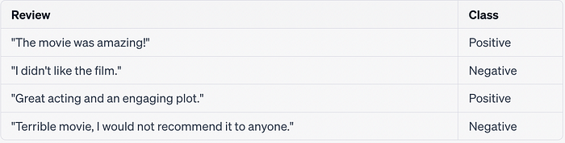
Example
Suppose we have the following training data:
www.midocean.ae

Slide 45
We preprocess the text by tokenizing it into words and creating a vocabulary: [“the,” “movie,” “was,” “amazing,” “I,” “didn’t,” “like,” “film,” “great,” “acting,” “and,” “an,” “engaging,” “plot,” “terrible,” “would,” “not,” “recommend,” “it,” “to,” “anyone”].
www.midocean.ae

Slide 46
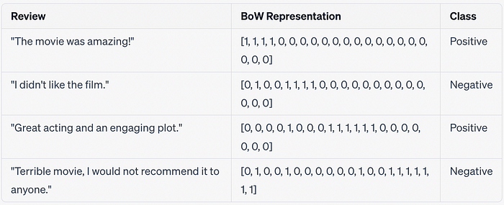
Next, we construct the BoW representation for each review:
www.midocean.ae

Slide 47
Now, let’s assume we have a new movie review: “The acting was superb!” We can convert this review into its BoW representation: [0, 0, 0, 0, 0, 0, 0, 0, 1, 1, 0, 0, 0, 0, 0, 0, 0, 0, 0, 0, 0].
To classify this review, we calculate the posterior probability for each class using Naive Bayes. We estimate the class prior probabilities based on the training data and calculate the likelihood of the BoW representation given each class. Finally, we normalize the probabilities to obtain the posterior probabilities.
www.midocean.ae

Slide 48
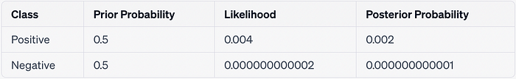
Let’s assume we obtain the following probabilities:
Based on these calculations, we can conclude that the new review is more likely to belong to the positive class. Thus, we classify it as a positive review.
www.midocean.ae

Slide 49
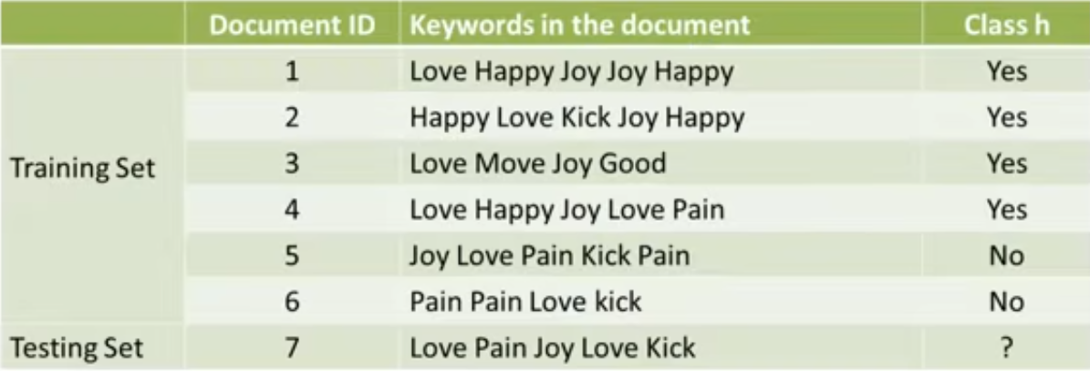
Example
www.midocean.ae

Slide 50
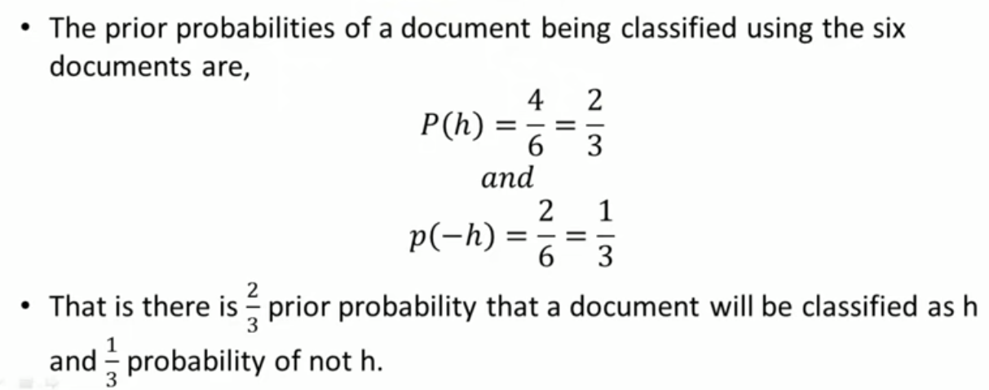
www.midocean.ae

Slide 51
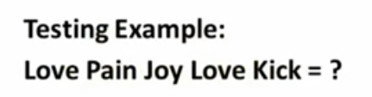
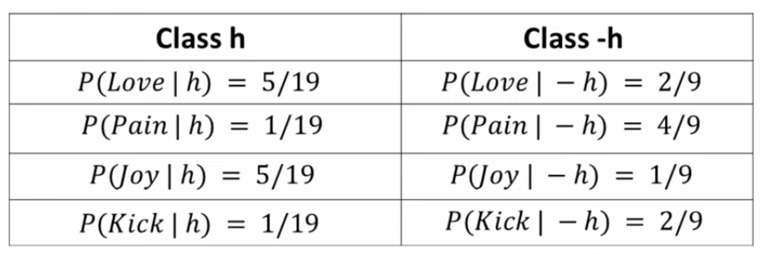
www.midocean.ae

Slide 52
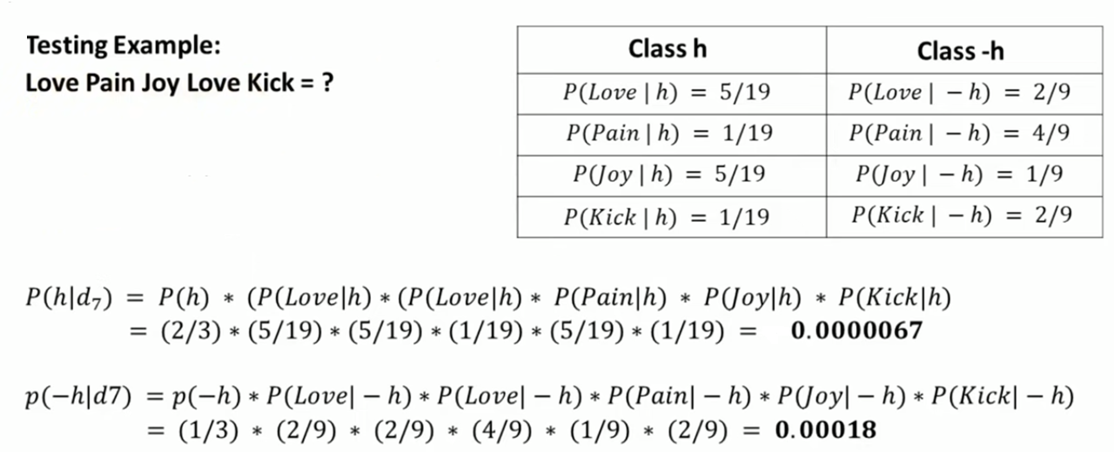

www.midocean.ae

Slide 53
Summary: Naive Bayes is Not So Naive
Very Fast, low storage requirements
Robust to Irrelevant Features
  Irrelevant Features cancel each other without affecting results
Very good in domains with many equally important features
Optimal if the independence assumptions hold: If assumed independence is correct, then it is the Bayes Optimal Classifier for problem
A good dependable baseline for text classification
  But we will see other classifiers that give better accuracy
www.midocean.ae

Slide 54


Thank You

