Slide 1


Machine Learning
for Finance
Prepared by Dr. Diaa Salama
FNT633
Data Preprocessing
Lecture 3

Slide 2




Machine Learning
for Finance
Lecture 3
FNT633
Data Preprocessing
Prepared by
Dr. Diaa Salama
www.midocean.ae

Slide 3

www.midocean.ae
Associate Professor, Data Science Department, Faculty of Computers Science , Misr International University, On Leave from Faculty of Computers & Artificial Intelligence, Banha University, Banha, Egypt.
Member, National Committee of Communications and Information Technology, Academy of Scientific Research & Technology, CAIRO, Egypt.
Member, International Telecommunication Union (ITU), United Nations (UN)
Member, International Federation for Information Processing - IFIP
Winner of the Arab Republic of Egypt Encouragement Award for Advanced Science and Technology in the Field of Engineering Sciences 2021
Winner of the Benha University Encouragement Award for Advanced Science and Technology in the Field of Engineering Sciences 2019
Winner of the DELL EMC AWARD for the academic year 2015/2016, 2016/2017, and 2017/2018
Dr.Diaa Salama Ph.D
One of the top 2% Scientists worldwide 2023 by Stanford university ranking.
Email: diaasalama@midocean.edu.km

Slide 4
Week
04
Today
Supervised learning KNN
Data Preparation (Preprocessing)
www.midocean.ae

Slide 5
Week
04
K-Nearest Neighbor Classification
K-NN
www.midocean.ae

Slide 6
Week
04
KNN
Used for
    Classification
    Regression
www.midocean.ae

Slide 7
Week
04
KNN
Used for
    Classification
    Regression
www.midocean.ae

Slide 8
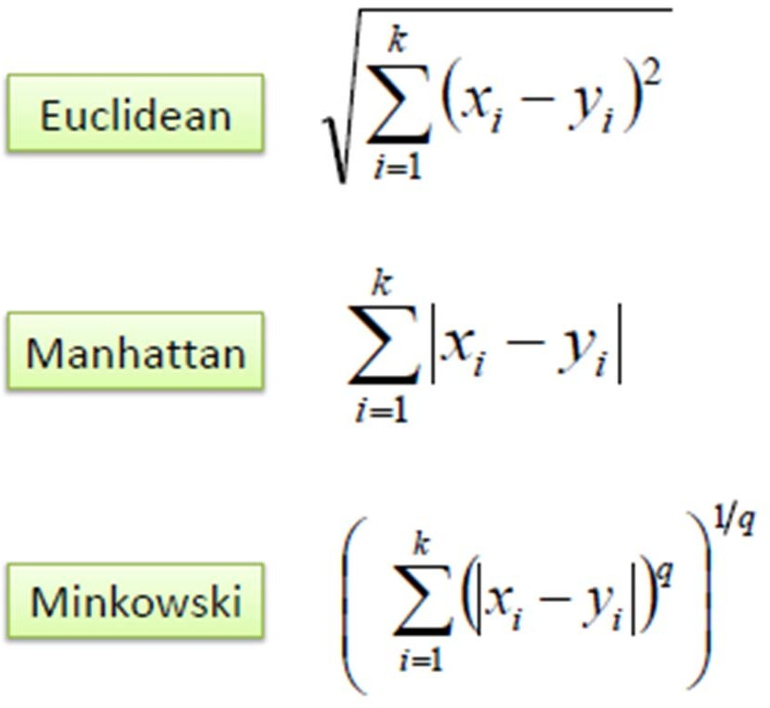
Week
04
K-Nearest Neighbor Classification
K nearest neighbors measured by a distance function.
These functions are valid only with continuous variables.
www.midocean.ae

Slide 9
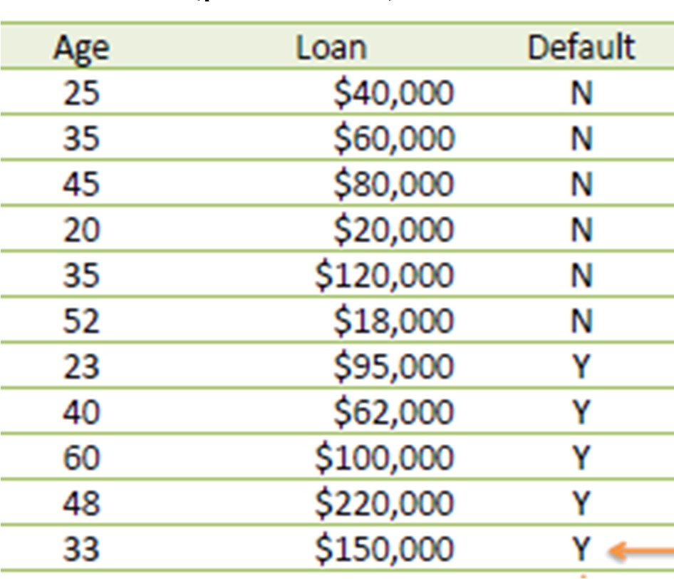
Week
04
KNN Example
Consider the following data concerning credit default. Age and Loan are two numerical variables (predictors) and Default is the target.
Know we want to classify unknown case ((Age=48 and Loan=$142,000) using Euclidean distance.) !!!!
www.midocean.ae

Slide 10
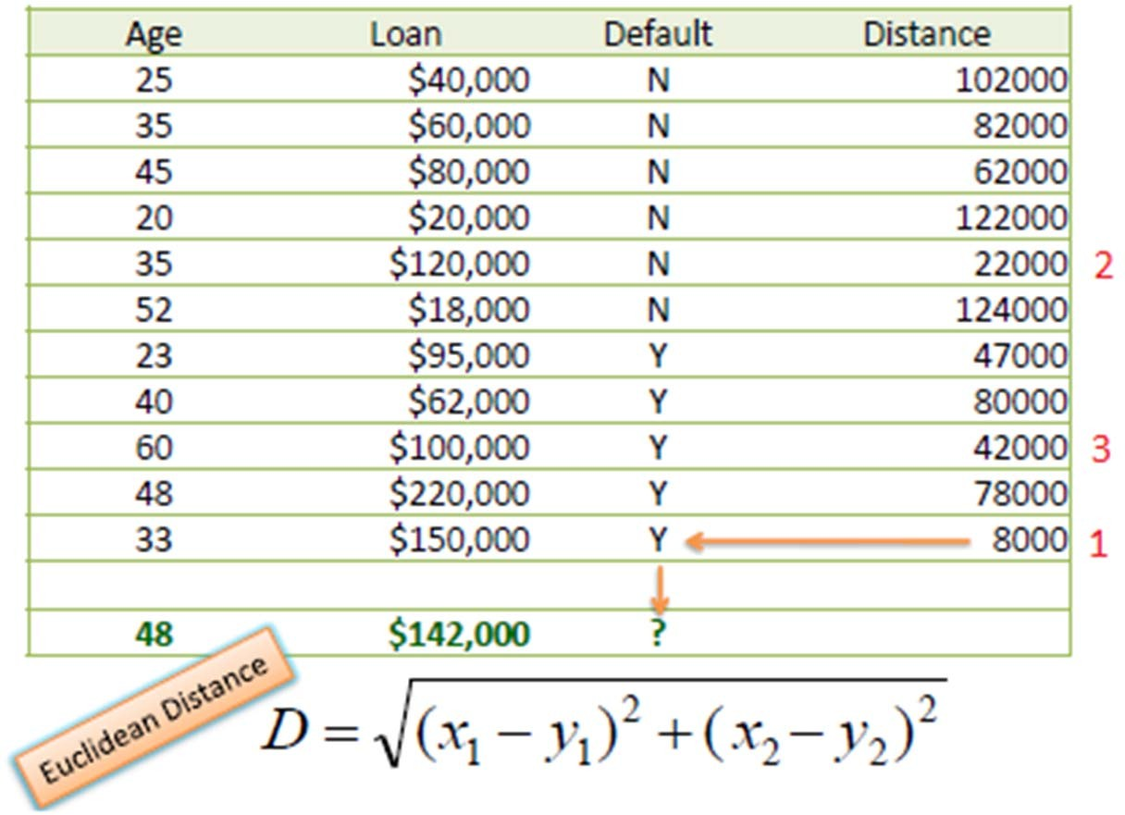
Week
04
KNN Example
Using Euclidean distance: E.g. distance between (48, $142k) and (33, 150k)
▫ Sqrt[(48-33)^2 + (142000-150000)^2] = 8000.01
So for all the dataset
www.midocean.ae

Slide 11
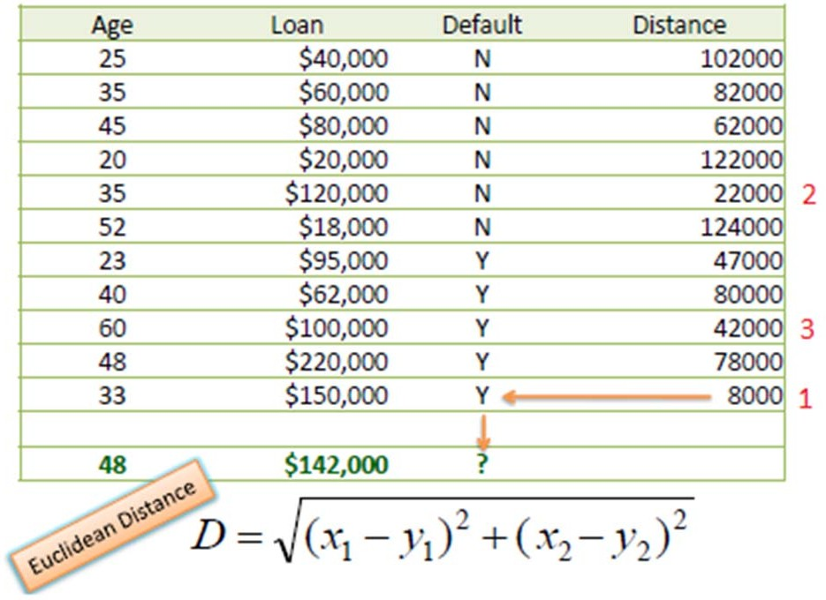
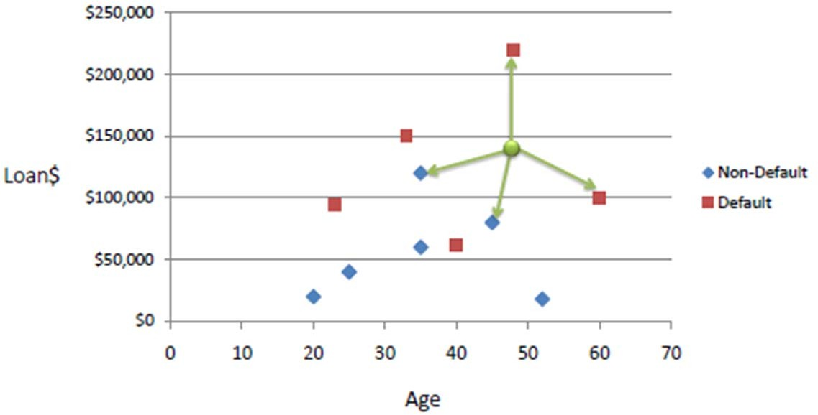
Week
04
KNN Example cont.
Know we choose the number of neighbors K
    If K=1 then this case is Y
    If K=3 then we have 2 Y and 1 N which give us Y
www.midocean.ae

Slide 12
Week
04
1- Classification using KNN:
Steps:
    Find distance.
    Find Rank.
    Find the output according to the value of k.
Euclidean Distance:
𝑑 = 𝑦₂ − 𝑦₁
2 ₊
𝑥₂ − 𝑥₁
2
www.midocean.ae

Slide 13
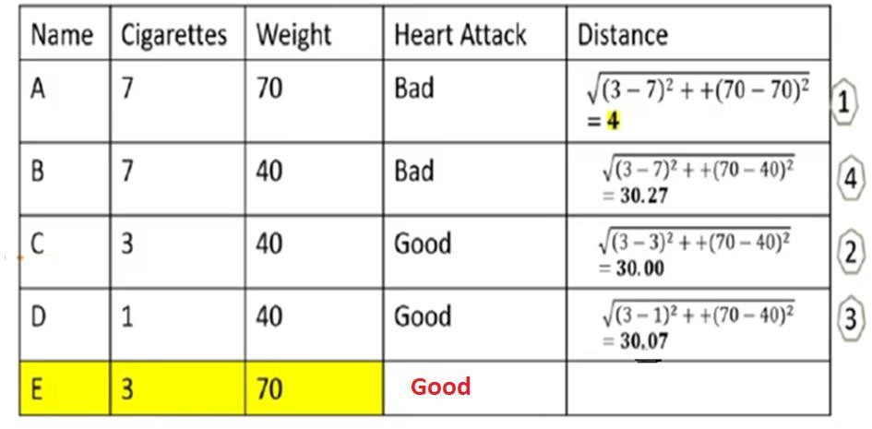
Week
04
Example
Consider k = 3
www.midocean.ae

Slide 14
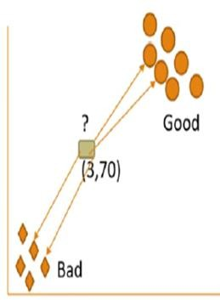
Week
04
Example
Consider k = 4
www.midocean.ae

Slide 15
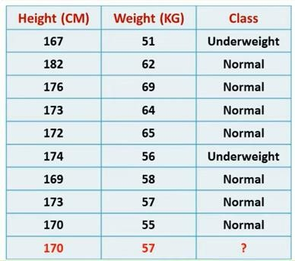
Week
04
Example2 :
www.midocean.ae

Slide 16
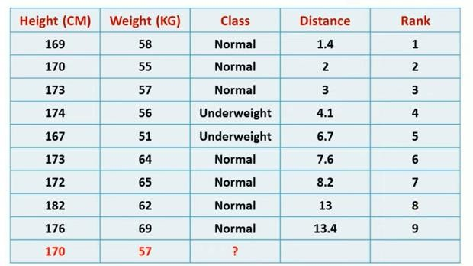
Week
04
Solution cont.:
www.midocean.ae

Slide 17
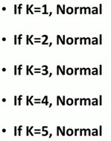
Week
04
Solution cont.:
www.midocean.ae

Slide 18
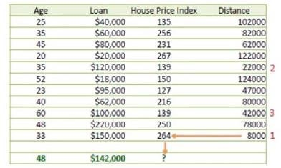
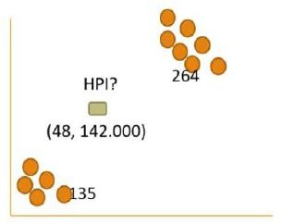
Week
04
2- Regression Using KNN:
www.midocean.ae

Slide 19
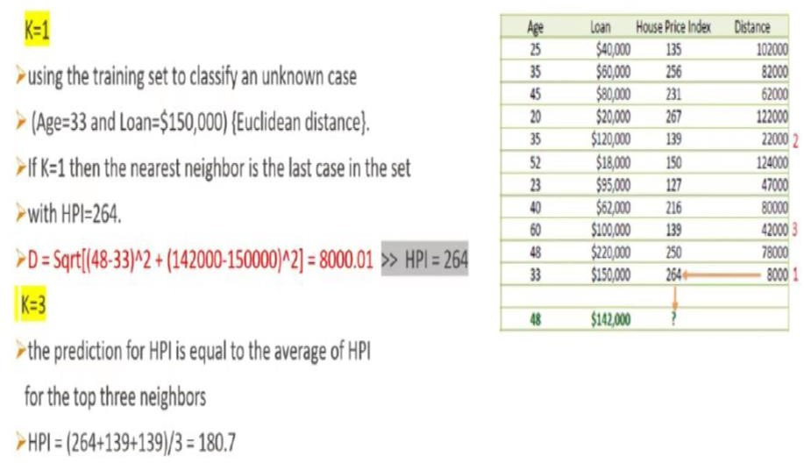
Week
04
2- Regression Using KNN:
www.midocean.ae

Slide 20
Week
04
Example: Assume k = 3
x1 | x2 | weight
7 | 7 | 6
7 | 4 | 3
3 | 4 | 2
1 | 3 | 1
2 | 1 | ?
www.midocean.ae

Slide 21
Week
04
Solution: K = 3
Weight = ³⁺²⁺¹ = 2
3
x1 | x2 | weight | Distance | Rank
7 | 7 | 6 | 7.81 | 4
7 | 4 | 3 | 5.83 | 3
3 | 4 | 2 | 3.16 | 2
1 | 3 | 1 | 2.23 | 1
2 | 1 | 2
www.midocean.ae

Slide 22
Week
04
KNN disadvantages
Computationally expensive
Requires a large memory to store the training data.
www.midocean.ae

Slide 23
Week
04
Data Preparation
(Data Preprocessing )
www.midocean.ae

Slide 24
Week
04
Reasons for Data Cleansing
The data to be analyzed may be:
  Incomplete; where the data is missing (empty record)
  Noisy; where data may contain errors (data that have incorrect values -Gender Z )or outlier values (Outliers are data values that deviate from expected values of the rest of the data set) (Age 2500)
  Inconsistent; where data may contain discrepancies in the values (age – birthdate ) , (Total-price and (unit-price and quantity).
www.midocean.ae

Slide 25
Week
04
How can Data be Cleaned?
Filling-in Missing Values
Smoothing Noisy Data (Validation and correction – Standardization)
Identifying and Removing Outliers Using Inter-quartile Range
Resolving Inconsistency (age – birthdate )
www.midocean.ae

Slide 26
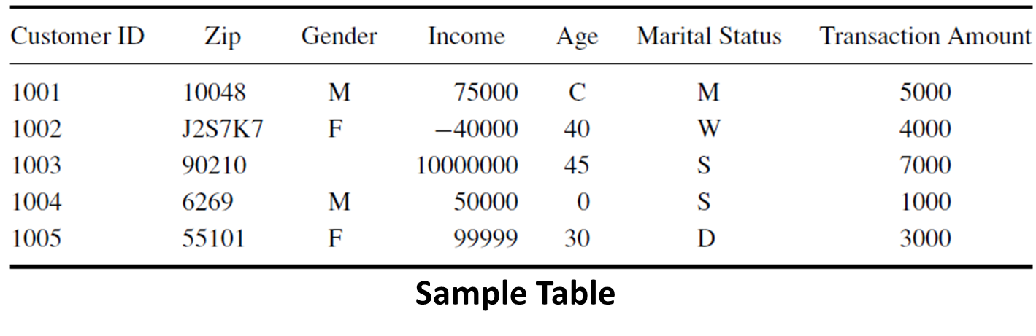
Week
04
Typical Example
www.midocean.ae

Slide 27
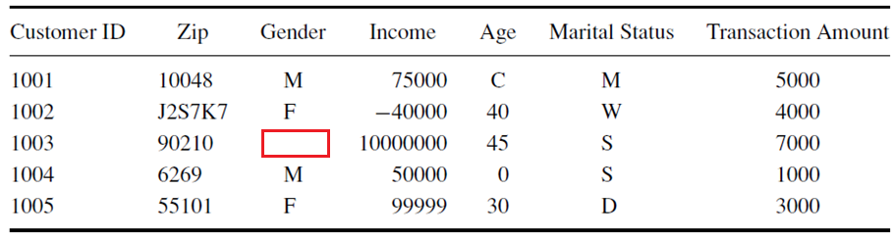
Week
04
Typical Example (Incomplete Data)
Sample Table
www.midocean.ae

Slide 28
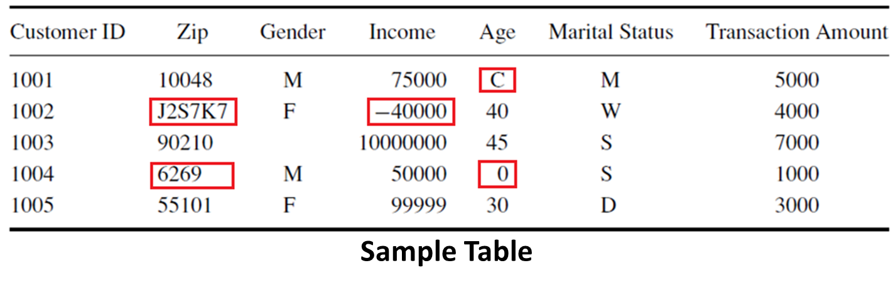
Week
04
Typical Example (Data Values Errors)
Reasons:
  The Zip code consists of five digits and cannot contain any letters
  Income must be positive number
  Age must be positive number
www.midocean.ae

Slide 29
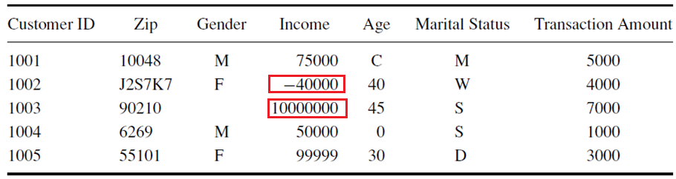
Week
04
Typical Example (Outlier Values)
Sample Table
Reasons:
  Outliers are data values that deviate from expected values of the rest of the data set
  The values 10000000 and -40000 look very divergent from the rest of values
www.midocean.ae

Slide 30
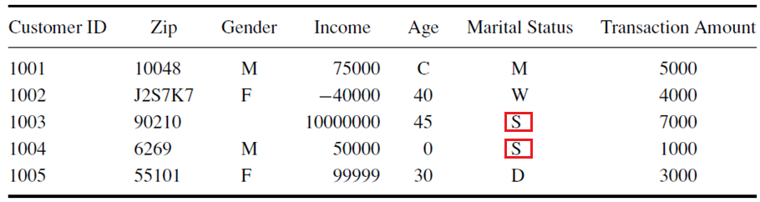
Week
04
Typical Example (Ambiguity)
Sample Table
Reasons:
  “S” in Marital Status could refer to “Single” or “Separated”
  So, there is a kind of ambiguity in the data
www.midocean.ae

Slide 31
Week
04
Reasons for Incomplete Data
Relevant data may not be recorded because:
  A misunderstanding from the data entry persons
  Equipment failure
Relevant data may not be available because it is unknown or providing it is optional
www.midocean.ae

Slide 32
Week
04
Dealing with Incomplete Data
There are several ways to deal with missing data:
Replace the missing value with some default value
Replace the missing value with the field mean for the fields that take numerical values or the mode (if exists) for the fields that take categorical values
Replace the missing values with a value generated at random from the field distribution observed
www.midocean.ae

Slide 33

Week
04
Mean, Median, and Mode
The mean for a population of size n can be computed by:
  Consider the following list of 9 numbers:
13, 15, 12, 17, 22, 11, 13, 19, 12
Mean = (13 + 15 + 12 + 17 + 22 + 11 + 13 + 19 + 12)/9 = 14.88889
www.midocean.ae

Slide 34
Week
04
Mean, Median, and Mode
The median is the middle value of the ordered list of numbers.
  Consider the following list of 9 numbers:
13, 15, 12, 17, 22, 11, 13, 19, 12
    To compute the median, you need first to order the numbers:
11, 12, 12, 13, 13, 15, 17, 19, 22
    Hence, the median is 13
www.midocean.ae

Slide 35
Week
04
Mean, Median, and Mode
The median is the middle value of the ordered list of numbers.
  Consider the following list of 10 numbers:
13, 15, 12, 17, 22, 11, 13, 19, 12, 14
    To compute the median, you need first to order the numbers:
11, 12, 12, 13, 13, 14, 15, 17, 19, 22
    Hence, the median is (13 + 14)/2 = 13.5
www.midocean.ae

Slide 36
Week
04
Mean, Median, and Mode
The mode of a set of data is the value in the set that occurs most often.
  Consider the following list of numbers:
13, 15, 12, 17, 22, 11, 13, 19, 13
    Number Occurrence Number Occurrence
    13 3 22 1
    15 1 11 1
    12 1 19 1
    17 1
    Mode is 13
www.midocean.ae

Slide 37
Week
04
Mean, Median, and Mode
The mode of a set of data is the value in the set that occurs most often.
  Consider the following list of numbers:
13, 15, 12, 17, 22, 11, 13, 19, 13
    Number Occurrence Number Occurrence
    13 3 22 1
    15 1 11 1
    12 1 19 1
    17 1
    Mode is 13
www.midocean.ae

Slide 38
Week
04
Mean, Median, and Mode
The mode of a set of data is the value in the set that occurs most often.
  Consider the following list of numbers:
13, 15, 12, 17, 22, 11, 13, 19, 12
    Number Occurrence Number Occurrence
    13 2 22 1
    15 1 11 1
    12 2 19 1
    17 1
    Mode is 13 and12 (Bimodal)
www.midocean.ae

Slide 39
Week
04
Mean, Median, and Mode
The mode of a set of data is the value in the set that occurs most often.
  Consider the following list of numbers:
13, 15, 12, 17, 22, 11, 19
    Number Occurrence Number Occurrence
    13 1 22 1
    15 1 11 1
    12 1 19 1
    17 1
    There is no mode
www.midocean.ae

Slide 40
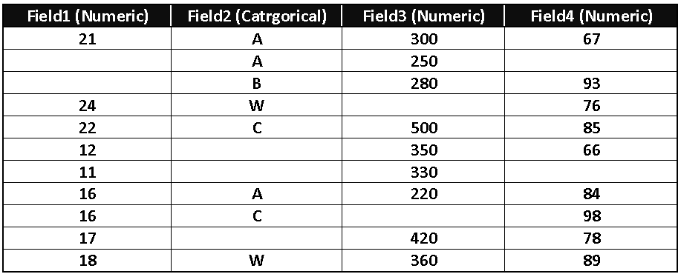
Week
04
Handling Missing Values
A set of fields with missing values
www.midocean.ae

Slide 41
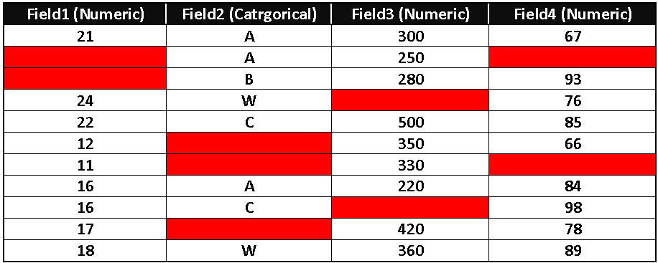
Week
04
Handling Missing Values
A set of fields with missing values
www.midocean.ae

Slide 42
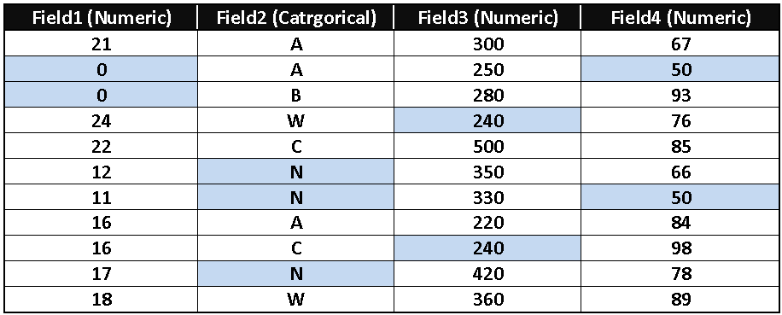
Week
04
Handling Missing Values (Using Default Values)
Defaults
Field1 Default: 0 Field2 Default: N
Field3 Default: 240 Field4 Default: 50
www.midocean.ae

Slide 43
Week
04
Handling Missing Values (Using Means and Modes)
Use the mean for the numeric fields and the mode (if exists) for the categorical fields
If mode doesn’t exist, you need to rely on either a default value or to use a random value
Numeric Fields: Field1, Field3, and Field4
Field1 Mean = (21+24+22+12+11+16+16+17+18)/9 = 17.44
Field3 Mean = 334.44
Field4 mean = 81.78
If any field doesn’t accept decimal values, just approximate the mean value
www.midocean.ae

Slide 44
Week
04
Handling Missing Values (Using Means and Modes)
Field2 is categorical, hence we need to compute the mode from the existing values
Category Occurrence
A 3
B 1
W 2
C 2
Hence, the mode is A
www.midocean.ae

Slide 45
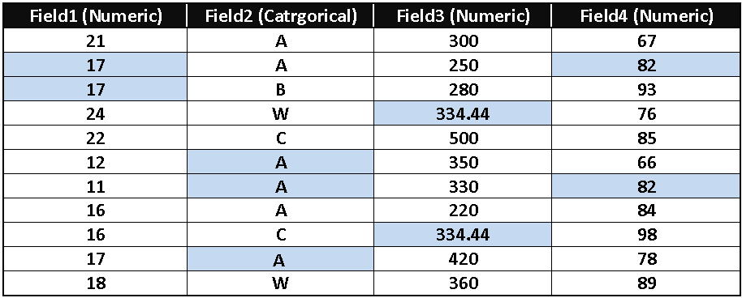
Week
04
Handling Missing Values (Using Means and Modes)
Assumptions
Assume Field 1 and Field4 don’t accept decimal numbers, Hence we approximate the mean
Field3 accepts decimal numbers, hence we don’t approximate the mean value
www.midocean.ae

Slide 46
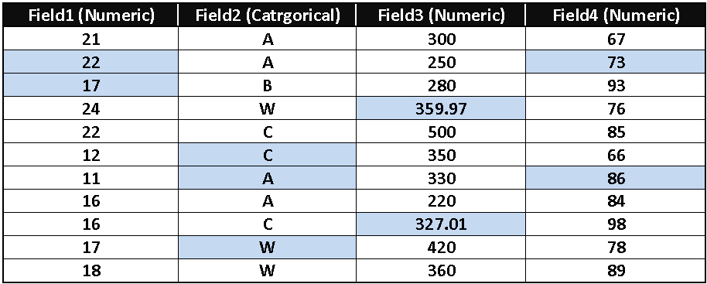
Week
04
Handling Missing Values (Using Random Values)
www.midocean.ae

Slide 47
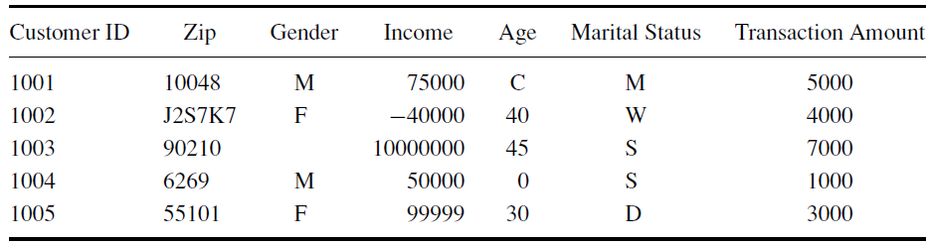
Week
04
Handling Outliers
Sample Table
Data Set
Possible Outlier Values
Outliers are data values that deviate from expected values of the rest of the data set
Outliers are extreme values that lie near the limits of the data range or go against the trend of the remaining data.
Normally, outliers need more investigation to make sure that they don’t occur due to mistakes during data entry
www.midocean.ae

Slide 48
Week
04
Handling Outliers Using Inter-quartile Range
Q1
Q3
75% of data items
Sorted Data Items
25% of data items
50% of data items
Q2
A Quartile is any of the three values which divide the sorted data set into four equal parts
First quartile (Q1) cuts off lowest 25% of data
Second quartile (Q2) cuts data set in half (it is the median of the data set)
Third quartile (Q3) cuts off highest 25% of data, or lowest 75%
www.midocean.ae

Slide 49
Week
04
Computing Q1, Q2, and Q3
to compute Q1, Q2, and Q3, use the following method:
  Order the given data set in ascending order.
  Use the median to divide the ordered data set into two halves. This median is second quartile (Q2). Exclude this median (if it is one of the data items) from any further computation.
  The first quartile (Q1) value is the median of the lower half of the data.
  The third quartile (Q3) value is the median of the upper half of the data.
www.midocean.ae

Slide 50
Week
04
Example #1 of Computing Q1, Q2, and Q3
compute Q1, Q2, and Q3 for the following data set:
6, 47, 49, 15, 42, 41, 7, 39, 43, 40, 36
  Order the given data set in ascending order:
  6, 7, 15, 36, 39, 40, 41, 42, 43, 47, 49
  Q2 = 40 (median of the data set)
  Q1 is the median of the lower half of the data (shown in red).
  Q1 = 15
  Q3 is the median of the upper half of the data (shown in green).
  Q3 = 43
www.midocean.ae

Slide 51
Week
04
Example #2 of Computing Q1, Q2, and Q3
compute Q1, Q2, and Q3 for the following data set:
39, 36, 7, 40, 41, 17
  Order the given data set in ascending order:
  7, 17, 36, 39, 40, 41
  Q2 = (36+39)/2 = 37.5 (median of the data set). Note, the number of data items is even so the median is the average of the middle two data items
  The median is not a data item, hence we need to use all items in the first half of the data items to compute Q1 and the rest of the items are used to compute Q3
  Q1 = 17
  Q3 is the median of the upper half of the data (shown in green).
  Q3 = 40
www.midocean.ae

Slide 52
Week
04
Detecting Outliers using Inter-quartile Range
Compute the Inter-Quartile Range (IQR) as follows:
IQR = Q3 − Q1
A data value is an outlier if:
  its value is <= (Q1 – 1.5*IQR), or
  its value is >= (Q3 + 1.5*IQR).
www.midocean.ae

Slide 53
Week
04
Example of Detecting Outliers using Inter-quartile Range
Sample Table
Data Set that might contains outliers
Data Set
75000, -40000, 10000000, 50000, 99999
www.midocean.ae

Slide 54
Week
Example of Detecting Outliers using Inter-quartile Range
04
Data Set:
75000, -40000, 10000000, 50000, 99999
Ordered Data Set:
-40000, 50000, 75000, 99999, 10000000
Q2 = 75000
Q1 = (–40000+50000)/2 = 5000
Q3 = (99999+10000000)/2 = 5049999.5
IRQ = Q3 – Q1
= 5049999.5 – 5000
= 5044999.5
Q1 – 1.5*IRQ = 5000 – 1.5*50449999.5 = – 7562499.5
Q3 + 1.5*IRQ = 5049999.5 + 1.5*5044999.5 = 12617498.75
All data in the data set are within range, hence there is no outliers in this example
www.midocean.ae

Slide 55
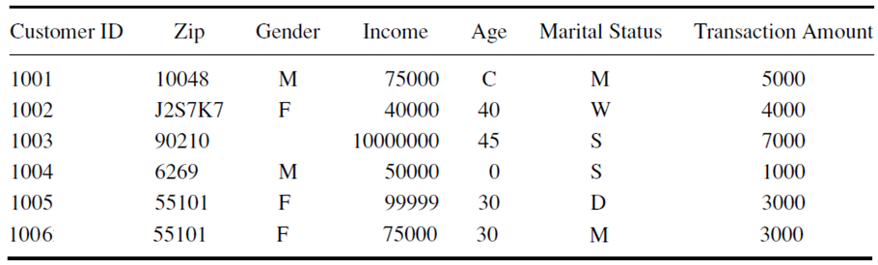
Week
Example of Detecting Outliers using Inter-quartile Range
04
Data Set that might contains outliers
Data Set
75000, 40000, 10000000, 50000, 99999, 75000
www.midocean.ae

Slide 56
Week
Example of Detecting Outliers using Inter-quartile Range
04
Data Set:
75000, 40000, 10000000, 50000, 99999, 75000
Ordered Data Set:
40000, 50000, 75000, 75000, 99999, 10000000
Q2 = (75000+ 75000)/2 = 75000
Q1 = 50000
Q3 = 99999
IRQ = Q3 – Q1
= 99999 – 50000
= 49999
Q1 – 1.5*IRQ = 50000 – 1.5*49999 = –24998.5
Q3 + 1.5*IRQ = 99999 + 1.5* 49999 = 174997.5
Hence data item 10000000 is an outlier and should be re-investigated for any data-entry errors
www.midocean.ae

Slide 57
Week
04
Noisy Data
Noisy data are the kind of data that have incorrect values
Some reasons for noisy data:
    Data collection instruments may be faulty
    Human or computer errors may occur during data entry
    Transmission errors may occur
    Technology limitations like buffer size, may occur during data-entry
www.midocean.ae

Slide 58
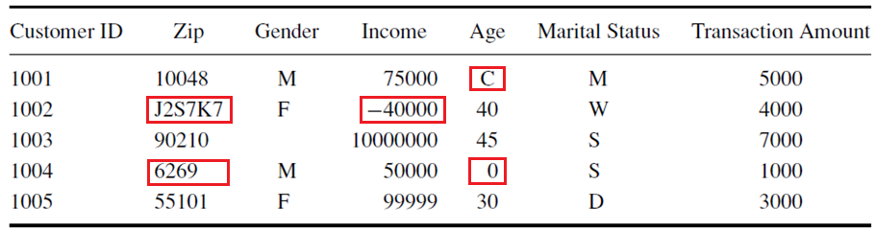
Week
04
Noisy Data
Examples of Noisy Data
www.midocean.ae

Slide 59
Week
04
Smoothing Noisy Data
By smoothing noisy data we can correct the errors
Smoothing noisy data is performed by:
    Validation and correction
    Standardization
www.midocean.ae

Slide 60
Week
04
Validation and Correction of Noisy Data
This step examines the data for data-entry errors and tries to correct them automatically as far as possible according to the following guidelines:
Spell checking based on dictionary lookup is useful for identifying and correcting misspellings.
      Example: Kairo can be spell-checked and corrected into Cairo
Use dictionaries on geographic names and zip codes helps to correct address data.
      Example: Zip code 1243456 can be detected as an error since there is no Zip code matches this value
www.midocean.ae

Slide 61
Week
04
Validation and Correction of Noisy Data (Cont.)
Check validation rules and make sure field values follow the rules; for example:
Age is not less than certain amount and age is a positive number.
  Example: if there is a rule governing your data says that age must be between 20 and 60, then ages of 18, 15, and 68 are detected as errors
Each value of the categorical values belong to certain category.
  Example: if all the categories you have are A, B, C, and D, Then if categories W or N are found they will be declared as errors
www.midocean.ae

Slide 62
Week
04
Validation and Correction of Noisy Data (Cont.)
Check the fields that have ambiguous values and check for any possible data-entry errors
    Example: Using the same category value to refer to different meaning. “S” in “Marital Status” field could refer to “Single” or “Separated”
www.midocean.ae

Slide 63
Week
04
Standardization to Smooth Noisy Data
Data values should be consistent and have uniform format. For example:
  Date and time entries should have a specific format
      Oct. 19, 2009 10/19/2009 19/10/2009
      All dates must be written with the same format that have been agreed upon (e.g., Day/Month/Year)
Names and other string data should be converted to either upper or lower case.
    MOHAMED AHMED instead of Mohamed Ahmed
Removing prefixes and suffixes from names.
    Mohamed Ahmed instead of Mr. Mohamed Ahmed
    Mohamed Ahmed instead of Mohamed Ahmed, Ph.D.
www.midocean.ae

Slide 64
Week
04
Standardization to Smooth Noisy Data (Cont.)
Abbreviations and encoding schemes should consistently be resolved by consulting special dictionaries or applying predefined conversion rules.
  US is the standard abbreviation of United States
www.midocean.ae

Slide 65
Week
04
Data Inconsistency
Data inconsistency means that different data items contain discrepancies in their values
It can occur when different data items depend on other data items and their values don’t match; for example:
Age and Birth-date; age can be computed from the birth-date, hence the value of Age must match the value computed from the birth-date
City and Phone-area-code; each city has certain area-code
Total-price and (unit-price and quantity); total-price can be computed from the unit-price and quantity
These dependencies can be utilized to detect errors and substitute missing values or correct wrong values
www.midocean.ae

Slide 66
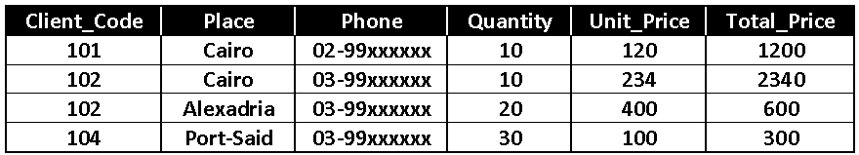
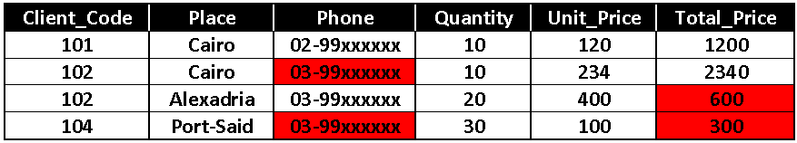
Week
04
Data Inconsistency Example
66
Example of Inconsistent Data
Data Inconsistency Marked in Red
Incorrect Area-Code
Total_Price doesn’t equal (Quantity*Unit_Price)
www.midocean.ae

Slide 67



Thank You

