Slide 1


Multicollinearity
7
www.midocean.ae

Slide 4
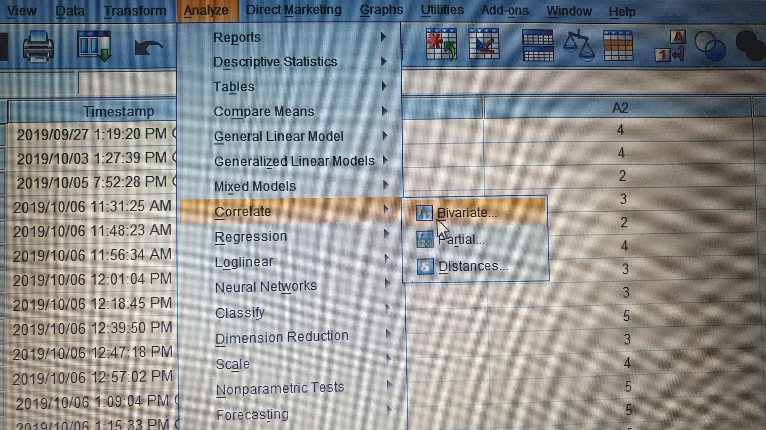
Based on the study of Montgomery, Peck and Vining, (2012) the correlation above .80 refers to collinearity

Slide 5
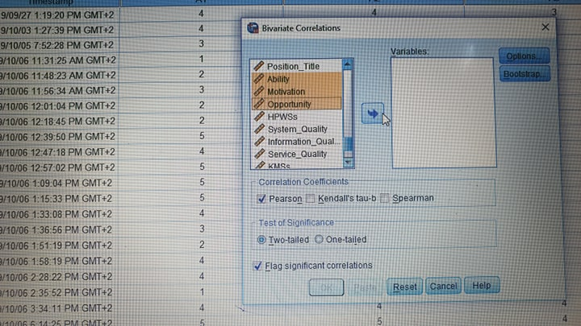

Slide 6
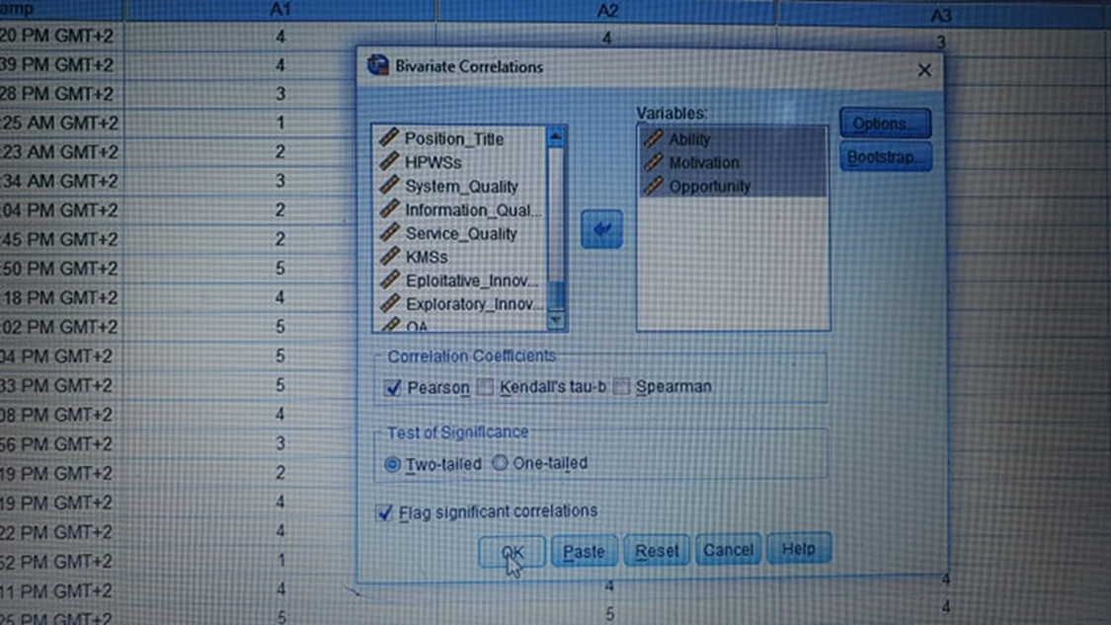

Slide 7
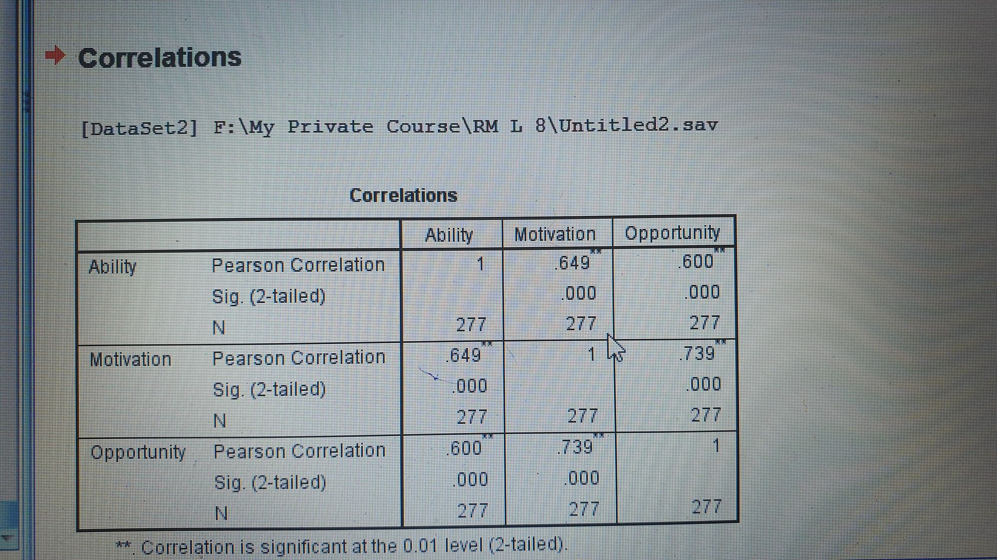

Slide 8
Another way used to measure the multicollinearity through calculating Variance Inflation Factor (VIF) to check any collinear variables that may exist in the research model, based on Field (2005, 2009).
There is no collinearity among the research variables, when all VIF values < 10. Moreover, the tolerance statistics scores of all the variables are > 0.2. Thus, based on the study of Field (2009)
Multicellularity tests are used to indicate to discriminant validity

Slide 9
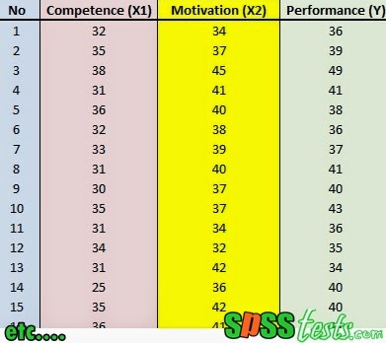

Slide 10
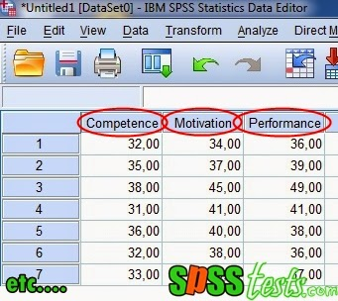
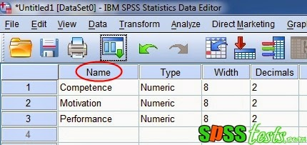

Slide 11
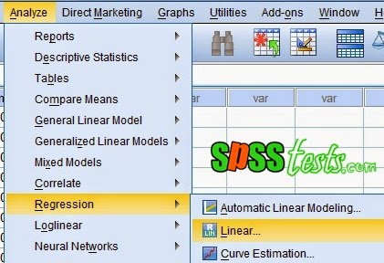

Slide 12
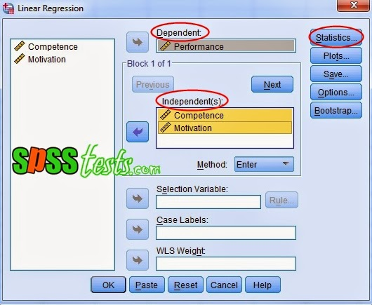

Slide 13
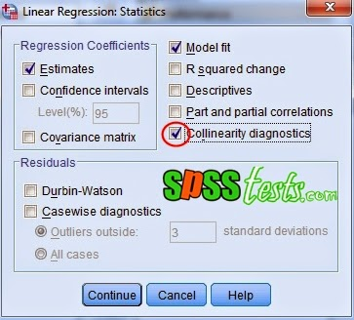

Slide 14
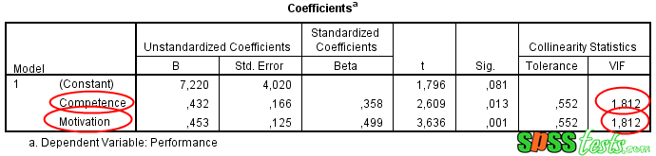

Slide 15
Kaiser–Meyer–Olkin (KMO) and Bartlett of sphericity Tests
8
www.midocean.ae

Slide 16
Regarding the sample size suitability (sampling adequacy) through using the Kaiser–Meyer–Olkin (KMO) and Bartlett’s test measure of sampling (Kaiser, 1974). The KMO test results should range from 0 to 1.
Result that is close to 1 refers to the more adequacy sample size. Consequently, the more consistent results of the factor analysis. Kaiser (1974) suggests a range to accept a sample size, which is the value of KMO > 0.5.
Moreover, Hutcheson and Sofroniou (1999) recommend that acceptable values that are laying between 0.5 and 0.7, good values that are laying between 0.7 and 0.8, great values are between 0.8 and 0.9, and perfect values that are greater than 0.9.
Also, test of Bartlett of sphericity must also be measured.
This test indicates the extent to which the study study`s correlation matrix is significantly distinct from an identity matrix which its covariances and coefficients of all correlation = zero (Bartlett, 1954). The significant result indicates that the correlation matrix of the study is completely different from the identity matrix. Thus, Bartlett’s test significance refers to the suitability of the factor analysis.

Slide 21
Course Evaluation
www.midocean.ae

Slide 22
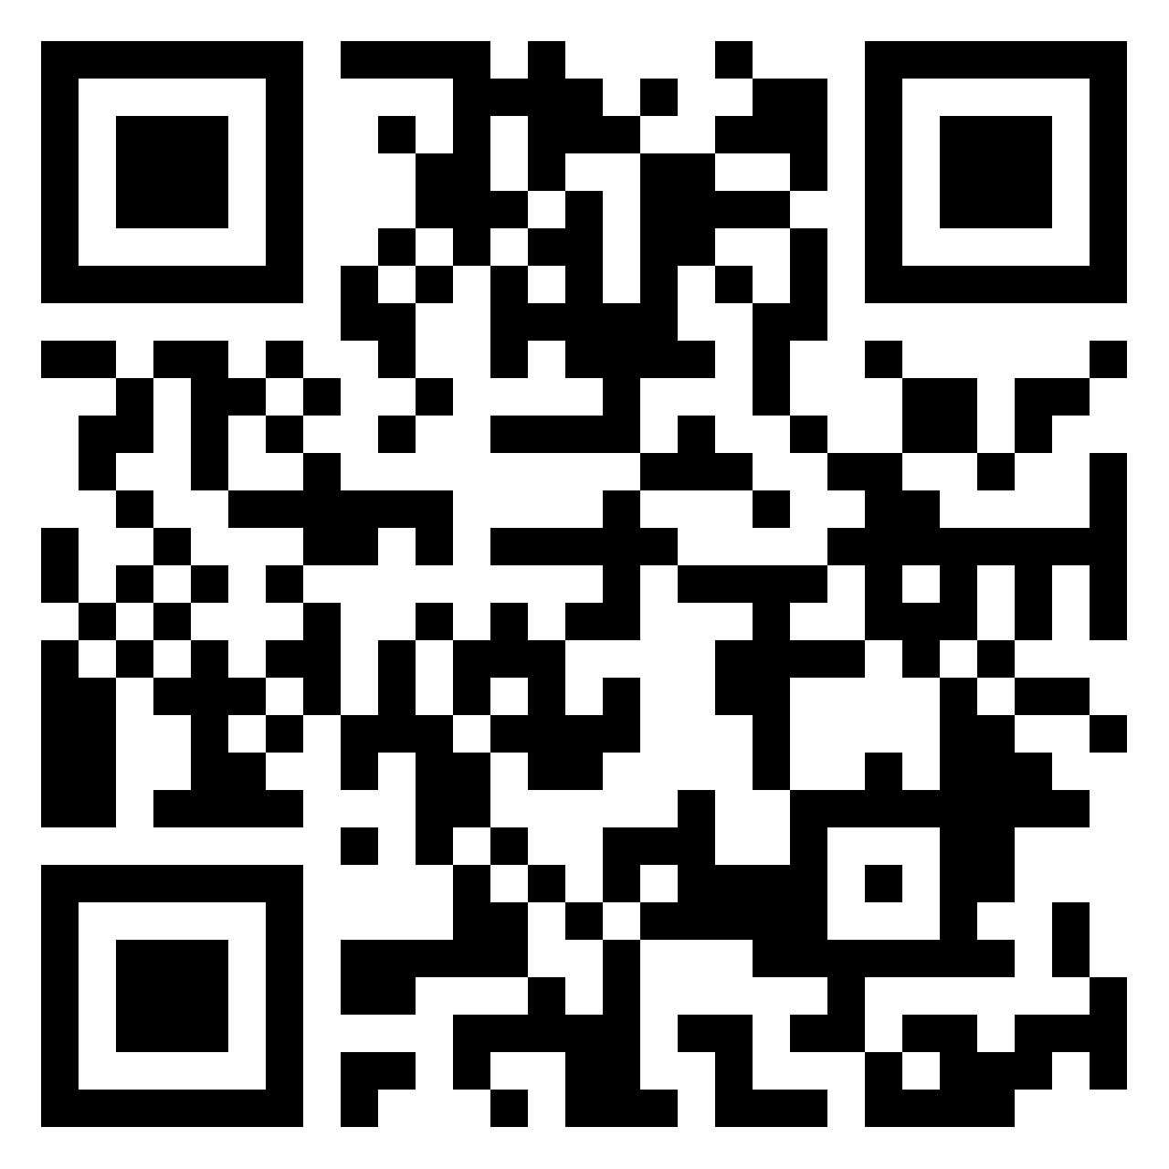
رأيك يهمني
أكتب أسمك + تقييمك لدورة البحث العلمي
https://padlet.com/monaalashry77/padlet-xr709opfeqfrbh7t
www.midocean.ae

Slide 23




Thank You

