Slide 1





Secure Operating Systems (CYB610)
Master of Science in Cybersecurity
Dr. Redhwan M. A. Saad
Head of Cybersecurity Department
Faculty of Informatics
Midocean University
Orientation show عرض توجيهي
www.midocean.ae

Slide 2

Who am I?
  Assistant Professor in Internet Infrastructure Security
    Ph.D from USM, Malaysia, April. 2016
    Thesis: “ICMPv6 Echo Request DDoS Attack Detection Framework using a Back-propagation Neural Network”.
    M.Sc from “LETI”, RUSSIA, Sep.2007
    B.Sc from “LETI”, RUSSIA, Sep.2004
Secure Operating Systems Dr. Redhwan M. A. Saad
www.midocean.ae

Slide 3
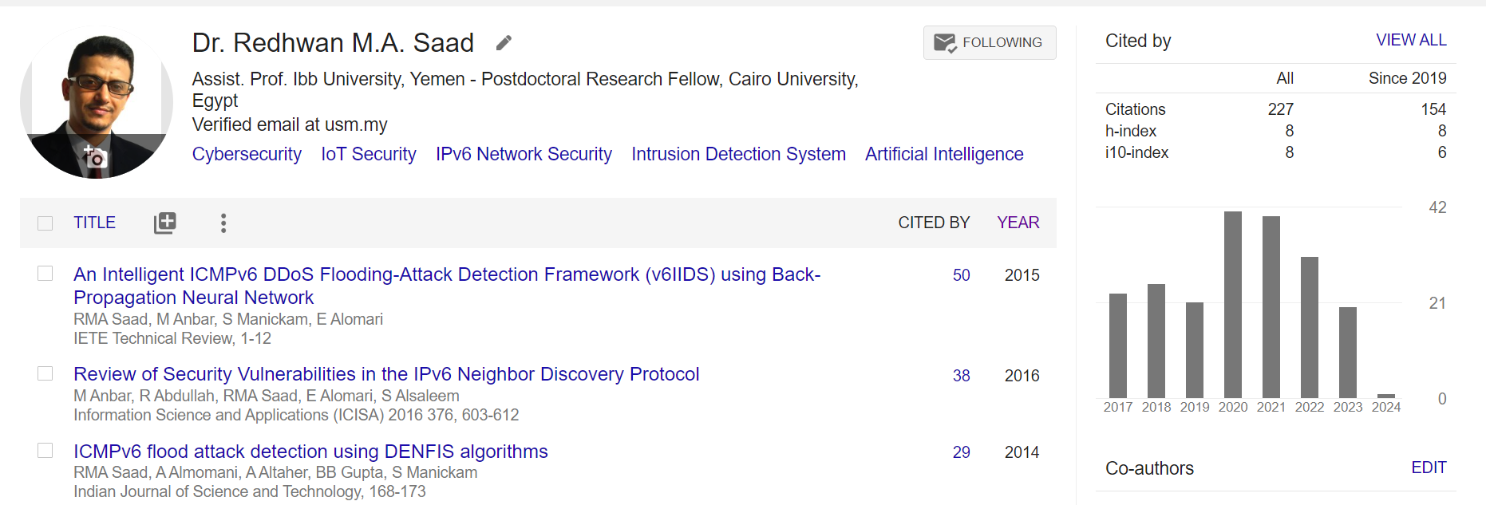



My Contact Information
  How to reach me
    By email at redhwan@midocean.edu.km
    ( please include “Secure Operating Systems” in subject line)
  Office hours
  Discussion Time (Monday at 9:00 PM) weekly
  More about me:
https://scholar.google.com.my/citations?user=4CFExCUAAAAJ&hl=en
https://www.scopus.com/authid/detail.uri?authorId=56105545600
https://orcid.org/0000-0001-7241-9327
Secure Operating Systems, Dr. Redhwan M. A. Saad
www.midocean.ae

Slide 4
The course that will be taught
Secure Operating Systems
Secure Operating Systems, Dr. Redhwan M. A. Saad
www.midocean.ae

Slide 5
A brief about OS
Operating System is a software, that manages all hardware resources associated with the computer.
Generally, Operating System is comprised of number of pieces such as
the Boot loader,
the Kernel,
Daemons,
Desktop environment and
Applications.
Typically, OS is deployed in any system when multi-tasking required to be performed, which is achieved by resource management functionality of the OS.
Along with that, the user also requires interface with the system to interact and invoke various applications. In modern day OS, these interfaces (popularly known as GUI) are expected to provide best-in-class User Experience (UX) to the users, by making it easy to use the system.
Secure Operating Systems, Dr. Redhwan M. A. Saad
www.midocean.ae

Slide 6
Introduction
In Previous Courses you learned:
The concepts of computer security, cryptography, digital money, secure protocols, detection, and other security techniques.
The essential techniques in protecting information systems, IT infrastructure, analyzing and monitoring potential threats and attacks, devising security architecture, and implementing security solutions.
Various network technologies and cyber-attacks and their issues.
The origin of Malware, and its security.
Secure Operating Systems, Dr. Redhwan M. A. Saad
www.midocean.ae

Slide 7
Introduction
In Previous Courses you learned:
How to Identify & Evaluate vulnerabilities in information systems and apply security measures to real-time scenarios.
Security Protocols for avoiding the basic level threat.
The use of standards to enhance information security in the development process and infrastructure protection.
Recognize the appropriate steps for information security risk, response, and recovery.
Demonstrate the ability to assess and implement access controls.
Secure Operating Systems, Dr. Redhwan M. A. Saad
www.midocean.ae

Slide 8
Primary Goal of This Course
In this course,
The goal is to gain an understanding of how hardware and software constructs protect modern operating systems.
Secure Operating Systems, Dr. Redhwan M. A. Saad
www.midocean.ae

Slide 9
Units of Course Contents
Module | Course Unit
1 | Module 1: Introduction, and an overview about OS Security Threats and basic components of OS Security.
2 | Module 2: User privileges, Permissions and Files systems and encryption.
3 | Module 3: Securing services.
4 | Module 4: Firewalls, Remote Access, Secure Network-attached storage (NAS).
5 | Module 5: Network application security.
6 | Module 6: Managing security alerts and updates.
7 | Module 7: Detecting and responding to security breaches.
Secure Operating Systems, Dr. Redhwan M. A. Saad
www.midocean.ae

Slide 10

Teaching Methodology
منهجية التدريس
Recorded Lectures
المحاضرات المسجلة
Live Sessions
جلسات وحلقات النقاش
References
المراجع المعتمدة للمقرر الدراسي
Virtual Labs
المعامل الأفتراضية
www.midocean.ae

Slide 11

Study System
Secure Operating Systems, Dr. Redhwan M. A. Saad
www.midocean.ae

Slide 12

Course Information - Evaluation
  Assessment Method:
Short Exam
  80% marks
    Count of short Exam 10 (Weekly)
    8 Marks for each of short Exam.
  20% marks
  Final Examination
Secure Operating Systems, Dr. Redhwan M. A. Saad
www.midocean.ae

Slide 13
Learning Outcomes
After completion of this course, the students should be able to:
Explain what operating system and network security means.
Explain how viruses, worms, and Trojan horses spread.
Explain encryption and authentication methods and how they are used.
Create account naming and security strategies.
implement directory, folder, and file security.
Configure the firewall capabilities in operating systems.
Explain physical security methods for workstations, servers, and network devices.
Configure security for wireless interfaces in workstation operating systems.
Explain how e-mail can be secured through certificates and encryption.
Explain how to use disaster recovery techniques to secure operating systems, prevent data loss, and reduce downtime.
Secure Operating Systems, Dr. Redhwan M. A. Saad
www.midocean.ae

Slide 14
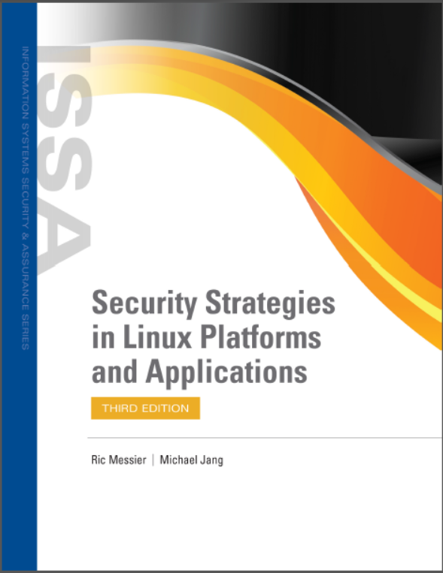
Learning Resources:
Credit Hours:
3 credit hours.
  Required Textbook:
Jang M. and Messier R., “Security Strategies in Linux Platforms and Applications”, 2024, Jones and Bartlett Learning, ISBN 9781284255850.
Secure Operating Systems, Dr. Redhwan M. A. Saad
www.midocean.ae

Slide 15


Thank You

