Slide 1


Mathematics 2
Prepared by Dr. Israa Lewaa
Lecture 5
MAT 122
Advanced Topics in Matrix Algebra

Slide 2

Lecture
05
Lecture Outline
The inverse of Matrix Definition
The inverse for 2 * 2 matrix by determinant
Solving Two Equations by Inverse matrix
The inverse for 2 * 2 matrix by Reduced Echelon Form
Lecture 5 Dr. Israa Lewaa Mathematics 2

Slide 3
Lecture
05
Inverse of matrices
Let A be a square matrix. A matrix B such that AB=I=BA is called the inverse matrix of A and is denoted by A⁻¹.
So if A⁻¹ exists, we have AA⁻¹=I=A⁻¹A and the matrix is said to be invertible.
If a matrix has no inverse, then it is said to be non-invertible.
Lecture 5 Dr. Israa Lewaa Mathematics 2

Slide 4
Lecture
05
Inverse of matrices
Let A be a square matrix. A matrix B such that AB=I=BA is called the inverse matrix of A and is denoted by A⁻¹.
So if A⁻¹ exists, we have AA⁻¹=I=A⁻¹A and the matrix is said to be invertible.
If a matrix has no inverse, then it is said to be non-invertible.
Lecture 5 Dr. Israa Lewaa Mathematics 2

Slide 5
Lecture
05
Definition of Inverse Matrix
Definition:
If (A) is an n x n matrix, form the n x 2n matrix (A| I), and Perform elementary row operations until the first n columns form a reduced matrix.
We will solve the system of linear equations by unit matrix.
Lecture 5 Dr. Israa Lewaa Mathematics 2

Slide 6
Lecture
05
The Inverse of a Matrix
Like a reciprocal in scalar math
Like the number one in scalar math
Lecture 5 Dr. Israa Lewaa Mathematics 2

Slide 7
Lecture
05
Inverse matrix by determinants
Inverse matrix by determinants
Lecture 5 Dr. Israa Lewaa Mathematics 2

Slide 8
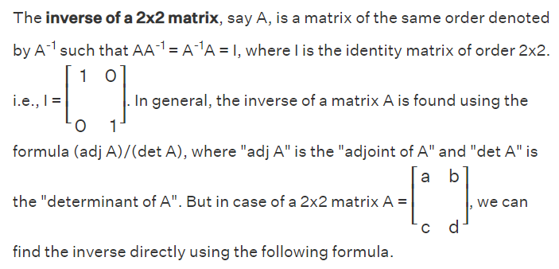
Lecture
05
What is the inverse of 2*2 Matrix
Lecture 5 Dr. Israa Lewaa Mathematics 2

Slide 9
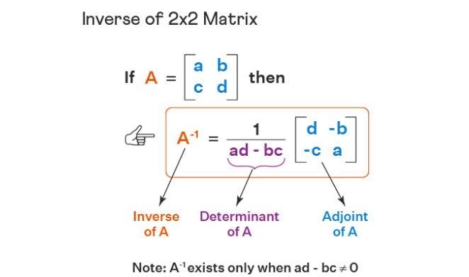
Lecture
05
Example
Lecture 5 Dr. Israa Lewaa Mathematics 2

Slide 10
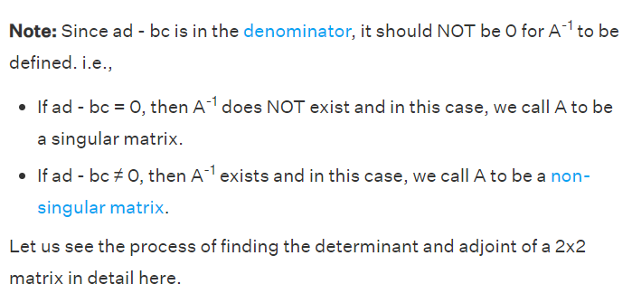
Lecture
05
Example
Lecture 5 Dr. Israa Lewaa Mathematics 2

Slide 11
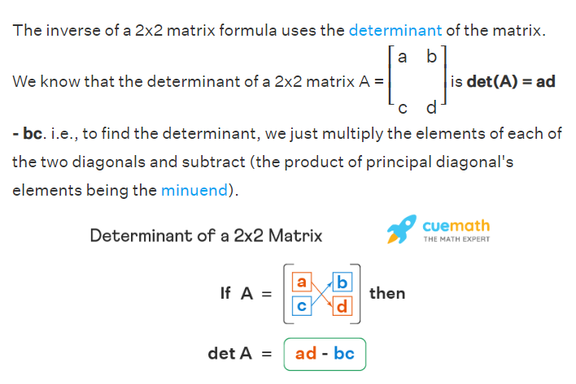
Lecture
05
Determinant of 2*2 matrix
Lecture 5 Dr. Israa Lewaa Mathematics 2

Slide 12
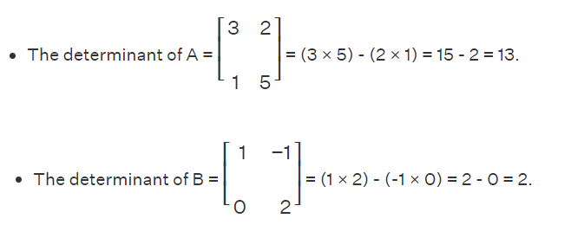
Lecture
05
Example for determinants
Lecture 5 Dr. Israa Lewaa Mathematics 2

Slide 13
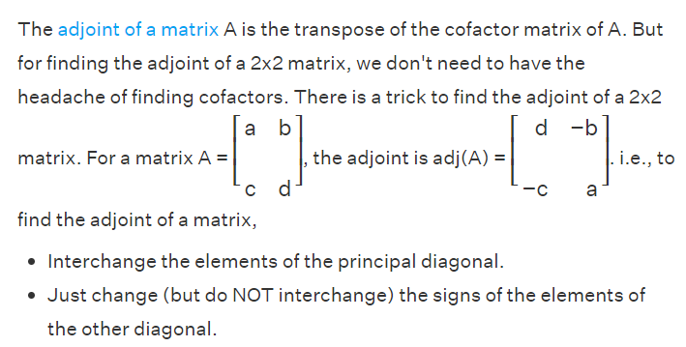
Lecture
05
Adjoint of 2*2 matrix
Lecture 5 Dr. Israa Lewaa Mathematics 2

Slide 14
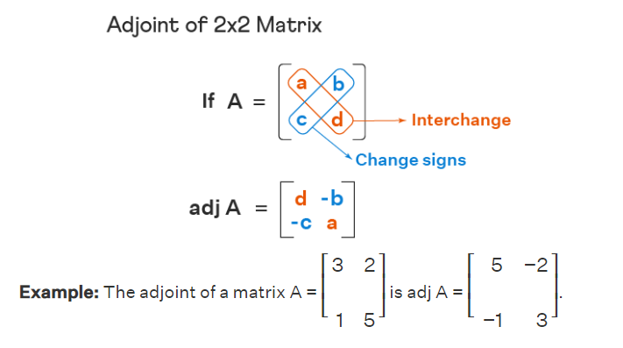
Lecture
05
Example
Lecture 5 Dr. Israa Lewaa Mathematics 2

Slide 15
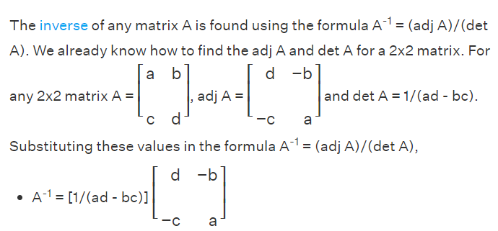
Lecture
05
Inverse of 2*2 matrix Formula
Lecture 5 Dr. Israa Lewaa Mathematics 2

Slide 16
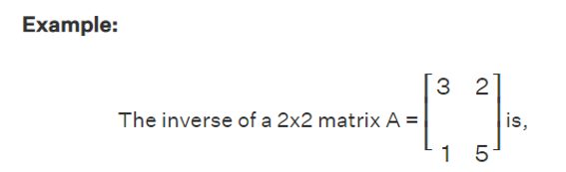
Lecture
05
Example
Lecture 5 Dr. Israa Lewaa Mathematics 2

Slide 17
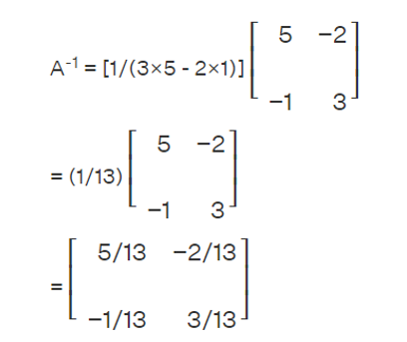
Lecture
05
Example
Lecture 5 Dr. Israa Lewaa Mathematics 2

Slide 18
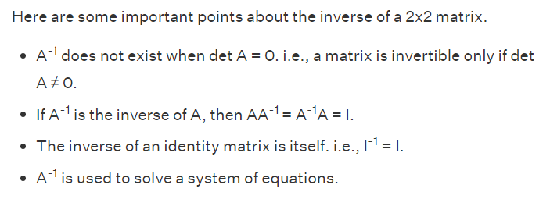
Lecture
05
Important notes on inverse for 2*2 matrix
Lecture 5 Dr. Israa Lewaa Mathematics 2

Slide 19
Lecture
05
Solving Equations by the inverse matrix
Solving Equations by Inverse matrix
Lecture 5 Dr. Israa Lewaa Mathematics 2

Slide 20
Lecture
05
Linear System of Simultaneous Equations
First precinct: 6 arrests last week equally divided between felonies and misdemeanors.
Second precinct: 9 arrests - there were twice as many felonies as the first precinct.
Lecture 5 Dr. Israa Lewaa Mathematics 2

Slide 21
Lecture
05
Example
Solve the following system by using inverse
6x + 5y = 2
x + y = – 3
Lecture 5 Dr. Israa Lewaa Mathematics 2

Slide 22
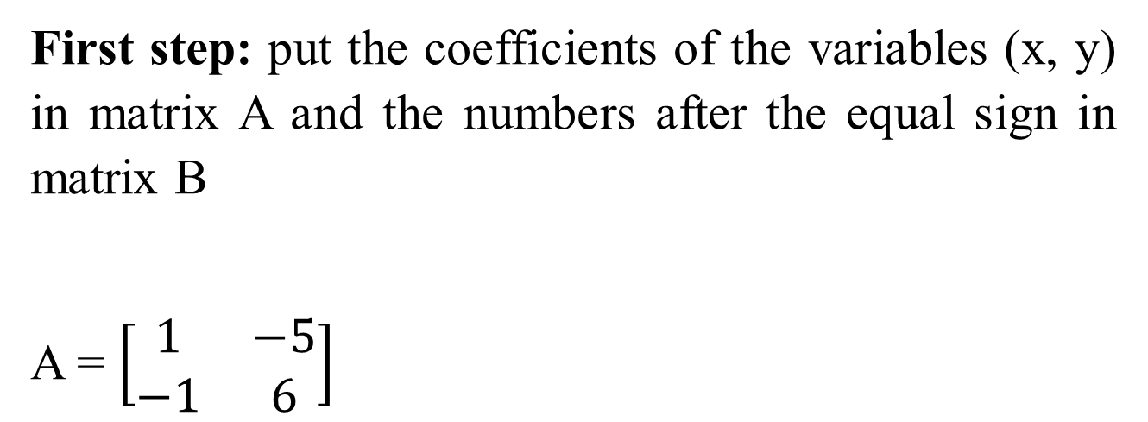
Lecture
05
Solution
First step: put the coefficients of the variables (x, y) in matrix A and the numbers after the equal sign in matrix B
A = $\left[\begin{matrix}1 & −5 \\ −1 & 6\end{matrix}\right]$
Lecture 5 Dr. Israa Lewaa Mathematics 2

Slide 23
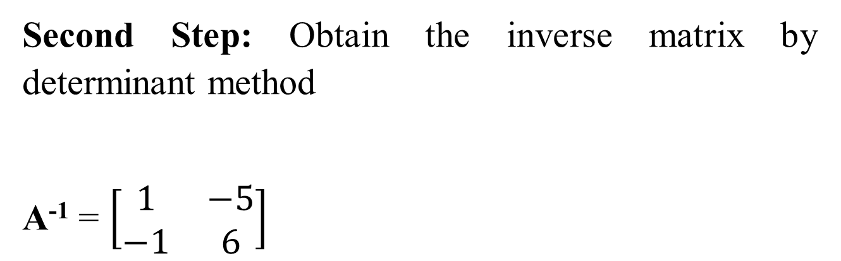
Lecture
05
Solution
Second Step: Obtain the inverse matrix by determinant method
A⁻¹ = $\left[\begin{matrix}1 & −5 \\ −1 & 6\end{matrix}\right]$
Lecture 5 Dr. Israa Lewaa Mathematics 2

Slide 24
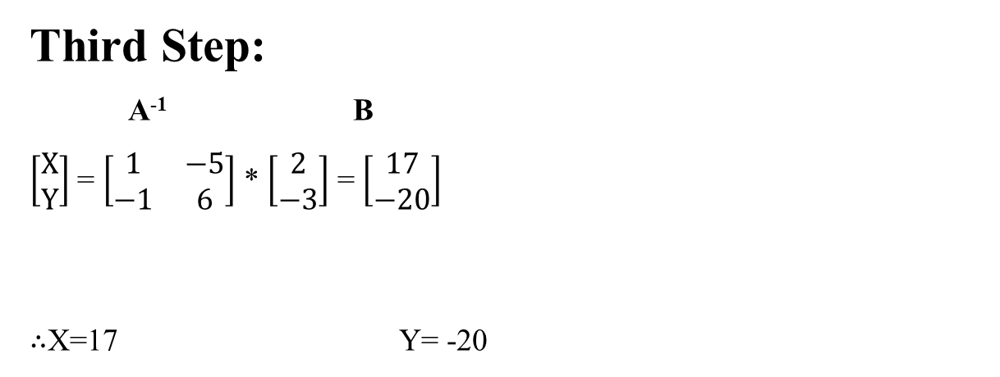
Lecture
05
Example
Third Step:
A⁻¹ B
$\left[\begin{matrix}X \\ Y\end{matrix}\right]$ = $\left[\begin{matrix}1 & −5 \\ −1 & 6\end{matrix}\right]$ * $\left[\begin{matrix}2 \\ −3\end{matrix}\right]$ = $\left[\begin{matrix}17 \\ −20\end{matrix}\right]$
$∴$X=17 Y= -20
Lecture 5 Dr. Israa Lewaa Mathematics 2

Slide 25
Lecture
05
Reduced Echelon Form
Reduced Echelon Form
Lecture 5 Dr. Israa Lewaa Mathematics 2

Slide 26

Lecture
05
Example
Find the inverse for matrix A using the reduced echelon form
Lecture 5 Dr. Israa Lewaa Mathematics 2

Slide 27

Lecture
05
Solution
Add unit matrix X to matrix A
you have to convert A to I, by adding the two rows, multiplying number by row, subtracting the two rows or multiplying number by row and add or subtract it from the other one.
Lecture 5 Dr. Israa Lewaa Mathematics 2

Slide 28
Lecture
05
Solution
So, We need to convert number 6 to 1.
So we will multiply row two by 7 and subtract row 1 from it. And write the second row as it is.
Lecture 5 Dr. Israa Lewaa Mathematics 2

Slide 29
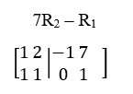
Lecture
05
Solution
So we will multiply row two by 7 and subtract row 1 from it. And write the second row as it is.
Lecture 5 Dr. Israa Lewaa Mathematics 2

Slide 30
Lecture
05
Solution
So we will multiply row two by 7 and subtract row 1 from it. And write the second row as it is.
Lecture 5 Dr. Israa Lewaa Mathematics 2

Slide 31
Lecture
05
Solution
Then we need to convert 1 to zero
So R₁ – R₂
and row one will be as it is.
Lecture 5 Dr. Israa Lewaa Mathematics 2

Slide 32
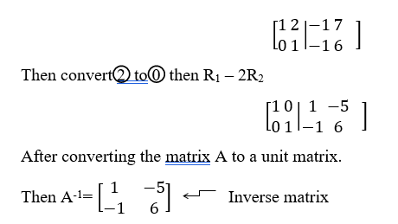
Lecture
05
Solution
Lecture 5 Dr. Israa Lewaa Mathematics 2

Slide 33
Lecture
05
** EXTRA PRACTICE
Let’s Practice
Lecture 5 Dr. Israa Lewaa Mathematics 2

Slide 34

Lecture
05
Example 1
Find the inverse of
Lecture 5 Dr. Israa Lewaa Mathematics 2

Slide 35
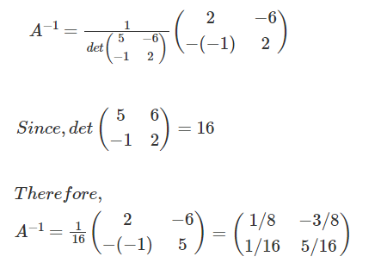
Lecture
05
Solution of Example 1
Lecture 5 Dr. Israa Lewaa Mathematics 2

Slide 36

Lecture
05
Example 2
Find the inverse of
Lecture 5 Dr. Israa Lewaa Mathematics 2

Slide 37
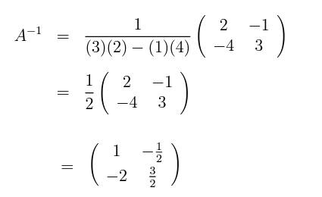
Lecture
05
Solution
Lecture 5 Dr. Israa Lewaa Mathematics 2

Slide 38

Lecture
05
Example 3
Find the inverse of
Lecture 5 Dr. Israa Lewaa Mathematics 2

Slide 39
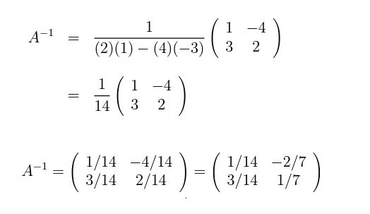
Lecture
05
Solution
Lecture 5 Dr. Israa Lewaa Mathematics 2

Slide 40

Lecture
05
Example 4
Find the inverse of
Lecture 5 Dr. Israa Lewaa Mathematics 2

Slide 41
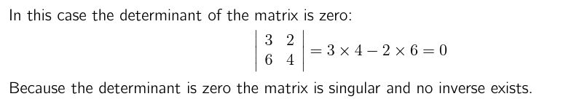
Lecture
05
Solution
Lecture 5 Dr. Israa Lewaa Mathematics 2

Slide 42
Lecture
05
Lecture Summary
The inverse of Matrix Definition
The inverse for 2 * 2 matrix by determinant
Solving Two Equations by Inverse matrix
The inverse for 2 * 2 matrix by Reduced Echelon Form
Lecture 5 Dr. Israa Lewaa Mathematics 2

