Slide 1



Project Resources and Time Management
PMG 605
Lecture 10
MS Project as a Tool for Resources and Time Management
Prepared by
Dr. Eng. Abdullah Jameel Halawany

Slide 2

Lecture
Session Outline
10
MS Project as a Tool for Resources and Time Management
MS Project 2019 Overview
Set Project Calendar
WBS
Task Type
Add and Level Resources
Timeline
Reports
10–2

Slide 3
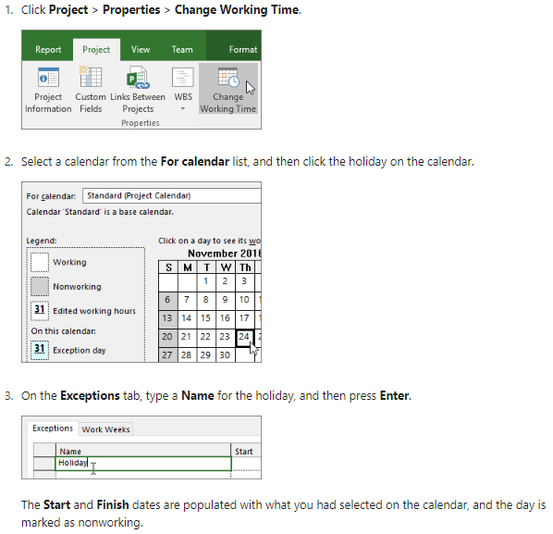
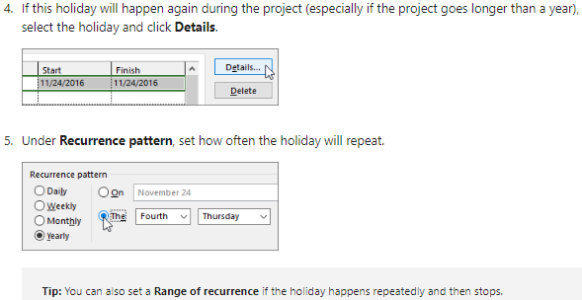
Add A Holiday To The Project Calendar
10–3

Slide 4
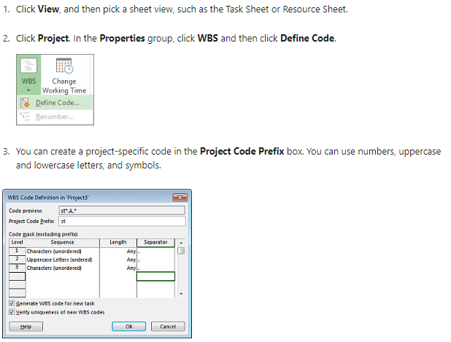
Lecture
Create WBS codes in Project desktop
10
10–4

Slide 5
Lecture
10
Change The Task Type For More Accurate Scheduling
You just assigned a few people to a task, and the task duration got longer, not shorter as you expected. Or maybe the reverse happened. Either way, you’re stumped.
Some tasks, such as curing cement, take a fixed amount of time no matter how workers are assigned to pouring the cement.
Others, like building roads or software, grow or shrink in their durations, depending on the people and resources applied to them.
To change the task types to better reflect these realities, double-click the task, click Advanced, and change the task type.
10–5

Slide 6
Lecture
How Task Types Change Your Schedule
10
Project uses a scheduling formula that relates the three values of work, duration, and assignment units:
Work = Duration x Units
Setting a task’s type allows you to “fix” (or make unchangeable) one of these values. Fixing one of the values places a priority on that value by telling Project not to change it when the other two values change.
This applies to both automatically and manually scheduled tasks.
Here’s a handy table to help keep all the moving parts of the scheduling formula in mind.
10–6

Slide 7
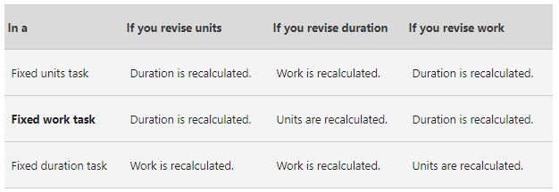
Lecture
How Task Types Change Your Schedule
10
https://support.microsoft.com/en-us/office/change-the-task-type-for-more-accurate-scheduling-b0b969ad-45bc-4e9e-8967-435587548a72
10–7

Slide 8
Lecture
Add A Milestone
10
Before your project gets rolling, you will probably want to mark its major goals with milestones.
Create a milestone with zero duration
Add a milestone with a duration
10–8

Slide 9
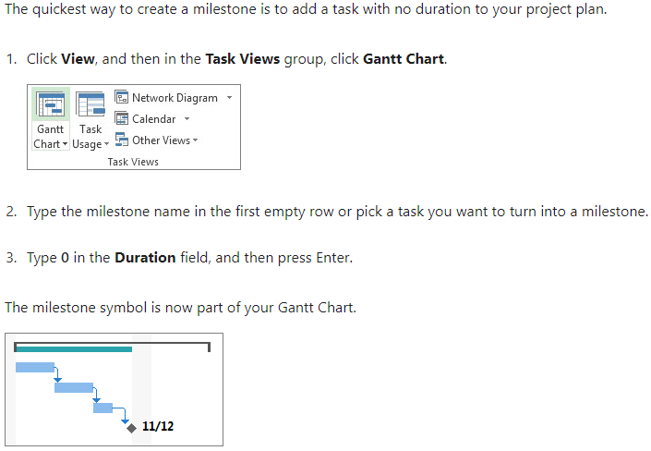
Create A Milestone With Zero Duration
10–9

Slide 10
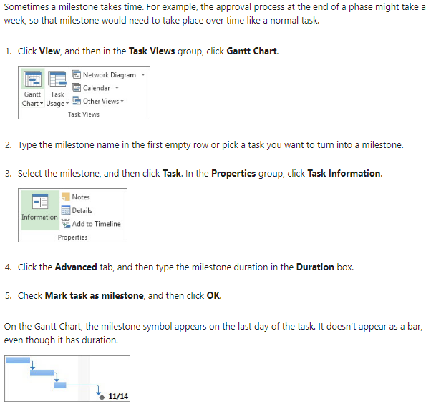
Add A Milestone With A Duration
10–10

Slide 11
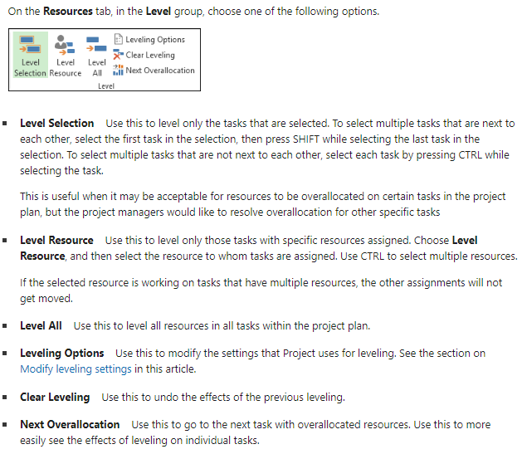
Level Resource Assignments
10–11

Slide 12
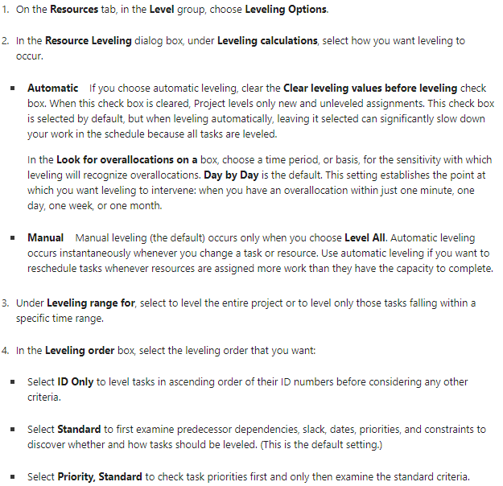
Modify Leveling Settings
10–12

Slide 13
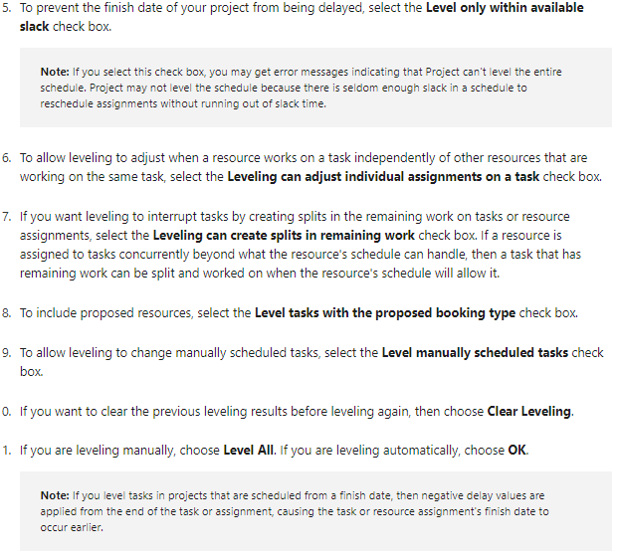
Modify Leveling Settings
10–13

Slide 14
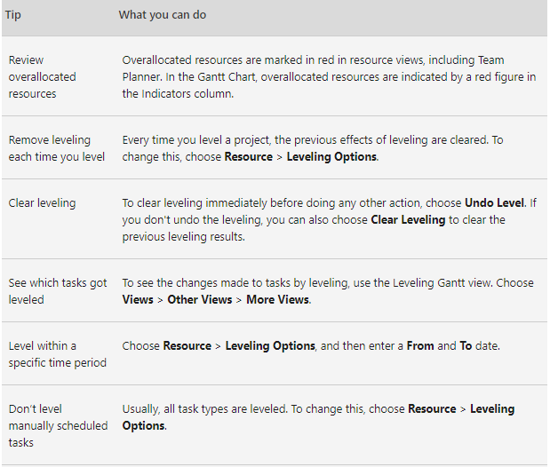
Some Tips You Can Use While Leveling
10–14

Slide 15
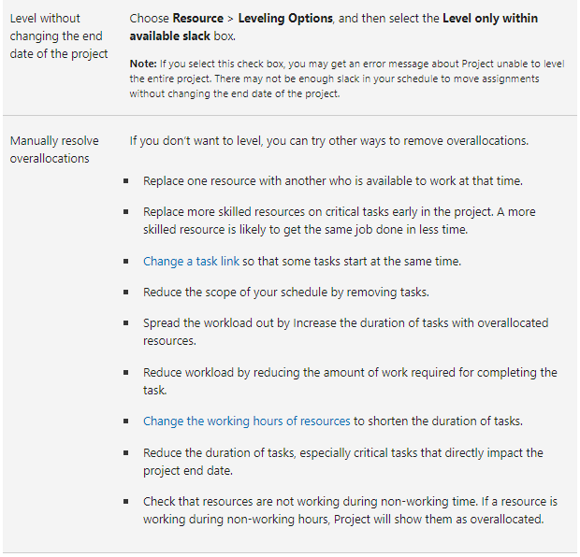
Some Tips You Can Use While Leveling
10–15

Slide 16
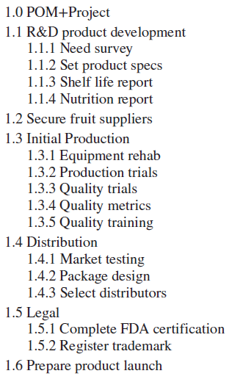
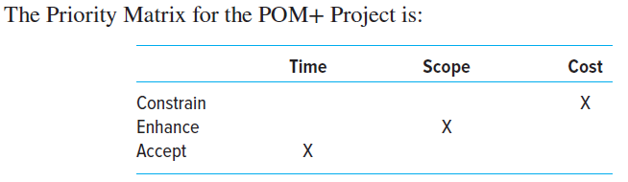
The POM+ Project - Big Kola Company – Part 1
10–16

Slide 17
Lecture
The POM+ Project - Big Kola Company
10
Develop the WBS outline using the software available.
Use this file and the information provided below to create a project schedule.
The following holidays are observed: January 1, Martin Luther King Day (third Monday in January), Memorial Day (last Monday in May), July 4th, Labor Day (first Monday in September), Thanksgiving Day (4th Thursday in November), December 25 and 26.
If a holiday falls on a Saturday, then Friday will be given as an extra day off, and if it falls on a Sunday then Monday will be given off.
The project team works eight-hour days, Monday through Friday.
10–17

Slide 18
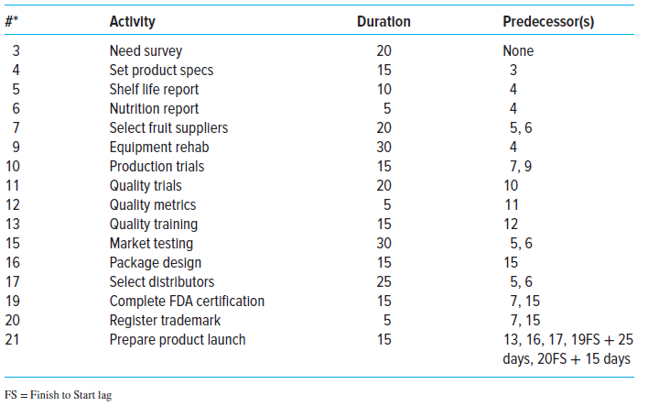
Lecture
The POM+ Project - Big Kola Company
10
10–18

Slide 19
Lecture
The POM+ Project - Big Kola Company
10
The project will begin on January 3, 2012.
Based on this schedule, submit a memo that answers the following questions:
  a. When is the project estimated to be completed? How many working days will it take?
  b. What is the critical path?
  c. Which activity has the most total slack?
  d. How sensitive is this network?
  e. Identify two sensible milestones and explain your choice.
10–19

Slide 20
The POM+ Project - Big Kola Company
10–20

Slide 21
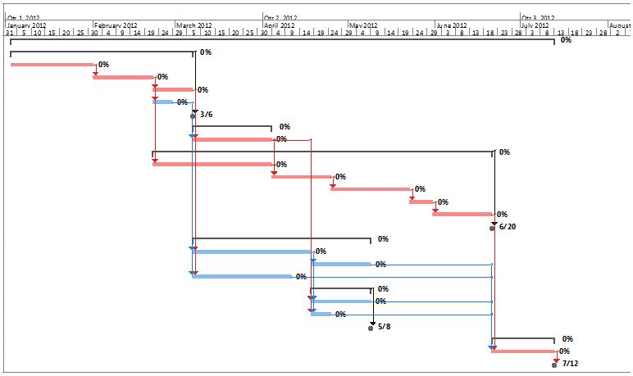
The POM+ Project - Big Kola Company
10–21

Slide 22
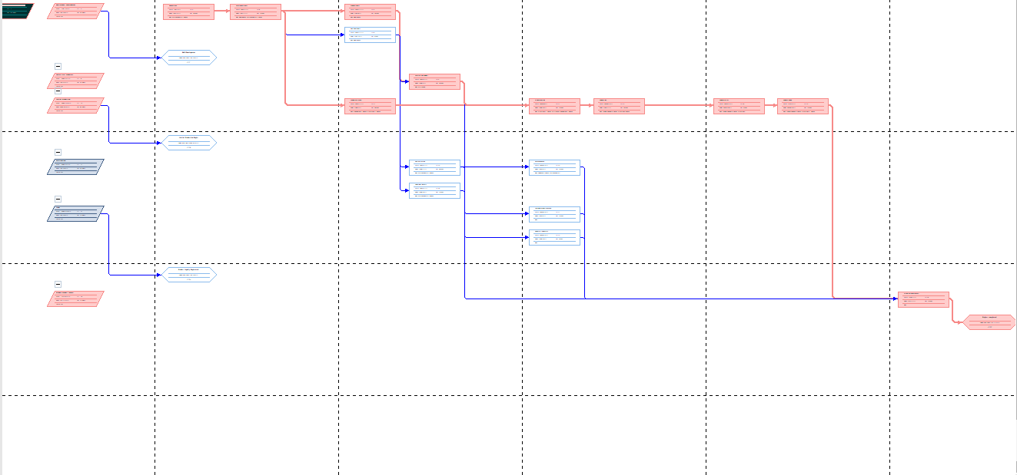
The POM+ Project - Big Kola Company
10–22

Slide 23
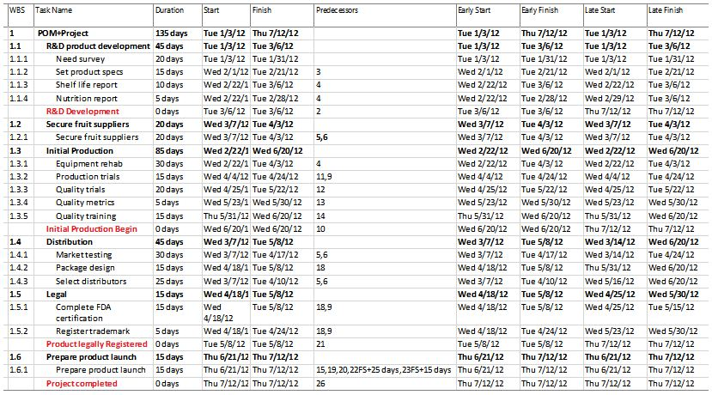
The POM+ Project - Big Kola Company
10–23

Slide 24
Lecture
The POM+ Project - Big Kola Company – Part 2
10
Remember the old saying, “A project plan is not a schedule until resources are committed.” This exercise illustrates this sometime subtle, but important point.
Using your files from Part 1, input resources and their costs if you have not already done so.
10–24

Slide 25
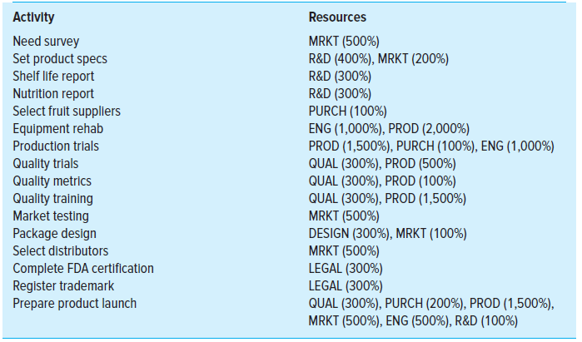
Lecture
The POM+ Project - Big Kola Company – Part 2
10
10–25

Slide 26
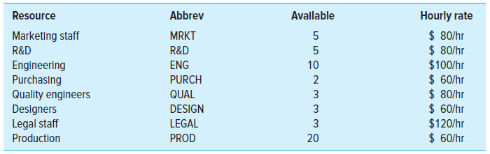
Lecture
The POM+ Project - Big Kola Company – Part 2
10
10–26

Slide 27
Lecture
The POM+ Project - Big Kola Company – Part 2
10
Remember the old saying, “A project plan is not a schedule until resources are committed.” This exercise illustrates this sometime subtle, but important point.
Using your files from Part 1, input resources and their costs if you have not already done so.
Prepare a memo that addresses the following questions:
1. Which if any of the resources are over allocated?
2. Assume that the project is time constrained and try to resolve any over allocation problems by leveling within slack. What happens?
3. Assume the project is resource constrained and resolve any over allocation problems by leveling outside of slack. What happens?
10–27

Slide 28
Lecture
The POM+ Project - Big Kola Company – Part 2
10
1. Which if any of the resources are over allocated?
10–28

Slide 29
Lecture
The POM+ Project - Big Kola Company – Part 2
10
1. Which if any of the resources are over allocated?
10–29

Slide 30
Lecture
The POM+ Project - Big Kola Company – Part 2
10
1. Which if any of the resources are over allocated?
10–30

Slide 31
Lecture
The POM+ Project - Big Kola Company – Part 2
10
1. Which if any of the resources are over allocated?
10–31

Slide 32
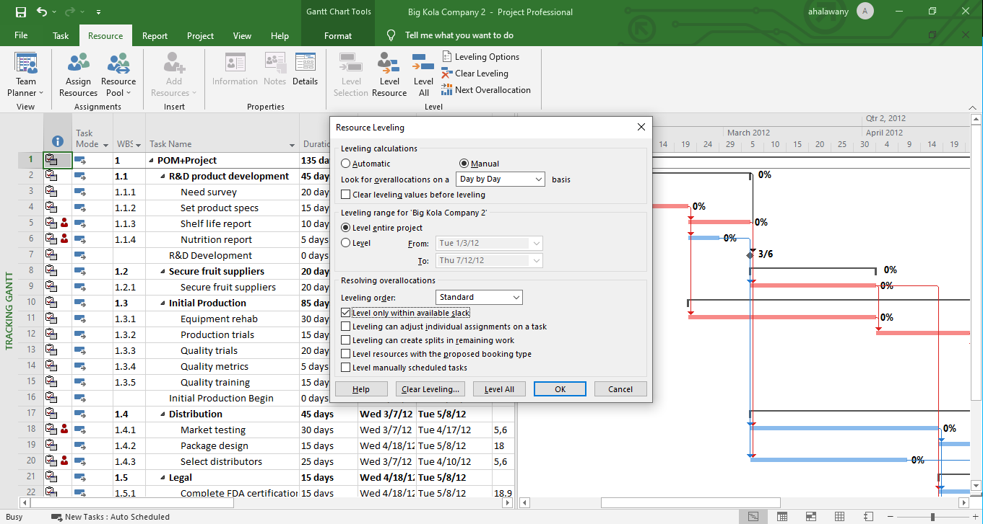
The POM+ Project - Big Kola Company – Part 2
2. Assume that the project is time constrained and try to resolve any overallocation problems by leveling within slack. What happens?
10–32

Slide 33
The POM+ Project - Big Kola Company – Part 2
2. Assume that the project is time constrained and try to resolve any over allocation problems by leveling within slack. What happens?
10–33

Slide 34

The POM+ Project - Big Kola Company – Part 2
Before Leveling within Slack
After Leveling within Slack
10–34

Slide 35
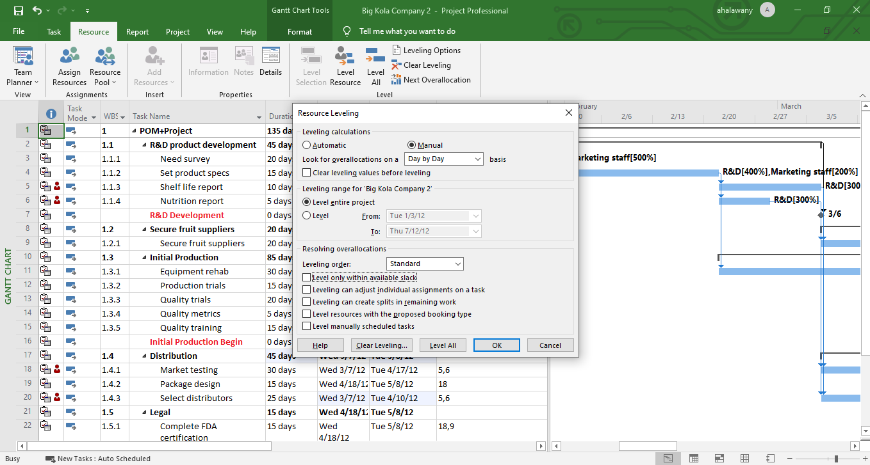
The POM+ Project - Big Kola Company – Part 2
3. Assume the project is resource constrained and resolve any over allocation problems by leveling outside of slack. What happens?
10–35

Slide 36
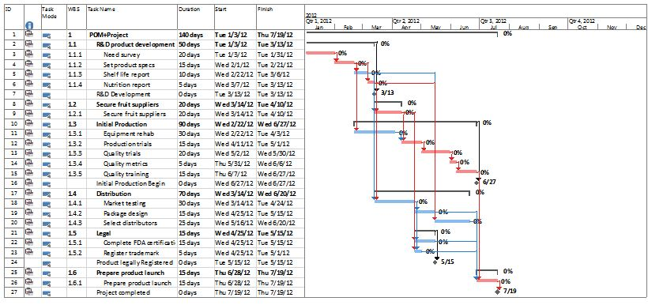
The POM+ Project - Big Kola Company – Part 3
3. Assume the project is resource constrained and resolve any over allocation problems by leveling outside of slack. What happens?
10–36

Slide 37
The POM+ Project - Big Kola Company – Part 3
3. Assume the project is resource constrained and resolve any over allocation problems by leveling outside of slack. What happens?
10–37

Slide 38
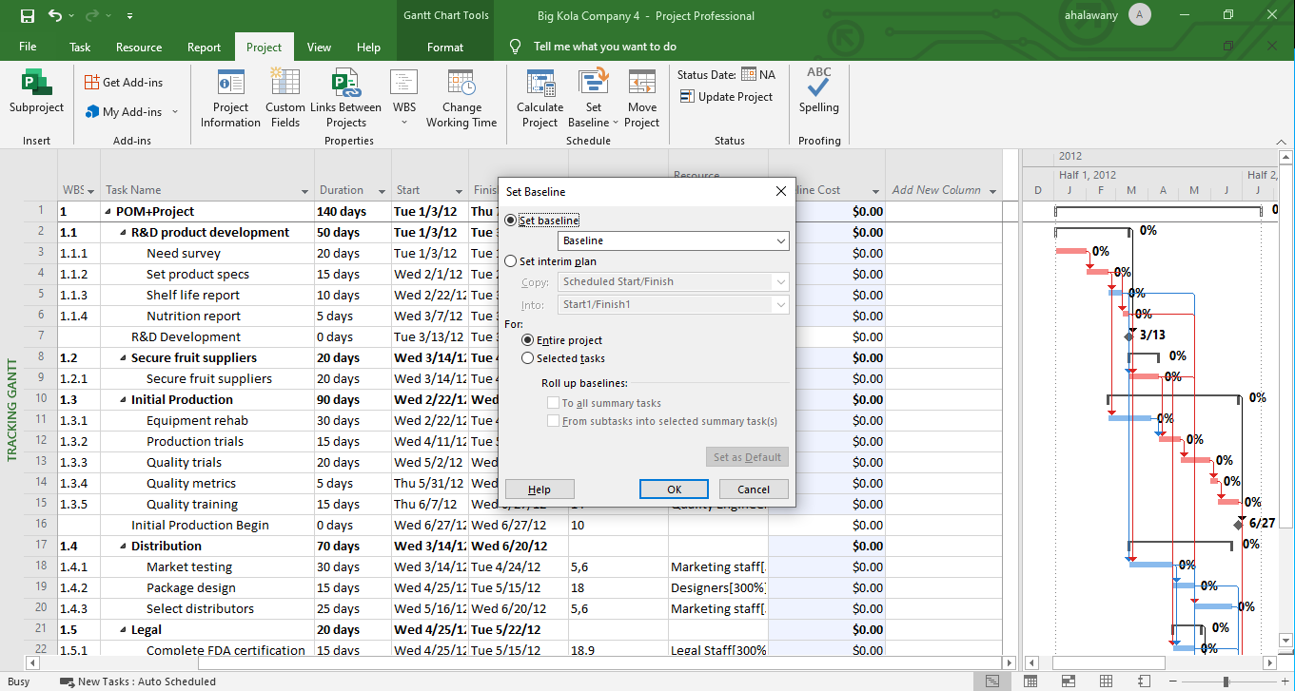
The POM+ Project - Big Kola Company – Part 3
10–38

Slide 39
Lecture
The POM+ Project - Big Kola Company – Part 3
10
Top management has accepted the July 19th completion schedule created at the end of Part 2. Prepare a brief memo that addresses the following questions:
1. How much will the project cost? What is the most expensive activity?
10–39

Slide 40
The POM+ Project - Big Kola Company – Part 3
10–40

Slide 41
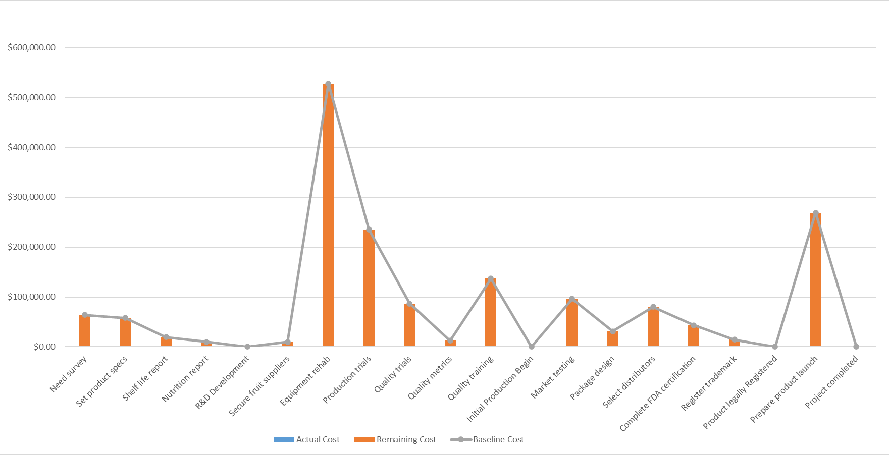
The POM+ Project - Big Kola Company – Part 3
10–41

Slide 42
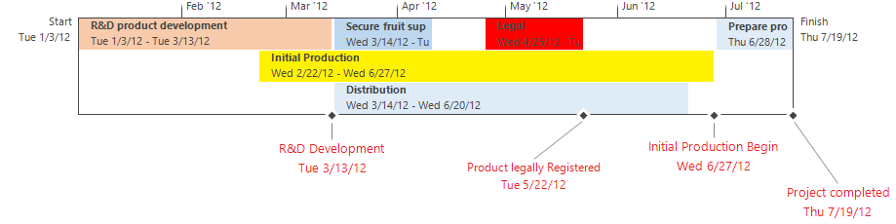
Lecture
Timeline
10
10–42

Slide 43
Lecture
The POM+ Project - Big Kola Company – Part 4
10
Assume that today is March 31, 2012, and Table A2.3 contains the tracking information for the project up till now. Enter this information into your saved baseline file and prepare a status report for the first three months of the POM+ project.
Your status report should also address the following questions:
1. How is the project progressing in terms of cost and schedule?
2. What activities have gone well? What activities have not gone well?
3. What do the PCIB and PCIC indicate in terms of how much of the project has been accomplished to date?
4. What is the forecasted cost at completion (EAC_{f})? What is the predicted VAC_{f}?
5. Report and interpret the TCPI for the project at this point in time.
6. What is the estimated date of completion?
10–43

Slide 44
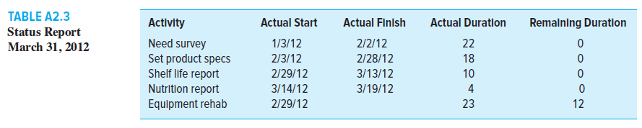
Lecture
The POM+ Project - Big Kola Company – Part 4
10
10–44

Slide 45
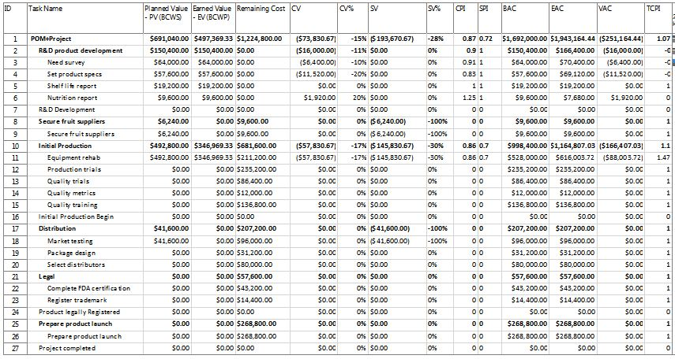
The POM+ Project - Big Kola Company – Part 4
10–45

Slide 46
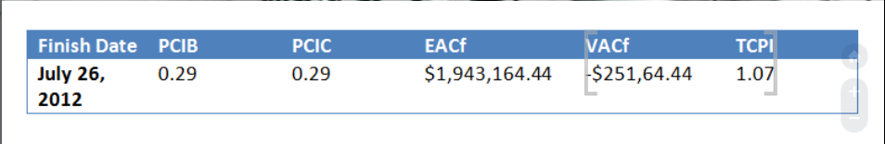
Lecture
The POM+ Project - Big Kola Company – Part 4
10
PCIB = EV/BAC = $497,369.33 / $1,692,000.00 = 0.29
PCIC = AC/ EAC_{re} = $571,200.00 / $1,943,164.44 = 0.29
10–46

Slide 47
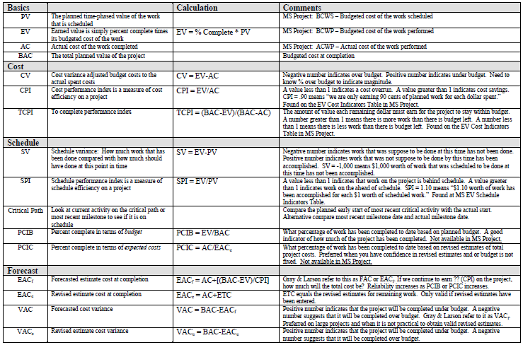
10–47

Slide 48
Resources
Project Management
The Managerial Process
Fifth Edition
By: Erik W. Larson
Oregon State University
Clifford F. Gray
Oregon State University
10-48

Slide 49



Thank You

