Slide 1


Supervised Learning Fundamentals
Prepared by Dr. Sumaya Alkubaisi
FNT633
Machine Learning in Finance
Lecture 5

Slide 2

Chapter
Learning Goals
5
By the end of this lecture, you will be able to:
Identify main types of ML and their financial applications.
Distinguish between regression and classification.
Evaluate model performance using MSE, RMSE, and R².
Apply K-Fold Cross Validation.
Implement KNN and Decision Tree models for finance datasets.

Slide 3
Chapter
Types of Machine Learning
5
Supervised Learning: Model learns from labeled data (input–output pairs).
Examples: credit scoring, stock price prediction.
Unsupervised Learning: Model finds hidden patterns or clusters in unlabeled data.
Examples: customer segmentation, anomaly detection.
Reinforcement Learning: Model learns by interacting with an environment and receiving feedback (rewards or penalties).
Examples: portfolio optimization, trading bots.

Slide 4
Chapter
Supervised Learning
5
In supervised learning, we have:
Features (X): Inputs (e.g., income, credit score, investment size)
Target (y): Output or label (e.g., default risk = Yes/No, volatility = High/Low)
The model’s goal: map inputs to outputs by minimizing prediction error.
Supervised Finance Applications
Credit Scoring: Predict loan approval likelihood.
Fraud Detection: Identify suspicious transactions.
Loan Approval: Classify clients as approved or rejected based on features.

Slide 5
Chapter
Model Assumptions Reminder
5
In this lecture, we assume the data roughly satisfies the key assumptions for each model — for example, linearity in regression or balanced class distribution in classification.
Detailed statistical checks (normality, significance testing, and visualization) were already covered in the Statistical Foundations for Data Science lecture.
Example:
Before modeling portfolio returns, perform a normality test.
If returns are not normally distributed, you may need to transform data or use a non-parametric method for more reliable predictions.

Slide 6
Chapter
What is Regression?
5
Regression is a supervised learning method used to predict continuous numerical values — numbers that can take many possible values.
It helps us understand how changes in one or more factors (independent variables) affect an outcome (dependent variable).
In finance, regression can be used to:
Estimate expected returns of a stock or portfolio.
Predict portfolio volatility (risk).
Analyze risk-adjusted performance, such as the Sharpe ratio.
Forecast financial metrics like revenue.
Regression helps answer questions like: “How much will a company’s profit increase if sales go up?”
“How will a stock’s price change if market conditions improve?”

Slide 7
Chapter
Linear Regression
5
Linear Regression assumes a straight-line relationship between variables.
It’s one of the simplest and most widely used regression techniques.
a. Simple Linear Regression
Equation: y=β₀+β₁x+ε
y: dependent variable (what we want to predict)
x: independent variable (predictor)
β₀: intercept (value of y when x = 0)
β₁: slope (how much y changes when x increases by 1)
ε: random error (difference between actual and predicted values)
Example: -Predicting a student’s exam score (y) based on hours studied (x).
As study hours increase, exam scores usually rise — showing a positive linear relationship.
-Predicting a stock’s return (y) based on overall market performance (x).
If the market performs well, the stock’s return is likely to increase in a similar trend.

Slide 8
Chapter
Linear Regression
5
b. Multiple Linear Regression
Equation: y=β₀+β₁x₁+β₂x₂+…+β_{n}x_{n}+ε
Used when more than one factor influences the outcome.
It helps us understand how several variables together affect a result.
Example:
Predicting a house price (y) based on its size (x₁), number of bedrooms (x₂), and location score (x₃).
Each feature adds different information to improve prediction accuracy.
Predicting a company’s stock return (y) using market performance (x₁), company growth rate (x₂), and sector performance (x₃).
Here, each variable contributes to explaining changes in the stock’s return.

Slide 9
Chapter
Measuring Model Performance
5
To know how well our regression model works, we measure its error and fit.
Mean Squared Error (MSE)
MSE= Σ(y_{true} ​− y_{pred}​)²​/n
Measures average squared difference between actual and predicted values.
Lower MSE = better performance.
Root Mean Squared Error (RMSE)
RMSE= √MSE
Easier to interpret because it’s in the same units as the target variable.
Lower RMSE means the model’s predictions are closer to the real values.
Example: -When predicting daily portfolio returns, a low MSE means the model’s predicted returns are close to the real market results.
-When forecasting stock prices, a smaller RMSE means the model’s predictions are only a few dollars away from actual prices.

Slide 10
Chapter
Measuring Model Performance
5
R² (Coefficient of Determination)
Measures how much of the variability in y is explained by the model.
R² ranges from 0 to 1:
1 → perfect prediction
0 → no relationship
Example:
-If R² = 0.9 when predicting car prices, it means 90% of the variation in prices can be explained by features like brand, mileage, and age.
-If R² = 0.85 when predicting stock returns, it means 85% of the variation in returns can be explained by the selected financial indicators (e.g., company performance or market movement).

Slide 11
Chapter
Cross Validation
5
Cross Validation is a technique to test how well a model performs on unseen data — in other words, how well it generalizes beyond the dataset it was trained on.
Instead of using a single train-test split, cross validation gives a more reliable estimate of performance.
K-Fold Cross Validation
The dataset is split into K equal parts (called folds).
The model is trained on K−1 folds and tested on the remaining fold.
This process repeats K times, each time using a different fold for testing.
The average of all K test results gives the final model performance.

Slide 12
Chapter
Cross Validation
5
Why it’s important:
Reduces the risk of overfitting (model memorizing data).
Provides a more accurate and fair evaluation.
Helps in model comparison (deciding which model performs best).
Example:
Testing a model that predicts loan default risk. Cross validation ensures the model performs reliably across different customer groups, not just the ones seen during training.

Slide 13

Python Demo: Linear Regression
X_train, X_test, y_train, y_test = train_test_split(X, y, test_size=0.2, random_state=0)
model = LinearRegression()
model.fit(X_train, y_train)
y_pred = model.predict(X_test)
train_test_split(X, y, test_size=0.2, random_state=0): Splits your dataset into training and testing sets.
X_train and y_train: Data used to train the model.
X_test and y_test: Data used to evaluate the model’s performance.
test_size=0.2: 20% of data is for testing, 80% for training.
model = LinearRegression(): Creates a linear regression model object, which will try to learn a linear relationship between features (X) and target (y).
model.fit(X_train, y_train):Trains the model using the training data so it can learn the relationship between features and target.
y_pred = model.predict(X_test): What it does: Uses the trained model to predict target values for the testing data (X_test).

Slide 14
Chapter
Classification
5
Classification predicts categories or labels, not continuous numbers.
It tells us which class an observation belongs to based on its features.
Example:
Predicting if an email is Spam / Not Spam, or if a tumor is Benign / Malignant.
Credit Risk: High / Medium / Low
Fraud Detection: Fraud / Not Fraud
Investment Category: Aggressive / Balanced / Conservative
In finance, classification helps automate decision-making by assigning outcomes to clear, predefined classes.

Slide 15
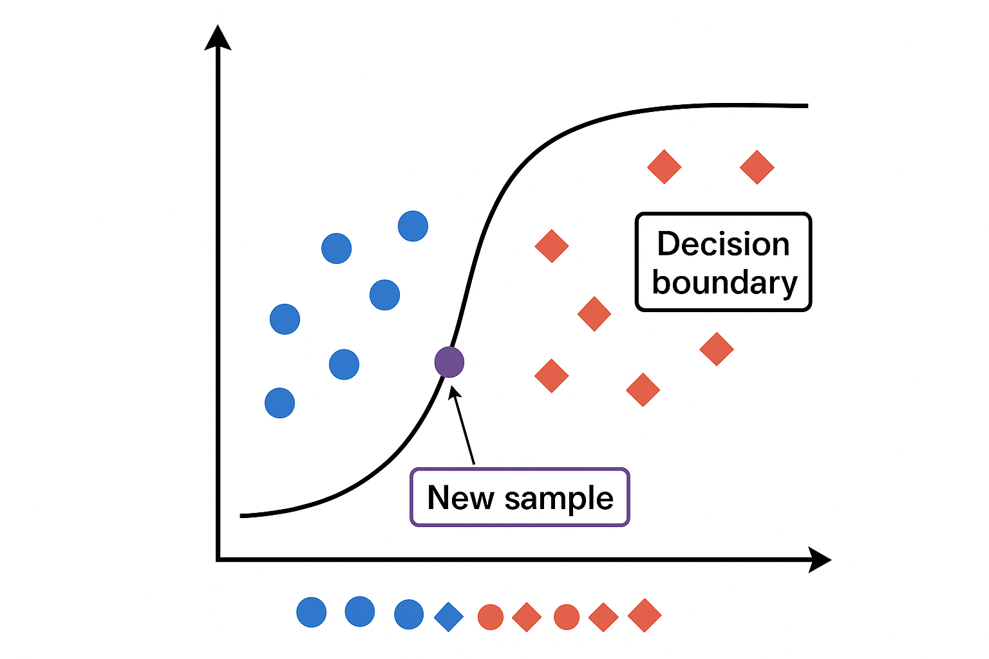
Chapter
Logistic Regression
5
Logistic Regression is a statistical model used for binary or multi-class classification.
It predicts the probability that an observation belongs to a certain class.
Instead of producing a direct number (like linear regression), it uses a sigmoid function to map predictions to values between 0 and 1.
P(y=1)= 1 / 1+e−(β0​+β1​x)
Output close to 1 → likely belongs to the positive class.
Output close to 0 → likely belongs to the negative class.

Slide 16
Chapter
Logistic Regression
5
Example
Logistic regression might output 0.85 for a loan application — meaning there’s an 85% chance this person will default (belong to the “High Risk” class).
If the output is 0.10, that means only a 10% chance they’re “High Risk.”
Then we decide a cutoff (usually 0.5):
≥ 0.5 → classify as 1 (positive class), e.g., “Yes, default.”
< 0.5 → classify as 0 (negative class), e.g., “No, safe.”
So, logistic regression basically converts a prediction into a probability — and then we label it as “yes” or “no” depending on that probability.

Slide 17
Chapter
K Nearest Neighbors (KNN)
5
K-Nearest Neighbors (KNN) is a simple but powerful machine learning algorithm that makes predictions based on similarity.
It doesn’t try to learn an internal mathematical model — instead, it looks at nearby data points to decide an outcome.
For classification → it assigns a label based on the majority class among its K nearest neighbors.
For regression → it predicts a numerical value by taking the average of the K nearest points.
Example:
Classifying whether a loan applicant is “High Risk” or “Low Risk” based on the most similar borrowers in the dataset.

Slide 18
Chapter
Distance Measurement
5
KNN depends on measuring how “close” two points are — that’s the distance metric.
The smaller the distance, the more similar the data points.
Euclidean Distance (most common): d=sqrt{Σ(x₁ - x₂)²}
Works well for continuous numeric data (e.g., income, age, balance).
Manhattan Distance: d=Σ|x₁ - x₂|
Useful when dealing with high-dimensional or grid-like data.
Minkowski Distance:
A generalized form that includes both Euclidean and Manhattan.
Example:Comparing two customers based on attributes like income, loan amount, and credit score — smaller distance = more similar financial behavior.

Slide 19
Chapter
KNN Workflow
5
Choose the number of neighbors (K) — often an odd number to avoid ties.
Compute distances between the new data point and all others in the dataset.
Select the K closest points (the nearest neighbors).
Make a prediction:
  For classification → use majority voting.
  For regression → take the average of neighbor values.
Example:
Predicting house prices — the price of a new house can be estimated by averaging the prices of the 5 nearest houses in the area.
Predicting whether a customer will default based on the payment history of the most similar customers.

Slide 20
Chapter
How to choose K
5
There’s no fixed rule, but here are best practices:
Start small (e.g., K = 3, 5, 7) and test performance.
Use Cross-Validation to find which K gives the best accuracy.
Generally:
  Too small K (like 1 or 2): very sensitive to noise → overfitting (high variance, low bias).
  Too large K: too smooth → underfitting (low variance, high bias) — too general / model ignores important patterns.
Often, choose odd K values for classification to avoid ties.
Example: When predicting loan default risk, you might test K = 3, 5, 7 and find that K = 5 gives the best accuracy on your validation data.
That means looking at the 5 most similar past borrowers gives a balanced and reliable prediction.

Slide 21
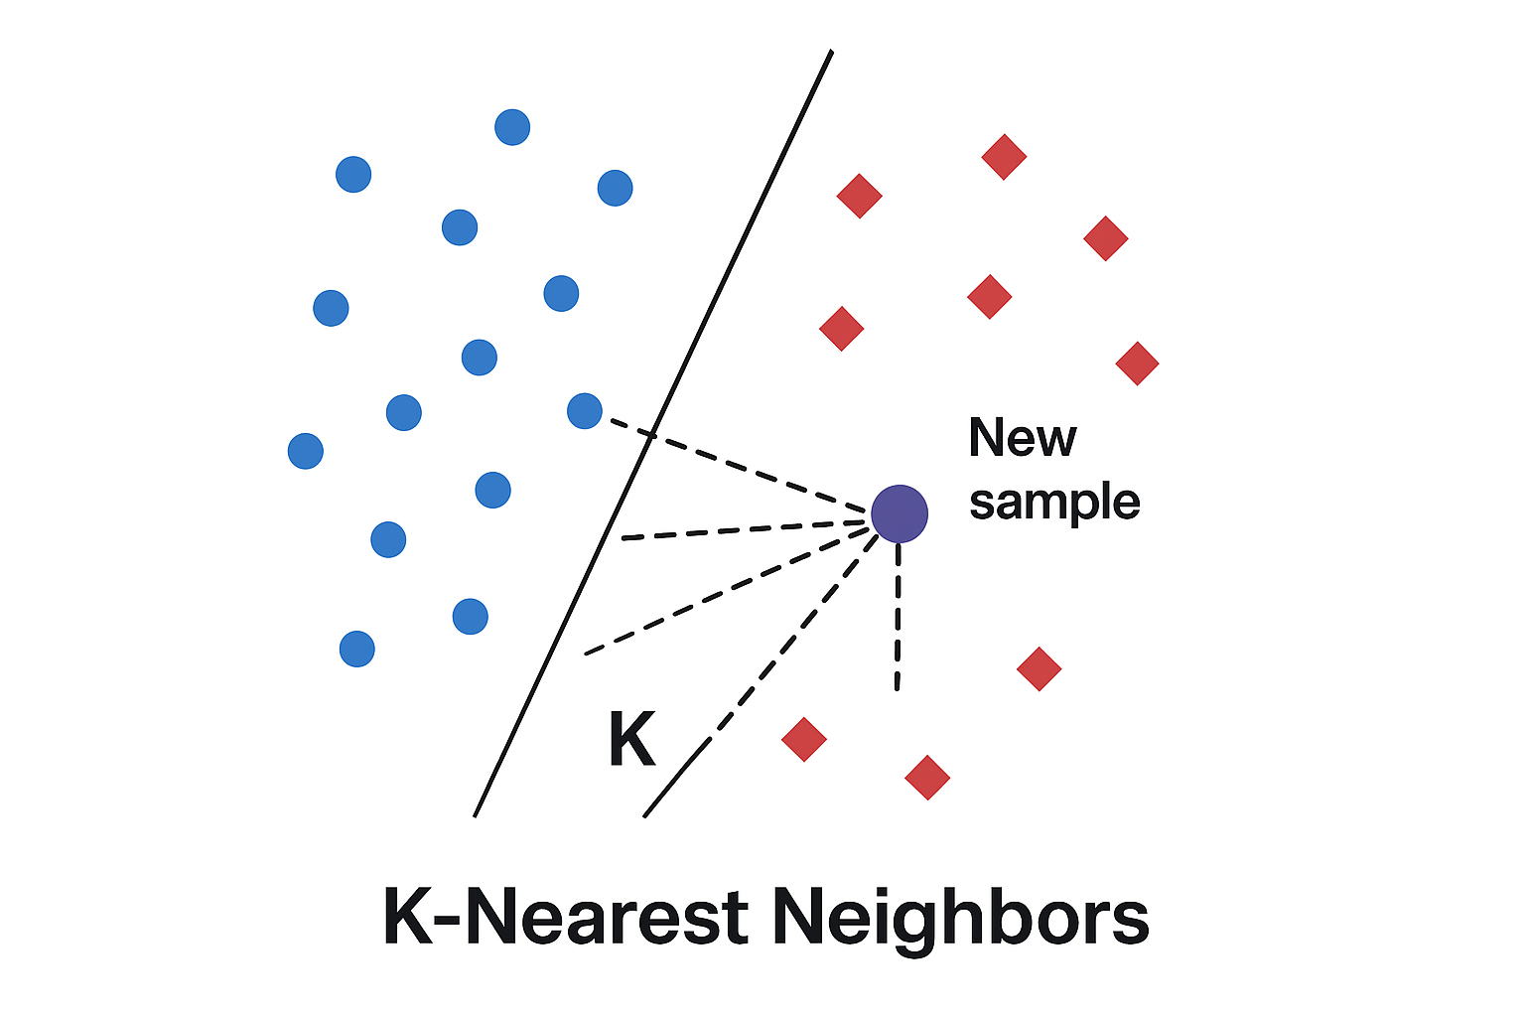
KNN classifies the new sample by checking which group (blue or red) its nearest neighbors belong to.
The class with the majority of close neighbors becomes the prediction.

Slide 22
Chapter
Feature Scaling
5
Since KNN depends on distance, all features must be on the same scale — otherwise, larger numerical ranges dominate the distance calculation.
For example, “income” (in thousands) might overshadow “age” (in years) if not scaled properly.
Common scaling methods:
MinMaxScaler
StandardScaler

Slide 23
Chapter
Pros and Cons
5
Advantages:
Simple, intuitive, and easy to implement.
No explicit training phase — predictions are made directly from stored data.
Adapts well to non-linear relationships.
Limitations:
Slow for large datasets — must calculate distances for every point.
Sensitive to irrelevant features — noisy data can reduce accuracy.
Performance depends on K — too small → overfits; too large → oversmooths results.
Requires feature scaling for fair distance comparisons.

Slide 24
Chapter
Finance Use Cases
5
KNN can be very effective in finance when relationships between features are non-linear and pattern-based.
Customer Segmentation:
Group customers with similar spending or saving behaviors for personalized marketing.
Credit Risk Categorization:
Classify borrowers into low, medium, or high risk groups based on historical repayment patterns.
Portfolio Behavior Classification:
Group investment portfolios by performance characteristics or volatility profiles to aid decision-making.
Fraud Detection:
Identify transactions that differ significantly from their nearest neighbors — potential anomalies.

Slide 25
Python Demo: Linear Regression
knn = KNeighborsClassifier(n_neighbors=5)
knn.fit(X_train_scaled, y_train_cls)
# Predict
y_pred_cls = knn.predict(X_test_scaled)
# Accuracy
acc = accuracy_score(y_test_cls, y_pred_cls)
print(f"KNN Accuracy (k=5): {acc:.3f}")
knn = KNeighborsClassifier(n_neighbors=5): Creates a K-Nearest Neighbors model that looks at 5 nearest neighbors to make predictions.
knn.fit(X_train_scaled, y_train_cls): Trains the KNN model using the scaled training data and corresponding class labels.
y_pred_cls = knn.predict(X_test_scaled): Uses the trained model to predict classes for the test data.
acc = accuracy_score(y_test_cls, y_pred_cls): Calculates how accurate the predictions are compared to the true test labels.

Slide 26
Chapter
Decision Trees
5
A Decision Tree is a tree-shaped model that makes predictions by splitting data step-by-step based on feature values.
Each internal node represents a decision rule (e.g., “Is income > $50,000?”), and each leaf node represents a final prediction or class (e.g., “Low Risk”).
It works like a flowchart — starting from a question at the top and following branches until reaching a final decision.
Example:
Classifying a customer as High Risk, Medium Risk, or Low Risk based on their loan history, income, and spending behavior.

Slide 27
Chapter
Splitting Criteria
5
Decision Trees divide the dataset at each node to make the groups as pure as possible (i.e., each branch contains mostly one class).
Common splitting criteria include:
Entropy / Information Gain: Measures how much information a split adds.
Higher information gain = better split.
Gini Index:Measures impurity (how mixed the classes are).
Lower Gini = purer node.
Example:
If we split customers by “income > 60K,” and one group mostly contains non-defaulters, that’s a good split with high information gain.

Slide 28
Chapter
Pros and Cons
5
Advantages
Easy to understand and visualize — can be displayed like a decision flowchart.
Interpretable — managers can easily follow the logic (“if income > X and credit score < Y, then high risk”).
Handles both numerical and categorical features.
No need for feature scaling or normalization, unlike KNN or regression.
Limitations
Can overfit the data:
Trees might become too detailed and memorize noise rather than learning real patterns.
(We’ll cover pruning and Random Forests as solutions in Lecture 6.)
Unstable with small data changes:
A slight change in data can lead to a very different tree structure.
Bias toward features with more levels:
If one variable has many unique values, it may dominate splits unfairly.

Slide 29
Chapter
Finance Use Cases
5
Decision Trees are widely used in financial decision-making and risk modeling because of their clarity and traceability.
Loan Default Prediction:
Predict whether a customer will default based on salary, credit score, and debt ratio.
Fraud Detection:
Identify suspicious transactions using features like transaction amount, frequency, and merchant category.
Client Creditworthiness Classification:
Classify clients into High, Medium, or Low creditworthiness levels for lending decisions.
Portfolio Risk Categorization:
Categorize investment portfolios by volatility or performance indicators.

Slide 30
Real-world finance use case: Portfolio Risk Prediction.
Chapter
5
Dataset: The dataset used here (Portfolio Risk Prediction) was created and explored in Lecture 4.
Goal: build predictive models that help banks or investors assess how risky or volatile a portfolio is — either as a continuous score (volatility) or as a categorical label (risk level). Tasks:
Regression Task →Predict the numerical value of portfolio_volatility (how much the portfolio’s value fluctuates).
Model used: Linear Regression
Classification Task →Classify the portfolio as Low, Medium, or High risk based on volatility and other financial features.
Model used: K-Nearest Neighbors (KNN)

Slide 31
Lab Activity: Supervised Learning with Financial Data
# ---------------------------------------------
# Application: Portfolio Risk Prediction
# ---------------------------------------------
# Importing essential libraries
import pandas as pd
import numpy as np
import seaborn as sns
import matplotlib.pyplot as plt
from sklearn.model_selection import train_test_split, KFold, cross_val_score
from sklearn.linear_model import LinearRegression
from sklearn.metrics import mean_squared_error, r2_score, accuracy_score
from sklearn.preprocessing import StandardScaler
from sklearn.neighbors import KNeighborsClassifier

Slide 32
Lab Activity: Supervised Learning with Financial Data
# The dataset was generated in Lecture 4
# Assume it is saved as 'portfolio_risk.csv'
data = pd.read_csv('portfolio_risk.csv')
print("Dataset Loaded Successfully!")
data.head()
# Check basic info
data.info()
# Summary statistics
data.describe().round(3)
# Check for duplicates and missing values
print("Duplicated rows:", data.duplicated().sum())
print("\nMissing values:\n", data.isnull().sum())

Slide 33
Lab Activity: Supervised Learning with Financial Data
# Predict portfolio_volatility (continuous variable)
X = data[['avg_return', 'volatility', 'investment_amount', 'credit_score']]
y = data['portfolio_volatility']
# Split Dataset for Regression Task— Train-test split
X_train, X_test, y_train, y_test = train_test_split(X, y, test_size=0.2, random_state=42)
# Initialize and train model
reg_model = LinearRegression()
reg_model.fit(X_train, y_train)
# Predictions
y_pred = reg_model.predict(X_test)

Slide 34
Lab Activity: Supervised Learning with Financial Data
# Compute evaluation metrics
mse = mean_squared_error(y_test, y_pred)
rmse = np.sqrt(mse)
r2 = r2_score(y_test, y_pred)
print("Regression Model Evaluation:")
print(f"MSE = {mse:.3f}")
print(f"RMSE = {rmse:.3f}")
print(f"R² = {r2:.3f}")
# Apply 5-Fold Cross Validation
cv = KFold(n_splits=5, shuffle=True, random_state=42)
cv_scores = cross_val_score(reg_model, X, y, cv=cv, scoring='r2')
print("Cross-Validation R² Scores:", cv_scores)
print("Average R²:", np.mean(cv_scores).round(3))

Slide 35
Lab Activity: Supervised Learning with Financial Data
# Preparing data to predict 'risk_level' (categorical variable)
X_cls = data[['avg_return', 'volatility', 'investment_amount', 'credit_score']]
y_cls = data['risk_level']
# Encode categorical target if not numeric
y_cls = y_cls.astype('category').cat.codes
# Split into training and test sets
X_train_cls, X_test_cls, y_train_cls, y_test_cls = train_test_split(
X_cls, y_cls, test_size=0.2, random_state=42)
# Feature Scaling
scaler = StandardScaler()
X_train_scaled = scaler.fit_transform(X_train_cls)
X_test_scaled = scaler.transform(X_test_cls)

Slide 36
Lab Activity: Supervised Learning with Financial Data
# Initialize KNN classifier (start with k=5)
knn = KNeighborsClassifier(n_neighbors=5)
knn.fit(X_train_scaled, y_train_cls)
# Predict
y_pred_cls = knn.predict(X_test_scaled)
# Accuracy
acc = accuracy_score(y_test_cls, y_pred_cls)
print(f"KNN Accuracy (k=5): {acc:.3f}")
# Apply cross-validation on KNN
cv_scores_knn = cross_val_score(knn, X_cls, y_cls, cv=5, scoring='accuracy')
print("Cross-Validation Accuracy Scores:", cv_scores_knn)
print("Average Accuracy:", np.mean(cv_scores_knn).round(3))

Slide 37
Lab Activity: Supervised Learning with Financial Data
# KNN Model Comparison (Different K Values)
k_values = [3, 5, 7, 9, 11]
acc_scores = []
for k in k_values:
model = KNeighborsClassifier(n_neighbors=k)
model.fit(X_train_scaled, y_train_cls)
pred = model.predict(X_test_scaled)
acc = accuracy_score(y_test_cls, pred)
acc_scores.append(acc)
plt.plot(k_values, acc_scores, marker='o')
plt.title("KNN Accuracy for Different K Values")
plt.xlabel("Number of Neighbors (K)")
plt.ylabel("Accuracy")
plt.grid(True)
plt.show()
best_k = k_values[np.argmax(acc_scores)]
print(f"Best K Value: {best_k}, Accuracy: {max(acc_scores):.3f}")

Slide 38
Lab Activity: Supervised Learning with Financial Data
# Summary of Results
print("===== Regression Results =====")
print(f"MSE: {mse:.3f}")
print(f"RMSE: {rmse:.3f}")
print(f"R²: {r2:.3f}")
print("\n===== KNN Classification Results =====")
print(f"Best K: {best_k}")
print(f"Accuracy: {max(acc_scores):.3f}")

Slide 39
Lecture
Recap
5
Introduced supervised learning for prediction and classification using labeled financial data.
Applied Linear Regression to predict portfolio volatility.
Evaluated performance using MSE, RMSE, and R² metrics.
Used 5-Fold Cross-Validation to ensure model reliability.
Implemented K-Nearest Neighbors (KNN) for classifying portfolio risk levels.
Highlighted the importance of feature scaling and model comparison.
Introduced decision tree concept

Slide 40
Chapter
References
5
Klaas, J. (2021). Machine Learning for Finance: Principles and Practice for Financial Insiders. Wiley.
López de Prado, M. (2018). Advances in Financial Machine Learning. Wiley.
Géron, A. (2022). Hands-On Machine Learning with Scikit-Learn, Keras & TensorFlow (3rd ed.). O’Reilly Media.
Raschka, S., & Mirjalili, V. (2019). Python Machine Learning (3rd ed.). Packt Publishing.
Scikit-learn Documentation. (2025). Supervised Learning Overview. https://scikit-learn.org/stable/supervised_learning.html
IBM Skills Network. (2024). Machine Learning Foundations for Finance — Course Materials.

