Slide 1



Change Management
Prepared by Dr. Amira Elfekky
PMG323
Lecture 9

Slide 2



Change Management
Lecture 9
PMG323
Prepared by
Dr. Amira Elfekky
www.midocean.ae

Slide 3

Agenda Complex change
Introduction.
Complex change
The definition of Complex Change
Senior leaders and managers duties on Complex Change
Change Management Model Examples
Change Management Model Lippitt-Knoster
Change Management Model Lippitt-Knoster components
Change Management Model- Kotter model
Change Management Model- Kotter model Steps
www.midocean.ae

Slide 4
Agenda Complex change
Introduction.
Complex change
The definition of Complex Change
Senior leaders and managers duties on Complex Change
Change Management Model Examples
Change Management Model Lippitt-Knoster
Change Management Model Lippitt-Knoster components
Change Management Model- Kotter model
Change Management Model- Kotter model Steps
www.midocean.ae

Slide 5

Change Management
This subject is about making sense of change management. The world we live in continues to change at an intense rate. Not a day goes by, it seems, without another important discovery or boundary-pushing invention in the scientific fields. The economics of globalization seems to dominate much of our political and corporate thinking, while the shadow side of globalization– develops at an equally alarming pace.
www.midocean.ae

Slide 6

Content
1 Individual change
Learning and the process of change
2 Team change
What is a group and when is it a team?
3 Organizational change
How organizations really work
4 Leading change
Roles that leaders play
5 The change agent
Models of change agency

Slide 7
Content
6 Mergers and acquisitions
The purpose of merger and acquisition activity
7 Cultural change
Guidelines for achieving successful cultural change
8 IT-based process change
The role of IT management
9 Complex change
When is change complex?
10 Leading change in uncertain times
The impact of uncertainty on our working lives

Slide 8
Agenda Complex change
Introduction
Complex change
The definition of Complex Change
Senior leaders and managers duties on Complex Change
Change Management Model Examples
Change Management Model Lippitt-Knoster
Change Management Model Lippitt-Knoster components
Change Management Model- Kotter model
Change Management Model- Kotter model Steps
www.midocean.ae

Slide 9
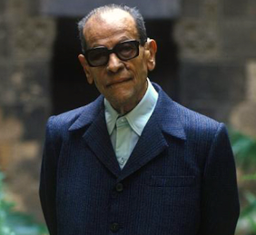
Chapter
09
Complex change
You can tell whether a man is clever by his answers.
You can tell whether a man is wise by his questions.
Naguib Mahfouz (Nobel Prize Winner)
www.midocean.ae

Slide 10
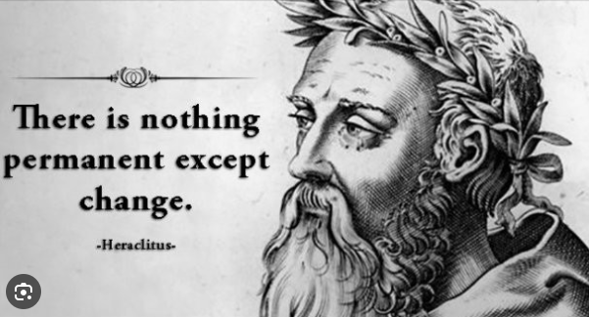
Chapter
09
Complex change
"Change is the only constant."–
Heraclitus, Greek philosopher
www.midocean.ae

Slide 11
Chapter
09
Complex change
"Change is the only constant."–
Heraclitus, Greek philosopher
What was true more than 2,000 years ago is just as true today. We live in a world where "business as usual" is change. New initiatives, project-based working, technology improvements, staying ahead of the competition – these things come together to drive ongoing changes to the way we work.
www.midocean.ae

Slide 12
Chapter
09
Complex change
Change management can be daunting, especially when it involves systems and multiple stakeholders.
It requires careful planning, effective communication, and a deep understanding of the organization’s culture and dynamics. However, with the right framework and approach, managing complex change can become more manageable and even successful.
www.midocean.ae

Slide 13
Agenda Complex change
Introduction
Complex change
The definition of Complex Change
Senior leaders and managers duties on Complex Change
Change Management Model Examples
Change Management Model Lippitt-Knoster
Change Management Model Lippitt-Knoster components
Change Management Model- Kotter model
Change Management Model- Kotter model Steps
www.midocean.ae

Slide 14

Chapter
09
The Definition of Complex Change
This chapter will look at the Complex Change models in detail and how it can help managers successfully manage complex change.
www.midocean.ae

Slide 15
Chapter
The Definition of Complex Change
09
What Is Complex Change?
A complex change management project occurs when one or more
complicating factors create an obstacle. They can include:
Geographically diverse locations
Low investment from employees
Major organizational restructuring
Involuntary redundancies or job losses
Crisis management
www.midocean.ae

Slide 16
Agenda Complex change
Introduction
Complex change
The definition of Complex Change
Senior leaders and managers duties on Complex Change
Change Management Model Examples
Change Management Model Lippitt-Knoster
Change Management Model Lippitt-Knoster components
Change Management Model- Kotter model
Change Management Model- Kotter model Steps
www.midocean.ae

Slide 17
Chapter
09
Senior leaders and managers duties on Complex Change
Think of the highly varied work that goes into managing complex change, such as transitioning data from an on-premises environment to the cloud, integrating the production systems of a recently acquired business, or rolling out a fleet of 5G-capable devices at a hospital.
Beyond marshalling the raw technical expertise necessary for determining what’s practical and on what timeline in scenarios like these, senior leaders and managers must also:
www.midocean.ae

Slide 18
Senior leaders and managers duties on Complex Change
Chapter
09
Review potentially applicable rules, regulations, and legal precedents, such as data privacy implications and employment practices laws.
Analyze the impact on company culture, including possible reorganization of teams and where they may work in the future, whether in-office, remote, or a combination of the two (i.e., hybrid work).
www.midocean.ae

Slide 19
Senior leaders and managers duties on Complex Change
Chapter
09
Consider how employees, customers, the public, competitors, and regulators may respond to any prominent action.
Plan and execute a communications strategy accounting for all of the considerations above.
www.midocean.ae

Slide 20
Senior leaders and managers duties on Complex Change
Chapter
09
Overall, managing complex change means steering projects that often have technological, cultural, and organizational dimensions, on top of all of their usual implications for the company bottom line. Such issues naturally test an organization’s change management strategy, creating challenges on top of the fundamental uncertainty and resistance that any type of organizational change may inspire.
www.midocean.ae

Slide 21
Agenda Complex change
Introduction
Complex change
The definition of Complex Change
Senior leaders and managers duties on Complex Change
Change Management Model Examples
Change Management Model Lippitt-Knoster
Change Management Model Lippitt-Knoster components
Change Management Model- Kotter model
Change Management Model- Kotter model Steps
www.midocean.ae

Slide 22
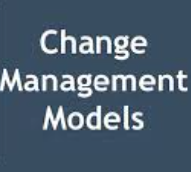
Chapter
09
Change Management Model Examples
Complex change warrants considerable detail and emphasis on a change management model that provides the guardrails, definitions, stakeholders, and processes for seeing a clear path forward despite expected obstacles. Ultimately, the model of choice can be configured to meet the needs of any organization or crafted entirely from scratch.
www.midocean.ae

Slide 23
Agenda Complex change
Introduction
Complex change
The definition of Complex Change
Senior leaders and managers duties on Complex Change
Change Management Model Examples
Change Management Model Lippitt-Knoster
Change Management Model Lippitt-Knoster components
Change Management Model- Kotter model
Change Management Model- Kotter model Steps
www.midocean.ae

Slide 24
Chapter
Change Management Models
09
www.midocean.ae

Slide 25
Chapter
Change Management Model Lippitt-Knoster
09
1- Lippitt-Knoster model
One common framework, for instance, is the Lippitt-Knoster model, popularized in academic circles in the 1980s with roots dating back to research in the 1950s. This model, which has been iterated upon for decades, is effectively a matrix for managing change based on six pillars and their relationship to one another. If certain elements are missing in the change process, the effort will result in varying kinds of failure, as seen following:
www.midocean.ae

Slide 26
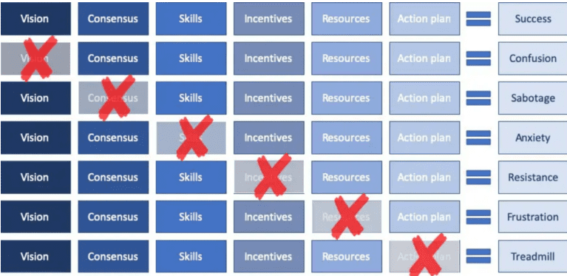
Chapter
Change Management Model Lippitt-Knoster
09
1- Lippitt-Knoster model
www.midocean.ae

Slide 27
Agenda Complex change
Introduction
Complex change
The definition of Complex Change
Senior leaders and managers duties on Complex Change
Change Management Model Examples
Change Management Model Lippitt-Knoster
Change Management Model Lippitt-Knoster components
Change Management Model- Kotter model
Change Management Model- Kotter model Steps
www.midocean.ae

Slide 28
Chapter
Change Management Model Lippitt-Knoster components
09
1- Vision: The picture of the future state you wish to achieve. Your vision will act as the guiding light, providing direction to the change process.
2- Consensus (Knoster's extra component): The collective agreement and support from all stakeholders involved in the change. Consensus ensures the change process is collaborative, reducing resistance and creating a sense of ownership.
www.midocean.ae

Slide 29
Chapter
Change Management Model Lippitt-Knoster components
09
3- Skills: The abilities and competencies required to implement the change. Skills ensure the team can convert the vision into reality.
4- Incentives: The motivators or rewards that encourage teams to embrace the change. Incentives can be intrinsic (like personal growth) or extrinsic (like bonuses).
www.midocean.ae

Slide 30
Chapter
Change Management Model Lippitt-Knoster components
09
5- Resources: These include the time, finances, personnel, and other assets necessary to support the change process.
6- Action plan: The detailed roadmap that outlines the steps to be taken to achieve the vision. It includes who does what, by when, and how.
www.midocean.ae

Slide 31
Agenda Complex change
Introduction
Complex change
The definition of Complex Change
Senior leaders and managers duties on Complex Change
Change Management Model Examples
Change Management Model Lippitt-Knoster
Change Management Model Lippitt-Knoster components
Change Management Model- Kotter model
Change Management Model- Kotter model Steps
www.midocean.ae

Slide 32
Chapter
Change Management Model Kotter
09
2- Kotter model
Another example is the Kotter model, developed by Dr. John Kotter of Harvard Business School in the 1990s. This approach rests on eight linear steps that focus on the business impetus and cultural context in which change is ultimately necessary, seeing the process through from start to finish.
www.midocean.ae

Slide 33
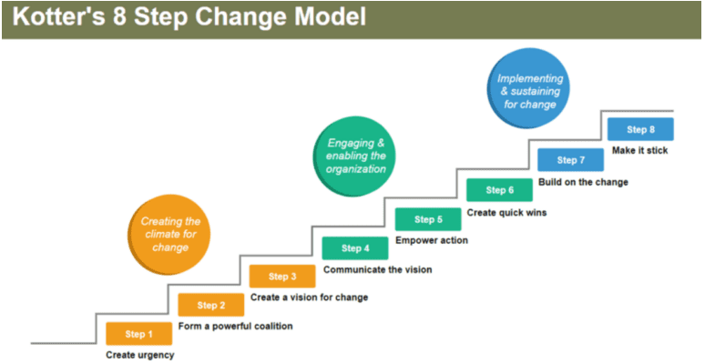
Chapter
Change Management Model Kotter
09
2- Kotter model
www.midocean.ae

Slide 34
Agenda Complex change
Introduction
Complex change
The definition of Complex Change
Senior leaders and managers duties on Complex Change
Change Management Model Examples
Change Management Model Lippitt-Knoster
Change Management Model Lippitt-Knoster components
Change Management Model- Kotter model
Change Management Model- Kotter model Steps
www.midocean.ae

Slide 35
Chapter
Change Management Model- Kotter model
09
Step 1: Create Urgency
For change to happen, it helps if the whole company really wants it. Develop a sense of urgency around the need for change. This may help you spark the initial motivation to get things moving.
www.midocean.ae

Slide 36
Chapter
Change Management Model- Kotter model Steps
09
Step 1: Create Urgency
What you can do?
Identify potential threats, and develop scenarios showing what could happen in the future.
Examine opportunities that should be, or could be, exploited.
Start honest discussions, and give dynamic and convincing reasons to get people talking and thinking.
Request support from customers, outside stakeholders and industry people to strengthen your argument.
www.midocean.ae

Slide 37
Chapter
Change Management Model- Kotter model
09
Step 2: Form a Powerful Coalition
Convince people that change is necessary. This often takes strong leadership and visible support from key people within your organization. Managing change isn't enough – you have to lead it.
www.midocean.ae

Slide 38
Chapter
Change Management Model- Kotter model
09
Step 2: Form a Powerful Coalition
What you can do:
Identify the true leaders in your organization, as well as your key stakeholders.
Ask for an emotional commitment from these key people.
Work on team building within your change coalition.
Check your team for weak areas, and ensure that you have a good mix of people from different departments and different levels within your company.
www.midocean.ae

Slide 39
Chapter
Change Management Model- Kotter model
09
Step 3: Create a Vision for Change
When you first start thinking about change, there will probably be many great ideas and solutions floating around. Link these concepts to an overall vision that people can grasp easily and remember.
www.midocean.ae

Slide 40
Chapter
Change Management Model- Kotter model
09
Step 3: Create a Vision for Change
What you can do:
Determine the values that are central to the change.
Develop a short summary (one or two sentences) that captures what you "see" as the future of your organization.
Create a strategy to execute that vision.
Ensure that your change coalition can describe the vision in five minutes or less.
Practice your "vision speech" often.
www.midocean.ae

Slide 41
Chapter
Change Management Model- Kotter model
09
Step 4: Communicate the Vision
What you do with your vision after you create it will determine your success. Your message will probably have strong competition from other day-to-day communications within the company, so you need to communicate it frequently and powerfully, and embed it within everything that you do.
www.midocean.ae

Slide 42
Chapter
Change Management Model- Kotter model
09
Step 4: Communicate the Vision
What you can do:
Talk often about your change vision.
Address peoples' concerns and anxieties, openly and honestly.
Apply your vision to all aspects of operations – from training to performance reviews. Tie everything back to the vision.
Lead by example.
www.midocean.ae

Slide 43
Chapter
Change Management Model- Kotter model
09
Step 5: Remove Obstacles
If you follow these steps and reach this point in the change process, you've been talking about your vision and building buy-in from all levels of the organization. Hopefully, your staff wants to get busy and achieve the benefits that you've been promoting.
www.midocean.ae

Slide 44
Chapter
Change Management Model- Kotter model
09
Step 5: Remove Obstacles
What you can do:
Identify, or hire, change leaders whose main roles are to deliver the change.
Look at your organizational structure, job descriptions, and performance and compensation systems to ensure they're in line with your vision.
Recognize and reward people for making change happen.
Identify people who are resisting the change, and help them see what's needed.
Take action to quickly remove barriers (human or otherwise).
www.midocean.ae

Slide 45
Chapter
Change Management Model- Kotter model
09
Step 6: Create Short-Term Wins
Nothing motivates more than success. Give your company a taste of victory early in the change process. Within a short time frame (this could be a month or a year, depending on the type of change), you'll want to have some "quick wins" that your staff can see. Without this, critics and negative thinkers might hurt your progress.
www.midocean.ae

Slide 46
Chapter
Change Management Model- Kotter model
09
Step 6: Create Short-Term Wins
What you can do:
Look for sure-fire projects that you can implement without help from any strong critics of the change.
Don't choose early targets that are expensive. You want to be able to justify the investment in each project.
Thoroughly analyze the potential pros and cons of your targets. If you don't succeed with an early goal, it can hurt your entire change initiative.
Reward the people who help you meet the targets.
www.midocean.ae

Slide 47
Chapter
Change Management Model- Kotter model
09
Step 7: Build on the Change
Kotter argues that many change projects fail because victory is declared too early. Real change runs deep. Quick wins are only the beginning of what needs to be done to achieve long-term change.
www.midocean.ae

Slide 48
Chapter
Change Management Model- Kotter model
09
Step 7: Build on the Change
What you can do:
After every win, analyze what went right, and what needs improving.
Set goals to continue building on the momentum you've achieved.
Learn about kaizen, the idea of continuous improvement.
Keep ideas fresh by bringing in new change agents and leaders for your change coalition.
www.midocean.ae

Slide 49
Chapter
Change Management Model- Kotter model
09
Step 8: Anchor the Changes in Corporate Culture
Finally, to make any change stick, it should become part of the core of your organization. Your corporate culture often determines what gets done, so the values behind your vision must show in day-to-day work.
www.midocean.ae

Slide 50
Chapter
Change Management Model- Kotter model
09
Step 8: Anchor the Changes in Corporate Culture
What you can do:
Talk about progress every chance you get. Tell success stories about the change process, and repeat other stories that you hear.
Include the change ideals and values when hiring and training new staff.
Publicly recognize key members of your original change coalition, and make sure the rest of the staff – new and old – remembers their contributions.
Create plans to replace key leaders of change as they move on. This will help ensure that their legacy is not lost or forgotten.
www.midocean.ae

Slide 51

www.midocean.ae

Slide 52

Thank You

