Slide 1




Fundamentals of
Risk Management
Lecture 10
PMG510
Prepared by
Prepared by Dr. Usama Al-Fendi
www.midocean.ae

Slide 2
Lecture
Lecture Organization
10
Risk management and business models
business models and sustainability
Ethics and corporate governance
CSR and risk management
Supply chain and ethical trading
Importance of reputation
www.midocean.ae

Slide 3
Lecture
Risk management and the business model
10
Risk management and business models
Each component of the business model can be subjected to a risk assessment. The
business model represents how the organization fulfils its vision and mission statement, as well as its aims and objectives.
Although the offering is at the heart of the business model, the starting point is often an assessment of the customer segment at which the offering will be targeted.
Risks are associated with identifying and securing customers and providing customer service and support.
www.midocean.ae

Slide 4
Lecture
Risk management and the business model
10
Risk management and business models
Reputation is often a feature of the sector within which the organization operates. Reputation is often considered to be the most important aspect of any organization. Reputation also has a sustainability component in that an organization will wish to sustain and/or enhance its reputation.
www.midocean.ae

Slide 5
Lecture
Risk management and the business model
10
business models and sustainability
All business models have to be sustainable, and this is normally represented by financial sustainability of resources and the need to balance expenditure against revenue streams. Sustainability has a wider context and has grown to include environmental considerations.
www.midocean.ae

Slide 6
Lecture
Risk management and the business model
10
business models and sustainability
In order to contribute to climate change sustainability, there is scope to address the business model to make this contribution. The scope of the sustainability requirements of the organization and its business model will need to be included in the risk assessment.
Assessment of the business model will focus on the hazards or operational risks, together with compliance risks. In order to achieve an effective and efficient business model, operational risks will need to be mitigated and compliance risks will need to be minimized.
www.midocean.ae

Slide 7
Lecture
Risk management and the business model
10
business models and sustainability
Having identified the business model and undertaken a risk assessment, an organization will then need to decide whether the existing business model is sustainable. If it is considered that there is scope to improve the business model, a new or modified business model will need to be identified.
Achieving this enhanced business model becomes the strategy of the organization. The means by which the business model is modified to achieve the strategy can be considered to be the tactics of the organization and these tactics will be implemented by way of projects and/or programs of work that achieve the required changes.
www.midocean.ae

Slide 8
Lecture
Risk management and the business model
10
business models and sustainability
A component of a successful business model is that it is successful in recruiting new customers and draws the customer into a deeper relationship with the organization, so that the relationship is sustained and becomes more secure.
Enhancements to the business model, therefore, need to not only recruit additional customers, but also retain existing customers at a constantly increasing level of customer satisfaction.
www.midocean.ae

Slide 9
Lecture
Risk management and the business model
10
Ethics and corporate governance
All types of organizations should be aware that good corporate social responsibility standards can enhance reputation and build stakeholder value.
Conversely, incidents, events and losses associated with poor standards of social responsibility can create bad publicity and destroy stakeholder value.
www.midocean.ae

Slide 10
Lecture
Risk management and the business model
10
Ethics and corporate governance
The importance of good standards of corporate social responsibility is widely recognized and achieving good standards can enhance the organization by:
protecting and enhancing reputation, brand and trust;
attracting, motivating and retaining talent;
managing and mitigating risk;
improving operational and cost efficiency;
www.midocean.ae

Slide 11
Lecture
Risk management and the business model
10
Ethics and corporate governance
giving the business a license to operate;
developing new business opportunities;
creating a more secure and prosperous operating environment.
www.midocean.ae

Slide 12
Lecture
Risk management and the business model
10
Ethics and corporate governance
There are a variety of definitions available for corporate social responsibility. It is generally accepted that CSR is a wide-ranging agenda that involves organizations looking at how to improve their social, environmental and local economic impact and their influence on society and human rights. The CSR agenda also extends to consideration of fair-trade issues and the elimination of corruption.
www.midocean.ae

Slide 13
Lecture
Risk management and the business model
10
Ethics and corporate governance
Before corporate social responsibility became a widely used term, several organizations used to refer to social, ethical and environmental (SEE) concerns. The CSR agenda includes all of the issues previously included in the SEE agenda.
www.midocean.ae

Slide 14
Lecture
Risk management and the business model
10
Ethics and corporate governance
There is no doubt that CSR is an issue for large multinational companies as well as for small, locally based businesses and the public sector. Indeed, it is relevant to all types of organizations, including charities.
www.midocean.ae

Slide 15
Lecture
Risk management and the business model
10
Ethics and corporate governance
The European Commission definition of corporate social responsibility is as follows:
“Corporate Social Responsibility is the concept that an enterprise is accountable for its impact on all relevant stakeholders. It is the continuing commitment by business to behave fairly and responsibly and contribute to economic development, while improving the quality of life of the workforce and their families, as well as of the local community and society at large”.
www.midocean.ae

Slide 16
Lecture
Risk management and the business model
10
CSR and risk management
The range of topics and scope of issues covered by CSR extends from health and safety concerns to broader considerations related to employees, customers, suppliers, the community, the environment and products/services provided by the organization. Both the CSR and risk management agendas are very broad, and they have significant overlap.
www.midocean.ae

Slide 17
Lecture
Risk management and the business model
10
CSR and risk management
Many of the issues are risk-based subjects, including health and safety at work and environmental impact. However, management of these issues simply as risks will fail to fully address the CSR agenda. Nevertheless, this is a good starting point. Many risk assessment workshops consider corporate social responsibility and social, ethical and environmental considerations within the topics that are evaluated.
www.midocean.ae

Slide 18
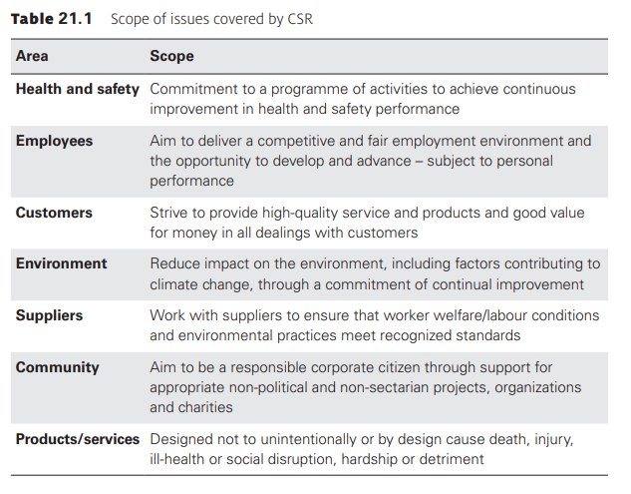
Lecture
Risk management and the business model
10
www.midocean.ae

Slide 19
Lecture
Risk management and the business model
10
CSR and risk management
Health and safety: Commitment to a program of activities to achieve continuous improvement in health and safety performance.
Employees: Aim to deliver a competitive and fair employment environment and the opportunity to develop and advance – subject to personal performance
Customers: Strive to provide high-quality service and products and good value for money in all dealings with customers
www.midocean.ae

Slide 20
Lecture
Risk management and the business model
10
CSR and risk management
Environment: Reduce impact on the environment, including factors contributing to climate change, through a commitment of continual improvement.
Suppliers: Work with suppliers to ensure that worker welfare/labour conditions and environmental practices meet recognized standards.
Community: Aim to be a responsible corporate citizen through support for appropriate non-political and non-sectarian projects, organizations and charities
www.midocean.ae

Slide 21
Lecture
Risk management and the business model
10
CSR and risk management
Products/services: Designed not to unintentionally or by design cause death, injury, ill-health or social disruption, hardship or detriment
www.midocean.ae

Slide 22
Lecture
Risk management and the business model
10
CSR and risk management
When assessing the CSR agenda, risk managers should take the opportunity to bring risk management tools and techniques to a broader agenda. The risk management approach of risk assessment, identification of control measures and auditing of compliance is an approach that can be transferred to corporate social responsibility and, indeed, to the broader corporate governance agenda.
www.midocean.ae

Slide 23
Lecture
Risk management and the business model
10
CSR and risk management
Most organizations consider CSR to be a reputational issue and see the component parts of CSR as hazard risks. Such organizations will consider that they need to reform their core processes and procedures in order to comply with these requirements. This may well be an accurate starting point for many organizations.
www.midocean.ae

Slide 24
Lecture
Risk management and the business model
10
CSR and risk management
As with other areas of risk management, organizations should seek to develop their level of sophistication in relation to CSR. Having got to the stage of complying with the CSR obligations, organizations should then look at the opportunities that are available. For example, it is now commonplace for supermarkets to offer goods that have been procured on a ‘fair trade’ basis and gain additional sales from offering this range of products.
www.midocean.ae

Slide 25
Lecture
Risk management and the business model
10
CSR and risk management
Corporate social responsibility is an area of concern where it is likely that public opinion will be ahead of the thinking within many organizations. CSR issues therefore represent a great opportunity for an organization to develop corporate social responsibility plans and actions that respond to public opinion. Treating the CSR agenda as a dynamic, proactive set of issues will enable the organization to gain reputational advantage.
www.midocean.ae

Slide 26
Lecture
Risk management and the business model
10
CSR and risk management
Many organizations have stakeholders that they do not necessarily want. This is certainly the case for several energy companies. Exploration for oil, coal and minerals is carefully scrutinized by environmental pressure groups. Even if they are ‘unwanted stakeholders’, environmental pressure groups are valid stakeholders in these organizations and can bring a considerable influence to bear on their activities. Environmental pressure groups have demands that are firmly within the CSR agenda.
www.midocean.ae

Slide 27
Lecture
Risk management and the business model
10
CSR and risk management
An example of the impact that a pressure group can exert is demonstrated by the impact of the ‘Black Lives Matter’ movement on many global corporations following the death of George Floyd in the USA, on camera. Walmart, Disney, and Facebook pledged donations to organizations such as the National Association for the Advancement of Colored People or launched diversity initiatives. Many organizations felt compelled to comment, from the financial community, such as Blackrock, the Investment giant and JP Morgan Chase, to the leisure sector where Lego ‘told online affiliates to remove links to 31 mainly police-themed products, as part of its own stand “against racism and inequality”’.
www.midocean.ae

Slide 28
Lecture
Risk management and the business model
10
Supply chain and ethical trading
Failure to ensure appropriate ethical behavior is increasingly recognized as a major business risk. Social media and press reports describing bribery and other forms of dishonesty have serious consequences for corporate reputation and future profits. The ease of access to information on the internet can result in organizations being investigated and exposed for unethical trading and/or unfair treatment of suppliers. Similarly, the dissemination and rapid spread of reports that achieve ‘viral’ status can be alarming.
www.midocean.ae

Slide 29
Lecture
Risk management and the business model
10
Supply chain and ethical trading
If the unethical behavior extends into illegal activity, this can undermine the organization itself. Illegal behavior and condoning actions that are outside the governance rules of the organization can have serious consequences. The perceived need to bribe officials in certain territories is both unethical and illegal.
www.midocean.ae

Slide 30
Lecture
Risk management and the business model
10
Supply chain and ethical trading
There are several areas where unethical trading can result in damage to reputation, the loss of future profitability and a refusal on the part of the customers and suppliers to deal with the organization. These issues include:
failure to comply with rules and regulations;
trading with undesirable overseas governments;
excessive payments to political parties;
www.midocean.ae

Slide 31
Lecture
Risk management and the business model
10
Supply chain and ethical trading
tax evasion or dubious tax arrangements;
inappropriate criticism of competitors;
false allegations against competitors;
unethical alliances with competitors.
www.midocean.ae

Slide 32
Lecture
Risk management and the business model
10
Supply chain and ethical trading
Another feature of the supply chain that may result in allegations of unethical trading relates to the sourcing of products produced in socially unacceptable working conditions. Also, the quality of products and failure to provide value for money can result in damage to reputation and may be associated with unethical trading. Goods that fall short of current safety standards can result in serious adverse publicity and damage to reputation.
www.midocean.ae

Slide 33
Lecture
Risk management and the business model
10
Importance of reputation
Reputation is fundamentally important to organizations and they should make sure that they understand the basis of their reputation. Reputation is based on the size, nature and complexity of an organization, but it is useful to put more structure into what makes a good reputation.
www.midocean.ae

Slide 34
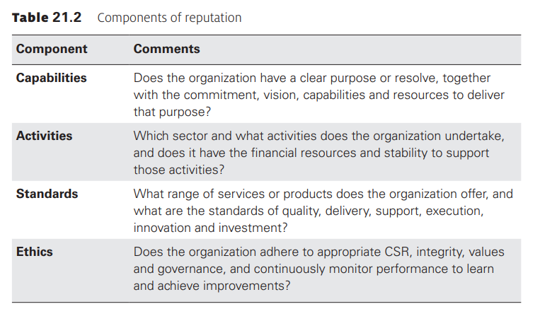
Lecture
Risk management and the business model
10
www.midocean.ae

Slide 35
Lecture
Risk management and the business model
10
Importance of reputation
Capabilities: Does the organization have a clear purpose or resolve, together with the commitment, vision, capabilities and resources to deliver that purpose?
Activities: Which sector and what activities does the organization undertake, and does it have the financial resources and stability to support those activities?
www.midocean.ae

Slide 36
Lecture
Risk management and the business model
10
Importance of reputation
Standards: What range of services or products does the organization offer, and what are the standards of quality, delivery, support, execution, innovation and investment?
Ethics: Does the organization adhere to appropriate CSR, integrity, values and governance, and continuously monitor performance to learn and achieve improvements?
www.midocean.ae

Slide 37
Lecture
Risk management and the business model
10
Importance of reputation
The use of a chart, such as that shown in Figure 21.2, will enable the organization to map its overall reputation, within the context of the sector in which it operates. For each of the four segments, or eight attributes, an organization should be able to plot its current status in a ranking of 1 to 4, representing poor, adequate, good and excellent. It will then be possible for the organization to identify the sectors that represent the greatest threats to its reputation.
www.midocean.ae

Slide 38
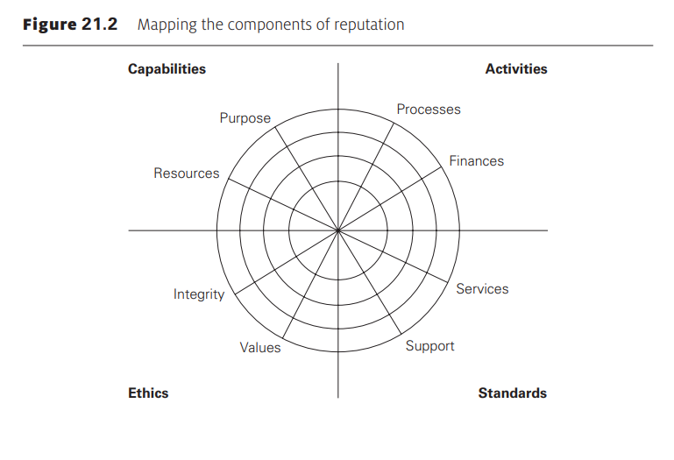
Lecture
Risk management and the business model
10
www.midocean.ae

Slide 39



Thank You

