Slide 1

PMG 611
Enterprise Risk Management
Prepared by Dr. Abdullah Jameel Halawany
Lecture 10
Cybersecurity and Information Technology and ERM

Slide 2

Session Outline
IT And The ERM Framework
IT Application Systems Risks
Effective IT Continuity Planning
Worms, Viruses, And System Network Risks
Session Outline

Slide 3
Introduction

Slide 4
Introduction
IT is so pervasive in all business and operations processes.
IT is also a challenging area for understanding risks and developing appropriate risk responses.
As has been the pattern over the years, no matter how strong are the designed and implemented internal controls—particularly those that are software based—someone will find a way to violate and get around them.

Slide 5
Introduction
Because of the complexity in building and maintaining Information Technology (IT) systems, their network interconnections, and all types of applications, Risk Management has been a very important consideration in all aspects of IT processes.
One does not have to have been a participant or observer of IT hardware and software projects for that many years to have observed many IT projects that were launched with high expectations but subsequently failed for any of a variety of reasons.

Slide 6
Introduction
Just as people involved in marketing often have overly high expectations that some new initiative will succeed, IT processes often have high, positive expectations but ignore the many business and technology risks associated with IT systems.
Digital transformation era.

Slide 7
Introduction
90% of organizations in North American that are engaged in Digital Transformation acknowledge their risk profiles have expanded due to their digital initiatives.
Managing Cybersecurity Risks is the top risk management objective for decision makers at organizations engaged in Digital Transformation.

Slide 8
Introduction
On any given day, there are numerous media reports about signiﬁcant cyber incidents.
Organizations of all types and sizes are susceptible to cyber attacks.
Which data, systems, and assets are of value at any particular point in time depends on the cyber attacker’s motives.

Slide 9
Introduction
As long as cyber incidents continue to have a negative impact on the reputation and ﬁnancial well-being of victim companies and continue to draw additional regulatory and legal scrutiny, cyber breaches will continue to be high proﬁle events that draw a substantial amount of negative press.

Slide 10
Introduction
Digital incidents are now costing small businesses $200,000 on average, according to insurance carrier Hiscox, and 60% going out of business within six months of being victimized.
The frequency with which these attacks are happening is also increasing, with more than half of all small businesses having suffered a breach and 4 in 10 having experienced multiple incidents.

Slide 11
IT And The COSO Erm Framework

Slide 12
IT And The COSO Erm Framework
Information systems general controls include hardware, software, and administrative control procedures that apply to all systems and applications, including:
  Reliability of information systems processing
  Integrity of programs, including configuration management
  Controls of the proper development and implementation of systems.
  Continuity of processing
  Controls of Application Inputs
  Self-balancing and other financial and data controls
  Application output components

Slide 13
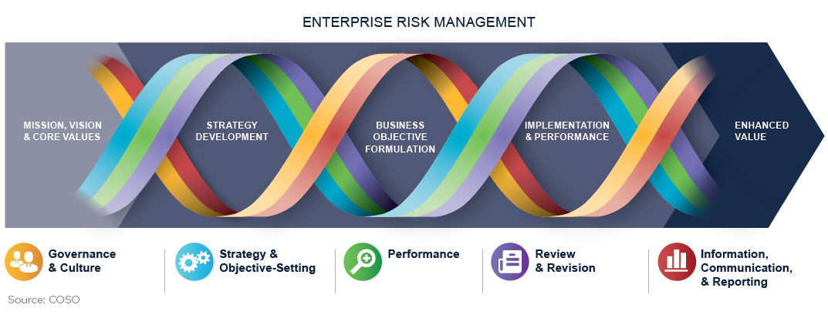
IT And The COSO Erm Framework

Slide 14
IT And The COSO Erm Framework
Governance and Culture (sets the entity’s tone, reinforcing the importance of cyber vigilance and establishing oversight responsibilities for the entity)
Strategy and Objective-Setting (Cyber risk management should integrated)
Performance (identifies and assesses cyber risks that may affect the achievement of that strategy and business objectives)
Review and Revision (reviewing cyber risk management capabilities and practices, and the entity’s performance relative to its targets)
Information, Communication, and Reporting

Slide 15
IT And The COSO Erm Framework
Governance and Culture (sets the entity’s tone, reinforcing the importance of cyber vigilance and establishing oversight responsibilities for the entity)
Strategy and Objective-Setting (Cyber risk management should integrated)
Performance (identifies and assesses cyber risks that may affect the achievement of that strategy and business objectives)
Review and Revision (reviewing cyber risk management capabilities and practices, and the entity’s performance relative to its targets)
Information, Communication, and Reporting

Slide 16
IT Application Systems Risks

Slide 17
IT Application Systems Risks
IT applications are pervasive and can contain many risks.
They may represent software routines that have been custom developed by an enterprise, purchased software products, or software that is embedded in many other tools and products.
Some of the areas where an enterprise faces risks with its application systems include situations when a project is poorly planned and misses schedule or budget targets.
Other risk areas are when there are integrity and performance problems, or when there are just ‘‘bugs’’ in the application.

Slide 18
IT Application Systems Risks
Failures here can cause problems or even embarrassments for an enterprise.
A new application may be launched where only a limited set of conditions may have been tested.
Increased variation of transactions or volume of transactions.
Whether it is a space launch rocket or a customer billing application, the causes for many if not most IT applications failures can be traced to poor design and testing processes.
Adequate procedures and other good processes in place can limit those risks.

Slide 19
Application Development and Acquisition Risks
Enterprise management would decide they needed some type of specific application and would proceed to use their own in-house programming resources to build it.
While some standard applications such as payroll and fixed asset applications have been offered by outside vendors and installed as purchased software for many years, many others have been built in-house by enterprise IT development resources.

Slide 20
Application Development and Acquisition Risks
There are risks associated with any new application development effort along with a somewhat different set of risks, depending whether the application is based on essentially purchased software or built by in-house enterprise resources.
Purchased applications typically take a large amount of tailoring work to install, and most in-house developed applications always use purchased software building blocks.
With the possible exception of some desktop system applications, most require some degree of application development work.

Slide 21
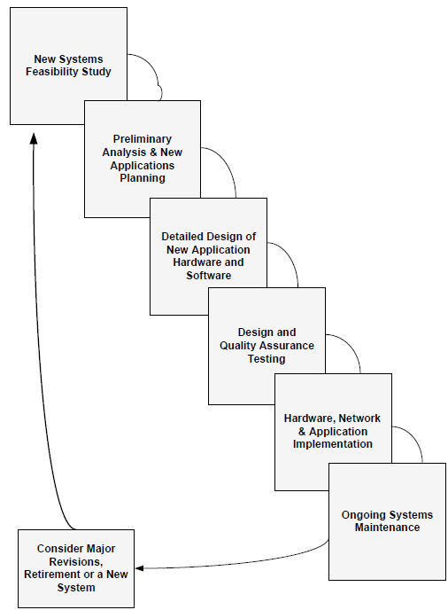
System Development Life Cycle Waterfall Development Processes

Slide 22
Purchased Software Application Risks
All-function applications called Enterprise Resource Planning (ERP) applications.
The concept behind these applications is that a change to one module, such as an inventory adjustment, will be reflected in related applications such as the general ledger and the bill of material.
These kinds of purchased ERP applications are not easy to install.
They typically require massive changes to existing processes to better match business operations to the ERP software application as well as some parameter-driven changes to the ERP to make it a better business fit.

Slide 23
Purchased Software Application Risks
An ERP system typically requires a long time period for its implementation with a need for specialized staff training and outside consultants.
Failure to select the appropriate software vendors can present major risks to any contracted software product.

Slide 24
Purchased Software Contract Guidelines to Reduce Risks
Software Product Feasibility/Compatibility
Product History
Vendor Background
Customer & Trade References
Revision Practices
Product Documentation & Training
Product Customer Support

Slide 25
In-House Developed Software Application Risks
Enterprises often decided they had to develop applications because of what they argued were their unique needs.
There is not a strict dividing line between applications purchased from software vendors and those developed in-house.
The reality is that the software development process does not fit totally on one side of this divide or the other.
Risks can be limited through good SDLC procedures supported by strong project management practices.

Slide 26
Software and Application Systems Testing
It is necessary to test all new applications before placing them into production.
An enterprise can face a major risk to the quality and integrity of its IT applications if new applications are not fully tested.
This testing process should take place at an application level and for overall systems.
IT testing required strong procedures in place for developing testing plans and for reviewing the results of those testing activities, including specified pass/fail criteria over the results of this testing.

Slide 27
Software and Application Systems Testing
The type of testing performed will vary depending on the features, objectives, and controls of the application being reviewed.
This testing should be performed by the application developers, or IT audit.
In order to provide sufficient testing activities to minimize risks, the results of the testing should be well documented so that any outside reviewers could assess the adequacy of this testing activity.

Slide 28
Effective IT Continuity Planning

Slide 29
Effective IT Continuity Planning
Just as we rely on electrical power and clean water resources to be in operation, an enterprise today depends on its IT systems to operate continuously and effectively.
Enterprise is largely responsible for the operation of its own IT resources.
An enterprise faces numerous risks around its IT assets.

Slide 30
Effective IT Continuity Planning
There typically is not one major or central computer facility for handling major automated applications but a wide range of desktop devices, servers, and other computer systems connected through often very complex wireless communications, storage management networks, and links to the Internet.

Slide 31
Effective IT Continuity Planning
An enterprise can face a major risk if they lose the ability to access and use their key IT systems for even a relatively short period of time.
To limit those risks, there is a need to have procedures in place to promptly restore their operations.
Systems today support many enterprise operations, and the concept of having tools and procedures in place to rapidly restore overall business operations is called Continuity Planning.

Slide 32
Effective IT Continuity Planning
In the event of an unexpected outage, the IT systems should be restored and operating as quickly and efficiently as possible in order to support and restore the business processes.
Enterprise should also be concerned about the continued and high availability of its IT resources.
Any form of computer systems downtime can be very costly to an enterprise.

Slide 33
Effective IT Continuity Planning
For example, the Disaster Recovery Institute5 estimated some years ago that the average hourly impact of an hour of systems downtime is $89,500 for an airline reservations system or $2.6 million for a credit card authorization provider, among others.
Beyond just estimates, eBay’s Internet auction site went down for 22 hours in August 1999.
This caused $4 million in lost fees and a $5 billion drop in eBay’s stock market value.

Slide 34
Effective IT Continuity Planning
To minimize risks, enterprises need to think through these various possible situations in advance.
Two types of emergency incidents are significant.
The first is the risk of a fire-in-the-building type of emergency incident.
The supporting emergency response plan here would include posted fire exits and past experience with frequent fire drills.
This type of emergency response plan should cover all enterprise operations, not just IT systems, and should be regularly tested.

Slide 35
Effective IT Continuity Planning
The second level of emergency response plan covers specific individual incidents that may or may not turn out to be significant but must be corrected at once followed by an investigation and a plan of corrective action to prevent further incidents.
These are called emergency incidents
  Security Breaches or
  Theft of hardware or software

Slide 36
Effective IT Continuity Planning
A good emergency incident response plan should be acted on quickly to minimize the effects of any further breaches.
It should also be formulated to reduce any negative publicity and to focus attention on quick reaction time.
Rather than just an IT-related plan, all appropriate levels of enterprise operations should be covered.

Slide 37
Effective IT Continuity Planning
An enterprise’s risk management function should work with their IT operations to develop appropriate emergency response plans that will exist at a total facility level, such as a fire escape plan, and at an individual level, such as a plan to respond to a security breach. To reduce risks, these plans should be regularly updated and tested.

Slide 38
Effective IT Continuity Planning
Beyond an emergency response plan, an enterprise needs to develop a set of IT continuity plans.
This type of plan is an outline of the steps necessary to help an enterprise recover from major service disruptions, whether a fire type of emergency, a computer or network equipment failure, or any other form of major disruption.
The goal of such a plan is to help an enterprise reduce the risk of a disaster outage or extended service interruption to an acceptable level and to bring business operations back.

Slide 39
Effective IT Continuity Planning
This type of continuity plan represents a change in emphasis from what IT professionals once called disaster recovery plans.
That older emphasis was to get data processing operations working while the continuity plan emphasizes needs of the business unit.
Today, these plans have been redesigned to broaden them and to reduce risks.
They are frequently called Business Continuity Plans (BCPs).

Slide 40
Worms, Viruses, And System Network Risks

Slide 41
Worms, Viruses, And System Network Risks
An enterprise’s IT operation today consists of much more than just its IT equipment and resources within offices and plants.
It also includes a wide variety of other facilities connected through the Internet and other often-wireless networked resources.
Even if an enterprise effectively prohibits the regular use of the Internet during regular working sessions, we are all effectively connected to these networks today.

Slide 42
Worms, Viruses, And System Network Risks
Communications with many banks, access to government reports, and even ordering certain parts and supplies requires Internet access.
These interconnections contain many risks in terms of exposures to what have become known as worms, viruses, and other types of malignant software code threats that can cause peril for all types of programs and networked computer systems, ranging from a home office desktop to a large central system.

Slide 43
Worms, Viruses, And System Network Risks
An enterprise needs to recognize the threat of what is often called cybercrime and needs to take steps to protect from these threats.
Establishing effective controls is a challenge.
Enterprise can reduce its risks and the threat of cybercrime by:

Slide 44
Worms, Viruses, And System Network Risks
Following ‘‘Best Practices’’ in Establishing and Maintaining an Effective IT Security System.
Regular systems of security maintenance should be established, including the regular updating of operating systems and software,
Enforcement of password policies, disabling unnecessary services, installation and updating of antivirus software on a very frequent basis, and the use of intrusion detection systems and firewalls.
Prevention is always the best cure.

Slide 45
Worms, Viruses, And System Network Risks
Remaining on High Alert.
Frequent scanning of Internet logs and incoming and outgoing e-mail should be performed regularly, and any suspicious activity should be looked into and reported to the local authorities, if necessary.
An emergency incident plan could be established as well, in case any system is temporarily or permanently disabled by a virus.

Slide 46
Summary

Slide 47
IT And Effective ERM Processes
IT processes play a significant role in the operations of any enterprise and certainly are a major factor when assessing and understanding relative risks.
This chapter has highlighted only three broad IT areas—the application development process, IT continuity plans, and malicious network programs—where an enterprise can face some significant IT risks.

Slide 48
References
COSO Enterprise Risk Management: Establishing Effective Governance, Risk, and Compliance Processes. Robert R. Moeller.

