Slide 1




Organizational Behavior and Projects
PMG421
Prepared by Mrs. Deena Ibrahim
Lecture 8
Analyzing Project Processes

Slide 2


Analyzing Project Processes.
1- Tools for Analyzing Processes . 2.1 Cause and Effect Diagrams 2.2 Pillar Diagrams
2. Summary

Slide 3

Analyzing Project Processes

Slide 4
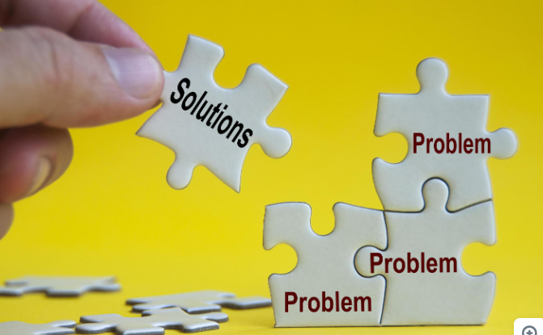
Analyzing Project Processes
Having achieved an understanding of data and processes, project managers are ready to analyze processes and solve problems. Merely understanding a process is not a sufficient basis for taking action. Action without analysis is limited to trial and error, or guesswork about what the boss wants. None of these approaches is likely to yield happy results. Analysis is necessary to determine the system interaction aspects of the process and cause-effect relationships.

Slide 5
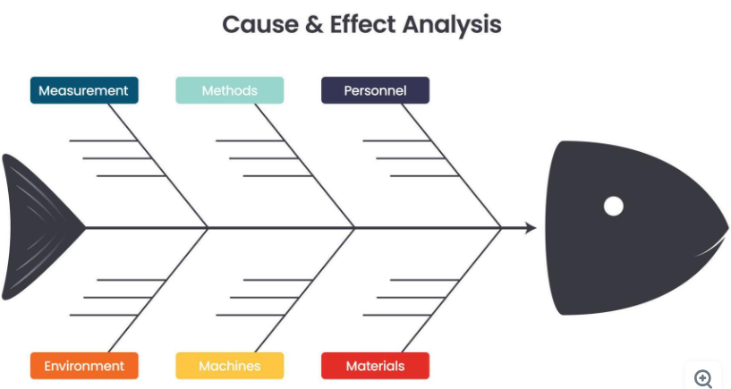
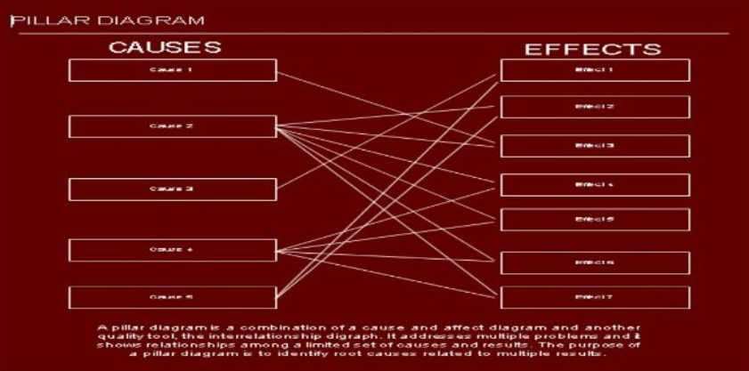
Tools for Analyzing Processes
Two tools are helpful in analyzing processes.
One is a classic tool, proven over many years of effective use.
The other is new.

Slide 6
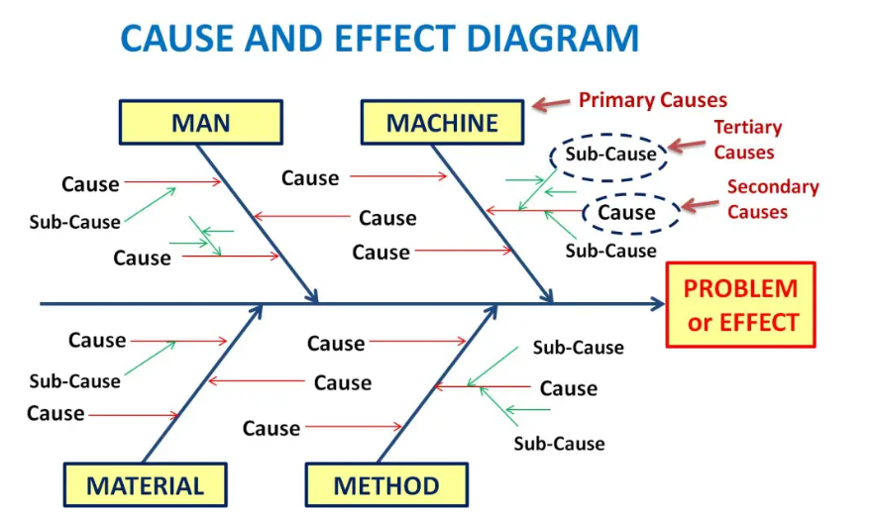
Cause and Effect Diagrams
This diagram is sometimes called a “fishbone diagram” because of its shape and sometimes called an “Ishikawa diagram” in honor of its developer, Dr. Kaoru Ishikawa. It is used to identify, explore, and graphically display all possible causes related to a problem, including root causes.

Slide 7
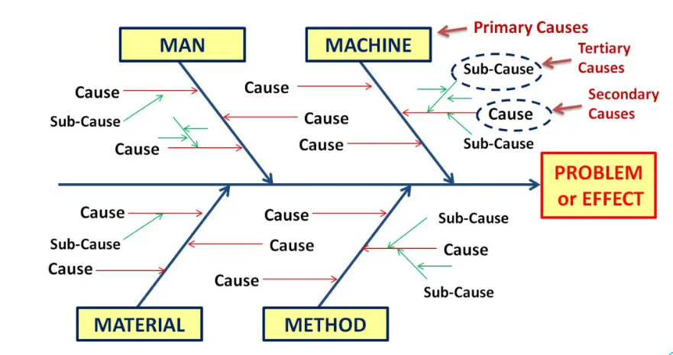
A cause and effect diagram is a powerful tool for analyzing a single problem and identifying all the possible causes. Sometimes a project team may want to analyze a situation in which multiple problems are related to multiple causes, all of which are generally known or can be identified readily and exist in limited number.

Slide 8

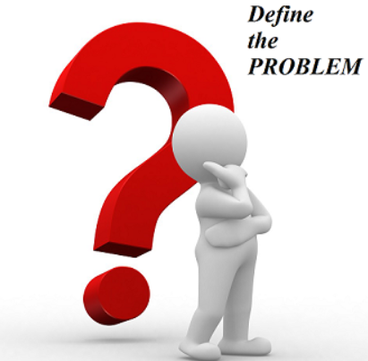
Using a cause and effect diagram includes four steps:
Identify and define the problem. Determine the extent of the problem to be addressed. It is important to establish specific and limited boundaries that will focus the analysis and avoid an overly broad approach that may include multiple problems.

Slide 9


2- Identify major categories for causes. Causes constitute a unique set for individual problems. General models for causes may be useful as a start (for example, people, policies, procedures, and equipment), but each analysis effort must consider causes relevant to the specific problem, not simply a predefined set that may well be incomplete.

Slide 10

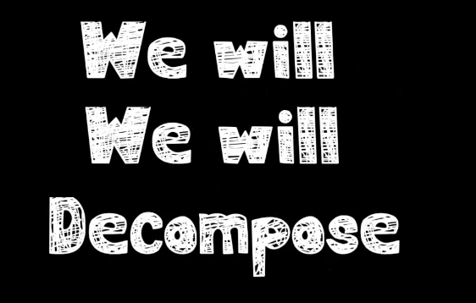
3. Decompose major causes down several levels. Carefully analyze each cause and determine what aspects or elements within that category might contribute to the problem being analyzed. Then analyze each aspect or element to determine what sub elements might contribute to the problem. Then analyze each sub element, and so on until the project team is comfortable that analysis is complete.

Slide 11


4. Identify root causes. Review the diagram and identify multiple occurrences of causes. For example, in a diagram with four categories, the sub element “budget” may occur at several levels within each category. Multiple occurrences indicate a root cause; that is, a single cause that has many instances of effect throughout the process.

Slide 12
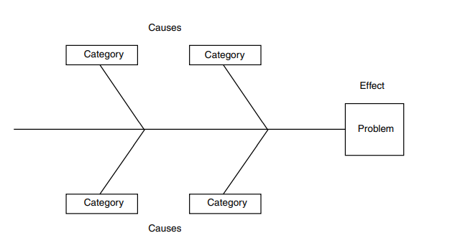
A basic model for cause and effect diagrams is shown here. The image shows why the diagram is sometimes called a fishbone diagram. The problem identified in the box on the right is the head of the fish. The centerline is the backbone of the fish, and the lines that connect the category boxes to the centerline are the ribs.

Slide 13
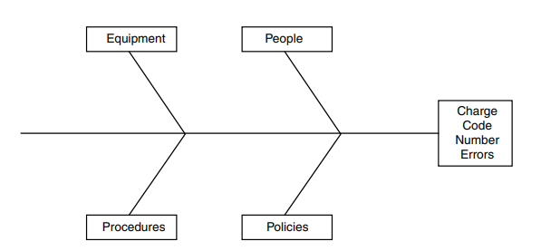
As an example of applying the model, consider the matter of charge code number errors in monthly status reports. Because this source offers the greatest opportunity for improvement, the project team decides to address it first.

Slide 14
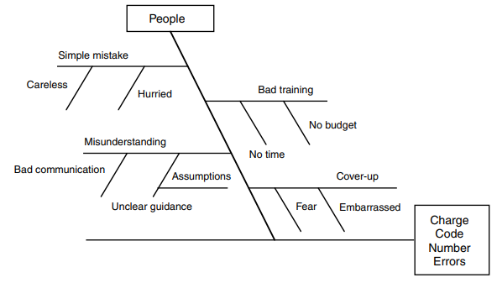
The team establishes “charge code number errors” as the problem and identifies four categories of possible cause:
1. People — Human error may be a contributing source.
2. Policies — Requirements established by management may also contribute.
3. Procedures — The manner in which policies are carried out may generate errors.
4. Equipment — The computers and other aspects of automated and manual systems may contribute to errors.

Slide 15
The real work — and the real benefit — comes next as the team analyzes one category at a time and decomposes it down several levels of cause.
The team focuses on each category individually and does not jump from category to category, as possible inter category relationships might arise. The goal is complete and deep analysis of possible causes within categories. The Figure shows the decomposition of the “people” category.

Slide 16
The project team first analyzed the “people” category to determine what people issues might be a cause of charge code number errors. They identified four possible causes: simple mistakes, bad training, misunderstandings, and cover-ups. Continuing the decomposition process, the team examined each one of these four causes and identified possible causes for each:

Slide 17
Simple mistakes — People could be careless and unintentionally enter a wrong number, perhaps by striking the wrong key on the keyboard when entering data into the automated accounting system. Or people could be rushed and make errors when trying to accomplish the data entry too quickly.
Bad training — It may be that people never completed essential training because they had no available time to attend training. Or perhaps training was never offered because funds were not available.

Slide 18
3. Misunderstandings — People may have used and reported erroneous charge codes because they misunderstood exactly what code they were allowed to use. Or they may have received unclear guidance and used the code they thought was most appropriate.
4. Cover-ups — People may have made errors and knew they made errors, but did not report and correct the errors because they were embarrassed by their mistake or afraid of being punished.

Slide 19
Then, continuing decomposition, the team looks at each one of the newly identified causes and identifies possible causes for it. The previous Figure shows that unclear guidance, which may be a cause of misunderstandings, may be caused by people making assumptions about what other people know.

Slide 20

Some teams find it easier to prepare an indented list first, then draw the diagram. This approach allows the team to probe and explore — to go back and forth, to add and delete — before putting the results on paper as a final diagram.

Slide 21

After the diagram is complete, the team reviews it, looking for repeated entries. Multiple occurrences suggest root causes. If, for example, “no budget” occurs in multiple locations across all categories, a lack of funding may be a root cause that, if eliminated, will have significant improvement effect on the problem being analyzed. Beyond root causes, the project team now has a comprehensive view of how things can go wrong. This information may be a basis for further focused data collection or a foundation for corrective action.

Slide 22

When to use an Ishikawa Diagram?
Problem-solving to focus on the Quality problem.
To sort out interactions among factors for a cause.
To analyze existing problems.
Why use the Ishikawa Diagram?
- Helps to determine the Root Cause of a Problem.
- To identify the Key Inputs variables. Primary, Secondary and Tertiary causes.
- Helps in identifying the possible cause for variation present in a process.
- Increases knowledge of a process and its factors.
- Helps to identify areas for data collection.

Slide 23

Benefits of “Fishbone Diagram“
Focus is on ‘Causes’ rather than on assumptions.
Break problems down into small pieces to find the real root cause.
Increase people involvement & teamwork.
Improves team performance & effectiveness.
Improves process knowledge.
A common understanding of factors causing the problem.

Slide 24
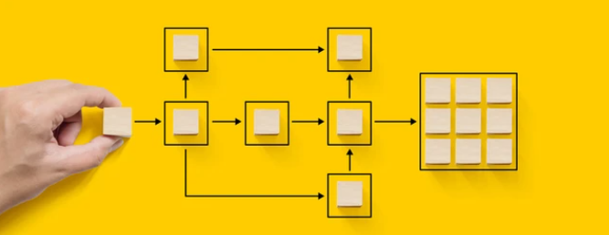
Pillar Diagrams

Slide 25

What is A pillar diagram
A pillar diagram (a new quality tool introduced here for the first time) is a combination of a cause and effect diagram and another quality tool, the interrelationship digraph.
It addresses multiple problems (a cause and effect diagram addresses just one) and it shows relationships among a limited set of causes and results. An interrelationship digraph is used to determine relationships among all contributing elements of a system.

Slide 26

An interrelationship digraph:
Encourages team members to think in multiple directions rather than linearly
Explores the cause and effect relationships among all the issues.
Allows key issues to emerge naturally rather than to be forced by a dominant or powerful team member.
Systematically surfaces the basic assumptions and reasons for disagreements among team members.
Allows a team to identify root cause(s) even when credible data does not exist.
When to use an interrelationship digraph?
When trying to understand links between ideas or cause-and-effect relationships
When a complex issue is being analyzed for causes.
When a complex solution is being implemented.
After generating an affinity diagram, fishbone diagram, or tree diagram, to more completely explore the relations of ideas.

Slide 27
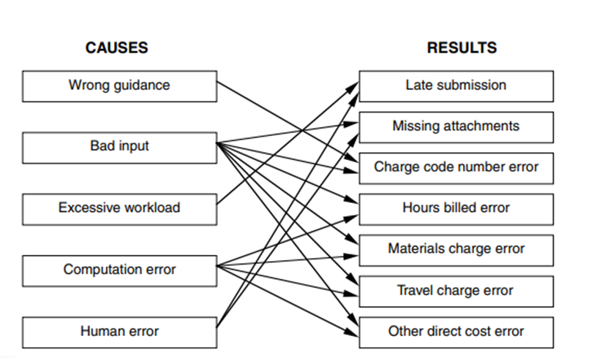
To create a pillar diagram:
1- Build the pillars by identifying results, then causes. Results and causes are represented by boxes stacked on top of one another, resembling a pillar.
2- Connect causes to relevant results using arrows. Analyze each cause against each result in successive pair-wise comparisons. If there is a relevant relationship from the cause to the result, connect the cause box to the result box with an arrow.
3- Count the “out” arrows for each cause.
4- Identify root causes. Causes with the most arrows are root causes; that is, causes that influence the most results.

Slide 28
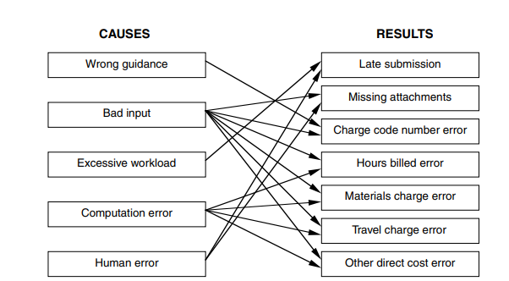

Slide 29

◆ Analyzing processes is an essential step before taking improvement action.
◆ A cause and effect diagram is used to identify, explore, and graphically display all possible causes related to a single problem. It is sometimes called a fishbone diagram because of its distinctive shape or an Ishikawa diagram in honor of its inventor.
◆ A cause and effect diagram includes several categories of causes, determined by the problem being analyzed. Basic categories useful to project managers for analyzing processes include people, policies, procedures, and equipment. Categories are decomposed down several levels in a treelike structure. ◆ In a cause and effect diagram, multiple occurrences of a single cause suggest it is a root cause. Eliminating root causes will have significant improvement effect across the process.

Slide 30
◆ Cause and effect diagrams may be constructed graphically or may be prepared first as an indented list, with the graphic being constructed after all causes have been identified.
◆ A pillar diagram is a new quality tool that may be used to identify root causes related to multiple results.
◆ A pillar diagram is created by graphically stacking multiple results and causes in columns that resemble pillars. Causes are then analyzed against each result. If a relationship exists, arrows are drawn from the cause to the result.
◆ Causes with the highest number of “out” arrows” are the most significant causes, those that have the most influence on results.
◆ Pillar diagrams address causes and their influence on results. They do not address the value of results.

Slide 31


