Slide 1


Risk Management
MGM510
Prepared by Dr. Majid Saad
Lec .10 : Analysis of Insurance Contracts
The Liability Risk

Slide 2
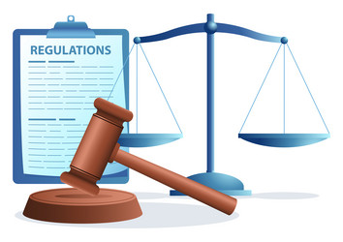
Part 1 :
Analysis of Insurance Contracts
“I was never ruined but twice, once when I lost a lawsuit and once when I won one.”
Voltaire

Slide 3

Lecture objectives
After studying this chapter, you should be able to:
Identify the basic parts of any insurance contract.
Explain the meaning of “insured” in an insurance contract.
Describe the common types of deductibles that appear in insurance contracts.
Explain how coinsurance works in insurance contracts.
Explain how losses are paid when more than one insurance contract covers the same loss.

Slide 4
Basic Parts of an Insurance Contract
Despite their complexities, insurance contracts generally can be divided into six parts:
Declarations
Definitions
Insuring agreement
Exclusions
Conditions
Miscellaneous provisions

Slide 5
Basic Parts of an Insurance Contract
6- Miscellaneous provisions
Although all insurance contracts do not necessarily contain all six parts in the order given here, such a classification provides a simple and convenient framework for analyzing most insurance contracts.
Declarations
The declarations section is the first part of an insurance contract.
Declarations are statements that provide information about the particular property or activity to be insured.

Slide 6
Definitions
Insurance contracts typically contain a page or section of definitions. Key words or phrases have quotation marks (“. . .”) around them. For example, the insurer is frequently referred to as “we,” “our,” or “us.” The
named insured is referred to as “you” and “your.” The purpose of the various definitions is to define clearly
the meaning of key words or phrases so that coverage under the policy can be determined more easily..

Slide 7
Exclusions
Exclusions are another basic part of any insurance contract. There are three major types of exclusions
excluded perils, (2) excluded losses, and (3) excluded property.
Excluded Perils The contract may exclude certain perils, or causes of loss.
Excluded Losses Certain types of losses may be excluded.
Excluded Property The contract may exclude or place limitations on the coverage of certain property.

Slide 8
Conditions
Conditions are another important part of an insurance contract.
Conditions are provisions in the policy that qualify or place limitations on the insurer’s promise to perform. In effect, the conditions section imposes certain duties on the insured. If the policy conditions are not met, the insurer can refuse to pay the claim.
Common policy conditions include notifying the insurer if a loss occurs, protecting the property after a loss, preparing an inventory of damaged personal property, and cooperating with the insurer in the event of a liability suit.

Slide 9
Miscellaneous Provisions
Insurance contracts also contain a number of miscellaneous provisions. In property and casualty insurance, miscellaneous provisions include cancellation, subrogation, requirements if a loss occurs, assignment of the policy, and other-insurance provisions. In life and health insurance, typical miscellaneous provisions include the grace period, reinstatement of a lapsed policy, and misstatement of age. Details of these provisions are discussed later in the text when specific insurance contracts are analyzed.

Slide 10
Definition of “insured”
An insurance contract must identify the person or parties who are insured under the policy. For ease in understanding, the meaning of “insured” can be grouped into the following categories:
Named insured : The named insured is the person or party named on the declarations page of the policy.
First named insured :is the first name that appears on the declarations page of the policy as an insured
Other insureds : are persons or parties who are insured under the named insured’s policy even though they are not specifically named in the policy.
Additional insureds :is a person or party who is added to the named insured’s policy by an endorsement.

Slide 11
Deductibles
A deductible is a common policy provision that requires the insured to pay part of the loss.
A deductible is a provision by which a specified amount is subtracted from the total loss payment that otherwise would be payable. Deductibles typically are found in property, health, and auto insurance contracts.
A deductible is not used in life insurance because the insured’s death is always a total loss, and a deductible would simply reduce the face amount of insurance. Also, a deductible generally is not used in personal liability insurance because the insurer must provide a legal defense, even for a small claim.

Slide 12
Purposes of Deductibles
Deductibles have several important purposes. They include the following:
To eliminate small claims: deductible eliminates small claims that are expensive to handle and process
To reduce premiums: Deductibles are also used to reduce premiums paid by the insured.
To reduce moral hazard and attitudinal hazard: deductibles are used by insurers to reduce both moral hazard and attitudinal (morale) hazard.

Slide 13
Coinsurance
Coinsurance is a contractual provision that often appears in property insurance contracts. This is especially true of commercial property insurance contracts.
A coinsurance clause in a property insurance contract encourages the insured to insure the property to a stated percentage of its insurable value. If the coinsurance requirement is not met at the time of loss, the insured must share in the loss as a coinsurer.
Purpose of Coinsurance : The fundamental purpose of coinsurance is to achieve equity in rating ( premiums ).
Health insurance contracts typically contain a coinsurance percentage clause, which is a provision that requires the insured to pay a specified percentage of covered medical expenses in excess of the deductible.
The purposes of coinsurance in health insurance are (1) to reduce premiums and (2) to prevent overutilization of policy benefits.

Slide 14
coinsurance percentage
A coinsurance percentage clause is typically found in individual and group medical expense policies. A typical provision requires the insured to pay 20, 25, 30 percent, or some higher percentage of covered expenses in excess of the deductible up to some specified annual limit.
Other-insurance provisions are present in many insurance contracts. These provisions apply to payment of a loss when more than one policy covers the same loss. The purpose of these provisions is to prevent profiting from insurance and violation of the principle of indemnity.
Some important other-insurance provisions include the pro rata liability clause, contribution by equal shares, and primary and excess insurance.

Slide 15

Part two:
The Liability Risk

Slide 16
Lecture objectives
After studying this chapter, you should be able to:
Define negligence and explain the elements of negligence.
Explain the following legal defenses that can be used in a lawsuit:
Contributory negligence
Comparative negligence
Apply the law of negligence to specific liability situations.
Explain the defects in the current tort liability system and the proposals for tort reform.
Assumption of risk
Last clear chance rule

Slide 17
Basis of Legal Liability
Each person has certain legal rights. A legal wrong is a violation of a person’s legal rights, or a failure to perform a legal duty owed to a certain person, to a business organization, or to society as a whole.
There are three broad classes of legal wrongs. A crime is a legal wrong against society that is punishable by fines, imprisonment, or death. A breach of contract is another class of legal wrongs. Finally, a tort is a legal wrong for which the law allows a remedy in the form of money damages. The person who is injured or harmed (called the plaintiff or claimant in a legal action) by the actions of another party (the tortfeasor [alleged wrongdoer] or defendant in a legal action) can sue for damages. Insurance companies often find themselves in court as a plaintiff or a defendant.

Slide 18
Law of Negligence
Negligence is defined as the failure to exercise the standard of care required by law to protect others from an unreasonable risk of harm. The meaning of the term standard of care is based on the care required of a reasonably prudent person. In other words, your actions are compared with the actions of a reasonably prudent person under the same circumstances. If your conduct and behavior are below the standard of care required of a reasonably prudent person, you may be found negligent.

Slide 19
Elements of negligence.
There are four essential elements of negligence.
Existence of a legal duty
Failure to perform that duty
Damage or injury to the claimant
Proximate cause relationship between the negligent act and the infliction of damage

Slide 20
Existence of a legal duty
The first requirement is the existence of a legal duty to protect others from harm. For example, a motorist has a legal duty to stop at a red light and to drive a car safely within the speed limits. A manufacturer has a legal duty to produce a safe product. A physician has a legal duty to inquire about allergies before prescribing a drug.

Slide 21
Failure to perform that duty
The second requirement is the failure to perform the legal duty required by law; that is, you fail to comply with the standard of care to protect others from harm. Your actions would be compared with the actions of a reasonably prudent person under similar circumstances. If your conduct falls short of this standard, the second requirement would be satisfied.

Slide 22
damage to the claimant
The third requirement is damage or injury to the claimant. The injured person must show damage or injury as a result of the action or inaction of the alleged tortfeasor
Compensatory damages are awards that compensate injured victims for the losses they have actually incurred. These damages include: Special damages: Awards for losses that can be determined and documented, such as medical expenses, lost earnings, or property damage. General damages: Awards for losses that cannot be specifically measured or itemized, such as compensation for pain and suffering, disfigurement, or loss of companionship of a spouse.
Punitive damages are awards designed to punish individuals and organizations for egregious acts, with the aim of deterring similar behavior in the future. others are deterred from committing the same wrongful act.

Slide 23
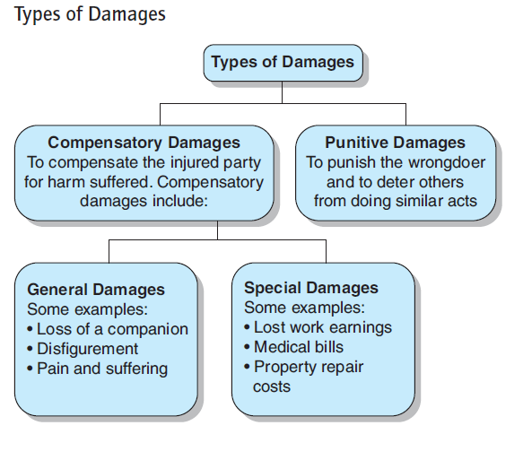
injury to the claimant

Slide 24
Proximate Cause Relationship
The final requirement is that a proximate cause relationship must exist. A proximate cause is a cause unbroken by any new and independent cause, which produces an event that otherwise would not have occurred.

Slide 25
Defenses Against Negligence
Certain legal defenses can defeat a claim of negligence. Some important legal defenses include the following:
Contributory negligence
Comparative negligence
Last clear chance rule
Assumption of risk

Slide 26
Contributory negligence
Contributory negligence refers to the principle that if the injured person's conduct falls below the standard of care required for their protection and this conduct contributes to the injury, the injured person cannot collect damages. Therefore, under a strict application of common law, if you contributed in any way to your own damage or injury, you cannot recover damages.

Slide 27
Comparative Negligence
Comparative negligence laws are not uniform among the states. They can be classified into major types as follows:
Pure Rule
50 Percent Rule
51 Percent Rule.

Slide 28
Last clear chance rule
Another statutory modification of the contributory negligence doctrine is known as the last clear chance rule. This rule states that a plaintiff who is endangered by his or her own negligence can still recover damages from the defendant if the defendant had a last clear chance to avoid the accident but failed to do so.

Slide 29
Assumption of risk
The assumption of risk doctrine is a defense that can be used to defeat a claim for damages. Under this doctrine, a person who understands and recognizes the danger inherent in a particular activity cannot recover damages in the event of an injury.

Slide 30
Standard of care
The standard of care required by law varies with the situation. Specific liability situations can involve:
Property owners
Owners and operators of automobiles
Governmental units and charitable institutions
Employers and employees
Parents and children
Owners of animals

Slide 31
Current Tort Liability Problems
The tort liability system has numerous problems at the present time. It is beyond the scope of the text to discuss all tort problems in detail. However, three timely problem areas merit a brief discussion:
Defective tort liability system
Medical sector claims
Liability arising from technological and societal change

Slide 32



Thank You

