Slide 1



Internet of Things & Consumer’s Privacy
Lecture 07
LAW 614
English Language for Digital Law
Prepared by
Samara Jasim
www.midocean.ae

Slide 2

Lecture
07
INTRODUCTION
The expansion of network-connected devices, also known as the “Internet of Things” (IoT), offers unprecedented opportunities for consumers and businesses. Yet devices such as fitness trackers, personal home assistants (e.g., Amazon Echo, Google Home), and digital appliances are changing the nature of privacy as they operate silently in the background while transmitting data about a broad range of human activities and behaviors.
www.midocean.ae

Slide 3
Lecture
07
INTRODUCTION
As “smart” becomes the new default setting for devices, consumers are further losing the ability to monitor and control the data collected about them, and they often have little awareness of what is done with their data downstream.
www.midocean.ae

Slide 4
Lecture
07
INTRODUCTION
The risks of sharing data through smart devices are not always clear, particularly as companies combine data from different sources to infer an individual’s habits, movements, and even emotions.
www.midocean.ae

Slide 5
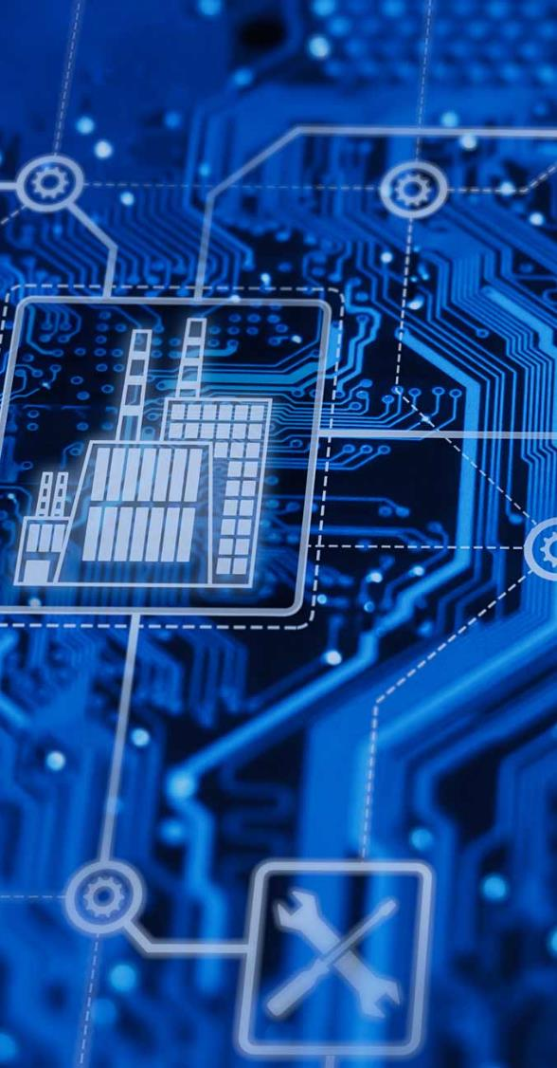
Lecture
07
INTRODUCTION
A. DEFINITION OF IOT
The Internet of Things (IoT) describes the network of physical objects—“things”—that are embedded with sensors, software, and other technologies for the purpose of connecting and exchanging data with other devices and systems over the internet. These devices range from ordinary household objects to sophisticated industrial tools.
www.midocean.ae

Slide 6
Lecture
07
INTRODUCTION
A. DEFINITION OF IOT
The Internet of Things emerged from a number of overlapping trends: widespread and inexpensive network access, cheap sensors and computing power, miniaturization, location positioning technology, inexpensive prototyping, and the ubiquity of smartphones as a platform for device interfaces.
www.midocean.ae

Slide 7
Lecture
07
INTRODUCTION
A. DEFINITION OF IOT
The connected devices of the IoT do not include multi-use computing platforms like laptops, tablets, or phones. Instead, they are products built for a narrow range of functions, and they share the ability to sense, analyze, and communicate.
www.midocean.ae

Slide 8
Lecture
07
INTRODUCTION
B. IOT DEVICES & THEIR IMPACT ON DAILY LIFE
The growth of IoT devices has been nothing short of astounding. The number of connected IoT devices worldwide is projected to reach a staggering 41.6 billion by 2025. This remarkable figure demonstrates the immense scale of IoT's expansion.
www.midocean.ae

Slide 9
Lecture
07
INTRODUCTION
B. IOT DEVICES & THEIR IMPACT ON DAILY LIFE
The impact of IoT is particularly pronounced in our homes, where it has ushered in the era of smart homes. Smart devices like speakers, thermostats, doorbells, lighting systems, and security cameras have become increasingly prevalent, offering us unparalleled convenience, energy efficiency, and enhanced security. Amazon's Alexa and Google Assistant, for example, have become household names, empowering users to control various devices with simple voice commands.
www.midocean.ae

Slide 10
Lecture
07
INTRODUCTION
B. IOT DEVICES & THEIR IMPACT ON DAILY LIFE
IoT's transformative influence extends to the healthcare industry as well. Wearable health trackers, such as fitness bands and smartwatches, monitor vital signs and activity levels, empowering individuals to take charge of their health. Hospitals utilize IoT devices to monitor patients remotely, ensuring real-time patient condition updates and more personalized healthcare solutions.
www.midocean.ae

Slide 11
Lecture
07
INTRODUCTION
B. IOT DEVICES & THEIR IMPACT ON DAILY LIFE
Beyond the confines of our homes and healthcare, IoT has found its way into the very fabric of our cities. Smart cities leverage interconnected devices to optimize urban services, using intelligent traffic management systems, parking sensors, and public transportation solutions to reduce congestion and enhance transportation efficiency. Additionally, IoT-driven waste management systems contribute to cleaner and more eco-friendly cities.
www.midocean.ae

Slide 12
Lecture
07
INTRODUCTION
B. IOT DEVICES & THEIR IMPACT ON DAILY LIFE
In the industrial sector, IoT's impact has given rise to Industry 4.0, where smart factories harness IoT technology for automation, predictive maintenance, and process optimization. IoT-enabled sensors and analytics offer valuable insights into production processes, minimizing downtime and operational costs.
www.midocean.ae

Slide 13
Lecture
07
INTRODUCTION
B. IOT DEVICES & THEIR IMPACT ON DAILY LIFE
However, amidst the plethora of benefits that IoT brings, it also presents significant challenges and concerns, particularly pertaining to privacy and security. With IoT devices collecting vast amounts of personal data, the risk of data breaches and unauthorized access becomes a paramount concern. The lack of standardized security protocols also renders IoT devices vulnerable to cyberattacks.
www.midocean.ae

Slide 14
Lecture
07
PRACTICAL TRANSFORMATION OF IOT INTO REALITY
The concept of IoT has been around for quite some time, but recent advancements in various technologies have made it a practical reality.
www.midocean.ae

Slide 15
Lecture
07
PRACTICAL TRANSFORMATION OF IOT INTO REALITY
One key factor enabling the widespread adoption of IoT is the availability of low-cost, low-power sensor technology. The affordability and reliability of these sensors have paved the way for more manufacturers to incorporate IoT capabilities into their devices.
www.midocean.ae

Slide 16
Lecture
07
PRACTICAL TRANSFORMATION OF IOT INTO REALITY
Moreover, the evolution of network protocols for the internet has greatly facilitated the connectivity of sensors to the cloud and other IoT devices. This seamless connection allows for efficient data transfer and real-time insights.
www.midocean.ae

Slide 17
Lecture
07
PRACTICAL TRANSFORMATION OF IOT INTO REALITY
The rise of cloud computing platforms has also played a significant role in propelling IoT forward. Both businesses and consumers can now access scalable infrastructure without the burden of managing it all, thereby unlocking the full potential of IoT applications.
www.midocean.ae

Slide 18
Lecture
07
PRACTICAL TRANSFORMATION OF IOT INTO REALITY
Additionally, the advancements in machine learning and analytics, coupled with vast amounts of data stored in the cloud, have revolutionized data insights. Businesses can now gather valuable information faster and with greater ease, enhancing the overall capabilities of IoT technologies.
www.midocean.ae

Slide 19
Lecture
07
PRACTICAL TRANSFORMATION OF IOT INTO REALITY
Conversational artificial intelligence (AI) has further expanded the horizon of IoT applications. Advances in neural networks have introduced natural-language processing (NLP) to IoT devices, making digital personal assistants like Alexa, Cortana, and Siri appealing, affordable, and suitable for home use.
www.midocean.ae

Slide 20
Lecture
07
PRACTICAL TRANSFORMATION OF IOT INTO REALITY
As IoT continues to evolve, the synergy among these allied technologies pushes its boundaries, while the data generated by IoT devices fuels further advancements in machine learning and analytics.
www.midocean.ae

Slide 21
Lecture
07
EXAMPLES OF IOT DEVICES & THEIR APPLICATIONS
1. Smart Home Devices:
· Smart Speakers: Devices like Amazon's Alexa and Google Assistant serve as digital personal assistants, capable of answering queries, controlling smart home devices, playing music, and providing weather updates.
www.midocean.ae

Slide 22
Lecture
07
EXAMPLES OF IOT DEVICES & THEIR APPLICATIONS
· Smart Thermostats: These devices offer energy-efficient temperature control, learning user preferences and optimizing heating and cooling schedules accordingly.
· Smart Lighting Systems: IoT-powered lights can be controlled remotely, scheduled to turn on or off, and adjusted for brightness and color, all from a smartphone app.
www.midocean.ae

Slide 23
Lecture
07
EXAMPLES OF IOT DEVICES & THEIR APPLICATIONS
2. Wearable Health Trackers:
· Fitness Bands: These devices monitor users' physical activity, heart rate, and sleep patterns, encouraging a healthy lifestyle and personalized fitness goals.
· Smartwatches: Apart from fitness tracking, smartwatches provide notifications, allow mobile payments, and enable quick access to essential apps.
www.midocean.ae

Slide 24
Lecture
07
EXAMPLES OF IOT DEVICES & THEIR APPLICATIONS
3. Connected Appliances:
· Smart Fridges: IoT-enabled refrigerators can monitor food inventory, expiration dates, and suggest recipes based on available ingredients.
· Smart Washing Machines: These appliances offer remote control, personalized wash cycles, and notifications when a wash cycle is completed.
www.midocean.ae

Slide 25
Lecture
07
EXAMPLES OF IOT DEVICES & THEIR APPLICATIONS
4. Surveillance Cameras and Home Security:
· IoT Cameras: Smart cameras provide real-time video feeds, motion detection, and cloud storage for footage, enhancing home security.
· Smart Doorbells: Equipped with cameras and intercoms, these devices allow homeowners to see and communicate with visitors remotely.
www.midocean.ae

Slide 26
Lecture
07
EXAMPLES OF IOT DEVICES & THEIR APPLICATIONS
5. Connected Cars:
· Telematics Devices: IoT devices in cars monitor performance, provide real-time diagnostics, and track vehicle location for enhanced safety and maintenance.
· Connected Infotainment Systems: Cars equipped with IoT technology offer GPS navigation, entertainment options, and connectivity with smartphones.
www.midocean.ae

Slide 27
Lecture
07
EXAMPLES OF IOT DEVICES & THEIR APPLICATIONS
5. Connected Cars:
· Telematics Devices: IoT devices in cars monitor performance, provide real-time diagnostics, and track vehicle location for enhanced safety and maintenance.
· Connected Infotainment Systems: Cars equipped with IoT technology offer GPS navigation, entertainment options, and connectivity with smartphones.
www.midocean.ae

Slide 28
Lecture
07
EXAMPLES OF IOT DEVICES & THEIR APPLICATIONS
6. Smart Cities Initiatives:
· Smart Traffic Management: IoT-powered sensors optimize traffic flow, reduce congestion, and improve overall transportation efficiency.
· Smart Waste Management: Connected bins and sensors enable efficient waste collection, reducing costs and promoting environmental sustainability.
www.midocean.ae

Slide 29
Lecture
07
EXAMPLES OF IOT DEVICES & THEIR APPLICATIONS
7. Industrial IoT (IIoT) Applications:
· Predictive Maintenance: IoT sensors in industrial machinery monitor performance and anticipate maintenance needs, minimizing downtime and costs.
· Supply Chain Optimization: IoT devices track inventory, monitor product conditions during transportation, and enhance supply chain visibility.
www.midocean.ae

Slide 30

Lecture
07
CONSUMER’S PRIVACY
Consumers' privacy refers to the safeguarding of personal information and data generated or collected by IoT devices that individuals use in their daily lives. This includes sensitive data such as health information, location data, browsing habits, and more.
www.midocean.ae

Slide 31
Lecture
07
CONSUMER’S PRIVACY
The proliferation of IoT devices has been astonishing, with countless interconnected gadgets seamlessly integrated into our homes, workplaces, and cities. From smart speakers and wearables to connected appliances and surveillance cameras, these devices continuously gather data about consumers' behaviors, preferences, and activities.
www.midocean.ae

Slide 32
Lecture
07
CONSUMER’S PRIVACY
One of the main trade-offs in the IoT realm is the delicate balance between the convenience offered by these devices and the potential risks to consumers' privacy. While IoT devices enhance our lives through automation, personalization, and real-time insights, they also raise concerns about data security and unauthorized access.
www.midocean.ae

Slide 33
Lecture
07
CONSUMER’S PRIVACY
Informed consent is a cornerstone of privacy protection, but obtaining it in the IoT context can be challenging. Often, consumers are unaware of the extent to which their data is being collected and used by IoT devices. Manufacturers and service providers must strive for transparency and ensure that users understand the implications of granting consent.
www.midocean.ae

Slide 34
Lecture
07
CONSUMER’S PRIVACY
As digital law professionals, we must navigate a complex regulatory landscape concerning consumers' privacy in the IoT. Various international and regional privacy laws and frameworks come into play, such as the General Data Protection Regulation (GDPR) in Europe and the California Consumer Privacy Act (CCPA) in the United States.
www.midocean.ae

Slide 35
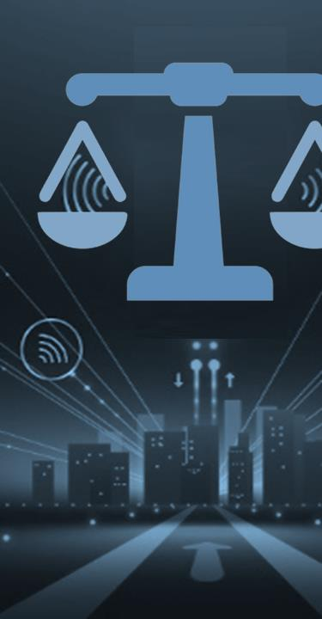
Lecture
07
BE UPDATED ON IOT DEVELOPMENTS
As digital law professionals, it is crucial to stay abreast of the rapidly evolving landscape of the Internet of Things (IoT) by exploring effective strategies for staying informed about the latest developments in the world of IoT, ensuring that we are well-equipped to address legal challenges, and protect consumers' privacy in this dynamic environment.
www.midocean.ae

Slide 36
Lecture
07
BE UPDATED ON IOT DEVELOPMENTS
Engaging with Industry Conferences and Events:
Participating in IoT-focused conferences, symposiums, and workshops provides a valuable opportunity to gain insights from industry experts, researchers, and policymakers. These events offer the latest updates on IoT technologies, privacy regulations, and emerging trends, enabling digital law professionals to be at the forefront of IoT developments.
www.midocean.ae

Slide 37
Lecture
07
BE UPDATED ON IOT DEVELOPMENTS
Following IoT Thought Leaders and Experts:
Actively following thought leaders, experts, and organizations specializing in IoT can provide a steady stream of information and analysis. Subscribing to blogs, newsletters, and social media accounts of reputable sources offers a continuous flow of valuable content on IoT advancements, legal implications, and best practices.
www.midocean.ae

Slide 38
Lecture
07
BE UPDATED ON IOT DEVELOPMENTS
Continuous Professional Development and Training:
As IoT technology evolves, it is essential for digital law professionals to continually update their knowledge and skills. Enrolling in specialized courses, workshops, and certifications related to IoT and privacy law ensures that professionals stay up-to-date with the latest developments and legal frameworks.
www.midocean.ae

Slide 39
Lecture
07
BE UPDATED ON IOT DEVELOPMENTS
Monitoring Regulatory Updates and Guidelines:
The legal landscape surrounding IoT is continually evolving with new regulations and guidelines. Digital law professionals should regularly monitor updates from regulatory bodies and government agencies concerning data protection, cybersecurity, and consumer privacy.
www.midocean.ae

Slide 40
Lecture
07
BE UPDATED ON IOT DEVELOPMENTS
Collaborating with Technology Experts:
Establishing partnerships with technology experts and professionals in the IoT industry can offer invaluable insights. Engaging in cross-disciplinary discussions and collaboration helps digital law professionals comprehend the technical aspects of IoT, enabling them to address legal issues more effectively.
www.midocean.ae

Slide 41
Lecture
07
Conclusion
In conclusion, the Internet of Things (IoT) has become an integral part of our daily lives, with an expansive array of devices and applications transforming various industries. However, this rapid proliferation raises significant challenges regarding consumer privacy and data security.
www.midocean.ae

Slide 42
Lecture
07
Conclusion
As digital law professionals, it is crucial to proactively address these issues by advocating for strong privacy regulations, staying informed about IoT developments through conferences and thought leaders, and engaging in continuous professional development. By embracing responsible practices, we can harness the potential of IoT while safeguarding individuals' privacy rights in this dynamic and ever-evolving landscape.
www.midocean.ae

Slide 43



Thank You

