Slide 1



Accounting for
Managers
Prepared by Dr. Sara Ahmed
MGM341
Lecture 4

Slide 2



Chapter 3: Job Costing
Lecture 4
Prepared by
Dr. Sara Ahmed

Slide 3


Chapter
Learning Objectives
03
What is meant by Job costing
Understand the flow of production and how direct materials and direct labor are traced to jobs
Compute a predetermined manufacturing overhead rate and use it to allocate MOH to jobs
Determine the cost of a job
How to dispose over-allocated or under-allocated manufacturing overhead

Slide 4
Chapter
03
Job Order Costing: An Overview
Job-order costing systems are used when:
Many different products are produced each period.
Products are manufactured to order. Many service industries use job-order costing.
The unique nature of each order requires tracing and allocating costs to each job and maintaining cost records for each job.

Slide 5
Chapter
03
Job Order Costing: An Overview
Examples of companies that
would use job-order costing include:
Boeing (aircraft manufacturing)
Bechtel International (large scale construction)
Walt Disney Studios (movie production)

Slide 6
Chapter
03
Job Order Costing-Cost Flow 1
Direct Costs
Charge direct material and direct labor costs to each job as work is performed.
Direct Materials
Job No. 1
Direct Labor
Job No. 2
Job No. 3

Slide 7
Chapter
03
Job Order Costing-Cost Flow 2
Manufacturing Overhead, including indirect materials and indirect labor, are allocated to all jobs rather than directly traced to each job.
Direct Costs
Direct Materials
Job No. 1
Direct Labor
Job No. 2
Indirect Costs
Manufacturing Overhead
Job No. 3

Slide 8
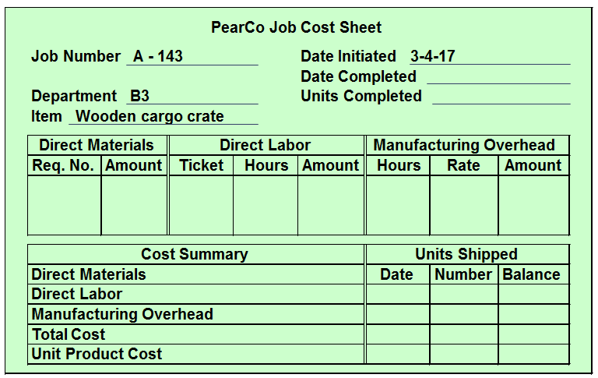
Chapter
03
Job Cost Sheet

Slide 9
Chapter
03
Measuring Direct Materials Cost

Slide 10
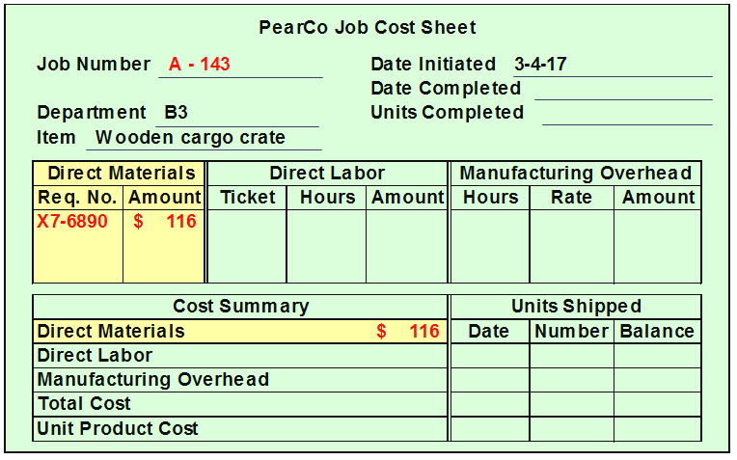
Chapter
03
Measuring Direct Materials Cost

Slide 11
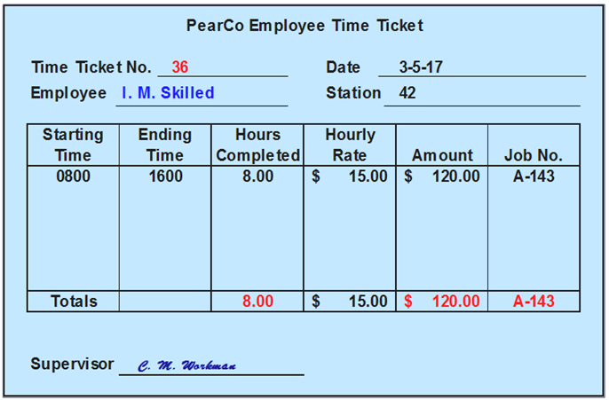
Chapter
03
Measuring Direct Labor Costs

Slide 12
Chapter
03
Job Order Costing

Slide 13
Chapter
03
Allocation of Manufacturing Overhead
Compute a predetermined overhead rate.

Slide 14
Chapter
03
Why Use an Allocation Base?
An allocation base, such as direct labor-hours, direct labor-dollars, or machine-hours, is used to assign manufacturing overhead to individual jobs.
We use an allocation base because:
It is impossible or difficult to trace overhead costs to particular jobs.
Manufacturing overhead consists of many different items ranging from the grease used in machines to the production manager’s salary.
Many types of manufacturing overhead costs are fixed even though output fluctuates during the period.

Slide 15
Chapter
Manufacturing Overhead Application/Allocation
03
The predetermined overhead rate (POHR) used to apply overhead to jobs is determined before the period begins.
Estimated total manufacturing
overhead cost for the coming period
POHR =
Estimated total units in the
allocation base for the coming period
Ideally, the allocation base is a cost driver that causes overhead.

Slide 16
Chapter
03
The need for POHR
Predetermined overhead rates that rely upon estimated data are often used because:
Actual overhead for the period is not
known until the end of the period, thus inhibiting the ability to estimate job costs during the period.
Actual overhead costs can fluctuate seasonally, thus misleading decision makers.

Slide 17
Chapter
03
Computing Predetermined Overhead Rate (POHR)
The predetermined overhead rate is computed before the period begins using a four-step process.
Estimate the total amount of the allocation base (the denominator) that will be required for next period’s estimated level of production.
Estimate the total fixed manufacturing overhead cost for the coming period and the variable manufacturing overhead cost per unit of the allocation base.

Slide 18
Chapter
03
Computing Predetermined Overhead Rate (POHR)
Use the following equation to estimate the total amount of manufacturing overhead:
Compute the predetermined overhead rate.
Y = a + bX
Where,
Y = The estimated total manufacturing overhead cost
a = The estimated total fixed manufacturing overhead cost
b = The estimated variable manufacturing overhead cost
per unit of the allocation base
X = The estimated total amount of the allocation base.

Slide 19
Chapter
03
Overhead Application
Apply overhead cost to jobs using a predetermined overhead rate.

Slide 20
Chapter
03
Overhead Application Rate
PearCo estimates that it will require 160,000 direct labor-hours to meet the coming period’s estimated production level. In addition, the company estimates total fixed manufacturing overhead at $200,000, and variable manufacturing overhead costs of $2.75 per direct labor-hour.
Y = a + bX
Y = $200,000 + ($2.75 per direct labor-hour × 160,000 direct labor-hours)
Y = $200,000 + $440,000
Y = $640,000
$640,000 estimated total manufacturing overhead
POHR =
160,000 estimated direct labor hours (DLH)
POHR = $4.00 per direct labor-hour

Slide 21
Chapter
Recording manufacturing Overhead
03

Slide 22
Chapter
03
Unit Product Cost Calculation
Compute the total cost and the unit product cost of a job using a plantwide predetermined overhead rate.

Slide 23
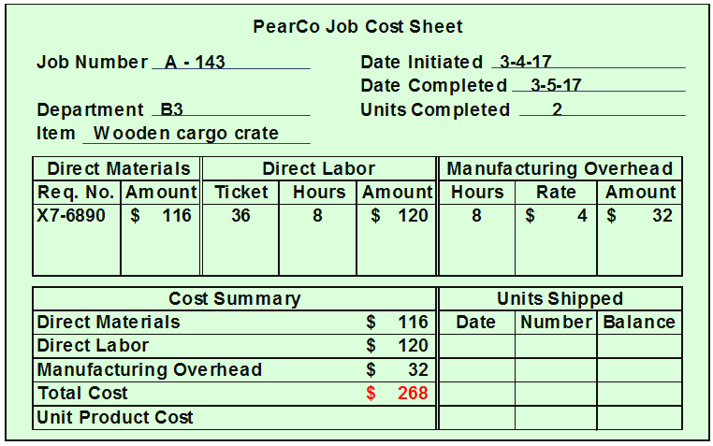
Chapter
03
Calculating TOTLAL Cost of a Job

Slide 24
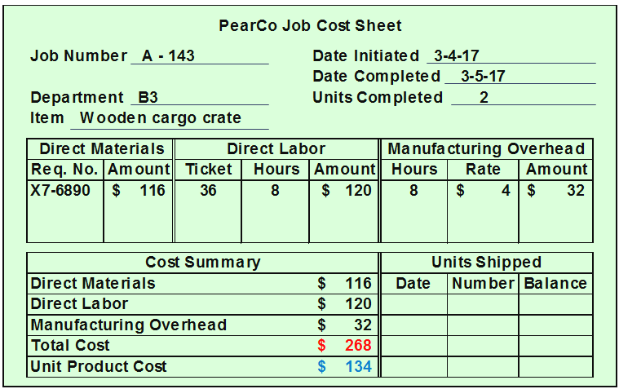
Chapter
03
Calculating Unit Product Cost

Slide 25
Chapter
03
Concept Check
Job WR53 at NW Fab, Inc. required $200 of direct materials and 10 direct labor-hours at $15 per hour. Estimated total overhead for the year was $760,000 and estimated direct-labor hours were 20,000. What would be recorded as the cost of job WR53?
  a. $200.
  b. $350.
  c. $380.
  d. $730.

Slide 26
Chapter
03
Concept Check
Job WR53 at NW Fab, Inc. required $200 of direct materials and 10 direct labor-hours at $15 per hour. Estimated total overhead for the year was $760,000 and estimated direct labor hours were 20,000. What would be recorded as the cost of job WR53?
  a. $200.
  b. $350.
  c. $380.
  d. $730.

Slide 27
Chapter
03
Job Order Costing: A Managerial Perspective
Inaccurately assigning manufacturing costs to jobs adversely influences planning and decisions made by manager.
Job-order costing systems can accurately trace direct materials and direct labor costs to jobs.
Job-order costing systems often fail to accurately allocate the manufacturing overhead costs used during the production process to their respective jobs.

Slide 28
Chapter
03
Job Order Costing: A Managerial Perspective
  Choosing an Allocation Base
  Job-order costing systems often use allocation bases that do not reflect how jobs actually use overhead resources. The allocation base in the predetermined overhead rate must drive the overhead cost to improve job cost accuracy. A cost driver is a factor that causes overhead costs.

Slide 29
Chapter
03
Job Order Costing: A Managerial Perspective
  Many companies use a single predetermined plantwide overhead rate to allocate all manufacturing overhead costs to jobs based on their usage of direct labor-hours.
  It is often overly-simplistic and incorrect to assume that direct labor-hours is a company’s only manufacturing overhead cost driver.
  If more than one overhead cost driver can be identified, job cost accuracy is improved by using multiple predetermined overhead rates.

Slide 30
Chapter
03
Multiple Overhead Rates
Compute the total cost and the unit product cost of a job using multiple predetermined overhead rates.

Slide 31
Chapter
03
Information to Calculate multiple Predetermined Overhead Rates
Dickson Company has two production departments, Milling and Assembly. The company uses a job-order costing system and computes a predetermined overhead rate in each production department. The predetermined overhead rate in the Milling Department is based on machine-hours and in the Assembly Department it is based on direct labor-hours. The company uses cost-plus pricing (and a markup percentage of 75% of total manufacturing cost) to establish selling prices for all of its jobs. At the beginning of the year, the company made the following estimates:

Slide 32
Chapter
03
Information to Calculate multiple Predetermined Overhead Rates
 | Department
 | Milling | Assembly
Machine-hours…………………………………………………………. | 60,000 | 3,000
Direct labor-hours……………………………………………………… | 8,000 | 80,000
Total fixed manufacturing overhead cost……………………………… | $ 390,000 | $ 500,000
Variable manufacturing overhead per machine-hour………………….. | $ 2.00 | –
Variable manufacturing overhead per direct labor-hour………………. | – | $ 3.75

Slide 33
Chapter
03
Step 1 – Calculate the Predetermined Overhead Cost for Each Department
During the current month the company started and completed Job 407. It wants to use its predetermined departmental overhead cost and rate for the Milling and Assembly Departments.
Milling Department = $390,000 + ($2.00 per MH × 60,000 MHs) = $510,000
Assembly Department = $500,000 + ($3.75 per DLH × 80,000 DLHs) = $800,000

Slide 34
Chapter
03
Step 2 – Calculate the Predetermined Overhead Rate for Each Department
Use the amounts determined on the previous slide to calculate the predetermined overhead rate (POHR) of each department.
Milling Department = $510,000 ÷ 60,000 MHs = $8.50 per MH
Assembly Department = $800,000 ÷ 80,000 DLHs = $10.00 per DLH

Slide 35
Chapter
03
Step 3 – Calculate the Amount of Overhead Applied from Both Departments to a Job
Use the POR calculated on the previous slide to determine the overhead applied from both departments to Job 407:
Milling Department = 90 MHs × $8.50 per MH = $765
Assembly Department = 20 DLHs × $10 per DLH = $200
Job 407 | Department
 | Milling | Assembly
Machine-hours……….. | 90 | 4
Direct labor-hours……. | 5 | 20
Direct materials………. | $ 800 | $ 370
Direct labor cost……… | $ 70 | $ 280

Slide 36
Chapter
03
Step 4 – Calculate the Total Job Cost for Job 407
We can use the information given to calculate the amount of the total cost of Job 407. Here is the calculation:
 | Milling | Assembly | Total
Direct materials…………………………………………… | $ 800 | $ 370 | $ 1,170
Direct labor……………………………………………….. | $ 70 | $ 280 | 350
Manufacturing overhead applied………………….. | $ 765 | $ 200 | 965
Total cost of Job 407………………………………. |  |  | $ 2,485

Slide 37
Chapter
03
Step 5 – Calculate the Selling Price for Job 407
(1 of 2)
Here is the selling price of Job 407 assuming a 75% markup:
Total cost of Job 407………….. | $ 2,485.00
Markup ($2,485 × 75%)……... | 1,863.75
Selling price of Job 407………. | $ 4,348.75

Slide 38
Chapter
03
Step 5 – Calculate the Selling Price for Job 407 (2 of 2)
It is important to emphasize that using a departmental approach to overhead application results in a different selling price for Job 407 than would have been derived using a plantwide overhead rate based on either direct labor-hours or machine-hours.
The appeal of using predetermined departmental overhead rates is that they presumably provide a more accurate accounting of the costs caused by jobs, which in turn, should enhance management planning and decision making.

Slide 39
Chapter
03
Multiple Predetermined Overhead Rates—An Activity-Based Approach
When a company creates overhead rates based on the activities that it performs, it is employing an approach called activity-based costing.
Activity-based costing is an alternative approach to developing multiple predetermined overhead rates. Managers use activity-based costing systems to more accurately measure the demands that jobs, products, customers, and other cost objects make on overhead resources.

Slide 40
Chapter
03
Job-Order Costing for Financial Statements to External Parties
The amount of overhead applied to all jobs during a period will differ from the actual amount of overhead costs incurred during the period.
When a company applies less overhead to production than it actually incurs, it creates what is known as underapplied overhead.
When it applies more overhead to production than it actually incurs, it results in overapplied overhead.

Slide 41
Chapter
03
Financial Adjustment for Overhead Applied
The cost of goods sold reported on a company’s income statement must be adjusted to reflect underapplied or overapplied overhead.
The adjustment for underapplied overhead increases cost of goods sold and decreases net operating income.
The adjustment for overapplied overhead decreases cost of goods sold and increases net operating income.

Slide 42
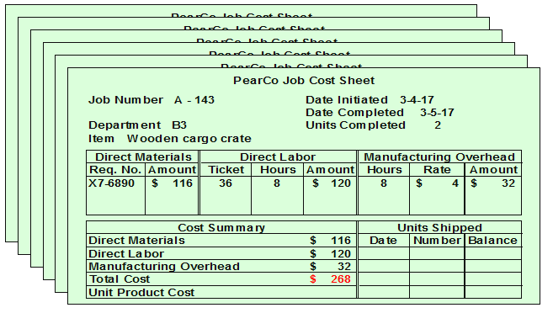
Chapter
03
Job Cost Sheets: A Subsidiary Ledger
All of a company’s job cost sheets collectively form a subsidiary ledger.

Slide 43
Chapter
03
Job Cost Sheets: Balance Sheet Reporting (1 of 2)
The job costs sheets provide an underlying set of financial records that explain what specific jobs comprise the amounts reported in Work-in-Process and Finished Goods on the balance sheet.

Slide 44
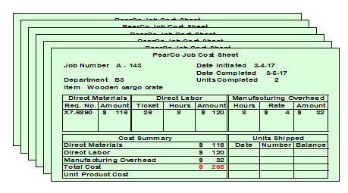
Chapter
03
Job Cost Sheets: Balance Sheet Reporting (2 of 2)

Slide 45
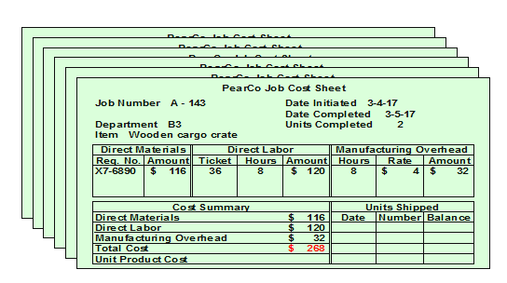
Chapter
03
Job Cost Sheets: Income Statement Reporting (2 of 2)

Slide 46
Chapter
03
Job Cost Sheets: Income Statement Reporting (1 of 2)
The job costs sheets provide an underlying set of financial records that explain what specific jobs comprise the amounts reported in Cost of Goods Sold on the income statement.

Slide 47
Chapter
03
Job-Order Costing in
Service Companies
Although out attention has focused upon manufacturing applications, it bears re-emphasizing that job-order costing is also used in service industries.
Job-order costing is used in many different types of service companies such as law firms, accounting firms, and medical treatment.

Slide 48
Which of the following is the correct formula to compute the predetermined overhead rate?
A) Predetermined overhead rate = Estimated total units in the allocation base ÷ Estimated total manufacturing overhead costs
B) Predetermined overhead rate = Estimated total manufacturing overhead costs ÷ Estimated total units in the allocation base
C) Predetermined overhead rate = Actual total manufacturing overhead costs ÷ Estimated total units in the allocation base
D) Predetermined overhead rate = Estimated total manufacturing overhead costs ÷ Actual total units in the allocation base.

Slide 49
Which of the following is the correct formula to compute the predetermined overhead rate?
A) Predetermined overhead rate = Estimated total units in the allocation base ÷ Estimated total manufacturing overhead costs
B) Predetermined overhead rate = Estimated total manufacturing overhead costs ÷ Estimated total units in the allocation base
C) Predetermined overhead rate = Actual total manufacturing overhead costs ÷ Estimated total units in the allocation base
D) Predetermined overhead rate = Estimated total manufacturing overhead costs ÷ Actual total units in the allocation base.

Slide 50
Steele Corporation uses a predetermined overhead rate based on machine-hours to apply manufacturing overhead to jobs. Steele Corporation has provided the following estimated costs for next year:
Direct materials | $ | 20,000
Direct labor | $ | 60,000
Sales commissions | $ | 80,000
Salary of production supervisor | $ | 40,000
Indirect materials | $ | 8,000
Advertising expense | $ | 16,000
Rent on factory equipment | $ | 20,000

Slide 51
Steele estimates that 10,000 direct labor-hours and 16,000 machine-hours will be worked during the year. The predetermined overhead rate per hour will be:
A) $4.25
B) $8.00
C) $9.00
D) $10.25

Slide 52
Predetermined overhead rate = Estimated total manufacturing overhead ÷ Estimated total amount of the allocation base
Predetermined overhead rate = $68,000 ÷ 16,000 machine-hours = $4.25 per machine-hour
Salary of production supervisor | $ | 40,000
Indirect materials |  | 8,000
Rent on factory equipment |  | 20,000
Manufacturing overhead | $ | 68,000

Slide 53
Steele estimates that 10,000 direct labor-hours and 16,000 machine-hours will be worked during the year. The predetermined overhead rate per hour will be:
A) $4.25
B) $8.00
C) $9.00
D) $10.25

Slide 54
Helland Corporation uses a job-order costing system with a single plantwide predetermined overhead rate based on direct labor-hours. The company based its predetermined overhead rate for the current year on the following data:
Total direct labor-hours |  | 30,000
Total fixed manufacturing overhead cost | $ | 189,000
Variable manufacturing overhead per direct labor-hour | $ | 2.50

Slide 55
The predetermined overhead rate is closest to:
A) $2.50 per direct labor-hour
B) $11.30 per direct labor-hour
C) $6.30 per direct labor-hour
D) $8.80 per direct labor-hour

Slide 56
Explanation: Estimated total manufacturing overhead cost = Estimated total fixed manufacturing overhead cost + (Estimated variable overhead cost per unit of the allocation base × Estimated total amount of the allocation base) = $189,000 + ($2.50 per direct labor-hour × 30,000 direct labor-hours) = $189,000 + $75,000 = $264,000
Predetermined overhead rate = Estimated total manufacturing overhead cost ÷ Estimated total amount of the allocation base = $264,000 ÷ 30,000 direct labor-hours = $8.80 per direct labor-hour

Slide 57
The predetermined overhead rate is closest to:
A) $2.50 per direct labor-hour
B) $11.30 per direct labor-hour
C) $6.30 per direct labor-hour
D) $8.80 per direct labor-hour

Slide 58


Thank You

