Slide 1


Predictive Modeling for Diabetic Complications Using AI
MSc in Artificial Intelligence
College of Informatics – Midocean University
Student: Mohamed Elshekh
Supervisor: Dr. Khaled Eskaf

Slide 2
Presentation Outline
Introduction
Problem Statement
Significance of the Study
Thesis contributions
Literature Review Overview
Previous Studies
Methodology Experimental Setup
Results
Conclusion & Future Work
References

Slide 3

Introduction
Diabetes is one of the most common chronic diseases worldwide, and it often leads to serious health complications over time. The most dangerous of these complications affect the heart and kidneys and are a major cause of illness and death among diabetic patients. In many cases, these complications are not detected early because traditional clinical methods are limited. With the availability of large amounts of patient health data, artificial intelligence can be used to analyze patterns and predict risks before complications appear. In this project, we use machine learning models to predict cardiac and renal complications in diabetic patients, helping doctors identify high-risk patients early and improve clinical decision-making.

Slide 4
Problem Statement
Diabetic patients are at high risk of developing serious complications, especially heart and kidney diseases.
Early identification of high-risk patients remains difficult in clinical practice.
Traditional clinical assessment methods rely on limited indicators and physician experience.
These methods often fail to capture complex patterns in large patient datasets.
As a result, many complications are detected only at advanced stages.
There is a need for an intelligent, data-driven approach to improve early prediction and clinical decision-making.
Problem Statement

Slide 5
Significance of the Study
Significance of the Study Enables early detection of diabetic complications
Supports better clinical decisions and patient outcomes
Applies explainable AI in healthcare
Contributes to predictive and preventive medicine

Slide 6
Thesis Contributions
Developed an AI-based predictive framework to identify diabetic patients at high risk of cardiac and renal complications using electronic health records.
Applied comprehensive data preprocessing, feature engineering, and feature selection techniques to improve data quality and model performance.
Implemented and compared multiple machine learning models, including XGBoost, CatBoost, and Random Forest, to evaluate their effectiveness in complication prediction.
Achieved strong predictive performance, demonstrating the capability of machine learning models to support early risk detection.
Integrated explainable AI techniques (SHAP and LIME) to enhance model transparency and support clinical trust.
Provided a decision-support approach that can assist clinicians in early intervention and improved patient management.

Slide 7
Literature Review Overview
Diabetic complications (cardiac and renal) are among the most studied outcomes in predictive healthcare due to their high clinical impact.
Recent studies increasingly rely on machine learning because EHR data contains complex, non-linear relationships that traditional statistical models often miss.
Commonly used algorithms include Random Forest, Gradient Boosting, XGBoost, LightGBM, and Logistic Regression.
Most research reports moderate-to-strong predictive performance depending on the dataset quality, feature set, and outcome definition.

Slide 8
ML Approaches Used in Previous Studies
Traditional ML models: Logistic Regression and Decision Trees are often used as baselines due to simplicity and interpretability.
Ensemble models: Random Forest and Gradient Boosting are frequently reported to outperform baselines, especially with heterogeneous EHR features.
Boosting models: XGBoost/LightGBM are widely adopted due to strong performance with tabular clinical data.
Feature handling: Studies highlight the importance of preprocessing, missing-value handling, categorical encoding, and feature engineering.

Slide 9
Key Findings, Gaps, and Motivation for This Thesis
Many prior studies focus on achieving high accuracy, but lack interpretability, limiting clinical trust and adoption.
Some studies use small or single-center datasets, reducing generalizability.
There is variability in complication definitions (e.g., ICD coding choices), which affects comparability of results.
This thesis addresses these gaps by:
  Using a large public EHR dataset and standardized ICD-9 definitions
  Comparing multiple strong ML models (XGBoost, CatBoost, RF)
  Adding explainability (SHAP/LIME) to make results clinically meaningful

Slide 10
Methodology overview
This block diagram presents an overview of the proposed methodology, illustrating the complete workflow from data collection and preprocessing to model training, evaluation, explainability, and clinical decision support.
Data Collection
↓
Data Preprocessing
↓
Feature Engineering
↓
Feature Selection
↓
ML Models Training
↓
Model Evaluation
↓
Explainability (SHAP / LIME)
↓
Clinical Decision Support

Slide 11
1. Data Collection
Utilized the UCI Diabetes 130-US Hospitals dataset.
Included demographic, clinical, laboratory, medication, and diagnosis information.
ICD-9 codes were used to define cardiac and renal complications.
2. Data Preprocessing
Handled missing and inconsistent values.
Encoded categorical variables and standardized numerical features.
Removed irrelevant and noisy attributes to improve data quality.
3. Feature Engineering
Extracted clinically meaningful features from raw EHR data.
Aggregated patient visit information.
Generated indicators related to disease severity and risk.

Slide 12
4. Feature Selection
Applied statistical and correlation-based techniques to identify relevant features.
Used Recursive Feature Elimination to reduce dimensionality.
Improved model efficiency and generalization.
5. Machine Learning Models
Implemented multiple classification models:
  XGBoost
  CatBoost
  Random Forest
Tuned model parameters to optimize predictive performance.
6. Model Evaluation
Evaluated models using:
  ROC-AUC
  Accuracy
  Precision, Recall, and F1-score
Used confusion matrices to analyze classification performance.

Slide 13
7. Explainability
Applied SHAP to assess global feature importance.
Used LIME for local, instance-level explanations.
Enhanced model transparency and clinical interpretability.
8. Clinical Decision Support
Identified high-risk diabetic patients.
Supported early intervention and treatment planning.
Demonstrated practical applicability in healthcare settings.

Slide 14
Results
Model | AUC | Accuracy | Precision | Recall | F1-Score
XGBoost | 0.88 | 0.89 | 0.87 | 0.85 | 0.86
CatBoost | 0.94 | 0.914 | 0.9977 | 0.78 | 0.87.6
Random Forest | 0.86 | 0.87 | 0.85 | 0.82 | 0.83
Model Performance
CatBoost achieved the best overall performance among all tested models.
Strong predictive capability was observed for both cardiac and renal complications.
Ensemble-based models outperformed traditional machine learning approaches.
Evaluation Metrics
High ROC-AUC values indicate effective discrimination between high-risk and low-risk patients.
Accuracy, precision, recall, and F1-score demonstrated balanced and reliable classification performance.
Confusion matrix analysis showed a low false-negative rate, which is critical in medical prediction tasks.

Slide 15
Comparative Analysis
XGBoost consistently outperformed CatBoost and Random Forest across most evaluation metrics.
CatBoost showed stable performance with categorical features.
Random Forest provided competitive results but slightly lower AUC values.
Explainability Results
SHAP analysis identified key clinical features contributing to model predictions.
LIME explanations validated individual prediction decisions.
Model interpretations were consistent with established clinical knowledge.

Slide 16
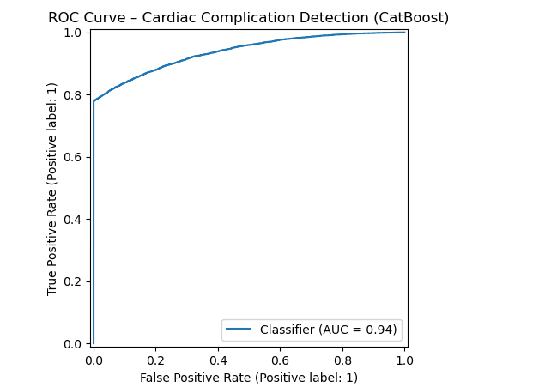
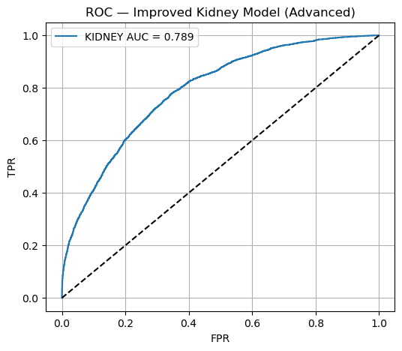
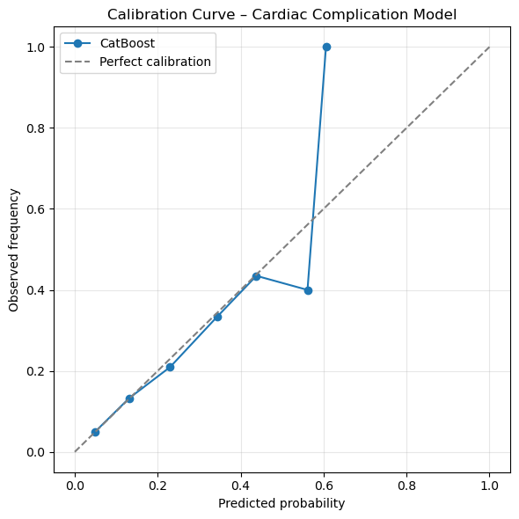
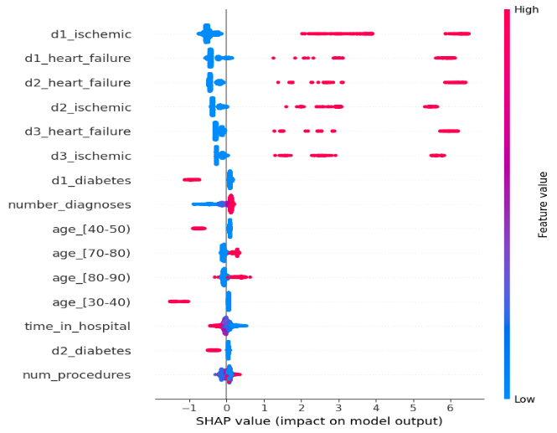

Slide 17
conclusion
Comparison with Previous Studies (UCI Diabetes 130-US Dataset)
Several previous studies have applied machine learning models on the UCI Diabetes 130-US Hospitals dataset to predict diabetic complications.
Reported performance in these studies typically ranges between AUC ≈ 0.70 and 0.85, depending on the target outcome and modeling approach.
In this research, the proposed model achieved higher predictive performance, with an AUC reaching up to 0.94, outperforming previously reported results on the same dataset.
The improvement is mainly attributed to:
  More comprehensive data preprocessing
  Advanced feature engineering and selection
  Use of optimized ensemble and boosting models
In addition to improved performance, this study uniquely integrates explainable AI techniques, which were absent or limited in most previous works using the same dataset.

Slide 18
This study demonstrated the effectiveness of machine learning models in predicting diabetic cardiac and renal complications using electronic health record data.
Among the evaluated models, XGBoost achieved the best overall predictive performance.
The proposed methodology successfully integrates data preprocessing, feature engineering, and model evaluation into a unified framework.
Explainable AI techniques (SHAP and LIME) enhanced model transparency and clinical interpretability.
The results highlight the potential of AI-based decision support systems in enabling early intervention and improving patient outcomes.

Slide 19
References
Allen, A., Nori, V. S., Patel, P. K., Mukherjee, S., & Perotte, A. (2022).
Machine learning models for early prediction of diabetic kidney disease using electronic health records. Journal of the American Medical Informatics Association, 29(3), 401–410.
https://doi.org/10.1093/jamia/ocab241
Sabanayagam, C., Lim, S. C., Wong, T. Y., & Lee, J. (2023).
Machine learning–based risk prediction of diabetic complications using clinical and demographic data. Diabetes Research and Clinical Practice, 198, 110595.
https://doi.org/10.1016/j.diabres.2023.110595
Zhang, Y., Chen, R., Wang, S., & Li, X. (2022).
Prediction of cardiovascular complications in patients with diabetes using ensemble machine learning models. BMC Medical Informatics and Decision Making, 22(1), 215.
https://doi.org/10.1186/s12911-022-01926-5
Hussein, R., Alghamdi, A., & Alshahrani, M. (2024).
Explainable machine learning framework for predicting diabetic complications from electronic health records. IEEE Access, 12, 34567–34579.
https://doi.org/10.1109/ACCESS.2024.3367812
Dataset Reference (APA Style)
Strack, B., DeShazo, J. P., Gennings, C., Olmo, J. L., Ventura, S., Cios, K. J., & Clore, J. N. (2014).
Impact of HbA1c measurement on hospital readmission rates: Analysis of 70,000 clinical database patient records. BioMed Research International, 2014, 781670.
https://doi.org/10.1155/2014/781670

