Slide 1


Accounting for Managers
Prepared by Dr. Emad Zaher
Assistant Professor of Accounting
MGM341
Lecture (9)
Standard costs & Balanced score card

Slide 2

Standard Costs and Balanced Scorecard
  Learning Objectives
  LO 1 Describe standard costs.
LO 2 Determine direct materials variances.
LO 3 Determine direct labor variances.
LO 4 Prepare variance reports and balanced scorecards.

Slide 3
Standard Costs
Distinguishing Between Standards and Budgets
Both standards and budgets are predetermined costs, and both contribute to management planning , control and performance evaluation .
There is a difference:
  A standard is a unit amount.
  A budget is a total amount.

Slide 4
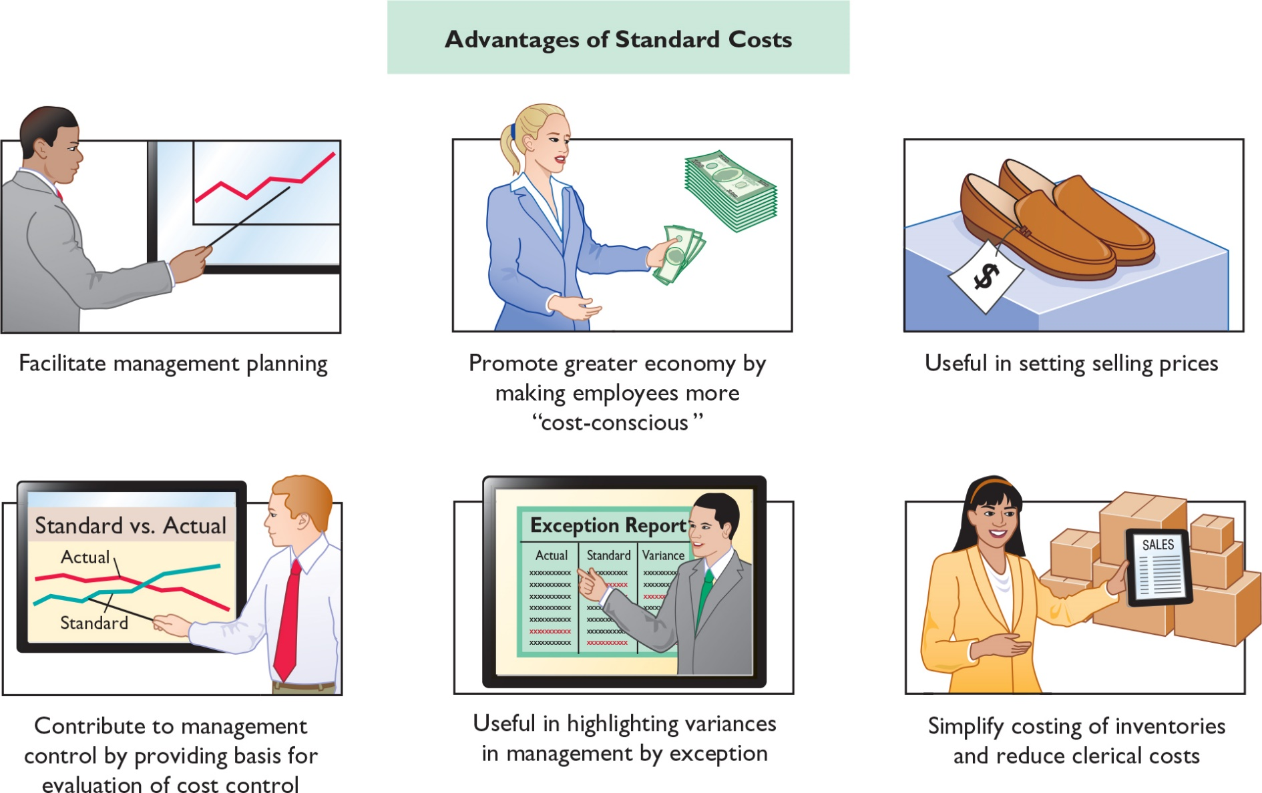
Advantages

Slide 5
Setting Standard Costs
Setting standard costs requires input from all persons who have responsibility for costs and quantities.
Standards should change whenever managers determine that the existing standard is not a good measure of performance.

Slide 6

Setting Standard Costs
    Ideal versus Normal Standards
    Companies set standards at one of two levels:
    Ideal standards represent optimum levels of performance under perfect operating conditions.
    Normal standards represent efficient levels of performance that are attainable under expected operating conditions.
Properly set, normal standards should be rigorous but attainable.

Slide 7
Setting Standard Costs
Question
Most companies that use standards set them at a(n):
  optimum level.
  ideal level.
  normal level.
  practical level.

Slide 8
Setting Standard Costs
A CASE STUDY
To establish the standard cost of producing a product, it is necessary to establish standards for each manufacturing cost element—
  direct materials,
  direct labor, and
  manufacturing overhead.
The standard for each element is derived from the standard price to be paid and the standard quantity to be used.

Slide 9
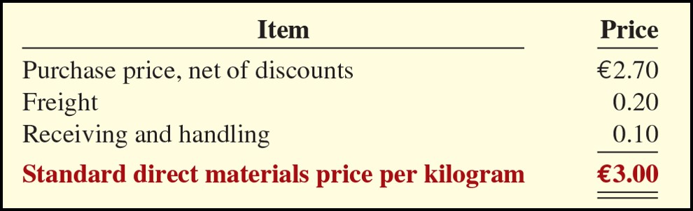
Setting Standard Costs
    Direct Materials
    Direct materials price standard is the cost per finished unit of direct materials that should be incurred.

Slide 10
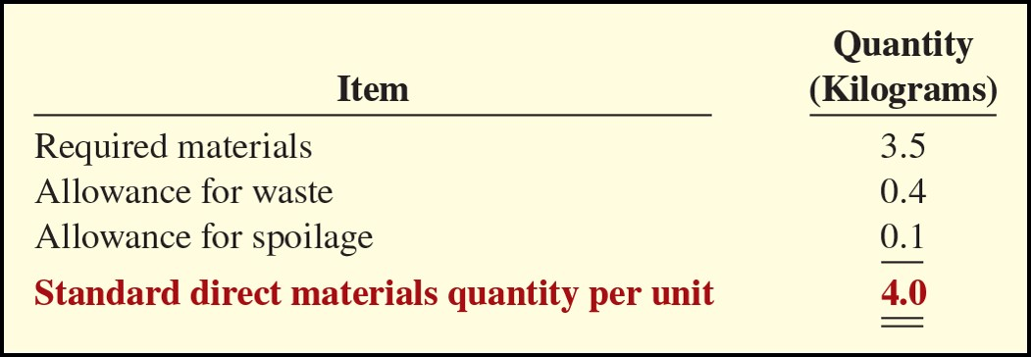
Setting Standard Costs
    Direct Materials
    The direct materials quantity standard is the quantity of direct materials that should be used per unit of finished goods.
Standard direct materials cost is €12.00 (€3.00 x 4.0 Kilograms).

Slide 11
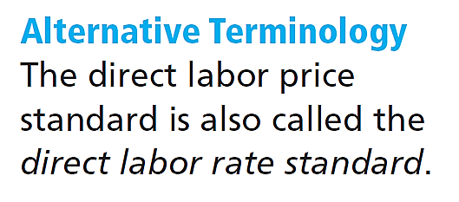
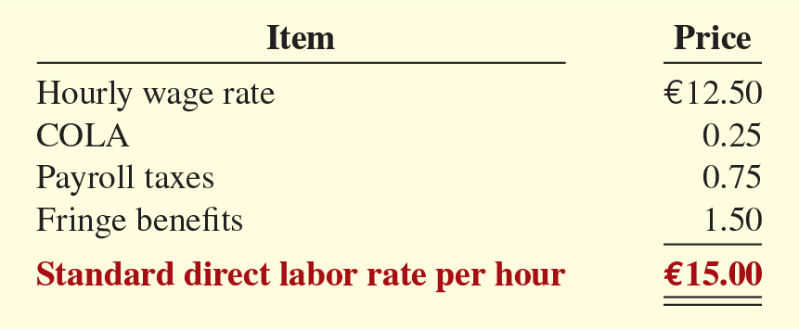
Setting Standard Costs
    Direct Labor
    The direct labor price standard is the rate per hour that should be incurred for direct labor (see Alternative Terminology).

Slide 12
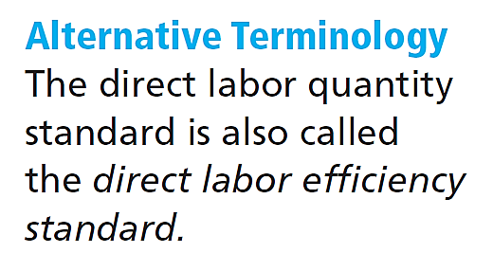
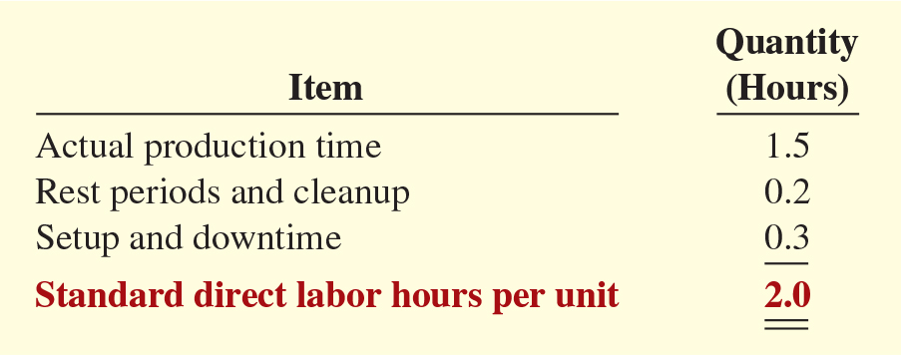
Setting Standard Costs
Direct Labor
ILLUSTRATION 26.5
Setting direct labor quantity standard
The direct labor quantity standard is the time that should be required to make one unit of the product (see Alternative Terminology).
The standard direct labor cost is €30 (€15.00 x 2.0 hours).

Slide 13
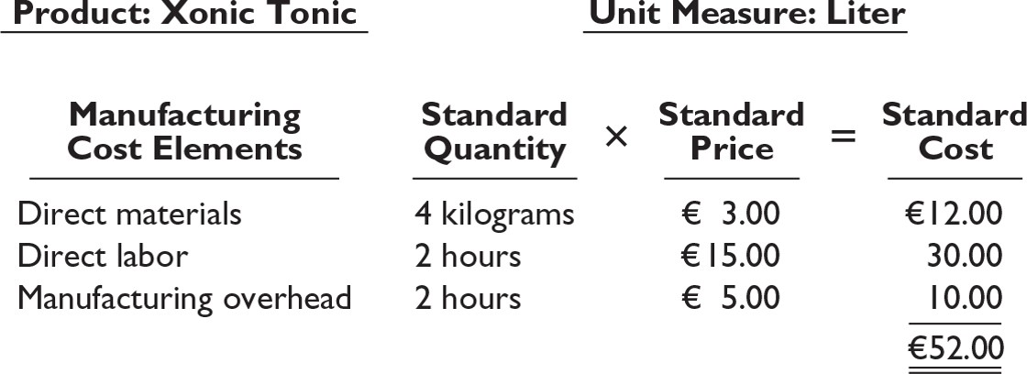
    Setting Standard Costs
Total Standard Cost Per Unit
The total standard cost per unit is the sum of the standard costs of direct materials, direct labor, and manufacturing overhead.
The total standard cost per liter

Slide 14
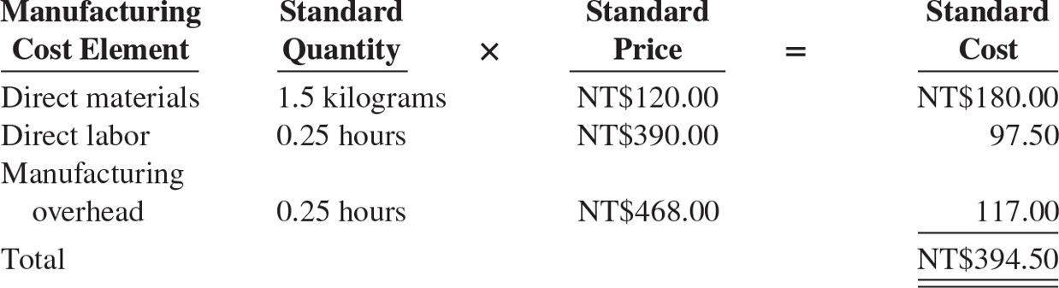
DO IT! 1 Standard Costs
Zafn Enterprises accumulated the following standard cost data concerning product Cty31.
  Direct materials per unit: 1.5 kilograms at NT$120 per kilogram.
  Direct labor per unit: 0.25 hours at NT$390 per hour.
  Manufacturing overhead: Predetermined rate is of NT$468 per direct labor hour.
Compute the standard cost of one unit of product Cty31.

Slide 15
Direct Materials Variances
In business, the term variance
is also used to indicate diff erences between total budgeted and total actual costs.
Analyzing and Reporting Variances
Variances are the differences between total actual costs and total standard costs (see Alternative Terminology).
variance= Actual costs - Standard costs.
Actual cost =
Standard cost =
Actual costs < Standard costs = Favorable variance.
Actual costs > Standard costs = Unfavorable variance.
Variance must be analyzed to determine the underlying factors.
Actual Quantity x Actual Price
(AQ) x (AP)
Standard Quantity x Standard Price
(SQ) x (SP)

Slide 16
Analyzing and Reporting Variances
Question
A variance is favorable if actual costs are:
  less than budgeted costs.
  less than standard costs.
  greater than budgeted costs.
  greater than standard costs

Slide 17
Analyzing and Reporting Variances
Direct Materials Variances
In completing the order for 1,000 liters of Tonic, Tonic used 4,200 kilograms of direct materials and the standard quantity is 4,000 kilograms of direct materials . These were purchased at a cost of €3.10 per unit. Standard price is €3.
Actual Quantity
x Actual Price
(AQ) x (AP)
-
Standard Quantity
x Standard Price
(SQ) x (SP)
=
Total Materials Variance
(TMV)
€13,020 (4,200 x €3.10)
-
€12,000 (4,000 x €3.00)
=
€1,020 U

Slide 18
Analyzing and Reporting Variances
Direct Materials Variances
Next, the company analyzes the total variance to determine the amount attributable to price (costs) and to quantity (use). The materials price variance is computed from the following formula.
Actual Quantity
x Actual Price
(AQ) x (AP)
Actual Quantity
x Standard Price
(AQ) x (SP)
Materials Price Variance
(MPV)
-
=
€13,020 (4,200 x €3.10)
-
€12,600 (4,200 x €3.00)
=
€420 U

Slide 19

Analyzing and Reporting Variances
Direct Materials Variances
The materials quantity variance is determined from the following formula.
Actual Quantity
x Standard Price
(AQ) x (SP)
Standard Quantity
x Standard Price
(SQ) x (SP)
Materials Quantity Variance
(MQV)
-
=
€12,600 (4,200 x €3.00)
-
€12,000 (4,000 x €3.00)
=
€600 U

Slide 20
Computing Direct Materials Variances
1
2
3
Actual Quantity
× Actual Price
(AQ) × (AP)
4,200 x €3.10 = €13,020
Actual Quantity
× Standard Price
(AQ) × (SP)
4,200 x €3.00 = €12,600
Standard Quantity
× Standard Price
(SQ) × (SP)
4,000 x €3.00 = €12,000
Price Variance
€13,020 – €12,600 = €420 U
Quantity Variance
€12,600 – €12,000 = €600 U
1
-
2
2
-
3
Total Materials Variance
€13,020 – €12,000 = €1,020 U
1
-
3

Slide 21
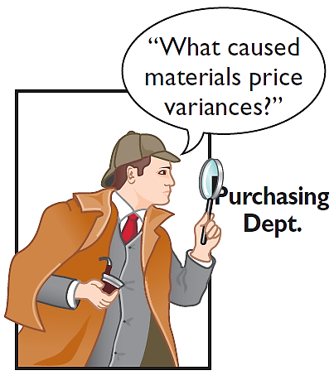
Analyzing and Reporting Variances
CAUSES OF MATERIALS VARIANCES
Materials price variance – factors that affect the price paid for raw materials include the
availability of quantity and cash discounts
quality of the materials requested
delivery method used.
To the extent that these factors are considered in setting the price standard, the purchasing department is responsible.

Slide 22
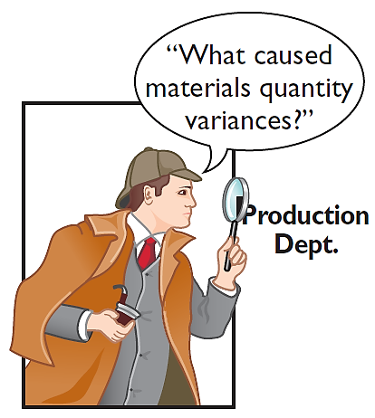
Analyzing and Reporting Variances
CAUSES OF MATERIALS VARIANCES
Materials quantity variance – if the variance is due to inexperienced workers, faulty machinery, or carelessness, the production department is responsible.

Slide 23
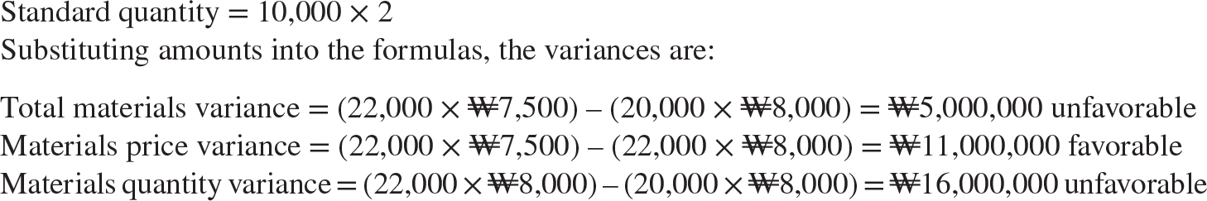
DO IT! 2 Direct Materials Variances
The standard cost of Wonder Walkers includes two units of direct materials at ₩8,000 per unit. During July, the company buys 22,000 units of direct materials at ₩7,500 and uses those materials to produce 10,000 units. Compute the total, price, and quantity variances for materials.

Slide 24
Direct Labor and Manufacturing Overhead Variances
Direct Labor Variances
In completing the Xonic Tonic order, Xonic incurred 2,100 direct labor hours at an average hourly rate of €14.80. The standard hours allowed for the units produced were 2,000 hours (1,000 liters x 2 hours). The standard labor rate was €15 per hour. The total labor variance is computed as follows.
Actual Hours
x Actual Rate
(AH) x (AR)
Standard Hours
x Standard Rate
(SH) x (SR)
Total Labor Variance
(TLV)
-
=
€31,080 (2,100 x €14.80)
-
€30,000 (2,000 x €15.00)
=
€1,080 U

Slide 25
Direct Labor Variances
Direct Labor Variances
Next, the company analyzes the total variance to determine the amount attributable to price (costs) and to quantity (use). The labor price variance is computed from the following formula.
Actual Hours
x Actual Rate
(AH) x (AR)
Actual Hours
x Standard Rate
(AH) x (SR)
Labor Price Variance
(LPV)
-
=
€31,080 (2,100 x €14.80)
-
€31,500 (2,100 x €15.00)
=
€420 F

Slide 26
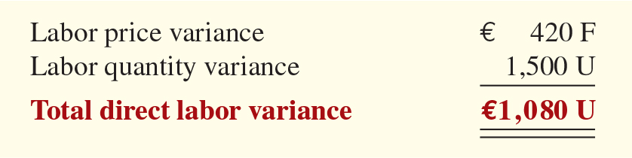
Analyzing and Reporting Variances
Direct Labor Variances
The labor quantity variance is determined from the following formula.
Actual Hours
x Standard Rate
(AH) x (SR)
Standard Hours
x Standard Rate
(SH) x (SR)
Labor Quantity Variance
(LQV)
-
=
€31,500 (2,100 x €15.00)
-
€30,000 (2,000 x €15.00)
=
€1,500 U

Slide 27
Analyzing and Reporting Variances
1
2
3
Actual Hours
× Actual Rate
(AH) × (AR)
2,100 x €14.80 = €31,080
Actual Hours
× Standard Rate
(AH) × (SR)
2,100 x €15.00 = €31,500
Standard Hours
× Standard Rate
(SH) × (SR)
2,000 x €15.00 = €30,000
Price Variance
€31,080 – €31,500 = €420 F
Quantity Variance
€31,500 – €30,000 = €1,500 U
1
-
2
2
-
3
Total Labor Variance
€31,080 – €30,000 = €1,080 U
1
-
3

Slide 28
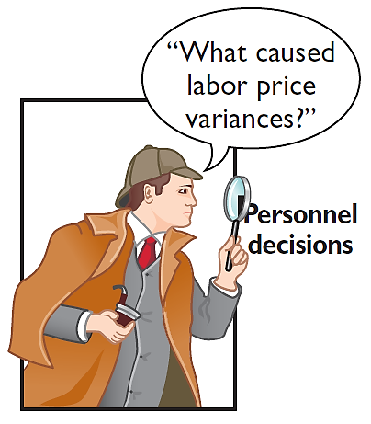
Analyzing and Reporting Variances
CAUSES OF LABOR VARIANCES
Labor price variance – usually results from two factors:
1. paying workers different wages than expected, and
2. misallocation of workers.
When workers are not unionized, the manager who authorized the wage increase is responsible for the higher wages.
Production department generally is responsible for labor price variances resulting from misallocation of the workforce.

Slide 29
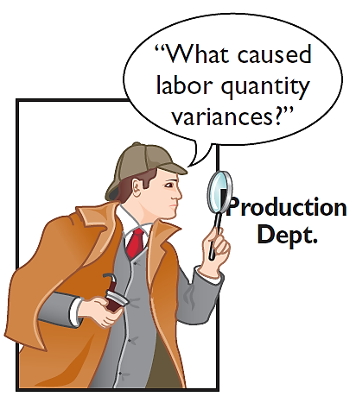
Analyzing and Reporting Variances
Causes of Labor Variances
Labor quantity variances
  Relates to the efficiency of workers.
  The cause of a quantity variance generally can be traced to the production department.

Slide 30
Variance Reports and Balanced Scorecards
Reporting Variances
  All variances should be reported to appropriate levels of management as soon as possible.
  The form, content, and frequency of variance reports vary considerably among companies.
  Facilitate the principle of “management by exception.”
  Top management normally looks for significant variances.

Slide 31
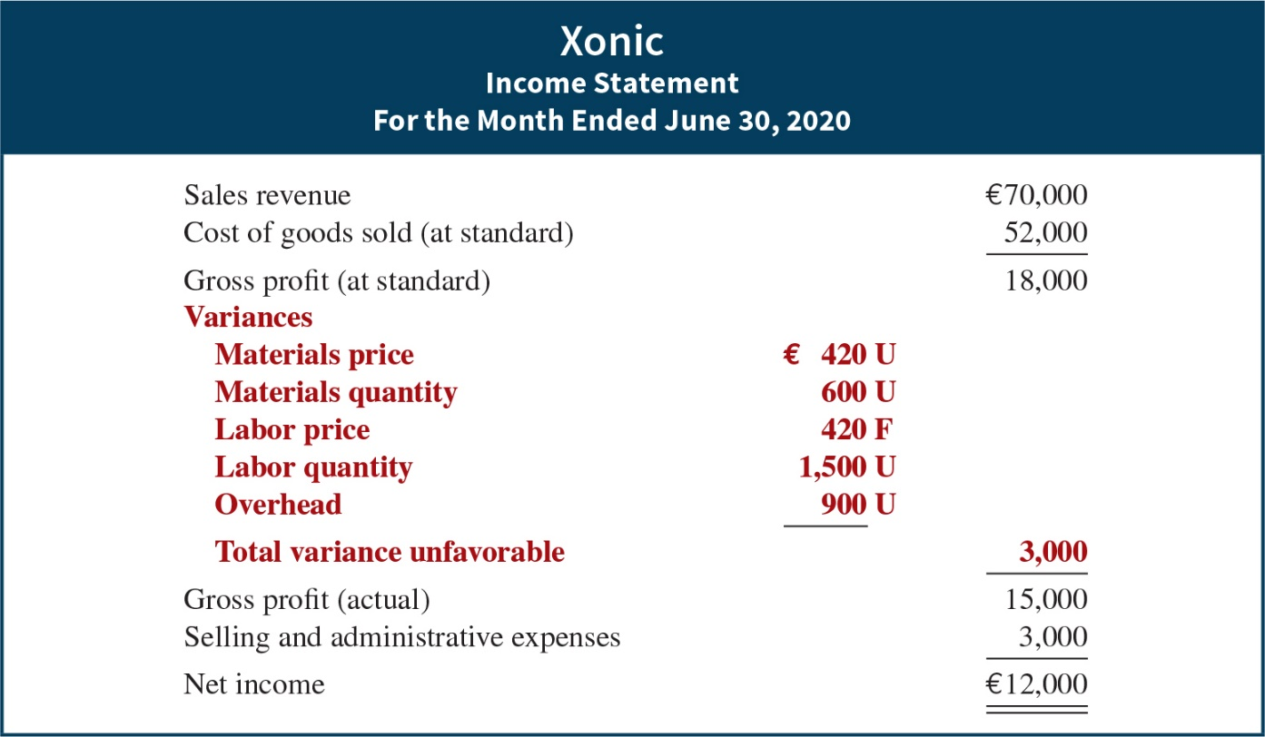
Analyzing and Reporting Variances
Income Statement Presentation of Variances
Illustration 26.27
In income statements prepared for management under a standard cost accounting system, cost of goods sold is stated at standard cost and the variances are disclosed separately.

Slide 32
Variance Reports
Question
Which of the following is incorrect about variance reports?
  They facilitate “management by exception.”
  They should only be sent to the top level of management.
  They should be prepared as soon as possible.
  They may vary in form, content, and frequency among companies.

Slide 33

Balanced Scorecard
The balanced scorecard incorporates financial and non-financial measures in an integrated system that links performance measurement and a company’s strategic goals.
The balanced scorecard evaluates company performance from a series of “perspectives.” The four most commonly employed perspectives are as follows.

Slide 34
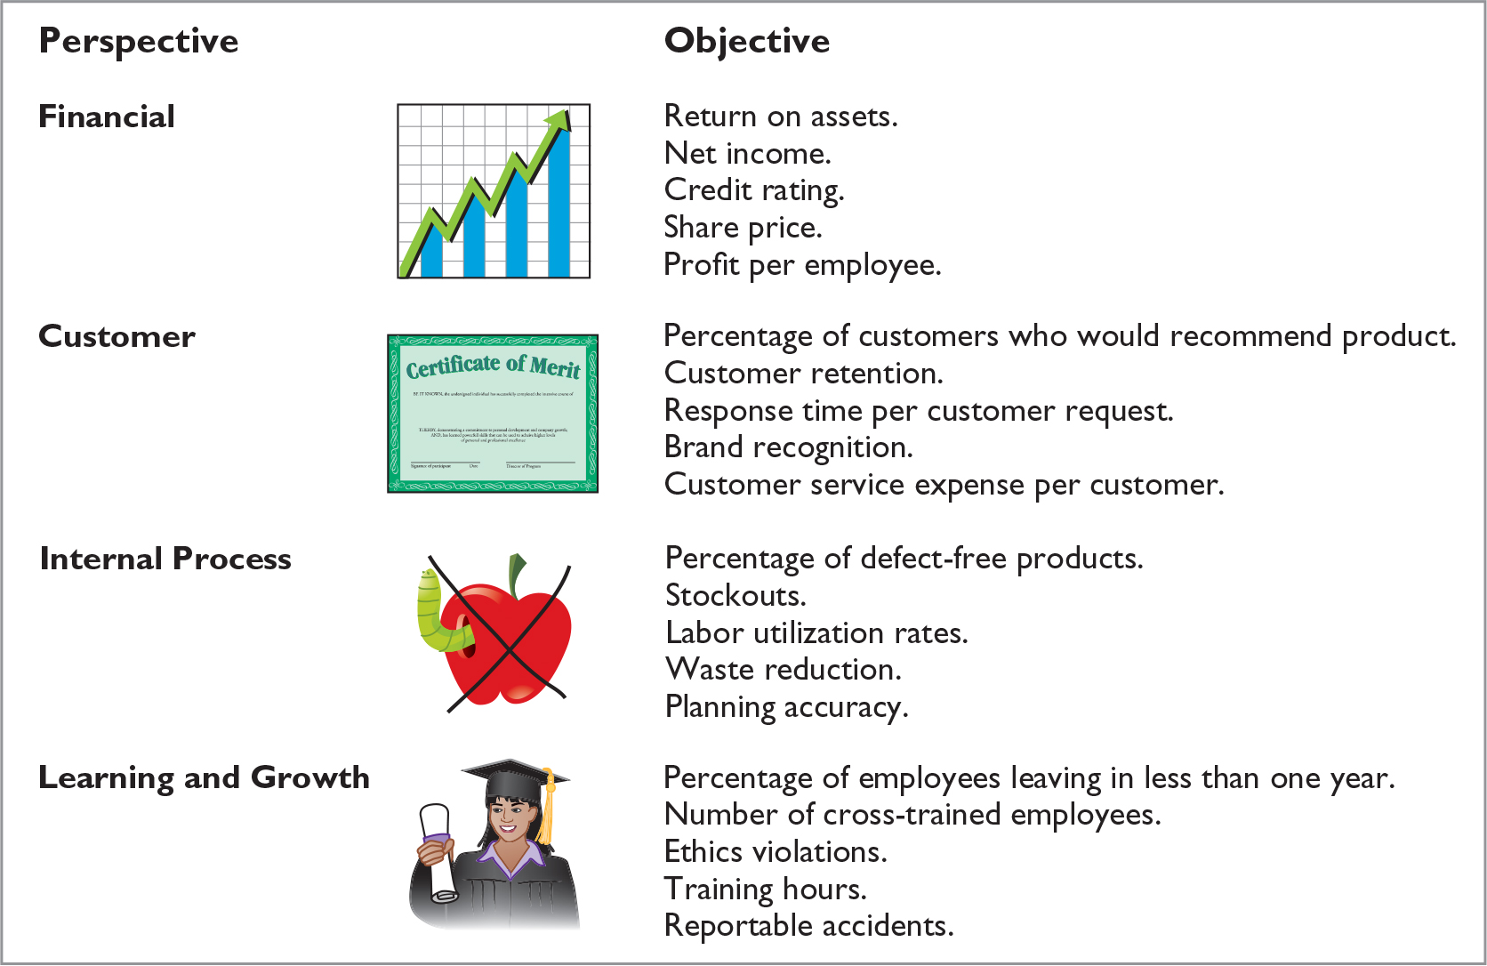

Slide 35
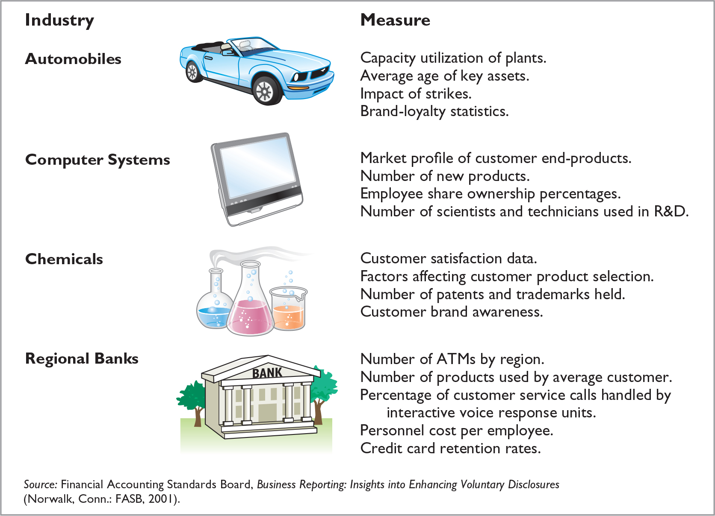

Slide 36
Balanced Scorecard
Question
Which of the following would not be an objective used in the customer perspective of the balanced scorecard approach?
  Percentage of customers who would recommend product to a friend.
  Customer retention.
  Brand recognition.
  Earnings per share.

Slide 37
Balanced Scorecard
In summary, the balanced scorecard does the following:
Employs both financial and non-financial measures.
Creates linkages so that high-level company goals can be communicated all the way down to the shop floor.
Provides measurable objectives for such non-financial measures such as product quality, rather than vague statements such as “We would like to improve quality.”
Integrates all of the company’s goals into a single performance measurement system, so that an inappropriate amount of weight will not be placed on any single goal.

Slide 38



Thank You

