Slide 1

Project Management Technologies
Prepared by Lecturer Waseem Tabbaa
Chapter 4 and 5
PMG 312
Picking the right projects and Gaining
support for a project

Slide 2

Chapter
04
Introduction
Section II: Project formulation using tools and techniques
Learning objectives.......................................................................................... 53
Overview........................................................................................................... 53
Chapter 4 Picking the right projects........................................................ 55
Introduction ...................................................................................................... 55
Financial decision models.......................................................................... 55
Feasibility study .......................................................................................... 55
Payback period ............................................................................................ 56
Net present value ........................................................................................ 57
Value driver analysis .................................................................................. 57
Depreciation and income tax..................................................................... 57
Nonfinancial decision models........................................................................ 58
Project questionnaire assessment............................................................. 58
Comparing different projects based on different criteria ..................... 60
Comparing different projects based on weighted criteria .................... 60
Summary........................................................................................................... 60
References ......................................................................................................... 62
Chapter 5 Gaining support for a project................................................. 63
Management approach.................................................................................... 63
Project manager................................................................................................ 64
Stakeholders...................................................................................................... 64
Project sponsor................................................................................................. 65
Project charter................................................................................................... 65
Background.................................................................................................. 68
Purpose......................................................................................................... 68
Deliverables.................................................................................................. 69
Budget........................................................................................................... 69
Team membership assumptions ............................................................... 69
Perceived risks ............................................................................................. 70
Project approval........................................................................................... 70
Summary........................................................................................................... 70
References ......................................................................................................... 71

Slide 3
Chapter
04
Introduction
Most organizations have many new project requests but not enough money, time, equipment, or resources available to implement all of them.
An organization needs to develop a selection process that is utilized consistently throughout the organization to pick the projects that are right or rather will most benefit the organization.
An organization’s resources are already scarce because they are currently implementing approved projects and/or supporting current systems.
Multiple goals frequently impose conflicting demands on resources. This requires a process for allocating resources based on organizational priorities. Organizational resources are limited!
Having a project review board with diverse backgrounds and skills is an efficient way to make sure an organization picks the right projects. Other approving entities may include the board of directors to approve a large project that implements some of the organization’s goals or an activation group that only takes on small projects (e.g., under 400 hours).
This chapter describes a significant set of common business factors and priorities to consider when approving a new project (Table 4.1).

Slide 4
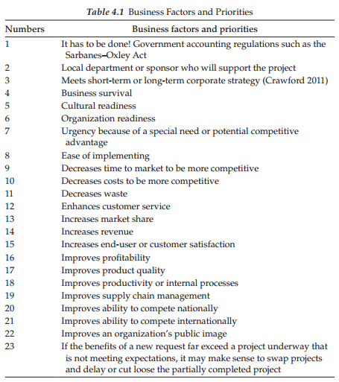
Chapter
04
Picking the right projects

Slide 5
Chapter
04
Picking the right projects
Financial decision models
  Many commercial cost-estimating tools are available that incorporate algorithms derived from hundreds of projects of various types.
  These algorithms correlate some project outcomes, such as effort or schedule, with factors such as product size, product characteristics, team productivity, team size, etc.
  The selected financial decision models should be created by the PM with stakeholder and sponsor input to determine whether the requested project is beneficial to the organization (Heldman 2011).
  The following models can be easily manipulated with Microsoft Excel:
    Feasibility study: Evaluate the overall costs and benefits to determine whether the project is worth pursuing, which would be a short or quick study. more detailed information will take it in L7 - Chapter 15.
    Payback period: Capital budgeting refers to the period of time required for the return on investment (ROI).
    Net present value (NPV): A time series of cash flows, both incoming and outgoing, which is the sum of the present values (PVs) of the individual cash flows.
    Value driver analysis: A financially driven process used to help focus on the trade-offs of success probability versus value for project analysis.
    Depreciation and income tax: Need to acquire capital assets that are depreciable for income tax purposes.

Slide 6
Chapter
04
B. Payback period
This method is reliable only if the returns are evenly distributed over the years and if the investments to be compared are equal in amount and have the same life estimates with little or no salvage values.
Assume an investment of $100,000 is expected to produce annual returns of $25,000 for 10 years. If you divide the $25,000 return into the $100,000 investment, then your payback period for the investment to be recovered is 4 years.
The ratio of the investment to the annual return is 4:1.
Expressed in another way, the unadjusted rate of return is 25% as follows: the $25,000 investment is divided by the $100,000 investment, which equals a 25% rate of return.

Slide 7
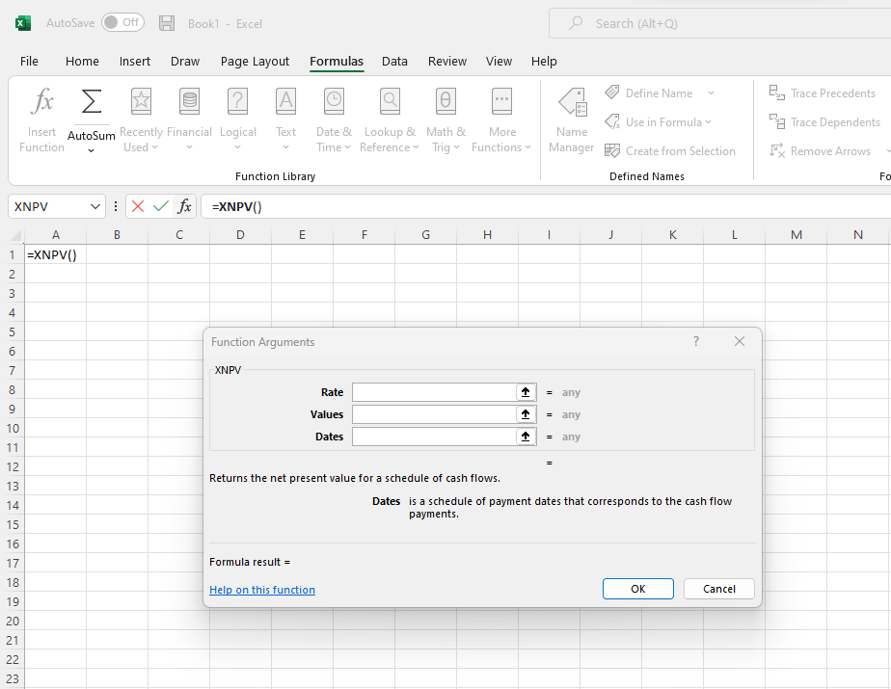
Chapter
04
C. Net present value
It gives a more accurate picture of financial performance than using the previously mentioned payback period (Biafore 2010).
For example, if the percentage of someone’s annual pay raise is less than the annual inflation rate, then it reduces what each paycheck dollar can buy.
A robust way of calculating the PV of returns is using Excel’s XNPV function found under the Formula tab—Insert Function and type XNPV in the search box and fill in the cell ranges for Rate, Values, and Dates. Click on the photo to play a YouTube for more details.

Slide 8
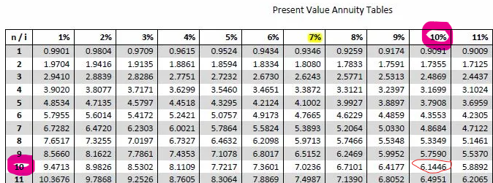
Chapter
04
C. Net present value
Again let us assume another investment is $100,000 and the annual returns are estimated to be $25,000 to be received over a 10-year period and the rate of return an organization requires is 10% annually. Found in standard accounting tables/textbooks (i.e., PV of $1 received annually for N years, which is broken down by percentages for inflation), the multiplying lookup factor (i.e., 10 years at 10% table intersection) would be 6.145. When the annual return of $25,000 is multiplied by this factor, the PV of returns equals $153,625. Therefore, the excess value of the returns equals $53,625 ($153,625 minus the original investment of $100,000), which passes the organization’s investment test. If the PV value of the returns is less than that of the investment, the investment alternative does not meet the rate-of-return requirement (10% in this case) and should be rejected (Moore and Jaedicke 1980; Loughran 2011).

Slide 9
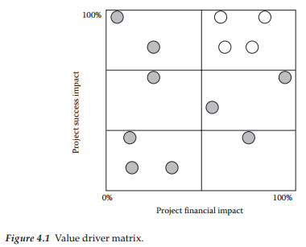
Chapter
04
D. Value driver analysis
Value driver analysis is a financially driven process used to help focus on the trade-offs of success probability versus value for project analysis.
First, management has to identify the value drivers (i.e., increasing revenue, decreasing costs, high rate of return, or achieving some other goal) and then convert these value drivers into quantitative metrics (i.e., shareholder value or free cash flow).
Second, there is a need to focus on resource availability and what impact they will likely have on value creation.
See Figure 4.1 for an example of this concept—obviously, the goal is to select strategic projects (white circles) that are value drivers in the top right-hand quadrant in which they want to concentrate their main resources.

Slide 10
Chapter
04
E. Depreciation and income tax
Organizations may need to acquire capital assets that are depreciable for income tax purposes.
Depreciation is the process of allocating an asset’s cost to the accounting periods over which the asset is being used.
Assume a piece of equipment is purchased by an organization for $800,000 with a life expectancy of 4 years.
If there is no trade-in or resale value at the end of 4 years, the annual tax deduction for depreciation would be $200,000 ($800,000/4) for 4 years.
If there was a trade-in or resale value at the end of 4 years of $200,000, then the annual tax deduction for depreciation would be $150,000 (($800,000 – $200,000)/4).
The possible tax effect of depreciation must be considered in evaluating an investment in computer-related products.
Ultimately, depreciation deductions will reduce annual cash out-flows by paying less income taxes.

Slide 11
Chapter
04
Picking the right projects
Nonfinancial decision models
  In support of using financial decision models, it is always good to use other supporting project request analysis to give more breadth for making a go or no-go decision.
  The following are useful nonfinancial decision techniques that can be used:
    Project questionnaire assessment
    Comparing different projects based on different criteria
    Comparing different projects based on weighted criteria

Slide 12
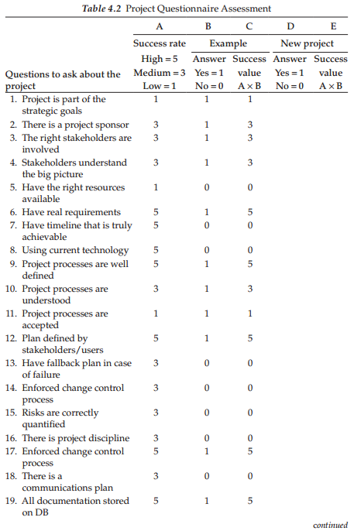
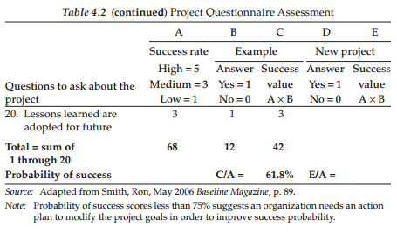
Chapter
04
A. Project questionnaire assessment
The key success questions to ask about a requested project are shown in Table 4.2.
Since every organization is unique. The organization might want to delete and/or add new questions and change the associated success rate number in column “A,” which is a constant.
This table should be reviewed for any possible updates before a new project request is calculated in the last two columns.

Slide 13
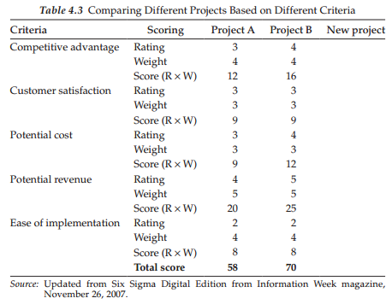
Chapter
02
Chapter
04
A. Project questionnaire assessment
B. Comparing different projects based on different criteria
Different project requests can be compared (e.g., one or more of them could be a project that is under development for comparison purposes) based on different criteria—competitive advantage, customer satisfaction, potential cost, potential revenue, and ease of implementation.
Table 4.3 shows rating and weight—in both cases 1 = low and 5 = high.
Finally, a new project request can be calculated in the last column and this table can be expanded to add more projects for comparison purposes.

Slide 14
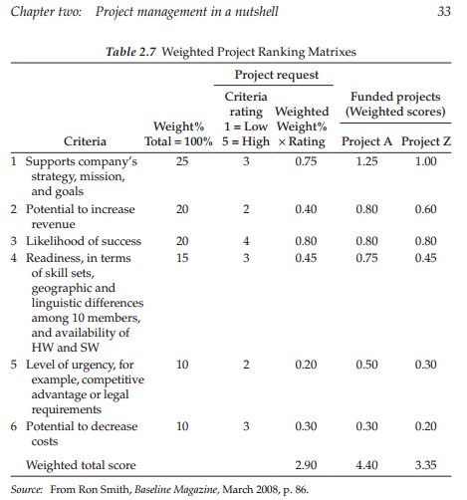
Chapter
04
C. Comparing different projects based on weighted criteria
Different project requests can be compared based on a weighted ranking matrix.
See Table 2.7 for an example.
Since every organization is unique, they may change the weight % in the table’s column 3 for the listed success items 1–6.
Also, Table 2.7 can be expanded to include additional requested projects for comparison purposes.

Slide 15
Chapter
04
Summary
Picking the right projects to pursue sounds so simple, but it is not! Why?
This is because organizations have an overabundance of project requests but limited resources like money, facilities, and staff.
If an organization wants to be successful and stay in business, it needs a consistent preassessment project evaluation process to build a business case to map out the correct pathway to do it.
Over time, the chosen financial and nonfinancial methods or models used need to be constantly reviewed routinely for improvements.
Without a well-developed business case for approving a new project request, an organization is opening the door to poorly chosen targets (e.g., nonstrategy, low-value, or overly risky choices, which collectively fail to achieve the desired results) that usually come back to haunt them.
Rejecting a project request should not be viewed as a “failure” but rather as successful resource management that frees up resources to work on projects that have higher-value returns.
Also, having standard financial and nonfinancial methods or models to approve project requests helps to eliminate the “politics” from the decision-making process.

Slide 16
Chapter
04
Summary
Sometimes an organization has to go against to their formal project decision-making process because of other factors external to those views.
For example, the expenditure of significant resources to implement a compliant Sarbines–Oxley infrastructure is necessary because of newly imposed government regulations.
Another example for approving a project outside the formal mechanics could come from the board of directors who are seeking to improve the company’s public image, which may be at a very low point, or approving a project that implements new goals.

Slide 17
Chapter
04
QUESTIONS
Review questions
Who approves projects?
Could a new project request replace a project that is underway?
What should happen if the PV returns are less than the PV of the total investment for a requested project?
In-class question
Assume an investment of $250,000 is expected to produce annual returns of $40,000 for 8 years. Is this a profitable investment and what is the rate-of-return percentage?
EXERCISE
Assume an investment of $250,000 is expected to produce annual returns of $40,000 for 10 years and the rate of return an organization requires is 10%. What is the PV of the returns? Does this meet the rate-of-return requirement?

Slide 18
Chapter
04
References
Biafore, B. Microsoft Project 2010—The Missing Manual. Sebastopol, CA: Pogue Press, 2010.
Crawford, J.K. The Strategic Project Office, 2nd ed. Boca Raton, FL: CRC Press, 2011.
Heldman, K. Project Management Jumpstart, 3rd ed. New York: John Wiley & Sons, 2011.
Loughran, M. Financial Accounting for Dummies. New York: John Wiley & Sons, 2011.
More, C.L. and Jaedicke, R.K. Managerial Accounting. Cincinnati, OH: SouthWestern Publishing Co., 1980.

Slide 19
Chapter
05
Gaining support for a project
Chapter 4 discussed how an organization selects the right projects that are in alignment with its strategic plan.
The goal of this process is to select different types of projects to produce a diverse balance of target initiatives.
As stated in Chapter 4, without a good business case for approving a new project request, an organization is opening the door to selecting projects that are not in alignment with the organization’s strategic plan and are therefore low-value or weak projects.
Now that the project target has been selected, what should occur next?
This chapter will address how stakeholder support for the project is gained, including the approach to officially launch a new project and the purpose of a project charter.
The processes required to produce a successful project require an enormous degree of planning and skilled leadership and some would even argue that it also takes a little bit of luck (Little 2011).
Of course, using the tools and techniques described in this textbook should help the PM even without good luck on their side.

Slide 20
Chapter
05
Management approach
Every organization has a slightly different way of approaching the official launch of a project, but the model approach requires that this can be done using a formal charter signed by the management and supported by a business case outlining the value of the project.
The initial target vision is used to produce a business case that then leads the management to approve further definition through issuance of the charter.
The primary goal of the business case is to validate that the initial project vision has value and is aligned with organizational objectives.
At the end of this process, the management will hopefully show approval and support for the effort by formally signing a charter document.
The first project team task following this usually revolves around expanding the definitional details of the project (Anonymous 2002; Little 2011).
This should also involve the identification of the PM since the effort at this stage has minimal management guidance. Some organizations may wait for this until further scope planning and work definition is complete.

Slide 21
Chapter
05
Project manager
At one appropriate point, it is important to formally identify a management individual who will be charged with leading the initiative forward through its life cycle.
There are three main routes to develop a PM as identified by Kilkelly (2009).
  One of the least desired of these is to allow a new PM to learn by making trial-and-error mistakes.
  However, most organizations are not very forgiving of errors, so it is better to instead learn through being mentored or begin as an assistant to an experienced PM, which is the second method.
  A third method is to learn the basic mechanisms of the process through some form of training whether a degree, a focused training course, or self-study.
Research suggests that the skills necessary to successfully run a project are not necessarily bred (Edmonds 2010).
PMs are often selected based on their recognized reliability and technical expertise within their specific field.

Slide 22
Chapter
05
Project manager
As a result of this action, they find themselves being responsible for a project team of individuals, but really do not have the appropriate background to deal with the complexity of this task.
Lack of appropriate training leaves a gap in the skills required to properly manage the process and can leave the individual dealing with unimportant details and losing track of the important details.
There is a saying about not being able to see the forest from the trees and this is another way of describing a PM focusing on the wrong details.
Blending all of these approaches offers the best chance of producing the proper outcome.
That is, mentorship, work for a successful PM and access to appropriate training materials.
Many organizations focus only on the success of producing project deliverables but also need to focus on the growth of successful PMs (Nixon et al. 2012).
Project deliverables may be deemed successful if they meet customer expectations; however, the PM is a success if the project was accomplished in alignment with organizational goals and if he or she grew professionally in the process.

Slide 23
Chapter
05
Stakeholders
One of the early definitional tasks in the life cycle is to formally identify the project stakeholders.
Stakeholders come in many different categories as there will be project sponsors, functional managers (line managers since resources come from these managers), team members, and many others who may not even realize until the signing of the charter that they are a key stakeholder.
This definition helps guide sources for further requirements definition.
Additional stakeholders may surface as the requirements are further elaborated in the planning process.
PMI (2008) identifies a process for stakeholder definition consisting of identification of stakeholders, determination of stakeholder’s requirements, and expectations and the management of their influence to help the project be successful.
Some stakeholders will be very active with the project providing financial and political support, whereas others will be more occasional contributors perhaps serving more as participants in focus groups or surveys.

Slide 24
Chapter
05
Stakeholders
Stakeholders generally are thought of as individuals who provide positive outcomes for the project.
However, it is important to note that there are also stakeholders who for whatever reason view the project as producing negative outcomes (or a particular stakeholder’s agenda), which in turn may negatively influence the project outcome.
Communication is important between all stakeholders.
The PM should ask each stakeholder to identify the preferred form and frequency of communication desired.
For instance, some stakeholders may prefer email updates monthly, whereas other stakeholders want formal status meetings quarterly or even bimonthly.
The only way to know that the stakeholder is getting the appropriate communication is to continuously ask.
At each status meeting or email, a simple statement such as “please let me know if you would prefer more or less status updates, or if a different form of communication is preferred.”
The best way to evaluate this is to directly ask the question to each stakeholder.

Slide 25
Chapter
05
Project sponsor
Someone within the organization must take the role of the primary sponsor (Kloppenborg et al. 2011).
A sponsor is typically a person in the organization who has a significant amount of influence and often will reap the deliverable benefits of the project.
PMI (2008) defines a sponsor as a person or even a group with financial resources who will ultimately champion a project by leading the project through the formal authorization process, charter issuance, and management leadership through later phases of the project as well.

Slide 26
Chapter
05
Project charter
The project charter has specific implications to the team.
PMI (2008) defines the charter as a document that formally authorizes a project and documents the stakeholder’s needs and expectations.
The basic roles for a charter are to formally give delegation of authority to the PM or the person identified by the management to lead and to formally display management approval for the project.
The term “PM” will be used but it is important to note that the charter may, in lieu of identifying a PM, state that the functional departments A, B, and C will support the approved core planning process and that Ron Jones is the team/project leader.
What is being said here is that the management believes that this effort is worthy of more expenditure of time, but they have not signed off on the final plan at this point.
Also, the execution team is not likely in place and cannot be named for all these same reasons.
The items that should be covered in the charter document are a statement of project goals, general project time and cost goals, purpose, project management, and any other relevant guidance that the management wishes to define at this point.

Slide 27
Chapter
05
Project charter
It is important to note that every organization has a different viewpoint on what a charter contains which comes from different definitions and the intermingling of these definitions for the project vision, business case, goal, and scope.
Chartering is an agreement between the PM, selected at this stage of the project, and the project sponsor (Miller 2001).
The project charter needs to be established, signed—symbolizing approval of the project—and then documented.
It is easy for a department to add in additional needs into the project charter that are unrelated to the original charter (Peled 2000).
However, the PM and/or project sponsor need to stop the charter from containing anything but the appropriate target goals.
If any part of the project is being outsourced, the role of the outsourced tasks must be carefully and clearly defined.
Unclear objectives, unrealistic deadlines, and unclear management roles and lines of authority are weaknesses in project management (Anonymous 2002).
A clearly defined line of authority to include an accountability framework must be established, which begins with the PM (Maddalena 2012).

Slide 28
Chapter
05
Project charter
The sponsor sets the physical vision for the output the project produces.
The PM turns the vision into the executed work to execute the output desired by the project sponsor.
The project vision fed the business case that was appealing enough to be selected by the organization, which set the discussion in the last chapter.
The goal turns the vision into a high-level project outcome that needs to occur so that the vision is successfully performed.
The scope appears in the WBS which will be discussed in Chapter 6.
The topic of the scope brings about the question of whether it is the product or the project scope.
The WBS top is a deliverables-oriented set of boxes representing the sponsor view of the project, whereas the lower WBS represents the work to be accomplished that produces the desired project output.
Some organizations have a very basic charter that does not contain much information, whereas some organizations will almost have a miniature version of the scope management plan as their charter.

Slide 29
Chapter
05
Project charter
This chapter focuses on the main charter roles, as the scope planning and scope definition processes will be covered in Chapter 6.
The charter provides the organization with a common purpose for which to exist so that there is a shared goal and it can assist in making individuals affiliated with the project be cohesive with a shared sense of project ownership (Peled 2000).
Once the project charter is signed by the management and the PM, it signifies again that management believes this effort is worthy of more expenditure of time, but they have not signed off on the final plan at this point as that occurs at the end of the planning stage, which will be addressed in Chapter 6.
It also serves to facilitate buy-in from key stakeholders on the project’s need for existence and ultimate purpose.
As previously mentioned, some charters are more detailed than others, as some organizations may have a charter template so that standardization throughout the organization exists.
Other organizations might leave the project charter up to the PM where each project charter looks different.

Slide 30
Chapter
05
Project charter
The basic template for a charter is to have the project title, tentative timeline, tentative budget, purpose with job title, and signatures from key stakeholders.
In lieu of a template, an organization may have a different name for this document and may just produce the document on letterhead.
A project charter is similar to a press release and should be distributed to anyone that participates or may be affected by the new project.
The charter information serves as an estimate to be validated by the sponsor and project team when developing the scope management plan and WBS.
Figure 5.1 displays the bare minimum that a project charter should contain, which is filled in to provide example details.
The charter signifies delegation of authority to the PM.

Slide 31
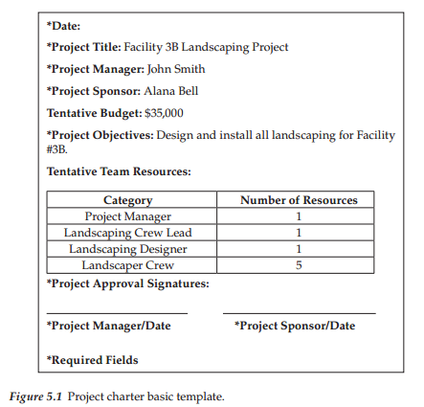
Chapter
05
Project charter
A charter can even include specific statements such as the PM has the authority to do the following:
  Communicate directly with the executive team regarding the project
  Communicate directly with all subcontractors regarding the project
  Negotiate contracts
  Authorize expenditures
  Hire subcontractors
  Assign resources to project tasks
A more detailed project charter can contain all the details listed in the basic template and additional categories as well.
A more detailed project charter may also list the background providing the rationale for the initiative, general deliverables of the project, perceived risk issues, and even team membership assumptions as the team is likely not known, but the management may provide a commitment to providing the resources needed to carry out the project.

Slide 32
Chapter
05
Project charter
The following sections discuss the charter basic template categories as well as additional potential charter items that may be added by some organizations.
  Background
  Purpose
  Deliverables
  Budget
  Team membership assumptions
  Perceived risks
  Project approval

Slide 33
Chapter
05
Background
In terms of the project background, the project did not just suddenly occur as the organization came about the business need or business case for the project that should be identified.
The project may serve to resolve a problem within the organization.
A project likely exists due to it being in alignment with the overall organization’s strategic mission, which could be discussed in this section as it serves as a justification for the project being funded.
In the background, there may also be information on why this project is important such that it serves different key stakeholder needs whether they are internal or external to the company.
The project may address a new law or regulation or even a social need that has arisen within the community where the organization’s facilities exist.
There may be demand for a new product that this project will produce. Or, it could just be a project to update a company’s website.
New technology may be integrated into the business that resulted from technological advances.
There may be a number of reasons why a project was selected, so the charter in this section would identify the reason why the project exists.

Slide 34
Chapter
05
Purpose
The purpose section of the project charter in the template doesn’t have to only be a high-level description.
It can provide details such as the high-level goal of the project and also identify all of the objectives that the project is anticipated to meet.
This provides a much-expanded view of the project.

Slide 35
Chapter
05
Deliverables
A project charter can also include information relating to the scope of the project but this information will be limited in the charter to the project, objectives and possibly the deliverables too.
The charter may be a mission statement that identifies the main tasks to be performed by the team.
The deliverables section should identify the specific deliverables that the team is required to produce.
Additionally, the charter may list project milestones.

Slide 36
Chapter
05
Budget
The budget in the basic template displays the overall project budget objective.
The budget is just a rough order of magnitude as the project work has not been fully identified yet at the charter stage.
Good planning now will hopefully produce a budget within 10% of the actual detailed budget later established.
This section may contain details of the amount of the budget for different aspects of the project, such as equipment, labor, and so on.
It may also address where the funds are from in terms of funding from a specific program or department or combination of different organizational departments.
In some projects, it may state how some of the project income is generated from sales such as a project for an event.
The event may be able to pay for entertainment, food, and so on based on the income that comes in from ticket sales.

Slide 37
Chapter
05
Team membership assumptions
The team membership section of the project charter may be part of the charter in just listing out the type of resources needed so that the PM does not later need to beg the management for additional resources.
The team member’s name it will be identified in the scope management plan.
This section may also outline the authority that is being granted to the PM along with the PM’s brief biography.
It may provide the PM the power and authority to directly communicate with company board members or specific customers or subcontractors.
The project team at this time will not likely be established but a limited amount of resources may assist either the project sponsor or the PM if one has been already selected.
Therefore, actual individuals may not yet be selected but an understanding of the right composition of skills that will successfully be able to accomplish the project goals may be identified, such as computer programmers, electrical engineers, paralegals, and so on. The project proposal may have identified some of these details already.
Many organizations will not put the full team together until the scope management plan (Maddalena 2012)

Slide 38
Chapter
05
Perceived risks
Risks are an entity of their own. In fact, Chapters 11 and 22 are devoted to the topic of risk.
However, the project charter may also include a section of high-level risks that apply to the project.
  For instance, it may have the risk of weather if the project pertains to an outdoor event.
  Another risk is that the supplier that the organization has a contract with may deliver supplies late, which will impact the project schedule.
Project risks can be identified, but other project documentation that will be discussed later in the course will explain how to document and handle the details of project risks.

Slide 39
Chapter
05
Project approval
The project approval section in the basic project charter template has signature blocks for the PM and the project sponsor.
The project charter can also outline the criteria for which the project will be approved and therefore categorized as successfully completed.
Examples of criteria are submission of all project close-out documentation and submission of all program code to the customer.
The criteria that are identified should be written in very concise statements so that no two individuals would interpret the requirement differently. This is for the protection of the PM and the project sponsor.
Once the signatures are obtained, the project can officially begin.
The distribution of the charter is like a project press release, and copies should be sent to the project team and anyone that is affected by the project.

Slide 40
Chapter
05
Summary
This chapter addressed how support for the project is gained, which includes the approach to officially launch a new project and the purpose of a project charter.
When the project was selected to be performed, it was at that time validated that the initial project vision had value and was aligned with organizational objectives.
At the end of this process, the management was obligated to show both approval and support for the effort by formally signing a charter document.
A determination is made to identify the PM or person identified by the management to lead the project at this stage in the life cycle and identify key stakeholders such as the project sponsor(s).
The basic template for the charter was addressed as well as the purpose of the charter in providing delegation of authority to the PM and formal management approval for the project to exist.

Slide 41
Chapter
05
Summary
Additional charter items to include were also discussed as every organization has a different viewpoint on what categories of information should be included in the charter.
Chartering assists in moving the project definition and process forward to the start of official scope planning and scope definition addressed in Chapter 6.
This will include discussion of the scope management plan and scope statement, which are the next documents developed once the project charter is completed.

Slide 42
Chapter
05
QUESTIONS
Review questions
Describe the different steps involved in officially launching a project.
List and describe each section of the basic charter and expanded project charter.
In-class question
Find a charter template on the Internet and describe the sections of the charter.
EXERCISE
Create a project charter for the car case study using the charter sections described in this chapter or found online.

Slide 43
Chapter
05
References
Anonymous. 2002. Redesigning project management at Kimberly-Clark Europe. Training Strategies for Tomorrow 16(6):8–11.
Edmonds, J. 2010. How training in project management can help businesses to get back on track. Industrial and Commercial Training 42(6):314–318.
Kilkelly, E. 2009. Blended learning: Pathways to effective project management. Development and Learning in Organizations 23(1):19–21.
Kloppenborg, T., D. Tesch and C. Manolis. 2011. Investigation of the sponsor’s role in project planning. Management Research Review 34(4):400–416.
Little, B. 2011. The principles of successful project management. Human Resource Management International Digest 19(7):36–39.
Maddalena, V. 2012. A primer on project management. Leadership in Health Services 25(2):80–89.
Miller, C.W. 2001. Meeting real needs with real products. Strategy & Leadership 29(1):15–20.
Nixon, P., M. Harrington and D. Parker. 2012. Leadership performance is significant to project success or failure: A critical analysis. International Journal of Productivity and Performance Management 61(2):204–216.
Peled, A. 2000. Creating winning information technology project teams in the public sector. Team Performance Management 6(1):6–15.
Project Management Institute (PMI). 2008. PMBOK® Guide, 4th ed. Newtown Square, PA: Project Management Institute.

Slide 44
Chapter
04 - 05
Thank You
The End..
Thank You

