Slide 1


System Administration (2)
IT401
Prepared by
Dr. Ahmed El-Douh
Lecture 2

Slide 2



System Administration 2
Lecture 2
IT401
Introduction to Linux & System Architecture
Prepared by
Dr. Ahmed El-Douh

Slide 3
Objectives
Upon completion of this lecture, you will be able to:
  Understand systems, services, and the role of system administration in organizations.
  Learn key responsibilities, tools, and challenges of system administrators.
  Apply best practices, rules, and ethics in system management.

Slide 4
Chapter
Outlines
02
Comparing User Interfaces: CLI vs. GUI
Introduction to the Linux Operating System
Linux Distribution
Linux Terminology
The Linux Command Line Environment
Installing Linux in a Virtual Machine
Fundamental Linux Commands

Slide 5


Chapter
02
Comparing User Interfaces: CLI vs. GUI

Slide 6
CLI vs GUI
    CLI: Command Line Interface allows users to interact with the computer using text commands.
    GUI: Graphical User Interface enables interaction through graphical elements like windows, icons, and menus.
  Both have their use cases in modern computing.

Slide 7
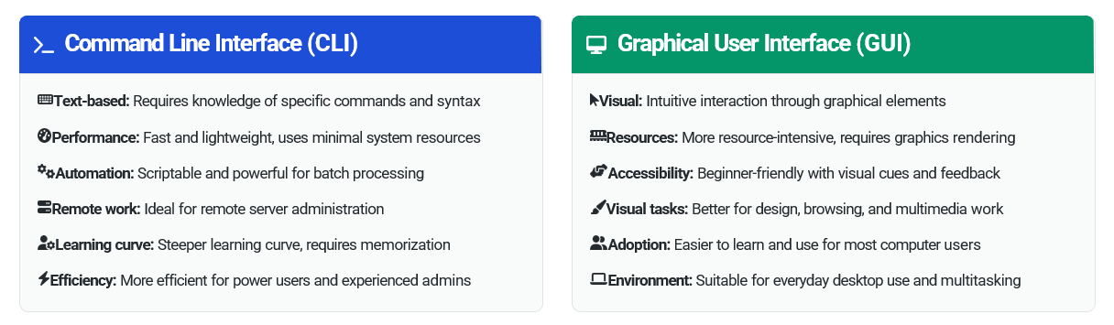
CLI vs GUI

Slide 8
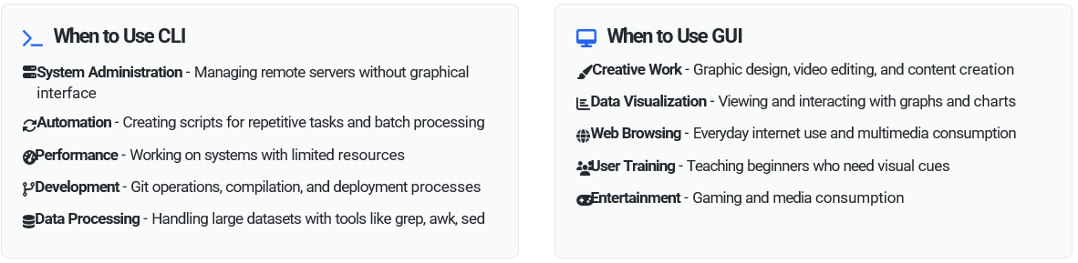
When to Use CLI vs GUI

Slide 9
Chapter
02
Introduction to the Linux Operating System

Slide 10

What is Linux?
Linux is an open-source operating system kernel that serves as the foundation for many different operating system distributions. Created by Linus Torvalds in 1991.
Linux is based on Unix principles and has become one of the most widely used operating systems in the world.
Open-source software meaning anyone can view, modify, and distribute its source code.

Slide 11
What is Linux?
Linux is a "Unix-like" operating system that was created from scratch to be a free and open-source alternative to the proprietary Unix systems.
Linux is the modern, open-source re-implementation of those ideas, which made the power of a Unix-like system accessible to everyone.

Slide 12
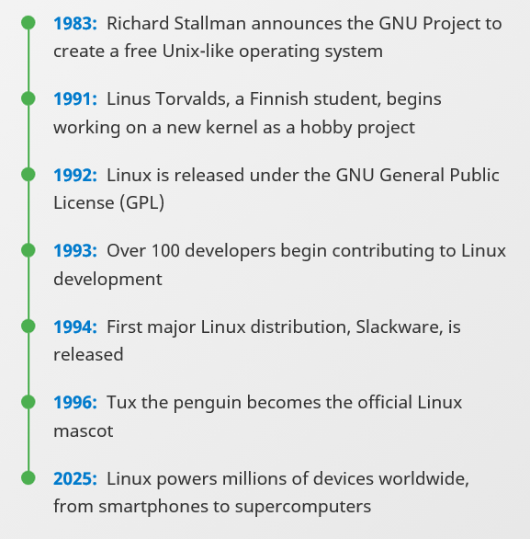
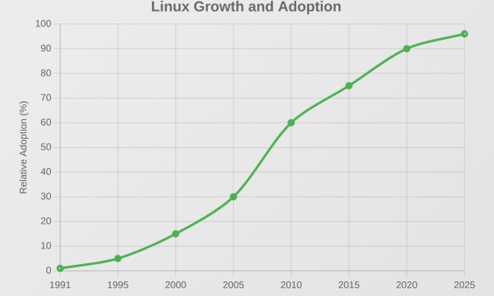
A Brief History

Slide 13
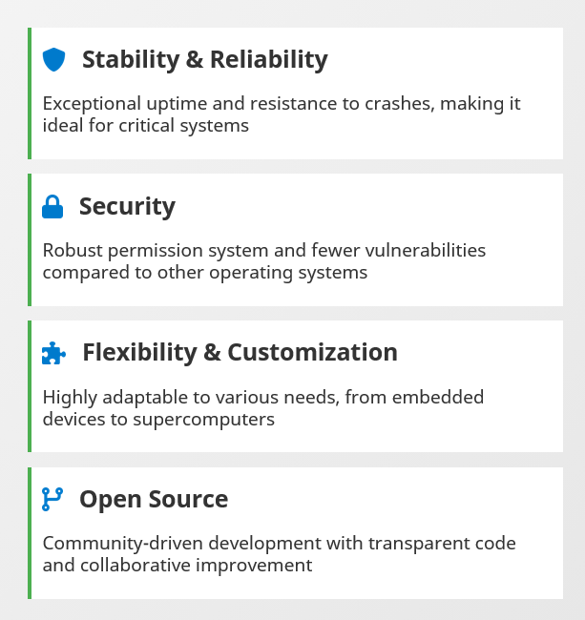
Linux Key Features

Slide 14
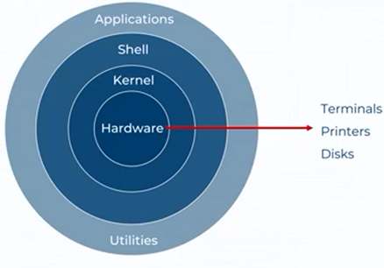
Linux Architecture
Linux follows a layered architecture design where each layer provides specific services to the layers above it.

Slide 15
Linux Architecture
Kernel
The core of Linux that interfaces directly with hardware. Manages memory, processes, devices, and system calls.
Shell
Command interpreter that provides an interface between the user and the kernel. Executes commands and scripts.
Application Layer
User applications, system utilities, and daemons (background services) that run on top of the shell and kernel.
Hardware Interaction
The kernel manages hardware resources through schedulers, memory management, and device drivers.

Slide 16
What is kernel?
A good way to understand the kernel is to think of it as the brain of the operating system. It manages all the essential, low-level operations that you rarely see but that are critical for the computer to function.
Just as your brain coordinates all your body's functions without you consciously thinking about it, the kernel manages the computer's resources behind the scenes.

Slide 17
What is kernel?
The kernel is the core component of an operating system that acts as a bridge between applications and the computer's hardware. It's the most fundamental part of the OS that manages system resources and provides essential services.

Slide 18
Key Functions of the Kernel
Hardware Management
Resource Allocation
Process Management
Memory Management
Security and Access Control
System Calls

Slide 19
Chapter
02
Linux Distribution

Slide 20
Definition of Linux Distribution
What is a Linux Distribution?
  Definition: A Linux distribution is an operating system based on the Linux kernel, including a collection of software.
  Components: Kernel, package manager, desktop environment, utilities.
"A Linux distribution is a version of Linux that bundles the Linux kernel with additional software, providing a complete operating system."

Slide 21
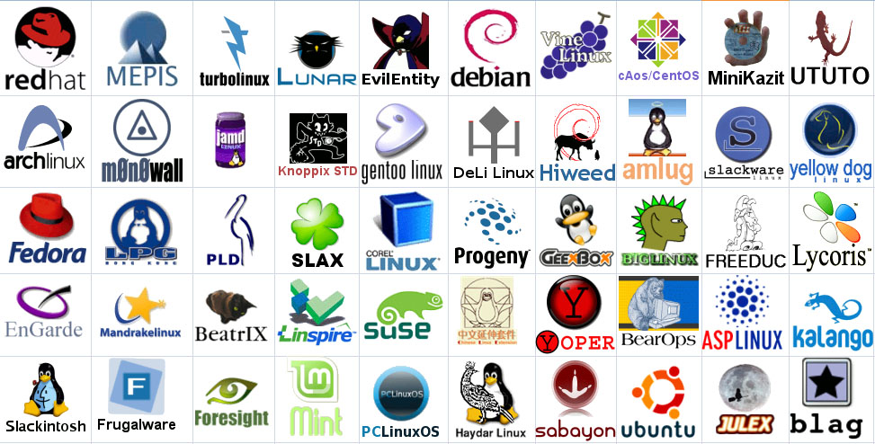
Linux Distributions

Slide 22
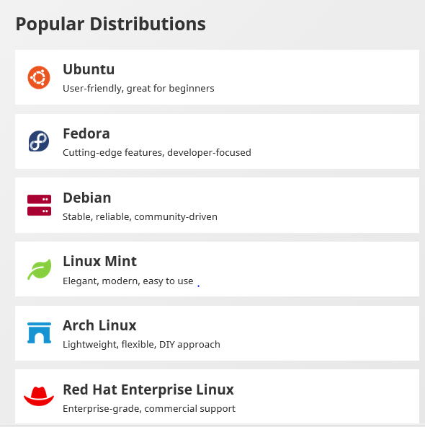
Linux Distributions
Over 600 active Linux distributions exist today

Slide 23
Major Linux Distributions
Why Are There So Many Distributions?
  Customization: Different distros are optimized for different tasks (e.g., servers, desktops).
  Community: Each distribution has a dedicated community with different goals and focuses.
"Linux distributions are numerous because they serve different purposes and communities, whether for servers, desktops, or specialized use cases."

Slide 24
Categories of Distributions
Categories of Linux Distributions:
  General-Purpose: Ubuntu, Fedora, openSUSE.
  Enterprise: Red Hat Enterprise Linux (RHEL), SUSE Linux Enterprise.
  Minimalist: Arch Linux, Gentoo.
  Specialized: Kali Linux (security), Raspberry Pi OS (embedded systems).
"Linux distros can be classified based on their use cases, from general-purpose to specialized for specific tasks like security or embedded systems."

Slide 25
Chapter
02
Linux Terminology

Slide 26
Linux Terminology
The terminal is the program that provides a text-based interface window where you can type commands. It's essentially a text input/output environment that displays a command prompt and shows the results of commands you run. Think of it as the "window" or "screen" where you interact with the system through text.

Slide 27
Linux Terminology
The shell is the command interpreter program that actually processes the commands you type in the terminal. When you type a command, the shell reads it, interprets what you want to do, executes the appropriate programs, and returns the results. The shell acts as an intermediary between you and the operating system kernel. It handles things like command parsing, variable expansion, and running programs.

Slide 28
Linux Terminology
Bash (Bourne Again Shell) is a specific type of shell - arguably the most popular and widely-used shell in Linux systems. It's the default shell on most Linux distributions. Bash includes features like command history, tab completion, scripting capabilities, and various built-in commands. Other shells include zsh, fish, dash, and the original Bourne shell (sh).

Slide 29
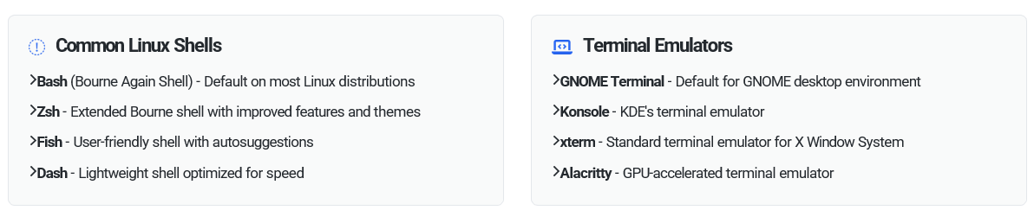
Linux Terminology

Slide 30
Linux Terminology
How They Work Together:
You open a terminal application.
The terminal starts a shell program, which is usually Bash by default
You type a command into the terminal.
The shell (Bash) interprets the command and tells the operating system what to do.
The output of the command is then displayed back to you in the terminal window.

Slide 31
Linux Account: Root Account
Superuser: Has complete administrative control over the system
User ID (UID): Always 0
Privileges: Can access all files, modify system configurations, install/remove software, manage other users, and perform any system operation
Prompt: Typically shows # symbol
Home directory: Usually /root
Risk: Commands run as root can potentially damage or compromise the entire system

Slide 32
Linux Account: Regular User Account
Limited privileges: Can only access their own files and perform non-administrative tasks
User ID (UID): Typically, 1000 and above for regular users
Restrictions: Cannot modify system files, install system-wide software, or access other users' private files without permission
Prompt: Typically shows $ symbol
Home directory: Usually /home/username
Safety: Mistakes are generally contained to the user's own files and space

Slide 33
Chapter
02
The Linux Command Line Environment

Slide 34
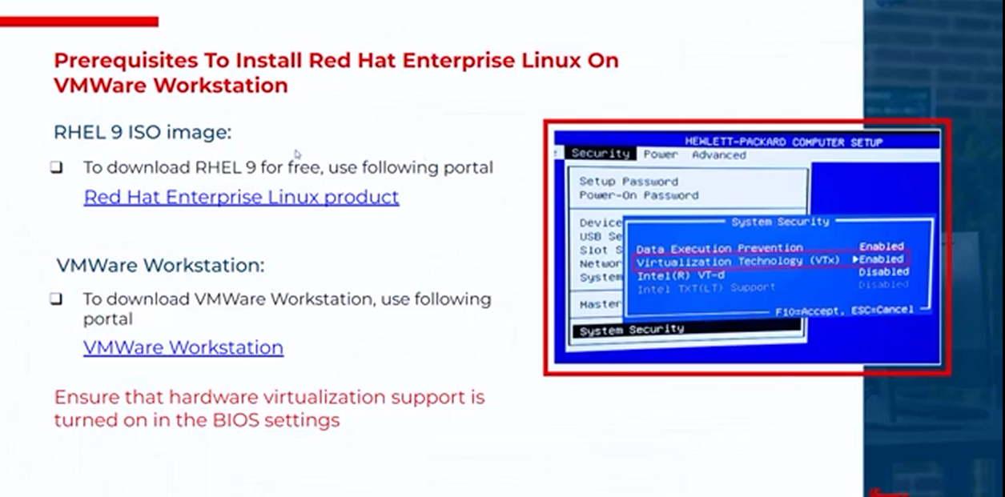
Exploring Linux Distributions

Slide 35
Chapter
02
Virtual Machine:

Slide 36
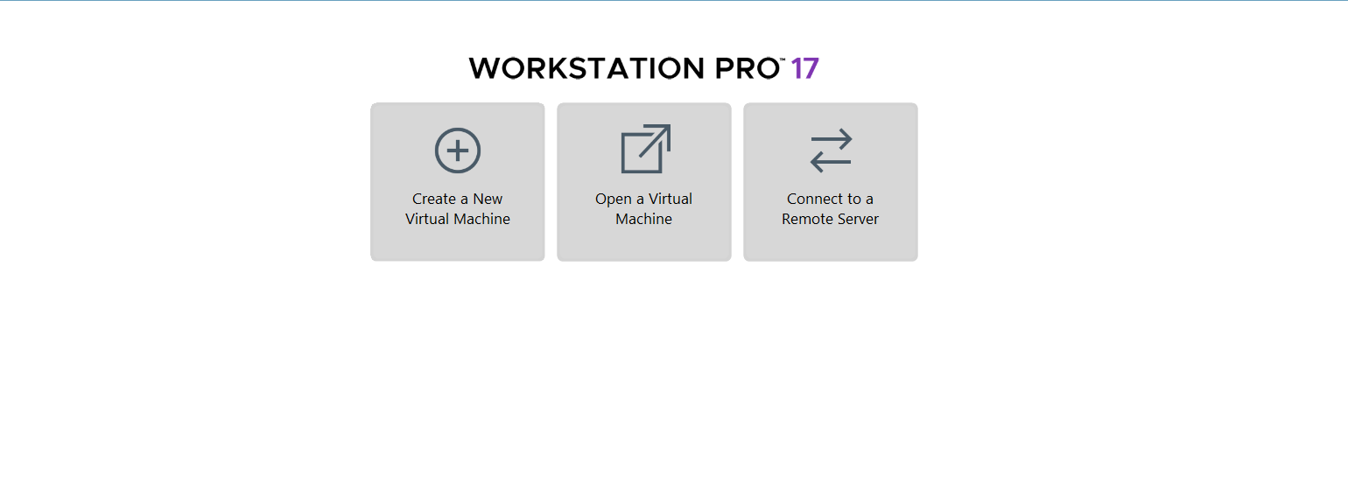
VMware Workstation Pro 17: Creating a New Virtual Machine

Slide 37
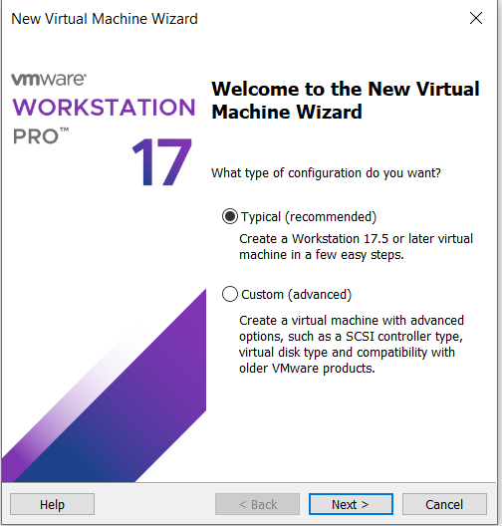
Creating a New Virtual Machine
Select Typical

Slide 38
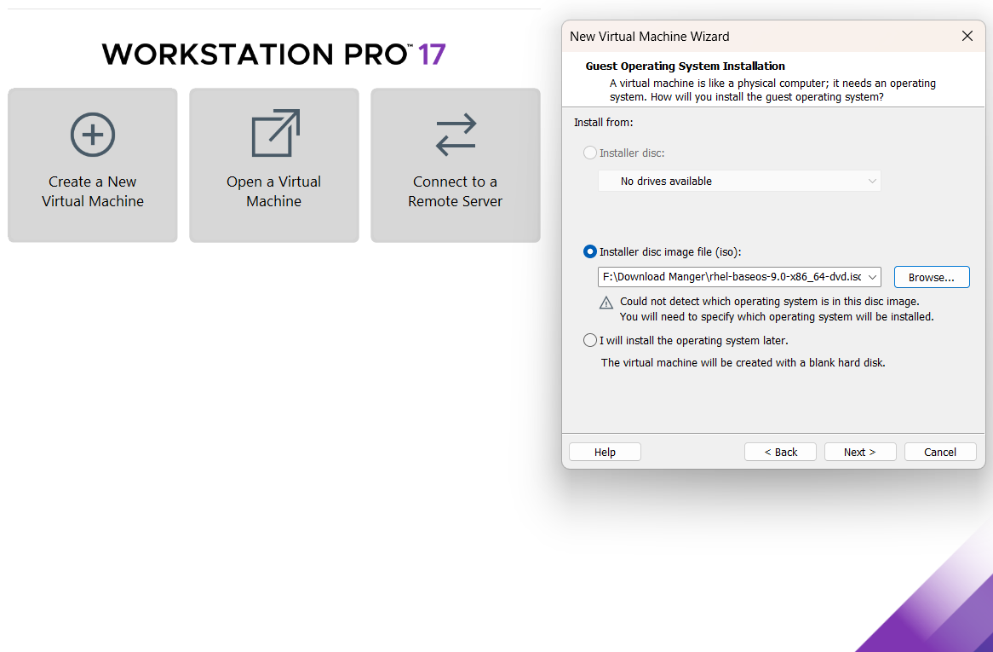
Creating a New Virtual Machine: Red Hat Enterprise Linux
Select Browse
Select Iso File for Red Hat

Slide 39
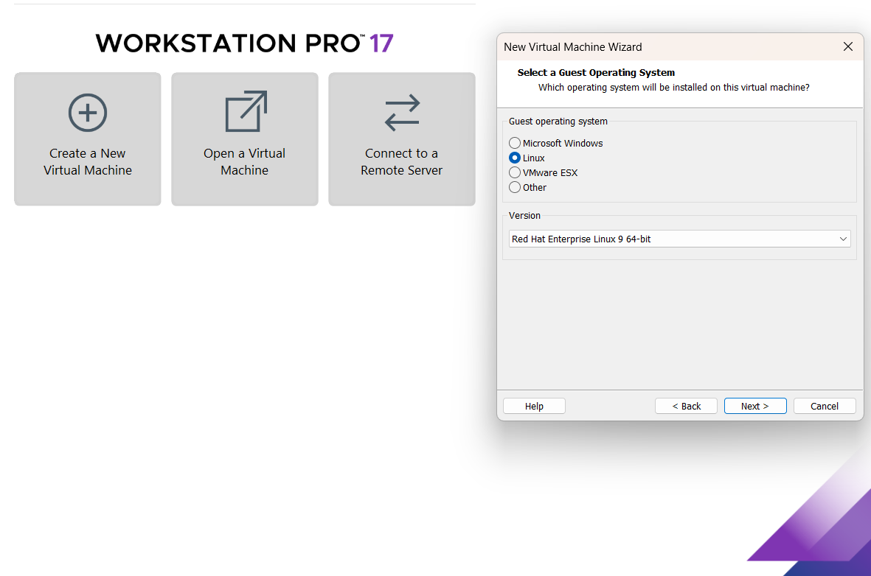
Creating a New Virtual Machine: Red Hat Enterprise Linux
Select Linux
Version: Red Hat Enterprise Linux 9

Slide 40
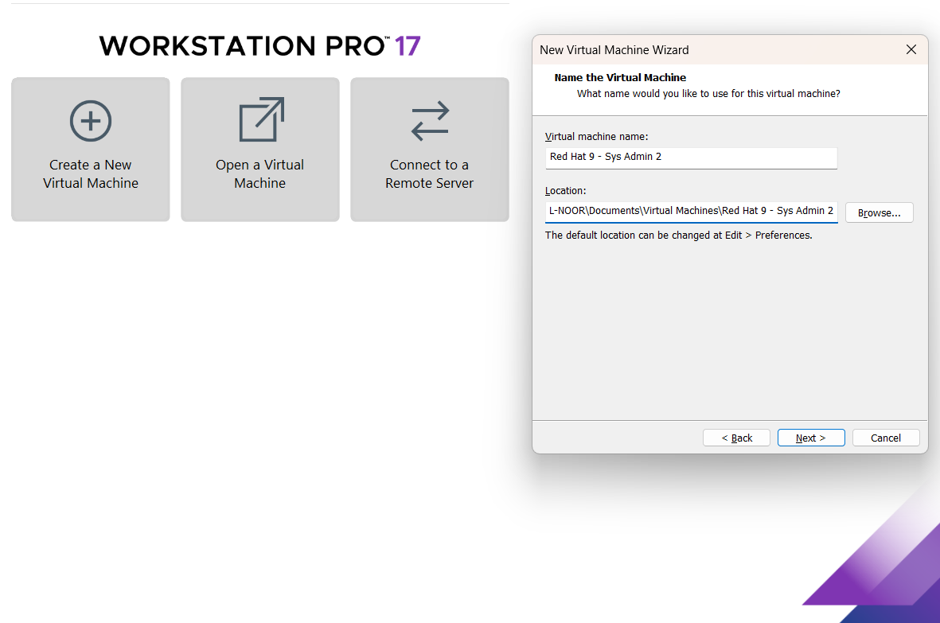
Creating a New Virtual Machine: Red Hat Enterprise Linux
Click the “Next" button

Slide 41
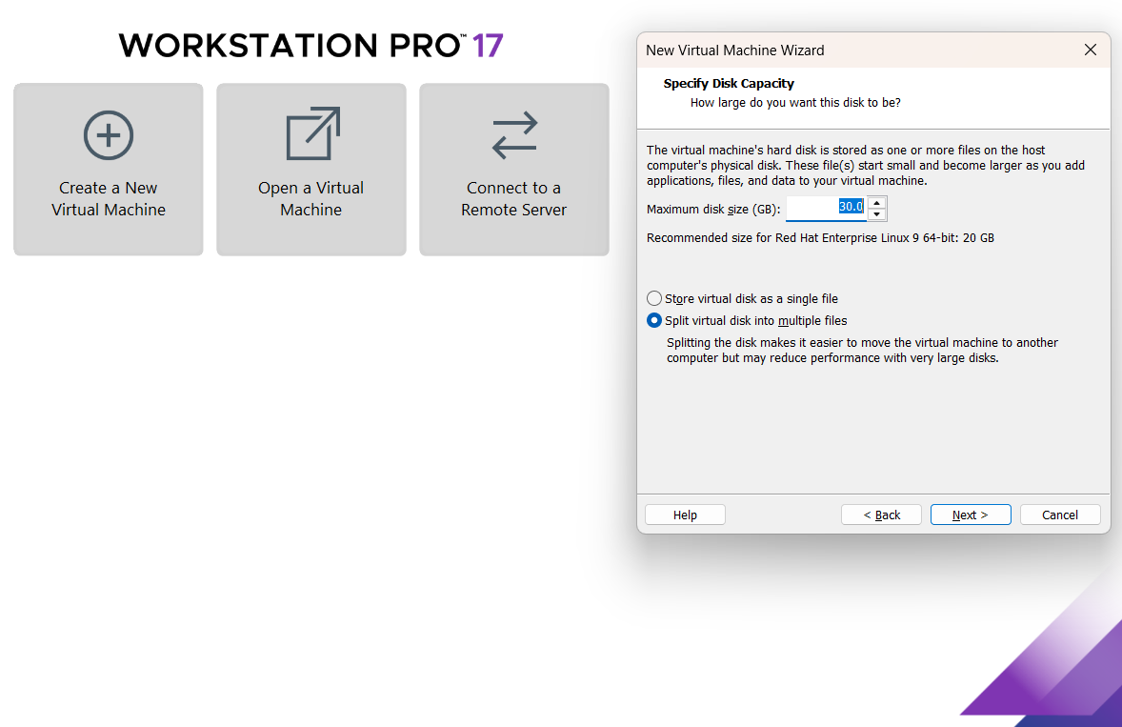
Creating a New Virtual Machine: Red Hat Enterprise Linux
Choose your Suitable Size and click “Next"

Slide 42
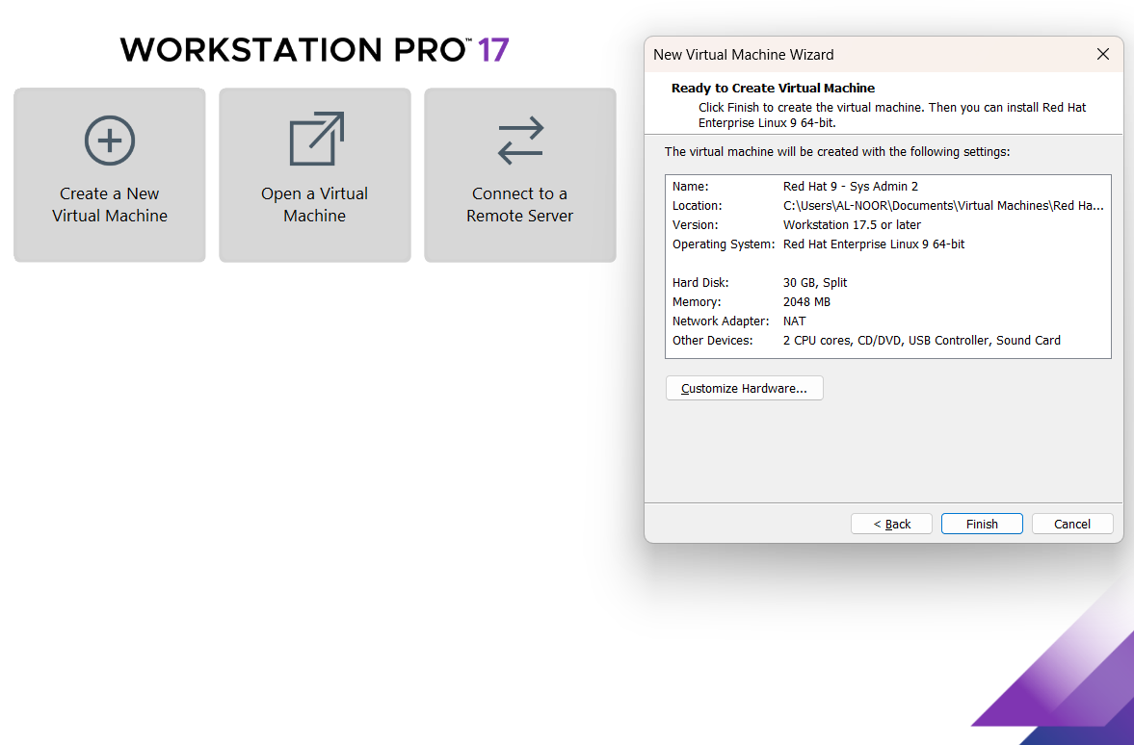
Creating a New Virtual Machine: Red Hat Enterprise Linux
Here are the
VM specifications

Slide 43
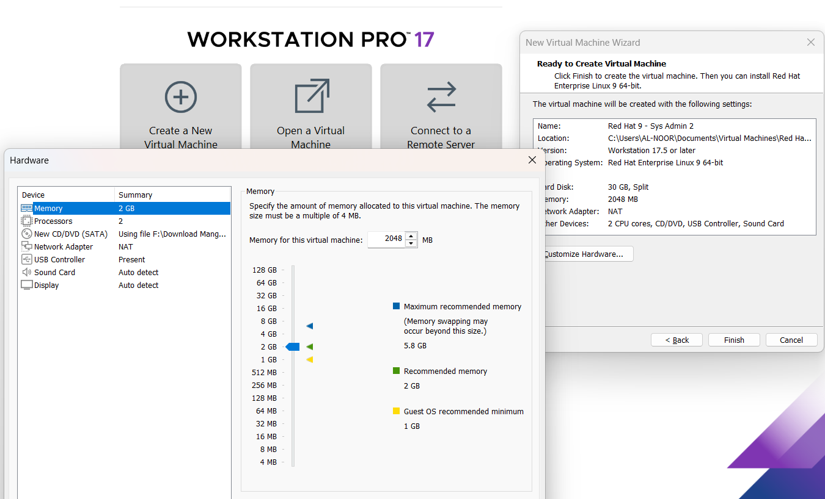
Creating a New Virtual Machine: Red Hat Enterprise Linux
Adjust memory and processors as required, then proceed
At least 2 GB RAM is needed
, then click Finish

Slide 44
Creating a New Virtual Machine: Red Hat Enterprise Linux
Click Finish

Slide 45
Chapter
02
Installation of RHEL 9

Slide 46
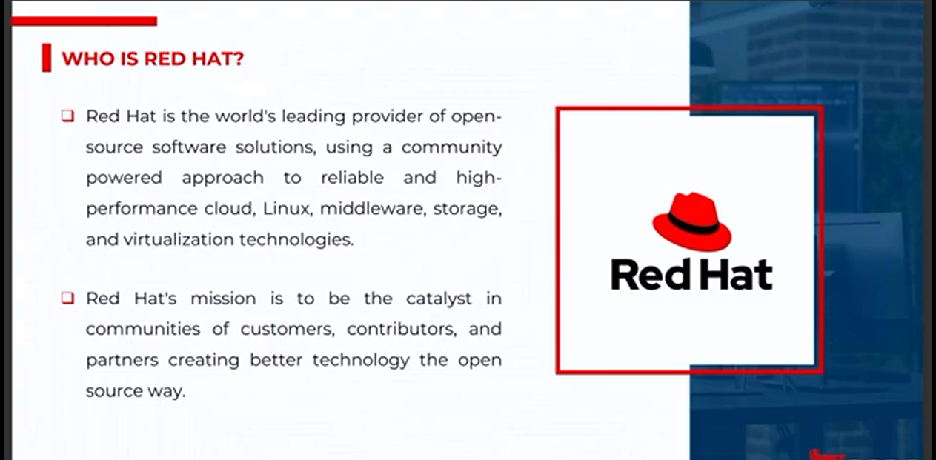
Red Hat Enterprise Linux (RHEL)

Slide 47
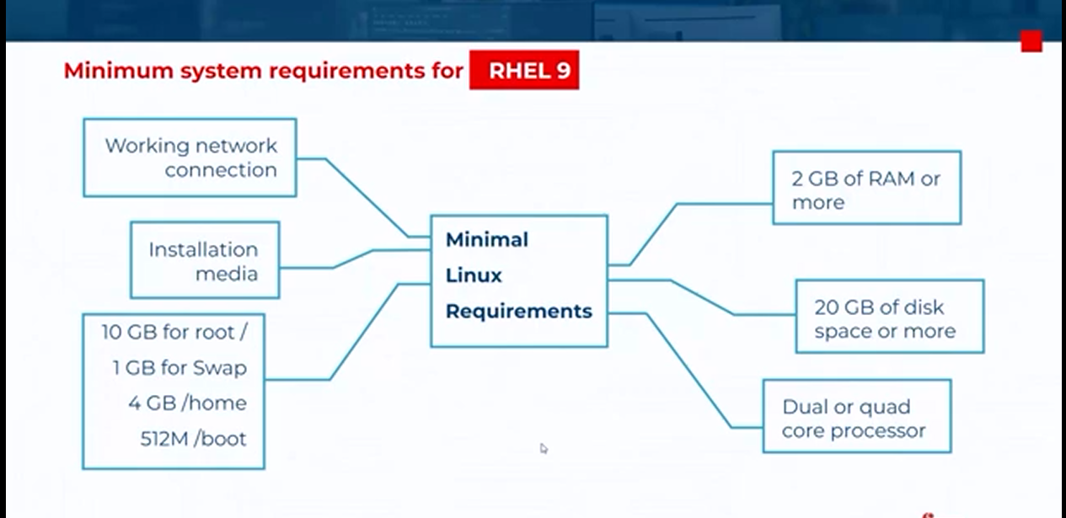
Red Hat Enterprise Linux (RHEL)

Slide 48
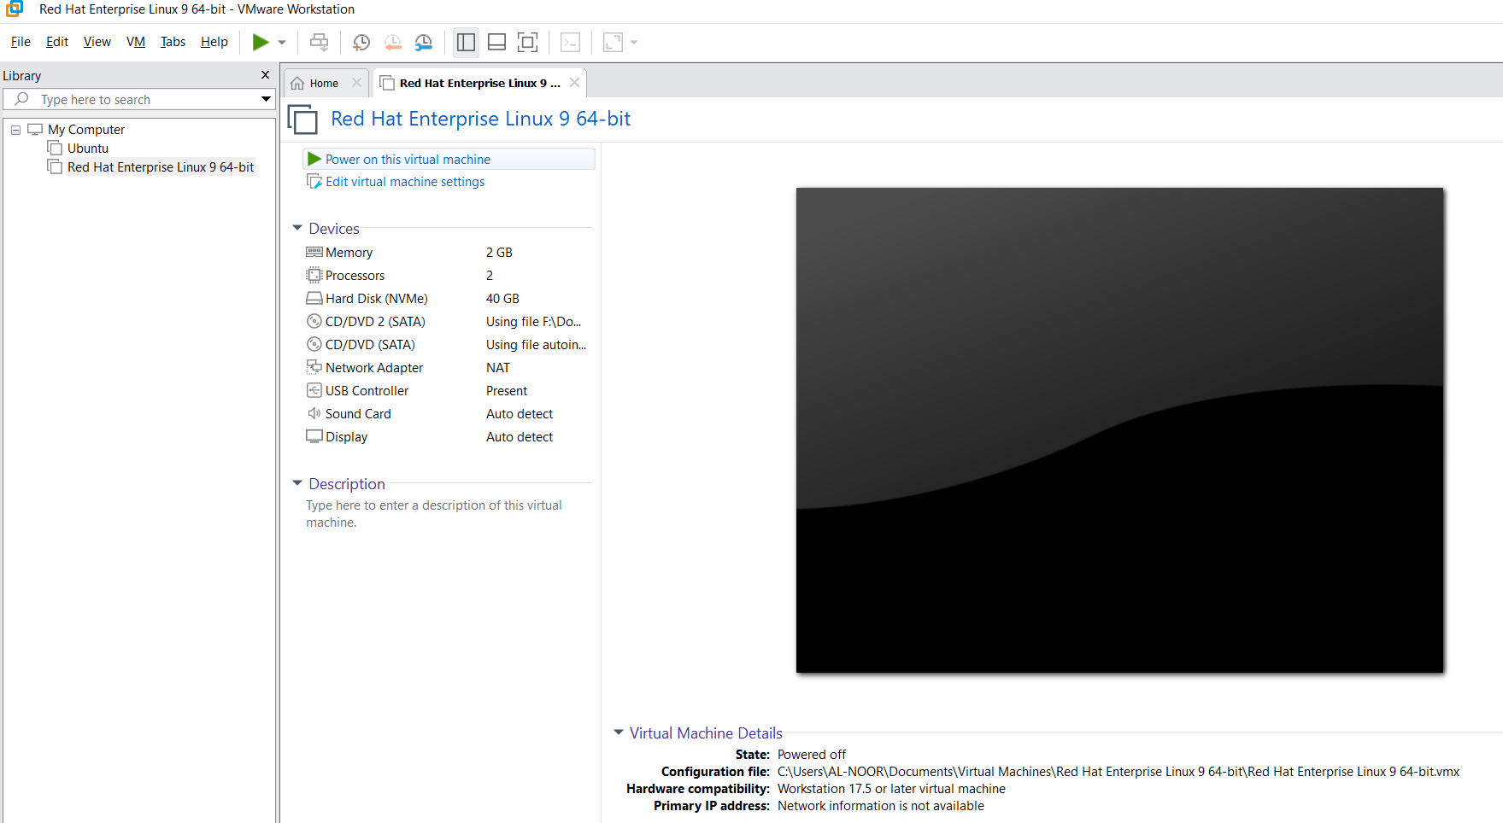
Click Power On

Slide 49
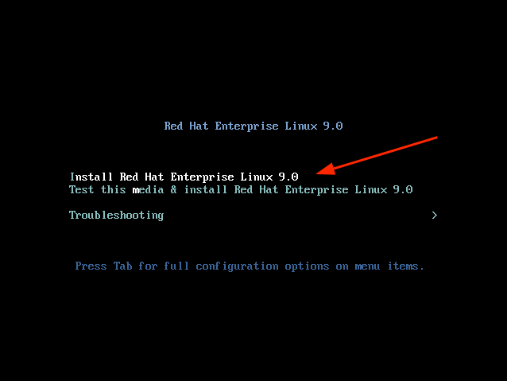

Step 1: Start RHEL 9 Installation
When the system reboots, you will get a black screen with the following options. To begin the installation, press ENTER on the first option ‘Install Red Hat Enterprise Linux 9.0’.

Slide 50
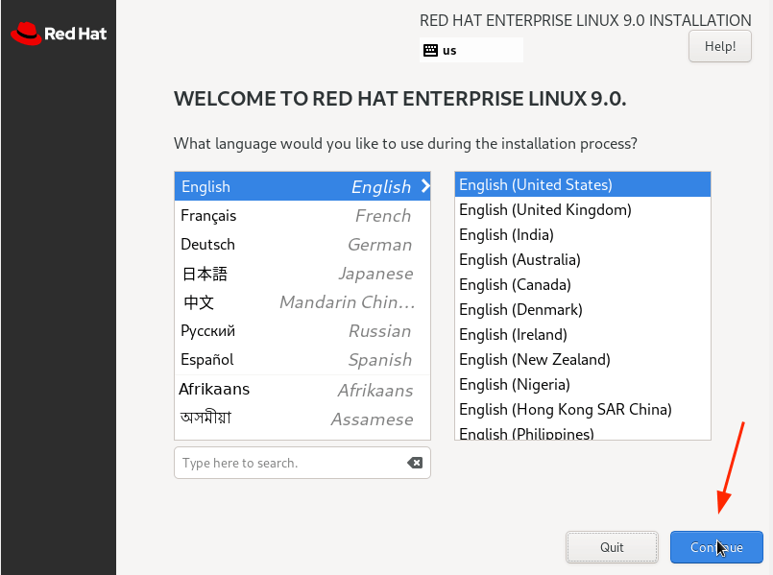

Slide 51
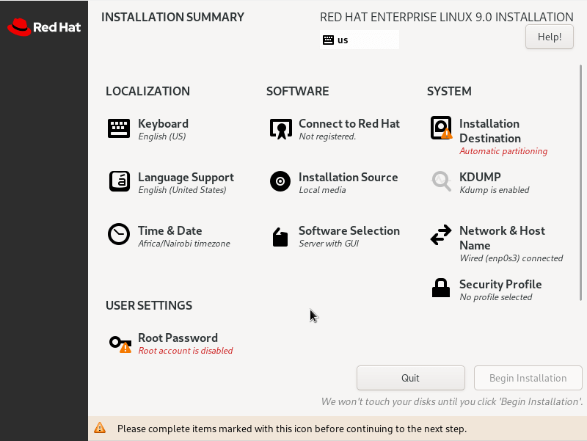
Step 2: Configure Partitioning

Slide 52
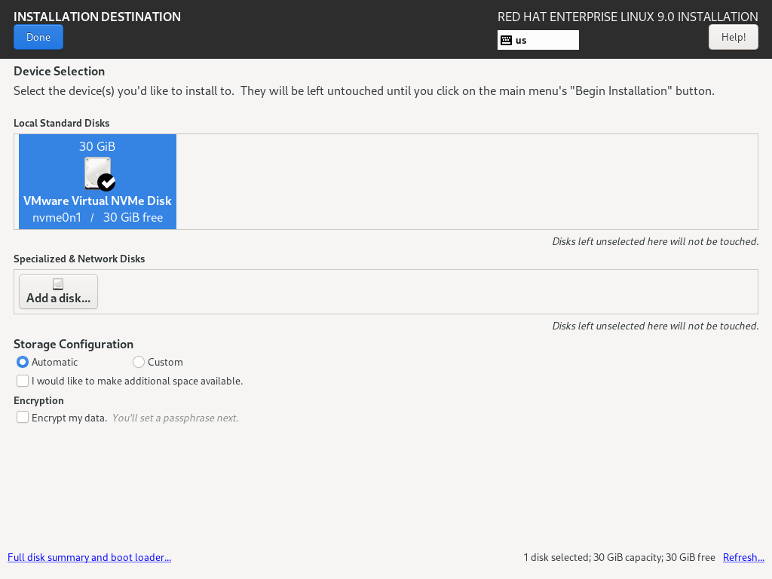
Click Done

Slide 53
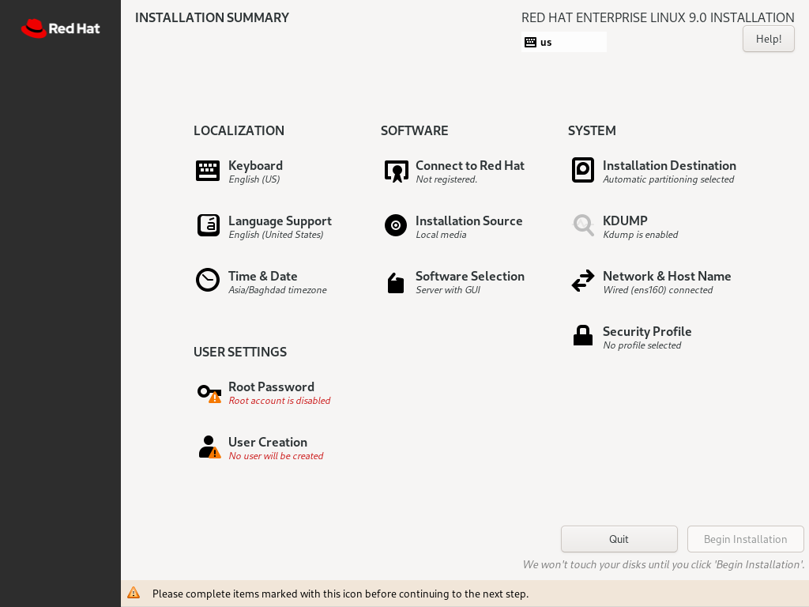

Slide 54
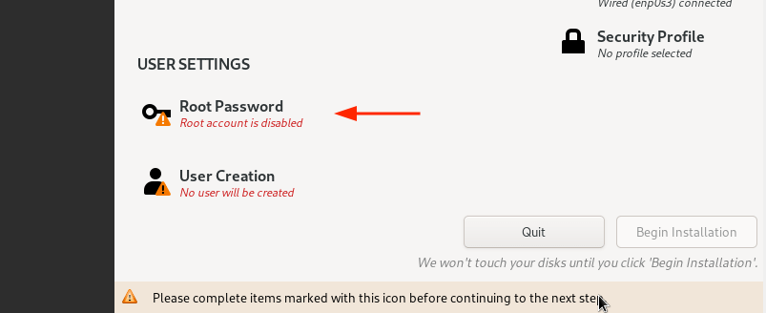

Slide 55
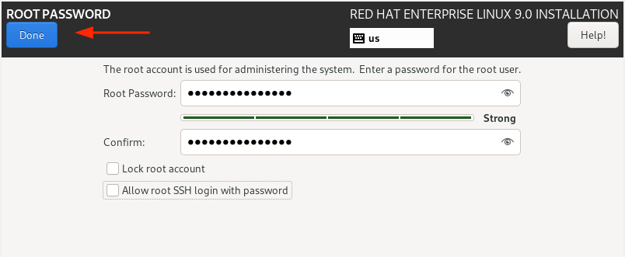

Slide 56
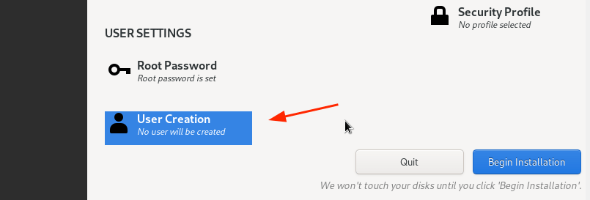

Slide 57
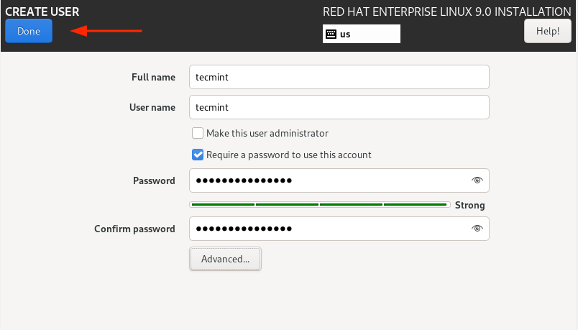

Slide 58
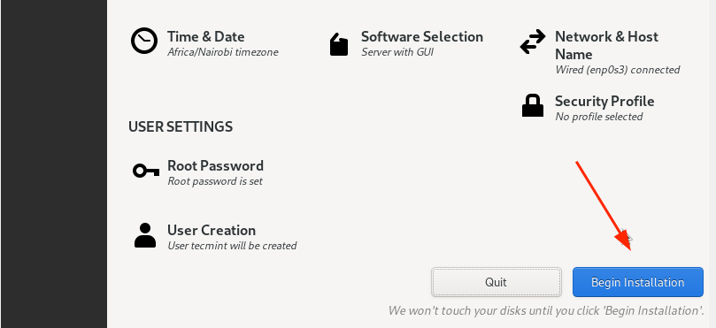

Slide 59
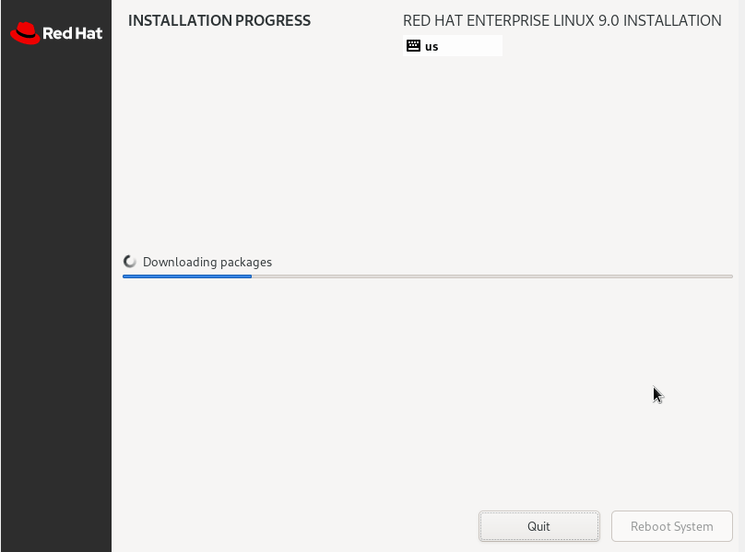

Slide 60
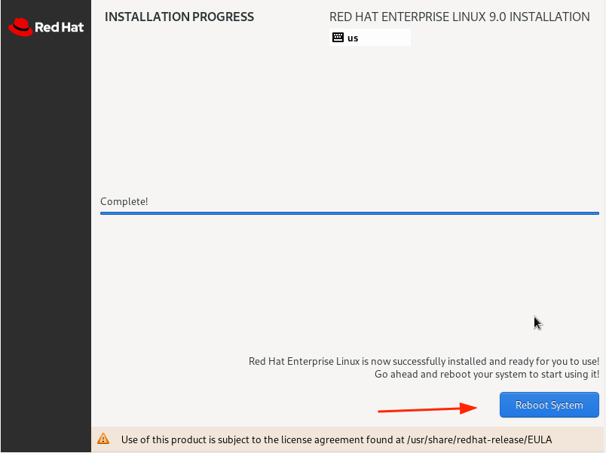

Slide 61
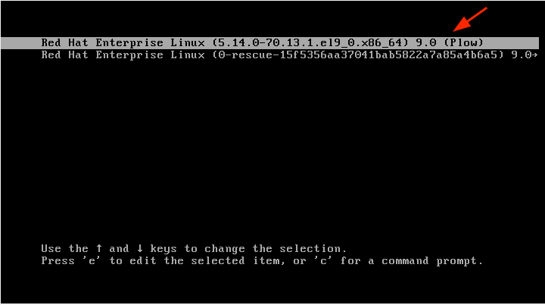

Slide 62
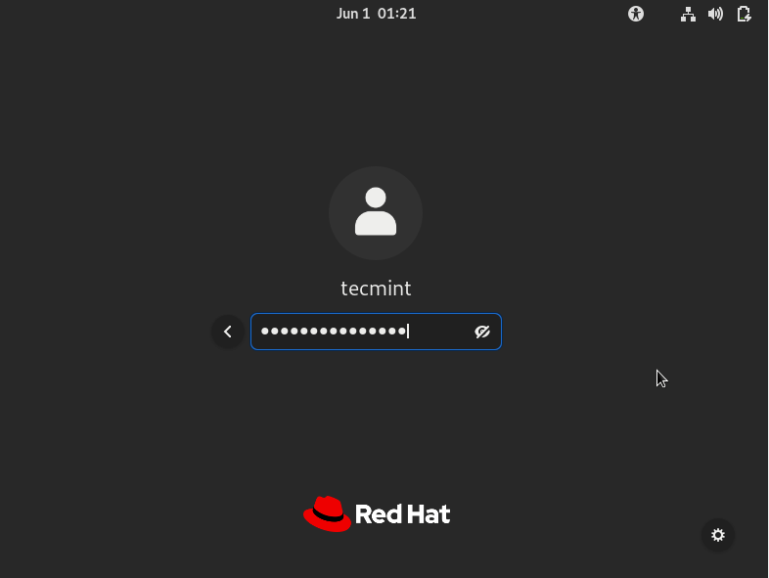

Slide 63
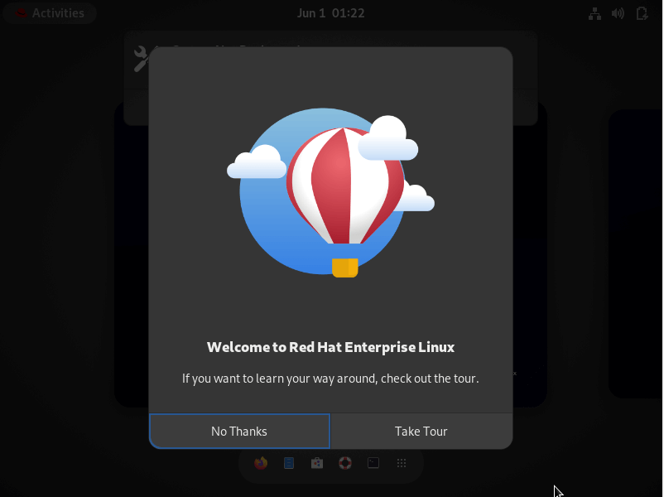

Slide 64
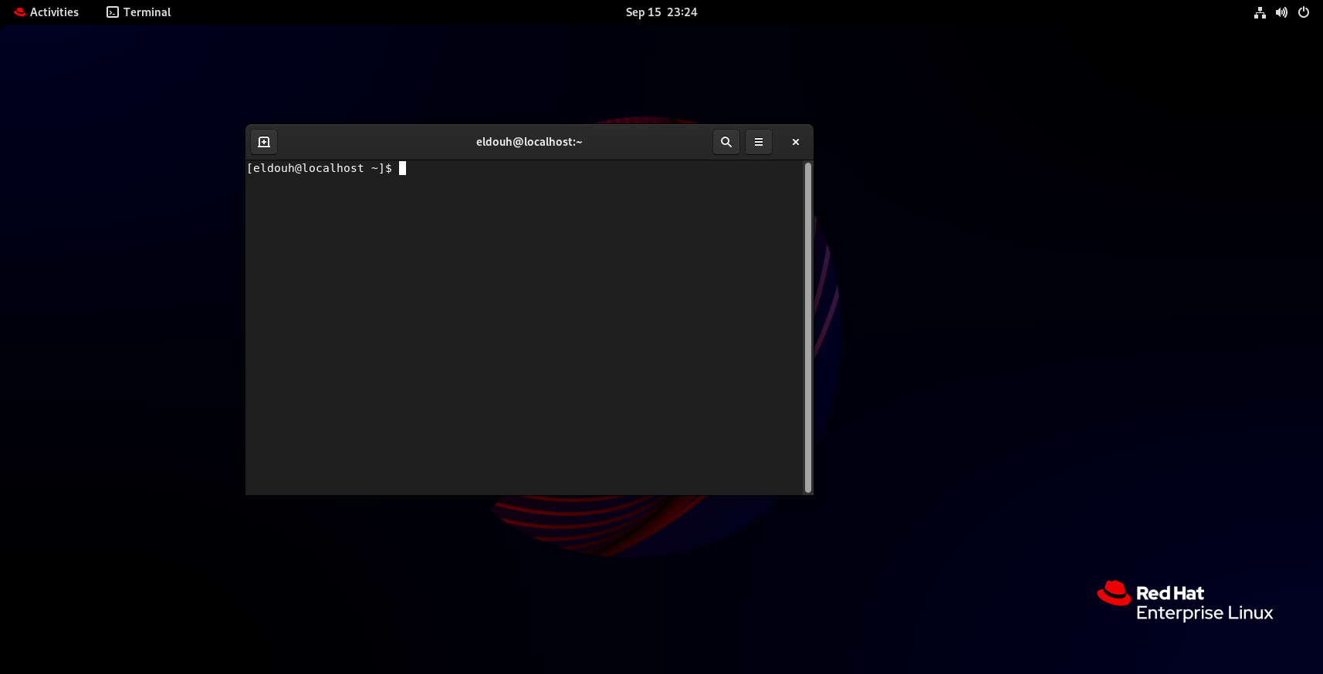
Click Ready

Slide 65
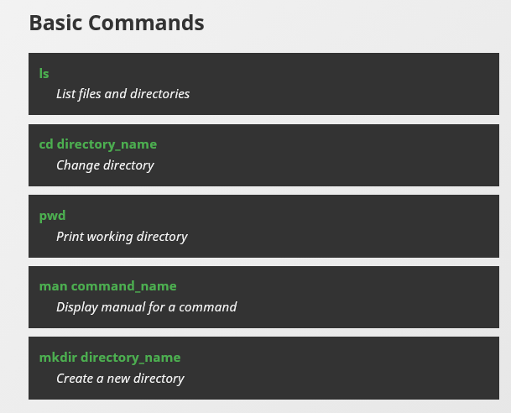

Slide 66



Thank You

