Slide 1


Project fundamental- Part one
Chapter 3
Everyone’s Smart University
PMG101
Project communication

Slide 2
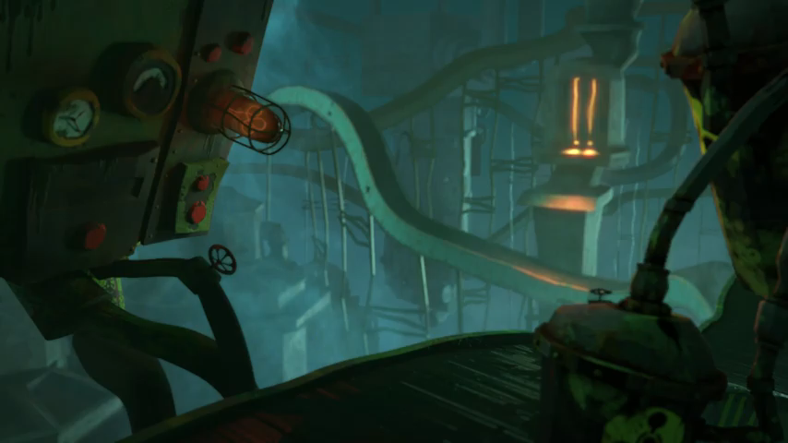

Slide 3
Section 2
Project environment
Lecture
Section 1
Project Fundamental
Project Phases

Slide 4
Section 1
Project Fundamentals

Slide 5
Project Fundamentals
In most cases, a project arises from a problem that needs to be solved or an opportunity that has the potential to be exploited. After identifying the problem or opportunity, sometimes called a business need, the project sponsor(s) explores the desirability of different options to determine whether the potential impact of the project is worth the investment in time and resources. Once a decision has been made to move forward, a project charter is created.

Slide 6
The Project charter
Does the project leader initiate the project, or does a project itself generate the need for a project leader?
The answer is the project charter, which can be defined as this document describes the need that the project is designed to address, specifies where project funding will come from, and identifies parties important to the project (stakeholders).

Slide 7
Defining “Project”
It would be impractical to move any further without a proper definition of what a “project” is. According to the Project Management Institute’s Project Management Body of Knowledge (PMBOK), a project has two defining features:
• A defined beginning and end (i.e. it’s temporary), and
• Unique goals and outcomes.
Some have observed a third feature common to many projects:
• The need for team members with varied skills

Slide 8
The difference between Projects and operational work
Projects differ from operational work, which is often considered “business as usual.”
Operational work is generally not unique. It’s often repetitive, and continues until it’s no longer needed, rather than seeking a defined endpoint.
Though varied skills are sometimes required for operational work, the application of these skills is usually less dynamic than in a project environment.

Slide 9
The difference between Projects and operational work
Projects differ from operational work, which is often considered “business as usual.”
Project outcomes are unique by definition.
Projects and operational work do share many core competencies the management techniques needed for each are quite different.

Slide 10
The difference between Projects and operational work
For instance
In some cases the distinction between projects and operational work can be rather difficult to define. One example is maintenance, including applying security patches to a server or changing parts on a machine. Though individual efforts may be unique during certain defined periods, the “larger picture” is somewhat repetitive and ongoing. Most professionals would define these as projects (because they are more dynamic than typical operational work) but understand that they require slightly different skillsets and strategies than the type of project work focused upon by this book.

Slide 11
Project Manager vs. Project Sponsor
Who is ultimately responsible for the success of the project, the project manager or the project sponsor?
The project sponsor is primarily responsible for the origination, financial support, and championing of the project to parties outside the project’s “circle of control.”
The project manager’s responsibilities lie primarily within the boundaries of the project itself and are constrained by the cost, scope, and schedule available

Slide 12
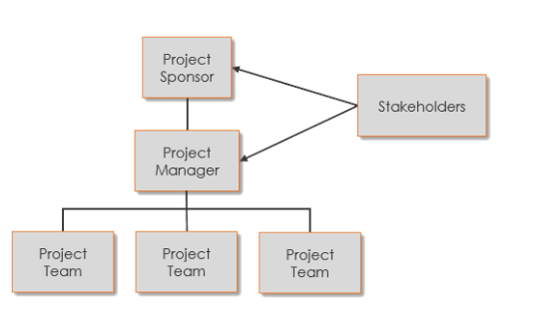
Project Manager vs. Project Sponsor

Slide 13

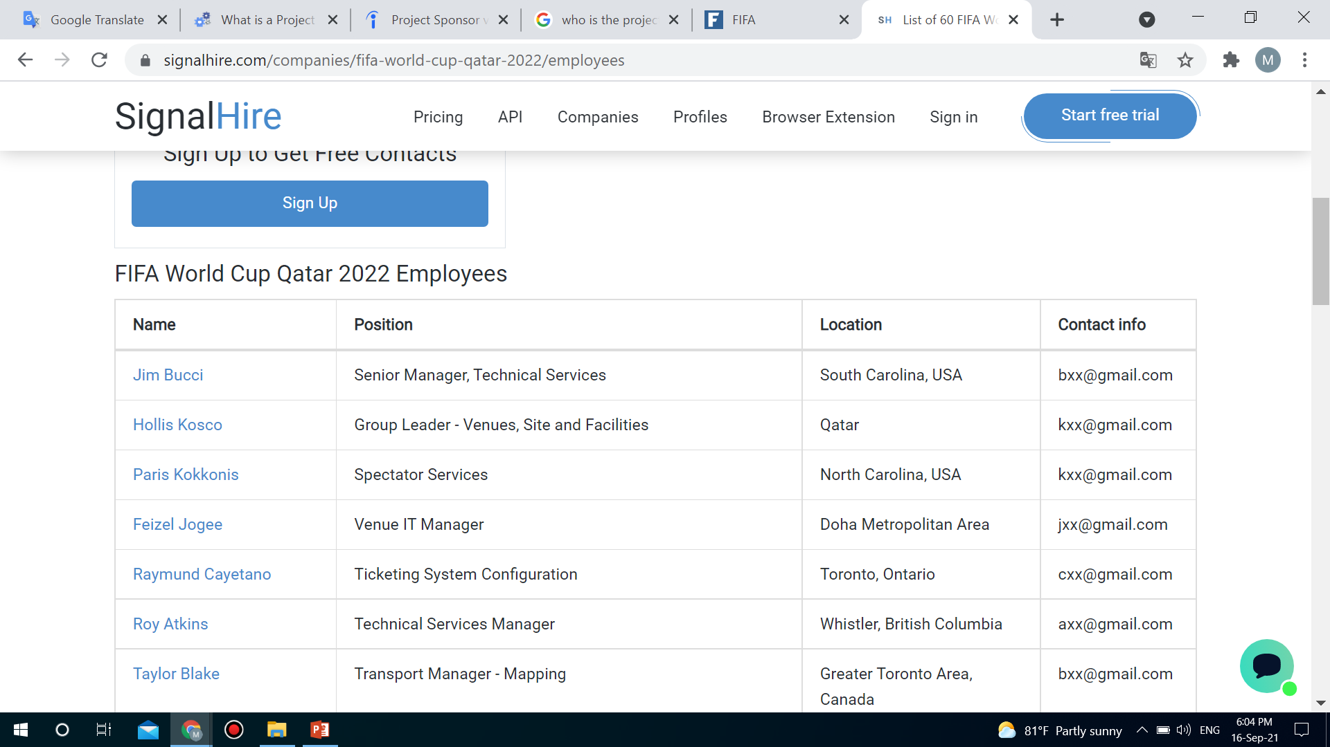

Slide 14
Project Manager vs. Project Sponsor
Responsibilities of project managers are:
  Preparing reports and other paperwork
  Analyzing the risks and creating solutions
  Managing timelines for milestones
  Keeping team members motivated
  Acting as a liaison among stakeholders
  Overseeing or executing each phase of the project plan
  Creating and managing each project's budget
  Planning projects with team members and higher-level professionals

Slide 15
Project Manager vs. Project Sponsor
Responsibilities of project Sponsers are:
Negotiating funding and acting as a spokesperson.
Providing guidance and direction for project empowerment, initiatives and key business strategies
Identifying, qualifying and managing project benefits
Participating in initial project planning, including developing the project scope and chart
Identifying critical success factors and approving deliverables
Negotiating with stakeholders to gain consensus when there are differences in opinions
Evaluating the project's success on completion

Slide 16
Section 1
Project Phases

Slide 17
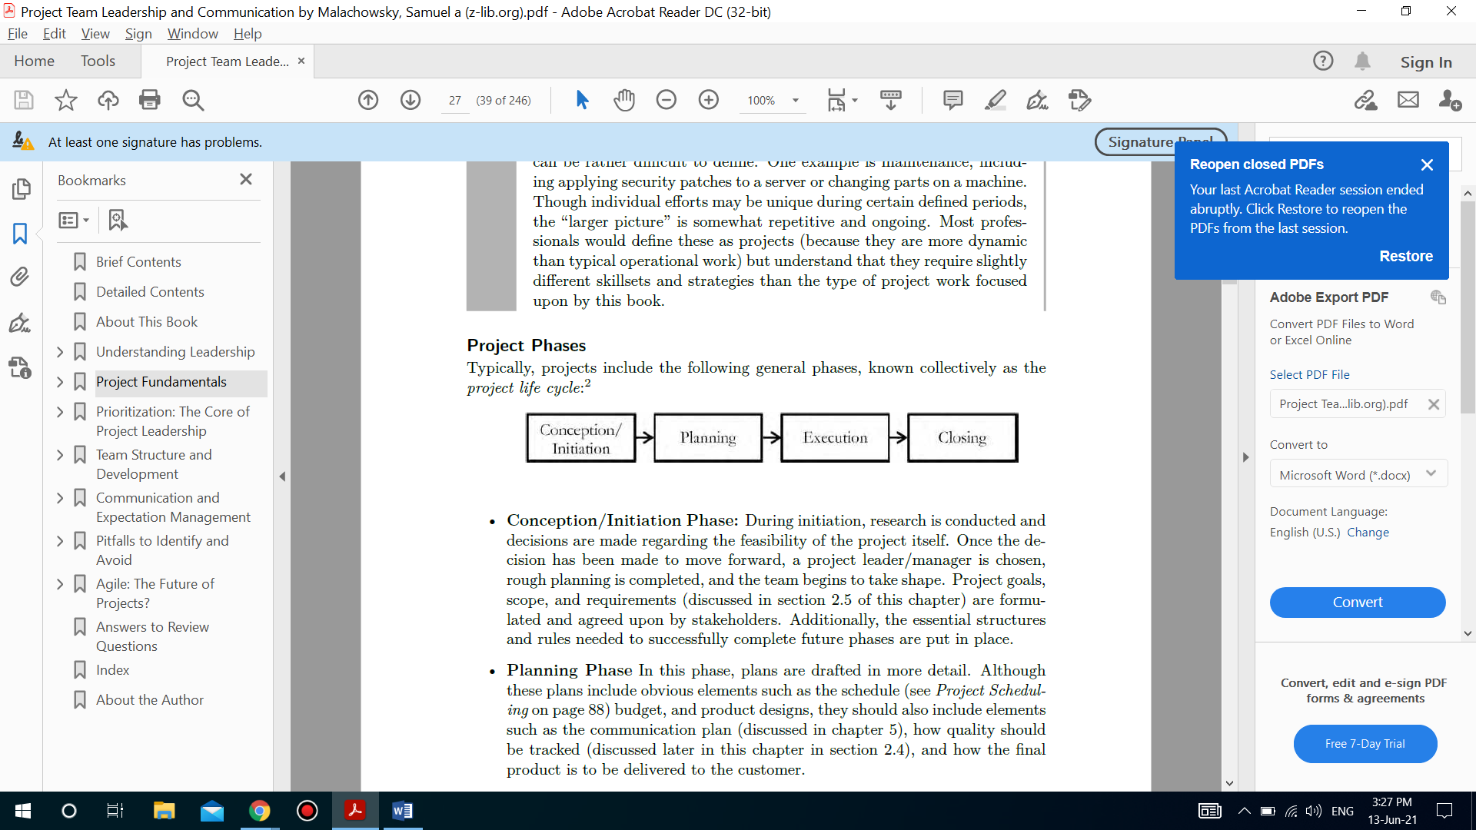
Project Phases
Typically, projects include the following general phases, known collectively as the
project life cycle:

Slide 18
Project Phases
Conception/Initiation Phase
During initiation, research is conducted and decisions are made regarding the feasibility of the project itself.
Once the decision has been made to move forward, a project leader/manager is chosen, rough planning is completed, and the team begins to take shape. Project goals, scope, and requirements are formulated and agreed upon by stakeholders.
Additionally, the essential structures and rules needed to successfully complete future phases are put in place.

Slide 19
Project Phases
Planning Phase
In this phase, plans are drafted in more detail. Although these plans include obvious elements such as the schedule budget, and product designs, they should also include elements such as the communication plan how quality should be tracked and how the final product is to be delivered to the customer.

Slide 20
Project Phases
Execution Phase
This is where “the rubber meets the road” and the bulk of the project work is completed. More specifically, the plans created in the previous phases are implemented. Because progress is being made, it is essential that other important activities such as schedule tracking and communication take place on a regular basis.
Complex or multi-phase projects may move between the planning and execution phases multiple times.

Slide 21
Project Phases
Closing Phase
The final phase ensures that previous efforts are appropriately brought to an end. This involves hand-off to the customer and the release of professional responsibility.
It also requires equipment, personnel, and budgets to be properly accounted for.
During this phase, one essential duty that’s often neglected is the collecting and properly disseminating of lessons learned so that future projects can benefit from the successes and failures experienced during the project.

Slide 22
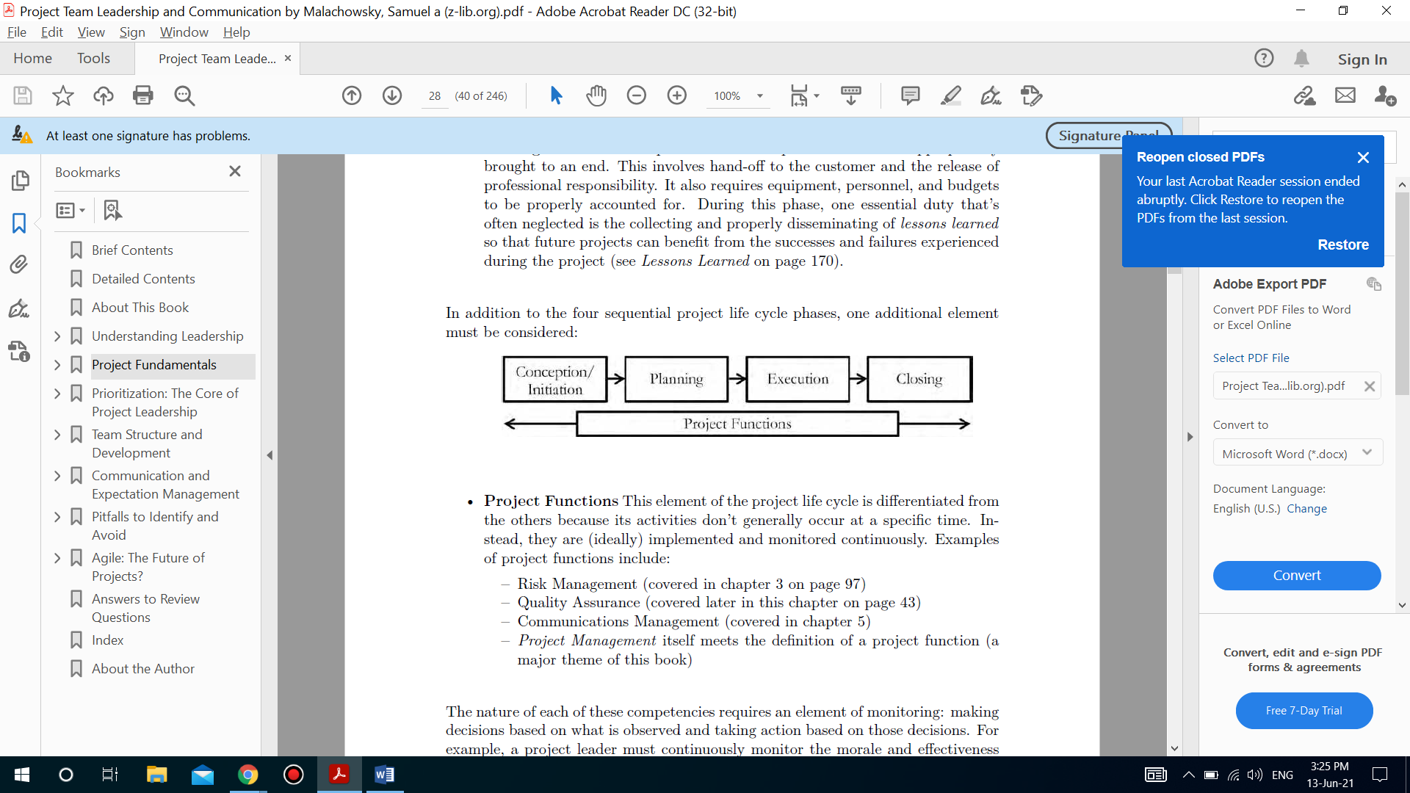
Project Phases
In addition to the four sequential project life cycle phases, one additional element must be considered:

Slide 23
Project Phases
Project Functions
Project Functions this element of the project life cycle is differentiated from the others because its activities don’t generally occur at a specific time. Instead, they are (ideally) implemented and monitored continuously.
Examples of project functions include:
– Risk Management
– Quality Assurance
– Communications Management
– Project Management itself meets the definition of a project function.

Slide 24
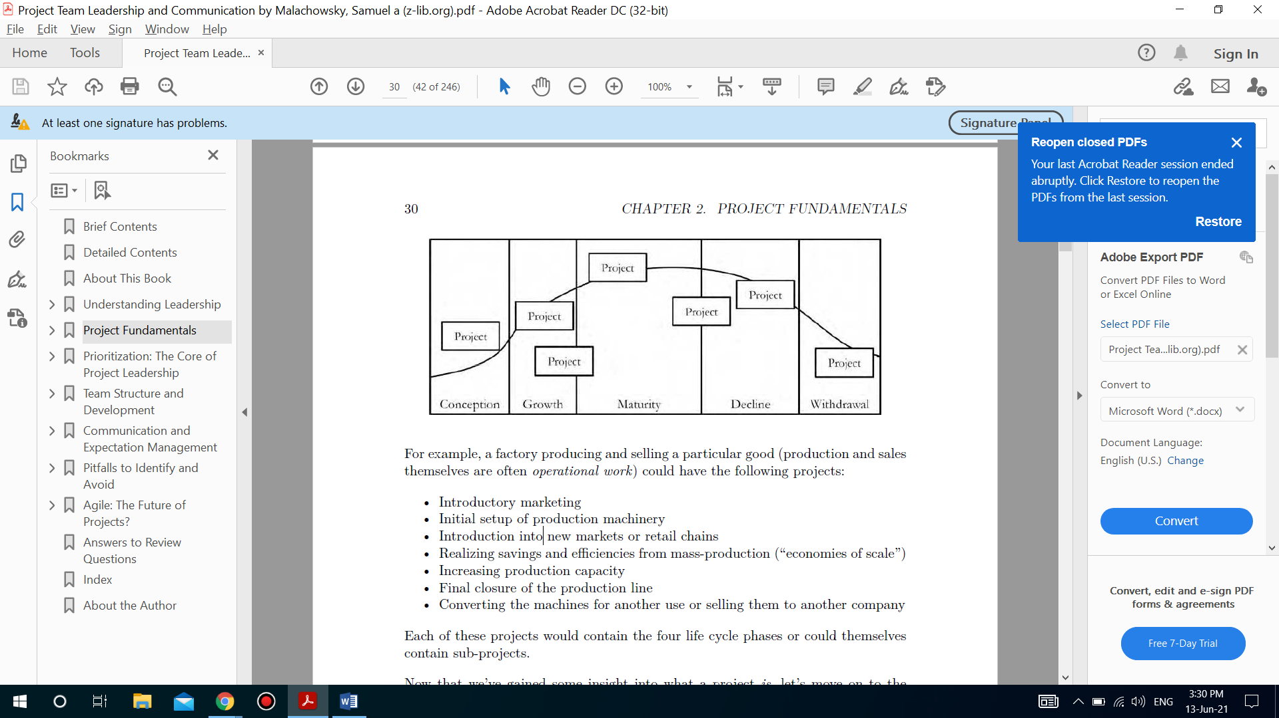
Project Phases
Project life cycle
In addition to projects that encompass a small part of a single effort, some projects are part of a product’s life cycle. Each stage of a product’s life could include one or more projects:

Slide 25
Project Phases
Project life cycle
In addition to projects that encompass a small part of a single effort, some projects are part of a product’s life cycle. Each stage of a product’s life could include one or more projects:
For example, a factory producing and selling a particular good (production and sales themselves are often operational work) could have the following projects:
• Introductory marketing
• Introduction into new markets or retail chains
• Increasing production capacity
• Final closure of the production line
• Converting the machines for another use or selling them to another company

Slide 26
Section 2
Project Environment

Slide 27
The Project environment
There are many factors beyond the goals of a project that affect its nature. The size or structure of a project.
Another element that has a huge effect on projects is the culture of the organization. The very structure of the organization itself also affects its projects.
By examining different structures, we can begin to draw conclusions about that effect, particularly as it pertains to resources and personnel. Experts generally divide organizations into three main types:
Functional
Project focused
Matrix

Slide 28
The Project environment
Functional organizations
What is the functional organizational structure?
It is the “classic” structure and is typically divided by specialty, with multiple layers of hierarchy in each functional area.
Structuring an organization in this manner may increase its efficiency. This is because resources with similar skill-sets are in close proximity, which in turn allows more efficient management, hiring practices, and cross-training.
. Though quite efficient for operational work, projects are forced to draw resources from multiple departments, and the project leaders themselves often report to one of them.

Slide 29
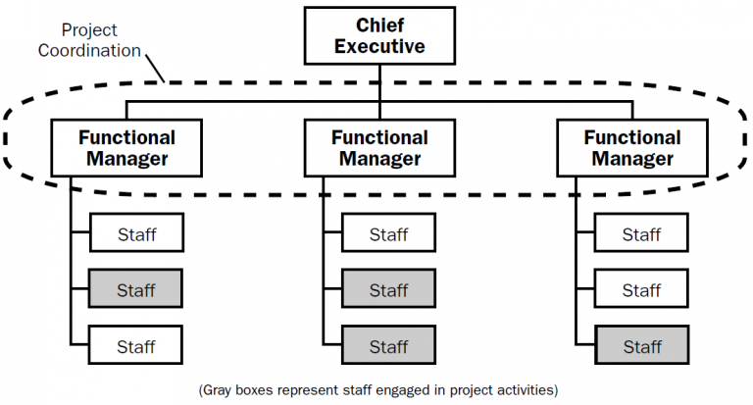
The Project environment
Functional organizations

Slide 30
The Project environment
Functional organizations
Because of the need to draw resources from multiple functional areas, this structure has the potential to present multiple difficulties during the project:
• Authority
Though the project leader is responsible for the success of the project, they rarely have direct, formal authority over all members of their team.
If difficulties arise, the best course of action is often to seek support from a resource’s functional manager, but this can be slow and inefficient and can be especially problematic if that manager tends to agree with their subordinate.
This type of “bureaucracy” can be extremely damaging to projects with tight schedules or vital outcomes.

Slide 31
The Project environment
Functional organizations
Because of the need to draw resources from multiple functional areas, this structure has the potential to present multiple difficulties during the project:
• Priority
The stark reality is that projects rarely get “100%” of any functional resource’s time assigned to them—it’s not uncommon for a functional manager to “lend” 25%.

Slide 32
The Project environment
Functional organizations
Because of the need to draw resources from multiple functional areas, this structure has the potential to present multiple difficulties during the project:
• Priority
Because projects are, by their very nature, temporary, it’s easy for the permanence of operational work to dominate the workplace—resources are, after all, hired and evaluated by their operational manager whose primary focus is on operational work.
This situation becomes even more complicated when resources are further divided, at say 50% operational work, 25% “project A,” and 25% “project B”—now even more priorities must compete for a single resource’s time.

Slide 33
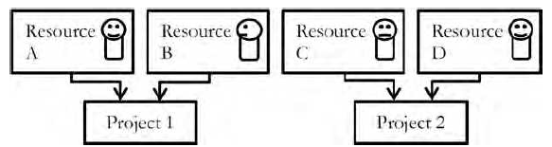
The Project environment
Project focused organizations
What are project-focused organizations?
Project-focused organizations are defined by resources’ primary attachment to individual projects rather than a department or division. They have minimized functional structure and are often rather “flat,” meaning there are very few layers of management between the bottom and top.

Slide 34
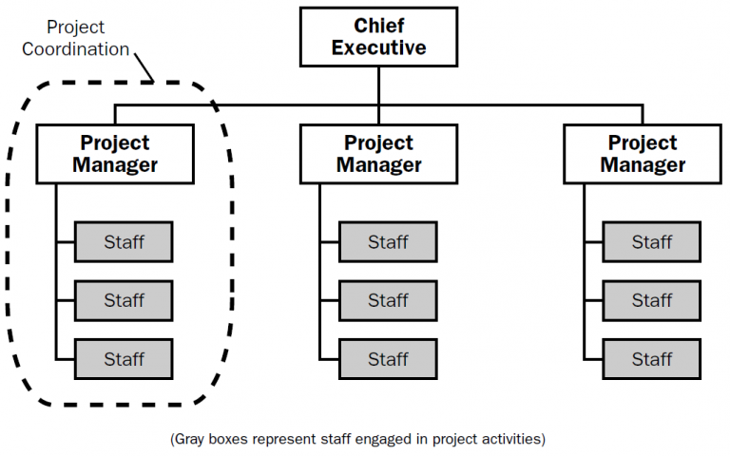
The Project environment
Project focused organizations

Slide 35
The Project environment
Project focused organizations
Because this structure is radically different from a functional structure, the issues affecting projects in functional organizations (authority and priority) are minimized.
Instead, the project is more likely to experience issues similar to those of a stand-alone organization:
Competition
Viability
Autonomy

Slide 36
The Project environment
Project focused organizations
Competition
Though competition is often seen as a good thing, competition between projects within the same organization can have negative effects, especially when it comes to finding and retaining resources and team members.
The temporary nature of projects means that team members must seek new projects as old ones come to an end, often in order to remain employed.
Vital projects that are nearing an end or are otherwise less desirable can be left starving for resources, struggling to complete their objectives and meet their schedules.

Slide 37
The Project environment
Project focused organizations
Viability
Because each project is essentially independent, greater demands are often present regarding its “return on investment.” Whether designed to meet a stated need, address a problem, or turn a financial profit, projects in this environment must consistently demonstrate the potential for a net-positive outcome.
Because of this, projects that exceed resource or time constraints face cancellation—even projects that are “on track” are regularly compared to other projects to decide if they remain a solid investment.
This reality often requires the project leader or sponsor to continuously advocate for the project within the larger organization, which can take time away from managing the project itself.

Slide 38
The Project environment
Project focused organizations
Autonomy
The independent nature of the project teams can also make it difficult to appreciate the lessons learned from previous projects: a disincentive to share these and benefit “competing” projects may even appear.

Slide 39
The Project environment
Matrix organizations
What is a matrix organizational structure?
A matrix organizational structure is a workplace format in which employees report to two or more managers rather than one manager overseeing every aspect of a project.
For example, an employee may have a primary manager they report to as well as one or more managers of projects they work under.
This type of structure is often useful when skills need to be shared across departments to complete a task and can allow companies to utilize a wide range of talents and strengths.

Slide 40
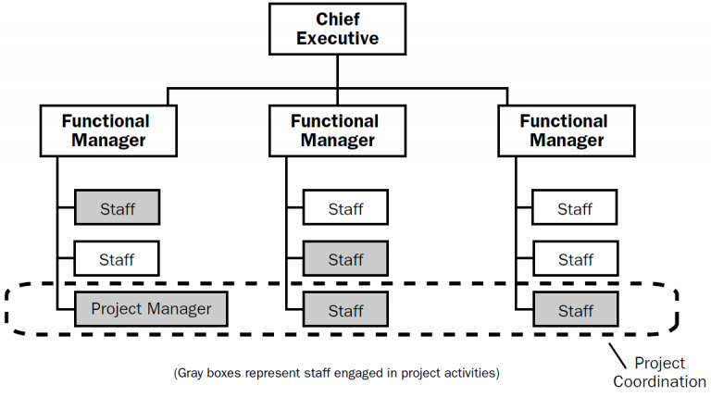
The Project environment
Matrix organizations

Slide 41
The Project environment
Matrix organizations
From a theoretical point of view, there are two more adjustments that can be made:
weak matrix
A weak matrix retains the management of the project in the hands of the functional managers instead of the project team, like this:

Slide 42
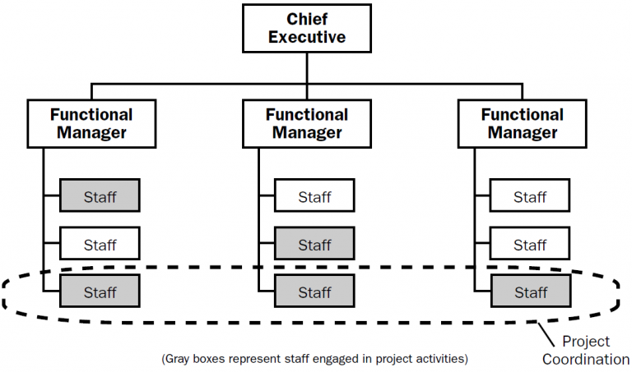
The Project environment
Matrix organizations
From a theoretical point of view, there are two more adjustments that can be made:
weak matrix

Slide 43
The Project environment
Matrix organizations
From a theoretical point of view, there are two more adjustments that can be made:
Strong matrix
a strong matrix is still a functional organizational structure, but has a completely separate project management arm. All of the project roles are still fulfilled within the functional departments, but the project manager is on the same level as the functional managers.

Slide 44
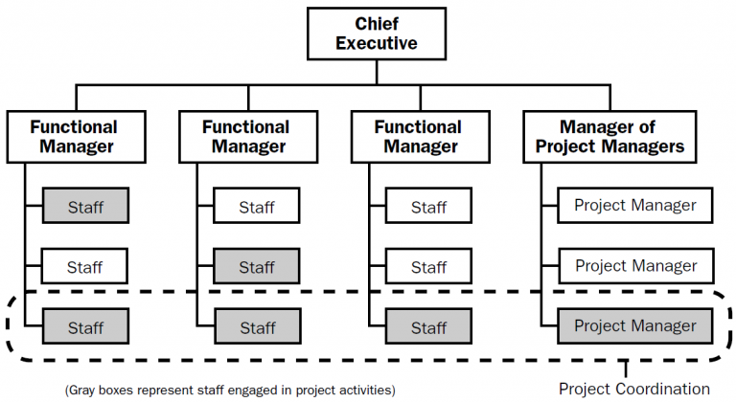
The Project environment
Matrix organizations
From a theoretical point of view, there are two more adjustments that can be made:
Strong matrix

Slide 45
The Project environment
Matrix organizations
Examples
A vehicle manufacturing firm sets up a project to modernize its assembly line, whereby the project manager is dedicated full time to the project and reports to the executive. The project manager chooses their project team from the design, production, and maintenance departments, who must balance their time between their regular duties and achieving their project work. This is a strong matrix organization.

Slide 46
The Project environment
Matrix organizations
Composite matrix
Functional organizations and project-oriented organizations are at opposite ends of the spectrum and matrix organizations fall somewhere in between. But it is possible to utilize both structures at the same time. Therefore, there is a fourth option that requires mention, the composite structure.

Slide 47
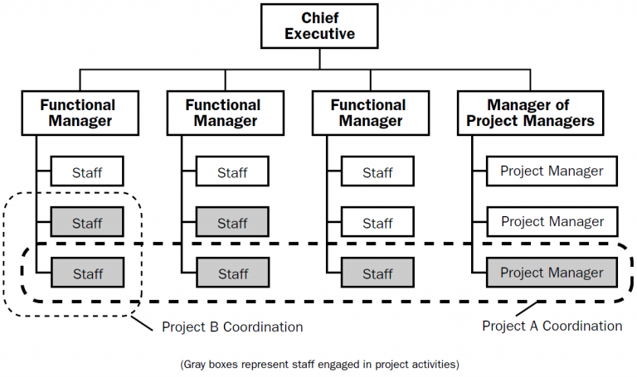
The Project environment
Matrix organizations
Composite matrix

Slide 48
The Project environment
Matrix organizations
Composite matrix
This occurs when a project structure and a functional structure both report to a central executive.

Slide 49
The Project environment
Matrix organizations
Composite matrix

Slide 50
The Project environment
Matrix organizations
Composite matrix
For example, a state government department of transportation has a maintenance division which seeks to maintain the level of service of the state’s roads and bridges, and a capital projects division which builds new roads and bridges. The maintenance division and the capital projects division are located side by side, reporting to the executive.
This is a composite organizational structure (A matrix structure would require new construction to occur within one of the maintenance departments – the project manager would report to a functional manager rather than the executive).

Slide 51
Thank You

