Slide 1



English Language 2
by Samara Jasim
ENG 102
Orientation Lecture

Slide 2



www.midocean.ae
Who am I?
Samara Jasim
  Lecturer: specialized in Teaching English as a Foreign Language Field;
  Educational Consultant;
  Sworn Translator; and
  Paralegal

Slide 3
www.midocean.ae
Course Details
This course aims to:
Develop basic skills to deal with people in business situations;
Increase knowledge of key business concepts worldwide;
Expand vocabulary related to general business situations; and
Develop confidence to deal with people and basic issues in the business world.

Slide 4


www.midocean.ae
Learning Resources
Credit Hours:
5 credit hours.
  Recommended Resources:
  Market Leader, Course Book, Pre-Intermediate, by Pearson
  Market Leader, Practice Book, Pre-Intermediate, by Pearson
  Essential References:
1. A Dictionary

Slide 5
www.midocean.ae
What is this course about?
Market Leader is a multi-level business English course for businesspeople and students of business English. It has been developed in association with the Financial Times, one of the leading sources of business information in the world. It consists of 12 units based on topics of great interest to everyone involved in international business.

Slide 6
www.midocean.ae
Course Content
Course Unit | No.of. Weeks | Contact Hours
Unit 1: Careers | 2nd | 5
Unit 2: Companies | 3rd | 5
Unit 3: Selling | 4th | 5
Unit 4: Great Ideas | 5th | 5
Unit 5: Stress | 6th | 5
Unit 6: Entertaining | 7th | 5
Unit 7: New Business | 8th | 5
Unit 8: Marketing | 9th | 5
Unit 9: Planning | 10th | 5
Unit 10: Managing People | 11th | 5
www.midocean.ae

Slide 7
www.midocean.ae
Assessment Tools
  Multiple Choice, T&F, Matching, Arranging, Audio Questions
  80% marks
    10 weekly quizzes (open on Saturdays, at 22:00 ksa and close next Saturday at 21:00 ksa)
    The duration of each quiz is (24 minutes only = 3 minutes for each question)
    8 Marks for each of short exam.
    8 questions
  20% Final Examination

Slide 8

www.midocean.ae
Assessment Tools

Slide 9

www.midocean.ae
Assessment Tools

Slide 10
www.midocean.ae
Online Session

Slide 11
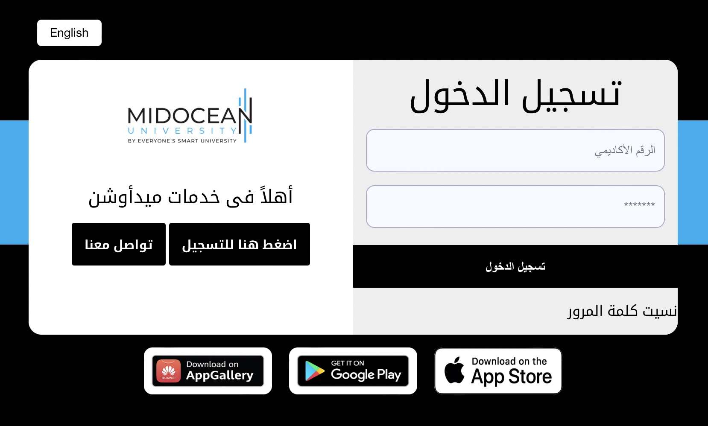
www.midocean.ae
Contact Us
SIS Platform:
https://sis.midocean.ae/login

Slide 12


