Slide 1


Healthcare Informatics
Foundations, Scope, and Strategic Value
Prepared by Dr. Hesham Mousli
MHA 621
Healthcare Informatics
Lecture 1

Slide 2

Intended Learning Objectives
Chapter
01
By the end of this lecture, you should be able to:
  Define healthcare informatics.
  Explain how data become useful decisions.
  Identify the main healthcare informatics domains.
  Describe the main hospital information systems.
  Explain the strategic value of health information technology.

Slide 3
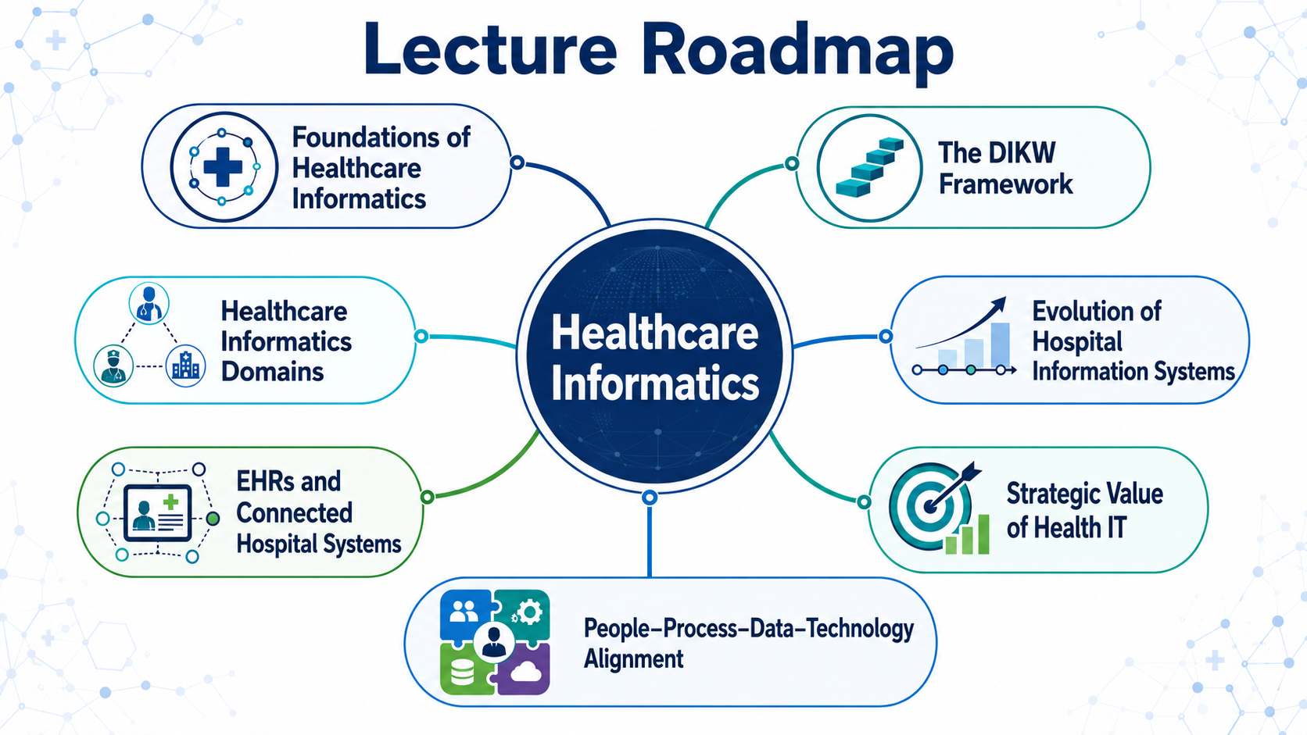

Slide 4
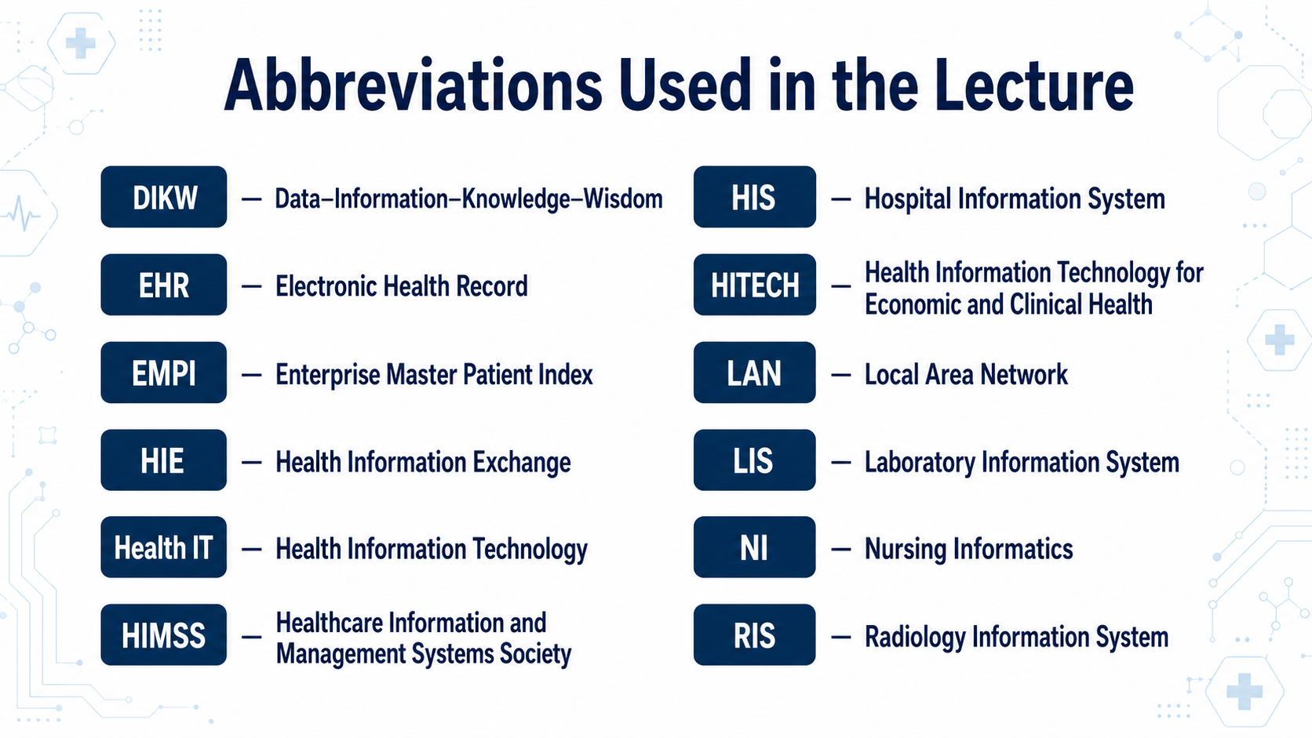

Slide 5
What Is Healthcare Informatics?
Chapter
01
Healthcare informatics is the use of data, information, knowledge, people, and technology to improve healthcare. It combines:
  Healthcare knowledge
  Information science
  Computer technology
  Healthcare informatics studies how information is collected, organized, shared, and used to support better healthcare decisions.

Slide 6
What Is Health Information Technology?
Chapter
01
Health Information Technology (Health IT) means the electronic systems and tools used to collect, store, process, share, and use health information.
Examples include:
  Electronic health records
  Laboratory systems
  Pharmacy systems
  Patient portals
  Healthcare dashboards
  Healthcare informatics is the wider field. Health IT includes the technological tools used within that field.

Slide 7
Chapter
Healthcare Informatics Is More Than Technology
01
A computer system alone cannot improve healthcare.
Healthcare informatics brings together:
  People: patients, clinicians, and managers
  Processes: the steps followed during healthcare work
  Information: meaningful healthcare facts
  Technology: the tools that manage information
All four parts must work together.

Slide 8
Why Healthcare Informatics Is Needed
Chapter
01
Healthcare produces large amounts of data every day.
Examples include:
  Patient information
  Diagnoses
  Medication orders
  Laboratory results
  Nursing assessments
  Without informatics, these data may remain scattered and difficult to use. Informatics turns them into information that supports healthcare decisions.

Slide 9
The DIKW Framework
Chapter
01
The Data–Information–Knowledge–Wisdom (DIKW) framework explains how basic facts lead to good decisions.
The four levels are:
  Data: basic facts
  Information: organized facts with meaning
  Knowledge: understanding the information
  Wisdom: using knowledge to make a decision
  Data → Information → Knowledge → Wisdom

Slide 10
Data
Chapter
01
Data are basic facts, measurements, or observations.
Examples:
  Temperature: 39°C
  Heart rate: 120 beats per minute
  Blood pressure: 85/55 millimetres of mercury
  Blood glucose: 300 milligrams per decilitre
A single data item may not explain the whole situation. Data must be accurate, complete, and connected to the correct patient.

Slide 11
Information
Chapter
01
Information is created when data are organized and placed in context.
Example:
    Data: temperature 39°C, heart rate 120, and low blood pressure.
    Information: the patient has fever, a rapid heart rate, and low blood pressure at the same time.
Information helps answer:
    What happened?
    When did it happen?
    Is the patient improving or becoming worse?

Slide 12
Knowledge
Chapter
01
    Knowledge means understanding the importance of information.
    Example:
    A healthcare professional knows that fever, a rapid heart rate, and low blood pressure may indicate a serious infection.
    Knowledge comes from:
    Education
    Clinical experience
    Research evidence
    Clinical guidelines

Slide 13
Wisdom
Chapter
01
    Wisdom means using knowledge correctly in a real situation.
    Example:
  The healthcare team recognizes that the patient may be seriously ill, assesses the patient, informs the responsible clinician, and starts appropriate care.
    Wisdom requires:
  Understanding the patient’s condition
  Considering risks and benefits
  Selecting the right action
  Acting at the right time
Technology supports wisdom but does not replace human judgment.

Slide 14
Complete DIKW Example
Chapter
01
Consider a hospitalized patient:
  Data: oxygen saturation is 86%.
  Information: it has fallen from 96% to 86%.
  Knowledge: the patient may not be receiving enough oxygen.
  Wisdom: assess the patient and begin the required response.
  The system may record the value, show the trend, and produce an alert.
  The healthcare professional must make the final clinical decision.

Slide 15
Main Domains of Healthcare Informatics
Chapter
01
The main domains include:
  Clinical informatics
  Nursing informatics
  Pharmacy informatics
  Public health informatics
  Administrative informatics
They have different areas of focus, but all use information and technology to improve healthcare.

Slide 16
Clinical Informatics
Chapter
01
Clinical informatics applies information and technology to direct patient care.
It may support:
  Electronic clinical documentation
  Medication and laboratory orders
  Test-result review
  Clinical alerts
  Communication among care-team members
  Clinical informatics is used by physicians, nurses, pharmacists, and other healthcare professionals.

Slide 17
Nursing Informatics
Chapter
01
Nursing Informatics (NI) combines:
  Nursing science
  Information science
  Computer science
Its purpose is to manage and communicate data, information, knowledge, and wisdom in nursing practice.
NI supports patients, nurses, other professionals, and healthcare leaders.

Slide 18
Nursing Informatics
What Nurse Informaticists Do
Chapter
01
A nurse informaticist connects nursing practice with technology.
Major responsibilities include:
  Studying nursing workflows
  Designing electronic nursing documentation
  Supporting system implementation
  Training nurses
  Improving system use and patient safety
The nurse informaticist acts as a translator between clinical users and technology specialists.

Slide 19
Pharmacy and Other Clinical Informatics Areas
Chapter
01
Pharmacy informatics supports the safe and effective use of medications.
Examples include:
  Electronic medication orders
  Medication databases
  Allergy and interaction alerts
  Automated dispensing systems
  Electronic medication administration records
Other informatics areas support laboratory, radiology, surgery, and rehabilitation services.

Slide 20
Public and Consumer Health Informatics
Chapter
01
Public health informatics uses information to improve the health of populations. Examples include:
  Disease surveillance
  Outbreak monitoring
  Vaccination records
Consumer health informatics supports patients through:
  Patient portals
  Mobile health applications

Slide 21
Administrative Informatics
Chapter
01
Administrative informatics supports the management of healthcare organizations.
Important applications include:
  Patient registration
  Appointment scheduling
  Billing and insurance claims
  Staff scheduling
  Inventory control
Clinical and administrative systems should work together to support the whole organization.

Slide 22
Early Hospital Information Systems
Chapter
01
In the 1960s, hospitals with computers usually used large mainframe computers. These computers were:
  Large
  Expensive
  Centrally controlled
  Shared by many users
Hospitals often used one central Hospital Information System (HIS), mainly for registration, billing, and patient accounts.

Slide 23
Departmental Systems and Best of Breed
Chapter
01
During the 1970s, hospital departments began using their own specialized systems.
Examples included:
  Laboratory Information System (LIS)
  Radiology Information System (RIS)
  Pharmacy information system
Using different specialized systems is called a best-of-breed architecture.
Its main challenge is making the separate systems communicate correctly.

Slide 24
Personal Computers and Connected Systems
Chapter
01
Personal computers became more common during the 1980s.
They were:
  Smaller
  Less expensive
  More available
  Easier to use in hospital departments
Local Area Networks (LANs) connected computers within the same organization. This supported the development of many connected hospital systems.

Slide 25
Why Paper Records Were Not Enough
Chapter
01
Paper records created important problems:
  Records could be missing or difficult to find.
  Handwriting could be unclear.
  Only one person might use a record at a time.
  Information was difficult to search and analyze.
  Information could not easily be shared between organizations.
These limitations encouraged the development of electronic patient records.

Slide 26
Patient Safety as a Major Driver
Chapter
01
Preventable healthcare errors showed the need for safer systems.
  Major examples included:
  Medication-related harm
  Incorrect blood transfusions
  Patient falls
  Mistaken patient identity
  Failures in communication
Health IT became important for improving communication, detecting risks, and supporting safer decisions.

Slide 27
Payment Reform and Efficiency
Chapter
01
Changes in payment methods encouraged hospitals to use information systems.
Hospitals needed better information to:
  Control costs
  Monitor resources
  Measure performance
  Improve efficiency
  Meet reporting requirements
Health IT connected clinical activities with operational and financial results.

Slide 28
Growth of Electronic Health Records
Chapter
01
An Electronic Health Record (EHR) is an electronic collection of a patient’s health information that supports care over time.
In the United States, the Health Information Technology for Economic and Clinical Health (HITECH) Act of 2009 encouraged the use of certified EHR systems.
According to the textbook, hospital EHR adoption in the United States increased from about 9% in 2009 to more than 95% in 2017.

Slide 29
Main Functions of an Inpatient EHR
Chapter
01
An inpatient EHR may support:
  Clinical and nursing documentation
  Medication and test orders
  Laboratory and imaging results
  Clinical alerts
  Admission and discharge information
The EHR gives different healthcare professionals access to a shared patient record.

Slide 30
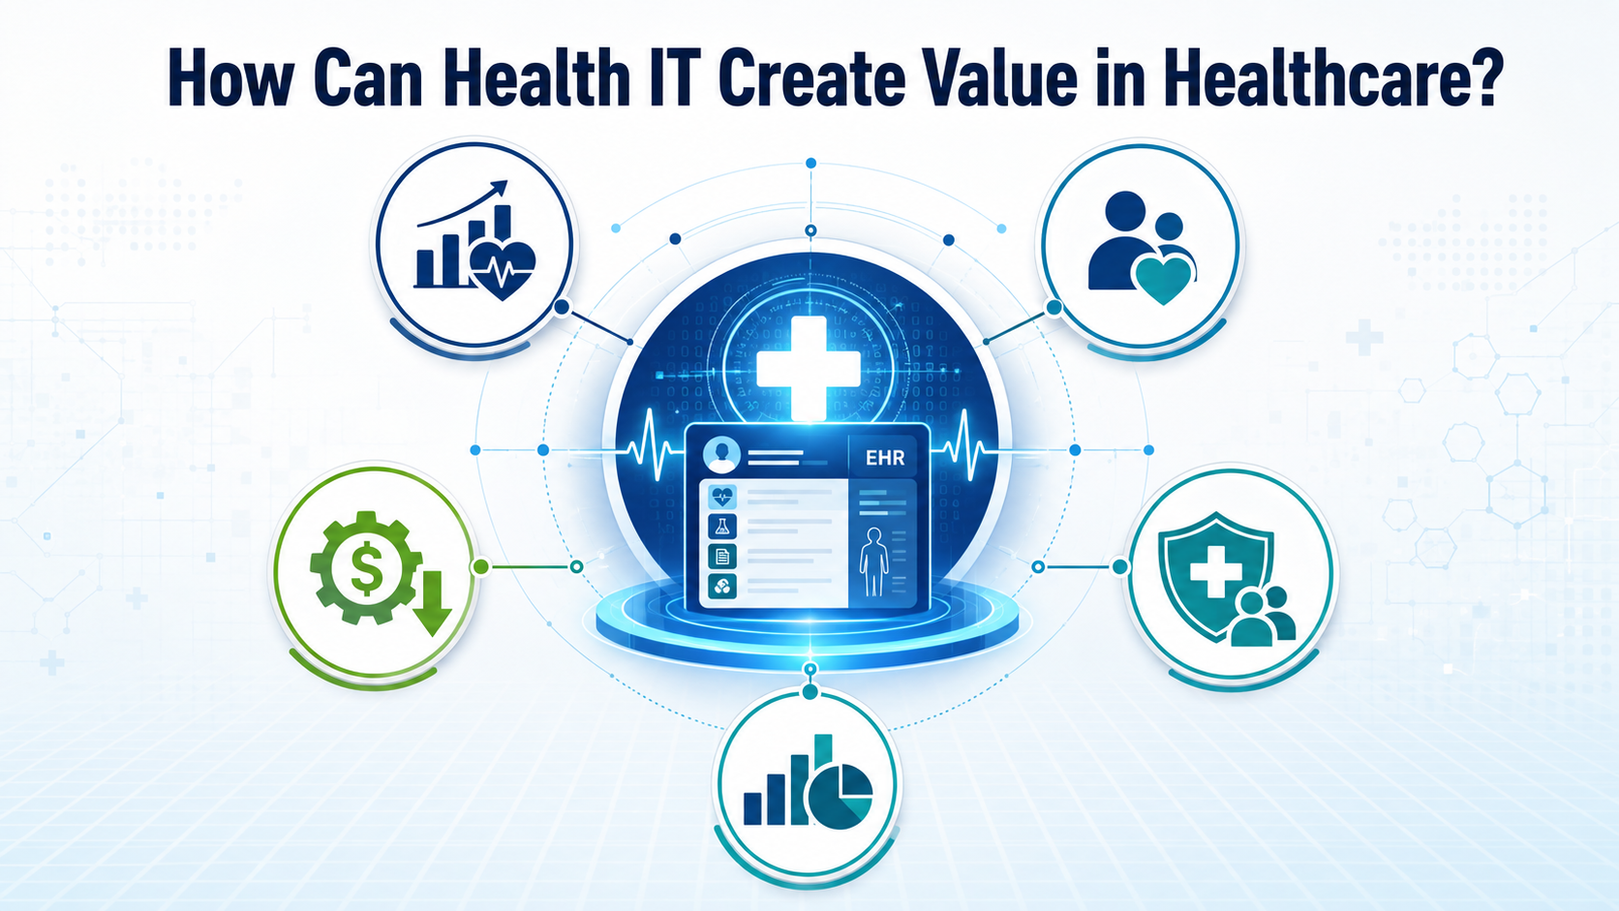

Slide 31
What Does Value Mean?
Chapter
01
In healthcare, value means achieving better results from the resources used.
Value may include:
  Better clinical outcomes
  Fewer errors
  Faster services
  Lower unnecessary costs
  Better patient experience
Value should be measured. It should not be assumed simply because a system has been installed.

Slide 32
Improving Quality and Safety
Chapter
01
Health IT may improve quality and safety by:
  Making patient information easier to access
  Supporting correct patient identification
  Providing medication-allergy warnings
  Showing abnormal results
  Identifying high-risk patients
Poorly designed technology may create new risks. Therefore, systems must be monitored and improved.

Slide 33
Improving Efficiency
Chapter
01
Efficiency means reducing wasted time, effort, and resources while maintaining quality.
Health IT may improve efficiency through:
  Faster information retrieval
  Less repeated data entry
  Electronic ordering
  Faster reporting of results
  Better patient scheduling
Automation should reduce unnecessary work without removing human judgment.

Slide 34
Improving Financial Performance
Chapter
01
Health IT may improve financial performance by:
  Supporting correct billing
  Reducing unnecessary tests
  Reducing preventable harm
  Improving patient flow
  Supporting better use of resources
Example: A hospital that uses a predictive model to reduce the number of emergency patients who left before being seen. This improvement may recover important revenue.

Slide 35
Patient Engagement and Technology-Enabled Care
Chapter
01
Patient engagement means involving patients as active partners in their care.
Technology may help patients:
  Access their health information
  Review test results
  Communicate with the care team
  Monitor health measurements
  Take part in shared decisions
Telehealth provides healthcare from a distance using communication technology.

Slide 36
Health IT Maturity
Chapter
01
Health IT maturity describes how far an organization has progressed in using technology effectively.
The Healthcare Information and Management Systems Society (HIMSS) developed maturity models that:
  Include eight stages, from Stage 0 to Stage 7.
  Measure an organization’s current level.
  Guide future improvement.
  Examine areas such as electronic records and analytics.
  Are not tied to one technology vendor.
Stage 7 represents highly advanced and integrated technology use.

Slide 37
Technology Alone Does Not Create Value
Chapter
01
Technology alone does not improve healthcare.
Value requires alignment between:
    People: users must understand and accept the system.
    Processes: workflows must be safe and effective.
    Technology: systems must be suitable and reliable.
    Data: information must be accurate and usable.
    Leadership: goals and responsibilities must be clear.
Healthcare technology is a sociotechnical system because people, work processes, and technology affect one another.

Slide 38
Wrap up
Chapter
01
Healthcare informatics combines healthcare, information, people, processes, and technology.
The Data–Information–Knowledge–Wisdom (DIKW) framework explains how facts become decisions.
Hospitals use connected clinical, departmental, and administrative systems.
Health IT can improve quality, safety, efficiency, and financial performance.
Technology produces value only when it is correctly connected with people, processes, data, and organizational goals.

Slide 39


Thank You

