Slide 1


Foundations Of Project Management
Prepared by Dr.Abdelrehim Nader
PMG 101
Introduction
Introduction

Slide 2

Introduction
Contents
Chapter 1:Overview of Project Management.
Chapter 2:Project Life Cycle & Stakeholders management.
Chapter 3:Organizational Structure & Its Impact on Project Management.
Chapter 4:Mission, Vision, Objectives and Culture of Organization.
Chapter 5:Planning, strategy and project selection.
Chapter 6:Project portfolio management system.

Slide 3
Introduction
Contents
Chapter 7: Project Scope Management.
Chapter 8: Managing Risk part1
Chapter9 : Managing Risk part2
Chapter10: Estimating project times and costs. Discussion Lectures

Slide 4

Discussion Lectures
Introduction
Weekly live Meeting through (Zoom)

Slide 5
Evaluation
Introduction
Weekly Quiz
8 Questions/8 Marks- in 24 Minutes.
Final Test
- 20 Marks- in 60 Minutes.
-True or False
-MCQ
-Verbal (Audio)

Slide 6
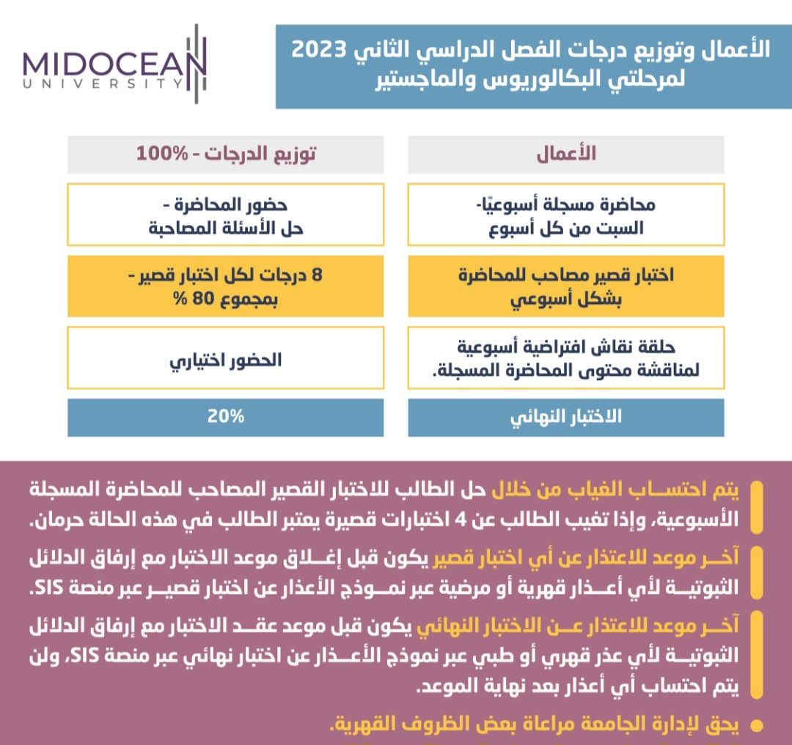

Slide 7



Thank You

