Slide 1


Risk Management
MGM 510
Prepared by
Dr. Hamed Almahadin
Lecture 8

Slide 2



Ch#8
Risk Assessment Considerations
www.midocean.ae

Slide 3

Chapter
Topics to Cover in Week 8
08
Risk Assessment
Importance of Risk Assessment
Approaches to Risk Assessment
Risk assessment techniques
Nature of the Risk Matrix
Attitude to Risk
www.midocean.ae

Slide 4
Chapter
Risk Assessment
08
Risk recognition and risk rating together form the risk assessment component of the risk management process.
www.midocean.ae

Slide 5
Chapter
Risk Assessment
08
Risk assessment involves the recognition of risks and the rating of them to determine the significant risks facing the organization, project or strategy.
www.midocean.ae

Slide 6
Chapter
Risk Assessment
08
It is defined in British Standard BS 31100 as the overall process of risk identification, risk analysis and risk evaluation.
www.midocean.ae

Slide 7
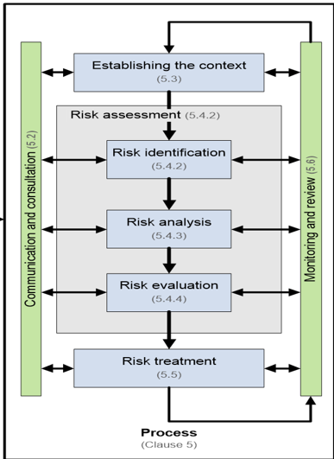
Chapter
Risk Assessment
08
www.midocean.ae

Slide 8
Chapter
Risk Assessment
08
Because the risk management input into strategy focuses on improved decision making, risk assessment is the main risk management input into strategy formulation.
www.midocean.ae

Slide 9
Chapter
Risk Assessment
08
Risks may be attached to corporate objectives, stakeholder expectations, core processes and key dependencies.
www.midocean.ae

Slide 10
Chapter
Risk Assessment
08
Whichever of these features is selected as the starting point, risk assessment can be undertaken.
The purpose of risk assessment is to identify the significant risks that could impact the selected feature.
www.midocean.ae

Slide 11
Chapter
Importance of Risk Assessment
08
Although risk assessment is vitally important, it is only useful if the conclusions of the assessment are used to inform decisions and/or to identify the appropriate risk responses for the type of risk under consideration.
www.midocean.ae

Slide 12
Chapter
Importance of Risk Assessment
08
It should be considered as the starting point of the risk management process, and it is certainly not an end.
www.midocean.ae

Slide 13
Chapter
Importance of Risk Assessment
08
An important feature of undertaking a risk assessment is to decide whether the identified risk is going to be evaluated at the inherent level or at the current (or residual) level.
Assessment of inherent risk is undertaken without taking account of the controls that are currently in place.
www.midocean.ae

Slide 14
Chapter
Importance of Risk Assessment
08
This is the approach that has been recommended by internal auditors.
An internal auditor will point out that two risks at the same current or net value may have significantly different inherent or gross values.
It is important to know when this is the case.
www.midocean.ae

Slide 15
Chapter
Importance of Risk Assessment
08
The benefit of undertaking assessment of inherent risk is that the difference between the current level and the inherent level can be identified.
www.midocean.ae

Slide 16
Chapter
Importance of Risk Assessment
08
This will give an indication of the importance of the existing control measures and the information is used by internal auditors to help identify critical controls and set audit priorities.
www.midocean.ae

Slide 17
Chapter
Importance of Risk Assessment
08
Although this may be a useful approach, there can be considerable difficulties in identifying the value of the inherent level of risk.
www.midocean.ae

Slide 18
Chapter
Approaches to Risk Assessment
08
There are several approaches that can be taken when planning how to undertake risk assessment.
One of the key decisions will be who to involve in the risk assessment exercise.
www.midocean.ae

Slide 19
Chapter
Approaches to Risk Assessment
08
Sometimes risk assessments are undertaken by the board of directors as a top-down exercise.
Risk assessments can also be undertaken by involving individual members of staff and local departmental management.
This bottom-up approach is also valuable.
www.midocean.ae

Slide 20
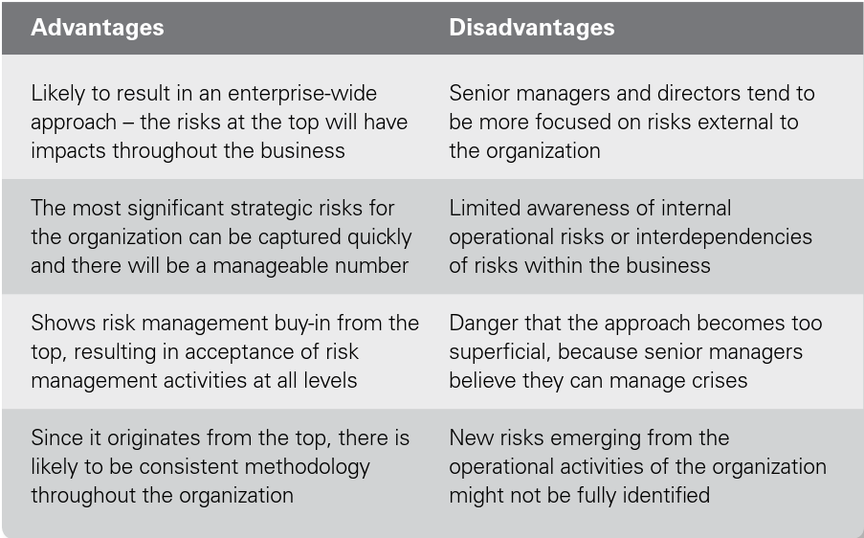
Chapter
Top-Down Risk Assessment
08
www.midocean.ae

Slide 21
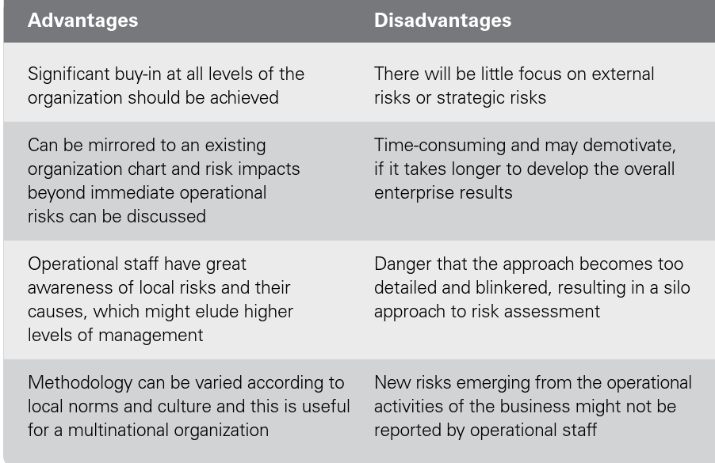
Chapter
Bottom-Up Risk Assessment
08
www.midocean.ae

Slide 22
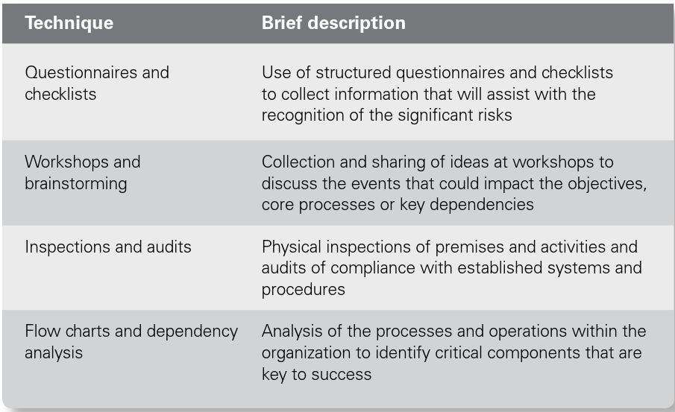
Chapter
Risk Assessment Techniques
08
www.midocean.ae

Slide 23
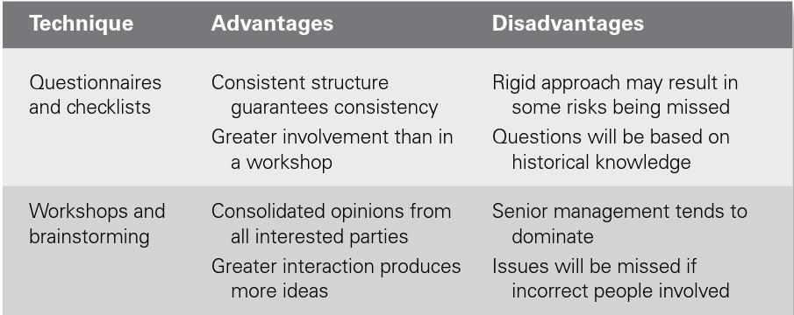
Chapter
Risk Assessment Techniques
08
www.midocean.ae

Slide 24
Chapter
Risk Assessment Techniques
08
www.midocean.ae

Slide 25
Chapter
Risk Assessment Techniques
08
Risk workshops are probably the most common of the risk assessment techniques.
Brainstorming during workshops enables opinions regarding the significant risks faced by the organization to be shared.
www.midocean.ae

Slide 26
Chapter
Risk Assessment Techniques
08
A common view and understanding of each risk is achieved.
However, the disadvantage can be that the more senior people in the room may dominate the conversation, and contradicting their opinions may be difficult and unwelcome.
www.midocean.ae

Slide 27
Chapter
Risk Assessment Techniques
08
In order to have a structured discussion at a risk assessment workshop, several brainstorming structures are in common use.
These may be qualitative or quantitative, depending on the level of analysis of the risk that is required.
www.midocean.ae

Slide 28
Chapter
Risk Assessment Techniques
08
The most common of the qualitative brainstorming structures are the SWOT and PESTLE analysis.
SWOT is an analysis of the strengths, weaknesses, opportunities and threats faced by the organization.
www.midocean.ae

Slide 29
Chapter
Risk Assessment Techniques
08
The SWOT analysis has the benefit that it also considers the upside of risk by evaluating opportunities in the external environment.
One of the strengths of the SWOT analysis is that it can be linked to strategic decisions.
www.midocean.ae

Slide 30
Chapter
Risk Assessment Techniques
08
However, because it is not a structured risk classification system, there is a possibility that not all of the risks will be identified.
www.midocean.ae

Slide 31
Chapter
Risk Assessment Techniques
08
The other common qualitative approach is the PESTLE analysis that considers the political, economic, social, technological, legal and ethical (or environmental) risks faced by the organization.
www.midocean.ae

Slide 32
Chapter
Risk Assessment Techniques
08
PESTLE is a well-established structure with proven results for undertaking brainstorming sessions during risk assessment workshops.
www.midocean.ae

Slide 33
Chapter
Nature of the Risk Matrix
08
When a risk has been recognized as significant, the organization needs to rate it so that the priority significant risks can be identified.
www.midocean.ae

Slide 34
Chapter
Nature of the Risk Matrix
08
Techniques for rating risks are well established, but there is also a need to decide what scope exists for further improving control.
www.midocean.ae

Slide 35
Chapter
Nature of the Risk Matrix
08
Consideration of the scope for further cost-effective improvement is an additional consideration that assists the clear identification of the priority significant risks.
www.midocean.ae

Slide 36
Chapter
Nature of the Risk Matrix
08
An organization will need to establish the measures of risk likelihood and risk impact that will be used throughout the organization.
www.midocean.ae

Slide 37
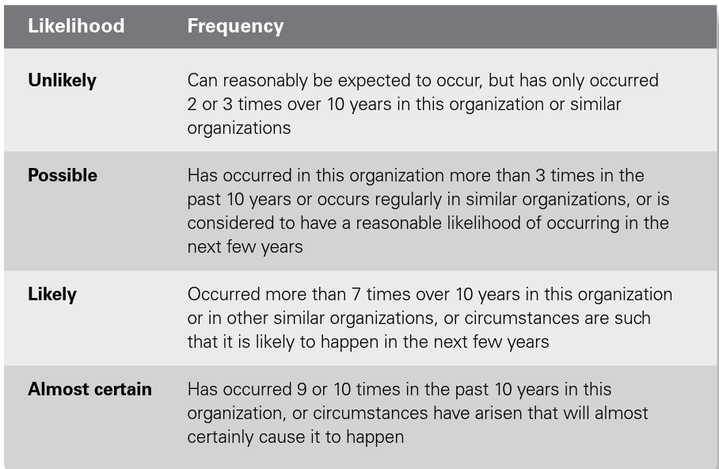
Chapter
Definitions of Likelihood
08
www.midocean.ae

Slide 38
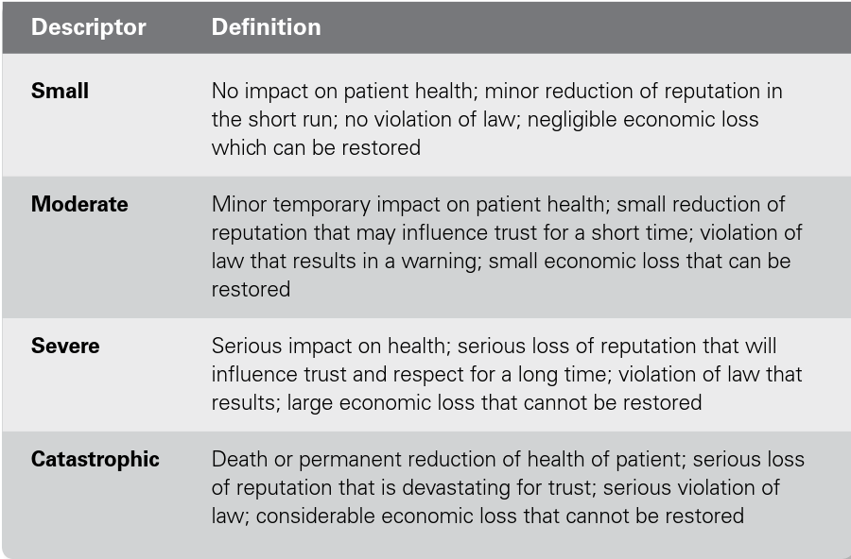
Chapter
Definitions of Impact
08
www.midocean.ae

Slide 39
Chapter
Attitude to Risk
08
Figure 10.1 provides an empirical illustration of risk attitude using a standard risk matrix.
It represents the risk attitude of a risk-averse organization.
www.midocean.ae

Slide 40
Chapter
Attitude to Risk
08
It is becoming more common for a risk attitude matrix to contain four sections.
These sections can be represented by the 4Cs of comfort, cautious, concerned and critical.
www.midocean.ae

Slide 41
Chapter
Attitude to Risk
08
Risk attitude represents the long-term approach of the organization to risk.
These descriptors can also be attached to the four sections on a risk appetite matrix to describe the approach to short-term risk taking.
www.midocean.ae

Slide 42
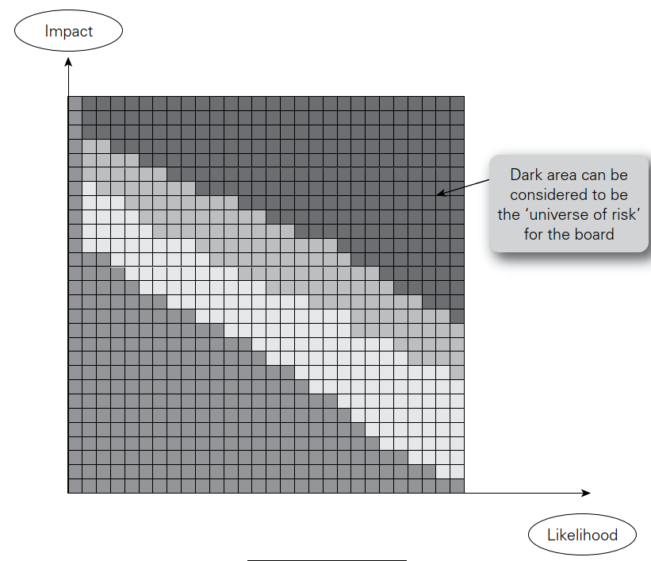
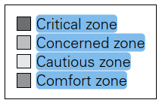
Chapter
Attitude to Risk
08
www.midocean.ae

Slide 43




Thank You

