Slide 1
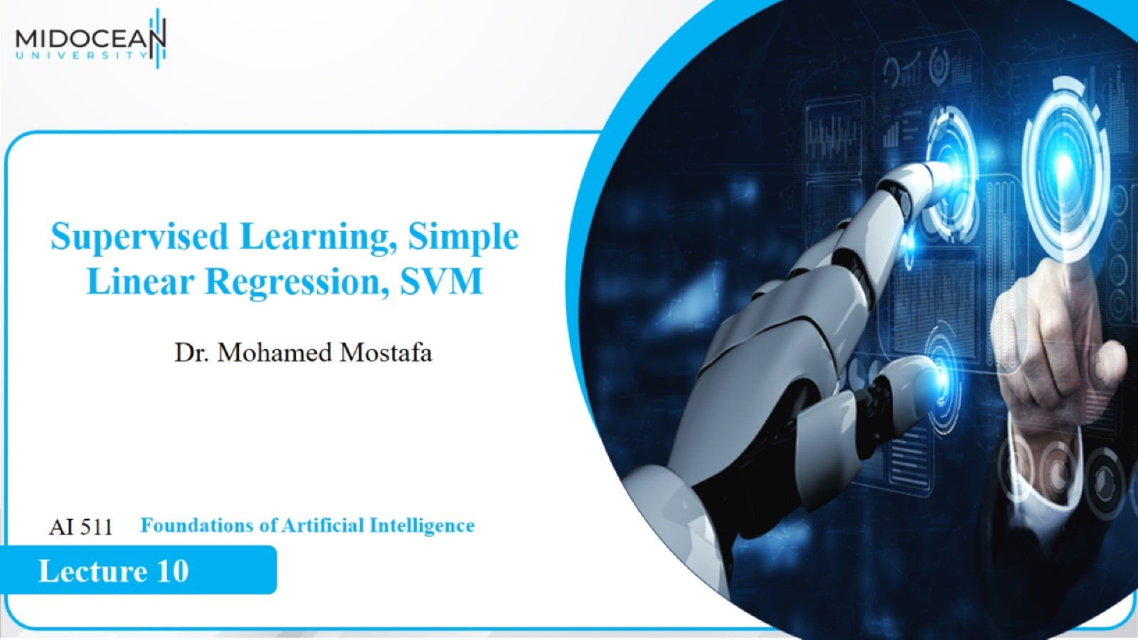

Slide 2
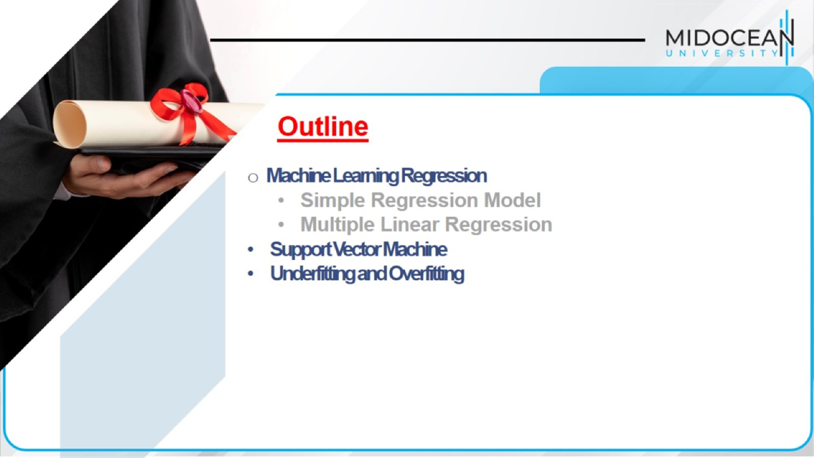

Slide 3
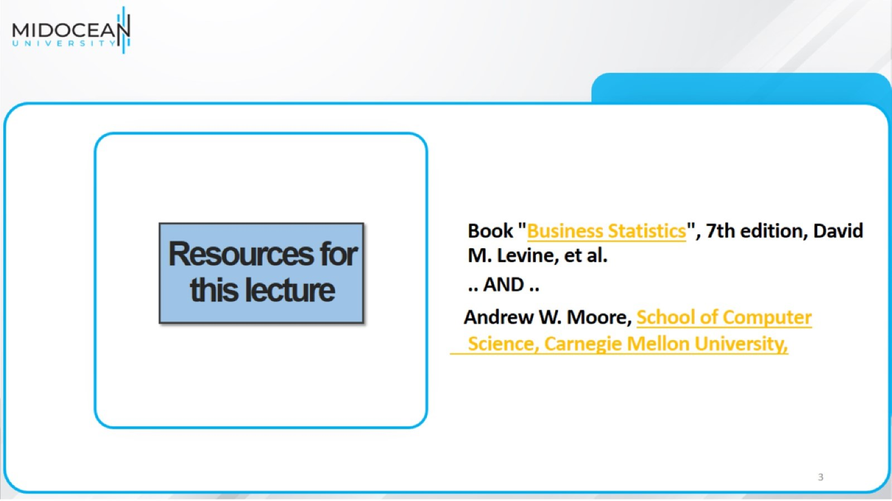
Resources for this lecture

Slide 4
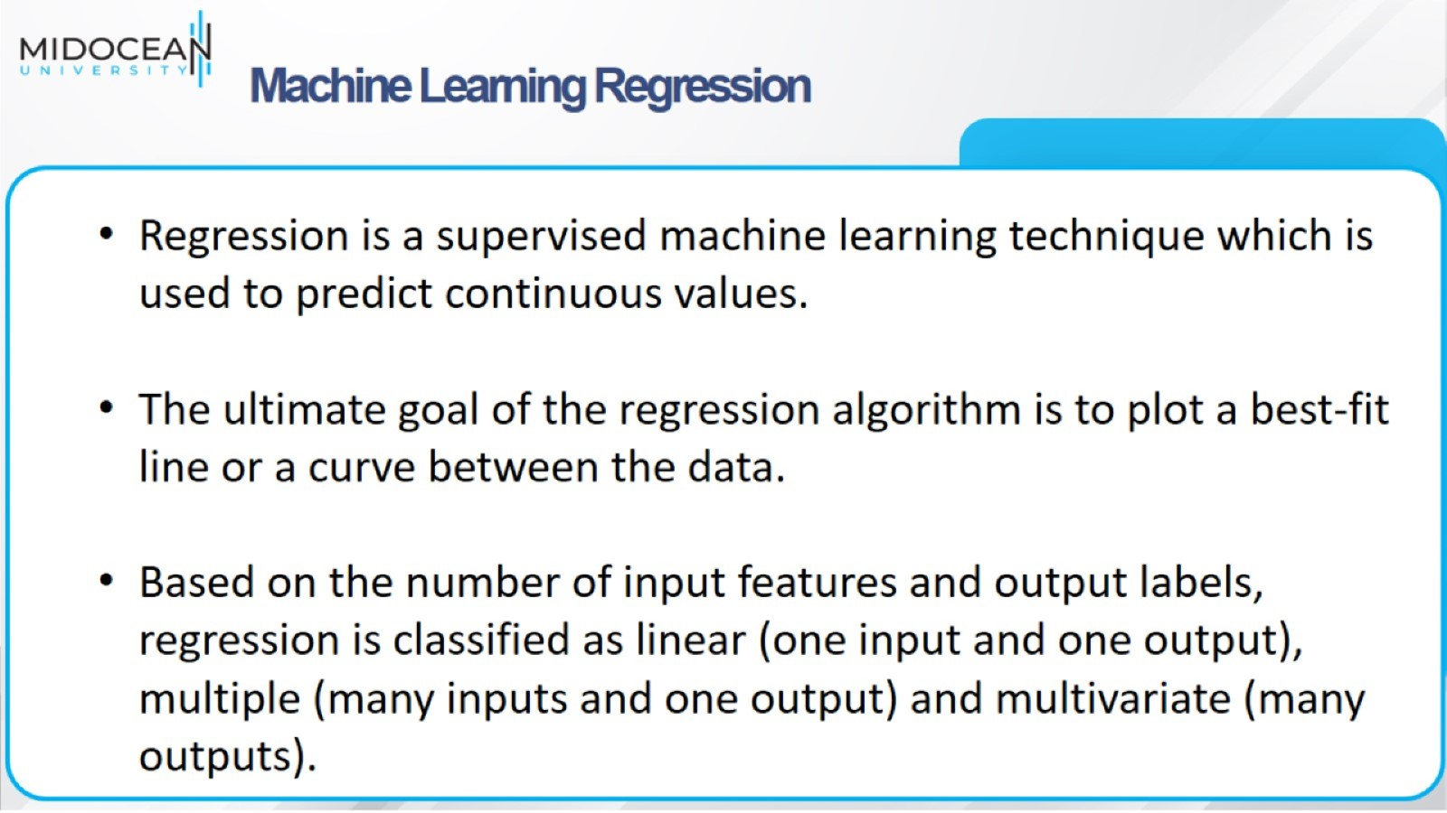
Machine Learning Regression

Slide 5
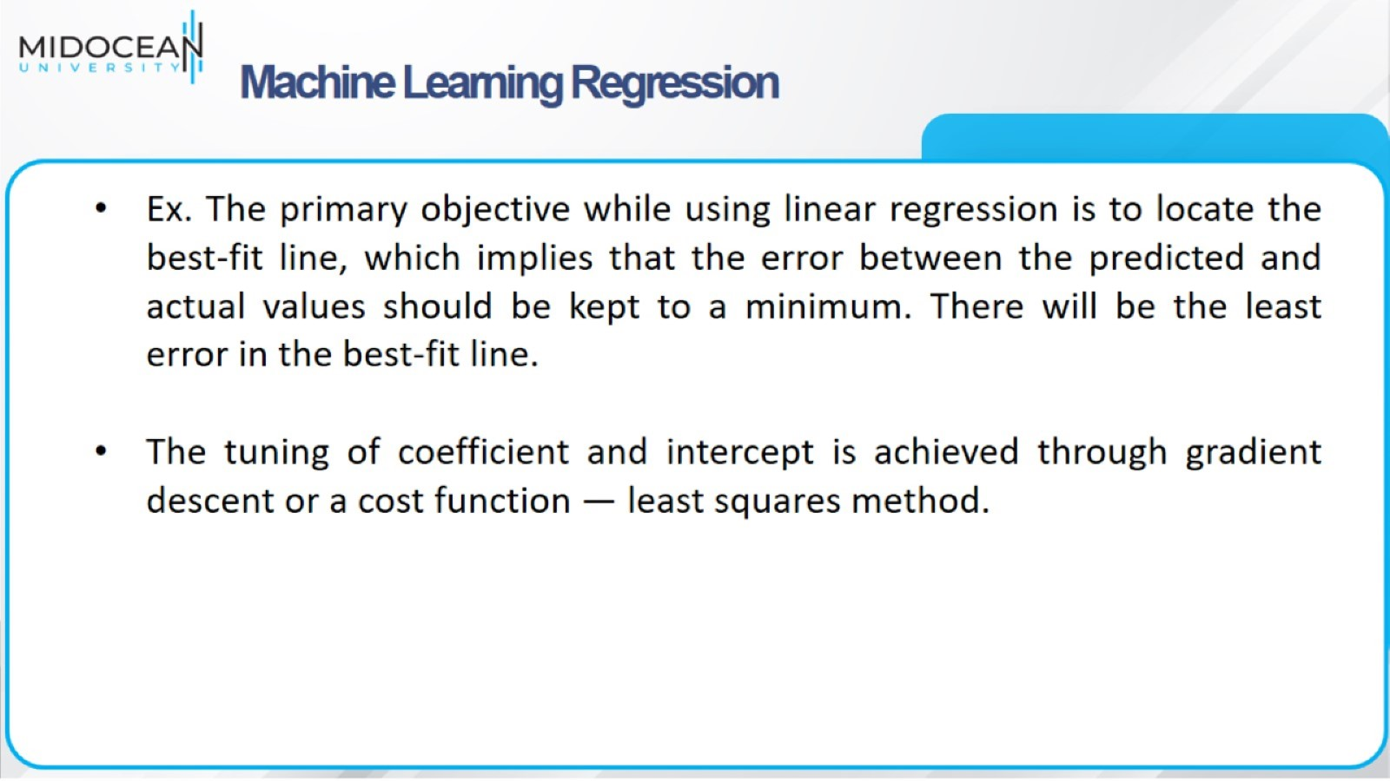
Machine Learning Regression

Slide 6
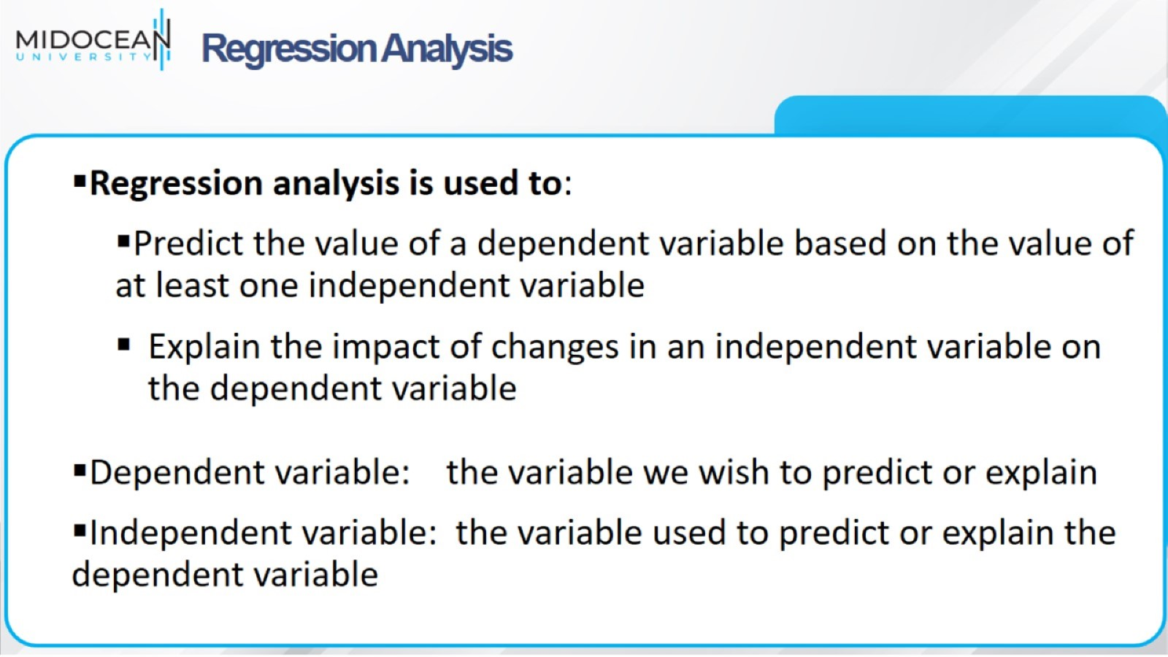
Regression Analysis

Slide 7
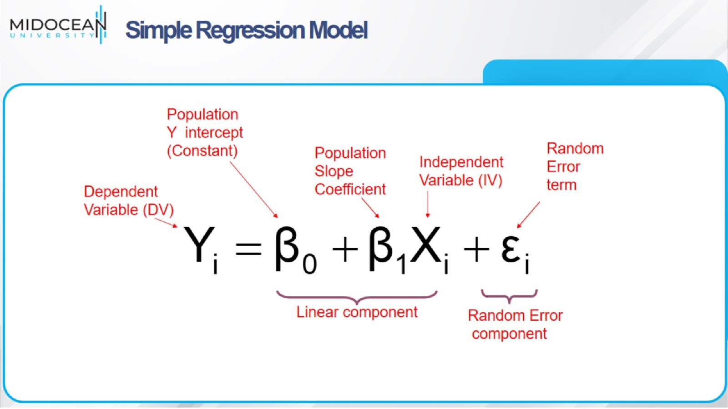
Simple Regression Model

Slide 8
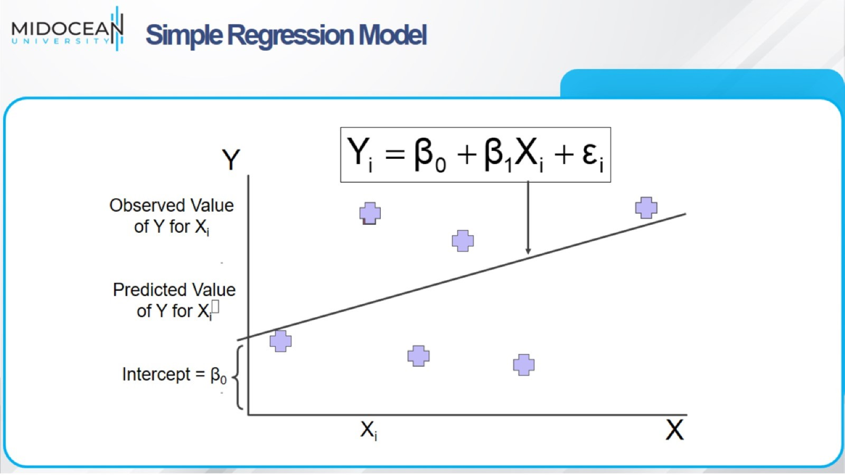
Simple Regression Model

Slide 9
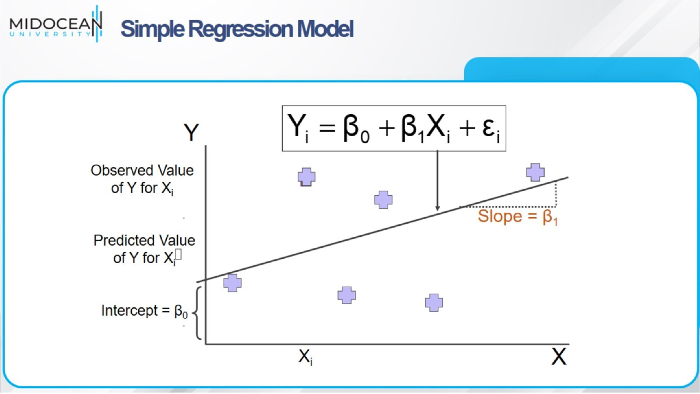
Simple Regression Model

Slide 10
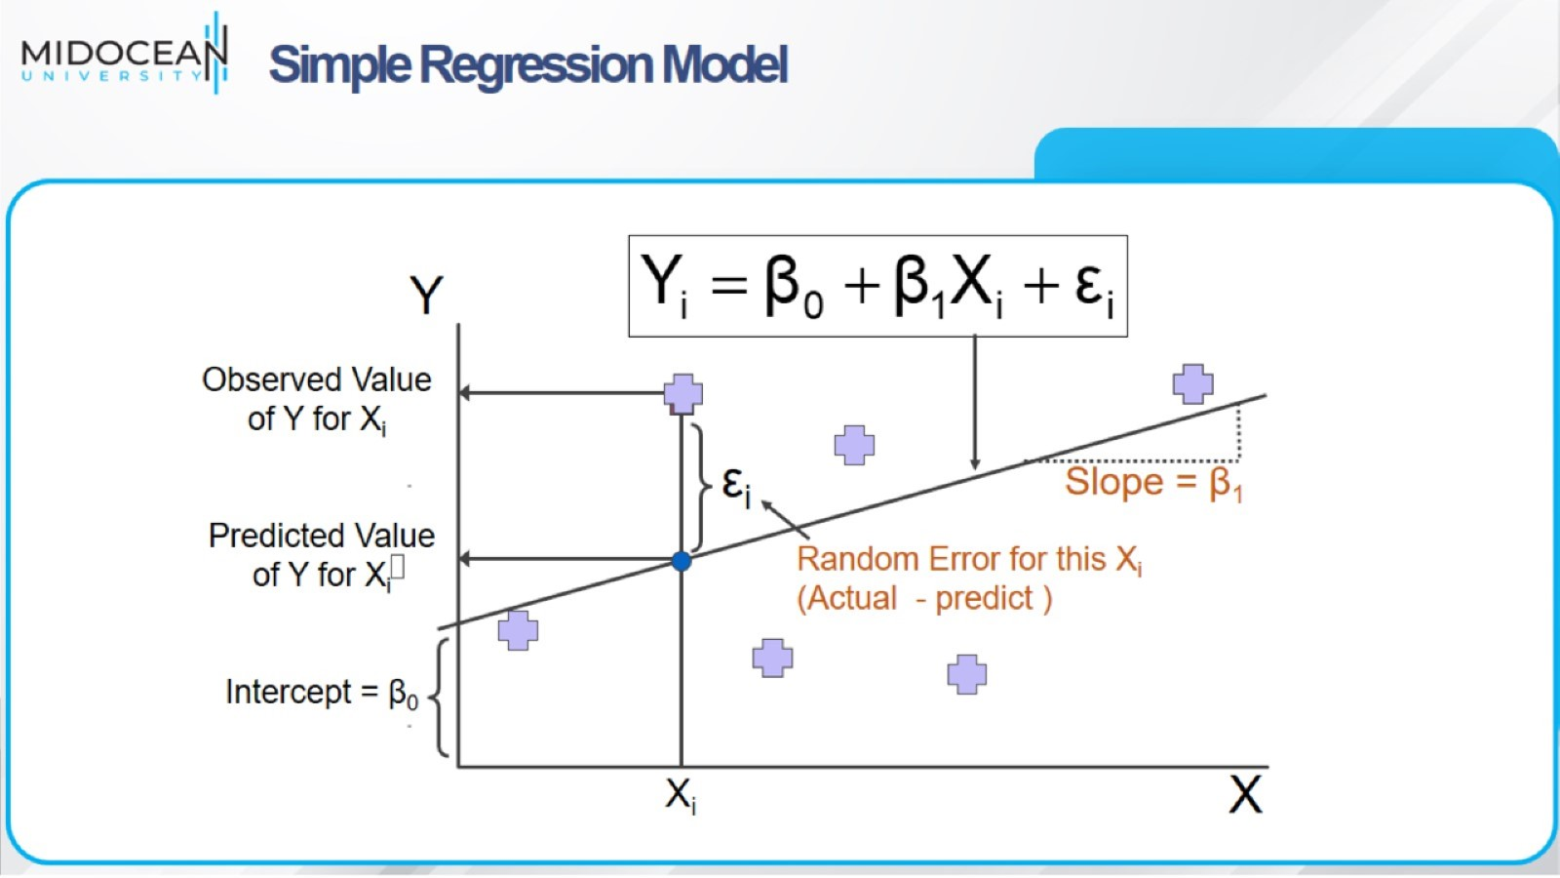
Simple Regression Model

Slide 11
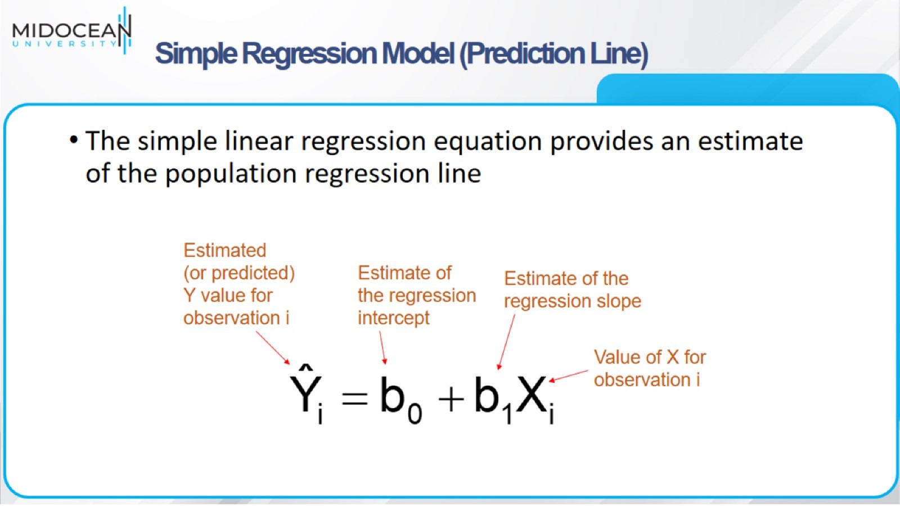
Simple Regression Model (Prediction Line)

Slide 12
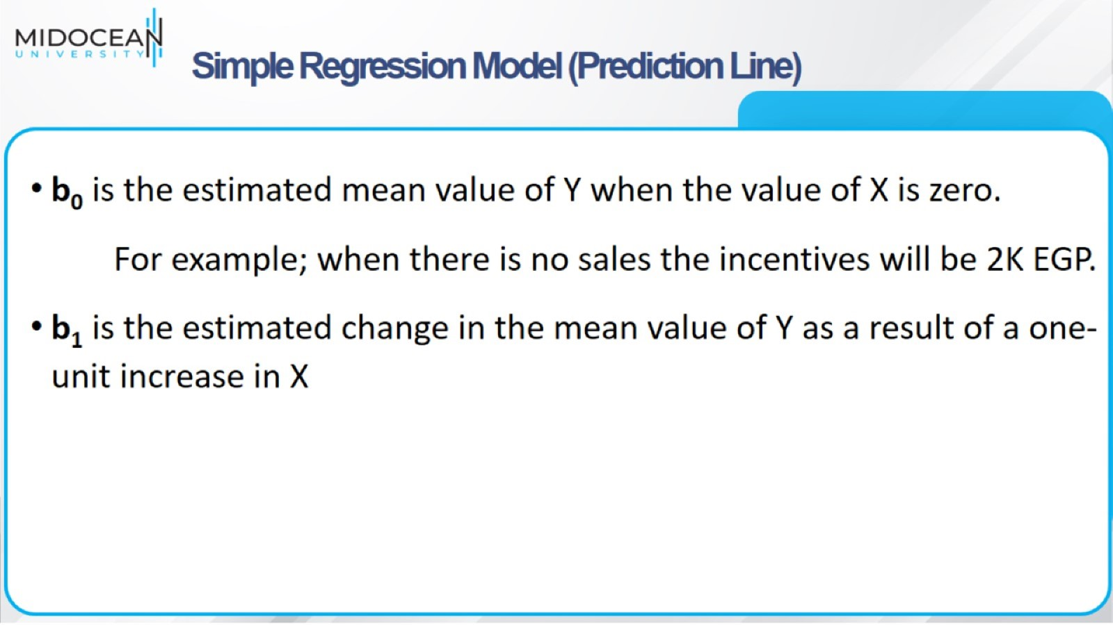
Simple Regression Model (Prediction Line)

Slide 13
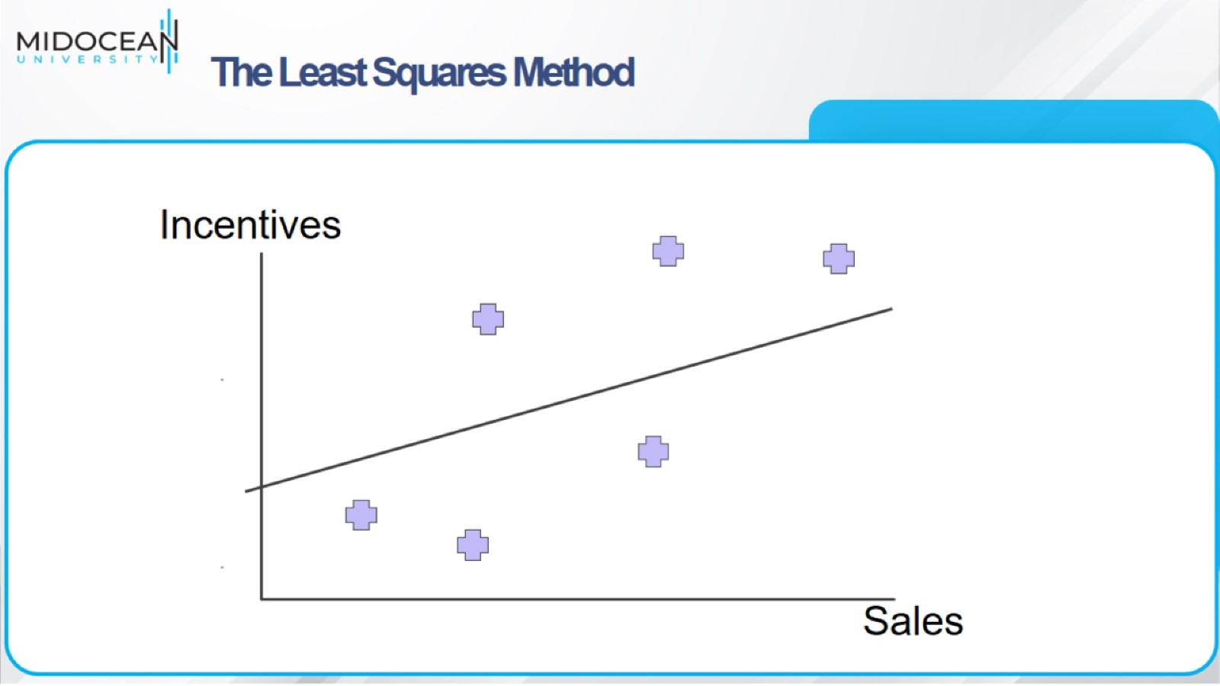
The Least Squares Method

Slide 14
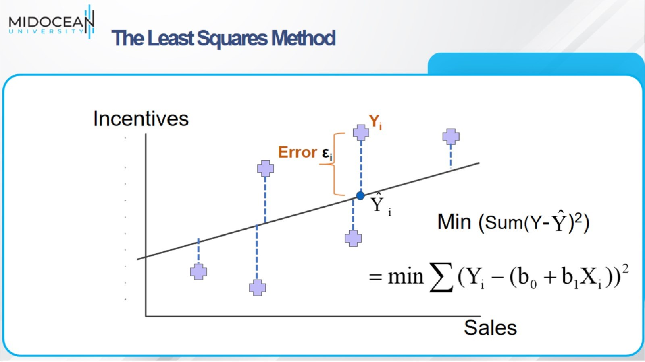
The Least Squares Method

Slide 15
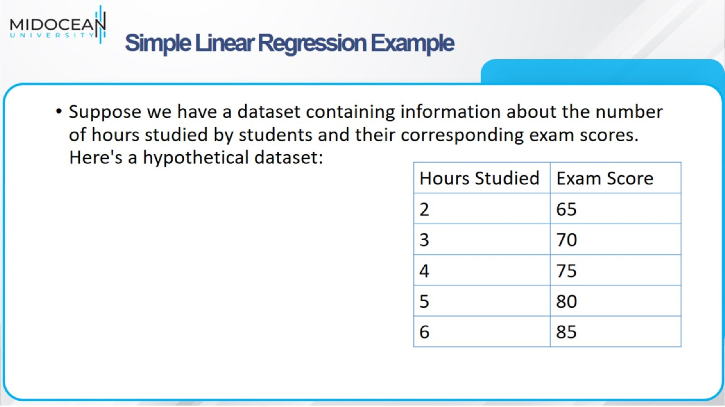
Simple Linear Regression Example

Slide 16
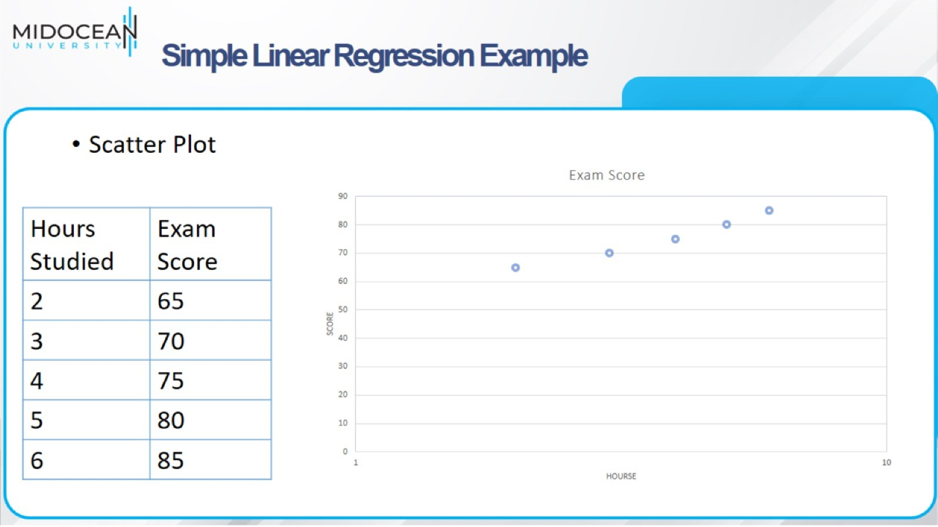
Simple Linear Regression Example

Slide 17
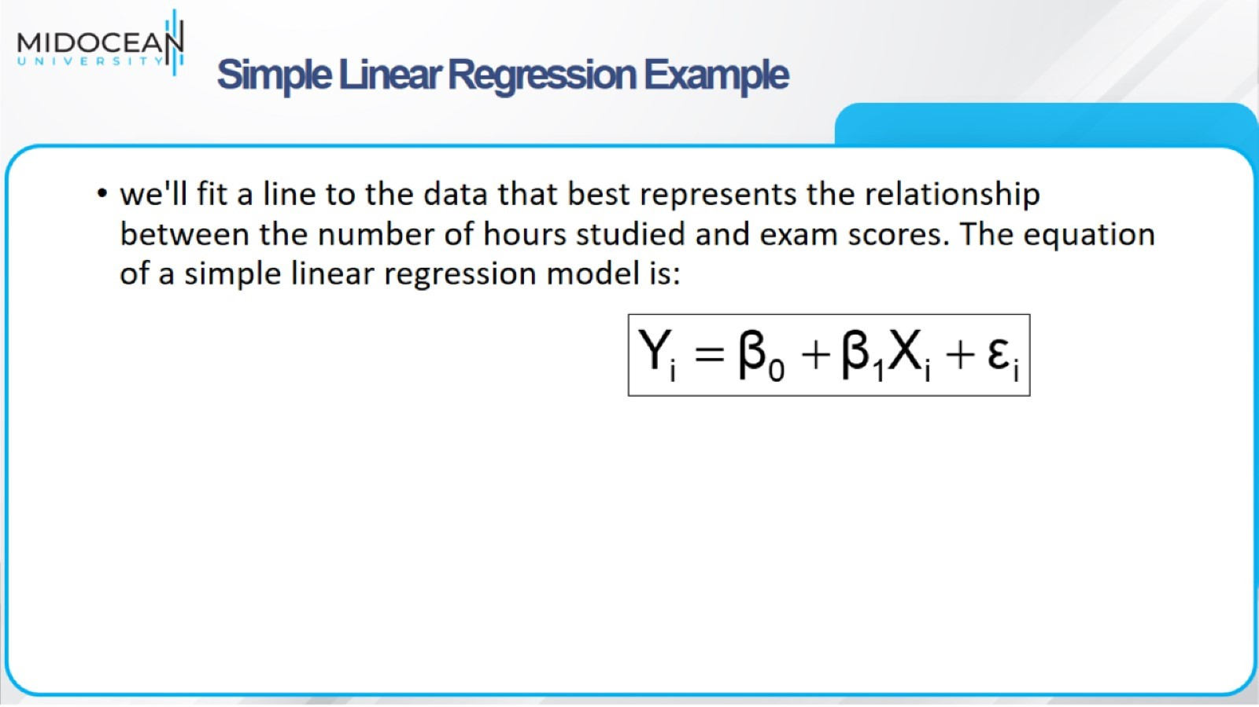
Simple Linear Regression Example

Slide 18
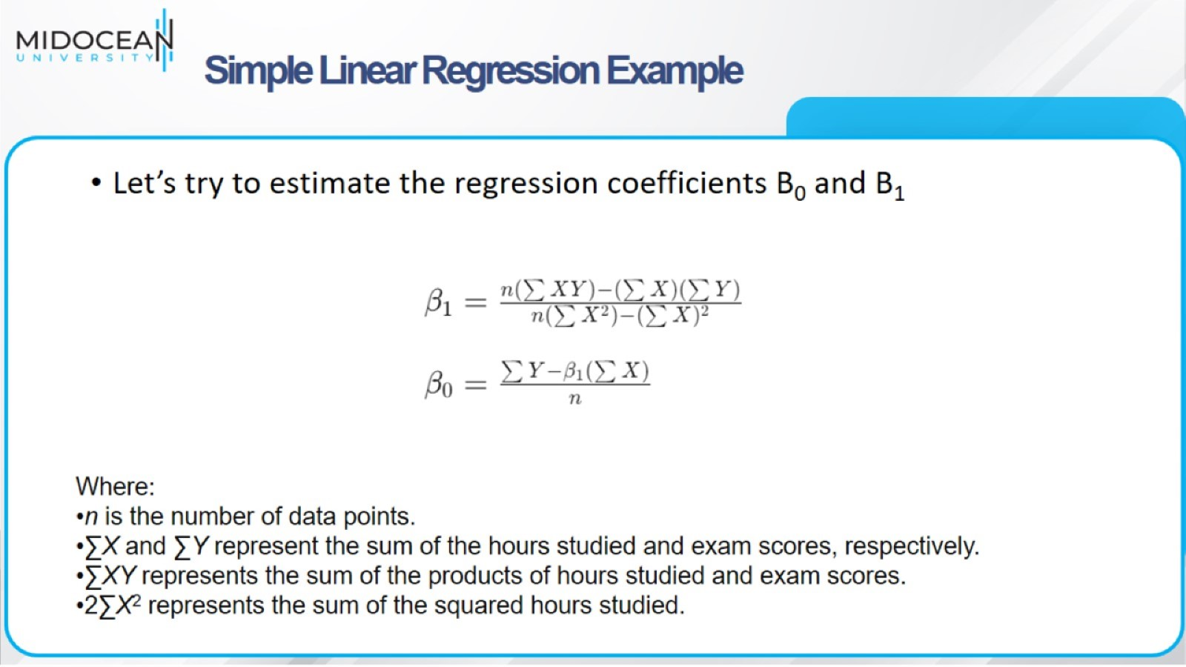
Simple Linear Regression Example

Slide 19
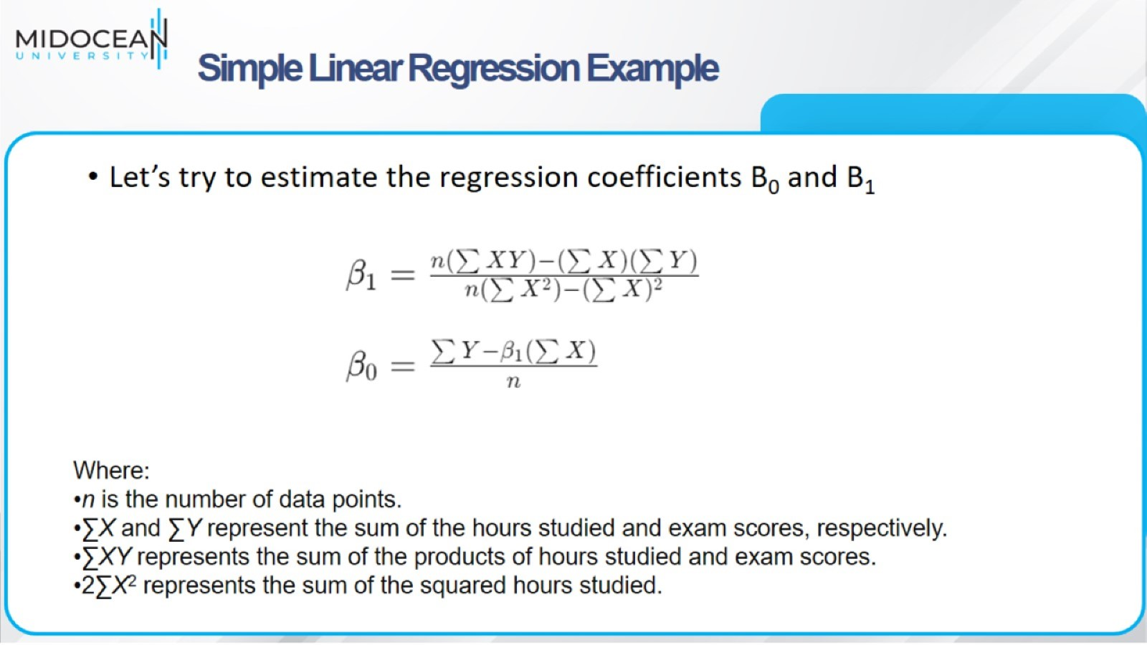
Simple Linear Regression Example

Slide 20
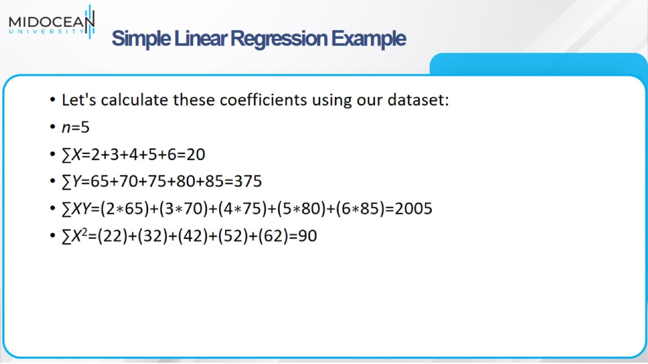
Simple Linear Regression Example

Slide 21
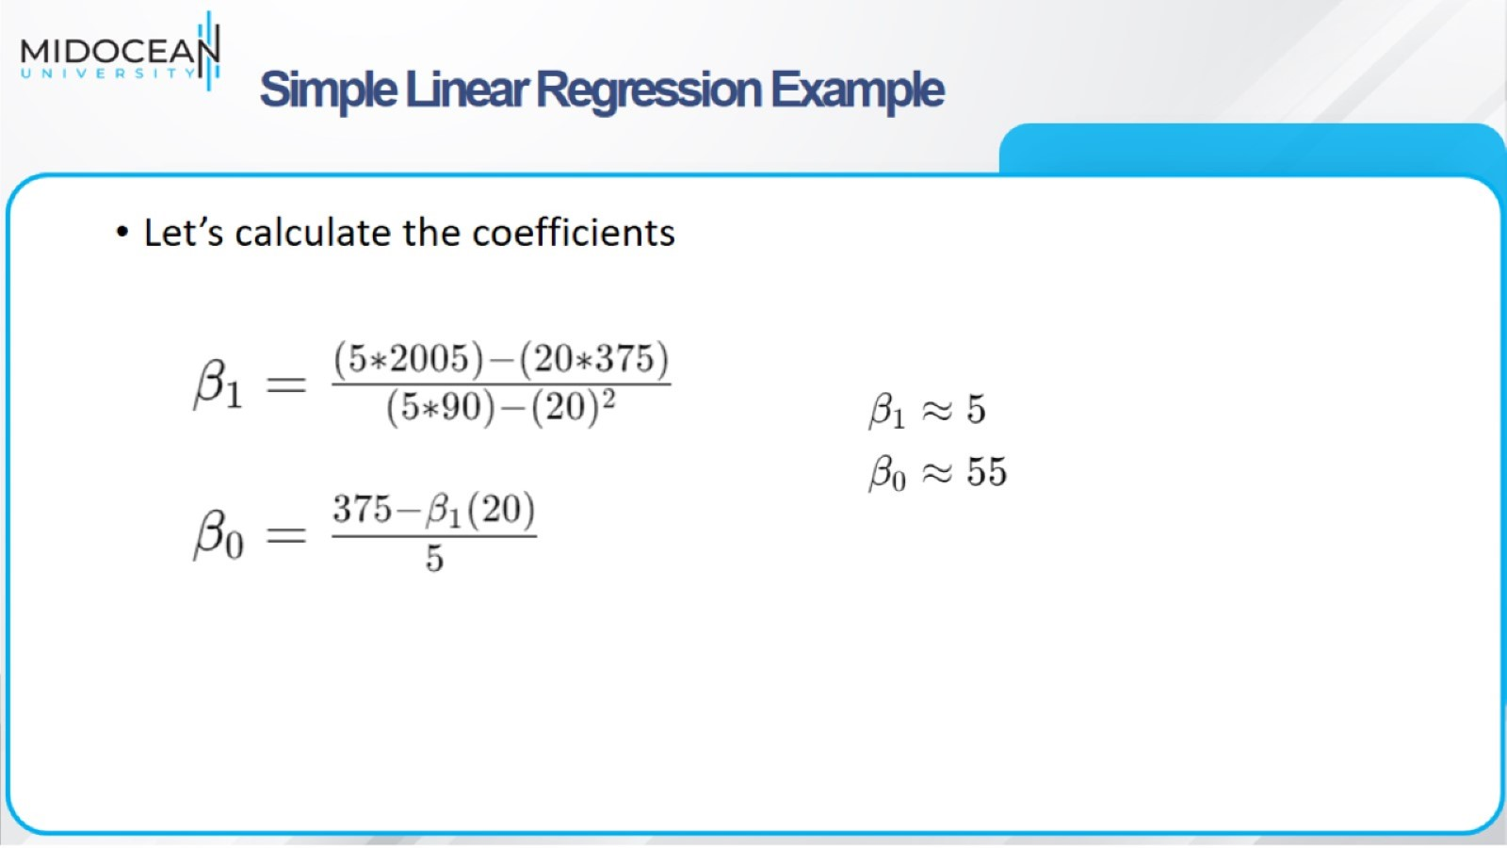
Simple Linear Regression Example

Slide 22
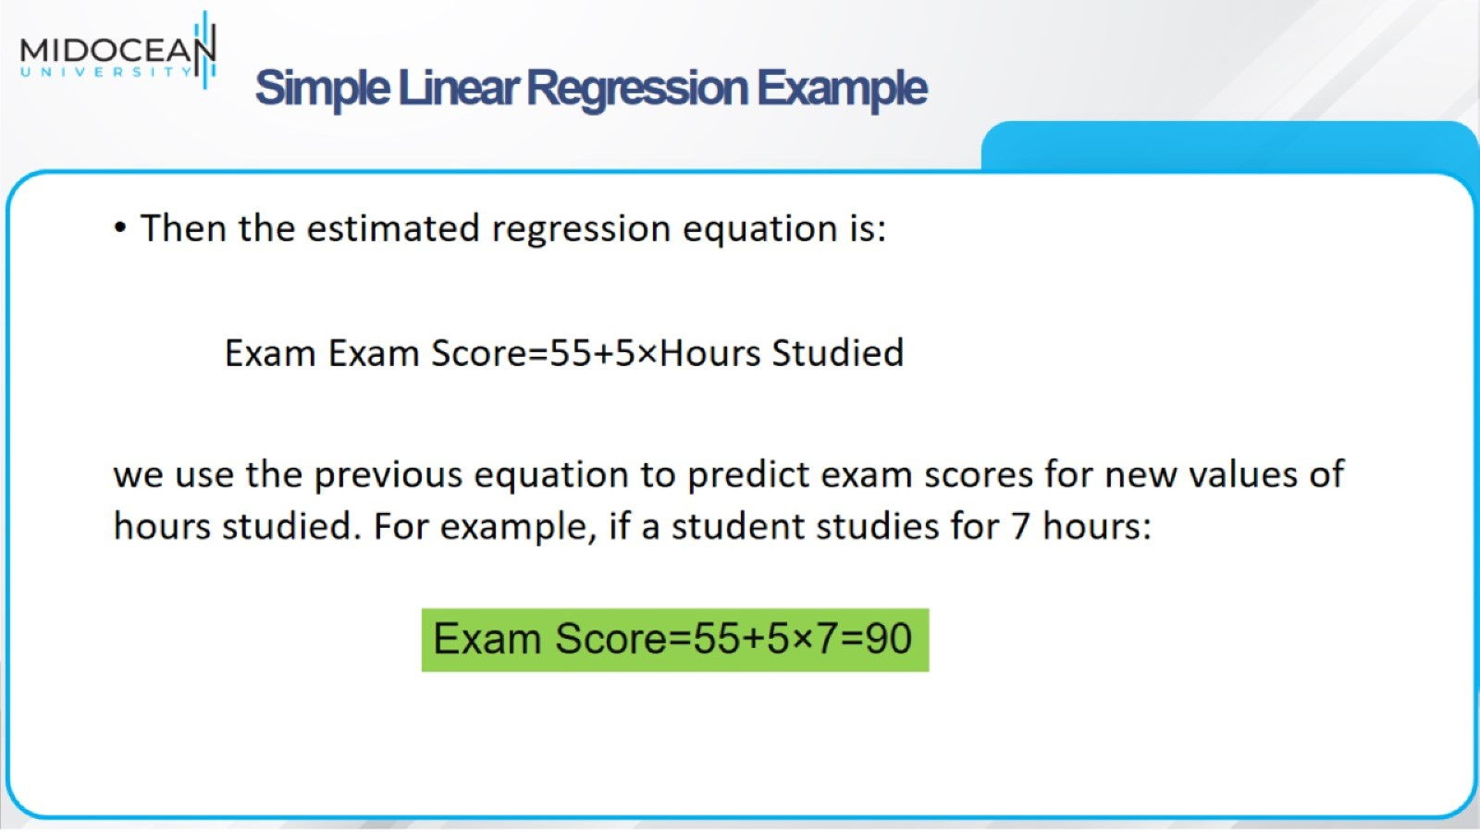
Simple Linear Regression Example

Slide 23
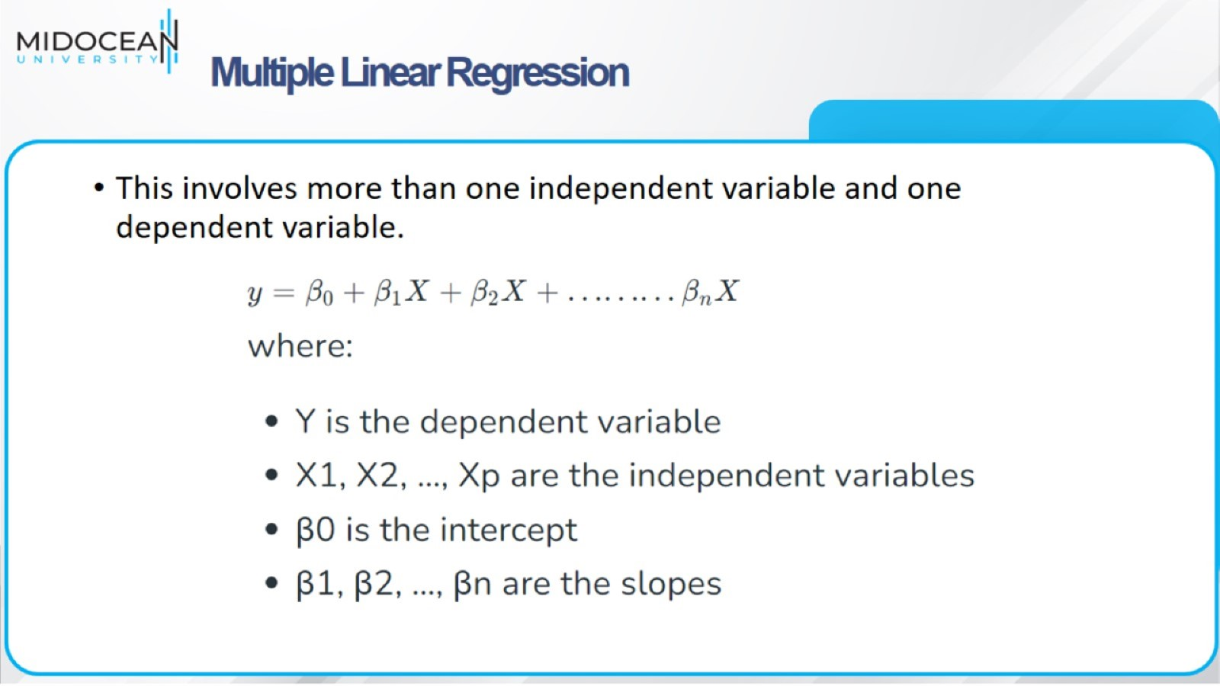
Multiple Linear Regression

Slide 24
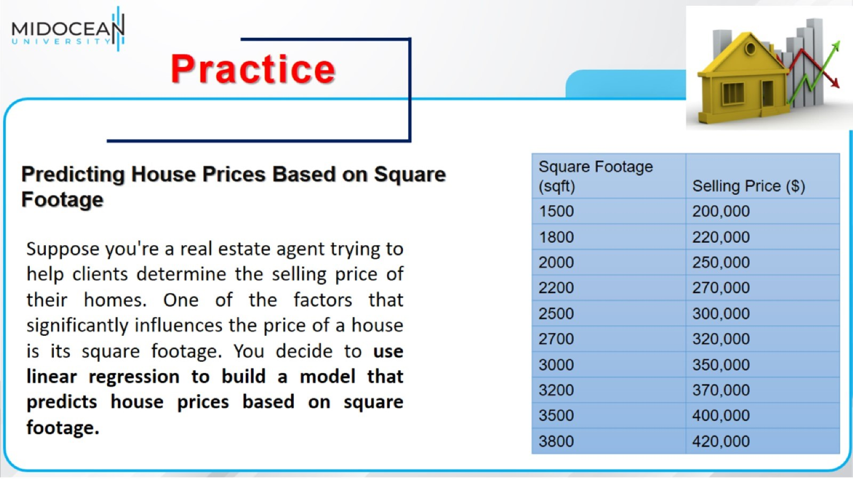

Slide 25
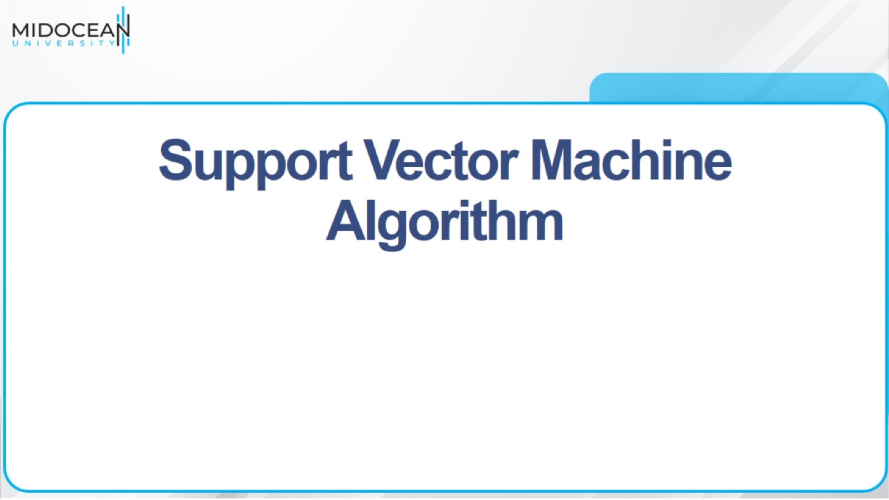
Support Vector Machine Algorithm

Slide 26
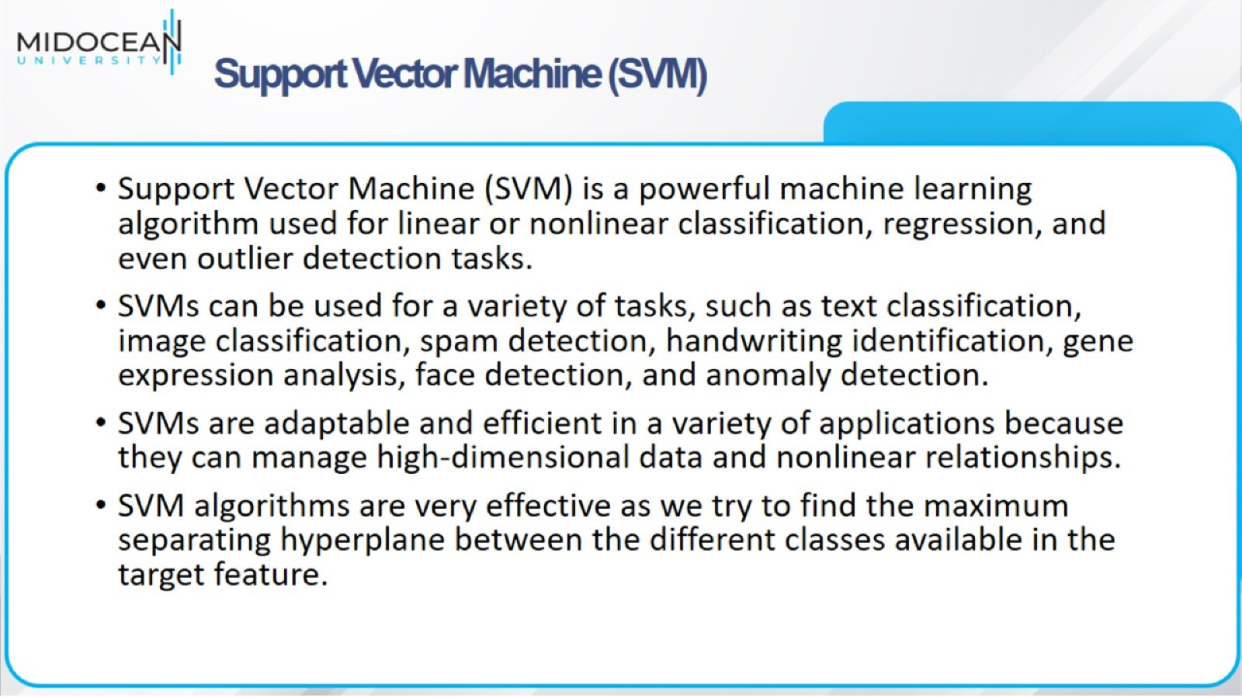
Support Vector Machine (SVM)

Slide 27
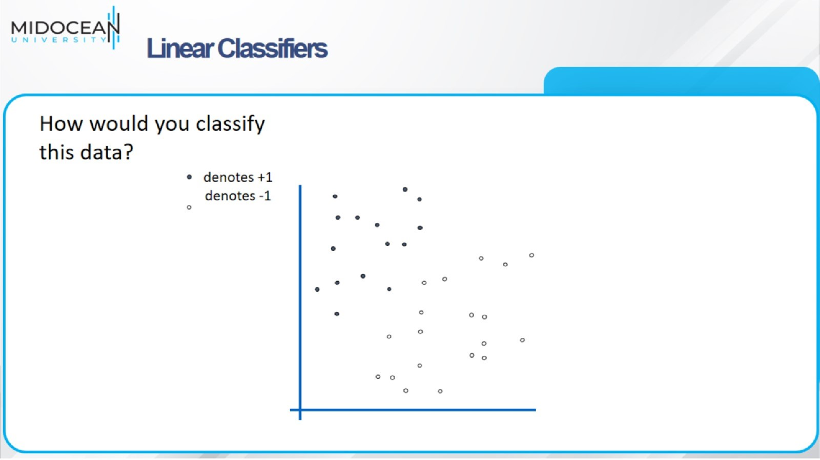
Linear Classifiers

Slide 28
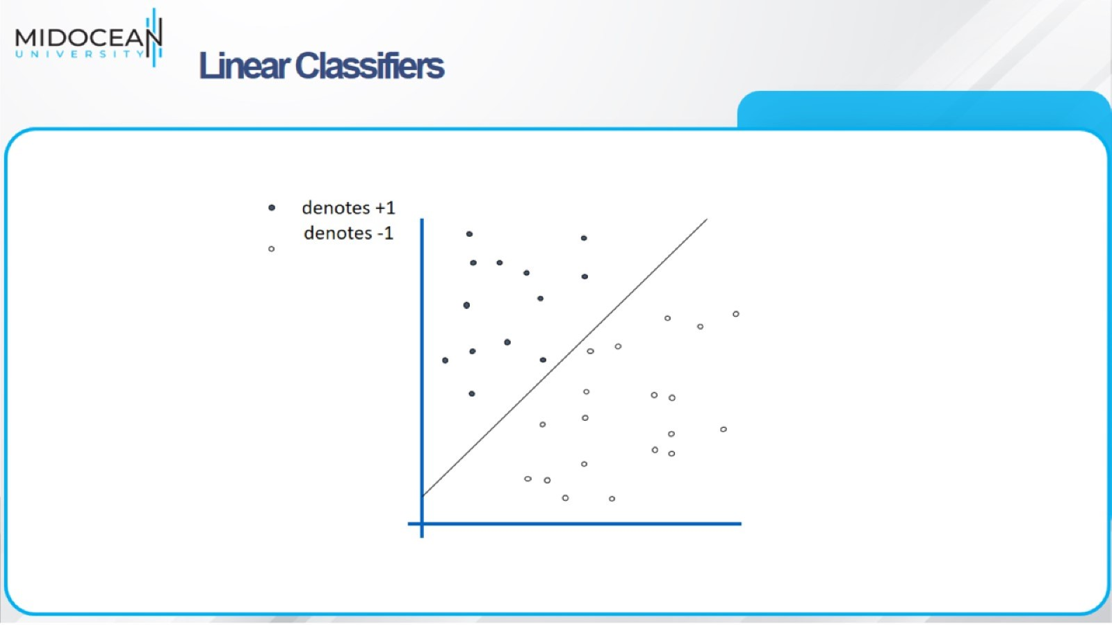
Linear Classifiers

Slide 29
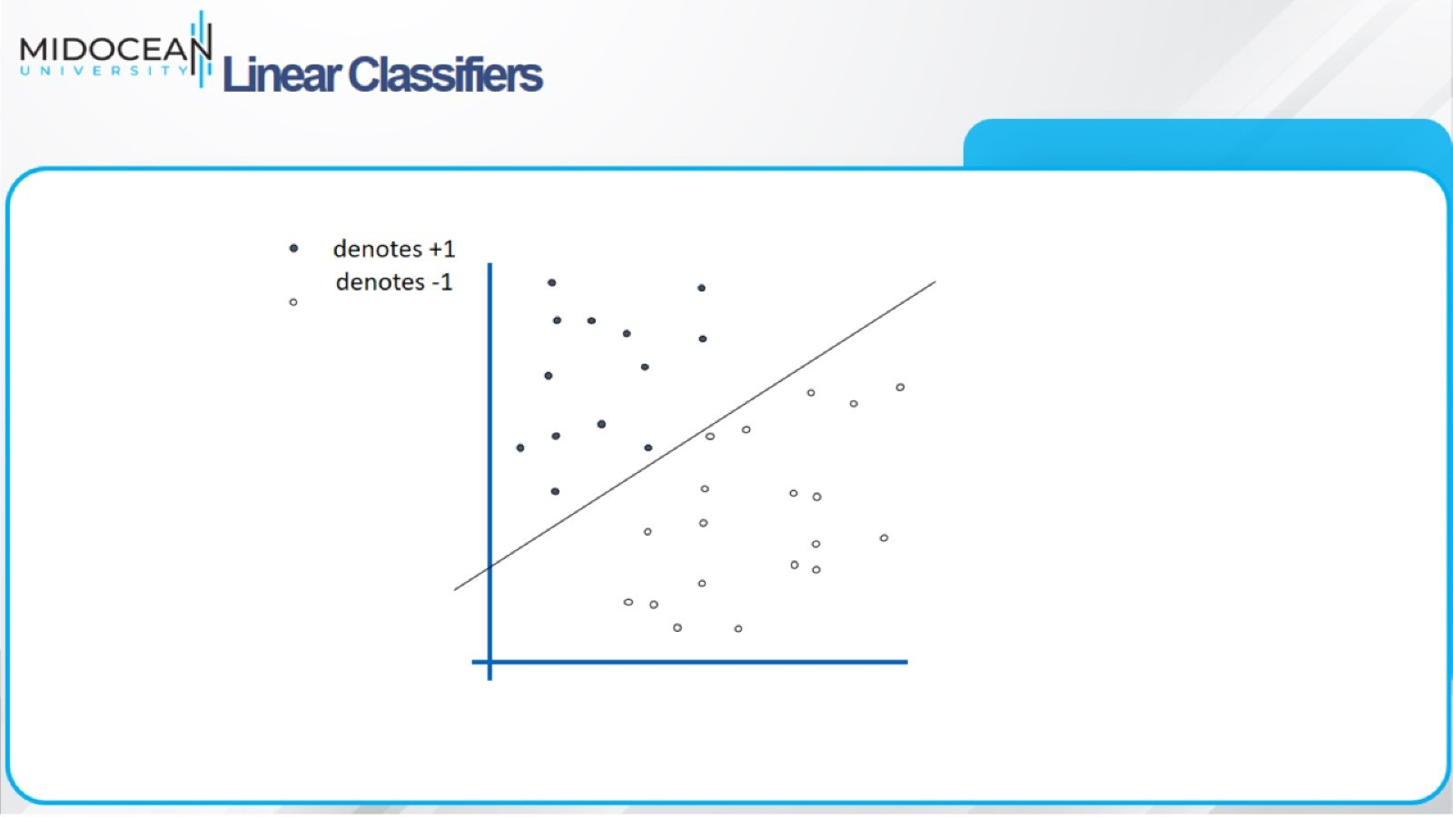
Linear Classifiers

Slide 30
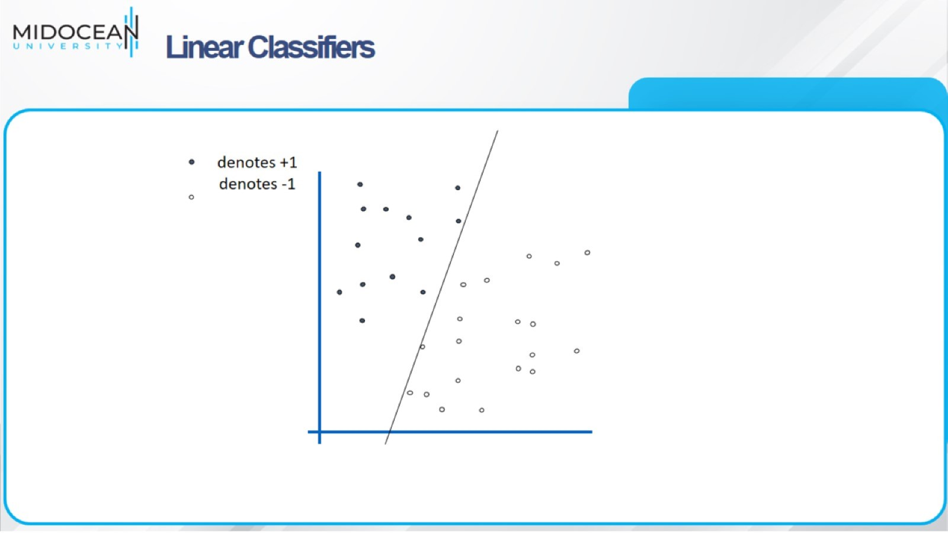
Linear Classifiers

Slide 31
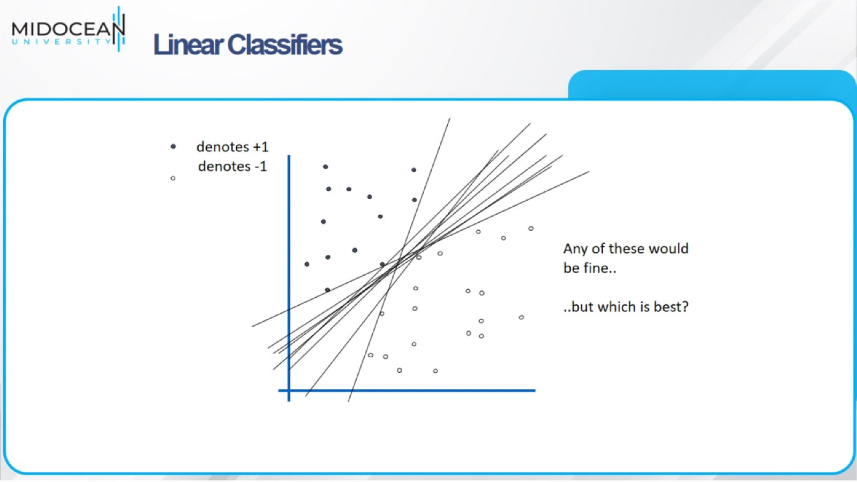
Linear Classifiers

Slide 32
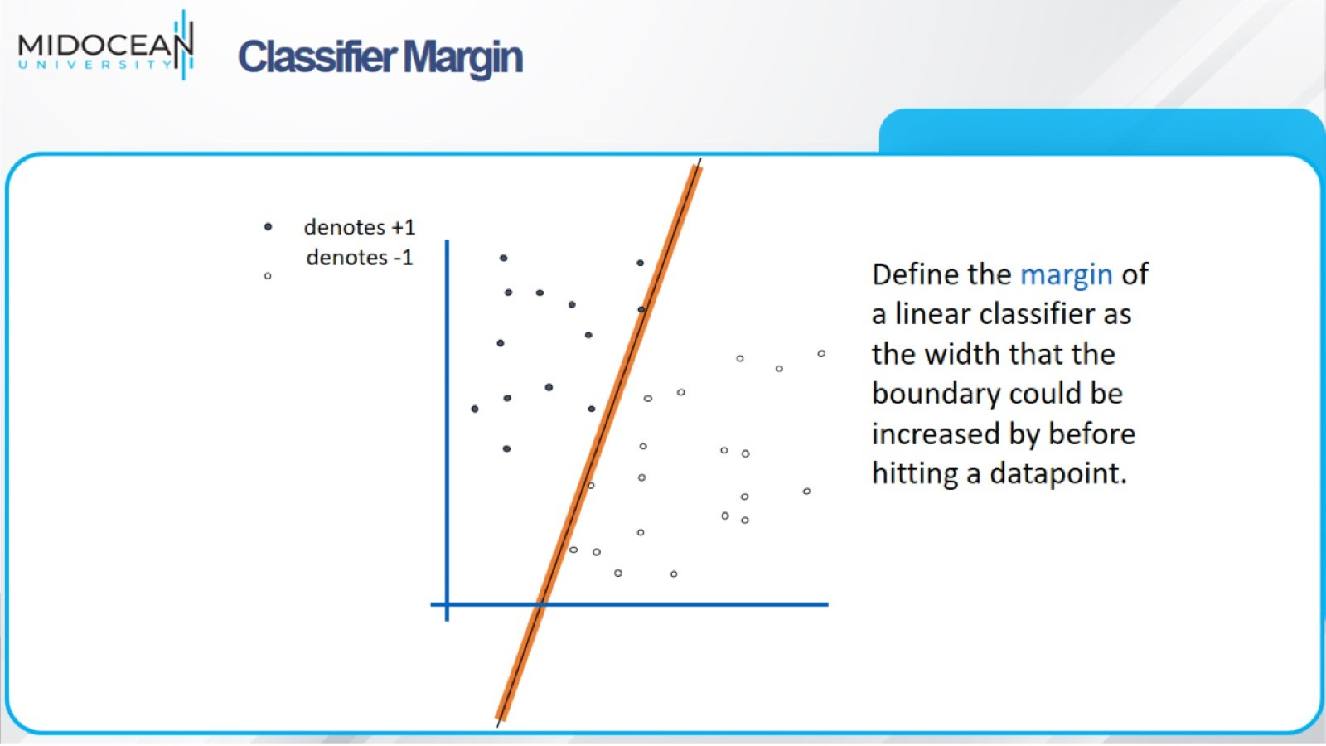
Classifier Margin

Slide 33
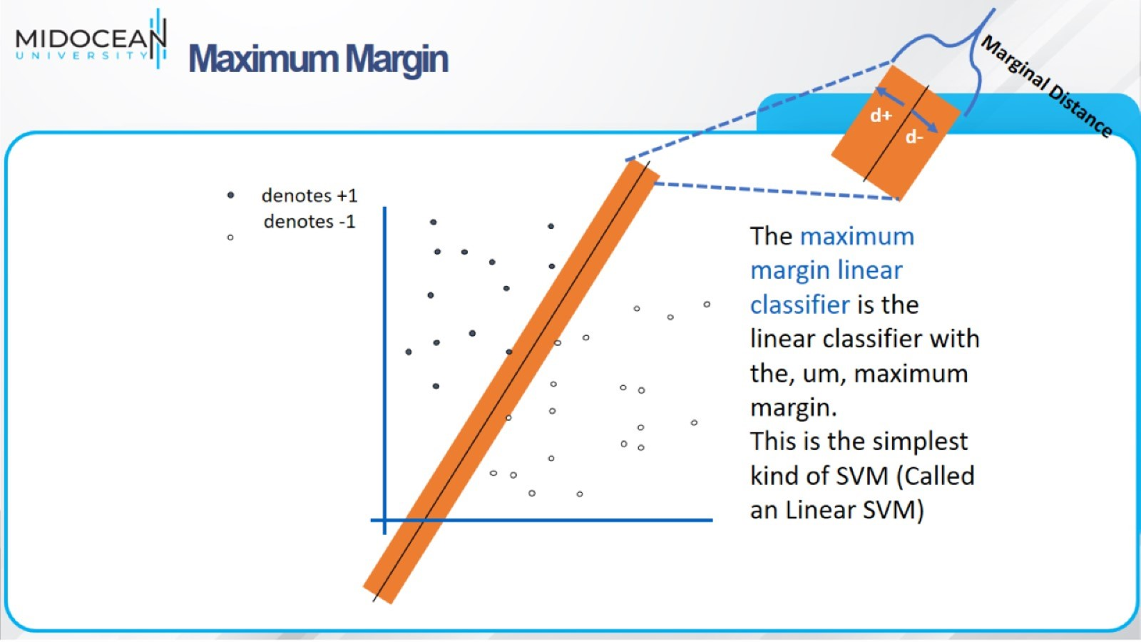
Maximum Margin

Slide 34
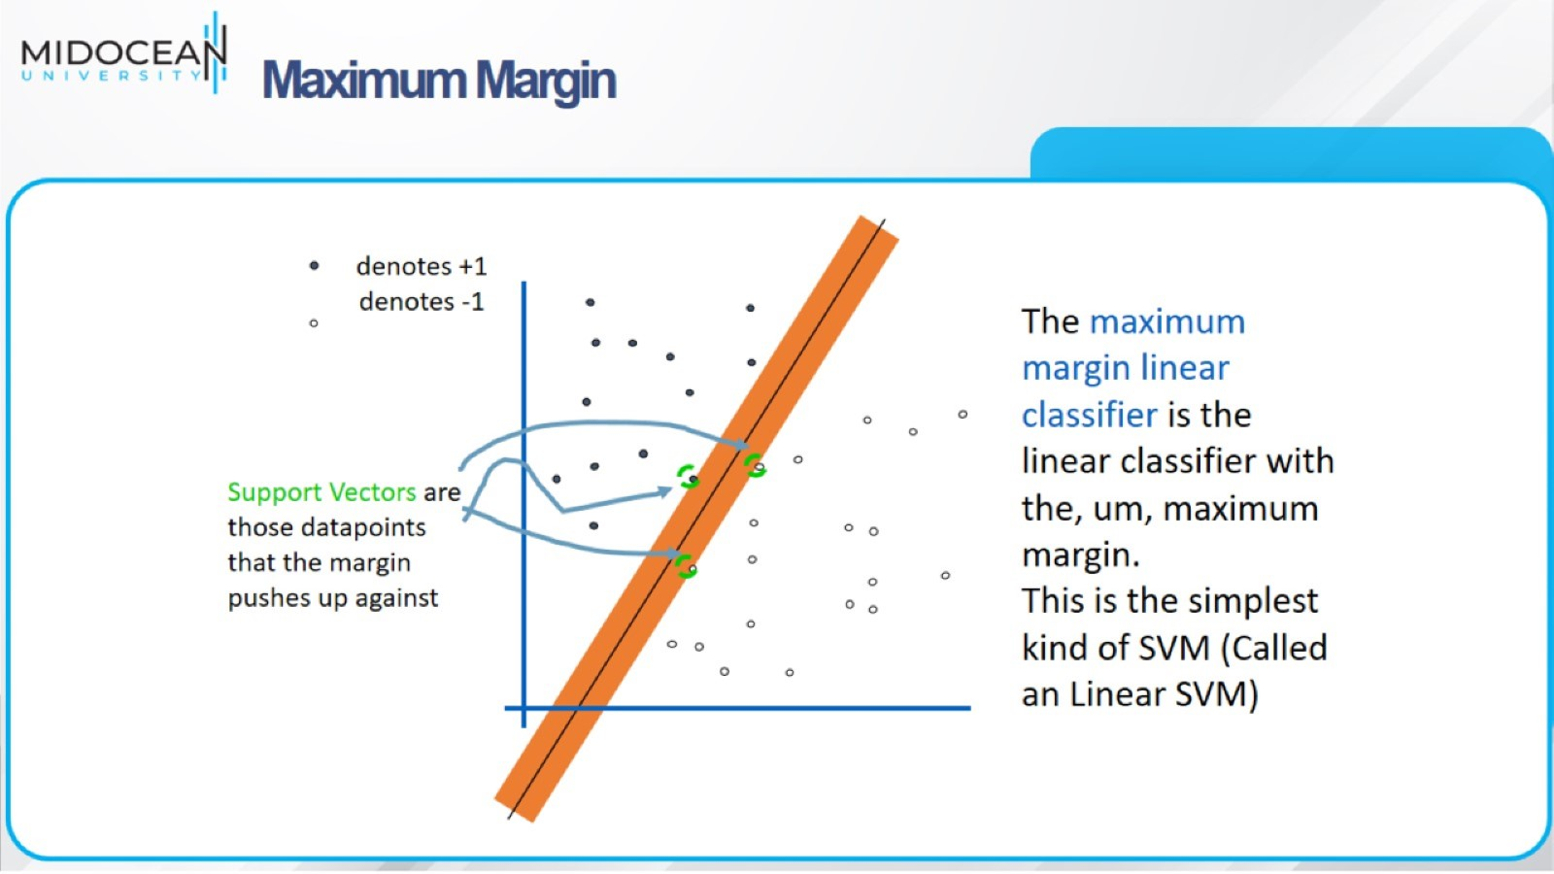
Maximum Margin

Slide 35
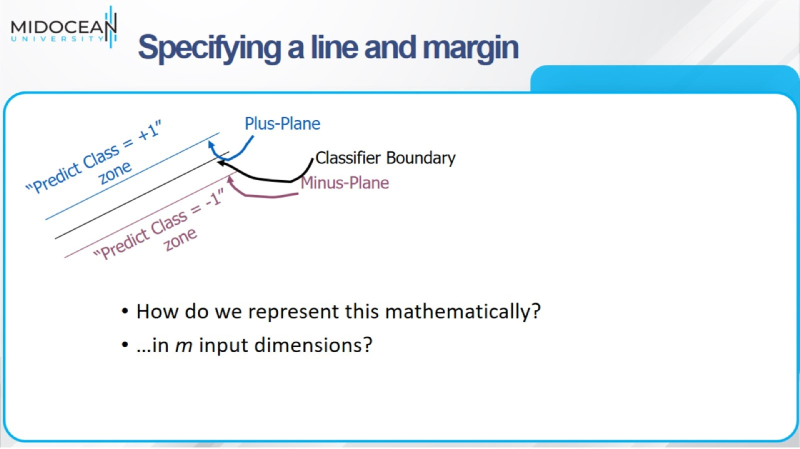
Specifying a line and margin

Slide 36
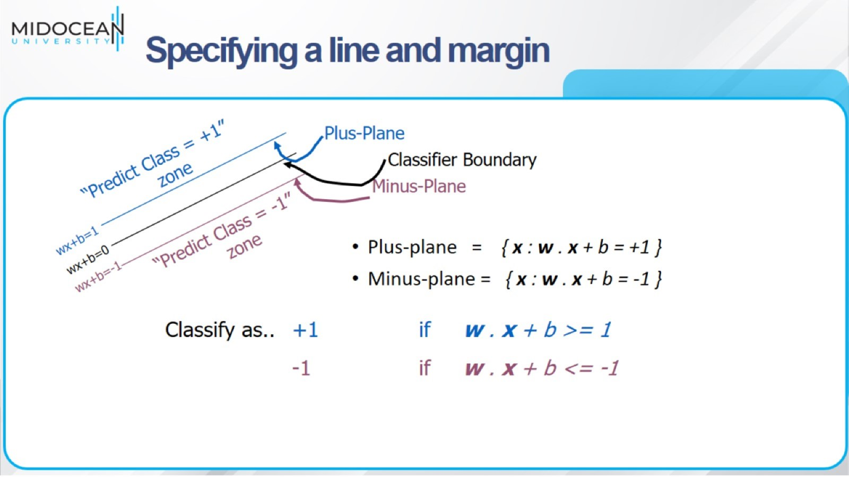

Slide 37
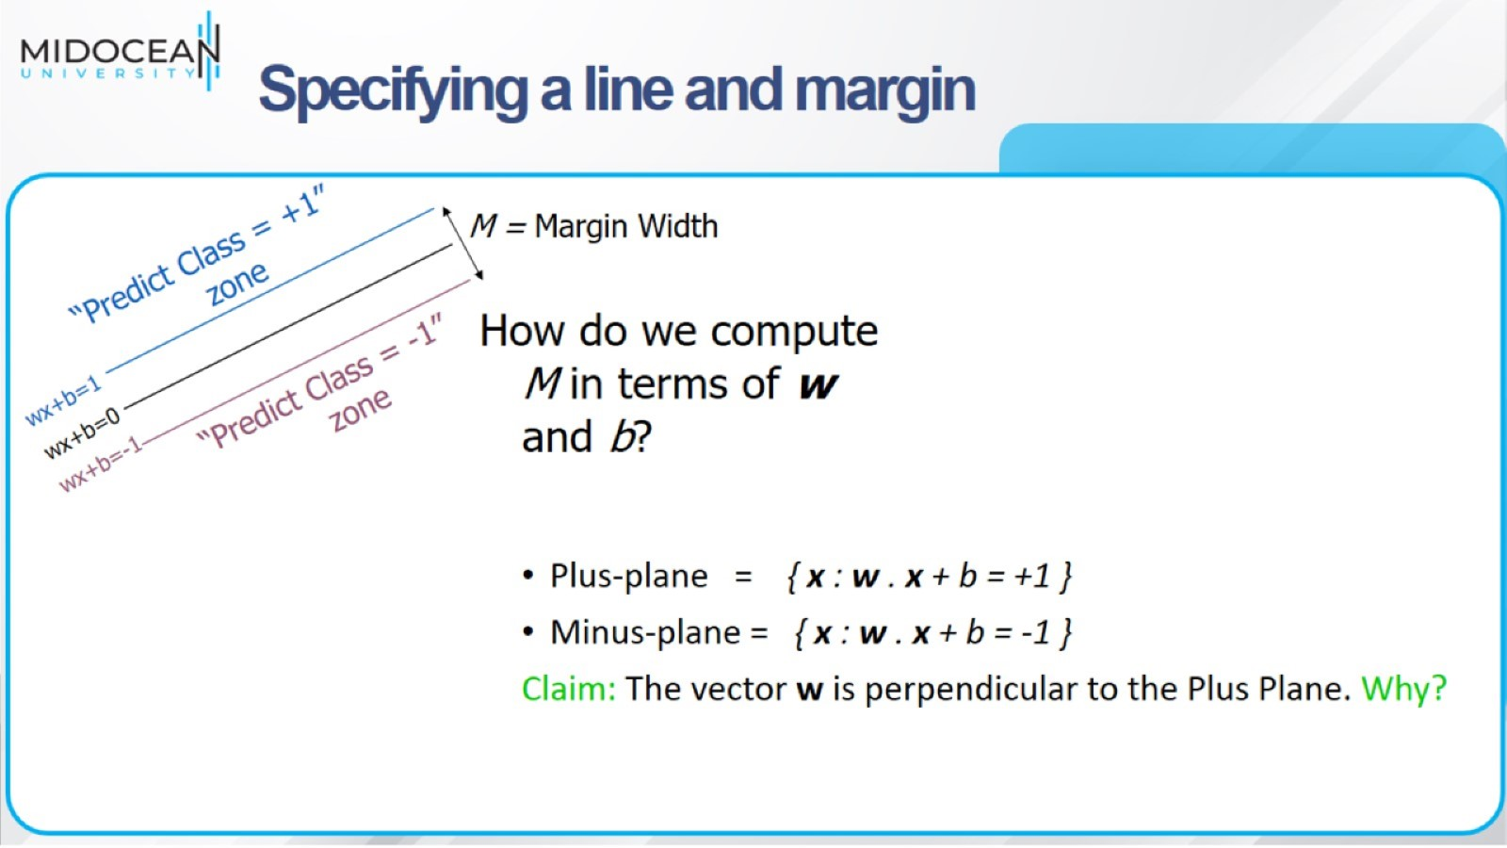

Slide 38
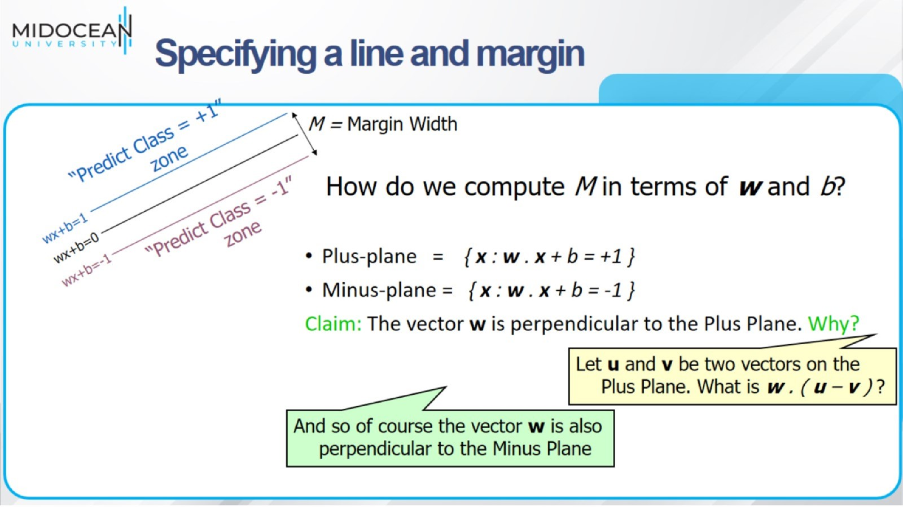

Slide 39
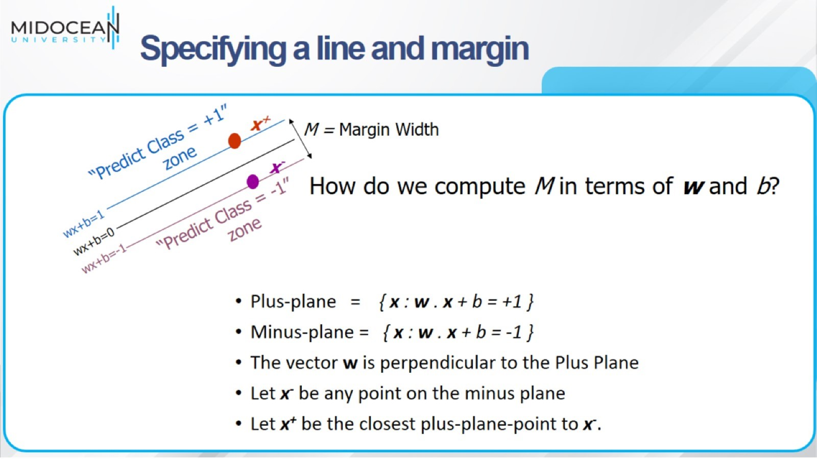

Slide 40
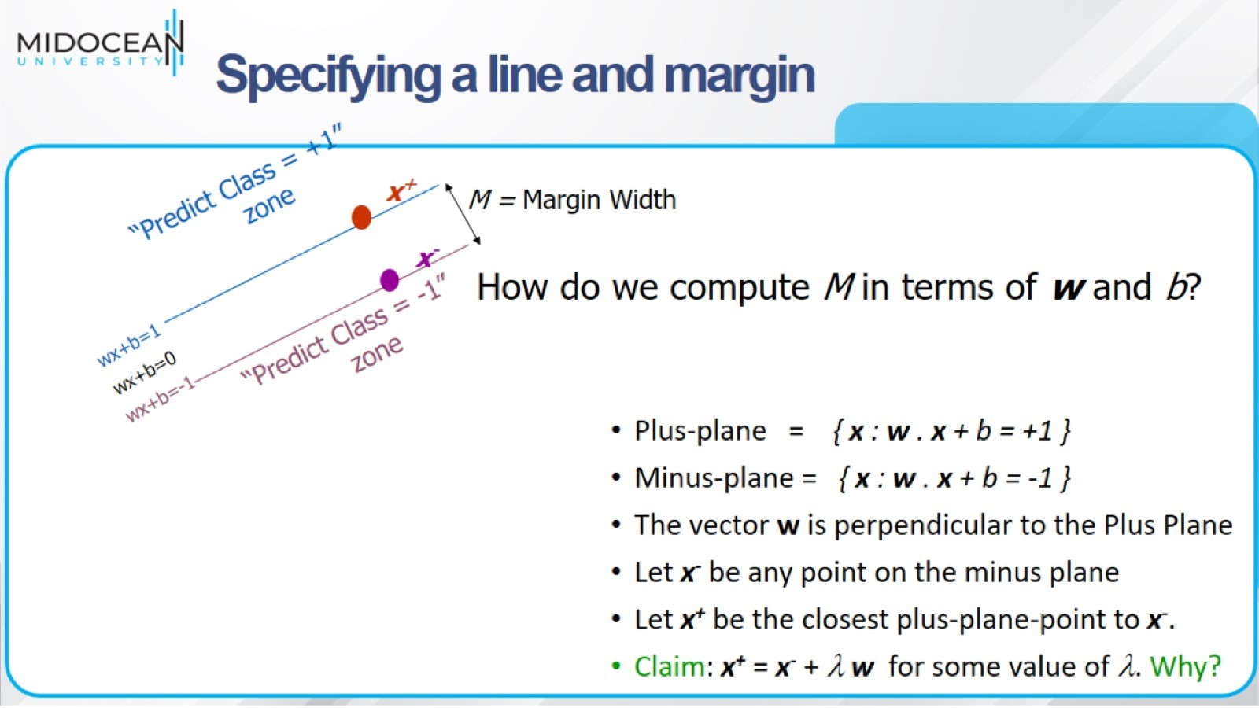

Slide 41
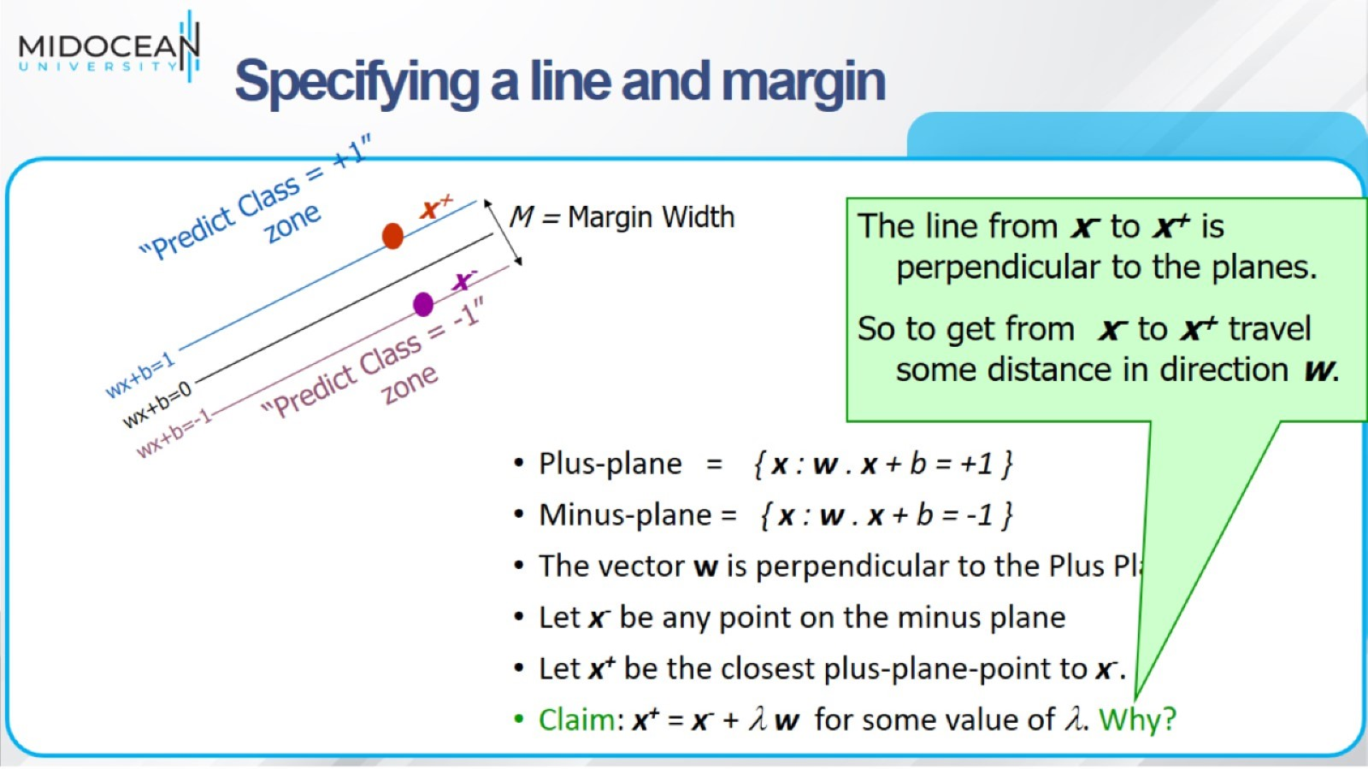

Slide 42
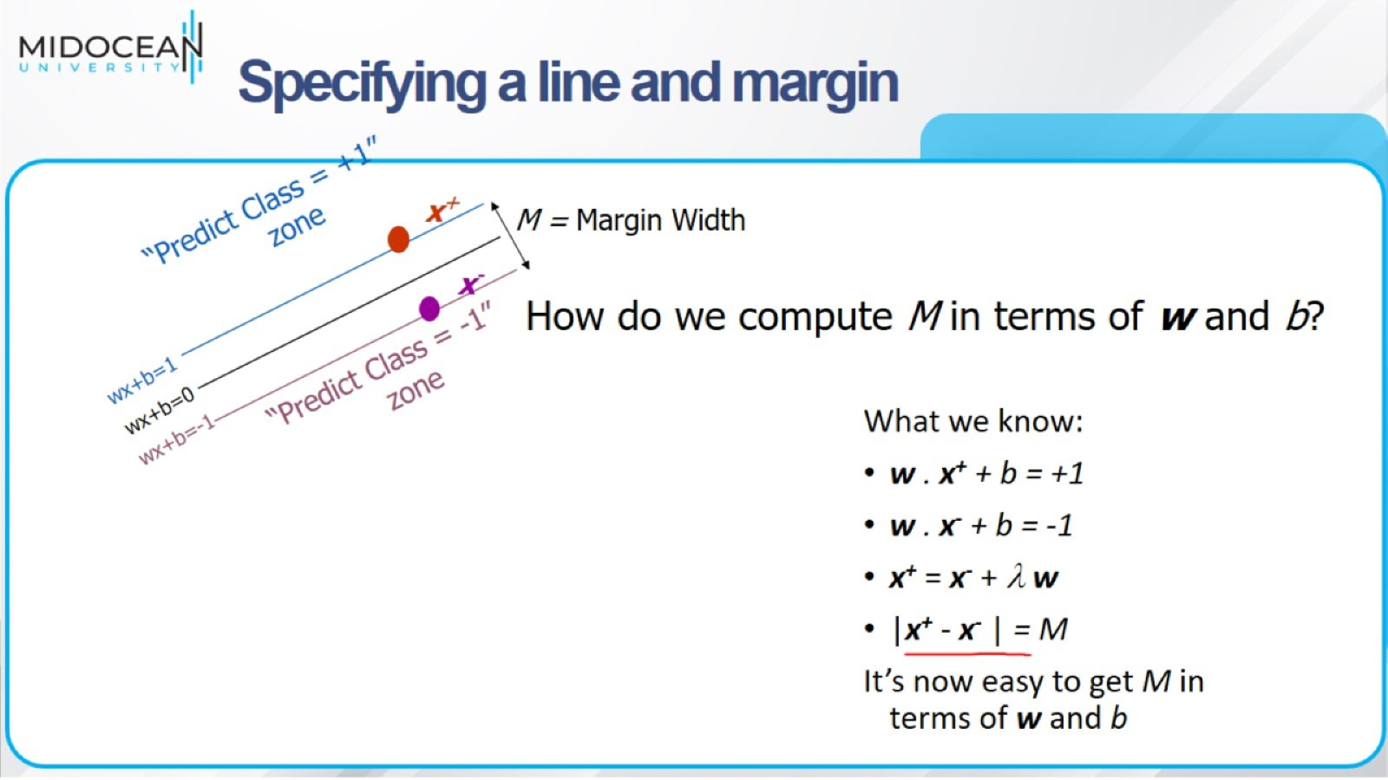

Slide 43
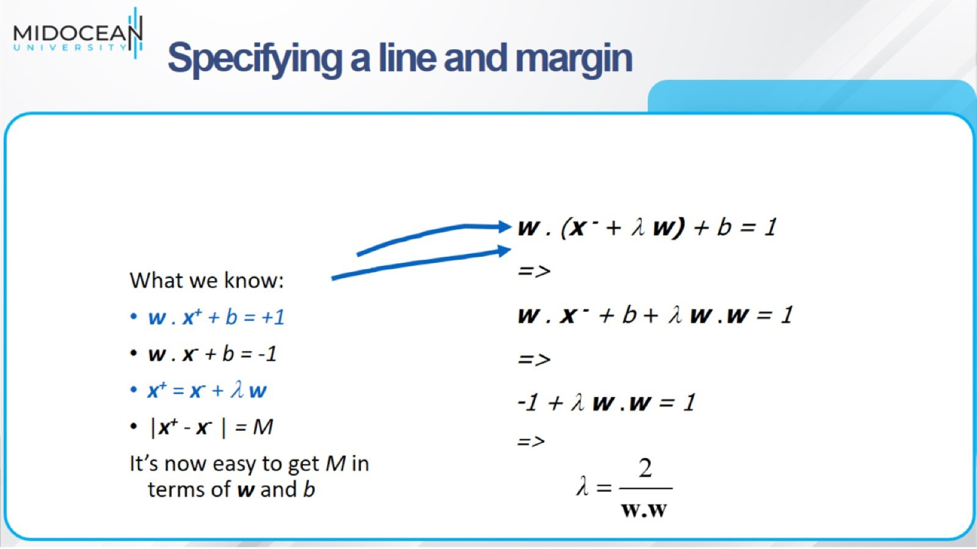

Slide 44
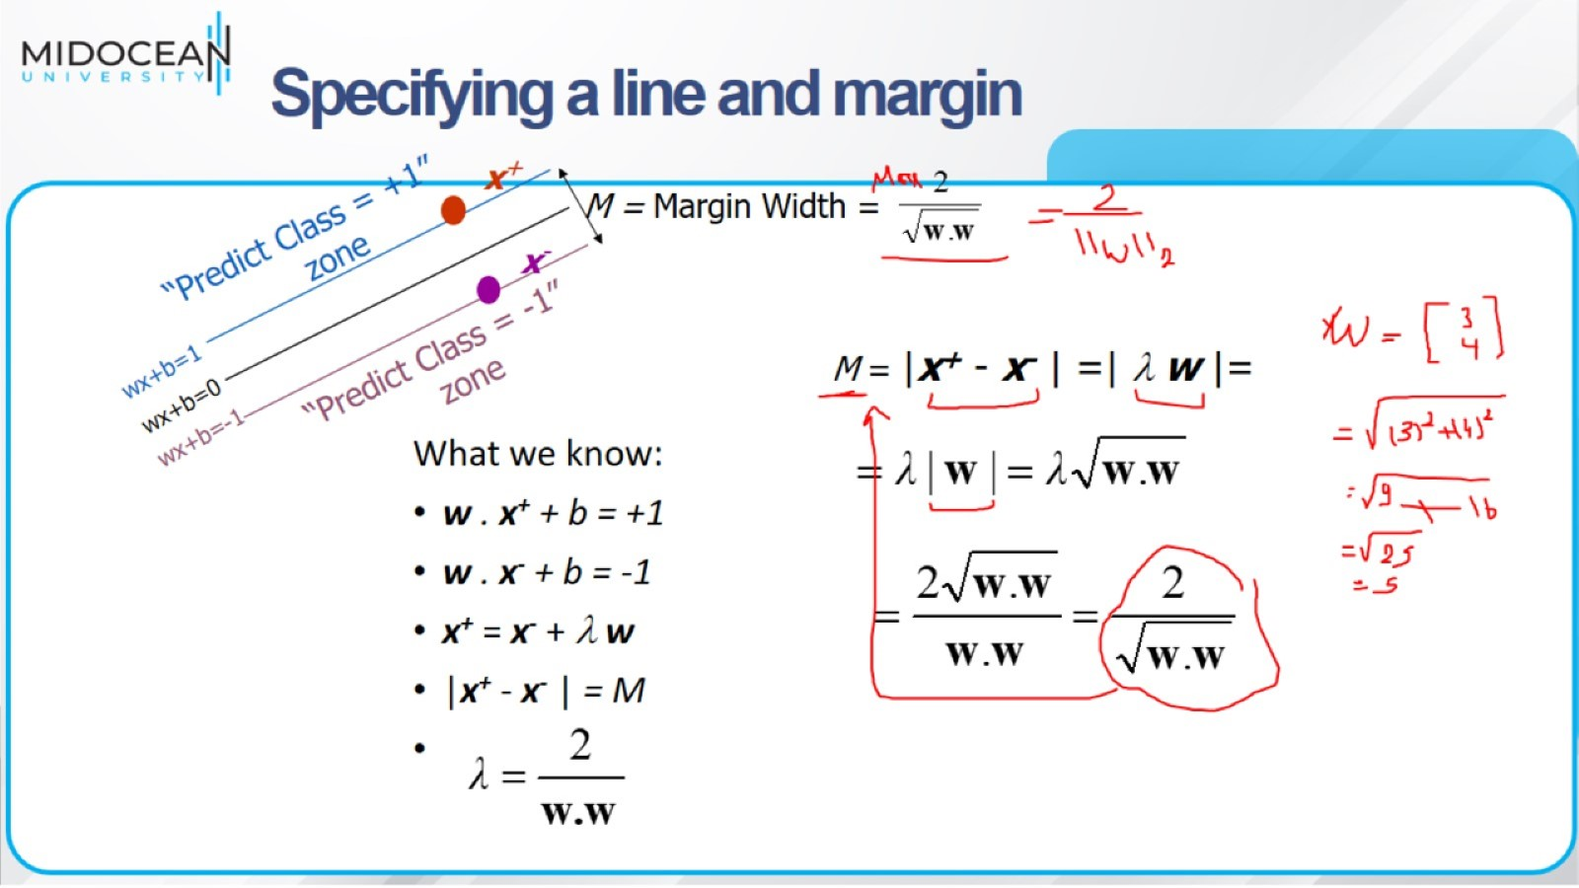

Slide 45
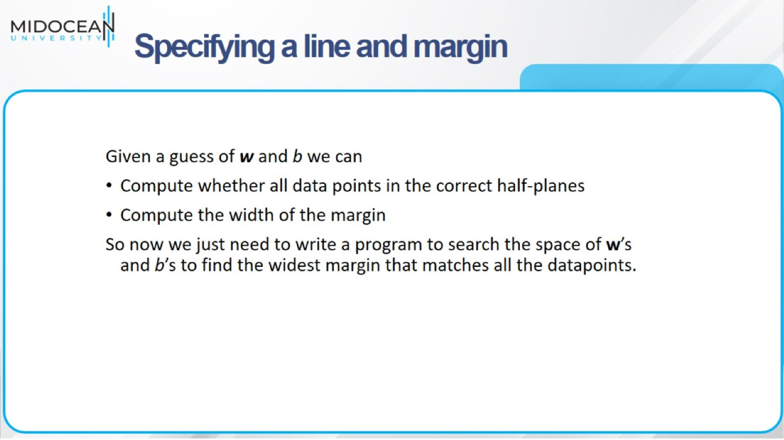

Slide 46
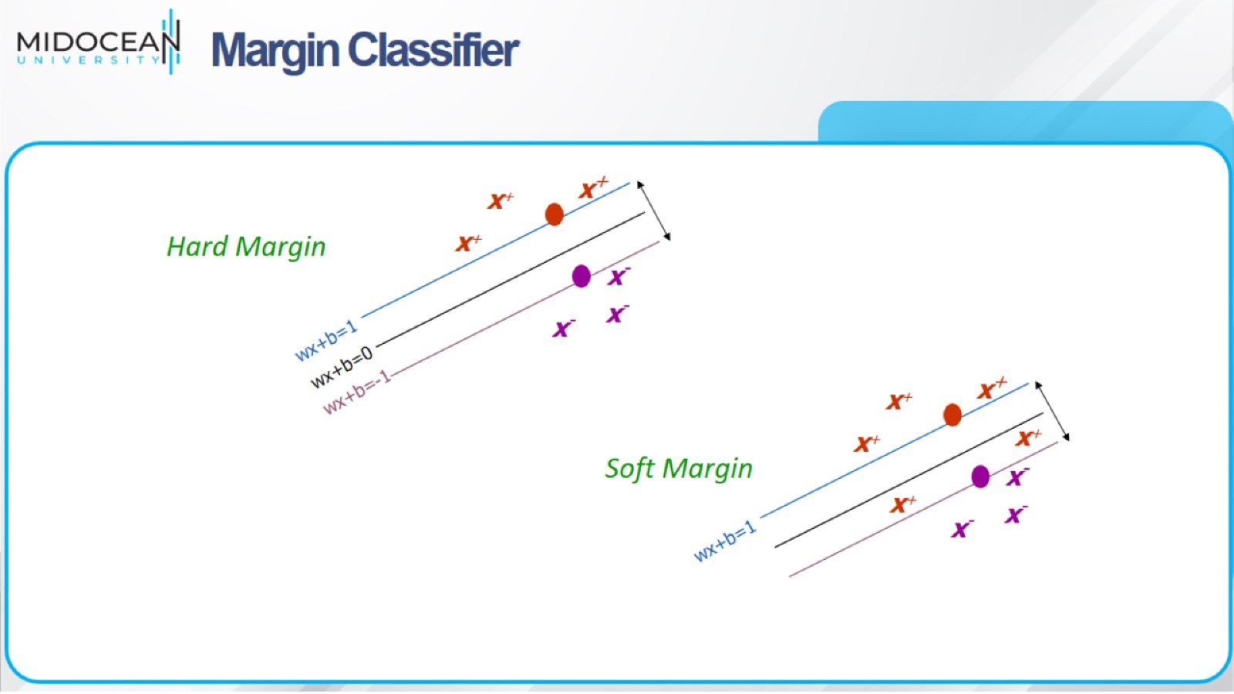
Margin Classifier

Slide 47
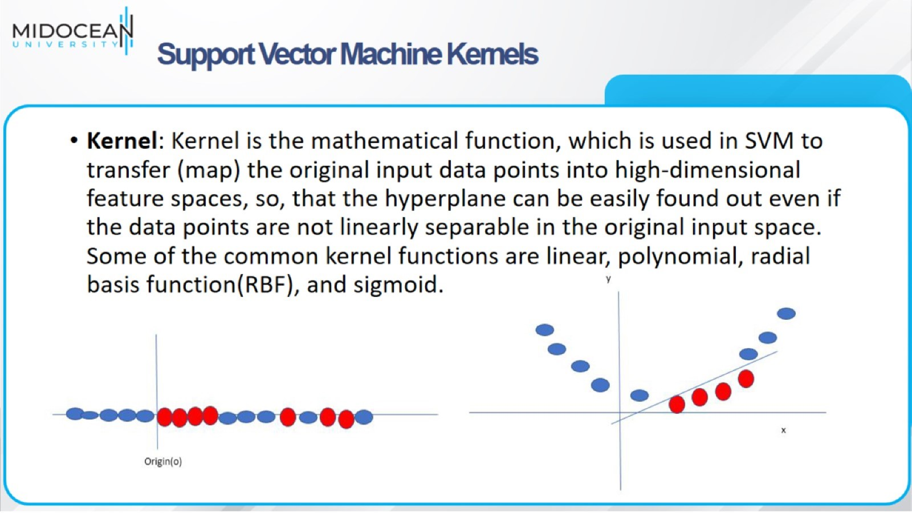
Support Vector Machine Kernels

Slide 48
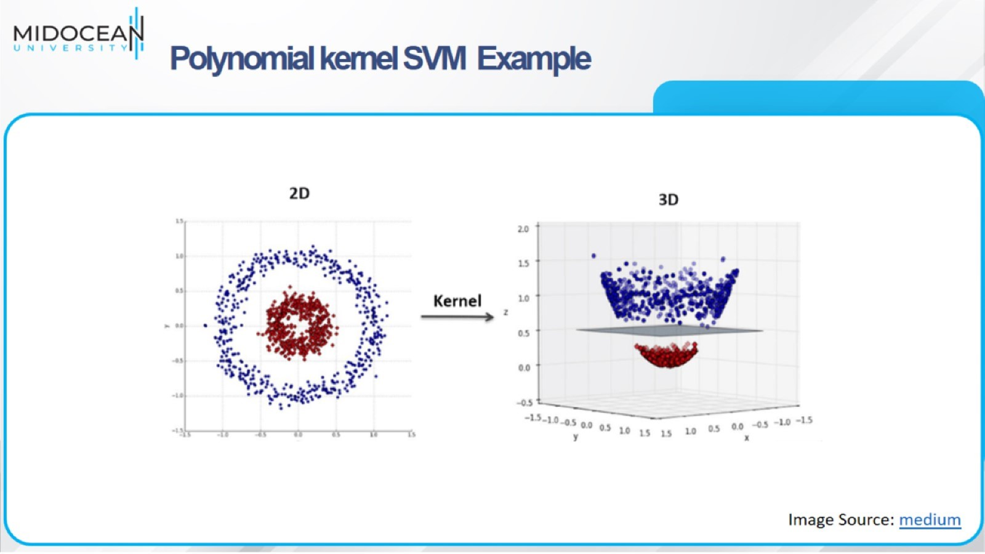
Polynomial kernel SVM Example

Slide 49
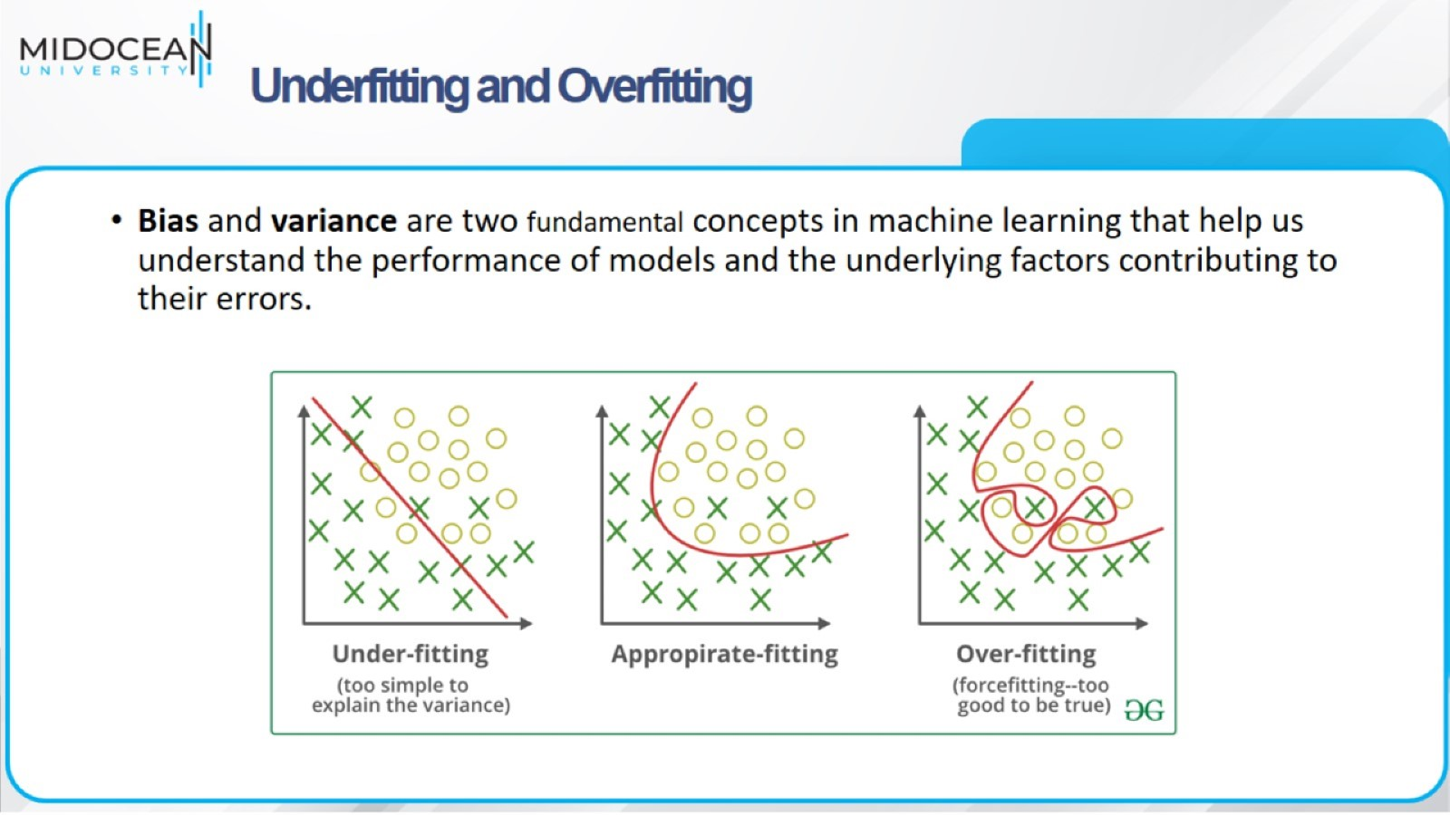
Underfitting and Overfitting

Slide 50
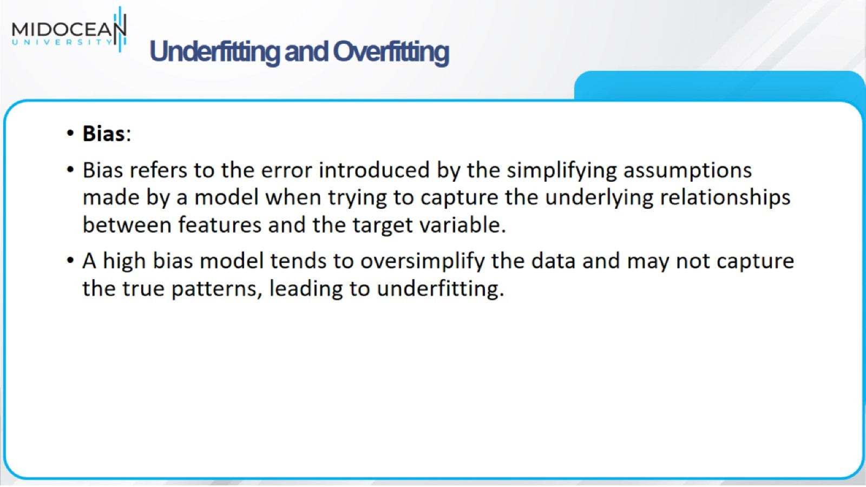
Underfitting and Overfitting

Slide 51

Underfitting and Overfitting

Slide 52


Slide 53

Recent AI
Approaches

Slide 54


Slide 55


Slide 56


Slide 57


Slide 58


Slide 59


Slide 60


Slide 61


Slide 62


Slide 63


Slide 64


Slide 65


Slide 66


Slide 67


Slide 68


Slide 69


Slide 70


