Slide 1

principle of management
Bachelor of Management
Orientation show
عرض توجيهي
Dr. Magdy al-haj
Everyone Smart University
2023

Slide 2

principle of management, DR. Magdy Al-Haj , 2023
principle of management

Slide 3
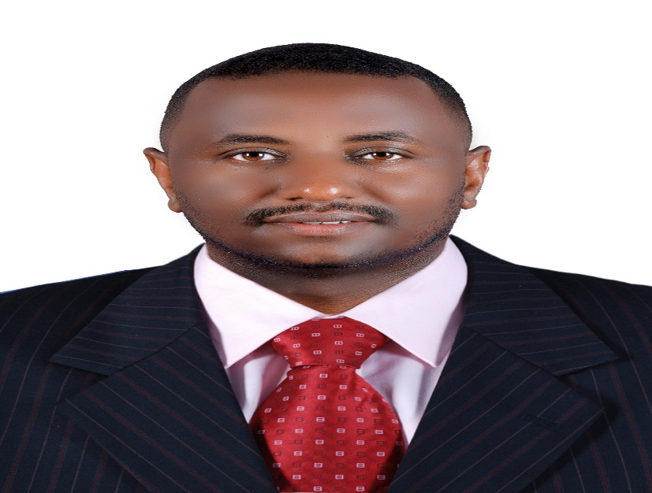


Who Am I?
DR. Magdy Ahmed Al-Haj Mahmoud
assistant's professor of Business Administration
Ph.D. in Business Administration, Omdurman Islamic University, Sudan. 2015
M.Sc. in Business Administration, University of Jazeera, Sudan.2011
B.Sc. in Textile Engineering (Hours), University of Jazeera, Sudan 2004
Worked assistant's professor at everyone smart university, Lecturer, community College king Khalid University, and, quality assurance unite coordinator, resident engineering. Published books& Researches , Professional Training,
principle of management, DR. Magdy Al-Haj , 2023

Slide 4
Who Am I?
  How to reach me:
    By email at magdy@esu.ac.ae
    ( please include “principle of management” in subject line)
  Office hours:
  Discussion Time (Wednesday At 5-6 PM) every week
principle of management, DR. Magdy Al-Haj , 2023

Slide 5

The course that will be taught
principle of management
principle of management, DR. Magdy Al-Haj , 2023

Slide 6
Primary Goal of This Course
This course aims to:
  Provide students with concepts of
This course covers the foundations and the concepts of business administration through the presentation of an integrated framework of business management. It will focus on improving the student understanding of the administrative process: planning, decision- making, organization, coordination, motivation and incentives, administrative communications, control and Its various functions
principle of management, DR. Magdy Al-Haj , 2023

Slide 7
Learning Resources:
Credit Hours:
3 credit hours.
  Required Textbook:
Principles of Management by David S. Bright, Anastasia H. Cortes, et al.
  Essential References:
The main material and reference for each course will be the textbook mentioned in the course specifications. Lecture notes and slides are additional resources that are prepared by the professor.
principle of management, DR. Magdy Al-Haj , 2023

Slide 8
Learning Outcomes
  The course will help students to gauge understanding in principle of management
Recognize the concepts of the administration, the manger and the
organization.
Recognize the administrative functions (planning, organization…)
Understand the concept of administration and its role in the development of organizations and communities
Students will understand functions of management as they relate to environmental professions. And time management
Students will understand the principles of effective leadership.
Students will learn how to systematically approach problem solving.
Students will understand how environmental management systems influence the managerial environment.
principle of management, DR. Magdy Al-Haj , 2023

Slide 9
Units of Course Contents
  Lecture Structure:
Module | Course Unit | No.of. Weeks | Contact Hours
1 | Lecture_1_Overview of management -1 | 1st | 3
2 | Lecture_2_Overview of management -2 | 2nd | 3
3 | Lecture_3_leadership | 3 | 3
4 | Lecture_4_Planning | 4 | 3
5 | Lecture_5_Time Management | 5 | 3
6 | Lecture_6 Making decisions Organizational Structure | 6 | 3
7 | Lecture_7_Organizational Structure and Design | 7 | 3
8 | Lecture_8_Organizing and MANAGERIAL COMMUNICATION | 8 | 3
9 | Lecture_9_Human Resource Management | 9 | 3
10 | Lecture_10_Controlling as a Management Function | 10 | 3
principle of management, DR. Magdy Al-Haj , 2023

Slide 10

Course Information
  Assessment Method:
Short Exam
  80% marks
    Count of short Exam 10 (Weekly)
    8 Marks for each of short Exam.
  20% Final Examination
principle of management, DR. Magdy Al-Haj 2023

Slide 11

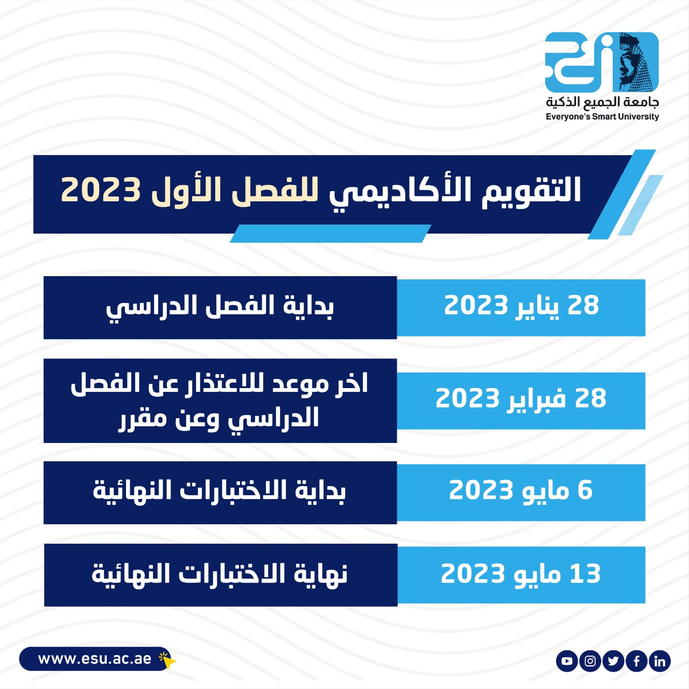
First Trimaster 2023 Academic
Calendar
Everyone's smart university
principle of management, DR. Magdy Al-Haj , 2023

Slide 12
Academic Calendar
-- اللغة الأساسية في المحاضرات هي:
اللغة الإنجليزية
-- الاختبارات باللغة الإنجليزية مع وجود
ترجمة للسؤال.
الفترة الزمنية التعليمية في الفصل الدراسي الخريف تكون مدة ١٣أسبوع
(منهم أسبوعين للاختبار النهائي)
principle of management, DR. Magdy Al-Haj , 2023

Slide 13

Academic Calendar
عبر برنامج ZOOM
سيتم تثبيت رابط حلقة النقاش على صفحة المقرر
principle of management, DR. Magdy Al-Haj , 2023

Slide 14
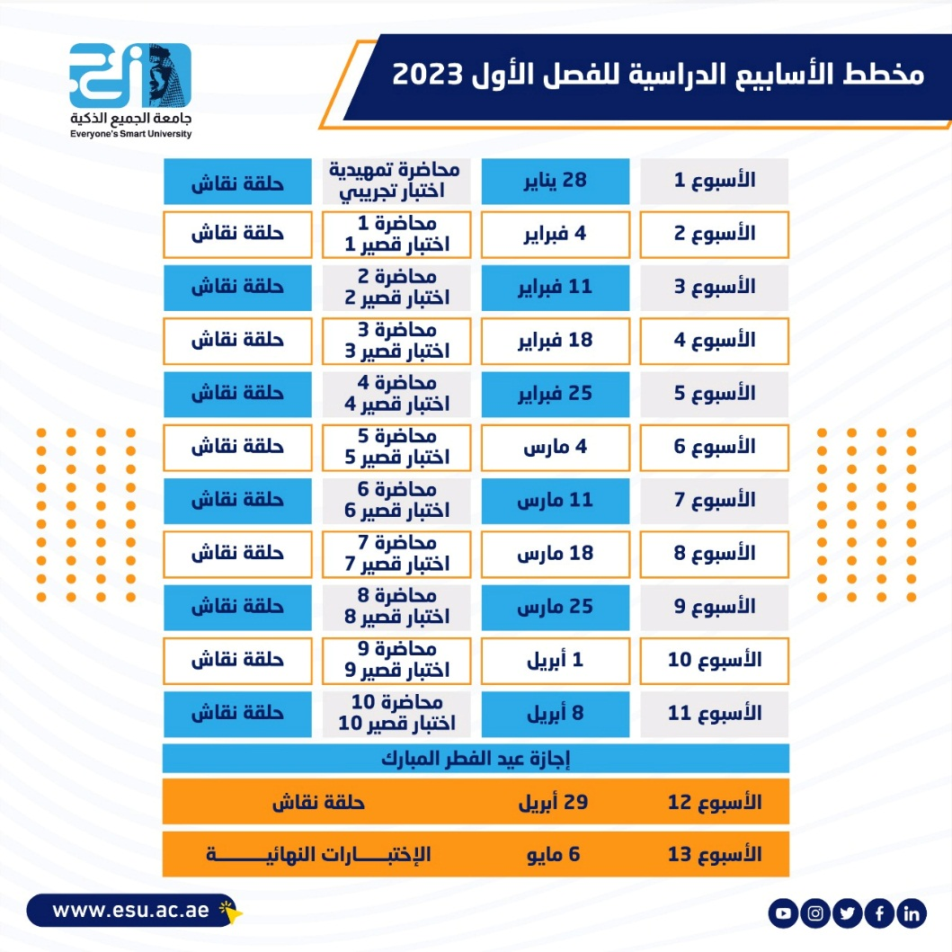
FALL 2022-2023
مخطط الأسابيع الدراسية
principle of management, DR. Magdy Al-Haj , 2023

Slide 15

First Trimaster 2023
اعمال الفصل الدراسي
الأول 2023
principle of management, DR. Magdy Al-Haj , 2023

Slide 16

principle of management, DR. Magdy Al-Haj . 2023

