Slide 1



Discrete Mathematics
Dr. Shahira Ahmed
IT241
Lecture 10

Slide 2


Discrete Mathematics
Lecture 10
Time Complexity Analysis: Techniques for Recursion, Recurrence, and Growth Functions

Slide 3

Learning Outcomes
Define and explain the concept of time complexity and its significance in algorithm design.
Understand and apply asymptotic notation, such as big O notation, to express and analyze the growth rate of algorithms.
Comprehend the principles and benefits of recursion in algorithmic problem-solving.
Analyze the time complexity of recursive algorithms using appropriate techniques.
www.midocean.ae

Slide 4
Learning Outcomes
Identify and solve recurrence relations using the master theorem.
Compare and contrast various growth functions, including constant, logarithmic, linear, and polynomial functions.
Understand proof techniques.
www.midocean.ae

Slide 5
Lecture Outline
The Growth of Functions
Time Complexity
Recursive Function
Recurrence using Master theorm
www.midocean.ae

Slide 6
How Can I Measure Efficiency of An algorithm?
Time complexity analysis is a measure of:
The algorithm's growth rate as the input size increases
  The number of operations or steps the algorithm will take to complete its task

Slide 7
The Growth of Functions
In both computer science and in mathematics, there are many times when we care about how fast a function grows.
In computer science, we want to understand how quickly an algorithm can solve a problem as the size of the input grows.
  We can compare the efficiency of two different algorithms for solving the same problem.
  We can also determine whether it is practical to use a particular algorithm as the input grows.

Slide 8
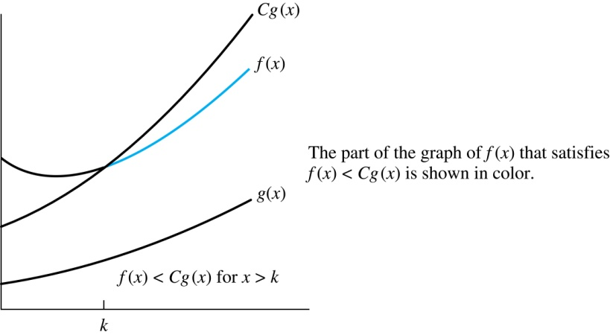
Illustration of Big-O Notation
Big-O gives an upper bound on the growth of a function
f(x) is O(g(x))

Slide 9
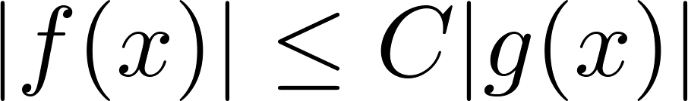
Big-O Notation
f and g be functions from the set of integers or the set of real numbers to the set of real numbers. We say that f(x) is O(g(x)) if there are constants C and k such that whenever x > k
This is read as “f(x) is big-O of g(x)” or “g asymptotically dominates f.”
The constants C and k are called witnesses to the relationship f(x) is O(g(x)). Only one pair of witnesses is needed.

Slide 10
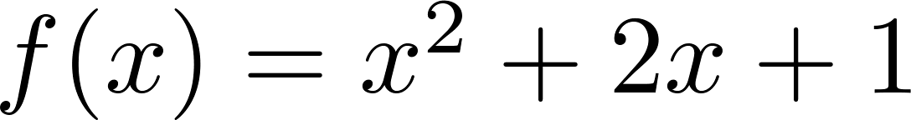
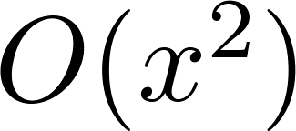
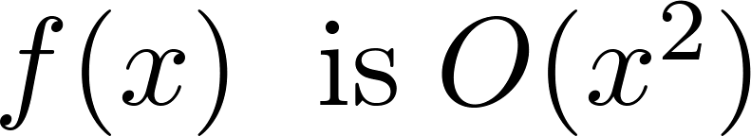
Using the Definition of Big-O Notation
Show that is .
Solution: Since when x > 1, x < x² and 1 < x²
  Can take C = 4 and k = 1 as witnesses to show that

Slide 11
Some Important Points about Big-O Notation
You may see “ f(x) = O(g(x))” instead of “ f(x) is O(g(x)).”
  But this is an abuse of the equals sign since the meaning is that there is an inequality relating the values of f and g, for sufficiently large values of x.
  It is ok to write f(x) ∊ O(g(x)), because O(g(x)) represents the set of functions that are O(g(x)).

Slide 12
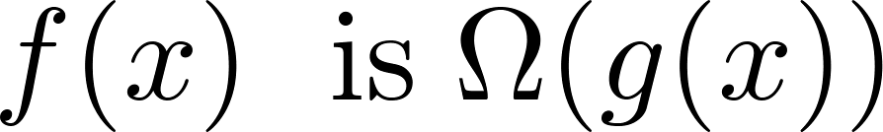
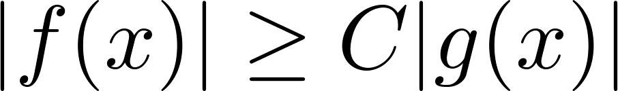
Big-Omega Notation
Let f and g be functions from the set of integers or the set of real numbers to the set of real numbers. We say that
if there are constants C and k such that when x > k. We say that “f(x) is big-Omega of g(x).”
Big-O gives an upper bound on the growth of a function, while Big-Omega gives a lower bound. Big-Omega tells us that a function grows at least as fast as another.

Slide 13
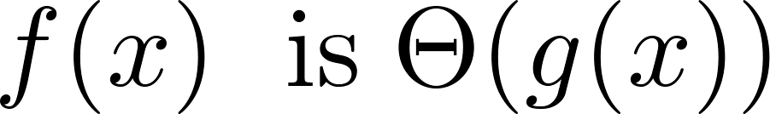
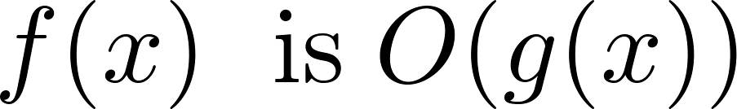
Big-Theta Notation
Let f and g be functions from the set of integers or the set of real numbers to the set of real numbers. The function
if and .
We say that “f is big-Theta of g(x)” and also that “f(x) is of order g(x)” and also that “f(x) and g(x) are of the same order.”
if and only if there exists constants C₁ , C₂ and k such that C₁g(x) < f(x) < C₂ g(x) if x > k. This follows from the definitions of big-O and big-Omega.

Slide 14
The Complexity of Algorithms
Given an algorithm, how efficient is this algorithm for solving a problem given input of a particular size? To answer this question, we ask:
  How much time does this algorithm use to solve a problem?
  How much computer memory does this algorithm use to solve a problem?

Slide 15
Time complexity vs Space Compexity
When we analyze the time the algorithm uses to solve the problem given input of a particular size, we are studying the time complexity of the algorithm.
When we analyze the computer memory the algorithm uses to solve the problem given input of a particular size, we are studying the space complexity of the algorithm.

Slide 16
The Complexity of Algorithms
We will measure time complexity in terms of the number of operations an algorithm uses and we will use big-O and big-Theta notation to estimate the time complexity.
We can use this analysis to see whether it is practical to use this algorithm to solve problems with input of a particular size. We can also compare the efficiency of different algorithms for solving the same problem.

Slide 17
Time Complexity
To analyze the time complexity of algorithms, we determine the number of operations, such as comparisons and arithmetic operations (addition, multiplication, etc.). We ignore minor details, such as the “house keeping” aspects of the algorithm.
We will focus on the worst-case time complexity of an algorithm. This provides an upper bound on the number of operations an algorithm uses to solve a problem with input of a particular size.
It is usually much more difficult to determine the average case time complexity of an algorithm. This is the average number of operations an algorithm uses to solve a problem over all inputs of a particular size.

Slide 18
Complexity Analysis of Algorithms
Example: Describe the time complexity of the algorithm for finding the maximum element in a finite sequence.
procedure max(a₁, a₂, …., a_{n}: integers)
max := a₁
for i := 2 to n
if max < a_{i} then max := a_{i}
return max{max is the largest element}
the time complexity of the algorithm is Θ(n).

Slide 19
Worst-Case Complexity of Linear Search
Example: Determine the time complexity of the linear search algorithm.
procedure linear search(x:integer,
a₁, a₂, …,a_{n}: distinct integers)
i := 1
while (i ≤ n and x ≠ a_{i})
i := i + 1
if i ≤ n then location := i
else location := 0
return location{location is the subscript of the term that equals x, or is 0 if x is not found}
the time complexity of the algorithm is Θ(n).

Slide 20
Worst-Case Complexity of Binary Search
Example: Describe the time complexity of binary search in terms of the number of comparisons used.
procedure binary search(x: integer, a₁,a₂,…, a_{n}: increasing integers)
i := 1 {i is the left endpoint of interval}
j := n {j is right endpoint of interval}
while i < j
m := ⌊(i + j)/2⌋
if x > a_{m} then i := m + 1
else j := m
if x = a_{i} then location := i
else location := 0
return location{location is the subscript i of the term a_{i} equal to x, or 0 if x is not found}
the time complexity of the algorithm is Θ(log n).

Slide 21
Quiz
for i in range(n):
x++
for x in range(n):
y++
for i in range(n):
for x in range(n):
y++
for i in range(n):
for x in range(n):
for s in range(n):
y++
Θ(n)
Θ(n²)
Θ(n³)

Slide 22
Quiz
for i in range(1000):
x++
for x in range(n):
y++
for i in range(1000):
for x in range(n):
y++
for i in range(1000):
for x in range(n):
for s in range(n):
y++
Θ(n)
Θ(n)
Θ(n²)

Slide 23
Quiz
for i in range(1000):
x++
for x in range(1000):
y++
for i in range(1000):
for x in range(1000):
y++
for i in range(1000):
for x in range(1000):
for s in range(9):
y++
Θ(1)
Θ(1)
Θ(1)

Slide 24
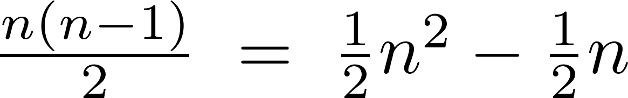
Worst-Case Complexity of Bubble Sort
What is the worst-case complexity of bubble sort in terms of the number of comparisons made?
procedure bubblesort(a₁,…,a_{n}: real numbers with n ≥ 2)
for i := 1 to n− 1
for j := 1 to n − i
if a_{j} >a_{j+1} then interchange a_{j} and a_{j+1}
{a₁,…, a_{n} is now in increasing order}
Solution: A sequence of n−1 passes is made through the list. On each pass n − i comparisons are made.
The worst-case complexity of bubble sort is Θ(n²) .

Slide 25
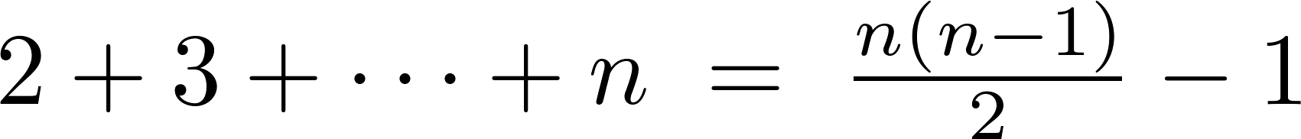
Worst-Case Complexity of Insertion Sort
What is the worst-case complexity of insertion sort in terms of the number of comparisons made?
procedure insertion sort(a₁,…,a_{n}:
real numbers with n ≥ 2)
for j := 2 to n
i := 1
while a_{j} > a_{i}
i := i + 1
m := a_{j}
for k := 0 to j − i − 1
a_{j-k} := a_{j-k-1}
a_{i} := m
Solution: The total number of comparisons are:
Therefore the complexity is Θ(n²).

Slide 26
Worst-Case Complexity of Selection Sort
What is the worst-case complexity of Selection sort in terms of the number of comparisons made?
the complexity is Θ(n²).

Slide 27
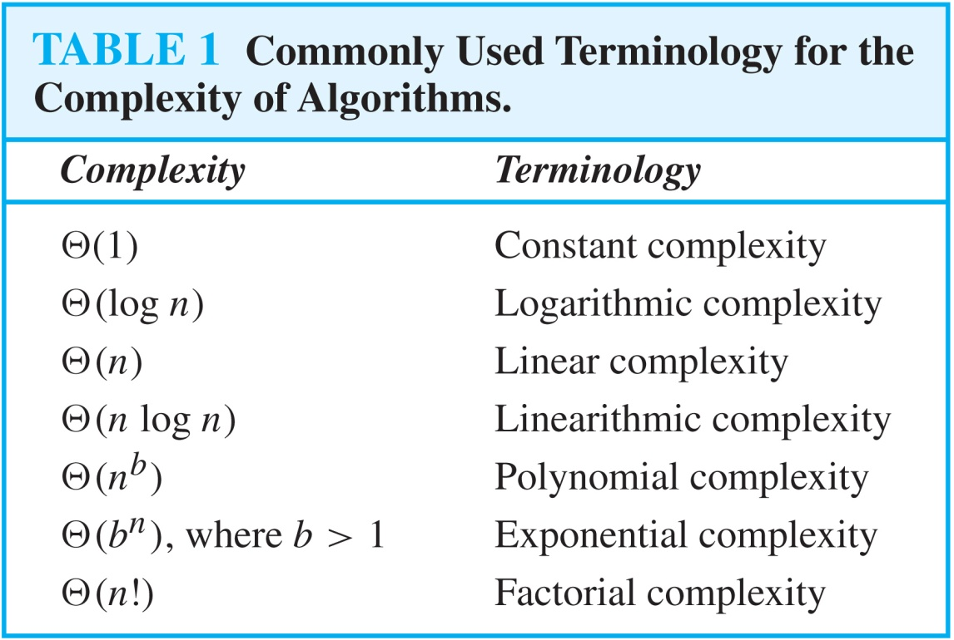
Understanding the Complexity of Algorithms

Slide 28
Understanding the Complexity of Algorithms

Slide 29
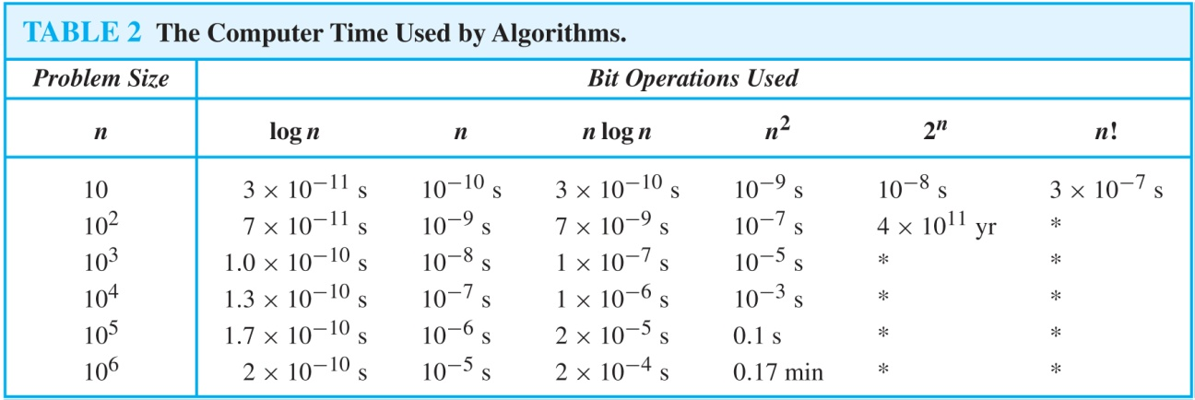
Understanding the Complexity of Algorithms
Times of more than 10¹⁰⁰ years are indicated with an *.

Slide 30
Recursively Defined Functions
Definition: A recursive or inductive definition of a function consists of two steps.
A Recursive function can be defined as a routine that calls itself directly or indirectly.
  BASIS STEP: Specify the value of the function at zero.
  RECURSIVE STEP: Give a rule for finding its value at an integer from its values at smaller integers.

Slide 31
Recursively Defined Functions
Example: Given a recursive definition of the factorial function n!:
  f(0) = 1
  f(n + 1) = (n + 1)∙ f(n), Find f(1), f(2), f(3)
  Solution
    f(1) = 1 * f(0) = 1
    f(2) = 2+f(1)=2
    f(3) = 3*f(2) =6

Slide 32
Recursively Defined Functions
Example: Suppose f is defined by:
f(0) = 3,
f(n + 1) = 2f(n) + 3
Find f(1), f(2), f(3), f(4)
Solution:
    f(1) = 2f(0) + 3 = 2∙3 + 3 = 9
    f(2) = 2f(1)+ 3 = 2∙9 + 3 = 21
    f(3) = 2f(2) + 3 = 2∙21 + 3 = 45
    f(4) = 2f(3) + 3 = 2∙45 + 3 = 93

Slide 33
Divide-and-Conquer Recurrence Relations
Suppose that a recursive algorithm divides a problem of size n into a subproblems.
Assume each subproblem is of size n/b.
Suppose g(n) extra operations are needed in the conquer step.
Then f(n) represents the number of operations to solve a problem of size n satisisfies the following recurrence relation:
f(n) = af(n/b) + g(n)
This is called a divide-and-conquer recurrence relation.

Slide 34
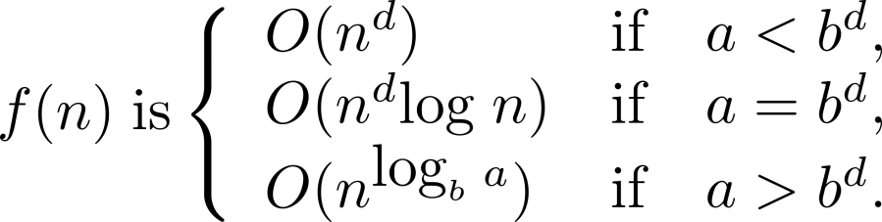
Estimating the Size of Divide-and-conquer Functions (continued)
Theorem 2. Master Theorem: Let f be an increasing function that satisfies the recurrence relation
f(n) = af(n/b) + cn^{d}
whenever n = b^{k}, where k is a positive integer greater than 1, and c and d are real numbers with c positive and d nonnegative. Then

Slide 35
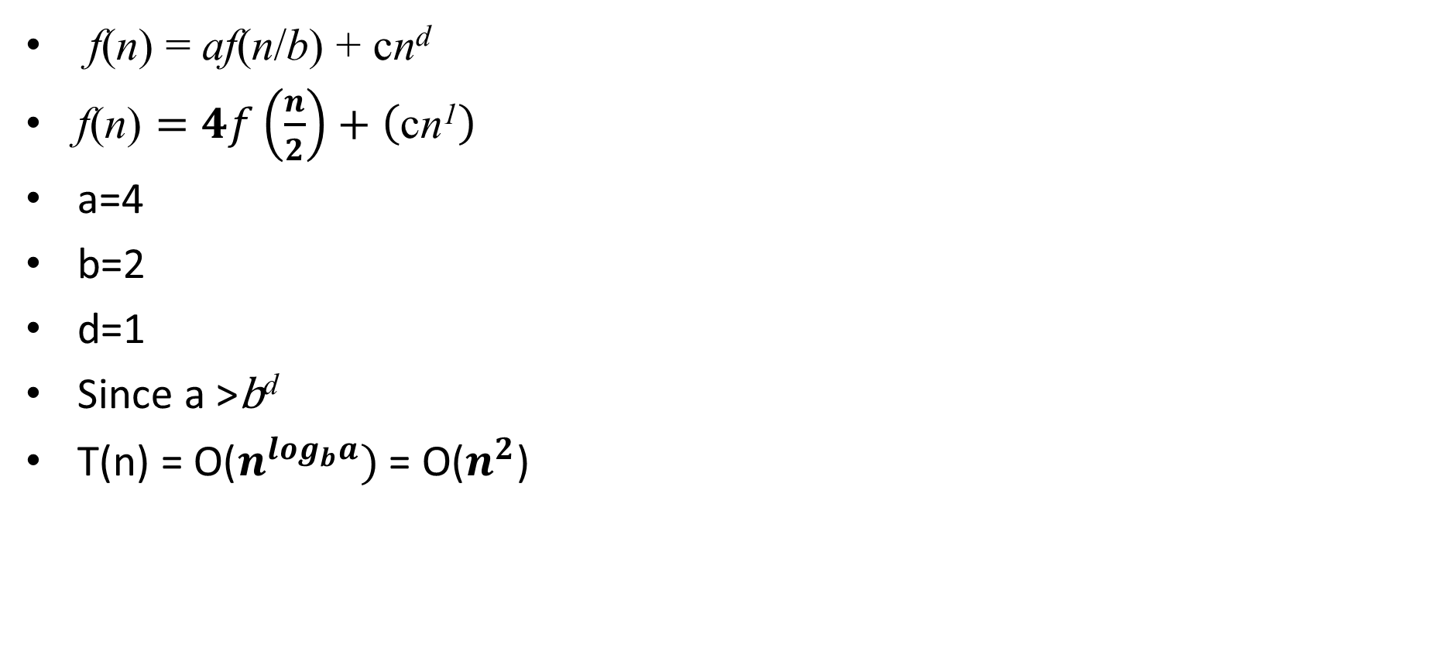
Example 1
f(n) = af(n/b) + cn^{d}
$\text{f}\text{(}\text{n}\text{)}=4f\left(\frac{n}{2}\right)+\left(\text{c}\text{n}\text{1}\right)$
a=4
b=2
d=1
Since a >$\text{b}\text{d}$
T(n) = $\text{O}\text{(}n^{\log_{b}a})$= O($n^{2}$)

Slide 36
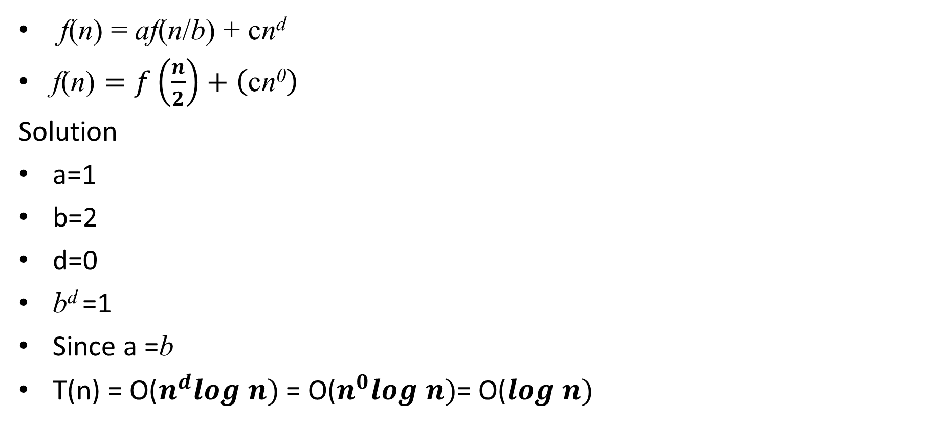
Example 2
f(n) = af(n/b) + cn^{d}
$\text{f}\text{(}\text{n}\text{)}=f\left(\frac{n}{2}\right)+\left(\text{c}\text{n}\text{0}\right)$
Solution
a=1
b=2
d=0
b^{d} =1
Since a =b
T(n) = $\text{O}\text{(}n^{d}log n)$= $\text{O}\text{(}n^{0}log n)$= $\text{O}\text{(}log n)$

Slide 37
Proof Techniques
Proof techniques refer to the methods employed in mathematics and logic to establish the validity or truth of a statement or proposition. some of the common proof techniques:
1. Direct Proof: This technique involves starting with the given statements and using logical reasoning to reach the desired conclusion.
2. Proof by Contradiction: In this technique, the proof assumes the negation of the desired conclusion and then shows that it leads to a contradiction or inconsistency. This establishes the original statement's validity.
3. Proof by Contrapositive: This technique involves proving the contrapositive of a statement instead of the original statement. The contrapositive is logically equivalent to the original statement, so proving it establishes the truth of the original statement.

Slide 38
Proof Techniques
4. Proof by Mathematical Induction: This technique is commonly used to prove statements that depend on a variable, typically natural numbers. It involves proving that a given statement holds for a base case (often n = 1) and then showing that if it holds for any arbitrary case (n = k), it also holds for the next case (n = k + 1).
5. Proof by Exhaustion: Also known as proof by cases, this technique involves considering all possible cases or scenarios and proving the statement for each specific case.
6. Proof by Counterexample: This technique aims to disprove a statement by providing a specific example or case that contradicts it. If a counterexample is found, it demonstrates that the statement is false.

Slide 39
Recap

Slide 40
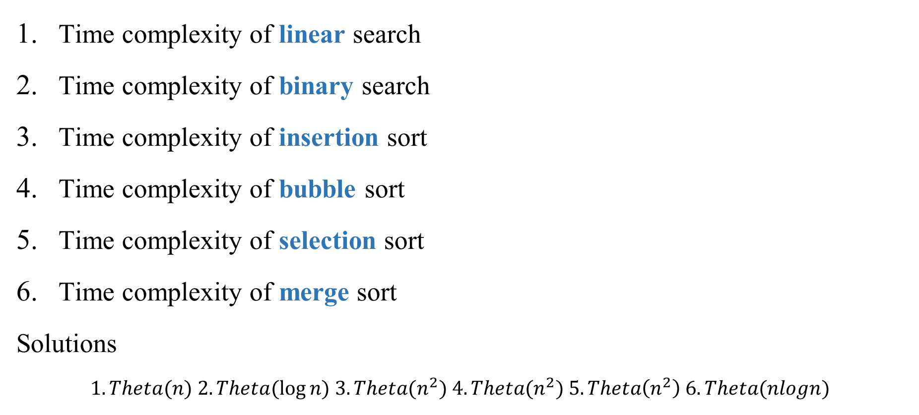
Quiz
Time complexity of linear search
Time complexity of binary search
Time complexity of insertion sort
Time complexity of bubble sort
Time complexity of selection sort
Time complexity of merge sort
Solutions
$$1. Theta(n) 2. Theta(log⁡n) 3. Theta(n^{2}) 4. Theta(n^{2}) 5. Theta\left(n^{2}\right) 6. Theta(nlogn)$$

Slide 41
Quiz
--------------------used to measure the time complexity of an algorithm?
--------------------used to measure the space complexity of an algorithm?
provides an upper bound on the time complexity of an algorithm.
provides a lower bound on the time complexity of an algorithm.
provides the same order on the time complexity of an algorithm.
Solution:
1. number of operations 2. Computer memory 3)Big-O 4) Omega 5) Theta

Slide 42
Quiz
Three algorithms A, B, C with the following time complexity Which is the fastest algorithm
A=theta(1) B= theta(n) C=theta (n^2)
A=theta(2^n) B= theta(n) C=theta (logn)
A=theta(1) B= theta(5^n) C=theta (nlogn)
A=theta(2^n) B= theta(n^2) C=theta (nlogn)
A=theta(n^2) B= theta(n^3) C=theta (n^4)
A=theta(2^n) B= theta(n) C=theta (nlogn)
Solution
1. A 2.C 3.A 4. C 5. A 6. B

Slide 43
Quiz
Example : The Fibonacci numbers are defined as follows:
  f₀ = 0
  f₁ = 1
  f_{n} = f_{n−1} + f_{n−2}
Find f₂, f₃ , f₄ , f_{5,} and f₆
    f2 = f1 + f0 = 1 + 0 = 1,
    f3 = f2 + f1 = 1 + 1 = 2,
    f4 = f3 + f2 = 2 + 1 = 3,
    f5 = f4 + f3 = 3 + 2 = 5,
    f6 = f5 + f4 = 5 + 3 = 8.

Slide 44
Quiz
Given an algorithm, how efficient is this algorithm for solving a problem given input of a particular size? We use--------,---------
If there exists constants C1 , C2 and k such that C< g(x) < f(x) < C2 g(x) if x > k
if there are constants C and k such that when x > k.
if there are constants C and k such that when x > k.
  Solution : 1) Time complexity – Space complexity 2) Theta 3)Big-O 4) Omega

Slide 45
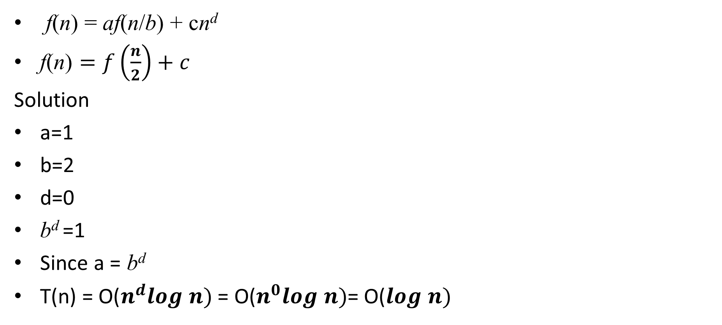
Quiz
f(n) = af(n/b) + cn^{d}
$\text{f}\text{(}\text{n}\text{)}=f\left(\frac{n}{2}\right)+c$
Solution
a=1
b=2
d=0
b^{d} =1
Since a = b^{d}
T(n) = $\text{O}\text{(}n^{d}log n)$= $\text{O}\text{(}n^{0}log n)$= $\text{O}\text{(}log n)$
Binary Search

Slide 46
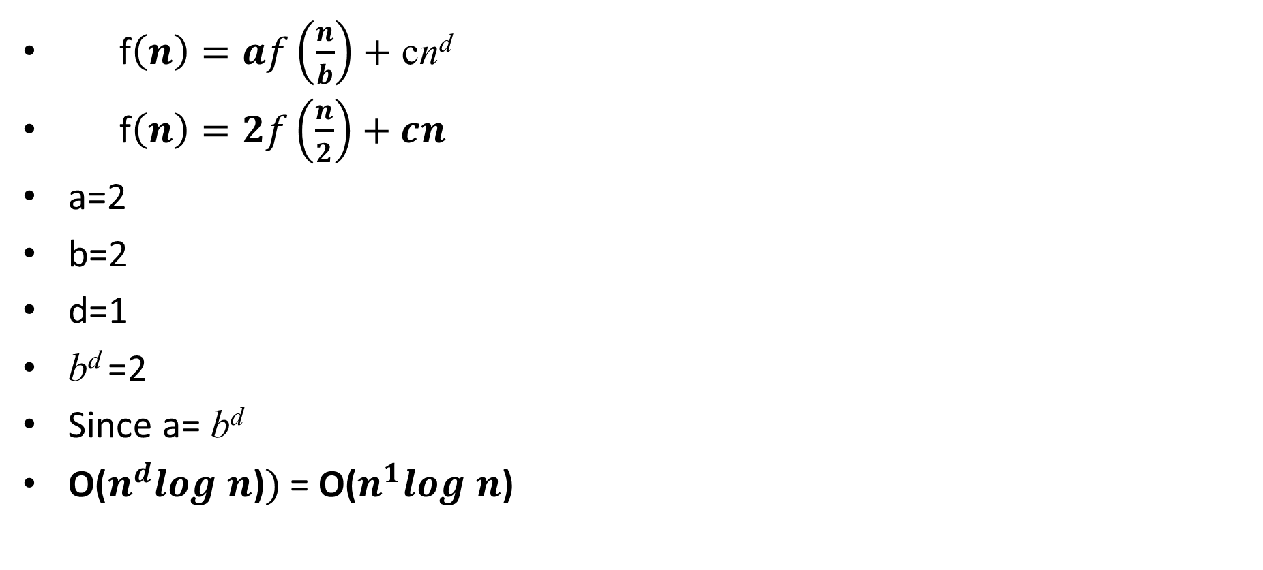
Quiz
f$\left(n\right)=af\left(\frac{n}{b}\right)+\text{c}\text{n}\text{d}$
f$\left(n\right)=2f\left(\frac{n}{2}\right)+cn^{}$
a=2
b=2
d=1
b^{d} =2
Since a= b^{d}
$\text{O}\text{(}n^{d}log n\text{)})$= $\text{O}\text{(}n^{1}log n\text{)}$
Merge Sort

Slide 47
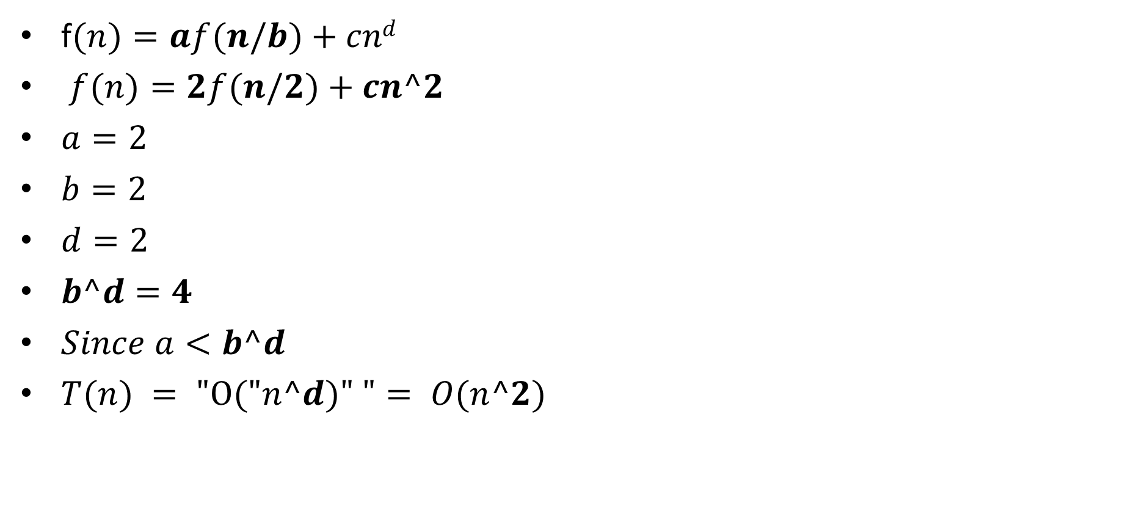
Quiz
f$(n)=af(n/b)+cnd$
$f(n)=2f(n/2)+cn^2$
$a=2$
$b=2$
$d=2$
$b^d=4$
$Since a<b^d$
$T(n) = "O("n^d)" "= O(n^2)$

Slide 48
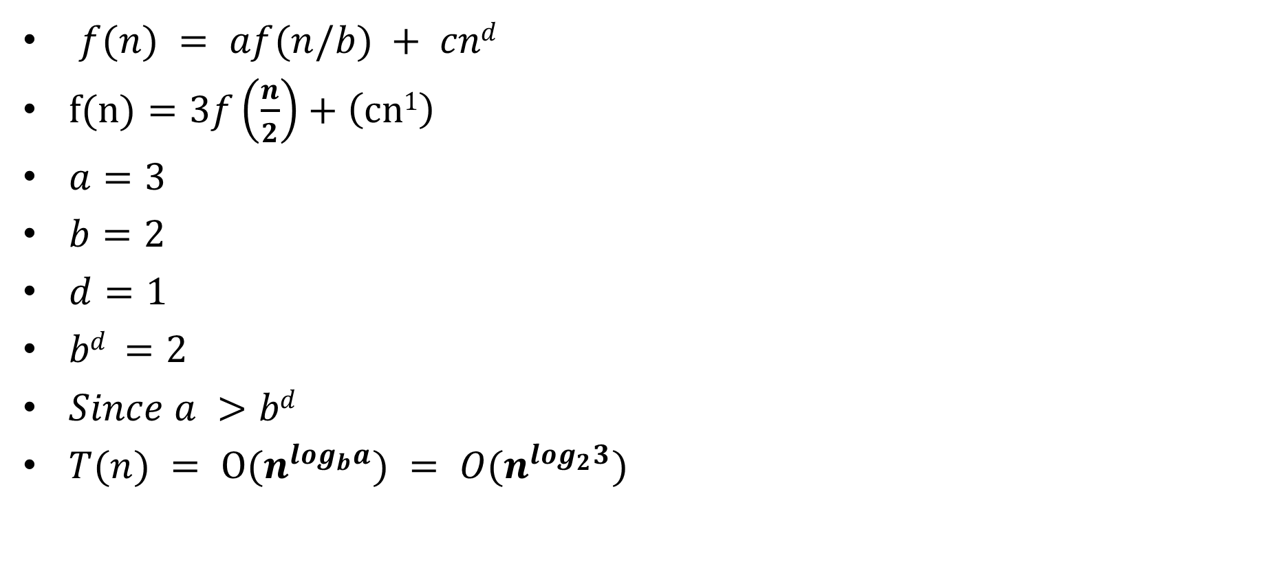
Quiz
$f(n) = af(n/b) + cnd$
$f(n)=3f\left(\frac{n}{2}\right)+\left(cn1\right)$
$a=3$
$b=2$
$d=1$
$bd =2$
$Since a >bd$
$T(n) = O(n^{\log_{b}a}) = O(n^{\log_{2}3})$

Slide 49
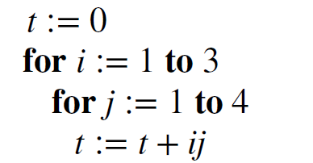
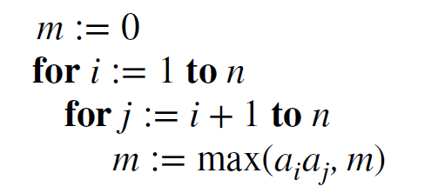
Quiz
Give big O
Suppose that an element is known to be among the first four elements in a list of 32 elements. Would a linear search or a binary search locate this element in a sorted list more rapidly?
Solution 1.O(1) 2.O(n^2) 3.Linear
1)
2)

Slide 50
Quiz
1. This technique involves starting with the given statements and using logical reasoning to reach conclusion.
2. the proof assumes the negation of the desired conclusion and then shows that it leads to an inconsistency.
3. proving the contrapositive of a statement instead of the original statement
Solution:
1.Direct Proof 2. Proof by Contradiction 3. Proof by Contrapositive

Slide 51
Proof Techniques
4. prove statements that depend on a variable, typically natural numbers.
5. consider all possible cases and proving the statement for each case.
6. disprove a statement by providing a specific example that contradicts it
Solution
1. Proof by Mathematical Induction 2. Proof by Exhaustion 3. Proof by Counterexample

Slide 52
Current Advancements in Discrete Mathematics
للإطلاع فقط

Slide 53
Introduction
Discrete mathematics is evolving rapidly, especially because of its deep connections to computer science, cryptography, AI, and network theory. The search results highlight that journals like Advances and Applications in Discrete Mathematics actively publish new developments in combinatorics, graph theory, coding theory, block designs, discrete geometry, and discrete probability.

Slide 54
Graph Theory & Network Science
Graph theory remains one of the most dynamic areas because of its applications in:
Social networks (community detection, influence maximization)
Biological networks (protein interactions, gene regulation)
Communication networks (routing, congestion control)
Graph algorithms for AI (graph neural networks, graph embeddings)
Recent work focuses on:
Hypergraphs and higher‑order networks
Dynamic and temporal graphs
Efficient algorithms for massive graphs (streaming, distributed)
Notes:
Today
You said
current advancements in discrete math
Copilot said
Here’s a clear, up‑to‑date snapshot of current advancements in discrete mathematics, grounded in the search results you triggered and expanded with broader context.
🔍 Current Advancements in Discrete Mathematics
(with citations from your search results)
Discrete mathematics is evolving rapidly, especially because of its deep connections to computer science, cryptography, AI, and network theory. The search results highlight that journals like Advances and Applications in Discrete Mathematics actively publish new developments in combinatorics, graph theory, coding theory, block designs, discrete geometry, and discrete probabilitypphmjopenaccess.com+1.
Below is a structured overview of the most active and cutting‑edge areas today.
🧩 1. Graph Theory & Network Science
Graph theory remains one of the most dynamic areas because of its applications in:
Social networks (community detection, influence maximization)
Biological networks (protein interactions, gene regulation)
Communication networks (routing, congestion control)
Graph algorithms for AI (graph neural networks, graph embeddings)
Recent work focuses on:
Hypergraphs and higher‑order networks
Dynamic and temporal graphs
Efficient algorithms for massive graphs (streaming, distributed)
🔐 2. Coding Theory & Cryptography
The search results emphasize coding theory as a major focus areapphmjopenaccess.com+1.
Current advancements include:
Post‑quantum cryptographic codes
Locally decodable and locally testable codes
Error‑correcting codes for DNA storage
Network coding and fountain codes
Algebraic geometry codes with improved bounds
🧮 3. Combinatorics & Extremal Methods
Combinatorics continues to explode with new results, especially in:
Probabilistic combinatorics
Additive combinatorics
Ramsey theory
Enumerative combinatorics
Design theory (block designs, Steiner systems)pphmjopenaccess.com+1
Applications now extend to:
Machine learning theory
Randomized algorithms
Statistical physics models (Ising, percolation)
📐 4. Discrete Geometry
Discrete geometry is highlighted as a real‑world application areaPushpa Publishing House.
Current research includes:
Geometric discrepancy theory
High‑dimensional convexity
Geometric graph theory
Applications to robotics (motion planning)
Computational geometry for big data (coresets, sketches)
🎲 5. Discrete Probability & Random Structures
Modern work focuses on:
Random graphs and hypergraphs
Phase transitions in combinatorial structures
Concentration inequalities
Probabilistic method refinements
Applications to randomized algorithms and complexity theory
🧠 6. Logic, Complexity, and Theoretical Computer Science
Discrete math is the backbone of TCS. Current advancements include:
Fine‑grained complexity
Parameterized complexity
SAT/SMT solving
Descriptive complexity
Logic for verification and model checking
🧪 7. Applications to Real‑World Problems
The journals emphasize efficient and powerful tools for real‑world applicationsPushpa Publishing House, especially in:
Networking and information sciences
Optimization in logistics and supply chains
Bioinformatics
Quantum computing
Cryptographic protocols
Machine learning theory (VC dimension, PAC learning, combinatorial generalization)
✅ Summary Table
AreaCurrent AdvancementsNotesGraph TheoryHypergraphs, dynamic graphs, GNNsStrong CS applicationsCoding TheoryPost‑quantum codes, DNA storageHighlighted in search resultspphmjopenaccess.com+1CombinatoricsExtremal, probabilistic, additiveCore of modern discrete mathDiscrete GeometryHigh‑dimensional geometry, roboticsEmphasized in journalsPushpa Publishing HouseDiscrete ProbabilityRandom structures, phase transitionsLinks to physics & MLLogic & ComplexitySAT solving, fine‑grained complexityFoundations of CSApplicationsNetworks, bioinformatics, MLJournals encourage applied workPushpa Publishing House
If you want, I can also summarize the hottest research topics for 2025, or tailor this to your field—given your background in healthcare time‑series analytics, I can highlight discrete math areas most relevant to your research.
pphmjopenaccess.com
Advances and Applications in Discrete Mathematics
Pushpa Publishing House
Advances and Applications in Discrete Mathematics
Show all
Edit in a page
You said
in arabic
Copilot said
بالطبع يا شهيرة — إليك أحدث التطوّرات في الرياضيات المتقطّعة بصياغة عربية واضحة ومنظّمة، وبأسلوب يناسب اهتمامك بالبحث العلمي والتحليل الرياضي.
🔍 أحدث التطوّرات في الرياضيات المتقطّعة
الرياضيات المتقطّعة أصبحت اليوم في قلب التطوّر العلمي، لأنها الأساس النظري للكثير من التقنيات الحديثة: الذكاء الاصطناعي، التشفير، تحليل الشبكات، والخوارزميات. فيما يلي أهم الاتجاهات البحثية المتقدّمة حاليًا.
🧩 1. نظرية الرسوم (Graph Theory) وتطبيقاتها
تُعدّ من أكثر المجالات نشاطًا، وتشمل:
الرسوم الفائقة (Hypergraphs)
الرسوم الديناميكية والزمنية
خوارزميات الرسوم الضخمة (Streaming & Distributed Graph Algorithms)
الرسوم في الذكاء الاصطناعي (Graph Neural Networks)
لماذا مهم؟ لأنها تُستخدم في تحليل الشبكات الاجتماعية، شبكات البروتينات، أنظمة التوصيل، وحتى في فهم بنية البيانات في التعلم العميق.
🔐 2. نظرية التشفير والشفرة (Coding & Cryptography)
من أكثر المجالات تطورًا بسبب الحاجة إلى أمان البيانات.
أبرز الاتجاهات:
التشفير المقاوم للحوسبة الكمومية
الشفرات القابلة للاختبار محليًا (Locally Testable Codes)
الشفرات المستخدمة في تخزين البيانات على DNA
تحسين حدود الشفرات الهندسية (Algebraic Geometry Codes)
🧮 3. التوافقيات (Combinatorics)
لا تزال من أكثر الفروع إنتاجًا للأفكار الجديدة.
أهم التطوّرات:
التوافقيات الاحتمالية
التوافقيات الإضافية (Additive Combinatorics)
نظرية رامزي
التعداد التوافقي
تصميمات الكتل (Block Designs)
📐 4. الهندسة المتقطّعة (Discrete Geometry)
تشهد تطوّرًا كبيرًا بسبب تطبيقاتها في:
الروبوتات وتخطيط الحركة
الهندسة الحسابية
تحليل البيانات عالية الأبعاد
نظرية التباين الهندسي (Discrepancy Theory)
🎲 5. الاحتمالات المتقطّعة والبنى العشوائية
تشمل:
الرسوم العشوائية
الانتقالات الطورية في البنى التوافقية
عدم المساواة في التركيز (Concentration Inequalities)
تطبيقات في الخوارزميات العشوائية
🧠 6. المنطق ونظرية التعقيد
أساس علوم الحاسوب النظرية.
أحدث الاتجاهات:
التعقيد الدقيق (Fine‑grained Complexity)
التعقيد المعلّم (Parameterized Complexity)
تحسينات ضخمة في محلّلات SAT و SMT
المنطق في التحقق من الأنظمة (Model Checking)
🧪 7. التطبيقات العملية
الرياضيات المتقطّعة أصبحت جزءًا من:
تحليل الشبكات
المعلوماتية الحيوية
تحسين الأنظمة اللوجستية
الحوسبة الكمومية
نظرية التعلم الآلي (VC dimension, PAC learning)
✅ خلاصة مركّزة
المجالأبرز التطوّراتأهم التطبيقاتنظرية الرسومالرسوم الفائقة، الرسوم الزمنيةالشبكات، الذكاء الاصطناعينظرية الشفرةالتشفير الكمومي، شفرات DNAالأمن السيبراني، التخزينالتوافقياتالتوافقيات الاحتمالية، رامزيالخوارزميات، MLالهندسة المتقطّعةالهندسة عالية الأبعادالروبوتات، البياناتالاحتمالات المتقطّعةالرسوم العشوائيةالخوارزمياتالمنطق والتعقيدSAT/SMT، التعقيد الدقيقالتحقق، TCS
إذا رغبت، أستطيع أن أخصّص لك أهم الاتجاهات في الرياضيات المتقطّعة المفيدة في تحليل السلاسل الزمنية الطبية — وهذا سيكون مرتبطًا مباشرة بعملك في بيانات الرعاية الصحية.
Edit in a page
You said
عربي 1و2و 7
Copilot said
أكيد يا شهيرة — سأقدّم لك النقاط 1 و2 و7 فقط باللغة العربية، وبأسلوب واضح ومباشر كما طلبت.
🧩 1. نظرية الرسوم (Graph Theory)
من أكثر فروع الرياضيات المتقطّعة تطورًا اليوم، وتشمل:
دراسة الرسوم الفائقة (Hypergraphs) التي تمثّل العلاقات المعقّدة بين أكثر من عنصرين.
الرسوم الديناميكية والزمنية التي تتغيّر بمرور الوقت، مثل شبكات التواصل الاجتماعي.
خوارزميات التعامل مع الرسوم الضخمة في بيئات موزّعة أو متدفّقة.
استخدام الرسوم في الذكاء الاصطناعي، خصوصًا الشبكات العصبية الرسومية (GNNs).
أهم التطبيقات: تحليل الشبكات الاجتماعية، شبكات البروتينات، أنظمة النقل، فهم بنية البيانات في التعلم العميق.
🔐 2. نظرية الشفرة والتشفير (Coding Theory & Cryptography)
تتطور بسرعة بسبب الحاجة إلى أمان البيانات والتعامل مع التهديدات الكمومية.
أبرز الاتجاهات الحديثة:
التشفير المقاوم للحوسبة الكمومية (Post‑quantum cryptography).
الشفرات القابلة للاختبار محليًا (Locally Testable Codes).
الشفرات المستخدمة في تخزين البيانات على DNA.
تحسين الشفرات الهندسية (Algebraic Geometry Codes).
الشفرات الشبكية (Network Coding) لتحسين نقل البيانات.
أهم التطبيقات: الأمن السيبراني، الاتصالات، تخزين البيانات، حماية الخصوصية.
🧪 7. التطبيقات العملية للرياضيات المتقطّعة
هذا المجال أصبح محوريًا لأنه يربط النظرية بالتطبيق.
أهم التطبيقات الحديثة:
تحليل الشبكات: الاجتماعية، الحيوية، والاتصالية.
المعلوماتية الحيوية: تحليل الجينات، البروتينات، ومسارات الإشارات.
تحسين الأنظمة اللوجستية: التوزيع، الجداول الزمنية، إدارة الموارد.
الحوسبة الكمومية: تصميم بروتوكولات آمنة وخوارزميات جديدة.
التعلم الآلي: فهم قدرة النماذج على التعميم باستخدام مفاهيم مثل VC dimension وPAC learning.
إذا أردت، أستطيع أن أقدّم لك أمثلة بحثية حديثة في كل نقطة، أو أربطها مباشرة بعملك في تحليل السلاسل الزمنية الطبية.
Edit in a page
You said
مخلص بالعربي للنقاط مع مصطلحات عربي وانجليزي زمقدمو وامثلة
Copilot said
أكيد يا شهيرة — جهّزت لك مُلخّصًا عربيًا مركزًا للنقاط 1 و2 و7 مع مصطلحات عربي + إنجليزي و أمثلة تطبيقية، وبأسلوب واضح وسهل.
✅ مُلخّص النقاط (1 و2 و7) مع مصطلحات عربي/إنجليزي وأمثلة
🧩 1. نظرية الرسوم (Graph Theory)
التعريف: فرع من الرياضيات المتقطّعة يدرس العلاقات بين العناصر باستخدام العُقد (Nodes) و الحواف (Edges).
🔑 مصطلحات أساسية
Graph — رسم بياني
Node / Vertex — عقدة / رأس
Edge — حافة
Hypergraph — رسم فائق
Dynamic Graph — رسم ديناميكي
Graph Neural Networks (GNNs) — الشبكات العصبية الرسومية
📌 أهم التطوّرات الحديثة
دراسة الرسوم الفائقة لتمثيل العلاقات المعقّدة.
تحليل الرسوم الزمنية التي تتغيّر مع الوقت.
خوارزميات للتعامل مع الرسوم الضخمة في البيانات الكبيرة.
دمج الرسوم في الذكاء الاصطناعي عبر GNNs.
🧪 أمثلة تطبيقية
تحليل الشبكات الاجتماعية: اكتشاف المجتمعات (Community Detection).
الطب الحيوي: تحليل شبكات البروتينات (Protein Interaction Networks).
التعلم العميق: تمثيل الجزيئات كرسوم لتحسين نماذج الكيمياء الحاسوبية.
النقل واللوجستيات: إيجاد أقصر مسار (Shortest Path Algorithms).
🔐 2. نظرية الشفرة والتشفير (Coding Theory & Cryptography)
التعريف: مجال يدرس تصميم الشفرات لضمان أمان البيانات وتصحيح الأخطاء أثناء النقل أو التخزين.
🔑 مصطلحات أساسية
Error-Correcting Codes — شفرات تصحيح الأخطاء
Post-Quantum Cryptography — التشفير ما بعد الكم
Locally Testable Codes — الشفرات القابلة للاختبار محليًا
DNA Storage — تخزين البيانات على الحمض النووي
Network Coding — الشفرات الشبكية
📌 أهم التطوّرات الحديثة
تطوير شفرات مقاومة للحوسبة الكمومية.
تحسين الشفرات الهندسية (Algebraic Geometry Codes).
استخدام الشفرات في تخزين البيانات على DNA.
تصميم شفرات فعّالة للاتصالات اللاسلكية.
🧪 أمثلة تطبيقية
الأمن السيبراني: حماية الاتصالات باستخدام تشفير قوي.
الطب الحيوي: تخزين قواعد بيانات ضخمة على DNA.
الفضاء والاتصالات: شفرات Reed–Solomon لتصحيح الأخطاء في الأقمار الصناعية.
الإنترنت: بروتوكولات HTTPS تعتمد على مبادئ التشفير.
🧪 7. التطبيقات العملية للرياضيات المتقطّعة (Applications of Discrete Mathematics)
التعريف: استخدام مفاهيم الرياضيات المتقطّعة في حل مشكلات حقيقية في التكنولوجيا، الطب، الشبكات، والذكاء الاصطناعي.
🔑 مصطلحات أساسية
Network Analysis — تحليل الشبكات
Optimization — التحسين
Bioinformatics — المعلوماتية الحيوية
Quantum Computing — الحوسبة الكمومية
Machine Learning Theory — نظرية التعلم الآلي
📌 أهم التطبيقات الحديثة
تحليل الشبكات الاجتماعية والحيوية.
تحسين الجداول الزمنية والموارد (Scheduling & Resource Allocation).
تصميم بروتوكولات آمنة للحوسبة الكمومية.
فهم قدرة النماذج على التعميم باستخدام VC Dimension و PAC Learning.
🧪 أمثلة تطبيقية
الرعاية الصحية: تحليل شبكات انتشار الأمراض.
الذكاء الاصطناعي: تحسين أداء النماذج باستخدام مفاهيم توافقيات واحتمالات.
اللوجستيات: حل مشكلة البائع المتجول (Travelling Salesman Problem).
الروبوتات: تخطيط الحركة باستخدام الهندسة المتقطّعة.
إذا أرد
Edit in a page
You said
مقدمة جيدة للموضوع
Copilot said
بالطبع يا شهيرة — إليك مقدمة قوية وجذابة تصلح لبحث أو عرض حول أحدث التطوّرات في الرياضيات المتقطّعة. كتبتها لك بأسلوب أكاديمي واضح وسلس.
✨ مقدمة مقترحة
تُعدّ الرياضيات المتقطّعة أحد أكثر فروع الرياضيات تطوّرًا في العصر الحديث، نظرًا لارتباطها المباشر بالتقنيات الرقمية التي تشكّل أساس حياتنا اليومية. فقد أصبحت مفاهيم مثل الرسوم البيانية، التشفير، الخوارزميات، والتوافقيات أدوات مركزية في تحليل البيانات، وأمن المعلومات، وتصميم الشبكات، والذكاء الاصطناعي. ومع التقدّم السريع في علوم الحاسوب والاتصالات، شهد هذا المجال توسّعًا ملحوظًا في موضوعاته وأساليبه، مما دفع الباحثين إلى تطوير نماذج رياضية جديدة قادرة على التعامل مع الأنظمة المعقّدة والبيانات الضخمة. وفي ظل هذا الزخم العلمي، تبرز الحاجة إلى استعراض أحدث الاتجاهات البحثية في الرياضيات المتقطّعة، وفهم دورها المتزايد في دعم الابتكار وحل المشكلات الواقعية في مختلف المجالات العلمية والتقنية.
إذا رغبت، أستطيع صياغة مقدمة أطول أو أكثر رسمية أو مناسبة لورقة بحثية حسب احتياجك.
Edit in a page
You said
شرح اكثر عربي ومصطلحات انجليزي
Copilot said
أكيد يا شهيرة 🌟 إليك شرحًا مفصّلًا لمسألة الفيزياء التي تتناول كتلة على مستوى مائل مع احتكاك، مع توضيح المصطلحات باللغتين العربية والإنجليزية، وتحليل رياضي مبسّط خطوة بخطوة.
🧠 فكرة المسألة
لدينا جسم كتلته $m$موضوع على مستوى مائل بزاوية $θ$عن الأفق، ويوجد احتكاك ساكن بين الجسم والمستوى بمعامل $μ_{s}$. المطلوب هو إيجاد أكبر زاوية ميل $θ_{\text{max}}$يمكن أن يبقى عندها الجسم ساكنًا دون أن ينزلق.
📚 المصطلحات الأساسية
المصطلح بالعربيةالمصطلح بالإنجليزيةالتعريفالكتلةMass $m$كمية المادة في الجسمالوزنWeight $mg$القوة الناتجة عن الجاذبية الأرضيةالقوة العموديةNormal Force $N$القوة العمودية على السطحقوة الاحتكاك الساكنStatic Friction $f_{s}$القوة التي تمنع الجسم من الحركةمعامل الاحتكاك الساكنCoefficient of Static Friction $μ_{s}$نسبة تحدد قوة الاحتكاك بين السطح والجسمزاوية الميلInclination Angle $θ$الزاوية بين المستوى المائل والخط الأفقي
🧮 التحليل الرياضي
1. تحليل القوى على الجسم:
الوزن $mg$يُحلّل إلى مركبتين:
موازية للمستوى: ← تدفع الجسم للانزلاق.
عمودية على المستوى: ← تؤثر على القوة العمودية.
القوة العمودية:
أقصى قوة احتكاك ساكن ممكنة:
2. شرط التوازن:
لكي يبقى الجسم ساكنًا، يجب أن تكون القوة التي تدفعه للانزلاق أقل من أو تساوي قوة الاحتكاك:
نقسم الطرفين على $mg$:
نقسم الطرفين على :
✅ النتيجة النهائية:
أكبر زاوية
Edit in a page
You said
لا
Copilot said
ولا يهمك يا شهيرة — فهمت إنك مش عايزة المقدمة اللي كتبتها. خلّيني أقدّم لك مقدمة أبسط، أقصر، وأوضح تناسب ملخص النقاط 1 و2 و7 بدون أي تعقيد.
✨ مقدمة مختصرة وواضحة للموضوع
تُعدّ الرياض
Edit in a page
You said
Graph theory remains one of the most dynamic areas because of its applications in: Social networks (community detection, influence maximization) Biological networks (protein interactions, gene regulation) Communication networks (routing, congestion control) Graph algorithms for AI (graph neural networks, graph embeddings) Recent work focuses on: Hypergraphs and higher‑order networks Dynamic and temporal graphs Efficient algorithms for massive graphs (streaming, distributed)
Copilot said
إليك يا شهيرة صياغة عربية قوية وواضحة للنص الذي أرسلته، مع الحفاظ على المعنى العلمي والدقّة، وبأسلوب يصلح لبحث أو عرض أكاديمي:
✅ صياغة عربية للنص
تُعدّ نظرية الرسوم (Graph Theory) من أكثر فروع الرياضيات المتقطّعة تطوّرًا وحيوية، وذلك بفضل اتساع تطبيقاتها في العديد من المجالات الحديثة، ومنها:
الشبكات الاجتماعية: مثل اكتشاف المجتمعات (Community Detection) وتعظيم التأثير (Influence Maximization).
الشبكات الحيوية: كتحليل تفاعلات البروتينات (Protein Interaction Networks) وتنظيم الجينات (Gene Regulation).
شبكات الاتصال: بما يشمل التوجيه (Routing) والتحكم في الازدحام (Congestion Control).
خوارزميات الرسوم في الذكاء الاصطناعي: مثل الشبكات العصبية الرسومية (Graph Neural Networks) وتمثيلات الرسوم (Graph Embeddings).
أما الأبحاث الحديثة في هذا المجال فتركّز على عدد من الاتجاهات المتقدمة، أبرزها:
الرسوم الفائقة (Hypergraphs) والشبكات ذات العلاقات متعددة الأطراف (Higher‑Order Networks).
الرسوم الديناميكية والزمنية (Dynamic and Temporal Graphs) التي تتغير بنيتها مع مرور الوقت.
الخوارزميات الفعّالة للرسوم الضخمة، سواء في بيئات البث المتدفق (Streaming) أو الأنظمة الموزّعة (Distributed).
إذا رغبت، أستطيع دمج هذا النص داخل فقرة أطول، أو تحويله إلى مقدمة، أو فقرة تحليلية، أو شرح مبسّط حسب أسلوب الكتابة الذي تحتاجينه.
Edit in a page
You said
شرح اكثر وامثلة
Copilot said
أكيد يا شهيرة — سأقدّم لك شرحًا أعمق بكثير لنظرية الرسوم (Graph Theory) مع أمثلة واقعية مفصّلة تساعدك على الفهم وربط المفاهيم بالتطبيقات الحديثة، خصوصًا في الذكاء الاصطناعي والبيانات الحيوية.
🧩 شرح موسّع لنظرية الرسوم (Graph Theory)
نظرية الرسوم هي علم يدرس العلاقات بين الأشياء. بدل أن ننظر إلى البيانات كأرقام أو جداول، ننظر إليها كـ عُقد (Nodes) مرتبطة بـ حواف (Edges).
هذا يجعلها مثالية لتمثيل أي نظام يعتمد على العلاقات: الأصدقاء في فيسبوك، الجينات في الخلية، المدن في شبكة الطرق، أو حتى الجزيئات في الكيمياء.
✅ أولًا: تطبيقات نظرية الرسوم
1) الشبكات الاجتماعية (Social Networks)
تُستخدم الرسوم لتحليل العلاقات بين المستخدمين.
✅ أمثلة:
اكتشاف المجتمعات (Community Detection): إيجاد مجموعات من الأشخاص يتفاعلون مع بعضهم أكثر من غيرهم. مثال: في فيسبوك، يمكن اكتشاف مجموعة "أصدقاء الجامعة" تلقائيًا.
تعظيم التأثير (Influence Maximization): اختيار مجموعة صغيرة من الأشخاص لنشر إعلان أو فكرة بحيث تنتشر بسرعة. مثال: اختيار مؤثرين (Influencers) لنشر حملة تسويقية.
2) الشبكات الحيوية (Biological Networks)
الخلية نفسها عبارة عن شبكة معقدة من الجينات والبروتينات.
✅ أمثلة:
شبكات تفاعل البروتينات (Protein Interaction Networks): كل بروتين = عقدة التفاعل بين بروتينين = حافة تُستخدم لاكتشاف البروتينات الأساسية في مرض معيّن.
تنظيم الجينات (Gene Regulation Networks): تساعد في فهم كيف تتحكم الجينات ببعضها البعض. مثال: تحديد الجينات التي تتحكم في استجابة الجسم للالتهاب.
3) شبكات الاتصال (Communication Networks)
الإنترنت نفسه عبارة عن رسم ضخم.
✅ أمثلة:
التوجيه (Routing): إيجاد أفضل مسار لحزمة بيانات من جهاز لآخر. مثال: بروتوكول Dijkstra لإيجاد أقصر مسار.
التحكم في الازدحام (Congestion Control): منع الشبكة من الانهيار عند زيادة عدد المستخدمين. مثال: خوارزميات TCP.
4) خوارزميات الرسوم في الذكاء الاصطناعي (AI Graph Algorithms)
الذكاء الاصطناعي بدأ يعتمد على الرسوم بشكل كبير.
✅ أمثلة:
الشبكات العصبية الرسومية (Graph Neural Networks – GNNs): تُستخدم في:
اكتشاف العقاقير (Drug Discovery)
تحليل الجزيئات
التوصية (Recommendation Systems)
تمثيلات الرسوم (Graph Embeddings): تحويل الرسم إلى أرقام يمكن للنموذج فهمها. مثال: خوارزمية Node2Vec.
✅ ثانيًا: الاتجاهات البحثية الحديثة
1) الرسوم الفائقة (Hypergraphs)
في الرسم العادي: كل حافة تربط عقدتين فقط. في الرسم الفائق: الحافة قد تربط 3 أو 4 أو 10 عقد معًا.
✅ مثال:
في دراسة مجموعة من الجينات التي تعمل معًا، العلاقة ليست ثنائية، بل جماعية.
2) الرسوم الديناميكية والزمنية (Dynamic & Temporal Graphs)
هذه الرسوم تتغير مع الوقت.
✅ مثال:
شبكة تفاعلات تويتر خلال يوم كامل:
في الصباح: نشاط منخفض
في المساء: نشاط مرتفع
أثناء حدث مهم: انفجار في الاتصالات
3) الخوارزميات الفعّالة للرسوم الضخمة (Massive Graph Algorithms)
البيانات اليوم ضخمة جدًا، لذلك نحتاج خوارزميات تعمل:
في الزمن الحقيقي (Streaming)
على عدة أجهزة (Distributed)
✅ مثال:
تحليل شبكة تضم مليار مستخدم مثل فيسبوك لا يمكن أن يتم على جهاز واحد.
✨ هل تريدين أن أشرح لك كيف تُستخدم الرسوم في تحليل البيانات الطبية مثل بيانات المرضى أو شبكات الأمراض؟ يمكنني تجهيز أمثلة مرتبطة مباشرة بعملك في السلاسل الزمنية
Edit in a page

Slide 55
Applications to Real‑World Problems
Networking and information sciences
Optimization in logistics and supply chains
Bioinformatics
Quantum computing
Cryptographic protocols
Machine learning theory (VC dimension, PAC learning, combinatorial generalization)

