Slide 1


Advanced Project Management
Introduction
PMG 506
Introduction
Prepared by
Dr. Abdelrehim Nader

Slide 2
Introduction
Contents
Chapter 1:Projects in Contemporary Organizations.
Chapter 2:Strategic Management and Project Selection 1.
Chapter 3:Strategic Management and Project Selection 2.
Chapter 4:The Project Manager.
Chapter 5:The Project in the Organizational Structure .
Chapter 6:Project Activity Planning.

Slide 3
Introduction
Contents
Chapter 7:Budgeting and Cost Estimation .
Chapter 8:Scheduling .
Chapter9 :Resource Allocation .
Chapter10:Monitoring and Information System

Slide 4

Introduction
Discussion Lectures
Weekly live Meeting through (Zoom)

Slide 5
Introduction
Evaluation
Weekly Quiz
8 Questions/8 Marks- in 24 Minutes.
Final Test
- 20 Marks- in 60 Minutes.
-True or False
-MCQ
-Verbal (Audio)

Slide 6
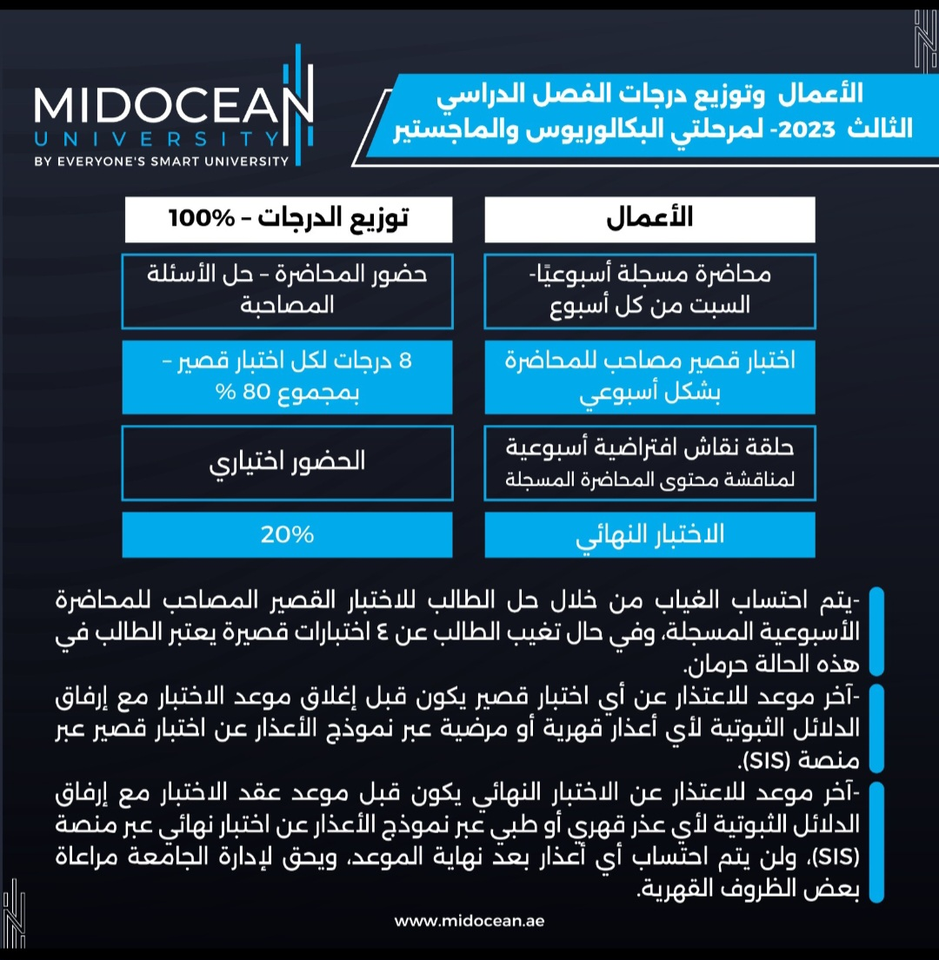

Slide 7


Thank You

