Slide 1

PMG 611
Global Project Management
Prepared by Dr. Maryem ZORGUI
Lecture 3
Global Communication Strategy

Slide 2
Session Outline
Global Communication Strategy
Defining the types of project
Define a global communication matrix
Types of Communication Strategies
Identifying the stakeholders’ requirements

Slide 3
I- Global Communication Strategy
I-1- Description
I-2- Basic Elements of Communication Strategies
I-3- Importance of Communication Strategies

Slide 4
I-1- Description
When significant events or issues arise, a communication strategy can help organize the information that needs to be communicated, identify concerns that may be raised, and ensure the proper audiences are reached

Slide 5

I-1- Description
Communication strategies are plans for communicating information related to a specific issue, event, situation, or audience.
They serve as the blueprints for communicating with the public, stakeholders, or even colleagues.

Slide 6
I-2- Basic Elements of Communication
Communication strategies should:
outline the objective/goals of the communication,
identify stakeholders,
define key messages,
pinpoint potential communication methods and vehicles for communicating information for a specific purpose, and
specify the mechanisms that will be used to obtain feedback on the strategy.

Slide 7
I-3- Importance of Communication
Strategies -1-
Communication is extremely important to the backbone of the company and its culture.
A highly engaged workforce increases productivity, reduces employee turnover and ultimately impacts the bottom line.
A good strategy must give an ansewer to these questions:
Why,
Who,
What,
How

Slide 8
I-3- Importance of Communication
Strategies -2-
Why?
The first step toward developing a communication strategy is to determine the reason why the communication is necessary and defining the desired objectives.
You, as the Community Involvement Coordinator (CIC), should ask yourself:
“What do we want to accomplish by communicating this information?”

Slide 9
I-3- Importance of Communication
Strategies -4-
Who?
Once your reason for communicating is determined, you can focus on defining the audiences you need to reach and how you want to reach them. Ask yourself the following questions:
■ Who is involved, affected, interested?
■ Is there an obvious audience?
■ Are there others who may be affected?
■ Are there traditionally underrepresented groups that need to be reached?

Slide 10
I-3- Importance of Communication
Strategies -5-
What?
Once the previous steps are complete, you may schedule a meeting with members of the site team to discuss the communication challenges facing them.
This discussion could involve coordinating with all Site Team members about community involvement goals and objectives and might involve brainstorming and prioritizing potential messages.
Focus on two or three key messages and rank them by importance, timeliness, or other factors.
It is possible that you have key messages that are only constructed for one or two of your identified audience,

Slide 11
I-3- Importance of Communication
Strategies -6-
How?
Once you have identified your key messages, you need to determine the vehicle for delivering your messages. Keep in mind that you may choose different mechanisms to meet different stakeholder needs.

Slide 12
I-3- Importance of Communication
Strategies -7-
The early development of a good communication strategy can reduce misunderstandings between stakeholders from different country and company cultures communicating over distance.
The main interested parties must work together to define this strategy, creating the project communications management plan.
This lecture suggests three main steps to prepare a global communication strategy, by:

Slide 13
I-3- Importance of Communication
Strategies -8-
identifying the types of information to be communicated;
gathering the communication requirements from key stakeholders;
determining how the communication will effectively happen.

Slide 14
III- Defining the types of project -1-
As a first step, you need to identify the project information that must be part of the communications plan, with the help of the project team members and other key stakeholders. The information items can be grouped into broad categories, which will vary according to the knowledge area, the project complexity and the type of organization.
These are some examples of information categories that are applicable to most projects:

Slide 15
III- Defining the types of project -2-
Project Management Plan – the heart of the project information, containing the detailed project definition that will serve as the main source of information for the project execution and control activities

Slide 16
III- Defining the types of project -3-
Project status – the project managers and coordinators must produce project performance statistics, which compare the current costs, schedule, customer satisfaction levels and quality measurements with the approved baseline.
Project records – different project records keep track of the elements that may affect the project performance, such as issues, risk and changes

Slide 17
III- Defining the types of project -4-
Status of the work packages – the work package owners maintain a status report for their activities, normally in a level of detail that allows the project team members to understand their tasks, and the project manager to link related events (issues and risks) that occurred in different activities.

Slide 18
III- Defining the types of project -5-
Project organization – the global project manager is responsible for the definition of the project organization chart, combined with clear roles and responsibilities for team members coming from different organisations and locations.
Logistics – the project team members collect useful information on office locations, travel guidelines and other basic knowledge for the stakeholders who are travelling across countries and working abroad.

Slide 19
III- Defining the types of project -6-
Standards and templates – the project team members must define a set of document templates that will form the project knowledge repository. They can also produce guidelines instructing the project office or other team members to collect the project information and
to update the documents in the repository. This will avoid project team members located in different countries or working for different organisations using various document formats with inconsistent information structures.

Slide 20

II- Types of Communication Strategies -1-
Communication strategies can be verbal, nonverbal, or visual. Integrating all the strategies together will allow you to see the most success. This allows a business to meet employee needs and increase workplace knowledge.
Verbal communication strategies can be broken down into the two categories of written and oral communication. Written strategies consist of avenues such as e-mail, text, and chat. Examples that fall into the oral category are phone calls, video chats, and face-to-face conversation.

Slide 21


II- Types of Communication Strategies -2-
Nonverbal communication strategies consist of mostly visual cues, such as body language, facial expressions, physical distance between communicators, or the tone of your voice. These cues are typically not intended. However, it is important to realize the message you are sending. Otherwise, you may be saying one thing, yet the receiver is hearing another.
Visual communication strategies can be seen through signs, webpages, and illustrations. These strategies are used in the workplace to draw attention and provide documentation. Human resources is required to post certain visuals throughout the workplace to comply with safety laws.

Slide 22
IV- Identifying the stakeholders’ requirements -1-
After the main project knowledge components are identified, you need to analyse the stakeholders’ information requirements.
One possible way is the preparation of a communication requirements matrix (see Figure below) describing the relationship between the stakeholders (listed in the matrix columns) and the information items (represented in the rows).
In each cell of the matrix, describe how the stakeholder contributes to the project communication, by:

Slide 23
IV- Identifying the stakeholders’ requirements -1-
preparing the information, alone or together with other stakeholders;
informing other stakeholders;
receiving and analysing the information;
reviewing or approving the information before distribution;
archiving or deleting the information or documentation.

Slide 24

IV- Identifying the stakeholders’ requirements -3-

Slide 25
IV- Identifying the stakeholders’ requirements -4-
You must prepare the requirements matrix during the communications planning activities, keeping in mind the strategies to change the stakeholder commitment level.
The investment of time and resources on knowledge generation and distribution must be measured against the value they produce to the project.

Slide 26
IV- Identifying the stakeholders’ requirements -5-
Thus, the project team must avoid producing information not specified in the communications requirements matrix, except if this is requested via the formal change control process. In this case, the communications requirements matrix must reflect the change and its impact on all stakeholders.
This will bring the added value of providing the new information to a larger community of stakeholders, increasing their level of commitment to the project goals and strategies.

Slide 27
V-Define a global communication matrix -1-
In the third component of the global communications management plan, you will define the format of each communication, its frequency and participants, by using all the information discussed in the previous lectures:

Slide 28
V-Define a global communication matrix - 2-
Meeting types and communication media – start your communication matrix with the main meeting types and communication media you have used in previous, similar projects. During the lessons-learned sessions, identify other types of meetings that can increase the level of commitment of key stakeholders. Review Chapter 7 when preparing this list, to identify the information distribution patterns to be used during the project.

Slide 29
V-Define a global communication matrix -3-
The project knowledge base – use the standard established by your company for the project knowledge base. If there is no standard available, define one for your project

Slide 30
V-Define a global communication matrix -4-
Online meeting templates – all documents on the communication matrix must be adapted for online meetings, promoting the use of online conferencing by allowing a quick capture of the discussions and decisions.

Slide 31
V-Define a global communication matrix -5-
The advantages of using visual information – consider publishing charts and dashboards with a visual status of your project, and use the same information during the status meetings. This can reduce the time required by the stakeholders to understand the message being transmitted.

Slide 32
V-Define a global communication matrix -6-
You can also shorten the preparation time by using the project knowledge base to produce charts automatically with the project performance information.
Visual information can help to obtain buy-in from stakeholders that are not available to participate in regular meetings, allowing them to learn the status of the project at a glance.

Slide 33
V-Define a global communication matrix -7-
The global communication channels – , all communication flowing across borders requires careful planning and the application of the principles specified across various chapters of the Global Project Management Framework©. The number of remote communication channels can also be reduced by assigning the roles of local coordinator to local team members.

Slide 34
V-Define a global communication matrix -8-
The stakeholder register – when determining the format and technology of communications and meetings, take all elements on the register into consideration, mainly power, influence, reactions, challenges, opportunities, knowledge level and cultural patterns.

Slide 35
V-Define a global communication matrix -8-
Cultural aspects – when preparing executive reports to specific-oriented stakeholders, start with an executive summary. On the other hand, people from diffuse-oriented cultures will appreciate having the executive summary at the end.

Slide 36
REAL-LIFE EXPERIENCE
During the planning phase of a top priority project involving four different companies in several locations across the globe, the project managers defined a global communication strategy that satisfied the main requirements of the key stakeholders.

Slide 37
REAL-LIFE EXPERIENCE
When the project implementation started, the team members from the supplier company were struggling with the aggressive schedule, and working very hard to commit to the agreed delivery dates. The project communication strategy was not followed, and the other three companies (the customer and two technology partners)

Slide 38
REAL-LIFE EXPERIENCE
Deliverables were completed on time, but the other parties only received the information afterwards, with impact to their own activities and to the availability of resources.
Some deliverables were not completed on time, and the other parties were not informed of the main causes, the impacts on schedule and costs and the new estimated dates.

Slide 39
REAL-LIFE EXPERIENCE
Meetings were repeatedly cancelled without warning, or key participants did not attend, increasing frustration and loss of time.
The levels of customer satisfaction and trust among the three partners were very low.

Slide 40
REAL-LIFE EXPERIENCE
A team of specialized project managers performed an assessment of the situation and recommended the immediate assignment of project coordinators. Their main role was to learn and follow the project communication strategy, adapting the frequency and format of meetings when required.

Slide 41
REAL-LIFE EXPERIENCE
The project finished on time, and the level of customer satisfaction was very high between the assessment and project closure. This showed, to all participants, the importance of following the project communication strategy, adapting it to new requirements and planning for resources to execute the strategy.

Slide 42
REAL-LIFE EXPERIENCE
The time required to collect information, process the data, build the project knowledge and attend meetings must be built into the project plan and included in the resource estimates

Slide 43
5 tips for crafting a global communications strategy
For organizations that must communicate in multiple languages to their employees or consumers, defining your global communications strategy is an important step to ensure predictable outcomes, repeatable processes and standardized methodologies.
It is by far the biggest pain point for most organizations.

Slide 44
What to do and What to avoid
1. Assessment:
Your language service provider should be a partner in your success.
2. Identify your champions:
These are the people that may already have some sort of experience with cultural exchanges or may be fascinated by languages.

Slide 45
What to do and What to avoid
3. Choose 2 to 3 objectives: Start small. Make gains
4. Take off the blinders: The great benefit is that you will learn as you go along and this affects your global competency; that personal skill which makes you more valuable within any organization.
5. Share your success: Now is the time to promote those successes and again, raise the level of awareness of the role and function of communication.

Slide 46

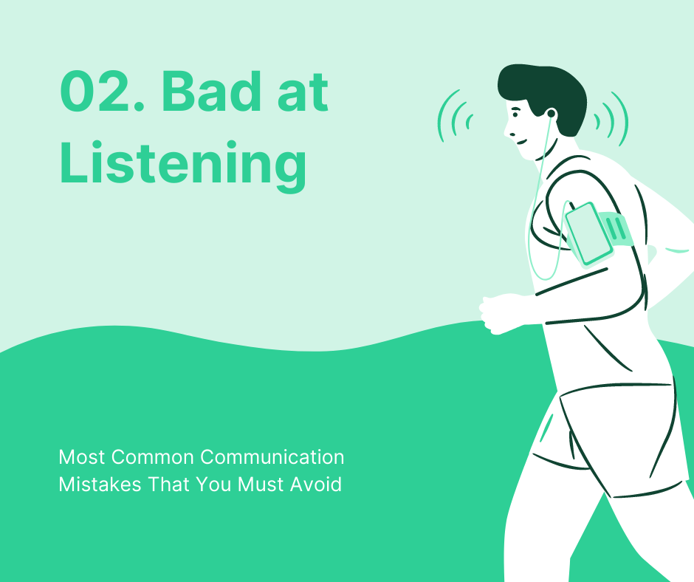
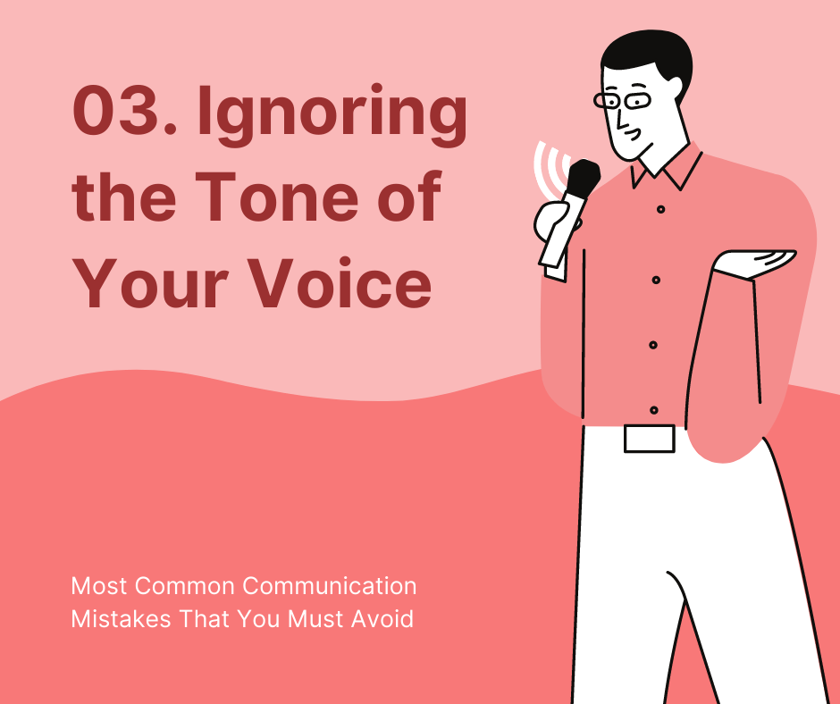






Slide 47
REAL-LIFE EXPERIENCE
Resources:
Global Project Management
Communication, Collaboration and Management Across Borders
© Jean Binder 2007

