Slide 1

Organizational Behavior
Prepared by Dr. Walid K. El Leithy
Lecture 2
ORG 123
Organizational Behavior

Slide 2

Chapter
02
Attitudes & Job Satisfaction
Chapter Learning Objectives
Contrast the three components of an attitude.
Summarize the relationship between attitudes and behavior.
Compare and contrast the major job attitudes.
Define job satisfaction and show how it can be measured.

Slide 3
Chapter
02
Attitudes & Job Satisfaction
Chapter Learning Objectives
Summarize the main causes of job satisfaction.
Identify four employee responses to dissatisfaction.
Show whether job satisfaction is a relevant concept in all cultures.

Slide 4
Chapter
02
Attitudes
Attitudes are evaluative statements or judgments concerning objects, people, or events.
Three components of an attitude:
The emotional or feeling segment of an attitude
Affective
Cognitive
Behavioral
Attitude
The opinion or belief segment of an attitude
An intention to behave in a certain way toward someone or something

Slide 5
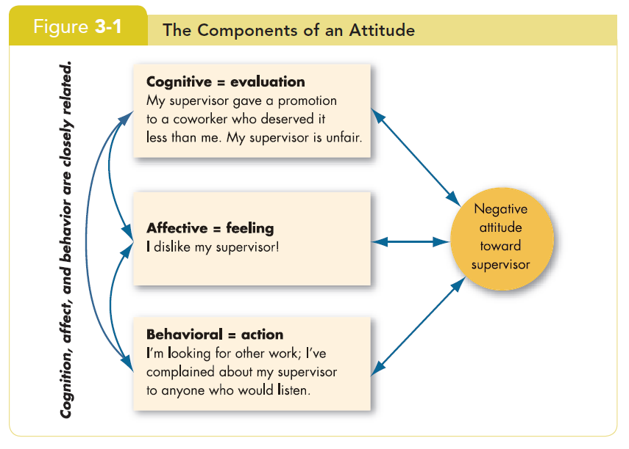
Chapter
02
Attitudes

Slide 6
Chapter
02
Does Behavior Always Follow from Attitudes?
No, the reverse is sometimes true!
Leon Festinger
Cognitive Dissonance is any incompatibility between two or more attitudes or between behavior and attitudes.
  Individuals seek to reduce this uncomfortable gap, or dissonance, to reach stability and consistency.

Slide 7
Chapter
02
Does Behavior Always Follow from Attitudes?
  Consistency is achieved by changing the attitudes, modifying the behaviors, or through rationalization.
  Desire to reduce dissonance depends on:
    importance of elements;
    degree of individual influence;
    rewards involved in dissonance.

Slide 8
Chapter
02
Predicting Behavior from Attitudes
  Important attitudes have a strong relationship to behavior.
  The closer the match between attitude and behavior, the stronger the relationship:
    Specific attitudes predict specific behavior.
    General attitudes predict general behavior.

Slide 9
Chapter
02
Predicting Behavior from Attitudes
  The more frequently expressed an attitude is, the better predictor it is.
  High social pressures reduce the relationship and may cause dissonance.
  Attitudes based on personal experience are stronger predictors.

Slide 10
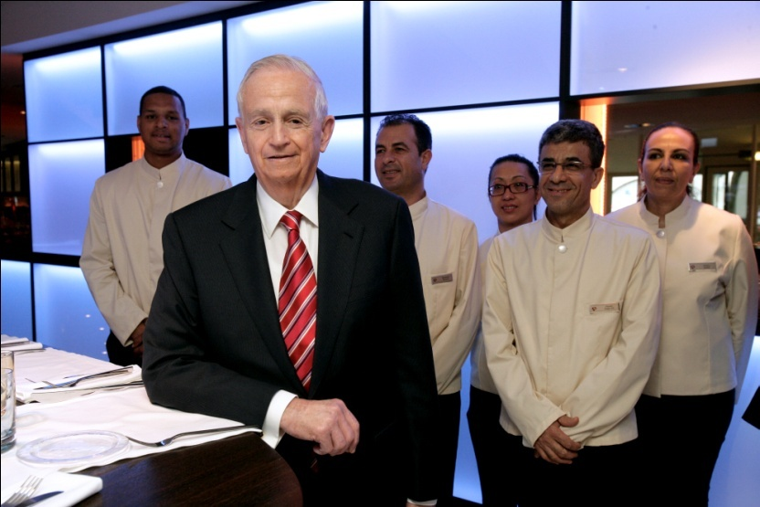
Chapter
02
Predicting Behavior from Attitudes (cont’d)

Slide 11
Chapter
02
Predicting Behavior from Attitudes (cont’d)
Marriott Hotels strives for consistency between attitudes and behavior through its motto ‘Spirit to Serve.’

Slide 12
Chapter
02
What Are the Major Job Attitudes?
Job satisfaction
  A positive feeling about the job resulting from an evaluation of its characteristics.

Slide 13
Chapter
02
What Are the Major Job Attitudes?
Job involvement
  Degree of psychological identification with the job where perceived performance is important to self-worth.

Slide 14
Chapter
02
What Are the Major Job Attitudes?
Psychological Empowerment:
Employees’ beliefs in the degree to which they influence their work environment, their competence, the meaningfulness of their job, and their perceived autonomy.
12 One study of nursing managers in Singapore found that good leaders empower their employees by involving them in decisions, making them feel their work is important, and giving them discretion to “do their own thing

Slide 15
Chapter
02
What Are the Major Job Attitudes?
Organizational Commitment
  Identifying with a particular organization and its goals, while wishing to maintain membership in the organization.
  Three dimensions:
    Affective commitment: emotional attachment to organization.
    Continuance commitment: economic value of staying.
    Normative commitment: moral or ethical obligations.

Slide 16
Chapter
02
What Are the Major Job Attitudes?
  Has some relation to performance, especially for new employees.
  Less important now than in past—now perhaps more of occupational commitment, loyalty to profession rather than a given employer.

Slide 17
Chapter
02
What Are the Major Job Attitudes?
Perceived organizational support (POS)
  The degree to which employees believe the organization values their contribution and cares about their well-being.
  Higher when rewards are fair, employees are involved in decision-making, and supervisors are seen as supportive.
  High POS is related to higher OCBs and performance.

Slide 18
Chapter
02
What Are the Major Job Attitudes?
Employee engagement
  The degree of involvement with, satisfaction with, and enthusiasm for the job.
  Engaged employees are passionate about their work and company.

Slide 19

Chapter
02
What Are the Major Job Attitudes?
To encourage employee engagement, Phillips has a program rewarding entrepreneurship in 22 Arab League states.

Slide 20
Chapter
02
What Are the Major Job Attitudes?
Job Satisfaction
Job satisfaction is one of the primary job attitudes measured
  Broad term involving a complex individual summation of a number of discrete job elements.
How to measure it?
  Single global rating (one question/one answer) – Best.
  Summation score (many questions/one average) – OK.

Slide 21
Chapter
02
What Are the Major Job Attitudes?
Are people satisfied in their jobs?
  Results depend on how job satisfaction is measured.
  Pay and promotion are the most problematic elements.
  Figures 3-2 and 3-3 show motivation and satisfaction levels in the Arab world.

Slide 22
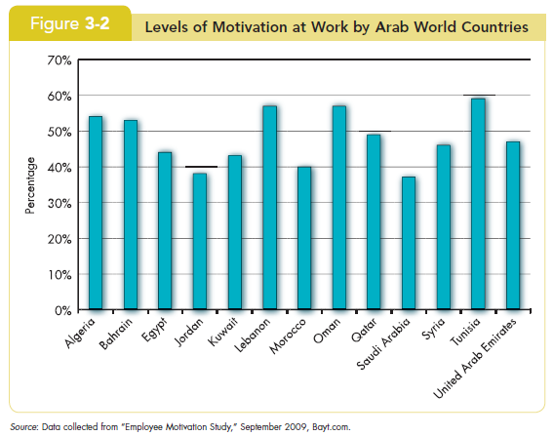
Chapter
02
Job Satisfaction

Slide 23
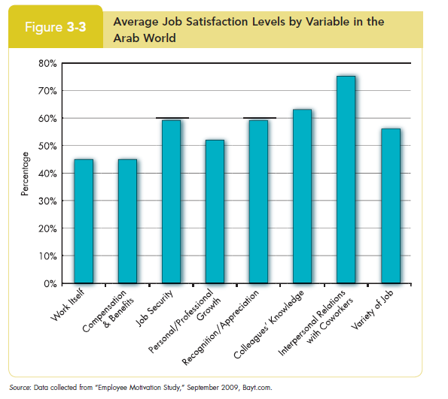
Chapter
02
Job Satisfaction

Slide 24
Chapter
02
Causes of Job Satisfaction
Pay influences job satisfaction only to a point
  Money may bring happiness, but not necessarily job satisfaction.
Personality can influence job satisfaction
  Negative people are usually not satisfied with their jobs.
  Those with positive core self-evaluation are more satisfied with their jobs.

Slide 25
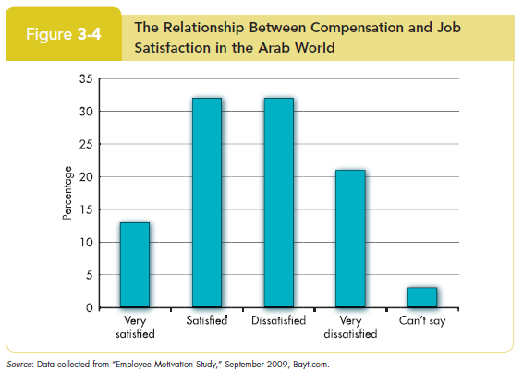
Chapter
02
Causes of Job Satisfaction

Slide 26
Chapter
02
Employee Responses to Dissatisfaction
Active
Exit
Neglect
Loyalty
Voice
Behavior directed toward leaving the organization
Active and constructive attempts to improve conditions
Allowing conditions to worsen
Passively waiting for conditions to improve
Destructive
Constructive
Passive

Slide 27
Chapter
02
Outcomes of Job Satisfaction
Job performance
  Satisfied workers are more productive AND more productive workers are more satisfied!
  The causality may run both ways.

Slide 28
Chapter
02
Outcomes of Job Satisfaction
Organizational citizenship behaviors
  Satisfaction influences OCB through perceptions of fairness.

Slide 29
Chapter
02
Outcomes of Job Satisfaction
Customer satisfaction
  Satisfied frontline employees increase customer satisfaction and loyalty.

Slide 30
Chapter
02
Outcomes of Job Satisfaction
Absenteeism
  Satisfied employees are moderately less likely to miss work.

Slide 31
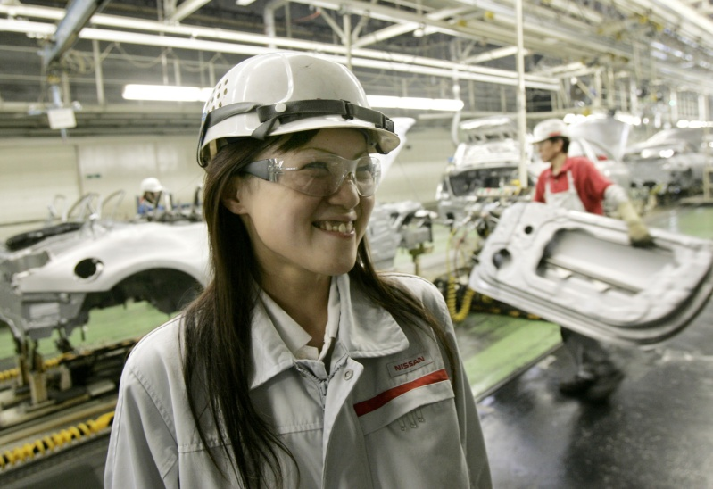
Chapter
02
Outcomes of Job Satisfaction
A major focus of Nissan Motor Company’s Diversity Development Office in Japan is helping female employees develop their careers.

Slide 32
Chapter
02
Outcomes of Job Satisfaction
Lower turnover
  Satisfied employees are less likely to quit.
  Many moderating variables in this relationship.
    Economic environment and tenure.
    Organizational actions taken to retain high performers and to weed out lower performers.

Slide 33
Chapter
02
Outcomes of Job Satisfaction
Workplace deviance
  Dissatisfied workers are more likely to unionize, abuse substances, steal, be tardy, and withdraw.

Slide 34
Chapter
02
Outcomes of Job Satisfaction
Despite the overwhelming evidence of the impact of job satisfaction on the bottom line, most managers are either unconcerned about, or overestimate, worker satisfaction.

Slide 35
Chapter
02
Global Implications
Is job satisfaction specific to cultures?
  Most of the research so far has been in the U. S., but the concept of job satisfaction is not specific to the U.S.
  More research is needed elsewhere.

Slide 36
Chapter
02
Global Implications
Are employees in Western cultures more satisfied with their jobs?
  Western workers appear to be more satisfied than those in Eastern cultures.
  Perhaps because Westerners emphasize positive emotions and individual happiness more than do those in Eastern cultures.

Slide 37
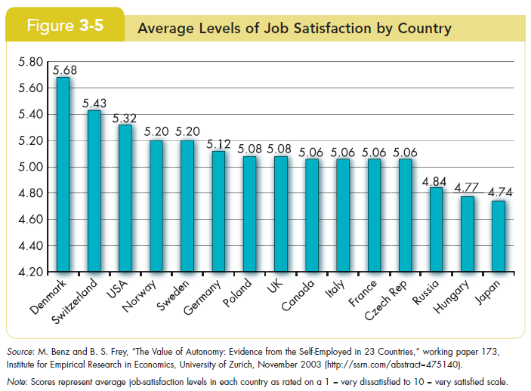
Chapter
02
Global Implications

Slide 38
Chapter
02
Summary and Managerial Implications
Managers should watch employee attitudes
  They give warnings of potential problems.
  They influence behavior.
Managers should try to increase job satisfaction and generate positive job attitudes
  Reduces costs by lowering turnover, absenteeism, tardiness, theft, and increasing OCB.
Focus on the intrinsic parts of the job
  Make work challenging and interesting.
  Pay is not enough.

