Slide 1

Pitfalls to Identify and Avoid
Avoid making the same mistakes over and over
Chapter 11
Everyone’s Smart
University
PMG511
Project Leadership
Dr.Sara Adel

Slide 2


Learning Outcomes:
    11.1 Pitfalls
    11.2 Common Project Pitfalls
    11.3 Team Pitfall
    11.4 Process/Product Pitfall
    11.5 Are Pitfalls Risks?
    11.6 Pitfall “Hot Spots”
    11.7 Summary and Conclusion.
    11.8 Self Assesment.
Dr.Sara Adel

Slide 3
11.1 Pitfalls
Dr.Sara Adel

Slide 4

Dr.Sara Adel

Slide 5
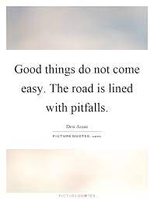
Dr.Sara Adel

Slide 6

Pitfalls classic mistakes. antipatterns.
Whatever the name, there are certain pitfalls—negative situations and mistakes—that experienced project leaders see over and over.
Dr.Sara Adel
Notes:
Corresponds to chapter 6, pages 179-194 of the Project Team Leadership and Communication book. ISBN: 9781732378902 (Softcover), 9781732378919 (Hardcover). These slides may only be posted or used in conjunction with the book in a training or classroom environment. Key terms (pages 193) are often italicized on the slides.
Outline:
Team Pitfalls
Blamestorming
Blowhard Jamboree
Groupthink
Heroics
Intellectual Violence
Loose Cannon
Poor Project Team/Stakeholder Relations
Wishful Thinking
Process and Product Pitfalls
Analysis Paralysis
Death March
Fire Drill
Ineffectively Adding Resources to the Team
Rushing to Execution
Scope Creep
Silver Bullet
Pitfall “Hot Spots”
Summary and Conclusions
Learning Objectives:
6.1 Team Pitfalls
Discuss 8 common team pitfalls, including how to prevent them from occurring
6.2 Process and Product Pitfalls
Discuss 7 common process and product pitfalls, including how to prevent them from occurring
6.3 Chapter Tool: Pitfall “Hot Spots”
Define ‘downstream’ in the context of a project
Identify causes and effects of 15 pitfalls in the context of the primary project phases
Associated Class Activities: (Separate Slides)
Pitfalls and Project Phase (10 minutes, chapter 6)

Slide 7
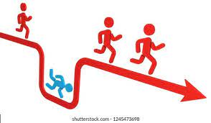
Common Project Pitfalls.
Common project mistakes are avoidable if identified early.
  Pitfalls Also known as antipatterns – common issues often caused by those experiencing them.
Pitfalls can occur at any time throughout the project, but their negative effects are often felt significantly downstream.
Individual industries or organizations have their own common pitfalls.
Dr.Sara Adel
Notes:
Corresponds to chapter 6, pages 179-194 of the Project Team Leadership and Communication book.
There are key terms defined on page 193.
Review questions cover most of the chapter (page 193, answers on page 224).
The exercises on pages 193-194 are designed to allow readers to apply and extend what they’ve learned.

Slide 8

Two types of The pitfalls
Patterns and Antipatterns:
A pattern is a generally accepted, reusable solution to a commonly occurring problem.
Antipatterns are the antithesis of this: well-known, common problems which are also commonly caused by the organization experiencing them. The pitfalls in this chapter are antipatterns, and the practices used to prevent them (and their remedies) are patterns.
Dr.Sara Adel

Slide 9
11.2 Common Project Pitfalls
Dr.Sara Adel

Slide 10

Common Project Pitfalls
Two categories covered here:
  Team Pitfalls (Blamestorming, Blowhard Jamboree, Groupthink, Heroics, Intellectual Violence, Loose Cannon, Poor Project Team/Stakeholder Relations, and Wishful Thinking)
  Process and Product Pitfalls (Analysis Paralysis, Death March, Fire Drill, Ineffectively Adding Resources to the Team, Rushing to Execution, Scope Creep, and Silver Bullet)
Awareness is key.
Dr.Sara Adel
Notes:
Corresponds to chapter 6, pages 179-194 of the Project Team Leadership and Communication book.
There are key terms defined on page 193.
Review questions cover most of the chapter (page 193, answers on page 224).
The exercises on pages 193-194 are designed to allow readers to apply and extend what they’ve learned.

Slide 11
11.3 Team Pitfall
Dr.Sara Adel

Slide 12
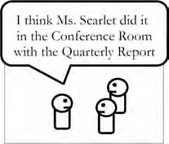
1- Blamestorming
Team members spend excess time analyzing and admiring the problem rather than productively working to find a solution. Has the tone of an inquisition.
Blame and responsibility become more important than the issue itself.
Team members are afraid to make (and learn from) mistakes.
External pressures such as a difficult stakeholder or missed deadline can be a factor.
Related: scapegoating, witch-hunt, cover-your-rear mentality.
Dr.Sara Adel
Notes:
Corresponds to page 180 of the Project Team Leadership and Communication book.

Slide 13
1- Blamestorming (CONT.)
The Fix:
Measurements of progress should be based on facts rather than opinion.
Focus on the most important issues (and the actions needed to resolve them) first, rather than the blame.
Encourage a culture of learning from mistakes rather than hiding them.
Dr.Sara Adel
Notes:
Corresponds to page 180 of the Project Team Leadership and Communication book.

Slide 14
2- Blowhard Jamboree
- Opinions, misinformation, or bias of (so-called) experts improperly influence important decisions, are often shared as facts, improperly influencing important decisions (planning, estimates, etc.)
- Because these opinions or misinformation are often touted as facts, they can form a flawed basis for planning, estimating, and other important project decisions that carry reflex down the line.
Can be unintentional: confirmation bias or poor sources of information.
Can be intentional: intentionally influencing important decisions for personal benefit.
Dr.Sara Adel
Brown, William J., Malveau, Raphael C., McCormick, Hays W., Mowbray, Thomas J. Anti-Patterns - Refactoring software, architectures, and projects in crisis. John Wiley & Sons. p. 214. 1998.
Notes:
Corresponds to pages 180-181 of the Project Team Leadership and Communication book.

Slide 15
2- Blowhard Jamboree (CONT.)
The Fix:
Honesty about why you have an opinion.
Spend additional time analyzing problems and potential solutions.
Seek better quality information: specialists, fact-based sources.
Dr.Sara Adel
Brown, William J., Malveau, Raphael C., McCormick, Hays W., Mowbray, Thomas J. Anti-Patterns - Refactoring software, architectures, and projects in crisis. John Wiley & Sons. p. 214. 1998.
Notes:
Corresponds to pages 180-181 of the Project Team Leadership and Communication book.

Slide 16
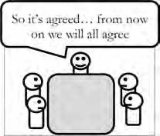
3- Groupthink
- One of the more well-known pitfalls.
- Groupthink happens when teams value harmony and conformity over diversity of though, leading to less creative decision-making and opposing viewpoints.
Making a decision as a group generally is beneficial because of diversity; groupthink erases that benefit, leading to wasted time for more individuals.
Can be caused by a fear of conflict, which can emerge from debate.
A strong, central leader can cause team members to hesitate in showing opposing viewpoints.
Dr.Sara Adel
Whyte, W. H., Jr. "Groupthink". Fortune. p. 114–117, 142, 146. March 1952.
Notes:
Corresponds to page 181 of the Project Team Leadership and Communication book.

Slide 17
3- Groupthink
The Fix:
Split the group into sub-groups, who discuss topics independently then recombine.
Use a meeting coordinator rather than the ‘boss’.
If needed, assign a “devil’s advocate” to introduce opposing viewpoints.
Dr.Sara Adel
Notes:
Corresponds to page 181 of the Project Team Leadership and Communication book.

Slide 18

4- Heroics
In spite of all obstacles (lack of time or resources, poor planning, etc.), a few “heroes” push to complete the project.
Team members who have a realistic view of the project may be seen as pessimists or “non-believers”
“Heroes” often are left feeling overworked and underappreciated, opting to leave.
Dr.Sara Adel
Notes:
Corresponds to pages 181-182 of the Project Team Leadership and Communication book.

Slide 19
4- Heroics
The Fix:
Most important is a realistic view of schedules, resources, and what can be accomplished. Accuracy (not optimism) in estimating should be valued.
A “sustainable pace” is an important organizational value – constant “panic mode” can lead to high resource turnover.
Remember that encouraging a “can-do” attitude can create an environment that suppresses accuracy in estimates and execution. Strive to build a culture that values good work/life balance.
Dr.Sara Adel
Notes:
Corresponds to pages 181-182 of the Project Team Leadership and Communication book.

Slide 20
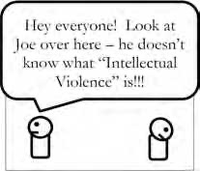
5- Intellectual Violence
One party understands a theory, technology, or jargon, and uses this knowledge to intimidate or subjugate others in public or a meeting
Fear of “not knowing” something can cause a more closed, less collaborative environment.
Can happen inadvertently and often stifles creativity within the team.
This can result in a closed and defensive culture where every- one becomes afraid of revealing inexperience or lack of understanding in an ever escalating war of information.
Dr.Sara Adel
Brown, William J., Malveau, Raphael C., McCormick, Hays W., Mowbray, Thomas J. Anti-Patterns - Refactoring software, architectures, and projects in crisis. John Wiley & Sons. p. 243. 1998.
Notes:
Corresponds to page 182 of the Project Team Leadership and Communication book.

Slide 21
5- Intellectual Violence (CONT.)
The Fix:
Team leaders should monitor for intellectual violence continuously, including their own behavior.
Teams must embrace mentorship instead of defensiveness.
The awareness that another party doesn’t know something is a make-or-break moment—instead of intellectual violence, the same situation makes the perfect opportunity for mentorship between the two parties, and a potentially disastrous situation becomes an opportunity for personal and team growth.
Related: Bullying
Dr.Sara Adel
Notes:
Corresponds to page 182 of the Project Team Leadership and Communication book.

Slide 22
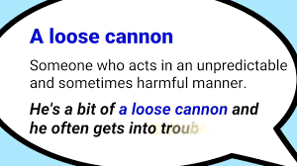
6-Loose Cannon
A single member of the team constantly causes disruption within the team environment affecting the outcomes the team is working towards.
Can be exasperated by tight deadlines, limited resources, or difficult work.
Loose cannons often prioritize workplace politics above substantive work
May have long-term effects such as degrading stakeholder relations or team members leaving rather than continue to work with the loose cannon.
Dr.Sara Adel
Notes:
Corresponds to pages 182-183 of the Project Team Leadership and Communication book.

Slide 23
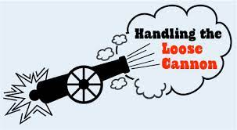
6-Loose Cannon (CONT.)
The Fix:
Personal attention by the team leader (mentoring, one-on-one time) may help address the individual causes directly.
Isolation (work from home, separate office location) or termination of the loose cannon may become necessary.
Dr.Sara Adel
Notes:
Corresponds to pages 182-183 of the Project Team Leadership and Communication book.

Slide 24
7- Poor Project Team/Stakeholder Relations
Poor relations between individual stakeholders (the customer, other teams, etc.) can have a significant impact on the viability of any project.
Different agendas, motivators, influencers, and personality types can cause friction.
Contract negotiation, financial risk, and market forces can exasperate the situation
Dr.Sara Adel
Notes:
Corresponds to page 183 of the Project Team Leadership and Communication book.

Slide 25
7- Poor Project Team/Stakeholder Relations(Cont.)
The Fix:
Limiting contact, such as having one “point person” for each group can be effective, especially if conflicting information is coming from multiple sources.
Eliminating stressors by engaging in appropriate planning and risk management can be effective.
Consistent, clear communication is key.
• Related: “Us vs. Them” Mentality
Dr.Sara Adel
Notes:
Corresponds to page 183 of the Project Team Leadership and Communication book.

Slide 26
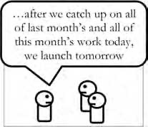

8- Wishful Thinking
Wishful thinking may be the most common pitfall teams experience.
Optimism, uncertainty, or ignorance can lead to inappropriate assumptions and poor decision making by project leaders and team members
Can lead to insufficient planning, ignored risks, and overly optimistic schedules, asking for an extended deadline but offering to complete more work before that deadline.
Often includes assumptions that outsourced/contracted work will be delivered on time and with sufficient attention to quality.
Regressive renegotiation can lead teams to promise an expanded scope in exchange for an extended deadline, leaving the project even further behind.
assuming that contractors or external resources will always deliver quality work on time with little monitoring.
Dr.Sara Adel
Notes:
Corresponds to page 183 of the Project Team Leadership and Communication book.

Slide 27

8- Wishful Thinking (CONT.)
The Fix:
Don’t confuse positive thinking or optimism with wishful thinking. Realistically consider future scenarios—if one or more elements of your plan require things to go “just right,” you may be falling victim to wishful thinking.
Schedules, realistic planning, tracking and risk scenarios should be considered carefully when creating schedules.
If the team tends to avoid negativity, they may also fail to consider legitimate issues.
• Related: Procrastination, Blind Optimism
Dr.Sara Adel
Notes:
Corresponds to page 183 of the Project Team Leadership and Communication book.

Slide 28
11.4 Process/Product Pitfall
Dr.Sara Adel

Slide 29
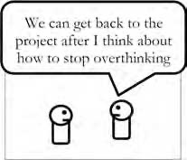
1- Analysis Paralysis
- Teams demonstrate reluctance in moving out of the early/planning stages of a project into implementation.
Often caused by the fear of failure, unclear channels of accountability, micromanagement, or a problem which has no apparent solution.
“Death by planning,” an overly complex plan can increase projects costs significantly.
Too much time spent in early stages can cause schedule pressure later on.
Dr.Sara Adel
Brown, William J., Malveau, Raphael C., McCormick, Hays W., Mowbray, Thomas J. Anti-Patterns - Refactoring software, architectures, and projects in crisis. John Wiley & Sons. p. 215-219. 1998.
Notes:
Corresponds to page 184 of the Project Team Leadership and Communication book.

Slide 30
1- Analysis Paralysis (CONT.)
The Fix:
An incremental/cyclical process allows the team to plan/implement a bit at a time.
Creating and demonstrating prototypes can alleviate the risk of early missteps.
Leaders and teams must be willing to learn from failure (a non-operational mindset)
Related: Fear of Commitment.
Dr.Sara Adel
Notes:
Corresponds to page 184 of the Project Team Leadership and Communication book.

Slide 31
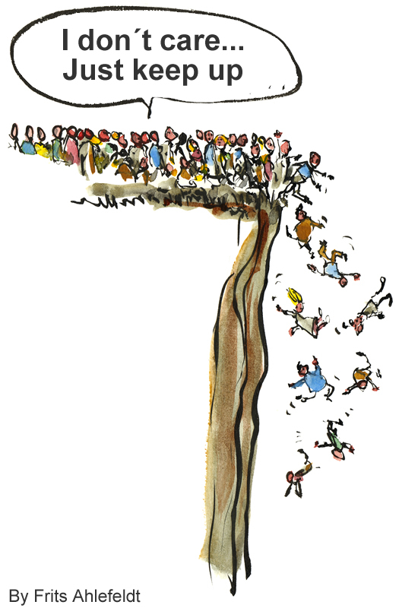
2- Death March
- Have you ever participated in a project you felt was destined to fail?
- “Death marches” are characterized by unattainable goals or deadlines, unsustainable work- loads, and supervisors who seem out of touch with the project team.
- This type of project environment can have a devastating effect on morale and team member retention—often “heroes” who commit to the project’s completion choose to leave soon after it’s finished in fear they will encounter a similar situation in the future.
Dr.Sara Adel
Notes:
Corresponds to pages 184-185 of the Project Team Leadership and Communication book.

Slide 32
2- Death March (CONT.)
The Fix:
Avoid committing to schedules and budgets before initial planning and estimates are completed.
Increase scheduling, budget, and tracking visibility to management.
Be sure to properly reward team members who have “stuck it out” or risk them leaving.
Avoid committing to due dates before estimation and scheduling .
Finally, if a death march does occur, you should make an effort to reward successful team members with an incentive that exceeds the price (time, emotional) they paid while working on the project.
Dr.Sara Adel
Notes:
Corresponds to pages 184-185 of the Project Team Leadership and Communication book.

Slide 33
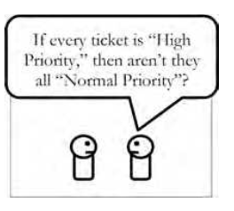
3- Fire Drill
“Fire drills” are characterized by constantly shifting priorities and a disorganized, reactive project environment.
Can be caused by poor leadership ambiguous or constantly shifting goals, or a hesitation to begin or commit to a course of action.
Some team members prefer a “fire drill” environment because it can mask poor quality work or lack of individual productivity
Dr.Sara Adel
Brown, William J., Malveau, Raphael C., McCormick, Hays W., Mowbray, Thomas J. Anti-Patterns - Refactoring software, architectures, and projects in crisis. John Wiley & Sons. p. 262-264. 1998.
Notes:
Corresponds to page 185 of the Project Team Leadership and Communication book.

Slide 34
3- Fire Drill (CONT.)
The Fix:
One effective strategy is “project management sheltering,” where the team leader personally acts as a single link with the outside world, working to create a consistent, evenly-prioritized work environment for the team.
Eliminating the circumstances that lead to “fire drills” is the best fix.
Dr.Sara Adel
Notes:
Corresponds to page 185 of the Project Team Leadership and Communication book.

Slide 35
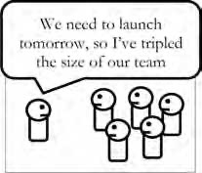
4- Ineffectively Adding Resources to the Team
Adding resources who don’t have proper skills/training or who are ineffectively managed can result in less productivity than expected.
Teams that hire external contractors often don’t manage them effectively.
Adding people to an already late project hoping to “catch up” can leave the team even further behind
Group work can introduce the opportunity for “social loafing,” allowing individuals to expend less effort (without being noticed) than if they worked alone
Dr.Sara Adel
Brooks, Frederick P., Jr. The Mythical Man-Month. Addison-Wesley. 1975.
Latane, B., Williams, K., and Harkins, S. Many Hands Make Light the Work: The Causes and Consequences of Social Loafing. Journal of Personality and Social Psychology, 37(6), p. 822-832.1979.
Notes:
Corresponds to page 186 of the Project Team Leadership and Communication book.

Slide 36
4- Ineffectively Adding Resources to the Team (CONT.)
The Fix:
Understand that introducing new team members will require a large initial commitment and effort before gains are realized.
Engage current team members in bringing new ones “up to speed”
Dr.Sara Adel
Notes:
Corresponds to page 186 of the Project Team Leadership and Communication book.

Slide 37
5- Rushing to Execution
Attempting to show “real” progress sooner, the project spends less time in the initiation and planning phases so that they can enter the execution phase sooner.
Early project phases require more discipline, forethought, and may bring more pressure from the customer or management who have less visibility of progress
Upstream activities such as design iterations, thorough estimation, risk management, and formal approval/signoff are often skipped, leading to issues downstream
Rushing to the execution phase of projects can become so commonplace that people may begin to accept the consequences of doing so as fact rather than circumstance.
Dr.Sara Adel
Notes:
Corresponds to pages 186-187 of the Project Team Leadership and Communication book.

Slide 38
5- Rushing to Execution (CONT.)
The Fix:
Properly consider early project activities, giving early achievements recognition similar to those in the execution phase
Retrospectives and lessons learned from previous projects will often call for increased early-project efforts (planning, estimation, stakeholder analysis, etc.)
Dr.Sara Adel
Notes:
Corresponds to pages 186-187 of the Project Team Leadership and Communication book.

Slide 39
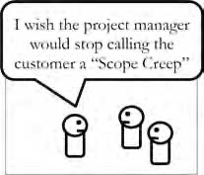
6- Scope Creep
Also known as “feature creep” .
As the project progresses, new requirements/specifications are slowly added. Eventually, this has a major cumulative effect on the schedule or resources.
Additional scope is just as likely to be added by the team as by the customer or other stakeholders
Shortchanging upstream activities such as writing a scope statement or detailed specifications increases the likelihood of scope creep.
Dr.Sara Adel
Notes:
Corresponds to page 187 of the Project Team Leadership and Communication book.

Slide 40
6- Scope Creep (CONT.)
The Fix:
Implement strong “change management” controls such as signoff for scope changes
incremental (agile) methods allow for and even expect requirements/ specifications changes throughout the project. Consider implementing them if needed.
Dr.Sara Adel
Notes:
Corresponds to page 187 of the Project Team Leadership and Communication book.

Slide 41

7- Silver Bullet
A new tool, technology, technique, or process is thought to have a “magical” effect on projects.
May be caused by marketing hype, previous success, or wishful thinking.
Can lead to poor performance or unrealistic estimates, ultimately leading to projects that are behind schedule
In the same way that a silver bullet may be considered a quick and easy solution for were wolves, many teams make the mistake of thinking that a new tool, technology, or process will have magical effect on their projects.
.
Dr.Sara Adel
Notes:
Corresponds to page 187 of the Project Team Leadership and Communication book.

Slide 42
7- Silver Bullet (CONT.)
The Fix:
Manage “opportunities” like “risks,” carefully considering their chance of occurring as well as realistically analyzing their potential impact.
When introducing new tools, products, or processes, understand that adoption of new ideas takes time, possibly more than might be saved.
Dr.Sara Adel
Notes:
Corresponds to page 187 of the Project Team Leadership and Communication book.

Slide 43
11.5 Are Pitfalls Risks?
Dr.Sara Adel

Slide 44
Are Pitfalls Risks?
Pitfalls share all three of the features that define risks (uncertainty, loss, and manageability)
Are they actually risks? The short answer is yes, but they are unlikely to appear on most risk registers. Because of their broad, universal nature.
pitfalls are hard to quantify into the probability and impact calculations needed to analyze them.
They are a risk that must be monitored by both the Team and the team leader, and simply understanding the nature of each pitfall is often enough to promote resistance to their taking root.
Dr.Sara Adel

Slide 45
11.6 Pitfall “Hot Spots”
Dr.Sara Adel

Slide 46
Pitfall “Hot Spots”
Each of the pitfalls in this chapter represents a constant hazard to both the team and the project it’s working on, but there are parts of the project that represent “hot-spots,” or areas of increased likelihood where the pitfall may manifest itself.
If pitfalls do occur, their negative results will inevitably manifest themselves later in the project when “the damage has already been done.” Put another way, mistakes or circumstances have a downstream effect on a project—this means that project leaders must carefully consider upstream manifestations of pitfalls as the project progresses and work to mitigate their effects down the road.
Though far from exhaustive, the following table is designed to help you consider both how pitfalls may present themselves and the consequences that may be felt from them:
Dr.Sara Adel

Slide 47
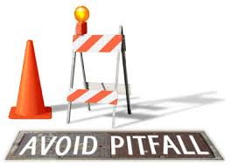
Pitfall “Hot Spots”
Pitfalls often occur during an early phase, causing negative consequences at later phases
Dr.Sara Adel
Notes:
These are 3 of 15 examples in the book. Corresponds to section 6.3, pages 188-191 of the Project Team Leadership and Communication book.

Slide 48
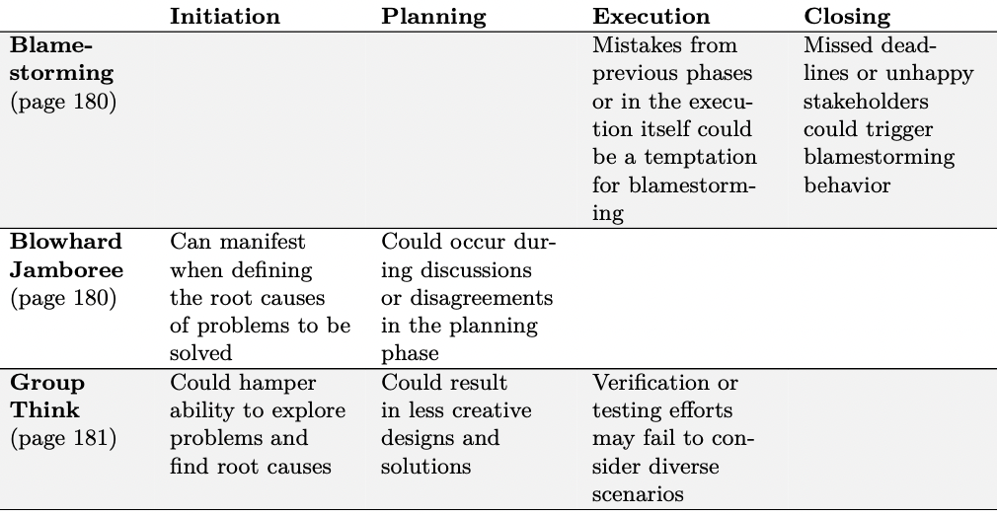
Dr.Sara Adel

Slide 49
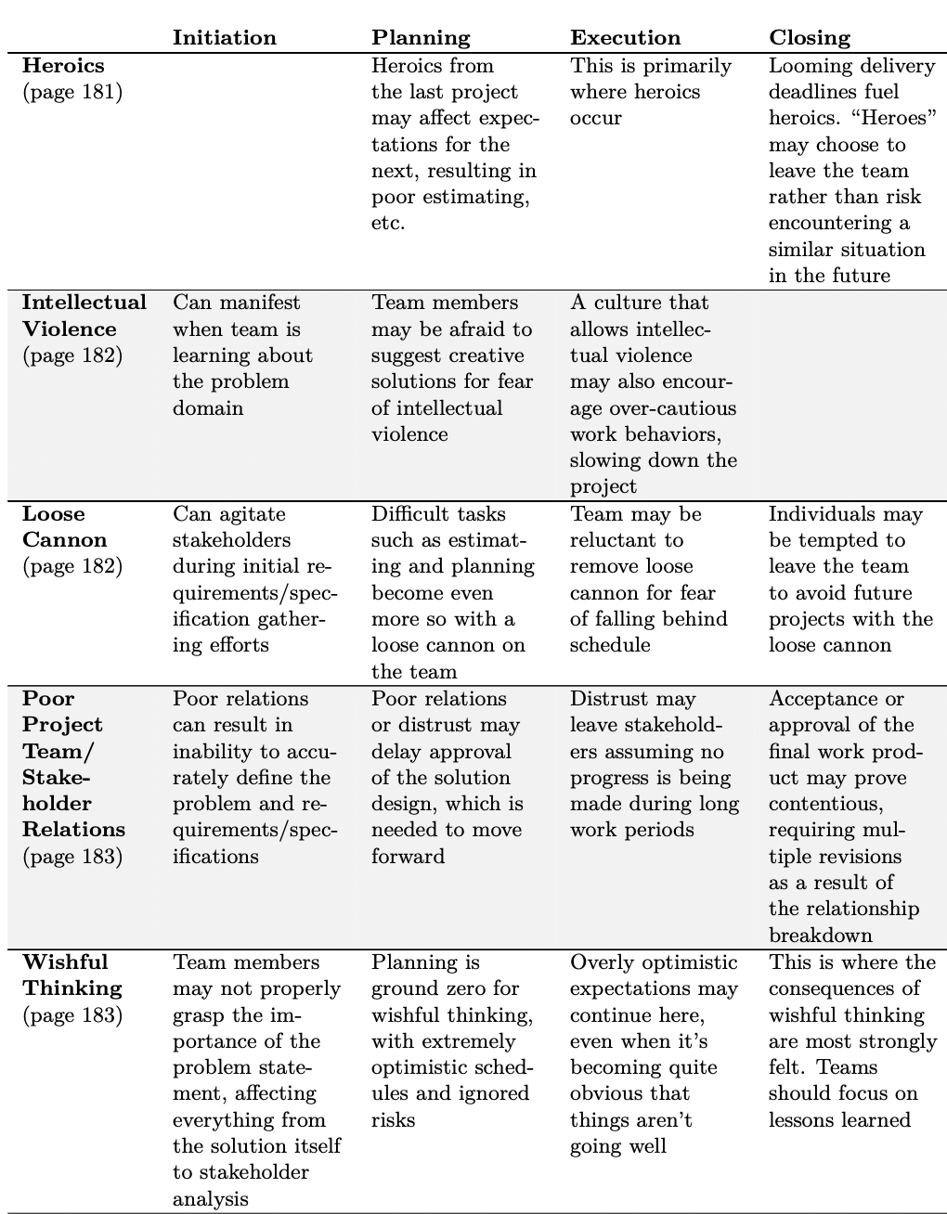
Dr.Sara Adel

Slide 50
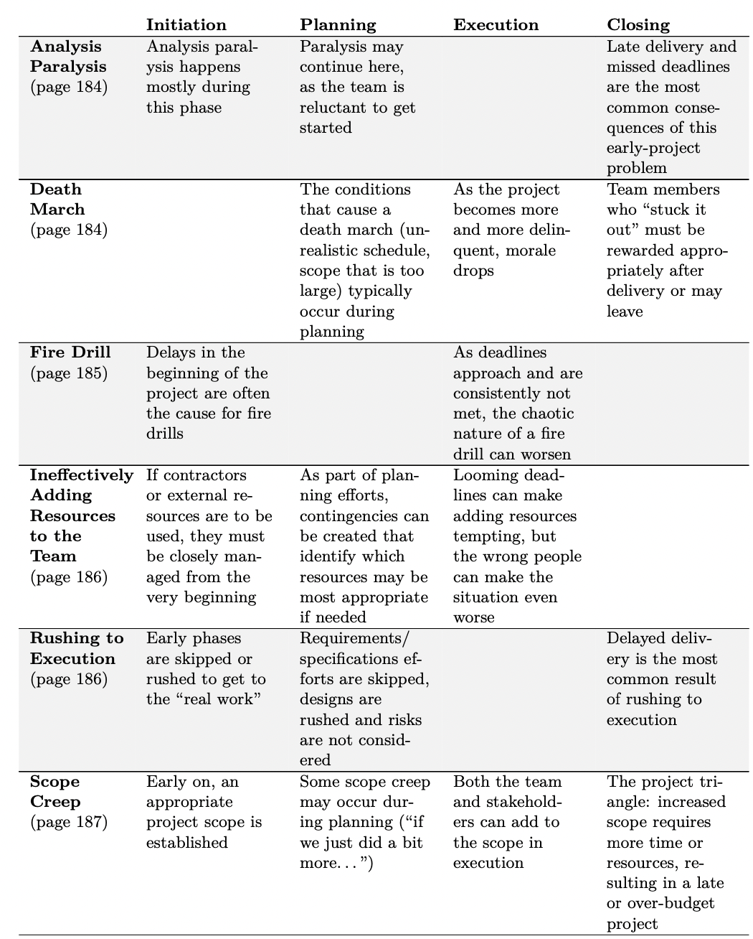
Dr.Sara Adel

Slide 51
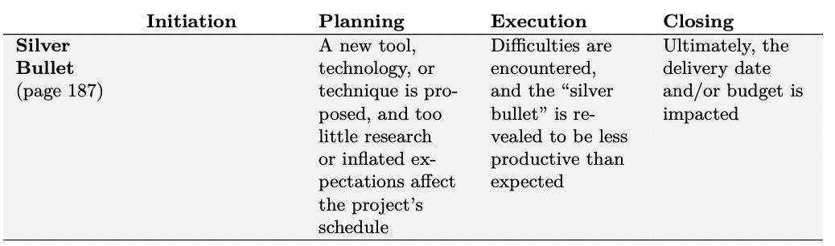
Dr.Sara Adel

Slide 52

All of these criteria are necessary because projects and their teams continuously feel the downstream effects of events and decisions that have occurred beforehand. If a pitfall has previously occurred, changing the conditions that led to it requires a concerted effort by parties at all levels, or else it’s likely to occur again.
As project leaders, we have the capacity to effect a change in all of these areas. One common excuse is to cite the powerlessness some project leaders feel within their larger organization—while it may not always be possible to affect the structures around you, it’s important to realize that each project team can have its own “micro- culture.” Within this micro-culture are possibilities that defy the larger norm— a project that effectively manages responsibility, priority, and communication, all while not losing sight of the goals and objectives that were set at initiation.
Nothing speaks louder than a successful leader and team completing a successful project. As a project leader, you have the power.
Dr.Sara Adel

Slide 53
11.7 Summary and Conclusions
Dr.Sara Adel

Slide 54
Summary and Conclusions
Consistently avoiding pitfalls requires the following:
An awareness of both what can happen and when it’s most likely to occur.
Diligence and continuous introspection.
Management and leadership support.
A deliberate culture shift within the team and organization.
It’s important to understand and consider the downstream effects that actions that a leader or team’s actions and decisions can create.
Dr.Sara Adel

Slide 55
11.8 Self Assessment.
Dr.Sara Adel

Slide 56

Activity – Pitfalls and Project Phase
Self Assessment
Organize into teams of 3-4. If your team were completing a project together, which pitfalls would be most likely in each of the 4 phases? Rank from most to least likely.
Pitfalls
Analysis Paralysis
Blamestorming
Death March
Fire Drill
Heroics
Scope Creep
Silver Bullet
Wishful Thinking
Project Phases
Conception / Initiation
Planning
Execution
Closing
Dr.Sara Adel
Notes:
Corresponds to sections 6.1, 6.2, and 6.3, pages 180-191 of the Project Team Leadership and Communication book. Uses resources from the entirety of chapter 6.
10 minute activity
Learning Objective: Classify common pitfalls by project phase

Slide 57
Activity - Pitfalls and Culture
Organize into teams of 3-4. For each of the cultural elements on the right, place each pitfall into one of the three cultural categories, based on which you feel would be most likely to experience the pitfall. Briefly discuss why you believe that team’s culture makes them prone to the pitfall.
Cultural Element - Communication
Pitfalls
Blowhard Jamboree
Groupthink
Intellectual Violence
Ineffectively Adding Resources to the Team
Loose Cannon
Poor Team/Stakeholder Relations
Rushing to Execution
Passionate
Debate
Middle/
Both
Conflict Avoidance
Cultural Element - Leadership
Authori-
tarian
Laissez-
faire
Democratic
Dr.Sara Adel
Notes:
Corresponds to sections 6.1, 6.2, and 6.3, pages 180-191 of the Project Team Leadership and Communication book. Uses resources from the entirety of chapter 6.
10 minute activity
Learning Objective: Analyze pitfalls in the context of team cultural dynamics

Slide 58
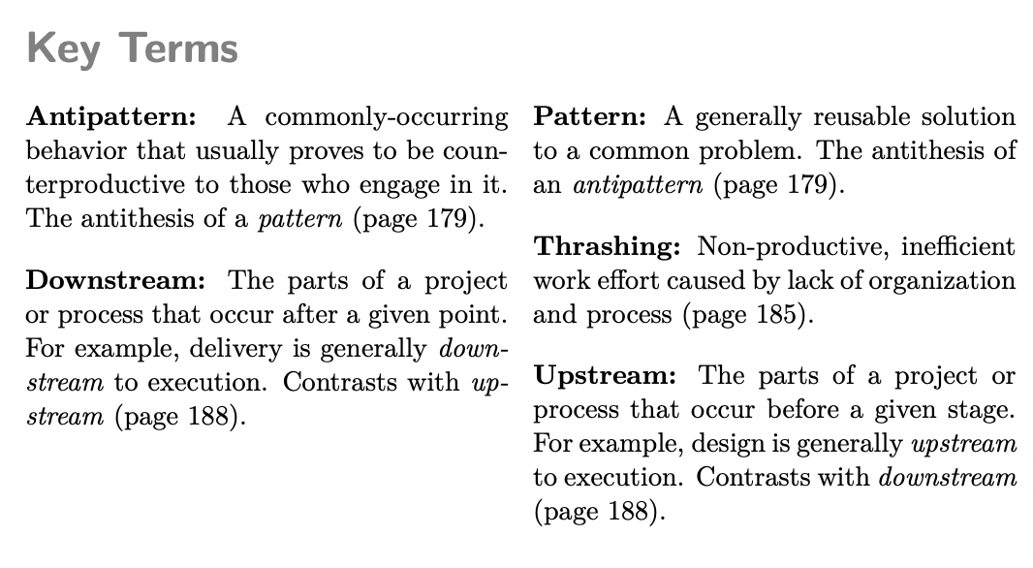
Key Terms:
Dr.Sara Adel

Slide 59

Resources:
Project Team Leadership and Communication by Samuel Malachowsky, 2018.
Dr.Sara Adel

Slide 60
THANKS!
Dr.Sara Adel

