Slide 1


Human Resources
Learning and Development
Prepared by Dr. Injy Nashaat
Orientation session

Slide 2


Introduction of Human Resource
Training and Development
Training and Development in Human Resource Management is the process of acquiring knowledge, skills, and attitude that helps improve employees' job performance and enables future career growth.
www.midocean.ae

Slide 3

Chapter
TRAINING IN ORGANIZATIONS
01
Updated data related to state of the training industry
We include a discussion of changes in training and movement toward mobile and agile learning and increasingly dynamic business environment. As part of the discussion, we cover the SAM model and why we use ADDIE rather than the alternatives.
Included a discussion of age/ generational differences
Enhanced the discussion of career paths and opportunities in training
www.midocean.ae

Slide 4


Slide 5
Chapter
ALIGNING TRAINING WITH STRATEGY
02
Added more examples of how training has been aligned with strategy in real organizations
Added information related to constraints on training related to the organizational strategy
Added a discussion of gender related to labor market strategy
Used more relevant jargon when discussing organizational change
Developed a table depicting issues the HRD officer needs to consider in aligning training with the strategic plan
Included discussion of the increasingly dynamic business environment
www.midocean.ae

Slide 6
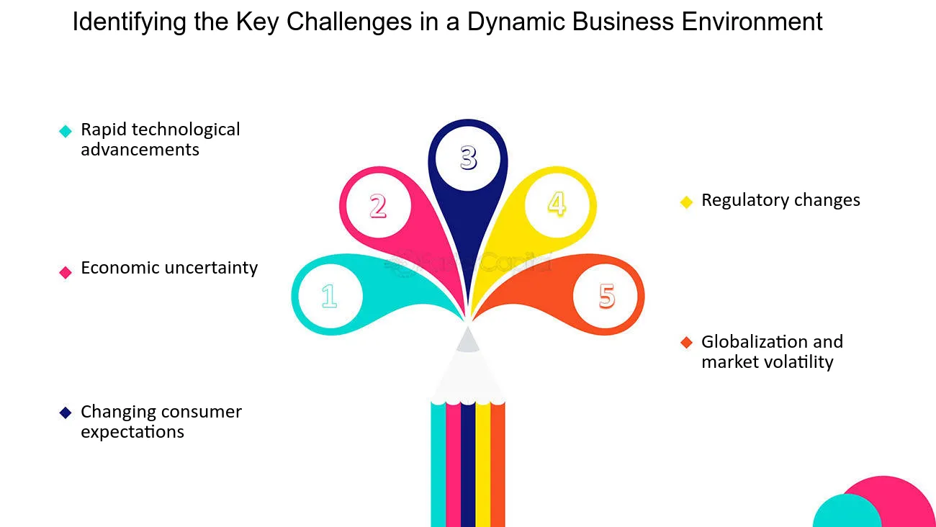

Slide 7
Chapter
LEARNING, MOTIVATION, AND PERFORMANCE
03
Expanded discussion of adult learning theory
Removed discussion of classical conditioning
Incorporated Keller's ARCS model into discussion of expectancy theory and reduce
the amount of detail when discussing expectancy theory Preface
Expanded discussion of supervisory support
Provided additional information on transfer of training
www.midocean.ae

Slide 8
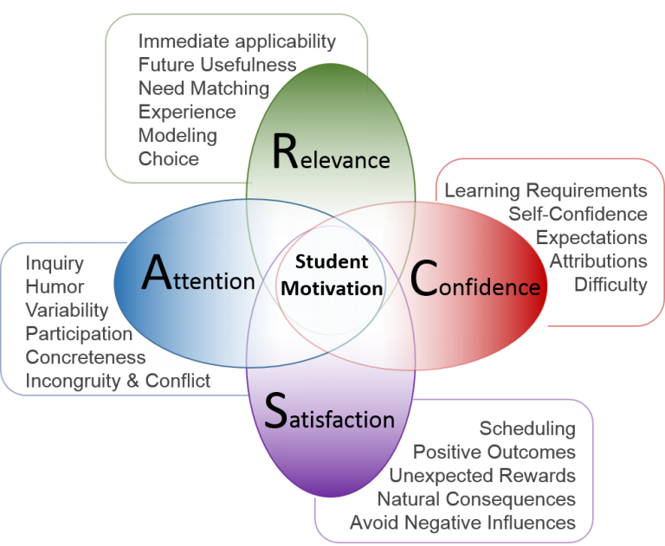
Keller's ARCS model
www.midocean.ae

Slide 9
Chapter
04
NEEDS ANALYSIS
Expanded discussion of how we use the needs analysis phase of the ADDIE model to help students understand the training process
Clarified terminology: TNA, needs assessment, and needs analysis have the same meaning.
Included discussion of cognitive task analysis
Included discussion of rapid needs analysis
Revised and enhanced discussion of competencies and competency modeling
www.midocean.ae

Slide 10
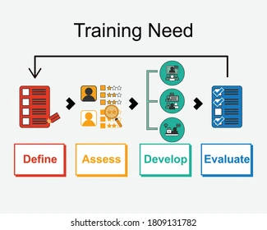
www.midocean.ae

Slide 11
Chapter
05
TRAINING DESIGN
Expanded discussion of how we use the design phase of the ADDIE model to help
students understand the training process
Included a discussion of the experiential learning model and how it fits into the design of training
Clarified the difference between design, development, and implementation
Described each of the different types of objectives for training
Removed discussion and references to classical conditioning
Added information about how the ARCS model integrates with the expectancy theory and self-efficacy
Enhanced the discussion of how transfer of training relates to theory
Placed emphasis on getting trainees to use the knowledge from training on the job
Made many references to the Chapter 4 material on Fabrics, Inc., to show how the
information in the needs analysis is used in the design phase
Added a discussion of age diversity and the design of training
www.midocean.ae

Slide 12
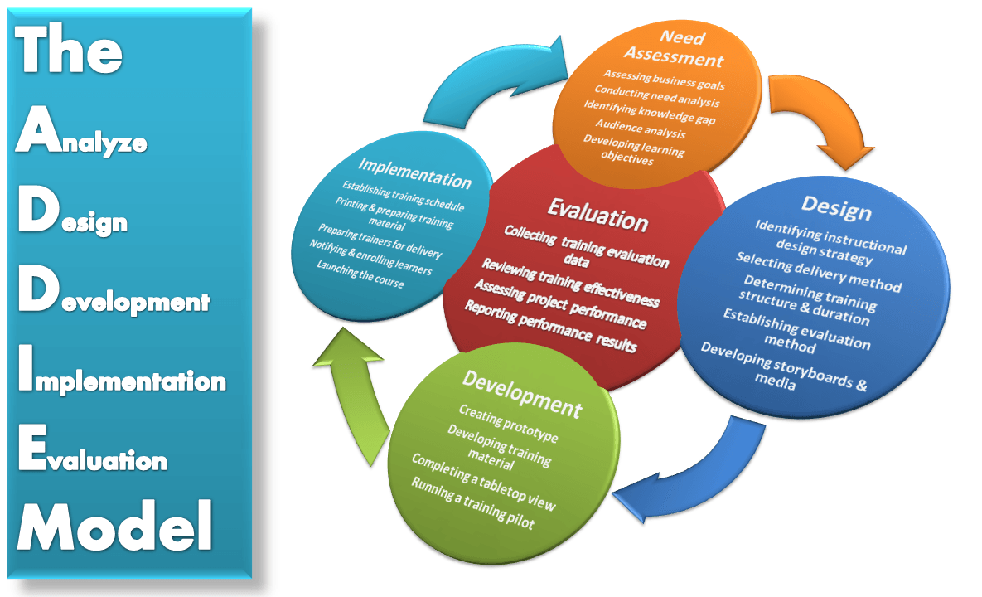

Slide 13
Chapter
TRADITIONAL TRAINING METHODS
06
Added a discussion of informal learning
Expanded the discussion on Exercises and Activities
Added a section on blended learning with emphasis on doing rather than listening,
building on this topic from Chapter 5
The table showing the various methods effectiveness at Meeting KSA Objectives was
moved to the end of the chapter
www.midocean.ae

Slide 14
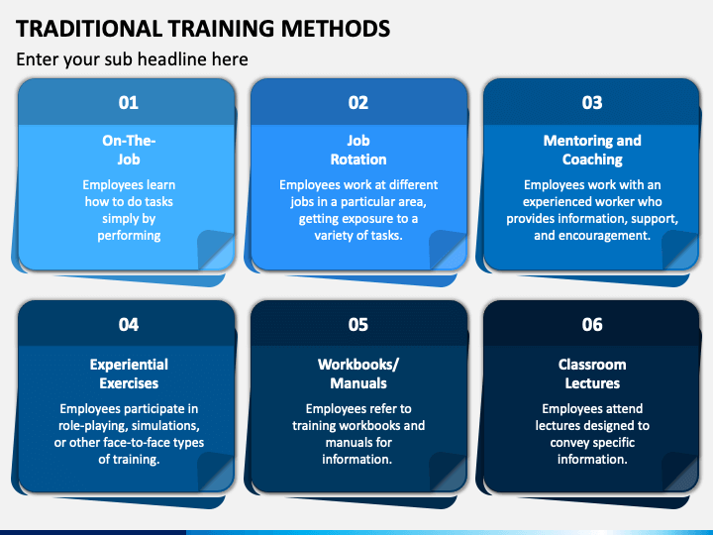

Slide 15
Chapter
ELECTRONIC TRAINING METHODS
07
Included a section on the common elements in a LMS
Added and/ or augmented information on online, web-based, smartphone and social
media learning technologies
Added a section on the process of developing an electronic training program
Added a discussion of blended learning of various technologies as well as with face-to-face methods.
www.midocean.ae

Slide 16
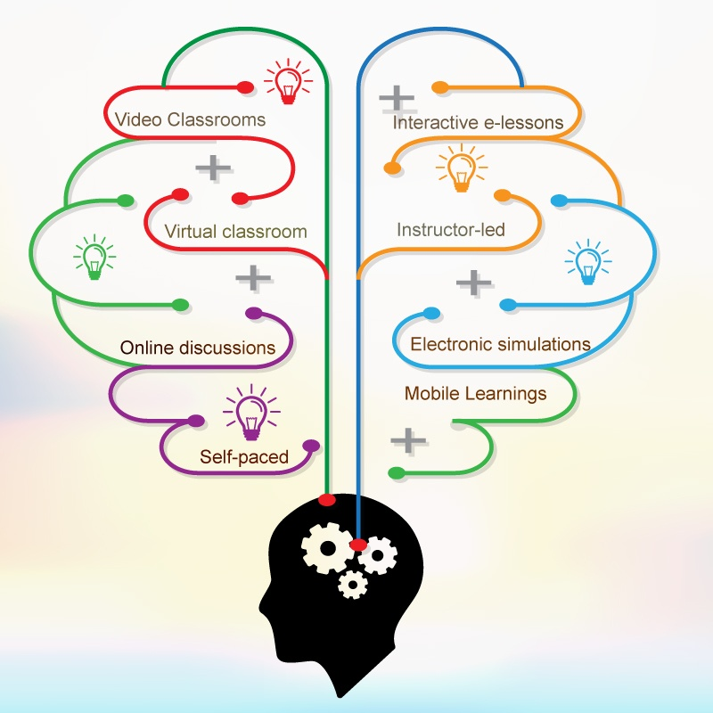

Slide 17
Chapter
DEVELOPMENT, IMPLEMENTATION, AND TRANSFER OF TRAINING
08
development, implementation, and transfer of training
Expanded discussion of how we use the development and implementation phases of the ADDIE model to help students understand the training process Reemphasized how design, development, and implementation differ
Increased information on how to enhance transfer of training. Discussed how to apply non-lecture methods
Used thee experiential learning cycle to illustrate this Enhanced the discussion of job aids, performance support systems, check lists, etc. that support the application of training in the work environment.
www.midocean.ae

Slide 18
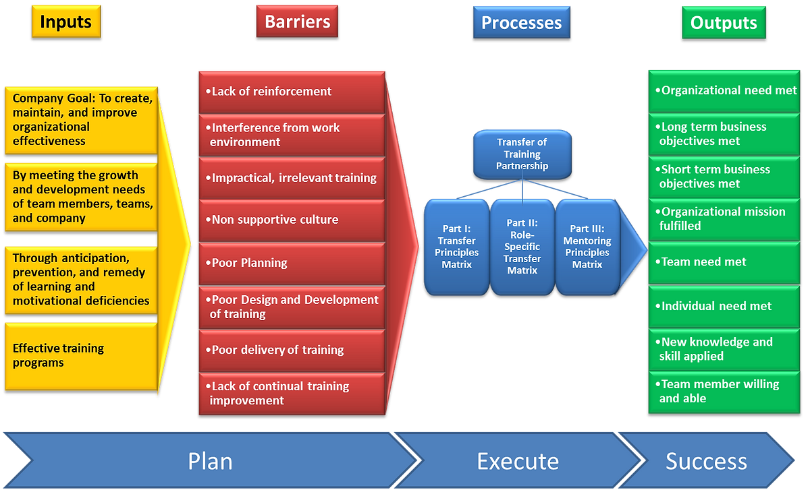

Slide 19
Chapter
EVALUATION OF TRAINING
09
Expanded discussion of how we use the evaluation phase of the ADDIE model to help
students understand the training process
Enhanced the financial evaluation discussions
Provided more examples of what is being done in industry
Clarified the relationship between outcomes and evaluations
Provided more "how to" information on methods used for evaluation of learning,
behavior, and results
www.midocean.ae

Slide 21


Thank You

