Slide 1


Creative and Scientific Thinking
Prepared by Prof. Shereen Taie
CRE252
Information Technology Department
Lecture 3

Slide 2




Creative and Scientific
Thinking
Lecture 3
CRE252
Information Technology Department
Prepared by
Prof. Shereen Taie
www.midocean.ae

Slide 3
Learning Objectives:
Three types of Scientific thinking
Creative/Divergent Thinking Definition
How to increase creativity?
Some approaches involved in creative thinking skills
Blocks to creativity
Critical/Convergent Thinking Definition
Lateral /Metacognition Thinking Definition
Three types of Scientific thinking Steps
Chapter
02
www.midocean.ae

Slide 4
Three types of Scientific thinking
Chapter
02
www.midocean.ae

Slide 5
Scientific Thinking:
Creative/Divergent Thinking
Critical/Convergent Thinking
Lateral /Metacognitive (thinking about their thinking) thinking individual.
Chapter
02
www.midocean.ae

Slide 6

Chapter
02
1. Creative/Divergent Thinking Definition
www.midocean.ae

Slide 7
1. Creative/Divergent Thinking Definition:
Divergent Thinking is a thought process or method used to generate creative ideas by exploring many possible solutions.
Divergent Thinking typically occurs in a spontaneous, free-flowing, “non-linear” manner, such that many ideas are generated in an emergent cognitive fashion.
Chapter
02
www.midocean.ae

Slide 8
1. Creative/Divergent Thinking Definition:
Many possible solutions are explored in a short amount of time, and unexpected connections are drawn.
After the process of divergent thinking has been completed, ideas and information are organized and structured using convergent thinking.
Chapter
02
www.midocean.ae

Slide 9
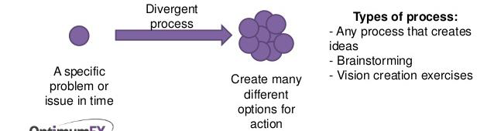
1. Creative/Divergent Thinking Definition:
Chapter
02
www.midocean.ae

Slide 10
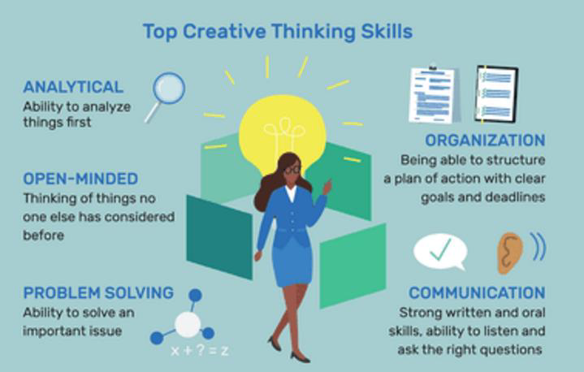
Chapter
02
www.midocean.ae

Slide 11
The background of creative thinking?
Creative thinking represent:
• Open approach more than critical thinking.
• Less ordered, less structured, less predictable than critical thinking.
Chapter
02
www.midocean.ae

Slide 12
Chapter
02
How to increase creativity?
www.midocean.ae

Slide 13

1. Learn Through Curiosity فضول- حب إستطلاع
• The human brain works magically when you read enough or talk to enough experts,
• When you have enough inputs, new ideas start appearing
Chapter
02
www.midocean.ae

Slide 14

2. Do Something You Love
• Do something that pleases you that is the way to learn the most
• When you are doing something with such enjoyment, you don't notice that the time passes.
Chapter
02
www.midocean.ae

Slide 15

3. have a hoppy
• participate in a hobby, such as playing an instrument, running, or collecting memorabilia تذكارات
can help you relax and fight stress while giving your creativity a boost.
Chapter
02
www.midocean.ae

Slide 16

4. Ask For Advice or Feedback
• Asking for help isn't a sign of weakness.
• Ask for help and advice from friends
• Even if you don't use their advice, it may spark some new, creative thinking that will get you where you need to go.
Chapter
02
www.midocean.ae

Slide 17
Some approaches involved in creative thinking skills
Chapter
02
www.midocean.ae

Slide 18
Creative thinking skills involve such approaches as:
Looking for many possible answers rather than one.
Allowing yourself to make wild جامح suggestions as well as those that seem sensible.
Not judging ideas early in the process.
Chapter
02
www.midocean.ae

Slide 19
Creative thinking skills involve such approaches as:
Treat all ideas as if they may contain the seeds of something potentially useful.
Don’t be afraid to make mistakes.
Learning from what has not worked as well as what did.
Chapter
02
www.midocean.ae

Slide 20
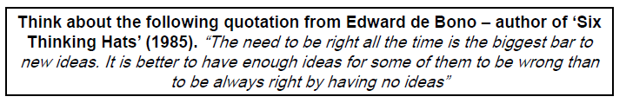
Bar:حاجز
Chapter
02
www.midocean.ae

Slide 21
Chapter
02
Blocks to creativity
www.midocean.ae

Slide 22
Blocks to creativity we may fear:
Fear that you are not a creative person:
  Solution Look around at the ways you overcome difficulties and see how creative you already are.
Fear of failure:
  Solution know that success is the process of exploring and learning.
Chapter
02
www.midocean.ae

Slide 23

Blocks to creativity we may fear:
Exercise:
  Try to remember a time when you were creative, what happened?
  How did you feel?
Chapter
02
www.midocean.ae

Slide 24
Chapter
02
2. Critical/Convergent Thinking Definition
www.midocean.ae

Slide 25
2. Critical/Convergent Thinking Definition:
Convergent Thinking is the process of finding a single best solution to a problem that you are trying to solve.
Many tests that are used in schools, such as multiple choice tests, spelling tests, math quizzes, and standardized tests, are measured of Convergent Thinking .
Traditional intelligent tests, such as the Stanford-Binet, also measure Convergent testing.
Chapter
02
www.midocean.ae

Slide 26
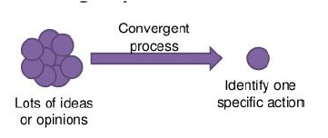
2. Critical/Convergent Thinking Definition:
Chapter
02
www.midocean.ae

Slide 27
Chapter
02
3. Lateral /Metacognition Thinking Definition
www.midocean.ae

Slide 28
3. Lateral /Metacognition Thinking Definition:
Lateral /Metacognition Thinking is solving problems through an indirect and creative approach.
Lateral /Metacognition Thinking using reasoning that is not immediately obvious and involving ideas that may not be obtainable by using only traditional step-by-step logic.
Chapter
02
www.midocean.ae

Slide 29
Chapter
02
1. Critical / Convergent Thinking Steps:
www.midocean.ae

Slide 30
1. Critical / Convergent Thinking Steps:
1. Critical / Convergent Thinking
1. Analyzing components and relationships in a system 2. Comparing and contrasting options 3. Making inferences and interpretations from data 4. Evaluating the relative worth of options
Chapter
02
www.midocean.ae

Slide 31
Chapter
02
2. Creative / Divergent Thinking Steps:
www.midocean.ae

Slide 32
2. Creative / Divergent Thinking Steps
2. Creative / Divergent Thinking
1.Generating many possible options 2.Generating a variety of types of possible options 3.Generating originality in possible options 4.What if . . .? How about . . .? Could we try this or that idea . . .?
Chapter
02
www.midocean.ae

Slide 33
Chapter
02
3. Lateral /Metacognition Thinking Steps:
www.midocean.ae

Slide 34
3. Lateral /Metacognition Thinking Steps
3. Lateral /Metacognition Thinkingg
1. Monitoring, 2. Evaluating 3. Revising own thinking
Chapter
02
www.midocean.ae

Slide 35
Examples
Chapter
02
www.midocean.ae

Slide 36
Creative/Divergent thinking:
Mr. A’s home is at a distance of five miles from work. His Chevrolet gets 30 MPG. However, he wishes to expend less fuel in his travel for both monetary and conservation-associated reasons. Money is not an issue.
Chapter
02
www.midocean.ae
Notes:
Pursuit: السعي

Slide 37
Creative/Divergent thinking:
What choices does he have to cut his fuel consumption?
{it could still be possible to find an option that is entirely different from what the user asked –like devise a vehicle that runs off of air, or start a new business from home.}
Chapter
02
www.midocean.ae
Notes:
Pursuit: السعي

Slide 38
Critical/Convergent thinking:
Mr. A’s home is at a distance of five miles from work. His Chevrolet gets 30 MPG. However, he wishes to expend less fuel in his travel for both monetary and conservation-associated reasons. Money is not an issue.
Chapter
02
www.midocean.ae
Notes:
Pursuit: السعي

Slide 39
Critical/Convergent thinking:
Which three vehicles are the best replacements for his car?
Chapter
02
www.midocean.ae
Notes:
Pursuit: السعي

Slide 40




Thank You

