Slide 1


English Course- Intermediate Level
Prepared by
Ahmed Soliman

Slide 2



Lecture 4
www.midocean.ae

Slide 3
Listening: Renting a car
Grammar: Clauses
www.midocean.ae

Slide 4
Listening
Renting a car
www.midocean.ae

Slide 5
Listen to a woman renting a car at a car rental office then choose the correct answer.
www.midocean.ae

Slide 6

1- Karen...
a.wants to rent a car today.
b.didn't book a car.
c.can choose from two different types of cars.
2- Which car does she choose?
a.The small car.
b.The medium car.
c.The large car.
www.midocean.ae

Slide 7
3- How much longer will the woman be on holiday here?
a.Two days.
b.Three days.
c.Five days.
4- Who will drive the car?
a.The woman and her husband.
b.The woman and her son.
c.The woman only.
www.midocean.ae

Slide 8
5- Why do they want to hire the car?
a.To visit some churches.
b.To hike in the mountains.
c.To get to the beach.
6- If the woman damages the car after this conversation, she must pay...
a.20 euros.
b.50 euros.
c.60 euros.
www.midocean.ae

Slide 9
7- The man advises the woman to buy fuel…
a.as soon as she collects the car.
b.before driving into the mountains.
c.before returning the car.
8- What's the earliest time the car can be collected tomorrow?
a.8 a.m.
b.9 a.m.
c.10 a.m.
www.midocean.ae

Slide 10
Grammar
Types of Sentences
www.midocean.ae

Slide 11
Clauses
What is a clause
A group of words which includes a subject and a verb.
The subject of a clause can be mentioned or hidden, but the verb must be apparent and distinguishable.
www.midocean.ae

Slide 12
Show Simon your project when he arrives.
The boy who has autism is the group leader.
Let's find a table that gets the sunlight
www.midocean.ae

Slide 13
All cars stop when they see a red flag.
This sentence has two clauses:
(1) "All cars stop“
independent clause
(2) "when they see a red flag“
dependent clause.
www.midocean.ae

Slide 14
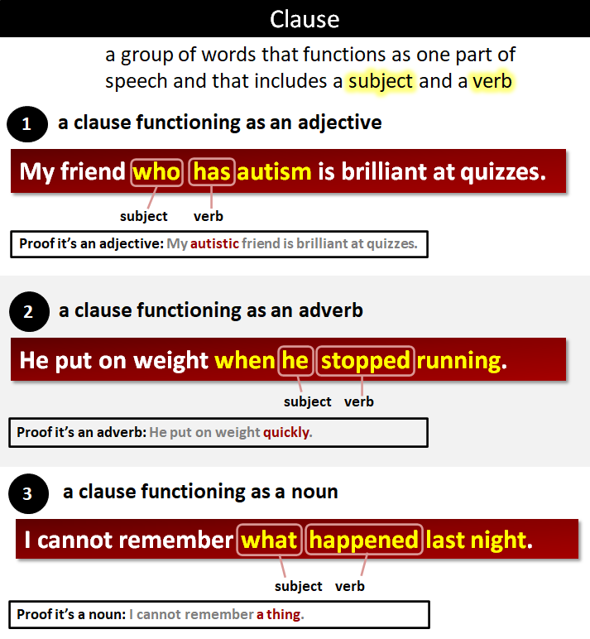
www.midocean.ae

Slide 15
Types of Clause
Clauses are categorized as one of the following:
(1) An Independent Clause. An independent clause functions like a complete sentence. For example: John eats eggs.
(2) A Dependent Clause. A dependent clause functions like an adjective, an adverb, or a noun. So, there are three types of dependent clause.
www.midocean.ae

Slide 16
A clause functioning like an adjective:
John eats eggs that his chickens lay.
(Compare this to "John eats free-range eggs." This proves the clause is functioning like an adjective. The subject of the dependent clause is "his chickens," and the verb of the dependent clause is "lay.")
A clause functioning like an adverb:
John eats eggs when his chickens lay them.
(Compare this to "John eats eggs constantly." This proves the clause is functioning like an adverb.)
A clause functioning like a noun:
John eats what his chickens lay.
(Compare this to "John eats eggs." This proves the clause is functioning like a noun. Notice that the noun clause is part of the independent clause.)
www.midocean.ae

Slide 17
Clauses vs Phrases
A clause contrasts with a phrase, which does not contain a subject and a verb.
Anna sings... | when she wakes up. This is a clause. It has a subject ("she") and a verb ("wakes up").
 | in the morning. This is a phrase. There is no subject and no verb.
www.midocean.ae

Slide 18
The ravens lived... | where the factories are. This is a clause. It has a subject ("the factories") and a verb ("are").
 | in the area of the new factories. This is a phrase. There is no subject and no verb.
www.midocean.ae

Slide 19
(1) An independent clause. An independent clause can stand alone as a sentence.
(2) A dependent clause. A dependent clause is a supporting part of a sentence.
www.midocean.ae

Slide 20
During the day, Vlad slept in a coffin.
(The subject of this clause is "Vlad." The verb is "slept." "During the day" is a phrase because there is no verb.)
www.midocean.ae

Slide 21
An Exercise
Which describes a clause?
A: A clause is the same as a phrase.
B: A clause is a group of words that functions as one part of speech and that includes a subject and a verb.
C: A clause is half a sentence.
www.midocean.ae

Slide 22
Which describes an independent clause?
A: An independent clause expresses a complete thought.
B: An independent clause always starts a sentence.
C: An independent clause is half a sentence.
www.midocean.ae

Slide 23
Select the example with an independent clause in bold.
A: Even though he likes jam, he hates marmalade.
B: Even though he likes jam, he hates marmalade.
www.midocean.ae

Slide 24
Which describes a dependent clause?
A: A dependent clause (or subordinate clause) is one that cannot stand alone as a complete sentence because it does not express a complete thought.
B: A dependent clause can be a simple sentence.
www.midocean.ae

Slide 25
Select the example with a dependent clause in bold.
A: The wax is melting because it's too hot.
B: The wax is melting because it's too hot.
www.midocean.ae

Slide 26
Select the example with a dependent clause in bold.
A: Your sauce has ruined my hamburger, which is not funny.
B: Your sauce has ruined my hamburger, which is not funny.
www.midocean.ae

Slide 27
Select the example with an independent clause in bold.
A: Ever since you have given up smoking, you get annoyed easily.
B: Ever since you have given up smoking, you get annoyed easily.
www.midocean.ae

Slide 28




Thank You

