Slide 1



Design Thinking
Prepared by Dr. Aya Mohamed
ENT 621
Master of Entrepreneurship (semester 2)
Lecture Eight

Slide 2



In The Previous Lecture: Design Thinking
Topics
v
4 Ways to Get Started with Design Thinking
The Empathy Map
Customer persona
Types of personas
Why do we need a personas ?
Tips for customer personas
Empathy
Persona
Map

Slide 3
In This Lecture: Design Thinking
Topics
v
What is the customer journey?
Customer Journey Stages
What is a customer journey map?
What's included in a customer journey map?
Steps for Creating a Customer Journey Map
Types of Customer Journey Maps
Customer Journey Map Best Practices"
Customer
Journey
Map

Slide 4
"understanding your customers' minds can be extremely challenging.”
And even when you think you've considered every possible factor, the journey from awareness to purchase for each customer will always be unpredictable, at least to some level

Slide 5
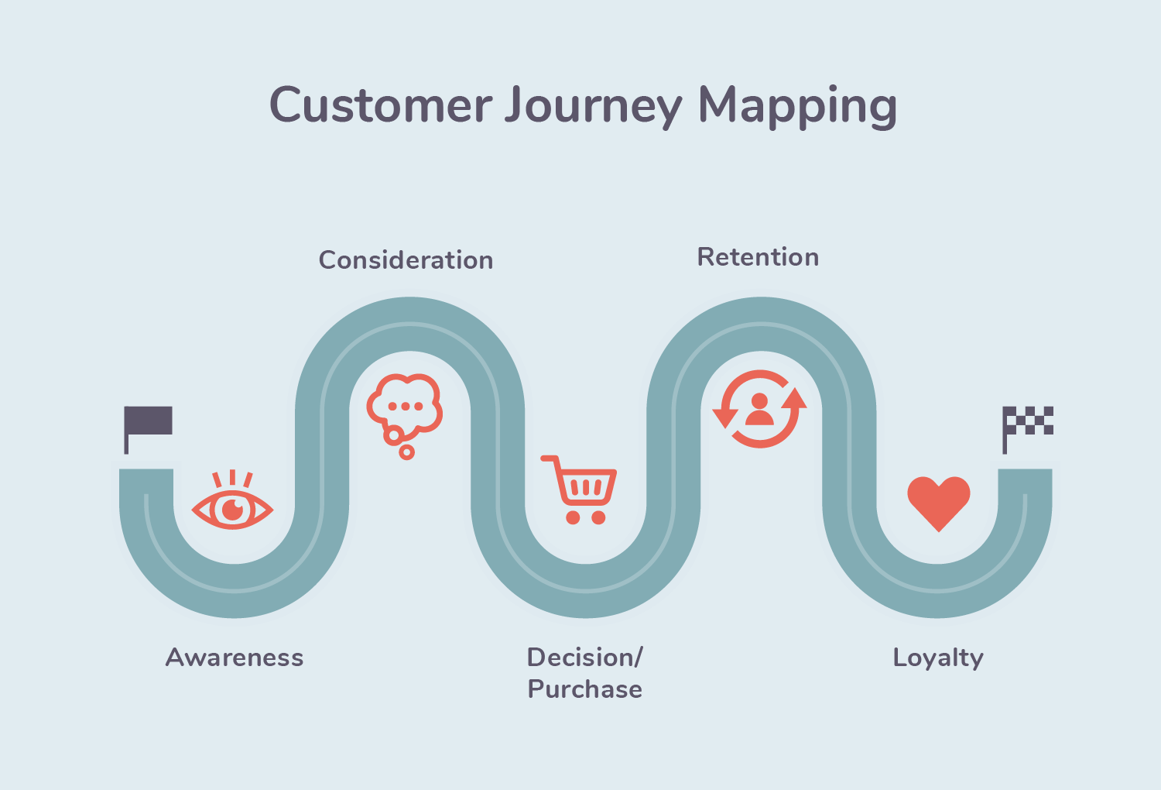
What is Customer Journey?
The customer journey is the series of interactions a customer has with a brand, product, or business as they become aware of a pain point and make a purchase decision.
While the buyer's journey refers to the general process of arriving at a purchase, the customer journey refers to a buyer's purchasing experience with a specific company or service

Slide 6
What is Customer Journey?
The buyer's journey is the entire buying experience from pre-purchase to post-purchase. It covers the path from the customer's awareness of an existing pain point to becoming a product or service user.
In other words, buyers don't wake up and decide to buy on a whim. They go through a process to consider, evaluate, and decide to purchase a new product or service.
The customer journey refers to your brand's place within the buyer's journey: that is, the customer touchpoints where you will meet your customers as they go through the stages of the buyer's journey.
When you create a customer journey map, you're taking control of every touchpoint at every stage of the journey, instead of leaving them up to chance

Slide 7
Customer Journey Stages?
There are 5 phases that customers go through when interacting with a brand or a product: Awareness, Consideration, Decision, Retention, and Loyalty
1. Awareness Stage
In the awareness stage, customers have realized that they have a problem and a pain point to solve.
At this point, a customer may not yet know that they need a product or service, but they will begin doing research either way.
During this stage of the customer journey, brands deliver educational content to help customers diagnose a problem and offer potential solutions. The aim is to help customers navigate their new pain point, not encourage a purchase.

Slide 8
Customer Journey Stages?
There are 5 phases that customers go through when interacting with a brand or a product: Awareness, Consideration, Decision, Retention, and Loyalty
1. Awareness Stage
Educational content include:
How-to articles and guides
General whitepapers
General ebooks
Free courses
Educational content may be delivered via customer touchpoints such as:
Your blog
Social media
Search engines

Slide 9
Customer Journey Stages?
There are 5 phases that customers go through when interacting with a brand or a product: Awareness, Consideration, Decision, Retention, and Loyalty
2. Consideration
In the consideration stage, customers have done enough research to realize that they need a product or service.
At this point, they begin to compare brands and their offerings.
During this stage of the customer journey, brands deliver product marketing content to help customers compare different offerings and, eventually, choose their product or service. The aim is to help customers navigate a crowded solution marketplace and move them toward a purchase decision

Slide 10
Customer Journey Stages?
There are 5 phases that customers go through when interacting with a brand or a product: Awareness, Consideration, Decision, Retention, and Loyalty
2. Consideration Stage
Product marketing content include:
Product listicles
Product comparison guides and charts
Product-focused white papers
Customer success stories or case studies
Product marketing content delivered via customer touchpoints such as:
Your blog
Your website
Search engines
Social media
Conferences

Slide 11
Customer Journey Stages?
There are 5 phases that customers go through when interacting with a brand or a product: Awareness, Consideration, Decision, Retention, and Loyalty
3. Decision Stage
In the decision stage, customers have chosen a solution and are ready to buy.
During this stage, brands deliver a seamless purchase process to make buying their products as easy and simple as possible.
No more educational or product content at this stage — it's all about getting customers to make a purchase. That means you can be more direct about wanting customers to buy from you

Slide 12
Customer Journey Stages?
There are 5 phases that customers go through when interacting with a brand or a product: Awareness, Consideration, Decision, Retention, and Loyalty
3. Decision Stage
"Decision-stage content include:
Free demos
Free consultations
Product sign-up pages
Pricing pages
Product promotions (i.e "Sign up now and save 30%")
Decision-stage content may be delivered via customer touchpoints such as:
Your website
Search engines
Email Direct selling exhibitions

Slide 13
Customer Journey Stages?
There are 5 phases that customers go through when interacting with a brand or a product: Awareness, Consideration, Decision, Retention, and Loyalty
4. Retention Stage
the retention stage, customers have purchased a solution and stay with the company they purchased from, as opposed to leaving for another provider.
During this stage, brands provide an excellent onboarding experience and ongoing customer service to ensure that customers don't churn

Slide 14
Customer Journey Stages?
There are 5 phases that customers go through when interacting with a brand or a product: Awareness, Consideration, Decision, Retention, and Loyalty
4. Retention Stage
Retention-stage strategies include:
Providing a dedicated customer success manager
Making your customer service team easily accessible
Creating a knowledge base in case customers ever run into a roadblock
Retention-stage strategies may be delivered via customer touchpoints such as:
Your website
Live chat
Email
Social media

Slide 15
Customer Journey Stages?
There are 5 phases that customers go through when interacting with a brand or a product: Awareness, Consideration, Decision, Retention, and Loyalty
5. Loyalty Stage
In the loyalty stage, customers not only choose to stay with a company — they actively promote it to their family, friends, and colleagues.
The loyalty stage can also be called the advocacy stage.
During this phase, brands focus on providing a fantastic end-to-end customer experience, from your website content to your sales reps, from your social media team to your product's UX.
Most importantly, customers become loyal when they've achieved success with your product — if it works, they will likely recommend your brand to others

Slide 16
Customer Journey Stages?
There are 5 phases that customers go through when interacting with a brand or a product: Awareness, Consideration, Decision, Retention, and Loyalty
5. Loyalty Stage
Loyalty-stage strategies include:
Having an easy-to-navigate website
Investing in your product team to ensure your product exceeds customer expectations
Making it easy to share your brand with others via a loyalty or referral program
Providing perks to continued customers, such as discounts
Loyalty-stage strategies may be delivered via customer touchpoints such as:
Your website
Email
Social media
Your products

Slide 17
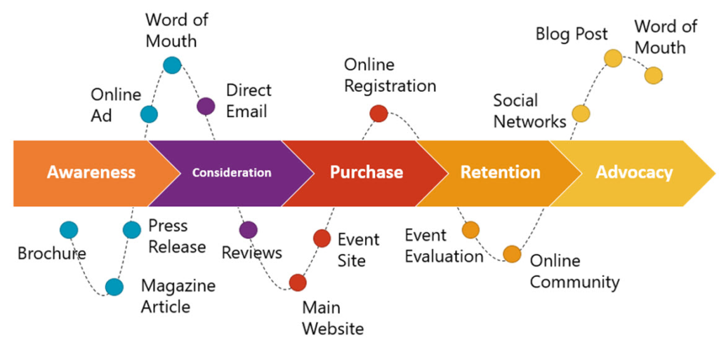
To find out whether your customers have reached the loyalty stage, it's advisable to carry out a Net Promoter Score survey, which asks one simple question: "On a scale of 0 to 10, how likely are you to recommend us to a friend?

Slide 18
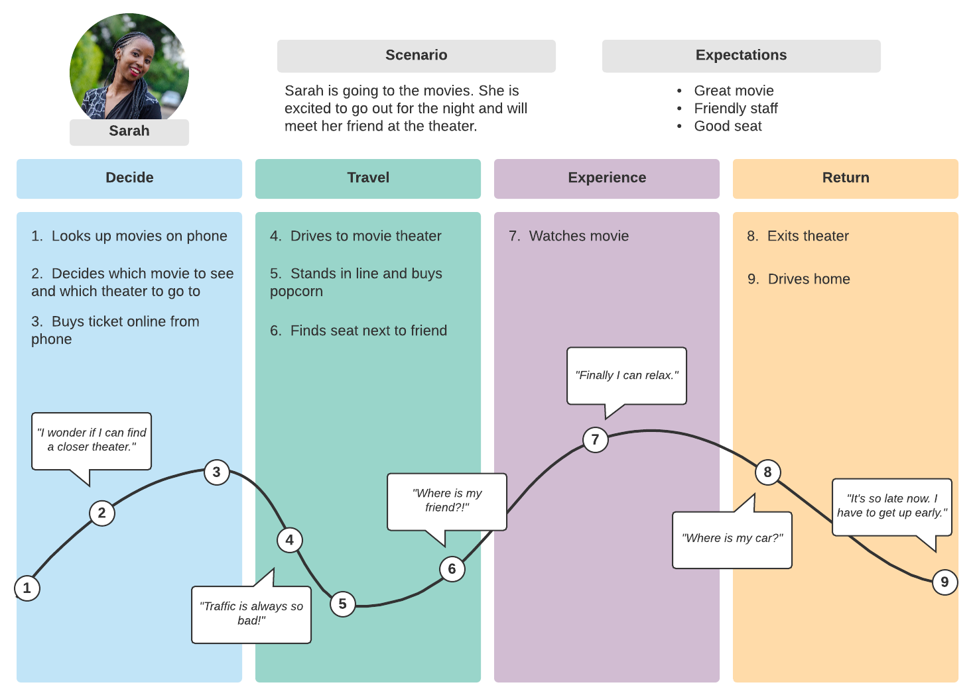
Customer Journey MAP
A customer journey map is a visual representation of the customer's experience with a company.
It also provides insight into the needs of potential customers at every stage of this journey and the factors that directly or indirectly motivate or inhibit their progress.
The business can then use this information to improve the customer's experience, increase conversions, and boost customer retention.

Slide 19
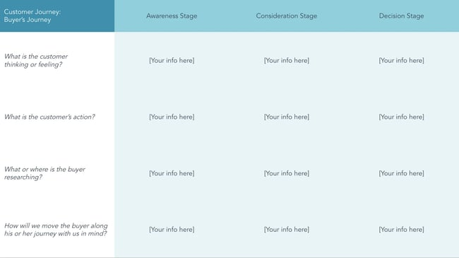
Customer Journey Map
What's included in a customer journey map?
The Buying Process
Emotions
User Actions
User Research
Solutions
you can keep it simple by creating broad categories using the typical buying journey process stages — awareness, consideration, and decision — and mapping them horizontally

Slide 20
Customer Journey MAP
2. Emotions
Whether the goal is big or small, it's important to remember your customers are solving a problem. That means they're probably feeling some emotion — whether that is relief, happiness, excitement, or worry.
Adding these emotions to the journey map can help you identify and mitigate negative emotions and the pain points that cause them.
3. User Actions
This element of the customer journey map details what a customer does in each stage of the buying process. For example, during the problem-awareness stage, customers might download ebooks or join educational webinars.
Essentially, you're exploring how your customers move through and behave at each stage of their journey.

Slide 21
Customer Journey MAP
4. User Research
Similar to the section, this element describes what or where the buyer researches when they are taking action.
More than likely, the buyer will turn to search engines, like Google, to research solutions during the awareness stage. However, it's important to pay attention to what they are researching so you can best address their pain points.
5. Solutions
As the final element in your customer journey map, solutions are where you and your team will brainstorm potential ways to improve your buying process so that customers encounter fewer pain points as they journey

Slide 22
Customer Journey MAP
How often should you update your customer journey map?
Your map should be a constant work in progress.
Reviewing it monthly or quarterly will help you identify gaps and opportunities for further streamlining your customer journey.
Use your data analytics along with customer feedback to check for any roadblocks.
Keep all stakeholders involved in this process, which is why you should consider visualizing your maps in a collaborative tool such as Google Sheets.
Additionally, consider having regular meetings to analyze how new products or offerings have changed the customer journey.

Slide 23

Select a Portion of the Lifecycle
1
This is the foundation on which each behavior line is built
Purchase Scenario
Select a portion of the lifecycle that relates well to the persona(s) you have selected
Aim for enough detail for roughly 15-25 steps on the behavior line
(so it will span an 8’ board)
Scenarios can span more than one board but our recommendation is to have a discrete scenario on each board
4
8
Support Scenario
BUY
OWN
3
7
Market & Sell
Support & Serve
1
5
2
6

Slide 24
DISCUSSION - Business Metrics
Need Phase – Organization’s Perspective:
“When a customer has a need for a product or service, are they aware of our brand?”
PURCHASE
RECOMMEND
8
Example KPI
4
ADVERTISING REACH AND FREQUENCY
SELECT
3
BUY
OWN
7
MAINTAIN
1
5
Example Financial Measure
RETURN ON ADVERTISING SPEND
2
6
RESEARCH
RECEIVE
NEED
USE

Slide 25
ACTIVITY – Business Metrics
Research Phase – Organization’s Perspective:
"When a customer begins their research, do they know our products or services could meet their needs?"
PURCHASE
RECOMMEND
8
Example KPI
4
INTERACTION RATE
SELECT
3
BUY
OWN
7
MAINTAIN
1
5
Example Financial Measure
NUMBER OF OPPORTUNITIES
2
6
RESEARCH
RECEIVE
NEED
USE

Slide 26
ACTIVITY – Business Metrics
Select Phase – Organization’s Perspective:
"What did our customer select, and how does it contribute to a financial benefit for us?"
PURCHASE
RECOMMEND
8
Example KPI
4
UP-SELL / CROSS-SELL RATE
SELECT
3
BUY
OWN
7
MAINTAIN
1
5
Example Financial Measure
AVERAGE ORDER SIZE
2
6
RESEARCH
RECEIVE
NEED
USE

Slide 27
ACTIVITY – Business Metrics
Purchase Phase – Organization’s Perspective:
“How effective were we at getting our customers to convert?"
PURCHASE
RECOMMEND
8
Example KPI
4
CART ABANDONMENT RATE
SELECT
3
BUY
OWN
7
MAINTAIN
1
5
Example Financial Measure
REVENUE PER TRANSACTION
2
6
RESEARCH
RECEIVE
NEED
USE

Slide 28
ACTIVITY – Business Metrics
Receive Phase – Organization’s Perspective:
“How efficiently and effectively did we deliver our product or service?"
PURCHASE
RECOMMEND
8
Example KPI
4
AVERAGE DELIVERY TIME
SELECT
3
BUY
OWN
7
MAINTAIN
1
5
Example Financial Measure
DELIVERY COST PER TRANSACTION
2
6
RESEARCH
RECEIVE
NEED
USE

Slide 29
ACTIVITY – Business Metrics
Use Phase – Organization’s Perspective:
“How are our customers using our products or services?"
PURCHASE
RECOMMEND
8
Example KPI
4
RATE OF ADOPTION
SELECT
3
BUY
OWN
7
MAINTAIN
1
5
Example Financial Measure
VOLUME OVER TIME
2
6
RESEARCH
RECEIVE
NEED
USE

Slide 30
ACTIVITY – Business Metrics
Maintain Phase – Organization’s Perspective:
“Are we making it easy and effortless for customers to resolve their issues?"
PURCHASE
RECOMMEND
8
Example KPI
4
SELF-SERVICE RATE
SELECT
3
BUY
OWN
7
MAINTAIN
1
5
Example Financial Measure
COST PER CHANNEL
2
6
RESEARCH
RECEIVE
NEED
USE

Slide 31
ACTIVITY – Business Metrics
Recommend Phase – Organization’s Perspective:
“How likely is it our customers will become advocates of our brand?"
PURCHASE
RECOMMEND
8
Example KPI
4
REVENUE PER REFERRED CUSTOMER
SELECT
3
BUY
OWN
7
MAINTAIN
1
5
Example Financial Measure
CUSTOMER CHURN RATE
2
6
RESEARCH
RECEIVE
NEED
USE

Slide 32
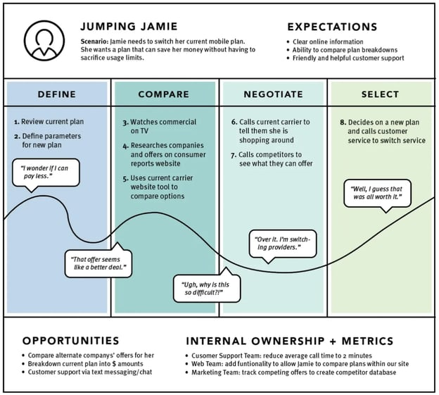
Types of Customer Journey MAP
Current State
These customer journey maps are the most widely-used type. They visualize the actions, thoughts, and emotions your customers currently experience while interacting with your company. They are best used for continually improving the customer journey

Slide 33
Types of Customer Journey MAP
Day in the Life
These customer journey maps visualize the actions, thoughts, and emotions your customers currently experience in their daily activities, whether or not that includes your company.
This type gives a broader lens into your customers' lives and what their pain points are in real life.
Day-in-the-life maps are best used for addressing unmet customer needs before customers even know they exist.
Your company may use this type of customer journey map when exploring new market development strategies

Slide 34
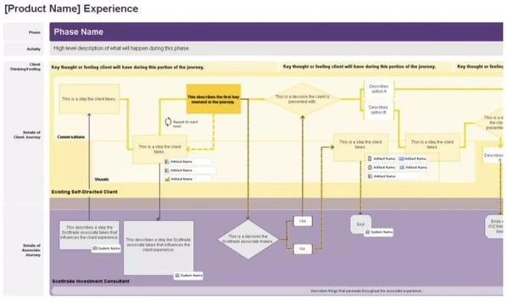
Types of Customer Journey MAP
Future State
These customer journey maps visualize what actions, thoughts, and emotions your customers will experience in future interactions with your company.
Based on their current experience, you'll have a clear picture of where your business fits in.
These maps are best used for illustrating your vision and setting clear, strategic goals

Slide 35
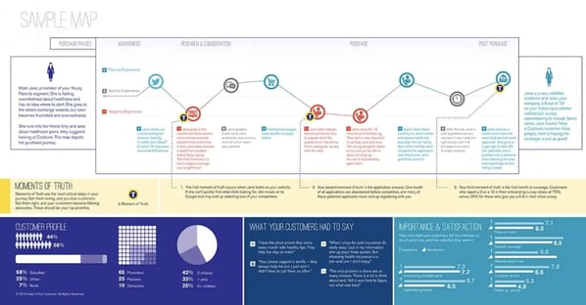
Types of Customer Journey MAP
Service Blueprint
These customer journey maps begin with a simplified version of one of the above map styles. Then, they layer on the factors responsible for delivering that experience, including people, policies, technologies, and processes.
Service blueprints are best used to identify the root causes of current customer journeys or the steps needed to attain desired future customer journeys.

Slide 36
Conclusion:
Breaking down the customer journey phase by phase, aligning each step with a goal, and restructuring your touchpoints accordingly are essential steps toward maximizing customer success.
After all, everything you do should be about solving customer problems and helping them achieve long-term success with your product or service

Slide 37
In This Lecture: Design Thinking
Wrap up
v
What is the customer journey?
Customer Journey Stages
What is a customer journey map?
What's included in a customer journey map?
Steps for Creating a Customer Journey Map
Types of Customer Journey Maps
Customer
Journey
Map

Slide 38


Thank You

