Slide 1


Project Communication
PMG 112
Prepared by Dr. Merna Emad
Enhancing Virtual project communications
Lecture 10

Slide 2
Section 2
LEADERSHIP STYLES TO COMMUNICATE TO DISTRIBUTED TEAMS
Lecture
Section 1
VARIOUS APPROACHES TO VIRTUAL COMMUNICATION

Slide 3
Section one
VARIOUS APPROACHES TO VIRTUAL COMMUNICATION

Slide 4
VARIOUS APPROACHES TO VIRTUAL COMMUNICATION
Different methods
Assuming that one particular communication medium works for all communications is a common pitfall for virtual management.
The e-leader and team should assess voice mail, blogs, wikis, teleconferences, fax, e-mail, videoconferences, electronic bulletin or discussion boards, collaboration sites, and other media in the early stages of the project to determine the most effective methods or tools for communication for the project and the team.
The best methods are the ones that all team members have equal and immediate access to and are trained on, and are effective for everyone.

Slide 5
VARIOUS APPROACHES TO VIRTUAL COMMUNICATION
Different methods
Categorizing communication media into synchronous and asynchronous tools and the number of participants necessary is helpful in organizing virtual communications. Synchronous tools include face-to-face meetings (not virtual), video- or teleconferencing, screen sharing, chat rooms, and chat or instant messaging.
Chat or instant messaging allows very short, synchronous, typewritten “talk” where questions can be asked and responses can be made quickly.
Videoconferencing allows people to see and hear one another in real time in a one-on-one or team setting.
Asynchronous tools include voice mail, e-mail, fax, postal mail, team rooms, websites, collaboration sites, bulletin boards, text, and blogs or discussion groups. These tools do not allow for real-time communication.

Slide 6
VARIOUS APPROACHES TO VIRTUAL COMMUNICATION
Tools and Techniques to Enhance Communications for Virtual Organizations
Tools and techniques to enhance communications for virtual organizations should be an integration of both traditional and virtual methodologies, processes, and theories.
Applying proven traditional project management practices with updated modification and focused training can provide an effective road map for success.
To improve communications, the organization should establish a common ground for communication and use networking within the organization to create information sharing.

Slide 7


VARIOUS APPROACHES TO VIRTUAL COMMUNICATION
Tools and Techniques to Enhance Communications for Virtual Organizations
Communications Technology
Virtual Etiquette

Slide 8

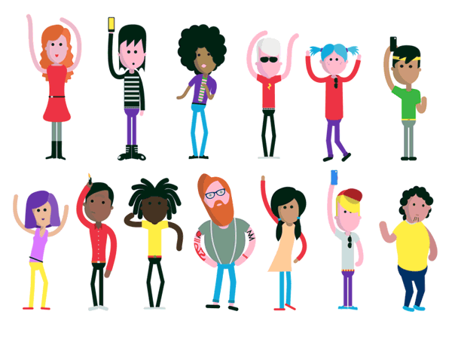
VARIOUS APPROACHES TO VIRTUAL COMMUNICATION
Tools and Techniques to Enhance Communications for Virtual Organizations
Share knowledge
Non-verbal communications

Slide 9
VARIOUS APPROACHES TO VIRTUAL COMMUNICATION
Tools and Techniques to Enhance Communications for Virtual Organizations
Communications Technology
The virtual team relies upon technology to communicate, such as e-mail, voicemail, teleconferences, and videoconferences. Proper training on technological methods and virtual communication techniques includes attention to meeting protocol (agendas, documents, presentation slides, and handouts distributed in advance), following teleconference courtesy rules, allowing all virtual team members adequate opportunities to speak, and keeping meetings in scope (begin and finish on time to accommodate different time zones).

Slide 10
VARIOUS APPROACHES TO VIRTUAL COMMUNICATION
Tools and Techniques to Enhance Communications for Virtual Organizations
Communications Technology
Both the teleconference and videoconference should not last more than two hours and both require good preparation to keep the team engaged in the conversation.
Traditional and newer software tools abound for the 21st century e-leader to use for effective communication. The most advanced technologies, such as Microsoft’s Lync, integrate multiple communication channels in a cloud-based platform that includes e-mail; voice over Internet protocol (VoIP); instant messaging; audio-, video-, and web-conferencing; chat; and DeskShare services.

Slide 11
VARIOUS APPROACHES TO VIRTUAL COMMUNICATION
Tools and Techniques to Enhance Communications for Virtual Organizations
Communications Technology
The type of communication should be matched to the type of message being communicated.
e-Mail is one of the most common forms of communication in virtual projects, and is a multipurpose tool that can be used to share thoughts to documents. Because e-mail is not real time, it allows the receiver the control to carefully compose a reply before sending it. It is also one of the most “dangerous” forms of virtual communication.

Slide 12

VARIOUS APPROACHES TO VIRTUAL COMMUNICATION
Tools and Techniques to Enhance Communications for Virtual Organizations
Communications Technology
Do not use e-mail—
in a confidential situation
to deliver bad or sensitive news
if there is a chance you might be misunderstood

Slide 13
VARIOUS APPROACHES TO VIRTUAL COMMUNICATION
Tools and Techniques to Enhance Communications for Virtual Organizations
Communications Technology
Do not use e-mail—
if you need an immediate response
for detailed, in-depth information or instructions
to debate a topic

Slide 14
VARIOUS APPROACHES TO VIRTUAL COMMUNICATION
Tools and Techniques to Enhance Communications for Virtual Organizations
Virtual Etiquette
Before the meeting
Create an Agenda
This will ensure that your meetings stay productive and on-point. It will also give attendees the chance to get ready for the digital gathering and prepare any materials they may need.

Slide 15
VARIOUS APPROACHES TO VIRTUAL COMMUNICATION
Tools and Techniques to Enhance Communications for Virtual Organizations
Virtual Etiquette
Before the meeting
Test Your Equipment
make sure you know how to login, that your webcam, microphone, and speakers are operational, and that you have a strong WiFi signal.

Slide 16
VARIOUS APPROACHES TO VIRTUAL COMMUNICATION
Tools and Techniques to Enhance Communications for Virtual Organizations
Virtual Etiquette
Before the meeting
Dress Appropriately
Ask yourself this question before joining a conference call: would I feel comfortable walking into company headquarters looking like this? If the answer is “yes,” you’re probably good to go. If the answer is “no,” clean yourself up before you login to the meeting.

Slide 17
VARIOUS APPROACHES TO VIRTUAL COMMUNICATION
Tools and Techniques to Enhance Communications for Virtual Organizations
Virtual Etiquette
Before the meeting
Check Your Surroundings
Once you’ve made sure YOU look presentable, check your surroundings. Are there obnoxious posters on the wall behind you? Is there a pile of laundry on the floor that your colleagues will be able to see? If so, clean up your area to minimize distractions.
Additionally, Find a quiet, noise-free place to join your meeting from so that you and your teammates don’t have to shout at each other to be heard.

Slide 18
VARIOUS APPROACHES TO VIRTUAL COMMUNICATION
Tools and Techniques to Enhance Communications for Virtual Organizations
Virtual Etiquette
During the meeting
Introduce Attendees
it’s difficult to work with a complete stranger. Once everybody knows the names and roles of the other people on the call, they’ll be able to communicate more effectively and your meeting will be more productive as a result.

Slide 19
VARIOUS APPROACHES TO VIRTUAL COMMUNICATION
Tools and Techniques to Enhance Communications for Virtual Organizations
Virtual Etiquette
During the meeting
Don’t Interrupt Others
don’t interrupt your teammates—even if you have something super important to say. If you happen to be hosting the virtual meeting, enforce a strict no-interrupting policy. If you’re attending someone else’s meeting, wait to speak your mind until it’s your turn.

Slide 20
VARIOUS APPROACHES TO VIRTUAL COMMUNICATION
Tools and Techniques to Enhance Communications for Virtual Organizations
Virtual Etiquette
During the meeting
Mute Your Mic
The only time you should unmute your microphone when attending a virtual meeting is when you’re speaking. Once someone else has the floor, so to speak, hit the mute button.
This will save your virtual get-together from echo noises caused by conflicting microphones. It will also help keep background noises from distracting your team.

Slide 21
VARIOUS APPROACHES TO VIRTUAL COMMUNICATION
Tools and Techniques to Enhance Communications for Virtual Organizations
Virtual Etiquette
After the meeting
Ask For Questions
Before you officially end your meeting and sign off, make sure to ask your team if they have any questions or concerns. Is everyone clear on their assignments? Does each person understand what the team is trying to achieve as a whole?

Slide 22
VARIOUS APPROACHES TO VIRTUAL COMMUNICATION
Tools and Techniques to Enhance Communications for Virtual Organizations
Virtual Etiquette
After the meeting
Follow-Up Post-Meeting
Take time to send meeting notes, individual assignments, and anything else you think is relevant to each video conference attendee.

Slide 23
VARIOUS APPROACHES TO VIRTUAL COMMUNICATION
Tools and Techniques to Enhance Communications for Virtual Organizations
Share knowledge
e-Leaders need to be extremely organized to be able to monitor work in remote locations. This requires the ability to get information as well as give information to the virtual team. Feedback and acknowledgment of shared knowledge is vital to the success of the project.

Slide 24
VARIOUS APPROACHES TO VIRTUAL COMMUNICATION
Tools and Techniques to Enhance Communications for Virtual Organizations
Share knowledge
Acknowledgments can be required through electronic response mechanisms, and feedback should be encouraged with processes in place to facilitate both positive and negative feedback within the virtual team.

Slide 25
VARIOUS APPROACHES TO VIRTUAL COMMUNICATION
Tools and Techniques to Enhance Communications for Virtual Organizations
Share knowledge
Talking through requirements, test cases, strategy, and review procedures are important in the virtual environment. This will require additional time, and the project manager should allocate extra time compared with face-to-face communication.

Slide 26
VARIOUS APPROACHES TO VIRTUAL COMMUNICATION
Tools and Techniques to Enhance Communications for Virtual Organizations
Share knowledge
With members who require more structure, e-leaders need to spend more time detailing the task. With members who require less structure, detailing the task will cause them to feel micromanaged. When providing confirmation of decisions, the virtual manager should follow up in writing.

Slide 27
VARIOUS APPROACHES TO VIRTUAL COMMUNICATION
Tools and Techniques to Enhance Communications for Virtual Organizations
Share knowledge
Meeting minutes should be completed and dispersed as soon as possible and should include the opportunity for team members to edit or correct the minutes within a stated timeline.

Slide 28
VARIOUS APPROACHES TO VIRTUAL COMMUNICATION
Tools and Techniques to Enhance Communications for Virtual Organizations
Non-verbal
communications
Many of the nonverbal communications that collocated teams take for granted are not available to the virtual team. Nonverbal cues are missing in the virtual world.
Body language is 55% of communication, words comprise only 7% of communication—but tone and inflection are considered 38%. Norms and unwritten rules, voice tonality and inflection, facial expressions, body language, social interaction, and gestures are some of the missing elements of communication for virtual team members.

Slide 29
VARIOUS APPROACHES TO VIRTUAL COMMUNICATION
Tools and Techniques to Enhance Communications for Virtual Organizations
Non-verbal
communications
Gestures can be easily misinterpreted in face-to-face international and multicultural communications. This is one area of communications the project manager of the virtual team does not have to be concerned about when facilitating teleconferences or e-mail threads.
The traditional, collocated team has the advantage of being able to see and hear oral conversations; often the virtual team has the ability to only hear or read. Without the benefit of face-to-face interaction and physical cues, team members can misinterpret the meaning of communications.

Slide 30
VARIOUS APPROACHES TO VIRTUAL COMMUNICATION
Tools and Techniques to Enhance Communications for Virtual Organizations
Non-verbal
communications
Written Communication
Misinterpretation of written communication can also be damaging to the virtual team, which is due to the inability to identify nonverbal cues. Certain rules of etiquette have evolved for electronic written communications:
• Do not send e-mails to everyone if only a few people need to know the information. And do not send junk mail or chain letters.

Slide 31
VARIOUS APPROACHES TO VIRTUAL COMMUNICATION
Tools and Techniques to Enhance Communications for Virtual Organizations
Non-verbal
communications
Written Communication
Misinterpretation of written communication can also be damaging to the virtual team, which is due to the inability to identify nonverbal cues. Certain rules of etiquette have evolved for electronic written communications:
• Angry, offensive, or insulting messages have no place in the business environment, and especially not in electronic communications.

Slide 32
VARIOUS APPROACHES TO VIRTUAL COMMUNICATION
Tools and Techniques to Enhance Communications for Virtual Organizations
Non-verbal
communications
Written Communication
Misinterpretation of written communication can also be damaging to the virtual team, which is due to the inability to identify nonverbal cues. Certain rules of etiquette have evolved for electronic written communications:
• Shouting is not allowed in the traditional workplace. Using CAPITAL LETTERS in the virtual environment is the equivalent to shouting out loud. Use upper- and lowercase sentence style.

Slide 33
VARIOUS APPROACHES TO VIRTUAL COMMUNICATION
Tools and Techniques to Enhance Communications for Virtual Organizations
Non-verbal
communications
Written Communication
Misinterpretation of written communication can also be damaging to the virtual team, which is due to the inability to identify nonverbal cues. Certain rules of etiquette have evolved for electronic written communications:
• Watch the use of acronyms, abbreviations, and jargon.
• If a document or a link is attached, be sure it is active.
• Smileys and emoticons (electronic symbols of emotions such as :->) should be avoided in business writing.

Slide 34
VARIOUS APPROACHES TO VIRTUAL COMMUNICATION
Tools and Techniques to Enhance Communications for Virtual Organizations
Non-verbal
communications
Written Communication
Misinterpretation of written communication can also be damaging to the virtual team, which is due to the inability to identify nonverbal cues. Certain rules of etiquette have evolved for electronic written communications:
• Follow the “no-scrolling” rule and keep e-mails concise, short, and to the point. The subject line is the first impression in virtual communication. Subject lines should be descriptive and complete. Many readers prioritize their in-box by looking at the subject line. The subject line “Meeting” is not as effective as “Team Meeting – 8 a.m. – 2/27.”

Slide 35
VARIOUS APPROACHES TO VIRTUAL COMMUNICATION
Tools and Techniques to Enhance Communications for Virtual Organizations
Non-verbal
communications
The body of the communication should be easy to read. Paragraphs should be simple and contain only one idea. A blank line between paragraphs will make your communication easier to read. Bulleted lists can help summarize main points and numbered lists can help your reader put things in order. White space will increase readability.
Jokes and comical comments can be misinterpreted in the virtual world. If a team member is making a joke, it is recommended that the project manager say: “The people on the phone cannot see that John is smiling, but I’ll bet he is”. Humor is healthy, but in the virtual world it often needs clarification.

Slide 36
Section two
USING MULTIPLE LEADERSHIP STYLES TO COMMUNICATE TO DISTRIBUTED TEAMS

Slide 37
USING MULTIPLE LEADERSHIP STYLES TO COMMUNICATE TO DISTRIBUTED TEAMS
There is no opportunity to visit at the coffee machine or jog during lunch in the virtual environment. It becomes the project manager’s responsibility to build the relationships and communications that are necessary for the virtual team to be successful. Team websites, collaborative tools, and networks that act as virtual water coolers can encourage informal team communication. A mix of communication methods is encouraged in most organizations.
Just as there are multiple ways to communicate, there are multiple leadership styles with which to most effectively use communication tools. Being able to match the communication tool to the needs of each individual in the project team is essential to the success of the project.

Slide 38
USING MULTIPLE LEADERSHIP STYLES TO COMMUNICATE TO DISTRIBUTED TEAMS
Situational Communication Styles
The key is communication. As a project manager you can try to force the team communication into the method that works for you—or you can adjust your communication to what fits each individual. Many people are able to manage their portion of the project with only e-mail and periodic telephone calls—others need you to check in by phone or face-to-face more often.
A project manager’s communication style is a significant factor for successful projects. However, depending on the project type (software, process, organizational change, etc.), team members experience, and project management maturity level of (one or more organizations—e.g., when working with vendors), the most critical component is the ability of the project manager to be a chameleon to adapt their style to get the best out of their project team and partners.

Slide 39
USING MULTIPLE LEADERSHIP STYLES TO COMMUNICATE TO DISTRIBUTED TEAMS
Situational Communication Styles
Understanding and analyzing each team member’s communication style and needs are important to the success of the project and the trust and relationships built by the project manager. The project manager can use any available personality-type index or style tool, such as Merrill’s style
The Merrill’s Style
The Myers-Briggs Personality Type Indicator is a self-report inventory designed to identify a person's personality type, strengths, and preferences. The questionnaire was developed by Isabel Myers and her mother Katherine Briggs based on their work with Carl Jung's theory of personality types. Today, the MBTI inventory is one of the most widely used psychological instruments in the world.

Slide 40
USING MULTIPLE LEADERSHIP STYLES TO COMMUNICATE TO DISTRIBUTED TEAMS
Situational Communication Styles
Understanding and analyzing each team member’s communication style and needs are important to the success of the project and the trust and relationships built by the project manager. The project manager can use any available personality-type index or style tool, such as Merrill’s style
How does it work?
Extroversion (E) – Introversion (I)
The MBTI measures introversion and extroversion differently than the way you’re used to hearing about it. According to the assessment, extroverts are “outward-turning,” tend to enjoy socializing with others and are wired for taking action.
In comparison, introverts are “inward-turning” and tend to prefer spending time alone. They spend more time thinking and enjoy more profound relationships with fewer people.

Slide 41
USING MULTIPLE LEADERSHIP STYLES TO COMMUNICATE TO DISTRIBUTED TEAMS
Situational Communication Styles
Understanding and analyzing each team member’s communication style and needs are important to the success of the project and the trust and relationships built by the project manager. The project manager can use any available personality-type index or style tool, such as Merrill’s style
How does it work?
Sensing (S) – Intuition (N)
This category looks at how people gather information and make judgments about the world around them. Individuals who prefer sensing tend to focus on tangible information. They enjoy hands-on experiences and focus more on the facts of a situation.
In comparison, individuals who lead with their intuition like to look at the big picture. They look for the patterns between the facts and enjoy thinking more about what’s possible.

Slide 42
USING MULTIPLE LEADERSHIP STYLES TO COMMUNICATE TO DISTRIBUTED TEAMS
Situational Communication Styles
Understanding and analyzing each team member’s communication style and needs are important to the success of the project and the trust and relationships built by the project manager. The project manager can use any available personality-type index or style tool, such as Merrill’s style
How does it work?
Thinking (T) – Feeling (F)
Thinkers tend to make decisions based on objective data and logical analysis. They tend to be more practical when making a decision and rarely make decisions based on their emotions. In contrast, feelers will think about what’s important to them and how a decision could impact those around them.

Slide 43
USING MULTIPLE LEADERSHIP STYLES TO COMMUNICATE TO DISTRIBUTED TEAMS
Situational Communication Styles
Understanding and analyzing each team member’s communication style and needs are important to the success of the project and the trust and relationships built by the project manager. The project manager can use any available personality-type index or style tool, such as Merrill’s style
How does it work?
Judging (J) – Perceiving (P)
This final category looks at how an individual lives their lives and interacts with others. If you lead with judging, you tend to prefer rules and structure. Those who lean toward perceiving are more flexible and enjoy more spontaneity in their lives.

Slide 44
USING MULTIPLE LEADERSHIP STYLES TO COMMUNICATE TO DISTRIBUTED TEAMS
Situational Communication Styles
Understanding and analyzing each team member’s communication style and needs are important to the success of the project and the trust and relationships built by the project manager. The project manager can use any available personality-type index or style tool, such as Merrill’s style
Communication based on the test
For example, the “analytical” may respond well to collaboration databases and issues management bulletin boards. The “driver” on the virtual team often finds it difficult to listen, so asynchronous communications, such as e-mail, messaging, and texting, may be the best communication media. The “amiable” virtual team member may be a good listener, sensitive, and patient. Good communication styles for this member may include video- and teleconferencing.

Slide 45
USING MULTIPLE LEADERSHIP STYLES TO COMMUNICATE TO DISTRIBUTED TEAMS
Situational Communication Styles
Understanding and analyzing each team member’s communication style and needs are important to the success of the project and the trust and relationships built by the project manager. The project manager can use any available personality-type index or style tool, such as Merrill’s style
Communication based on the test
The “expressive” team member may need more informal contact with the team and e-leader, because of the sociable, personable, and emotional nature of this individual. This team member may respond well to chats, social media, and videoconferencing. Videoconferencing, however, must be prescheduled, which may detract from the expressive-type team member’s need for informal, personable communication.

Slide 46
USING MULTIPLE LEADERSHIP STYLES TO COMMUNICATE TO DISTRIBUTED TEAMS
Situational Communication Styles
Understanding and analyzing each team member’s communication style and needs are important to the success of the project and the trust and relationships built by the project manager. The project manager can use any available personality-type index or style tool, such as Merrill’s style
Communication based on the test
The manager may choose to have the virtual project team share their individual MBTI types with each other and suggest that the team members attempt to communicate with the other individuals on the team in the best medium for that individual.

Slide 47
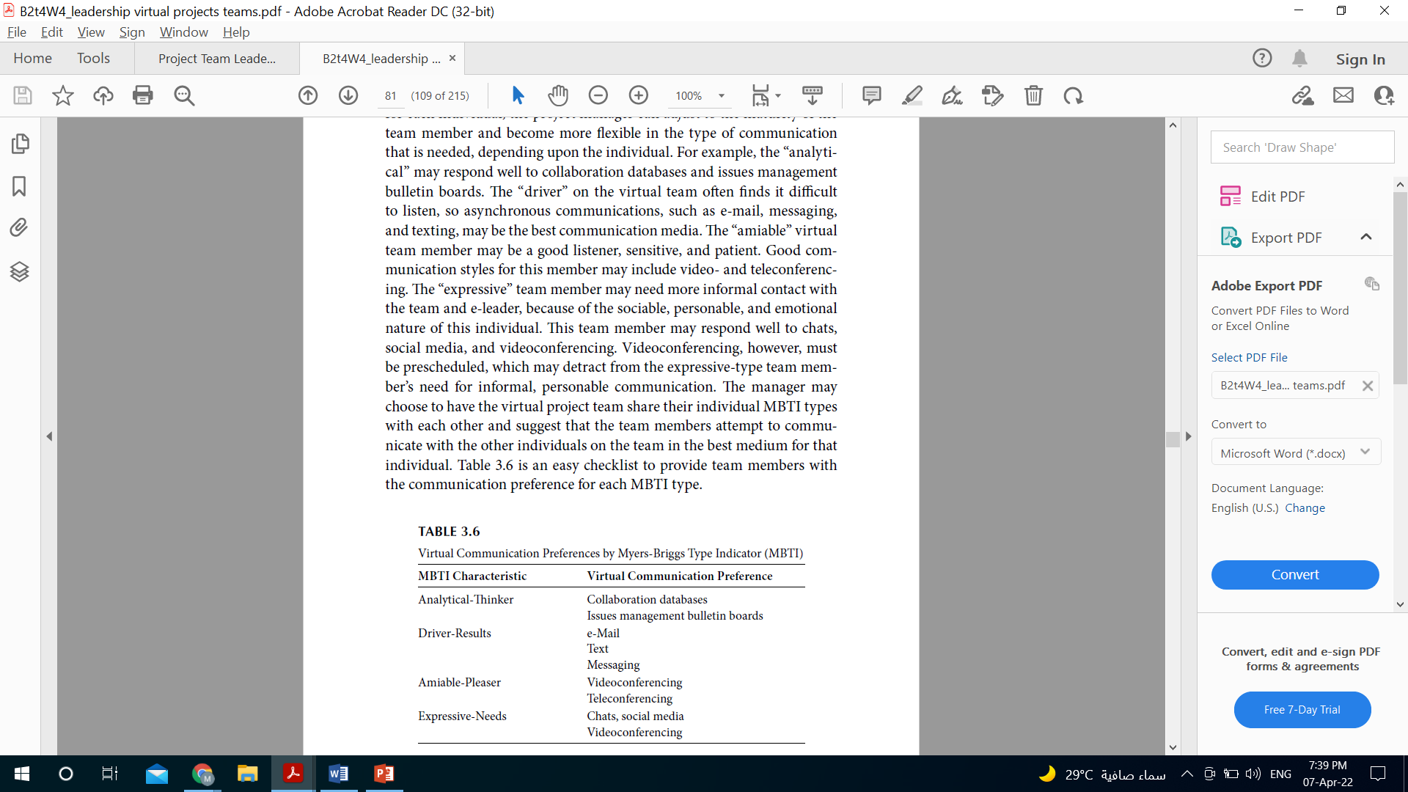
USING MULTIPLE LEADERSHIP STYLES TO COMMUNICATE TO DISTRIBUTED TEAMS
Situational Communication Styles

Slide 48
USING MULTIPLE LEADERSHIP STYLES TO COMMUNICATE TO DISTRIBUTED TEAMS
Servant Communication Styles
The servant-leader shares power, engages the team in participative decision making, puts the needs of others first, and encourages individual development.
It is important that the e-leader take time to listen to each team member. For remote team members, sharing a sympathetic ear to discuss issues, problems, and frustrations may eliminate issues later in the project.

Slide 49
USING MULTIPLE LEADERSHIP STYLES TO COMMUNICATE TO DISTRIBUTED TEAMS
Servant Communication Styles
It is difficult to pick up on these nuances virtually, and extra effort needs to be made by the project manager to decipher what is and is not important when listening to feedback from the team.
Providing the opportunity for team members to edit or correct the minutes from team meetings is one way to involve the team and encourage feedback. Encouraging participative decision making through the use of multiple avenues of communication using several tools, the e-leader can guide the team toward success.

Slide 50
USING MULTIPLE LEADERSHIP STYLES TO COMMUNICATE TO DISTRIBUTED TEAMS
Servant Communication Styles
Suggestions for participative communication are listed below:
• Conduct frequent check-ins.
• Ask questions using a Likert scale of 1–5 to draw out all team members.
• Ask open-ended questions.
• Ask team members to repeat.
• Follow up with phone calls and e-mails.

Slide 51
USING MULTIPLE LEADERSHIP STYLES TO COMMUNICATE TO DISTRIBUTED TEAMS
Empowerment communication
The virtual team leader can use empowerment leadership techniques to enhance communications and promote emerging leadership within the team.
The self-managing team still needs clear direction and goal setting, and the e-leader provides the organization’s rules, guidelines, and procedures regarding document management, collaboration databases, cloud, or company databases.

Slide 52
USING MULTIPLE LEADERSHIP STYLES TO COMMUNICATE TO DISTRIBUTED TEAMS
Empowerment communication
Indicating the following can be used as a guide to developing shared leadership and communications:
• Purpose (team charter, goals, vision, deliverable requirements)
• Team (team member roles, leadership responsibilities, team skills database, interpersonal communications, team member contact information)
• Processes (work breakdown structure, monitoring and controlling processes, quality measurements, risk and issues logs, communication plan for disseminating project information)

Slide 53


