Slide 1



Master of Science in Artificial intelligent
Lecture 3
Solving problems by Searching
AI511
Foundations of Artificial Intelligence
Prepared by
Prof. Lamiaa Fattouh Ibrahim
www.midocean.ae

Slide 2
Outline
Solving problems by Searching
  Types of agents
  State Space Search
    Example: Tic-Tac-Toe Game
    Example: Mechanical Fault Diagnosing
  How human beings think?
    Heuristic Search

Slide 3
Outline
  Search
    Search problem components
    Example: Romania
    State space & State Space Graph
    Example: Vacuum world
    Vacuum world state space graph
    Example: The 8-puzzle
    Example: Robot motion planning
    Example: Tic- Tac-Toe
    Example: Traveling Salesperson
  State Space Search Strategies
  Selecting Search Strategy

Slide 4
Resources for this lecture
This lecture covers the following chapters:
  Chapter 3 (Solving Problems by Searching; only sections 3.1, 3.2, & 3.3) from Stuart J. Russell and Peter Norvig, "Artificial Intelligence: A Modern Approach," Third Edition (2010), by Pearson Education Inc.
… AND …
  Part II (pages 41 to 45) and Chapter 3 (only sections 3.0, 3.1, and 3.2) from
George F. Luger, "Artificial Intelligence: Structures and strategies for complex
problem solving, " Sixth edition (2009), Pearson Education Limited.

Slide 5
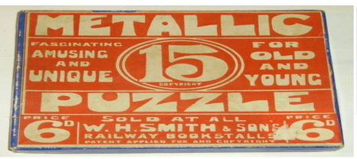
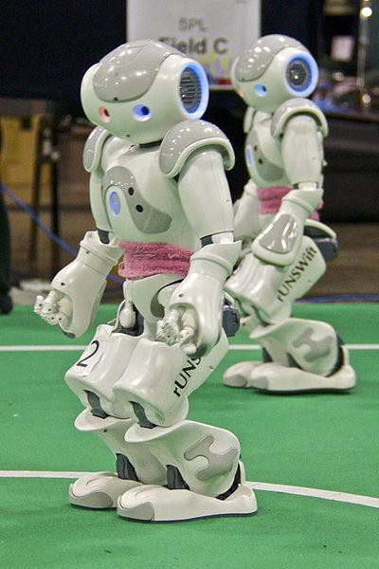
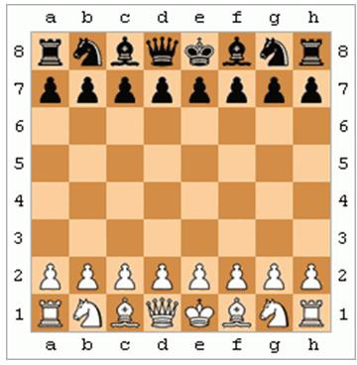
Solving Problems by SEARCHING

Slide 6
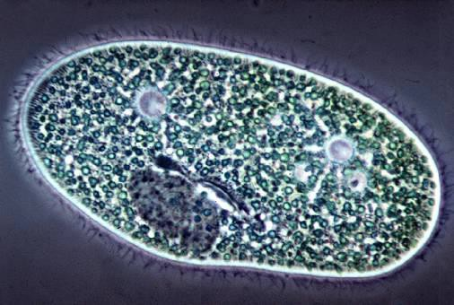
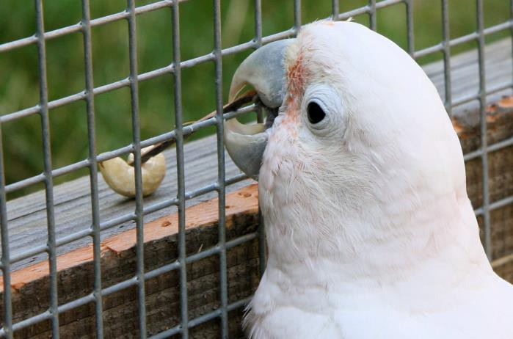
Types of Agents
Reflex agent
Planning agent
Consider how the world IS
Choose action based on current percept.
Do not consider the future consequences of actions.
Consider how the world WOULD BE
Decisions based on (hypothesized) consequences of actions.
Must have a model of how the world evolves in response to actions.
Must formulate a goal.
Source: D. Klein, P. Abbeel

Slide 7
State Space Search
Problems are solved by searching among alternative choices.
Humans consider a number of alternative strategies on their
way to solving a problem.
  A Chess player considers a number of alternative moves.
  A mathematician chooses from a different strategies to find a proof for a theorem.
  A physician evaluates a number of possible diagnoses.

Slide 8
Example: Tic-Tac-Toe Game
X
 | X
 |  | X
X
 | X
 |  | X
 | X
 |  | X
X
O
 | X
 | O
 | X
 |  | O
 | X |  |  | O | X |  |  |  | X | O
 | X
O
 | X |  |  |  | X
 | O |  |  |  |  | O

Slide 9
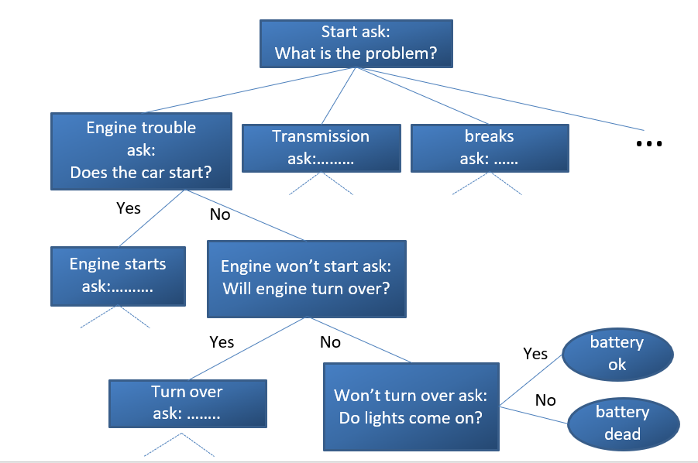
Example: Mechanical Fault Diagnosing

Slide 10
How human beings think?
Human beings do not search the entire state space
(exhaustive search).
Only alternatives that experience has shown to be effective are explored.
Human problem solving is based on judgmental rules that limit the exploration of search space to those portions of state
space that seem somehow promising.
These judgmental rules (rule of thumb) are known as “heuristics”.

Slide 11
Search method
Exhaustive
Uninformed
Brute force
What if graph
Heuristic
Informed
Rule thumb

Slide 12
Heuristic Search
A heuristic is a strategy for selectively exploring the search space.
It guides the search along lines that have a high probability of success.
It employs knowledge about the nature of a problem to find a solution.
It does not guarantee an optimal solution to the problem but can come close most of the time.
Human beings use a large number of heuristics in problem solving.

Slide 13
Properties of task environments | Descriptions
Fully observable (vs Partially Observable) | If an agent’s sensors give it access to the complete state of the environment at each point in time. A task environment is effectively fully observable if the sensors detect all aspects that are relevant to the choice of action.
Deterministic (vs Stochastic) | If the next state of the environment is completely determined by the current state and the action executed by the agent, then we say the environment is deterministic; otherwise, it is stochastic.
Discrete (vs Continuous) | Chess also has a discrete set of percepts and actions. Taxi driving is a continuous-state and continuous-time problem: the speed and location of the taxi and of the other vehicles sweep through a range of continuous values and do so smoothly over time

Slide 14
Properties of task environments | Descriptions
Episodic (vs Sequential) | In an episodic task environment, the agent’s experience is divided into atomic episodes. In each episode the agent receives a percept and then performs a single action. Crucially, the next episode does not depend on the actions taken in previous episodes.
Known vs Unknown | In a known environment, the outcomes (or outcome probabilities if the environment is stochastic) for all actions are given. Obviously, if the environment is unknown, the agent will have to learn how it works in order to make good decisions.

Slide 15



Search
We will consider the problem of designing goal-based agents in fully observable, deterministic, discrete, known environments.
Start State
Goal State

Slide 16
Search
We will consider the problem of designing goal-based agents in fully observable, deterministic, discrete, known environments.
The agent must find a sequence of actions that reaches the goal. The performance measure is defined by:
reaching the goal, and …
how “expensive” the path to the goal is.

Slide 17
Search Problem Components
Initial
Initial state Actions
State
Transition model
What state results from performing a given action in a given state?
Goal state Solution Path Path cost
Assume that it is a sum of
nonnegative step costs
Goal State
The optimal solution is the sequence of actions that gives the
lowest path cost for reaching the goal.

Slide 18
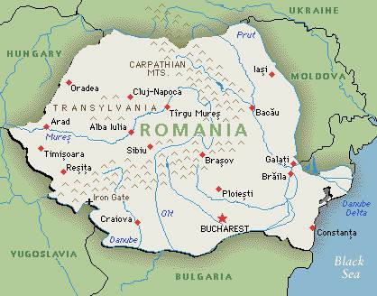

Slide 19
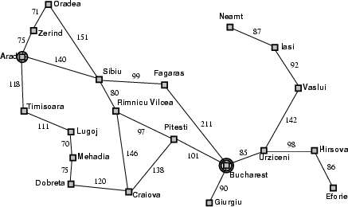
Example: Romania
On vacation in Romania; currently in Arad.
Flight leaves tomorrow from Bucharest.
Initial state
  Arad
Actions
  Go from one city to another
Transition model
  If you go from city A to
city B, you end up in city B
Goal state
  Bucharest
Path cost
  Sum of edge costs (total distance traveled)

Slide 20
State Space Representation of Problems
The initial state, actions, and transition model define the state
space of the problem;
The set of all states reachable from initial state by any sequence of actions.
Can be represented as a directed graph where the nodes are states and links between nodes are actions.
What is the state space for the Romania problem?

Slide 21
State Space
An AI problem can be represented as a state space graph.
A graph is a set of nodes and links that connect them. Graph theory:
Labeled graph.
Directed graph.
Path.
Rooted graph.
Tree.
Parent.
Child.
Sibling.
Ancestor.
Descendant.

Slide 22









State Space
Graph Theory, Kônigsberg Bridges Problem, & Euler Tour ..
Riverbank 1
4
River
Island 1
1
Island 2
7
Riverbank 2

Slide 23
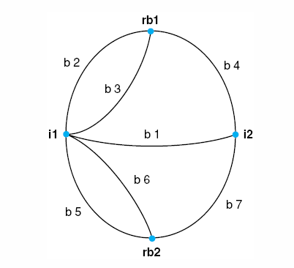
Figure 3.2: Graph of the Königsberg bridge system.
3

Slide 24
Graph Theory
Structures for State Space search
A graph is a set of nodes and arcs that connect them.
A Labeled graph has one or more descriptors (labels) attached to each node that distinguish that node from any other node in the graph.
In State Space graph, these descriptors identify states in a problem-solving process.
The arcs of a graph may also be labeled. Arc labels are used to indicate that an arc represents a named relationship (as in a semantic network) or to attach weights to arcs.
If there are different arcs between the same two nodes, these can also be distinguished through labeling.

Slide 25
A graph is directed if arcs have an associated directionality.
Arcs that can crossed in either direction may have two arrows attached but more often have no direction indicators at all.
A path through a graph connects a sequence of nodes through successive arcs.
A rooted graph has a unique node, called the root, such that there is a path from the root to all nodes within the graph.
The state space graphs for games are usually rooted graphs with the start of the game as the root.
A tree is a graph in which two nodes have at most one path between them, therefore it is impossible for a path to loop or cycle continuously through a sequence of nodes.
Trees often have roots.
For rooted trees or graphs, relationships between nodes include parent, child, and sibling.
Ancestor comes before a descendant in some path of a directed graph.

Slide 26
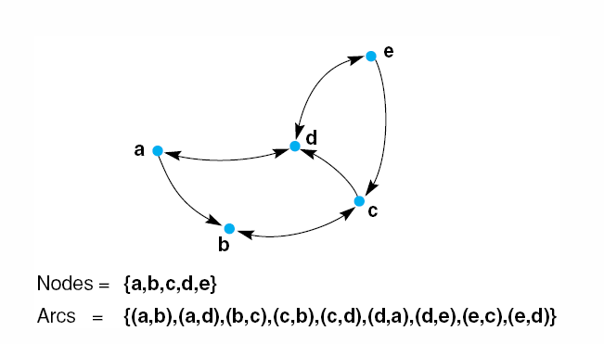
Figure 3.3: A labeled directed graph.
Luger: Artificial Intelligence, 5th edition. © Pearson Education Limited, 2005
4

Slide 27
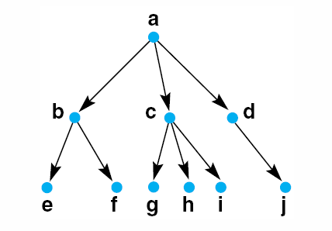
Figure 3.4: A rooted tree, example family relationships.
b is a parent of nodes e and f ( which are, therefore, children of b and sibling of each other).
Nodes a and c are ancestors of states g, h, and i, and g, h, and I are descendants of a and c.
5

Slide 28










Trees and Graphs
Trees:
  Consists of nodes connected
by links (or edges).
  every node has a single parent.
  The root has no parents.
  No cycles exist.
Graphs:
  Consists of nodes connected by links (or edges).
  Nodes have any number of parents.
  Cycles may exists
28

Slide 29
The of a search algorithm is to find a solution path through such a problem space.
The actual generation of new states along the path is done by applying operators such as legal moves in a game.
Search algorithms must keep track of the paths from a start to a goal node, because these paths contain the series of operations that lead to the problem solution.
A goal may describe:
1- A state, such as a winning board in a simple game.
2- Some property of the solution path itself.

Slide 30
State Space
State space search is the process of finding a solution path from the start state to a goal
A state space is represented by four-tuple [N, A, S, GD].
N, is the set of nodes or states of the graph. These
correspond to the states in the problem-solving process.
A, is the set of arcs between nodes. These correspond to the steps in a problem-solving process.
S, a nonempty subset of N, contains the start-state (s) of
the problem.
GD, a nonempty subset of N, contains the goal-state(s) of the problem. The states in GD are described using either:
  A measurable property of the states encountered in the search.
  A property of the solution path developed in the search, for example, the transition costs for the arcs of the path.
  A solution path is a path through this graph from a node in S to a node in GD.

Slide 31
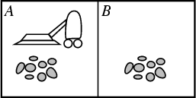
Example: Vacuum World
States:
  Agent location and dirt location
  How many possible states?
  What if there are n possible locations?
    The size of the state space grows exponentially with the “size” of the world!
Actions:
  Left, right, suck.
Transition model ..

Slide 32
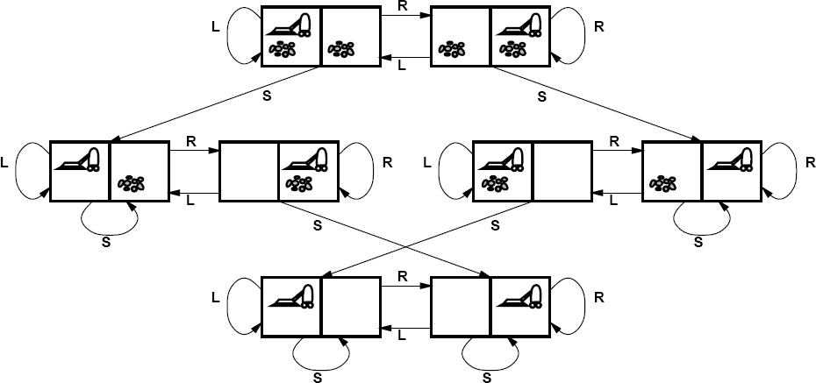
Example: Vacuum World State Space Graph

Slide 33
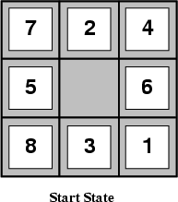
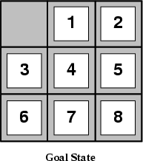
Example: The 8-puzzle
States
  Locations of tiles
o 8-puzzle: 181,440 states (9!/2)
    15-puzzle: ~10 trillion states
    24-puzzle: ~10²⁵ states
Actions
  Move blank left, right, up, down
Path cost
  1 per move

Slide 34
Example: Tic-Tac-Toe
Nodes(N): all the different configuration of Xs and Os that the game can have.
Arcs (A): generated by legal moves by placing an X or an O in unused location.
Start state (S): an empty board.
Goal states (GD): a board state having three Xs in a row, column, or diagonal.
The arcs are directed, then no cycles in the state space,
directed acyclic graph (DAG).
Complexity: 9! Different paths can be generated.

Slide 35
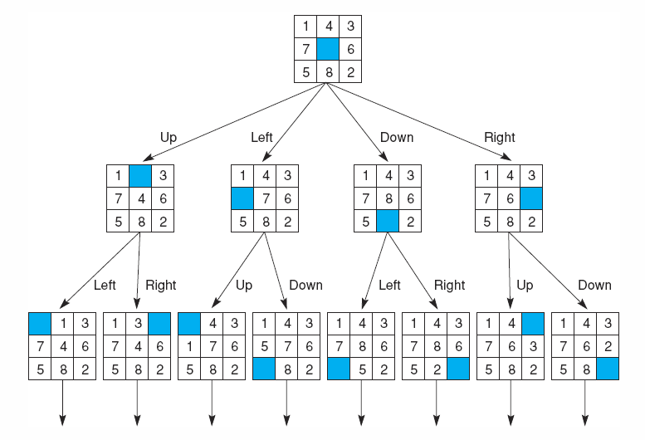
Fig 3.8 State space of the 8-puzzle generated by “move blank” operations
10
Notes:
Insert fig 3.8

Slide 36
Example: Traveling Sales person
A sales person has five cites to visit and ten must return home.
Nodes(N): represent 5 cites.
Arcs(A): labeled with weight indicating the cost of traveling between connected cites.
Start state(S): a home city.
Goal states(GD): an entire path contains a complete circuit with
minimum cost.

Slide 37
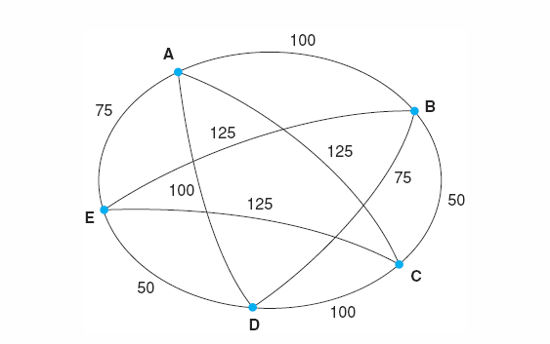
Fig 3.9 An instance of the travelling salesperson problem. Nodes of the graph represent cities. Each arc is labelled with the distance between two cities . The salesperson lives in city A and will return there.
In the traveling salesperson problem, search terminates when the ‘shortest’ path is found through all nodes of the graph.
Luger: Artificial Intelligence, 5th edition. © Pearson Education Limited, 2005
11

Slide 38
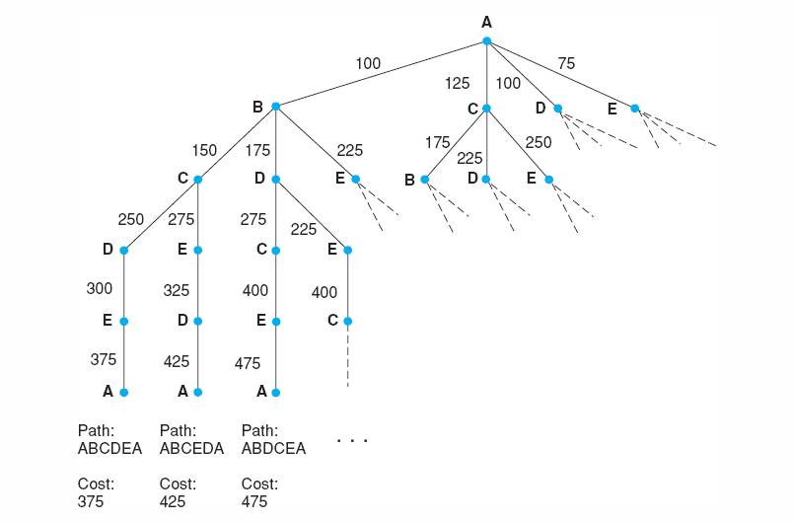
Fig 3.10 Search for the travelling salesperson problem. Each arc is marked with the total weight of all paths from the start node (A) to its endpoint.
Search trees do not suffer from the condition of detect and eliminate loops from the solution path.
Luger: Artificial Intelligence, 5th edition. © Pearson Education Limited, 2005
12

Slide 39
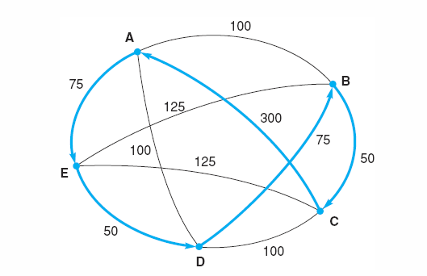
Fig 3.11 An instance of the travelling salesperson problem with the nearest neighbour path in bold. Note this path (A, E, D, B, C, A), at a cost of 550, is not the shortest path. The comparatively high cost of arc (C, A) defeated the heuristic.
Luger: Artificial Intelligence, 5th edition. © Pearson Education Limited, 2005
13
Notes:
Insert fig 3.11

Slide 40
State Space Search Strategies
There are two distinct ways for searching a state space graph:
Data-Driven Search: (Forward chaining)
Start searching from the given data of a problem instance toward a goal.
Goal-Driven Search: (Backward chaining)
Start searching from a goal state to facts or data of the given
problem.

Slide 41
State Space Search Strategies..
Selecting Search Strategy
Data-Driven Search is suggested if:
The data are given in the initial problem statement.
There are few ways to use the given facts.
There are large number of potential goals.
It is difficult to form a goal or hypothesis.
Goal- Driven Search is appropriate if:
A goal is given in the problem statement or can easily formulated.
There are large number of rules to produce a new facts.
Problem data are not given but acquired by the problem solver.

Slide 42
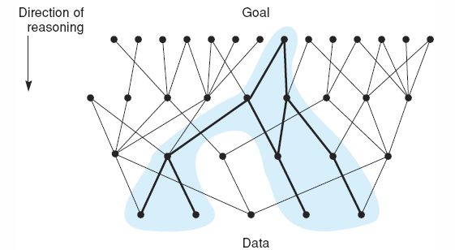
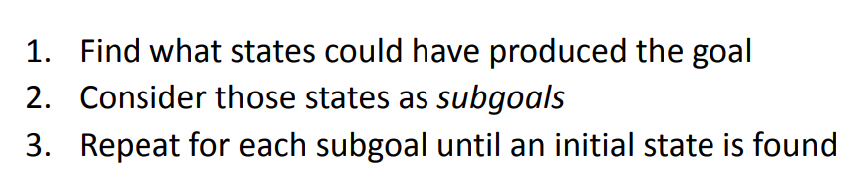
Fig 3.12 State space in which goal-directed search effectively prunes extraneous search paths.
Luger: Artificial Intelligence, 5th edition. © Pearson Education Limited, 2005
14

Slide 43
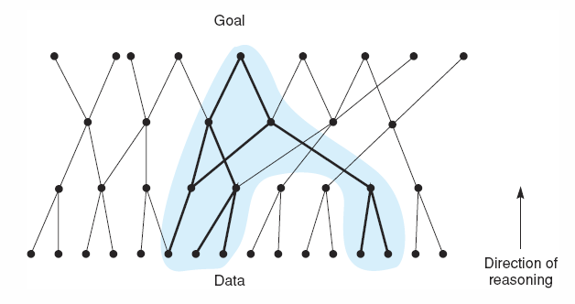
Fig 3.13 State space in which data-directed search prunes irrelevant data and their consequents and determines one of a number of possible goals.
Luger: Artificial Intelligence, 5th edition. © Pearson Education Limited, 2005
15
Notes:
Insert fig 3.13

Slide 44
Summary
Solving problems by Searching
Types of agents.
State Space Search.
Heuristic Search.
Graph Theory.
Strategies for Space State Search.
Using Space State to Represent Reasoning.
Examples.

Slide 45



Thank You

