Slide 1




Mathematics 3 – MAT132
Dr. Israa Lewaa
Lecture 8 – Calculus Applications in real life

Slide 2



Lecture Objective
Lecture
05
Chapter Objectives
1- Show several uses of Calculus in Real Life
2- Explain Different Applications using Differential
3- Explain Different Applications using Integration
4- Obtain Marginal cost
5- Obtain Marginal Revenue
6- Obtain Demand Function
Lecture 8 Dr. Israa Lewaa Mathematics 3

Slide 3
Lecture Outline
Lecture
09
Lecture Outline
1- Uses of Calculus in Real Life
2- Different Applications using Differential
3- Different Applications using Integration
4- Marginal cost
5- Marginal Revenue
6- Demand Function
Lecture 8 Dr. Israa Lewaa Mathematics 3

Slide 4
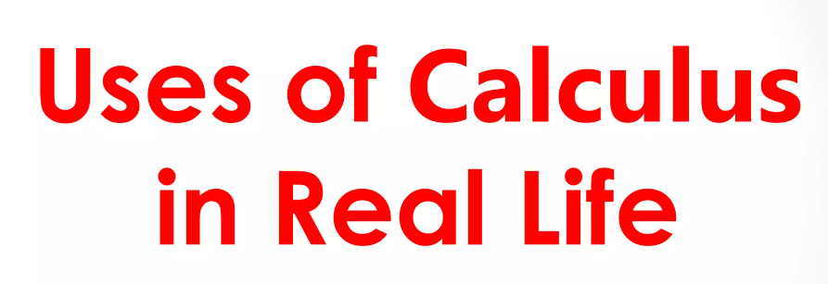
Uses of Calculus in real Life
Lecture
08
1- Integration by parts
Lecture 8 Dr. Israa Lewaa Mathematics 3

Slide 5
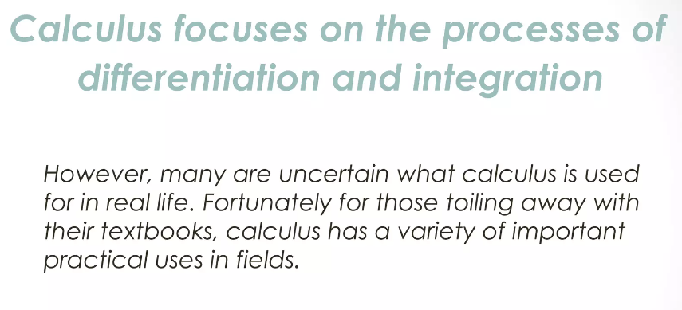
Process of differentiation and Integration
Lecture
08
Example
Lecture 8 Dr. Israa Lewaa Mathematics 3

Slide 6
Various Fields of using Calculus
Lecture
08
Example
Uses of Calculus in Economics
Uses of Calculus in Biology
Uses of Calculus in Engineering
Uses of Calculus in Architect
Uses of Calculus in Finance
Lecture 8 Dr. Israa Lewaa Mathematics 3

Slide 7
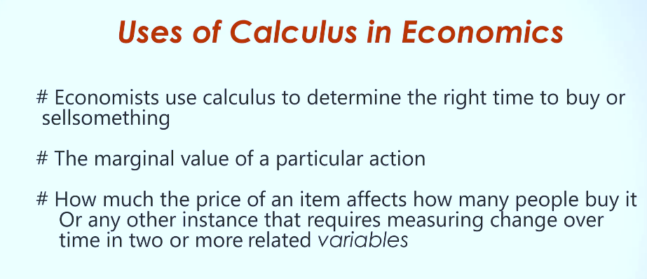
Uses of Calculus in Economics
Lecture
08
** Revision – Fundamentals
Lecture 8 Dr. Israa Lewaa Mathematics 3

Slide 8
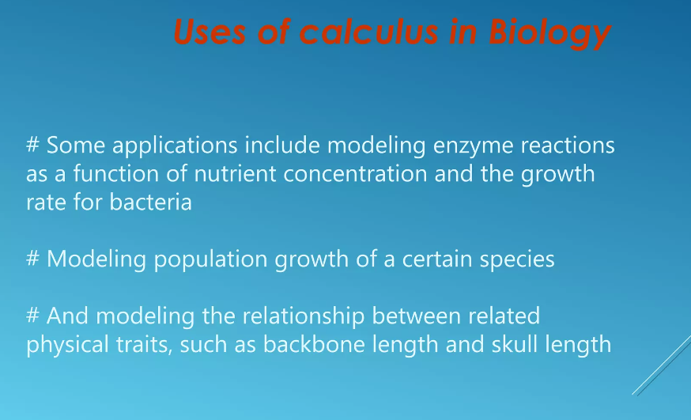
Uses of Calculus in Biology
Lecture
08
Example
Lecture 8 Dr. Israa Lewaa Mathematics 3

Slide 9
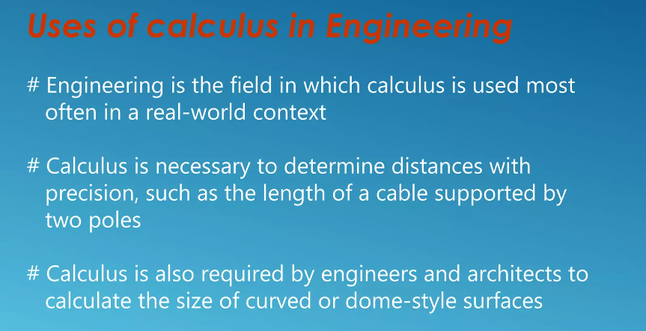
Uses of Calculus in Engineering
Lecture
08
Example
Lecture 8 Dr. Israa Lewaa Mathematics 3

Slide 10
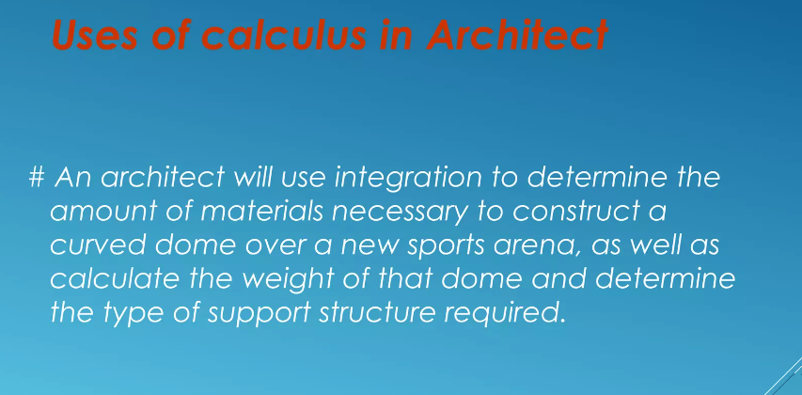
Uses of Calculus in Architect
Lecture
08
Example
Lecture 8 Dr. Israa Lewaa Mathematics 3

Slide 11
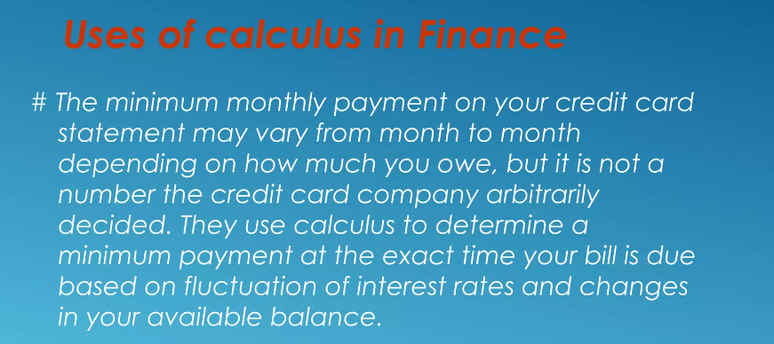
Uses of Calculus in Finance
Lecture
07
** EXTRA PRACTISE
Lecture 8 Dr. Israa Lewaa Mathematics 3

Slide 12
Applications for Calculus
Lecture
08
Example
Applications for Calculus
Lecture 8 Dr. Israa Lewaa Mathematics 3

Slide 13
Applications for Calculus
Lecture
08
Example
Marginal cost
Marginal Revenue
Demand Function
Lecture 8 Dr. Israa Lewaa Mathematics 3

Slide 14
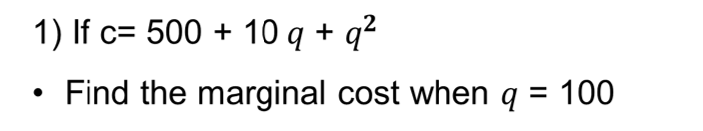
Extra Practice – Example 1
Lecture
08
The Definite Integral
Lecture 8 Dr. Israa Lewaa Mathematics 3

Slide 15
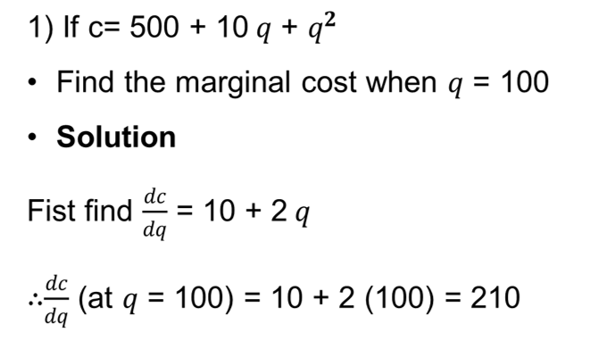
Extra Practice – Example 1 Solution
Lecture
08
Example 1 - Definite Integration
Lecture 8 Dr. Israa Lewaa Mathematics 3

Slide 16
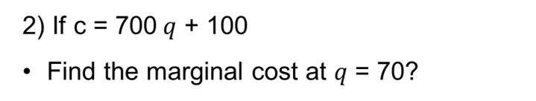
Extra Practice – Example 2
Lecture
08
Example
Lecture 8 Dr. Israa Lewaa Mathematics 3

Slide 17
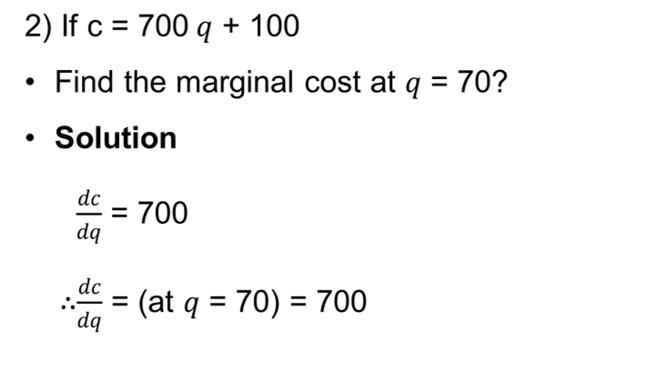
Extra Practice – Example 2 Solution
Lecture
08
Example
Lecture 8 Dr. Israa Lewaa Mathematics 3

Slide 18
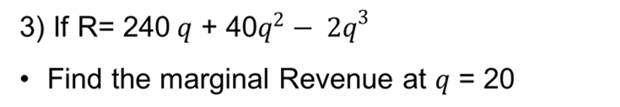
Extra Practice – Example 3
Lecture
08
** EXTRA PRACTISE
Lecture 8 Dr. Israa Lewaa Mathematics 3

Slide 19
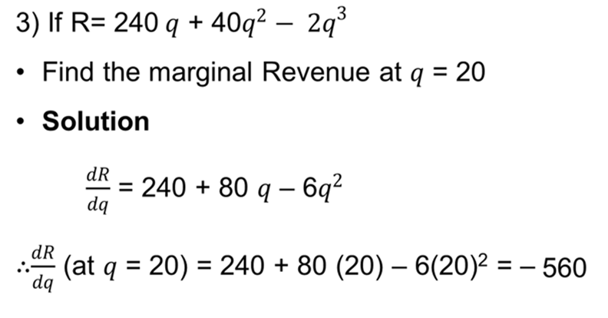
Extra Practice – Example 3 solution
Lecture
08
** EXTRA PRACTISE
Lecture 8 Dr. Israa Lewaa Mathematics 3

Slide 20
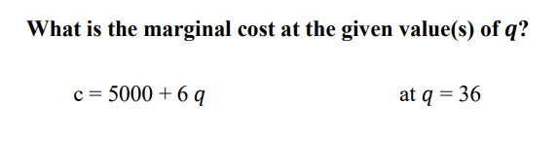
Extra Practice – Example 4
Lecture
08
** EXTRA PRACTISE
Lecture 8 Dr. Israa Lewaa Mathematics 3

Slide 21
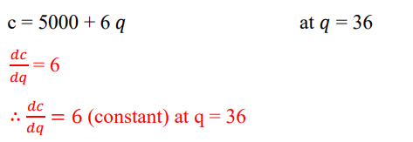
Extra Practice – Example 4 solution
Lecture
08
** EXTRA PRACTISE
Lecture 8 Dr. Israa Lewaa Mathematics 3

Slide 22


Extra Practice – Example 5
Lecture
08
** EXTRA PRACTISE
Lecture 8 Dr. Israa Lewaa Mathematics 3

Slide 23
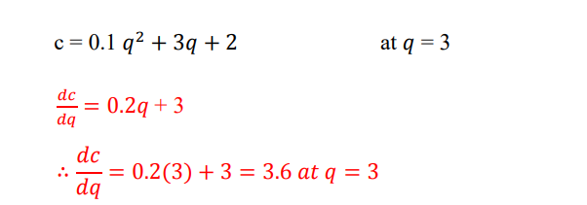
Extra Practice – Example 5 Solution
Lecture
08
** EXTRA PRACTISE
Lecture 8 Dr. Israa Lewaa Mathematics 3

Slide 24

Extra Practice – Example 6
Lecture
08
** EXTRA PRACTISE
Lecture 8 Dr. Israa Lewaa Mathematics 3

Slide 25
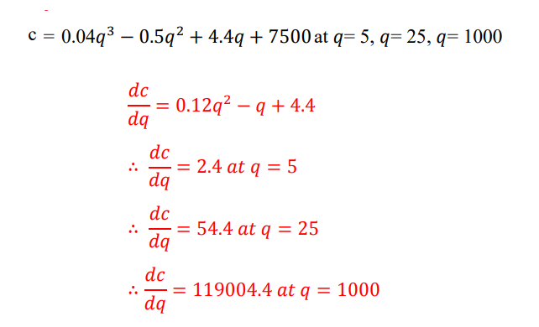
Extra Practice – Example 6 Solution
Lecture
08
** EXTRA PRACTISE
Lecture 8 Dr. Israa Lewaa Mathematics 3

Slide 26
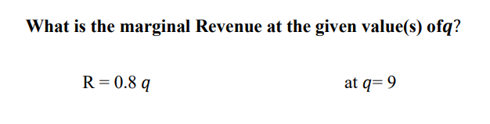
Extra Practice – Example 7
Lecture
07
** EXTRA PRACTISE
Lecture 8 Dr. Israa Lewaa Mathematics 3

Slide 27
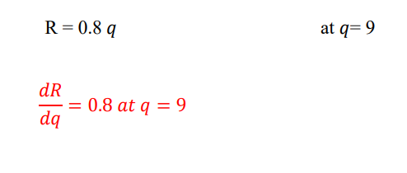
Extra Practice – Example 7 Solution
Lecture
07
** EXTRA PRACTISE
Lecture 8 Dr. Israa Lewaa Mathematics 3

Slide 28


Extra Practice – Example 8
Lecture
07
** EXTRA PRACTISE
Lecture 8 Dr. Israa Lewaa Mathematics 3

Slide 29
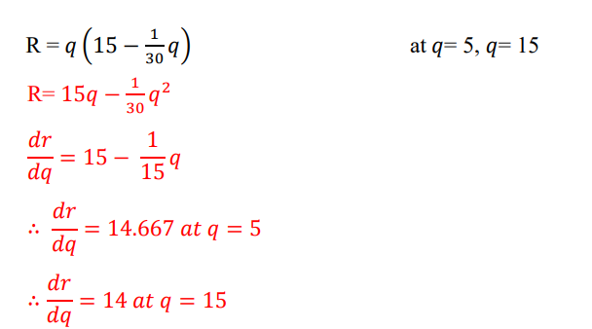
Extra Practice – Example 8 Solution
Lecture
07
** EXTRA PRACTISE
Lecture 8 Dr. Israa Lewaa Mathematics 3

Slide 30
Extra Practice – Example 9
Lecture
07
** EXTRA PRACTISE
Lecture 8 Dr. Israa Lewaa Mathematics 3

Slide 31
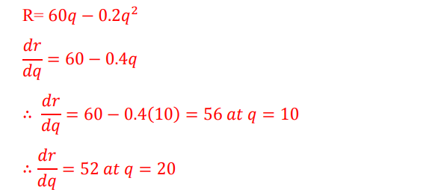
Extra Practice – Example 9 Solution
Lecture
07
** EXTRA PRACTISE
Lecture 8 Dr. Israa Lewaa Mathematics 3

Slide 32
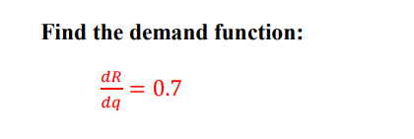
Extra Practice – Example 10
Lecture
07
** EXTRA PRACTISE
Lecture 8 Dr. Israa Lewaa Mathematics 3

Slide 33
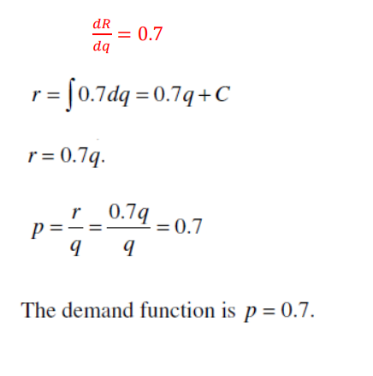
Extra Practice – Example 10 Solution
Lecture
07
** EXTRA PRACTISE
Lecture 8 Dr. Israa Lewaa Mathematics 3

Slide 34


Extra Practice – Example 11
Lecture
07
** EXTRA PRACTISE
Lecture 8 Dr. Israa Lewaa Mathematics 3

Slide 35
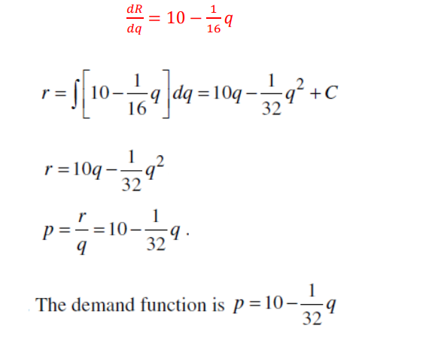
Extra Practice – Example 11 Solution
Lecture
07
** EXTRA PRACTISE
Lecture 8 Dr. Israa Lewaa Mathematics 3

Slide 36

Extra Practice – Example 12
Lecture
07
** EXTRA PRACTISE
Lecture 8 Dr. Israa Lewaa Mathematics 3

Slide 37
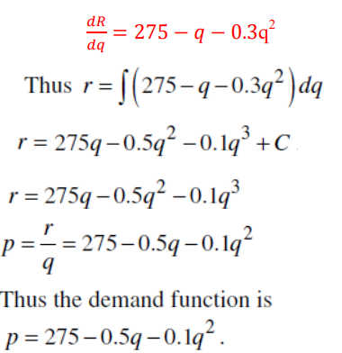
Extra Practice – Example 12 Solution
Lecture
07
** EXTRA PRACTISE
Lecture 8 Dr. Israa Lewaa Mathematics 3

Slide 38

Extra Practice – Example 13
Lecture
07
** EXTRA PRACTISE
Lecture 8 Dr. Israa Lewaa Mathematics 3

Slide 39
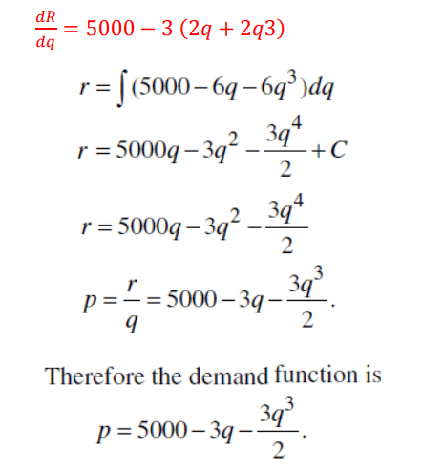
Extra Practice – Example 13 Solution
Lecture
07
** EXTRA PRACTISE
Lecture 8 Dr. Israa Lewaa Mathematics 3

Slide 40
Lecture Summary
Lecture
09
Lecture Summary
1- Uses of Calculus in Real Life
2- Different Applications using Differential
3- Different Applications using Integration
4- Marginal cost
5- Marginal Revenue
6- Demand Function
Lecture 8 Dr. Israa Lewaa Mathematics 3

