Slide 1


Probability and
Statistics
Prepared by Dr. Alfaisal Hasan
STA 201
Probability and Statistics
Lecture NO 2

Slide 2


Probability and
Statistics
Lecture NO 2
STA 201
Probability and Statistics
Prepared by
Dr. Alfaisal Hasan

Slide 3

Chapter
Topics
Chapter 1: Introduction To Statistics الفصل الأول: مقدمة في الإحصاء
Chapter 2: Descriptive Statistics الفصل الثاني: الإحصاء الوصفي
Chapter 3: Probability الفصل الثالث: الاحتمالات
Chapter 4: Discrete Probability Distributions الفصل الرابع: التوزيعات الاحتمالية المنفصلة
Chapter 5: Normal Probability Distributions الفصل الخامس: التوزيع الاحتمالي الطبيعي
Chapter 6: Confidence Intervals الفصل السادس: فترات الثقة
Chapter 7: Hypothesis Testing with One Sample الفصل السابع: اختبار الفرضيات لعينة واحدة
Chapter 8: Hypothesis Testing with Two Samples الفصل الثامن: اختبار الفرضيات لعينتين
Chapter 9: Correlation And Regression الفصل التاسع: الارتباط والانحدار
Chapter 10: Chi-Square Tests and The F-Distribution
الفصل العاشر: اختبارات كاي تربيع وتوزيع

Slide 4
Chapter
Descriptive Statistics
1- Frequency Distributions and Their Graphsالتوزيعات التكرارية وتمثيلها بيانيا
2- More Graphs and Displaysبعض نماذج التمثيل البياني
3- Measures of Central Tendency مقاييس النزعة المركزية
4- Measures of Variation مقاييس التشتت
5- Measures of Position مقاييس الموقع

Slide 5
Chapter
Frequency Distributions and their Graphs
1- Frequency Distributions التوزيعات التكرارية
2- Graphs of Frequency Distributions تمثيل التوزيعات التكرارية بيانيا

Slide 6
Chapter
Frequency Distributions and their Graphs
A frequency distribution is a table that shows classes or intervals of data entries with a count of the number of entries in each class. The frequency f of a class is the number of data entries in the class.
To Draw the frequency table, determine
the three items:
1- number of classes
2- Range
3- Class Width
التوزيع التكراري هو جدول يوضح فئات أو فترات إدخالات البيانات مع حساب عدد الإدخالات في كل فئة. التردد f للفئة هو عدد إدخالات البيانات في الفئة.
لرسم الجدول التكراري حدد العناصر الثلاثة:
1- عدد الفئات
2- المدى
3- عرض الفئة

Slide 7
Example
The following sample data set lists the prices (in dollars) of 30 portable global positioning system (GPS) navigators. Construct a frequency distribution that has seven classes.
Construct a Frequency Distribution from a Data Set
تسرد مجموعة البيانات النموذجية التالية الأسعار (بالدولار) لـ 30 ملاحًا محمولًا يعمل بنظام تحديد المواقع العالمي )GPS). أنشئ توزيعًا تكراريًا يحتوي على سبع فئات.
بناء التوزيع التكراري من مجموعة البيانات
Chapter
90 | 130 | 200 | 400 | 350 | 70 | 325 | 250 | 150 | 250
275 | 270 | 150 | 130 | 59 | 200 | 160 | 450 | 300 | 130
220 | 100 | 200 | 400 | 200 | 250 | 95 | 180 | 170 | 150

Slide 8
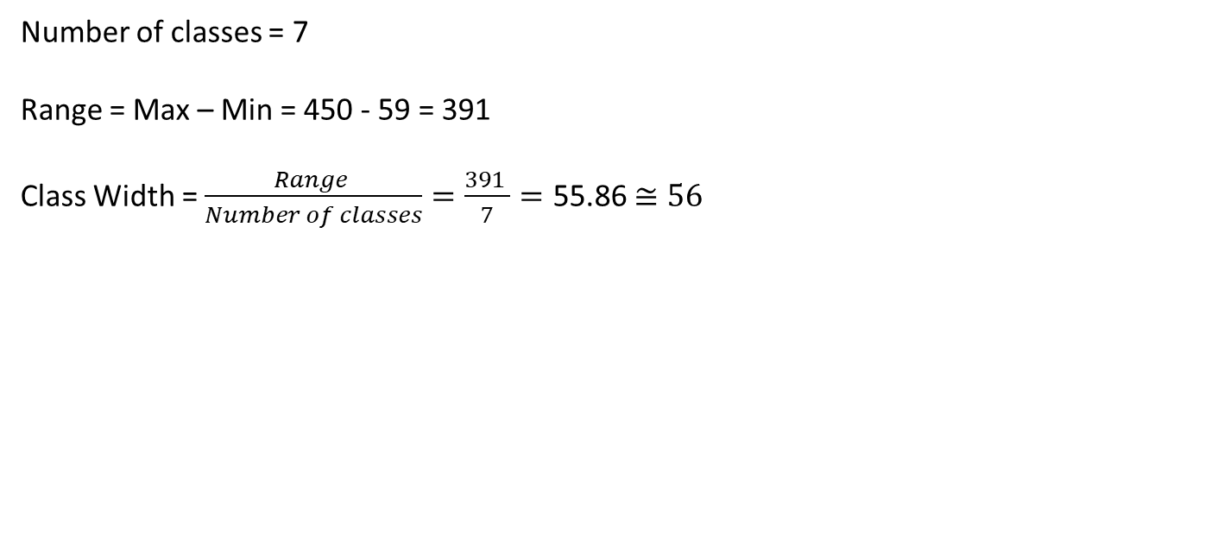
Chapter
Solution of Example
Number of classes = 7
Range = Max – Min = 450 - 59 = 391
Class Width = $\frac{Range }{Number of classes}=\frac{391 }{7}=\text{55.86}$ $≅56$
90 | 130 | 200 | 400 | 350 | 70 | 325 | 250 | 150 | 250
275 | 270 | 150 | 130 | 59 | 200 | 160 | 450 | 300 | 130
220 | 100 | 200 | 400 | 200 | 250 | 95 | 180 | 170 | 150
59
450

Slide 9
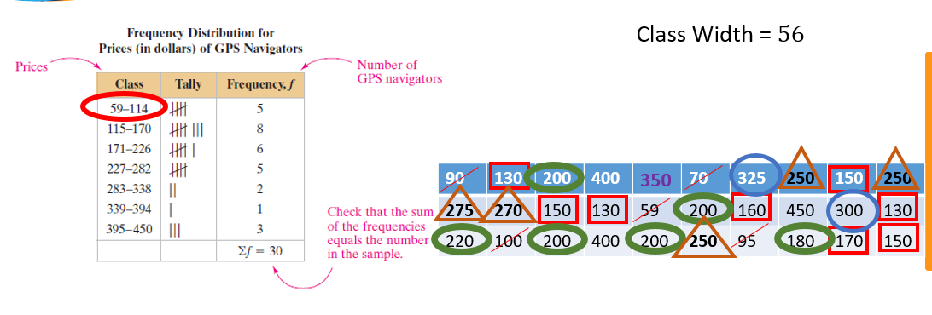
Chapter
Frequency Distributions and their Graphs

Slide 10
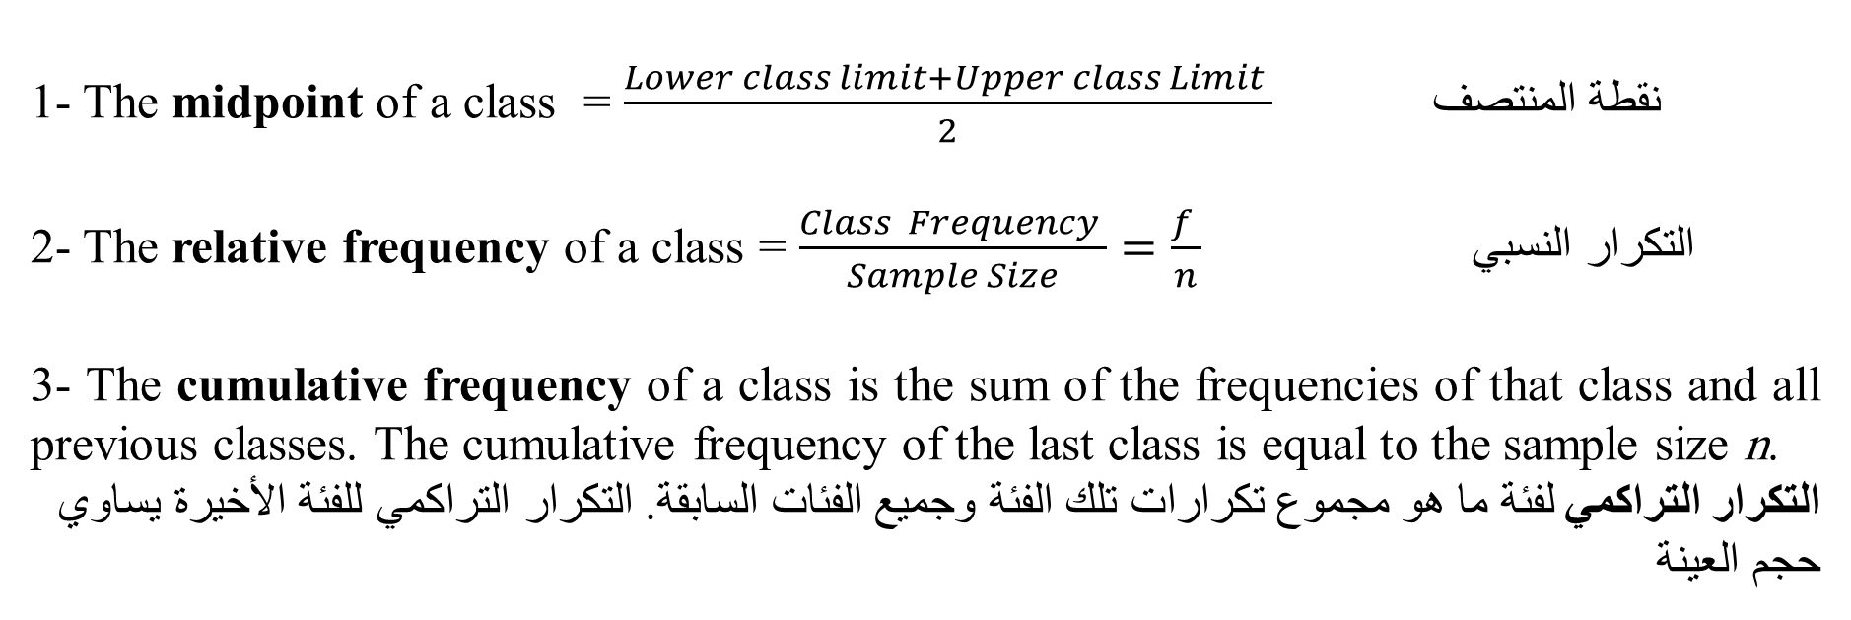
Chapter
Cumulative Frequency Distributions
1- The midpoint of a class = $\frac{Lower class limit+Upper class Limit }{2}$نقطة المنتصف
2- The relative frequency of a class = $\frac{Class Frequency }{Sample Size}=\frac{f }{n}$التكرار النسبي
3- The cumulative frequency of a class is the sum of the frequencies of that class and all previous classes. The cumulative frequency of the last class is equal to the sample size n.
التكرار التراكمي لفئة ما هو مجموع تكرارات تلك الفئة وجميع الفئات السابقة. التكرار التراكمي للفئة الأخيرة يساوي حجم العينة

Slide 11
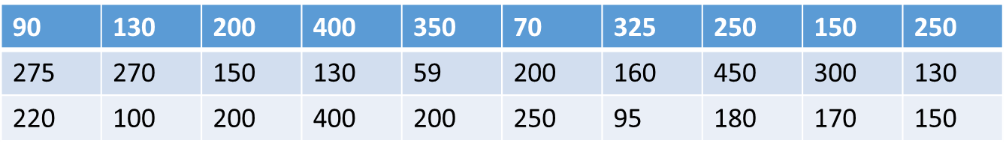
Example
Chapter
The following sample data set lists the prices (in dollars) of 30 portable global positioning system (GPS) navigators. Construct a frequency distribution that has seven classes.
Find the mid point, Relative frequency and a Cumulative Frequency Distribution from a Data Set below
تسرد مجموعة البيانات النموذجية التالية الأسعار (بالدولار) لـ 30 ملاحًا محمولًا يعمل بنظام تحديد المواقع العالمي )GPS). أنشئ توزيعًا تكراريًا يحتوي على سبع فئات.
ابحث عن نقطة المنتصف والتكرار النسبي والتوزيع التكراري التراكمي من مجموعة البيانات أدناه

Slide 12
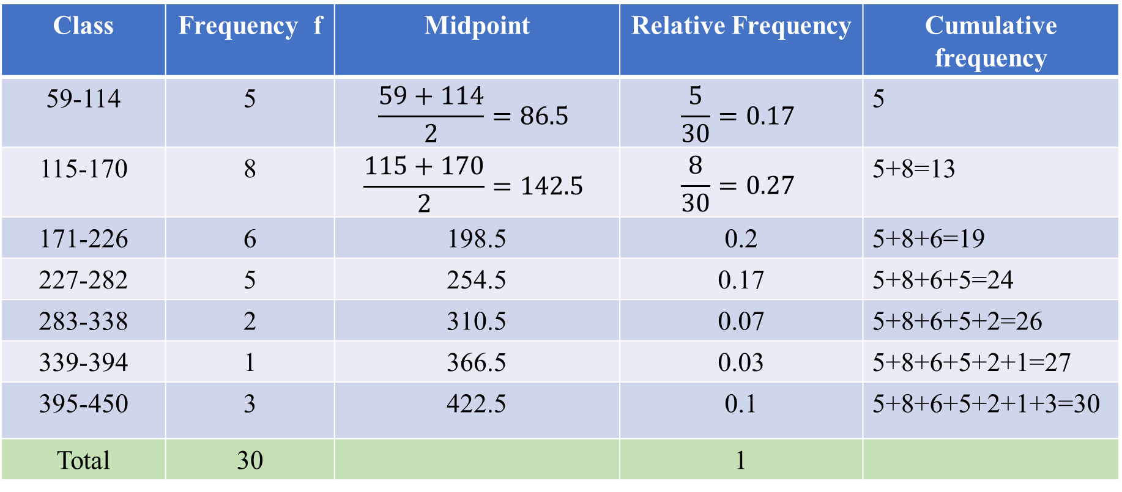
Solution of Example
Chapter
Class | Frequency f | Midpoint | Relative Frequency | Cumulative frequency
59-114 | 5 | $$\frac{59+114}{2}=86.5$$ | $$\frac{5}{30}=0.17$$ | 5
115-170 | 8 | $$\frac{115+170}{2}=142.5$$ | $$\frac{8}{30}=0.27$$ | 5+8=13
171-226 | 6 | 198.5 | 0.2 | 5+8+6=19
227-282 | 5 | 254.5 | 0.17 | 5+8+6+5=24
283-338 | 2 | 310.5 | 0.07 | 5+8+6+5+2=26
339-394 | 1 | 366.5 | 0.03 | 5+8+6+5+2+1=27
395-450 | 3 | 422.5 | 0.1 | 5+8+6+5+2+1+3=30
Total | 30 |  | 1

Slide 13
Graphs of Frequency Distributions
1- Frequency Histogram الأعمدة التكرارية
2- Frequency Polygon المضلع التكراري
3- Relative Frequency Histogram الأعمدة التكرارية النسبية

Slide 14
Chapter
Frequency Histogram
Frequency histogram is a bar graph that represents the frequency distribution of a data set. A histogram has the following properties.
1. The horizontal scale is quantitative and measures the data values.
2. The vertical scale measures the frequencies of the classes.
3. Consecutive bars must touch.
الأعمدة التكرارية هو رسم بياني شريطي يمثل التوزيع التكراري لمجموعة البيانات. يحتوي الرسم البياني على الخصائص التالية.
1. المقياس الأفقي كمي ويقيس قيم البيانات.
2. يقيس المقياس العمودي ترددات الفئات.
3. يجب أن تتلامس الأشرطة المتتالية.

Slide 15
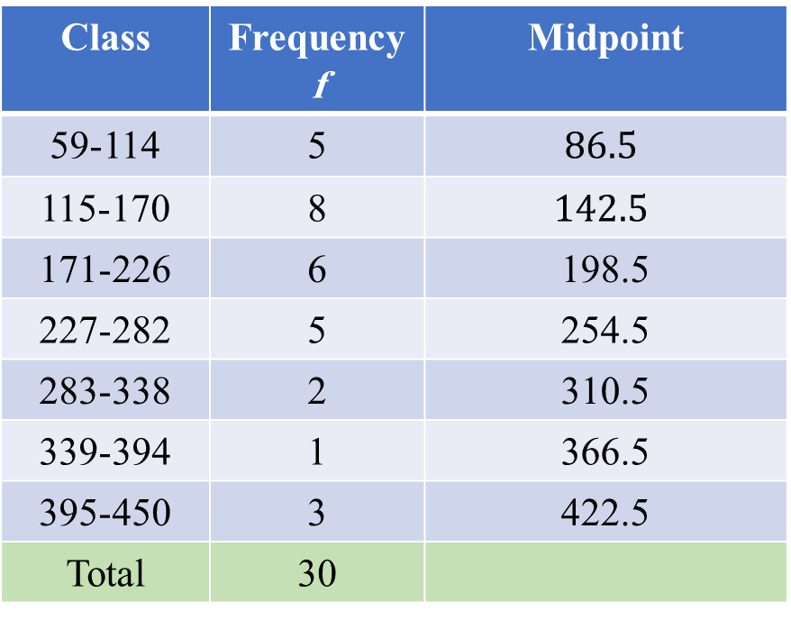
Chapter
Example
Draw the frequency Histogram based on the data in the below table:
Class | Frequency f | Midpoint
59-114 | 5 | $$86.5$$
115-170 | 8 | $$142.5$$
171-226 | 6 | 198.5
227-282 | 5 | 254.5
283-338 | 2 | 310.5
339-394 | 1 | 366.5
395-450 | 3 | 422.5
Total | 30

Slide 16
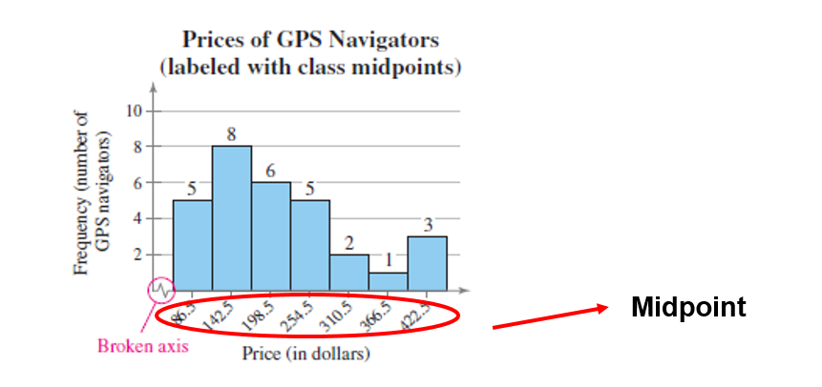
Chapter
Frequency Histogram

Slide 17
Chapter
Frequency Polygon
A frequency polygon is a line graph that emphasizes the continuous change in frequencies.
المضلع التكراري هو رسم بياني خطي يؤكد على التغيير المستمر في التكرارات.

Slide 18
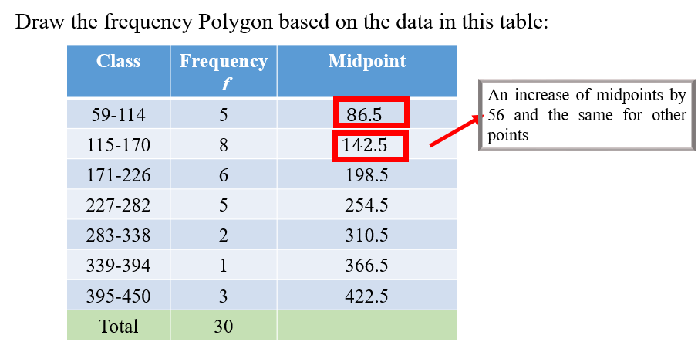
Chapter
Example

Slide 19
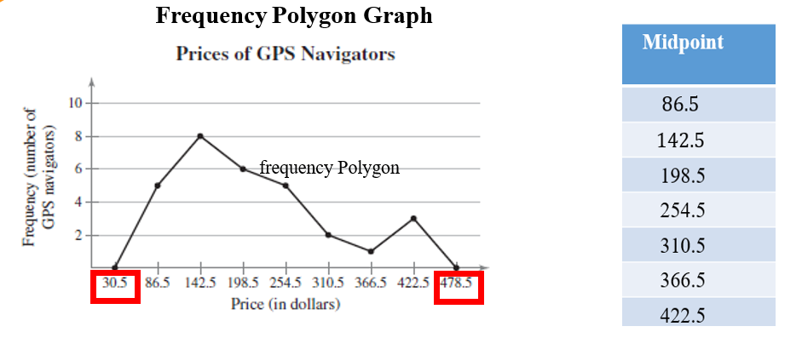
Chapter
Solution of Example

Slide 20
Chapter
Relative Frequency Histogram
A relative frequency histogram has the same shape and the same horizontal scale as the corresponding frequency histogram. The difference is that the vertical scale measures the relative frequencies, not frequencies.
الأعمدة البيانية التكرارية النسبية له نفس الشكل ونفس المقياس الأفقي مثل الرسم البياني للتردد المقابل. والفرق هو أن المقياس الرأسي يقيس التكرارات النسبية وليس التكرارات.

Slide 21
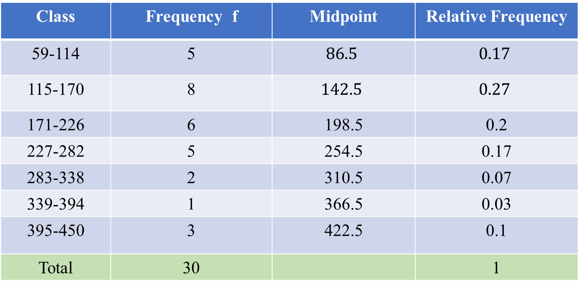
Example
Chapter
Draw the relative frequency Histogram based on the data in this table:
Class | Frequency f | Midpoint | Relative Frequency
59-114 | 5 | $$86.5$$ | $$0.17$$
115-170 | 8 | $$142.5$$ | $$0.27$$
171-226 | 6 | 198.5 | 0.2
227-282 | 5 | 254.5 | 0.17
283-338 | 2 | 310.5 | 0.07
339-394 | 1 | 366.5 | 0.03
395-450 | 3 | 422.5 | 0.1
Total | 30 |  | 1

Slide 22
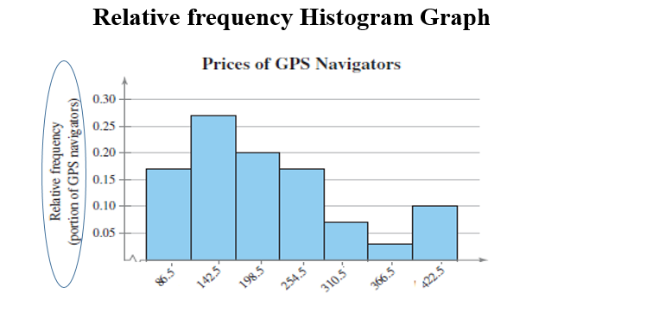
Chapter
Solution of Example

Slide 23
Chapter
Frequency Distributions and their Graphs
1- Frequency Distributions and Their Graphsالتوزيعات التكرارية وتمثيلها بيانيا
2- More Graphs and Displaysبعض نماذج التمثيل البياني
3- Measures of Central Tendency مقاييس النزعة المركزية
4- Measures of Variation مقاييس التشتت
5- Measures of Position مقاييس الموقع

Slide 24
Chapter
Measures of Central Tendency
We have three measures of Central Tendency: مقاييس النزعة المركزية
1- Mean المتوسط الحسابي
2- Median الوسيط
3- Mode المنوال

Slide 25
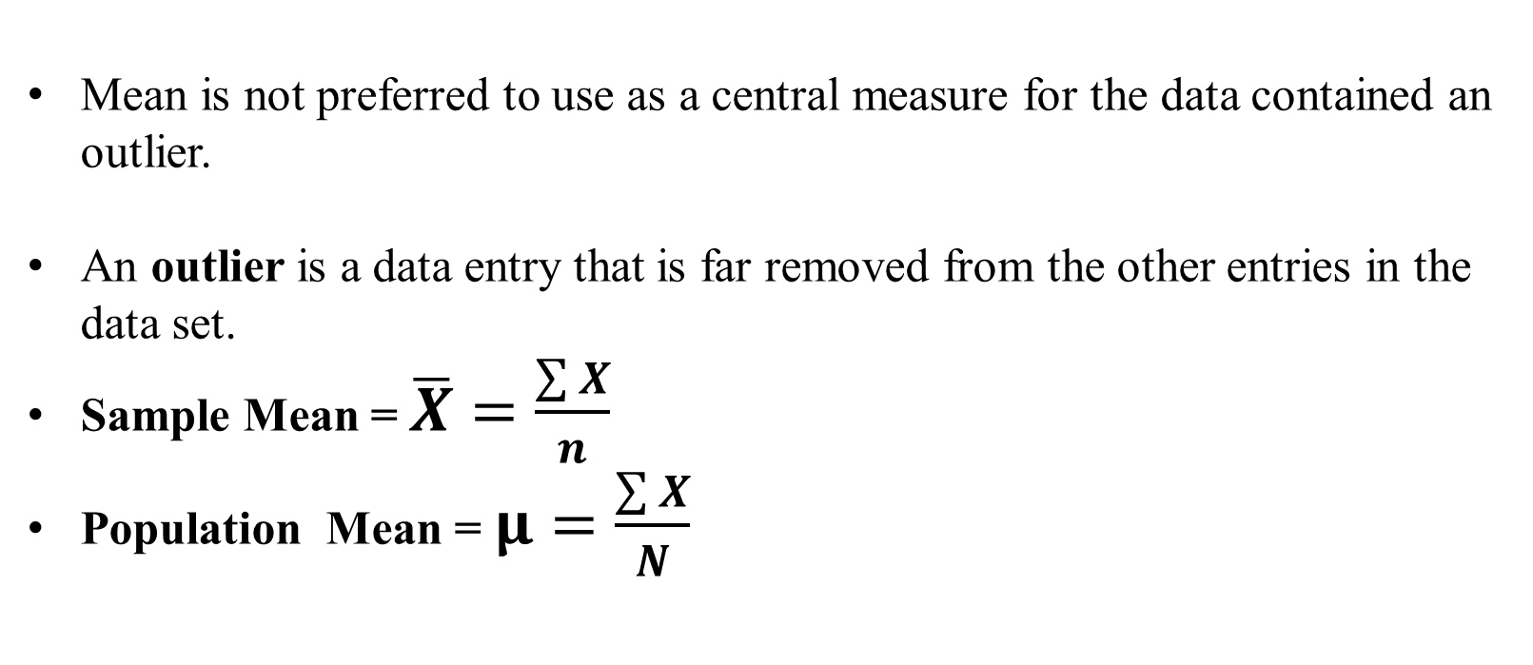
Chapter
Important Notes
Mean is not preferred to use as a central measure for the data contained an outlier.
An outlier is a data entry that is far removed from the other entries in the data set.
Sample Mean = $\overline{X}=\frac{\sum{X}}{n}$
Population Mean = $μ=\frac{\sum{X}}{N}$

Slide 26
Chapter
Example
Given the following Macroeconomics exam grades for a sample of 6 students:
81 75 66 16 90 90
Calculate the central tendency measures and state the best central measure for this data.

Slide 27
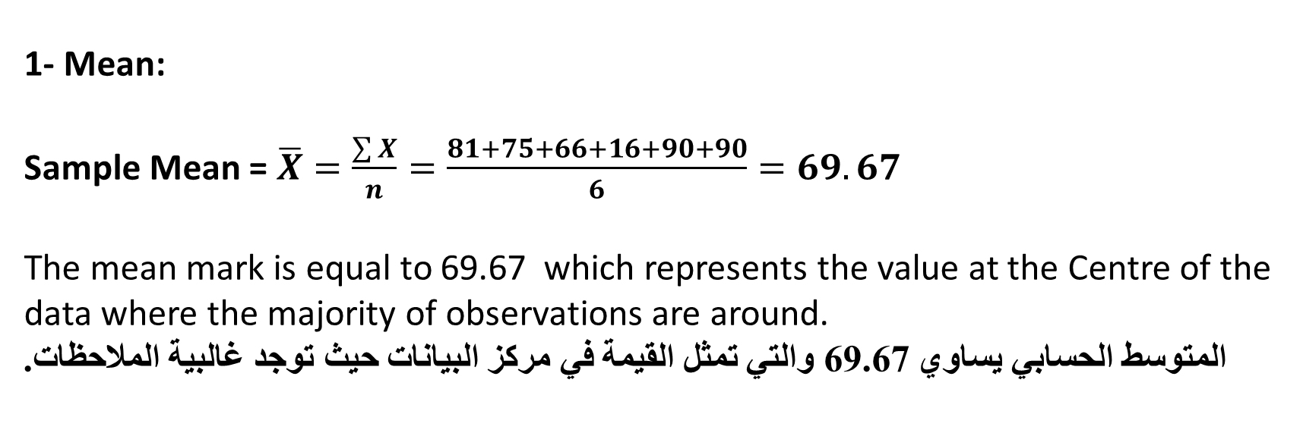
Chapter
Solution of Example
1- Mean:
Sample Mean = $\overline{X}=\frac{\sum{X}}{n}=\frac{81+75+66+16+90+90}{6}=69.67$
The mean mark is equal to 69.67 which represents the value at the Centre of the data where the majority of observations are around.
المتوسط الحسابي يساوي 69.67 والتي تمثل القيمة في مركز البيانات حيث توجد غالبية الملاحظات.

Slide 28
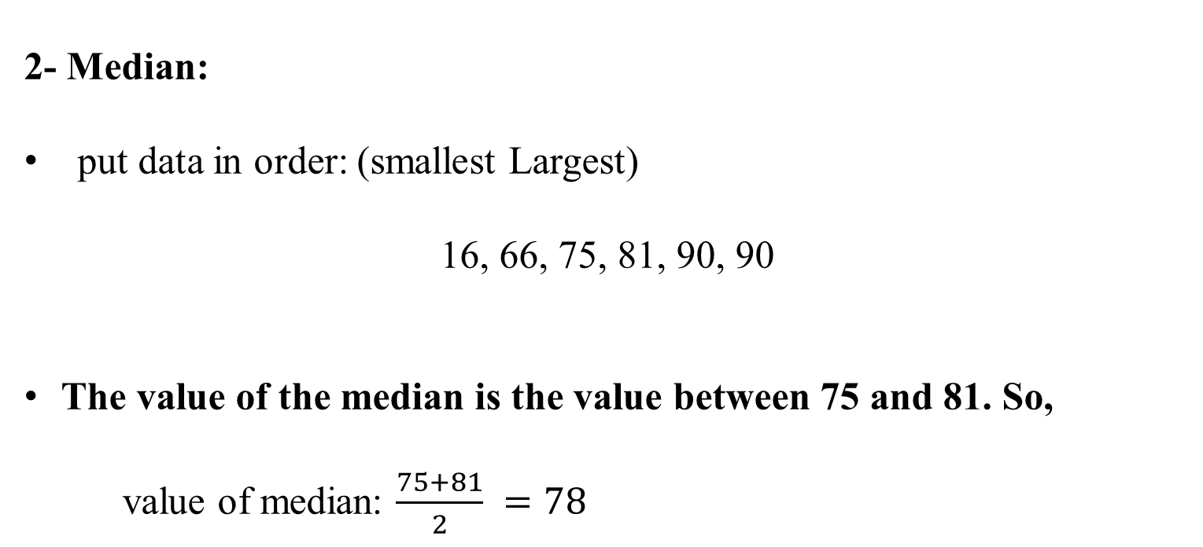
Chapter
Solution of Example
2- Median:
put data in order: (smallest Largest)
16, 66, 75, 81, 90, 90
The value of the median is the value between 75 and 81. So,
value of median: $\frac{75+81}{2} =78$

Slide 29
Chapter
Solution of Example
3- Mode:
The most repeated number in the data. So,
Mode = 90

Slide 30
Chapter
Example
Given the following Macroeconomics exam grades for a sample of 7 students:
5 6 9 10 14 11 12
Calculate the central tendency measures and state the best central measure for this data.

Slide 31
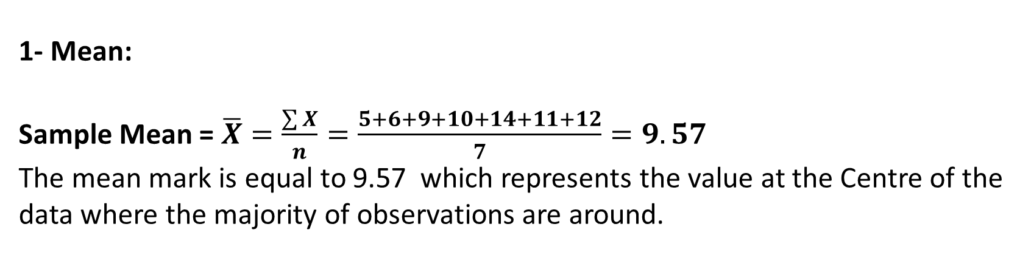
Chapter
Solution of Example
1- Mean:
Sample Mean = $\overline{X}=\frac{\sum{X}}{n}=\frac{5+6+9+10+14+11+12}{7}=9.57$
The mean mark is equal to 9.57 which represents the value at the Centre of the data where the majority of observations are around.

Slide 32
Chapter
Solution of Example
2- Median:
put data in order: (smallest Largest)
5, 6, 9, 10, 11, 12, 14
The value of the median is the value 10

Slide 33
Chapter
Solution of Example
3- Mode: 5 6 9 10 14 11 12
The most repeated number in the data. So,
The data has No mode عديمة المنوال

Slide 34
Chapter
Example
Find Mean – Median – Mode for the following data
أوجد المتوسط الحسابي – الوسيط – المنوال للبيانات التالية
18 | 29 | 43 | 24 | 31 | 9 | 12 | 19 | 16 | 14

Slide 35
Chapter
Solution of Example
Mean المتوسط الحسابي

Slide 36
Chapter
Solution of Example
Median الوسيط

Slide 37
Chapter
Solution of Example
Mode المنوال
The data has No mode عديمة المنوال

Slide 38
Chapter
Example
Find Mean – Median – Mode for the following data
أوجد المتوسط الحسابي – الوسيط – المنوال للبيانات التالية
14 | 16 | 9 | 8 | 12 | 15 | 20 | 9 | 10 | 24 | 22 | 10 | 10

Slide 39
Chapter
Solution of Example
Mean المتوسط الحسابي
14 | 16 | 9 | 8 | 12 | 15 | 20 | 9 | 10 | 24 | 22 | 10 | 10

Slide 40
Chapter
Solution of Example
Median الوسيط
14 | 16 | 9 | 8 | 12 | 15 | 20 | 9 | 10 | 24 | 22 | 10 | 10
8 | 9 | 9 | 10 | 10 | 10 | 12 | 14 | 15 | 16 | 20 | 22 | 24

Slide 41
Chapter
Solution of Example
Mode المنوال
8 | 9 | 9 | 10 | 10 | 10 | 12 | 14 | 15 | 16 | 20 | 22 | 24

Slide 42
Chapter
Example
In the following three groups, it is required to calculate the mean, median, and mode:
Group 1: 2 – 4 – 4 – 6
Group 2: -2 – 4 – 4 - 10
Group 3: -70 – 4 – 4 - 78

Slide 43
Chapter
Solution of Example
Mode | Median | Mean | Group
4 | 4 | 4 | 1
4 | 4 | 4 | 2
4 | 4 | 4 | 3

Slide 44
Chapter
Measures of Variation
We have three measures of Variations:
1- Range المدى
2- Varianceالتباين
3- Standard deviation الانحراف المعياري

Slide 45
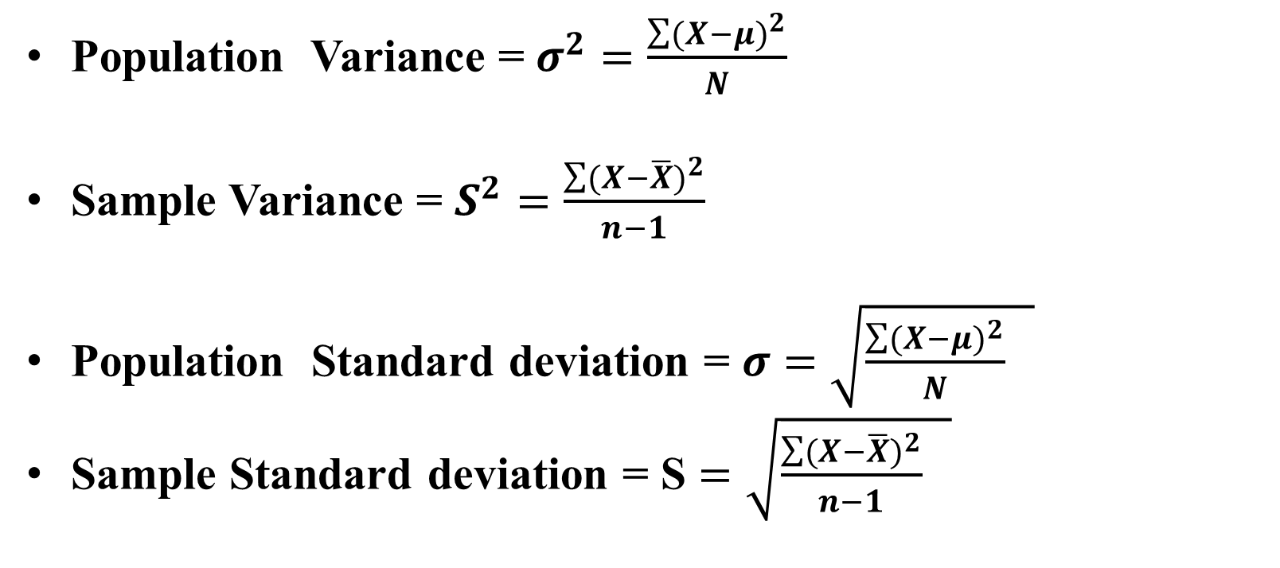
Important Notes
Chapter
Population Variance = $σ^{2}=\frac{\sum{{(X−μ)}^{2}}}{N}$
Sample Variance = $S^{2}=\frac{\sum{{(X−\overline{X})}^{2}}}{n−1}$
Population Standard deviation = $σ$ $=\sqrt{\frac{\sum{{(X−μ)}^{2}}}{N} }$
Sample Standard deviation = S $=\sqrt{\frac{\sum{{(X−\overline{X})}^{2}}}{n−1} }$

Slide 46
Chapter
Example
Given the following Mathematics exam grades for a sample of 5 students.
8 12 20 7 3
Calculate the dispersion measures for the above data

Slide 47
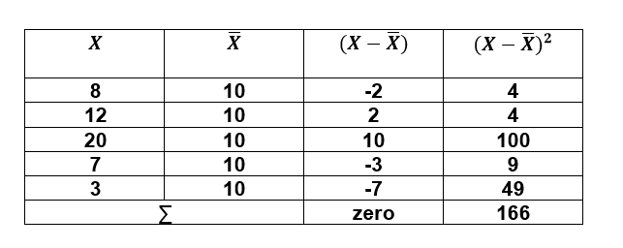
Chapter
Solution of Example
1- Range = Max – Min = 20- 3 = 17
2- Sample Variance = $S^{2}=\frac{\sum{{(X−\overline{X})}^{2}}}{n−1}$

Slide 48
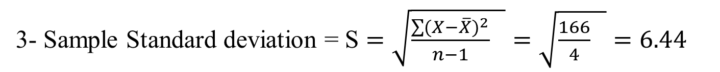
Solution of Example
1- Range = Max – Min = 20- 3 = 17
Chapter
2- Sample Variance = $S^{2}=\frac{\sum{{(X−\overline{X})}^{2}}}{n−1}$
3- Sample Standard deviation = S $=\sqrt{\frac{\sum{{(X−\overline{X})}^{2}}}{n−1} }=\sqrt{\frac{166}{4} }=6.44$

Slide 49
Chapter
Example
Given the following Macroeconomics exam grades for a sample of 5 students.
81 75 66 84 96
Calculate the dispersion measures for the above data

Slide 50
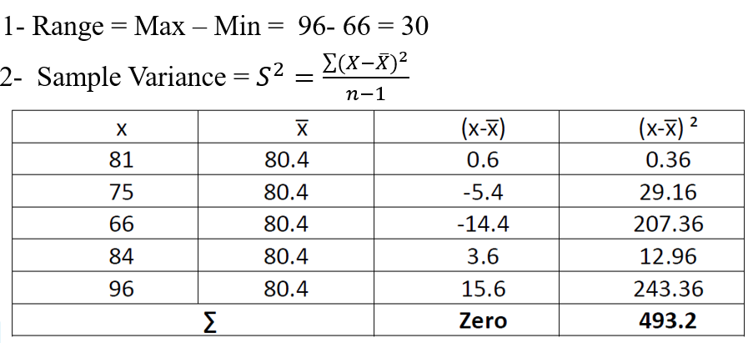
Solution of Example

Slide 51
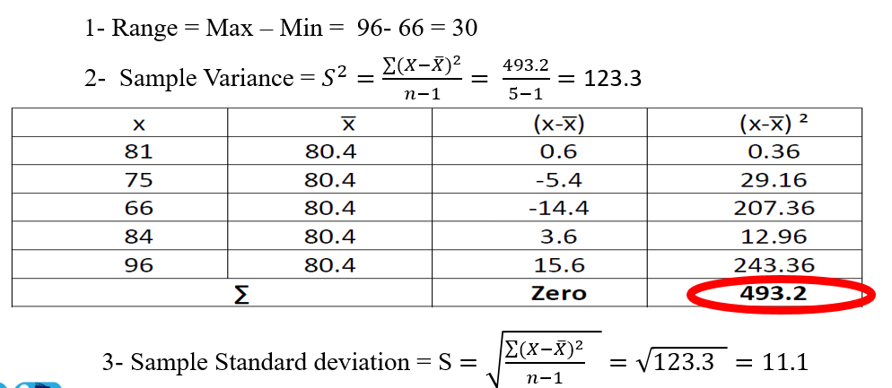
Chapter
Solution of Example

Slide 52
Chapter
Example
Find Mean – Median – Mode and Range for the following data
أوجد المتوسط الحسابي – الوسيط – المنوال والمدى للبيانات التالية
14 | 16 | 9 | 8 | 12 | 15 | 20 | 9 | 10 | 24 | 22 | 10 | 10 | 9 | 13

Slide 53
Chapter
Solution of Example
Mean المتوسط الحسابي
14 | 16 | 9 | 8 | 12 | 15 | 20 | 9 | 10 | 24 | 22 | 10 | 10 | 9 | 13

Slide 54
Chapter
Solution of Example
Median الوسيط
14 | 16 | 9 | 8 | 12 | 15 | 20 | 9 | 10 | 24 | 22 | 10 | 10 | 9 | 13
8 | 9 | 9 | 9 | 10 | 10 | 10 | 12 | 13 | 14 | 15 | 16 | 20 | 22 | 24

Slide 55
Chapter
Solution of Example
Mode المنوال
8 | 9 | 9 | 9 | 10 | 10 | 10 | 12 | 13 | 14 | 15 | 16 | 20 | 22 | 24

Slide 56
Chapter
Solution of Example
Range المدى
8 | 9 | 9 | 9 | 10 | 10 | 10 | 12 | 13 | 14 | 15 | 16 | 20 | 22 | 24

Slide 57
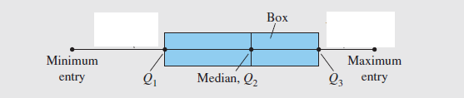
Measures of Position
Chapter
Q1 is the first Quartileالربع الأول
Q2 is the Second Quartile ( Median )الربع الثاني (الوسيط)
Q3 is the third Quartileالربع الثالث
Interquartile range IQR = Q3 - Q1المدى الربيعي
Box Plot

Slide 58
Chapter
Example
The number of nuclear power plants in the top 15 nuclear power-producing
countries in the world are listed.
Find the first, second, and third quartiles of the data set.
Calculate IQR
Draw the Box plot

Slide 59
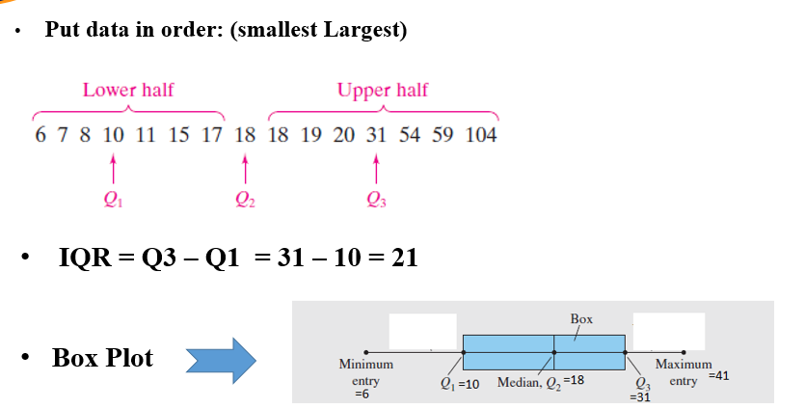
Chapter
Solution of Example

Slide 60
Chapter
Example
For the following data.
Find the first, second, and third quartiles of the data set.
Calculate IQR
14 | 16 | 9 | 8 | 12 | 15 | 20 | 9 | 10 | 24 | 22 | 10 | 10 | 9 | 13

Slide 61
Chapter
Solution of Example
8 | 9 | 9 | 9 | 10 | 10 | 10 | 12 | 13 | 14 | 15 | 16 | 20 | 22 | 24
IQR =Q3-Q1= 16-9=7

Slide 62
Chapter Summary
Chapter
Measures of Central Tendency:
1- Mean
2- Median
3- Mode
Measures of Position:
1- First Quartile
2- Second Quartile
3- Third Quartile
4- IQR
5- Box Plot
Frequency Distributions
Graphs and Displays:
1- Frequency Histogram
2- Frequency Polygon
3- Relative Frequency Histogram
Measures of Variation:
1- Range
2- Variance
3- Standard deviation

Slide 63
Un Solved Examples
Chapter
Given the following data
11 25 30 24 22 10 12
Find Mean – Median – Mode - Range

Slide 64
Un Solved Examples
Chapter
The value of Q1 for the values [12,10,33,49,18,90,100]

Slide 65
Un Solved Examples
Chapter
The value of Q3 for the values [12,10,33,49,18,90,100]

Slide 66
Un Solved Examples
Chapter
The value of Q2 for the values [12,10,33,49,18,90,100]

Slide 67
Un Solved Examples
Chapter
The value of IQR for the values [12,10,33,49,18,90,100]

Slide 68


Thank You

