Slide 1


Principles of Accounting
Lecture 2
Prepared by:
Dr. Rasha B. AL Jerd
Subject code: MGM 227

Slide 2

7
Describe the accounting equation, and define assets, liabilities, and equity

Slide 3
THE BASIC ACCOUNTING EQUATION
Assets
Liabilities
Equity
=
+
resources
owned by
a business
Creditor’s claims
on assets
Owners’
claim
on assets
Economic
Resources
Claims to Economic
Resources

Slide 4
The Accounting Equation
Assets
Liabilities
Equity
$3,000
$2,000
$1,000
Assets
Liabilities
Equity
Use of fund
Source of fund

Slide 5
Assets
Economic resources
Benefit the business in the future
Recorded at cost which is measurable
Examples:
  Cash
  Machine
  Property, land
  Furniture
  Merchandise inventory
  Accounts receivable

Slide 6
Claims to Assets
Liabilities
Equity
Debts payable mainly to outsiders
Examples:
  Bank loans
  Mortgages
  Accounts payable
  wages payable
  tax payable
Owner’s claims to the assets of the business
Residual claim
Net worth or net asset

Slide 7


The Accounting Equation for proprietorships & partnerships
Assets
=
Liabilities
+
Equity
The owner’s capital refers to the owner contribution
profit
Owner’s Capital
+Revenue
-Expense
-Owner’s Withdrawals

Slide 8
Revenues
Amounts earned in business operation by delivering goods, services to customers, rental of property, lending of money or investment.
  Sales revenue
  Service revenue
  Interest revenue
  Dividend revenue

Slide 9
Expenses
Outflows of assets or increasing liabilities in operating business (delivering goods or services to customers)
Occurred in the process of earning revenue
  Store or rent expense
  Salary expense
  Advertising expense
  Utilities expense
  Interest expense
  Property tax expense

Slide 10
Owner’s Withdrawals
Also called drawings
Payments of equity to the owner(usually in the form of cash)
Is Owner’s Withdrawals an example of expense?

Slide 11
Equity (for a corporation)
For a corporation, equity is called Stockholders’ equity:
Stockholders’ equity= Paid-in capital + Retained earnings
Paid in Capital represents the total amount invested by stockholders in a corporation.
Retained earnings represents cumulative profits (or losses) retained in the business over time.
=beginning retained earning +revenue-expense-dividend
Dividend is like owner’s withdrawals for proprietorship.

Slide 12
E1-16: CHARACTERISTICS OF A CORPORATION, ACCOUNTING CONCEPTS, AND USING THE ACCOUNTING EQUATION
Select financial information for three corporations follows:
Requirements:
1.Compute the missing amount in the accounting equation for each entity.
2.If revenue increases, how does it affect owner’s equity?
3.If expense increases, how does it affect owner’s equity?
4.If drawing increases, how does it affect owner’s equity?decrease
 | Assets | Liabilities | Equity
New Rock Gas |  | $24,000 | $50,000
DJ Video Rentals | $75,000 |  | $32,000
Corner Grocery | $100,000 | $53,000
$ ?
$ ?
$ ?

Slide 13
E1-16: CHARACTERISTICS OF A CORPORATION, ACCOUNTING CONCEPTS, AND USING THE ACCOUNTING EQUATION
Select financial information for three corporations follows:
Requirements:
1.Compute the missing amount in the accounting equation for each entity.
2.If revenue increases, how does it affect owner’s equity?
3.If expense increases, how does it affect owner’s equity?
4.If drawing increases, how does it affect owner’s equity?decrease
 | Assets | Liabilities | Equity
New Rock Gas |  | $24,000 | $50,000
DJ Video Rentals | $75,000 |  | $32,000
Corner Grocery | $100,000 | $53,000
$74,000
$43,000
$47,000

Slide 14
TRY IT!

Slide 15
8
Use the accounting equation to analyze transactions

Slide 16
Transaction
What is a business transaction?
An event that affects the financial position of the business and must be recorded by accountants
Can be measured reliably
In recording transactions:
The accounting equation balances before and after each transaction
Every transaction impacts at least two items
Remember: the two sides of
the accounting equation
must always be equal
Dual effect

Slide 17
TRANSACTION 1
November 2, 2014, Sheena Bright decide to start e-learning agency company as a proprietorship named Smart Touch Learning, Inc.
She invests $30,000 cash in exchange for $30,000 of capital.
Assets
=
Liabilities
+
Owner’s Equity
Cash
Bright, capital
(1) +30,000 = +30,000
1 accounts? types?
2 change?
3 balanced?
There is an increase in the asset Cash, $30,000, and an equal increase in the owner’ equity, Bright ,capital, $30,000.

Slide 18
TRANSACTION 2
Smart Touch purchases land by $20,000 cash.
Assets
=
Liabilities
Owner’s Equity
+
Bright,
Cash
+
Land
=
capital
Old Bal.
$30,000
$30,000
(2) -20,000 +$20,000
New Bal.
$ 10,000
+
$20,000
=
$30,000
Asset Cash is decreased $20,000 and the asset Land is increased $20,000.

Slide 19
TRANSACTION 3
Smart Touch purchases office supplies of $500 from a store.
Smart Touch Learning pay this $500 now.
This transaction is often referred to as a purchase on account or a credit purchase.
Assets
=
Liabilities
+
Owner’s Equity
Accounts
Bright,
Cash
+
Supplies
+
Land
=
Payable
+
capital
Old Bal.
$10,000
$20,000
$30,000
(3) +$500 +$500
New Bal.
$10,000
+
$500
+
$20,000
=
$500
+
$30,000
The asset Office Supplies is increased $500 and the liability Accounts Payable is increased by the same amount.

Slide 20
TRANSACTION 4
Smart Touch receives $5,500 cash from customers for services it has provided. It has earned service revenue and collect the cash immediately.
Assets
Liabilities
Owner’ Equity
=
+
(4) +5,500 +5,500
Cash is increased $5,500 and Service Revenue is increased $5,500 because it is earned.

Slide 21
TRANSACTION 5
Smart Touch provides service for a customer and earned service revenue . But the customer does not pay immediately and promise to pay $3000 cash within one month.
Assets
=
Liabilities
+
Owner’ Equity
(6) +3,000 +3,000
The asset Accounts Receivable is increased $3,000; and Owner’s Equity is increased $3,000 because of revenue earned.

Slide 22
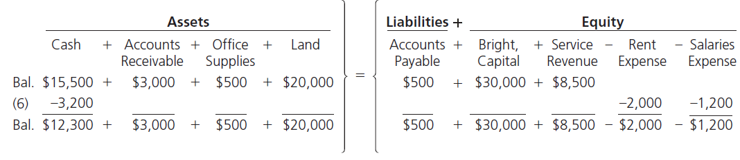
TRANSACTION 6
Smart Touch pays $3,200 cash for expenses:
$2,000 for office rent and $1,200 for employee salaries.
$35,700
Cash is decreased $3,200 and Owner’s equity is decreased by $3,200 because of expense occurred.
.

Slide 23
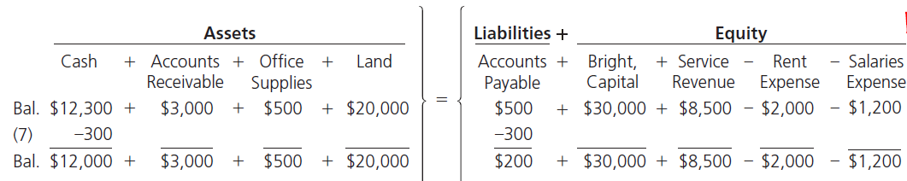
TRANSACTION 7
Smart touch pays $300 in cash for supplies purchased in transaction 3. It is called “payment on account”
Cash is decreased $300 and Accounts Payable is decreased by $300.

Slide 24
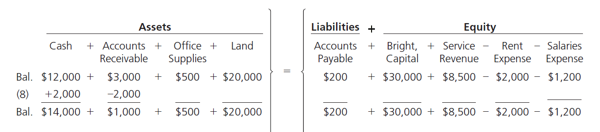
TRANSACTION 8
Smart Touch collects $2,000 from the client for which Smart Touch performed services in Transaction #5 .
It is called “collection on account”.
Cash is increased $2000 and Accounts Receivable is decreased by the same amount.

Slide 25
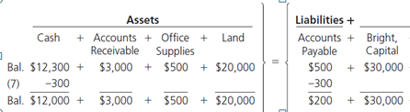
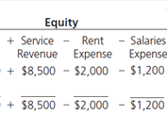
TRANSACTION 9
Sheena Bright withdraws $5,000 cash from the business.
-Bright
Withdrawals
$14,000
$1,000
$200
(9)
-$5,000
-$5,000
$9,000
$1,000
-$5,000
Cash is decreased $5,000 and Owner’s Equity is decreased by the same amount because of drawings .

Slide 26
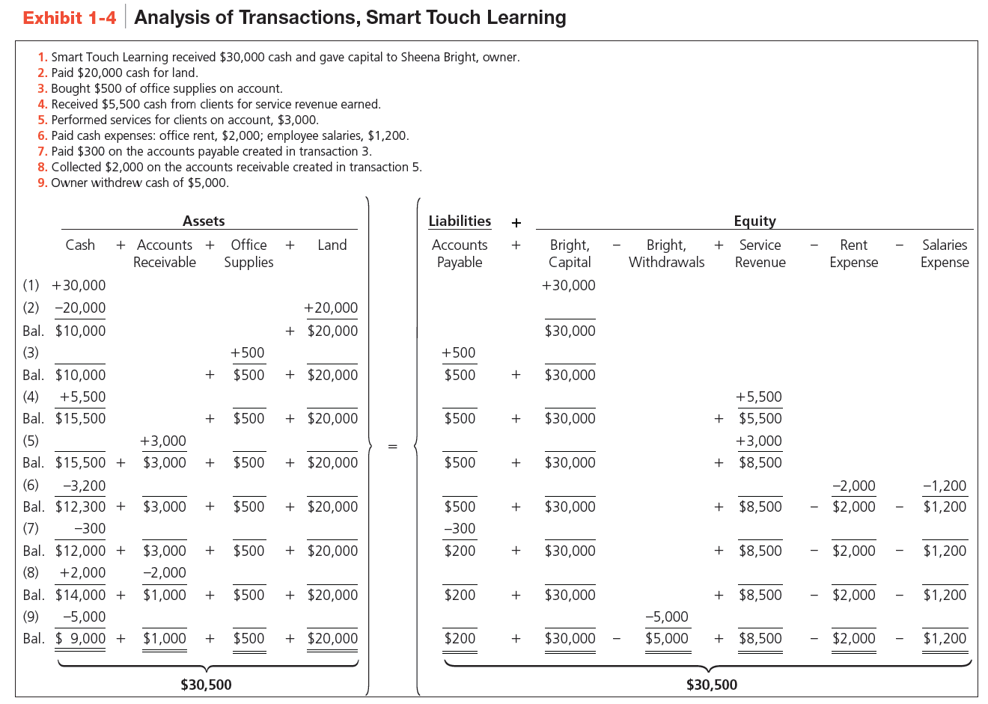
LO4: How Do You Analyze A Transaction?
A summary of all nine transactions for Smart Touch Learning is presented in Exhibit 1-4.

Slide 27


Slide 28
9
Prepare financial statements

Slide 29
Preparing the Financial Statements
After all transactions for the period are recorded, financial data
is summarized and that summary
data is used to generate the basic financial statements
-used by all companies as the primary means of communicating to stakeholders.
-usually prepared at the end of a fiscal year, season or month
-the final product of the whole accounting process
Income
Statement
Balance
Sheet
Statement of Owner’s Equity
Statement of owner’s equity are prepared for
proprietorships and partnerships.

Slide 30

Income STATEMENT
Reports the success or failure of the company’s operations for a period of time.
5,300
Net income of $5,300 will be added to Equity.

Slide 31
Statement of Owner’s Equity
Shows amounts and causes of changes in owner’s capital during the period.
Statement of Equity Month ended Dec31,2014
Bright capital, Dec1, 2014 30,300
owner contribution
Net income
withdrawal
Bright capital, Dec31, 2014

Slide 32

Balance Sheet
balance
1.equality
2.leftover
Note that the Balance Sheet follows the Accounting Equation.

Slide 33
P1-36A: PREPARING FINANCIAL STATEMENTS
Studio Photography is a priortership . The balance of Ansel, capital was $45,000 at November 31, 2012. At December 31, 2012, the business’s accounting records show these balances:
Prepare the following financial statements for Studio Photography, Inc. (a proprietorship)for the month ended December 31, 2012:
a. Income statement
b. Statement of owner’s equity
c. Balance sheet
Insurance expense | $ 8,000 | Accounts receivable | $ 8,000
Cash | 37,000 | Note payable | 12,000
Accounts payable | 7,000 | Ansel, capital, Dec 31, 2012 | ?
Advertising expense | 3,000 | Salary expense | 25,000
Service revenue | 80,000 | Equipment | 50,000
Ansel, drawing | 13,000

Slide 34
P1-36A: CONTINUED
Studio Photography
Income Statement
For the Month Ended December 31, 2012
 | Revenue:
 | Service revenue |  | $ 80,000
 | Expenses:
 | Salary expense | $ 25,000
 | Insurance expense | 8,000
 | Advertising expense | 3,000
 | Total expenses |  | 36,000
 | Net income |  | $ 44,000

Slide 35
P1-36A: CONTINUED
Studio Photography
Statement of Owner’s Equity
For the Month Ended December 31, 2012
 | Ansel, capital, December 31, 2011 | $ 45,000
 | Net income | 44,000
 | Subtotal | $ 89,000
 | Less: Drawings | (13,000)
 | Ansel, capital, December 31, 2012 | $ 76,000

Slide 36

P1-36A: CONTINUED
Studio Photography, Inc.
Balance Sheet
December 31, 2012
 | Assets |  |  | Liabilities
 | Cash | $37,000 |  | Accounts payable | $ 7,000
 | Accounts receivable | 8,000 |  | Note payable | 12,000
 | Equipment | 50,000 |  | Total liabilities | $19,000
 |  |  |  | Owner’s Equity
 |  |  |  | Ansel, capital
 | Total assets | $95,000 |  | Total liabilities and owner’s equity | $95,000
76,000

Slide 37


Slide 42
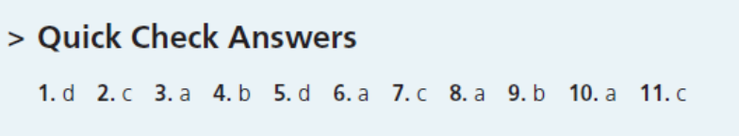

Slide 43
Chapter 1 Summary
Accounting is the language of business. Financial statements report a company’s activities in monetary terms.
Different users—including individuals, business owners, managers, investors, creditors, and tax authorities—review a company’s financial statements for different reasons. Each user’s goal will determine which pieces of the financial statements he or she will find most useful.
Most U.S. businesses follow generally accepted accounting principles (GAAP). If the company is publicly traded, then it must also follow SEC guidelines. If the company operates internationally, then international financial reporting standards (IFRS) will apply. The goal is that, eventually, all public U.S. companies will report using IFRS rules.
There are five main forms of business organizations: proprietorships, partnerships, corporations, LLPs/LLCs, and not-for-profits. Each is unique in its formation, ownership, life, and liability exposure.

Slide 44
Chapter 1 Summary
Proprietorships are formed when one person creates a business. One person owns the proprietorship. Although the proprietorship is a separate entity, it has no continuous life, and the owner has unlimited liability for the business’s debts. Proprietorships have a more difficult time raising capital, but have the advantage of reduced regulation and less taxes than the corporate form of business.
The accounting concepts are the underlying assumptions used when recording financial information for a business. Think of the concepts like rules of a game. You have to play by the rules.

Slide 45
Chapter 1 Summary
The accounting equation must always equal. That is, Assets (what you own) must equal Liabilities (what you owe) + Equity (net worth).
The accounting equation is Assets = Liabilities + Equity. Every business transaction affects various parts of the equation, but after each transaction is recorded, the equation must ALWAYS balance (equal).
Financial statements are prepared from the ending balances of each account. Each financial statement shows a different view of the company’s overall results
Financial statements are prepared from the transaction analyses (summary of events) reported in each account (Exhibit 1-6) in the order shown in Exhibit 1-7. No one financial statement shows everything about a company. It is the financial statements AND the relationships the statements show that give users the overall picture for a specific company

Slide 46



Thank You

