Slide 1



Introduction to Economics
Lecture 8
MGM112
Monetary, and Fiscal Policy
Prepared by
Lec. Dina ElWakkad
www.midocean.ae

Slide 2

Monetary, and Fiscal Policy
Chapter
08
v
After studying this chapter, you will be able to
  Describe the structure of the Federal Reserve System (the Fed), and the tools used by the Fed to conduct monetary policy
  Explain what an open market operation is, how it works, and how it changes the quantity of money
  Explain how the Fed influences interest rates
  Explain how the Fed’s actions influence spending plans, real GDP, and the price level
www.midocean.ae

Slide 3
Learning objectives
Chapter
08
v
After studying this chapter, you will be able to
  Understand what fiscal policy is and how it impacts the economy
  Apply fiscal policy to economic booms and busts to solve those issues effectively
www.midocean.ae

Slide 4
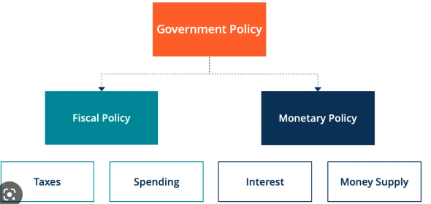
Monetary, and Fiscal Policy
Chapter
08
www.midocean.ae

Slide 5
Monetary, and Fiscal Policy
Chapter
08
1) Monetary Policy
www.midocean.ae

Slide 6
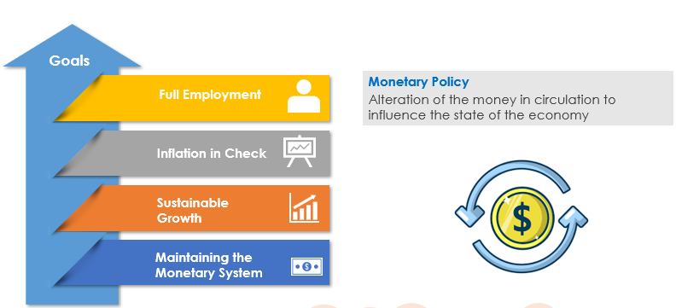
Monetary Policy
Chapter
08
The most important Federal Reserve monetary policy goal is achieving price level stability
www.midocean.ae

Slide 7
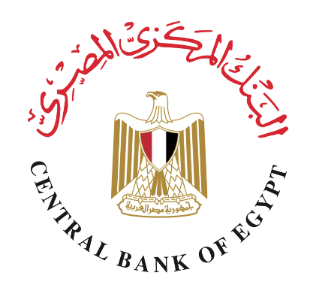


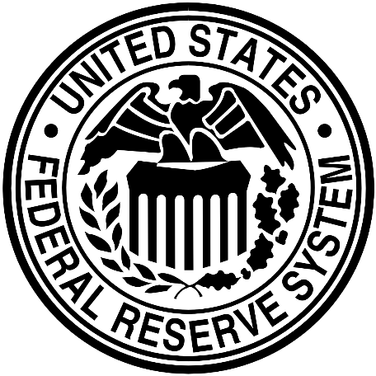
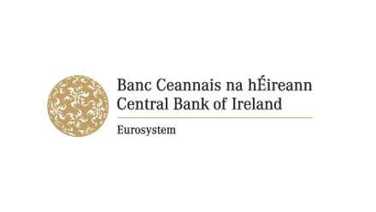
Monetary Policy
Chapter
08
v
A CENTRAL BANK/ Federal Bank is the public authority that regulates a nation’s depository institutions and controls the quantity of money.
It is an independent authority in most of countries of the world
www.midocean.ae

Slide 8
Monetary Policy
Chapter
08
v
Monetary policy affect money in circulation, and interest rate through 3 tools:
Discount Rate
Deposit Reserve
Open Market Operation
www.midocean.ae

Slide 9
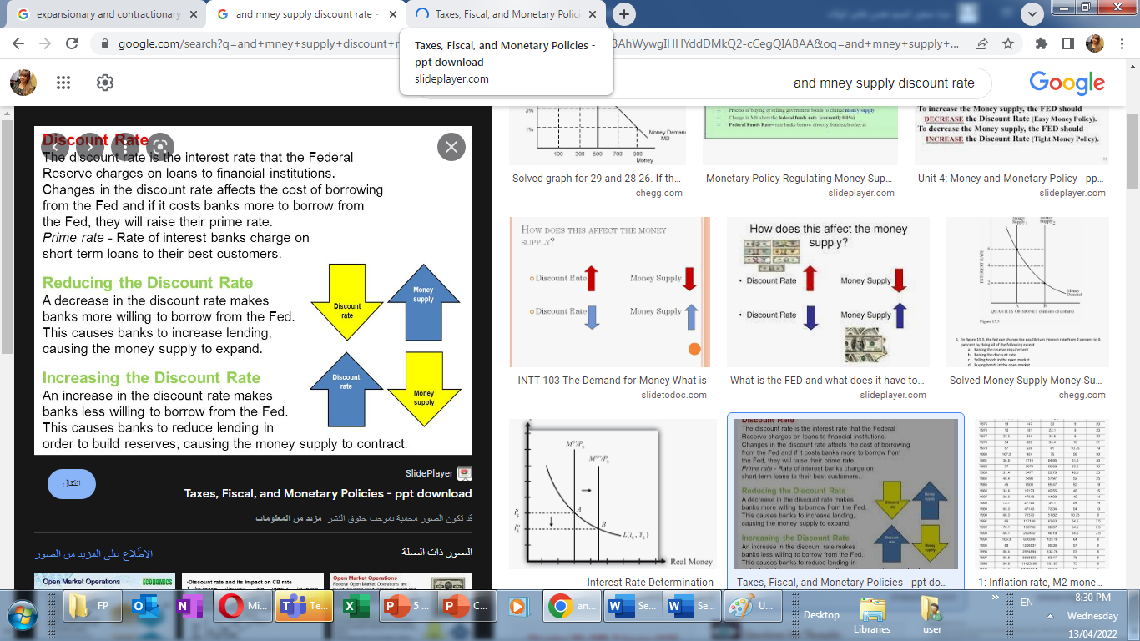
Monetary Policy
Chapter
08
v
Tools monetary policy
Discount Rate (-Ve).
The discount rate is the interest rate at which the Fed stands ready to lend reserves to depository institutions
www.midocean.ae

Slide 10
Monetary Policy
Chapter
08
v
Tools monetary policy
Deposit Reserve (-Ve).
  Required reserve ratio are the total amount of reserves that banks are required to keep.
  The Central banks set the required reserve ratios, which are the minimum percentages of deposits that depository institutions must hold as reserves
  The higher RRR, the lower available loans for people, causing decrease in money supply, and increase in interest rate.
www.midocean.ae

Slide 11
Monetary Policy
Chapter
08
v
Tools monetary policy
Open Market Operation
Open market operations are used mainly to regulate the money supply in an economy by selling and buying government securities/ bonds by the central bank of a nation
www.midocean.ae

Slide 12
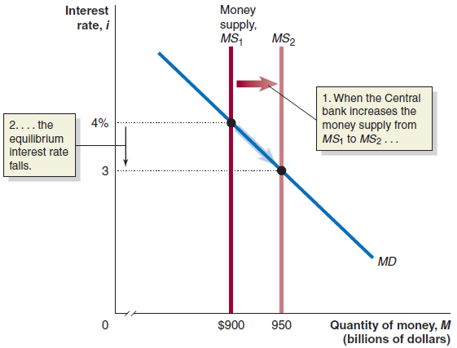
Monetary Policy
Chapter
08
v
Tools monetary policy
Open Market Operation
To control Recession
→ increase the money supply
→ the equilibrium interest rate decreases
→ people prefer to hold money (sell bonds)
→ the central bank buys back bonds from commercial banks.
www.midocean.ae

Slide 13
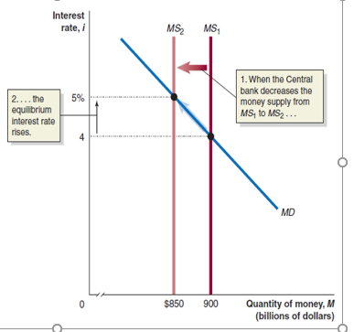
Monetary Policy
Chapter
08
v
Tools monetary policy
Open Market Operation
To control Expansion/ Inflation
→ decrease the money supply
→ the equilibrium interest rate increases
→ people prefer to hold bonds (buy bonds)
→the central bank sells bonds to commercial banks
www.midocean.ae

Slide 14
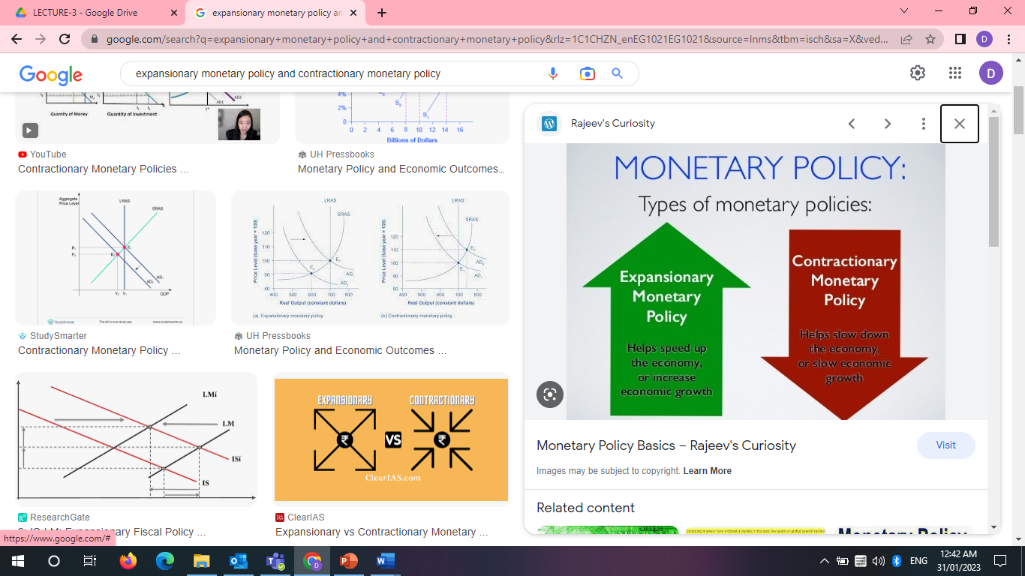
Monetary Policy
Chapter
08
www.midocean.ae

Slide 15
Monetary Policy
Chapter
08
v
1) Expansionary MP
At the time of recession, and Unemployment
CB buys bonds through open market operations CB reduces discount rate CB reduces RRR ↓ MS↑ ↓ r↓ ↓ I↑ ↓ AD↑ ↓ Output (GDP), and Prices (inflation)↑
www.midocean.ae

Slide 16
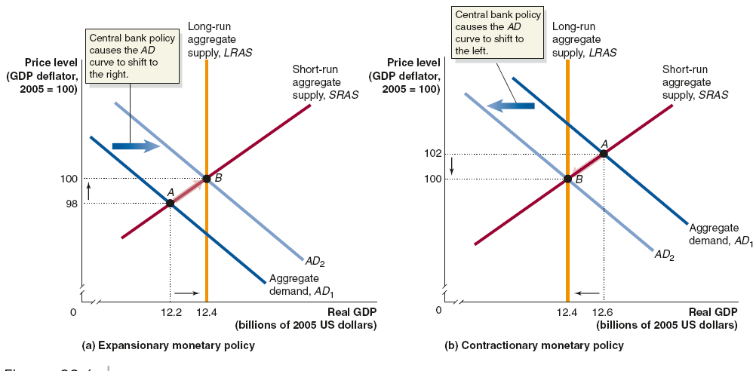
Monetary Policy
Chapter
08
1) Expansionary MP
www.midocean.ae

Slide 17
Monetary Policy
Chapter
08
v
2) Contractionary MP
At the time of expansion, and inflation
CB sells bonds through open market operations CB increases discount rate CB increases RRR ↓ MS↓ ↓ r↑ ↓ I↓ ↓ AD↓ ↓ Output (GDP), and Prices (inflation)↓
www.midocean.ae

Slide 18
Monetary Policy
Chapter
08
2) Contractionary MP
www.midocean.ae

Slide 19
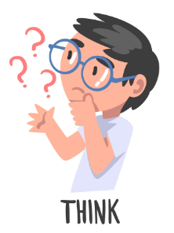
Think
Chapter
08
v
What is meant by monetary policy?
The process by which the Parliament controls the money supply
The process by which the central bank or monetary authority of a country controls the supply of money
The process by which International Market controls the money supply
None of the above
If interest rate decreases in an economy, it will
Decrease the investment expenditure in the economy
Increase the loan repayment by the government
Increase the consumption expenditure in the economy
Increase the total savings in the economy
www.midocean.ae

Slide 20
Think
Chapter
08
v
If the economy experiences an expansionary gap and the Fed sells US government securities in the open market, then _____.
money supply increases, investment increases, aggregate demand increases
money supply increases, the interest rate increases, and the aggregate demand increases
money supply decreases, the interest rate decreases, and the aggregate demand falls
money supply decreases, the investment decreases, and the aggregate demand decreases
Which of the following is not a monetary policy instrument?
Reserve requirement ratio.
Interest on reserve. (Discount rate)
Capital gains tax rate.
Open market operations.
www.midocean.ae

Slide 21
Think
Chapter
08
v
Which of the following is not one of the Fed’s monetary policy tools?
A. Buying bonds on the open market
B. Selling bonds on the open market
C. Raising or lowering taxes
D. Raising or lowering the reserve requirement ratio
An open market purchase by the Fed
increases bank reserves, loans, and deposits, and thus increases the money supply.
decreases bank reserves, loans, and deposits, and thus decreases the money supply.
increases bank reserves, loans, and deposits, and thus decreases the money supply.
decreases bank reserves, loans, and deposits, and thus increases the money supply.
www.midocean.ae

Slide 22
Think
Chapter
08
v
Suppose the Fed wanted to engage in an expansionary monetary policy. Which of the following should it do?
Sell bonds on the open market.
Increase the reserve requirement ratio.
Increase the discount rate.
Buy bonds on the open market.
Expansionary Monetary policy is a monetary policy designed to decrease activity in the economy.
True
False
False, Contractionary MP
www.midocean.ae

Slide 23
Monetary, and Fiscal Policy
Chapter
08
2) Fiscal Policy
www.midocean.ae

Slide 24
Fiscal Policy
Chapter
08
v
Fiscal Policy is determined by government/ congress/ president (Fiscal Authorities) using Taxes and the government expenditure to influence economic conditions
Goals:
  Boosting employment level to achieve Full Employment
  Inflation in Check
  Maintain Sustainable Growth
www.midocean.ae

Slide 25
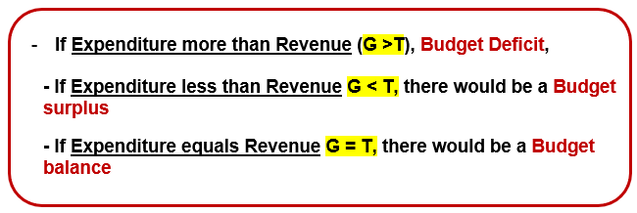
Fiscal Policy
Chapter
08
Government Budget ≡ G – T
www.midocean.ae

Slide 26
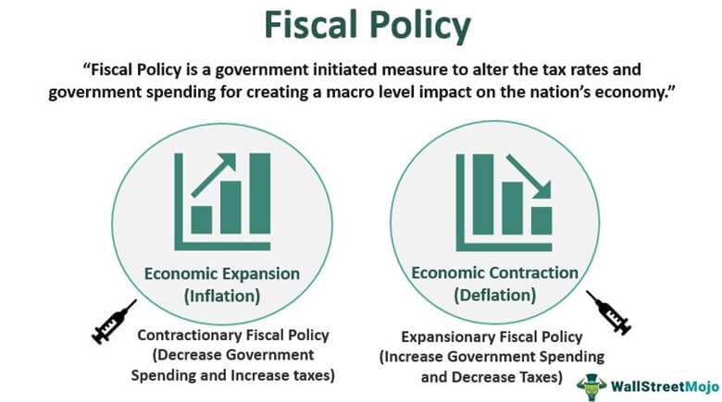
Fiscal Policy
Chapter
08
Types of Fiscal policy
www.midocean.ae

Slide 27
Fiscal Policy
Chapter
08
 | Expansionary fiscal policy
When | Stimulate the economy during the recession (during Budget surplus)
Action | T↓ or G↑
results | T↓: consumer spending↑ G↑: Business investment ↑ AD curve increases and shift to the right
effect | Real GDP ↑ Price level ↑ Employment ↑
www.midocean.ae

Slide 28
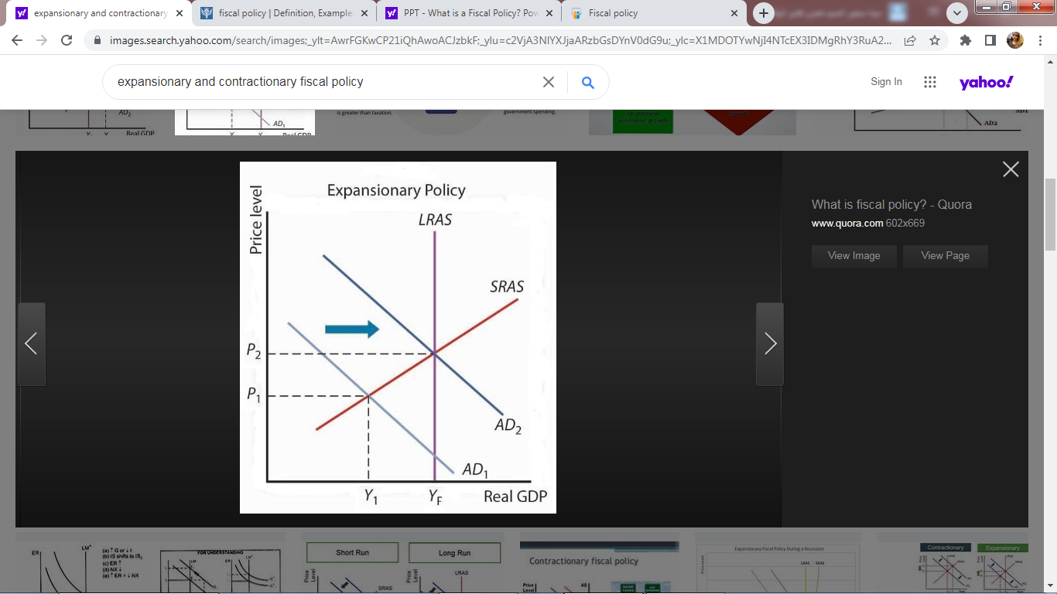
Fiscal Policy
Chapter
08
1) Expansionary FP
www.midocean.ae

Slide 29
Fiscal Policy
Chapter
08
 | Contractionary fiscal policy
When | Stimulate the economy during inflation (during Budget Deficit)
Action | T↑ or G↓
results | T↑: consumer spending↓ G↓: Business investment ↓ AD curve decreases and shift to the left
effect | Real GDP ↓ Price level ↓ Employment ↓
www.midocean.ae

Slide 30
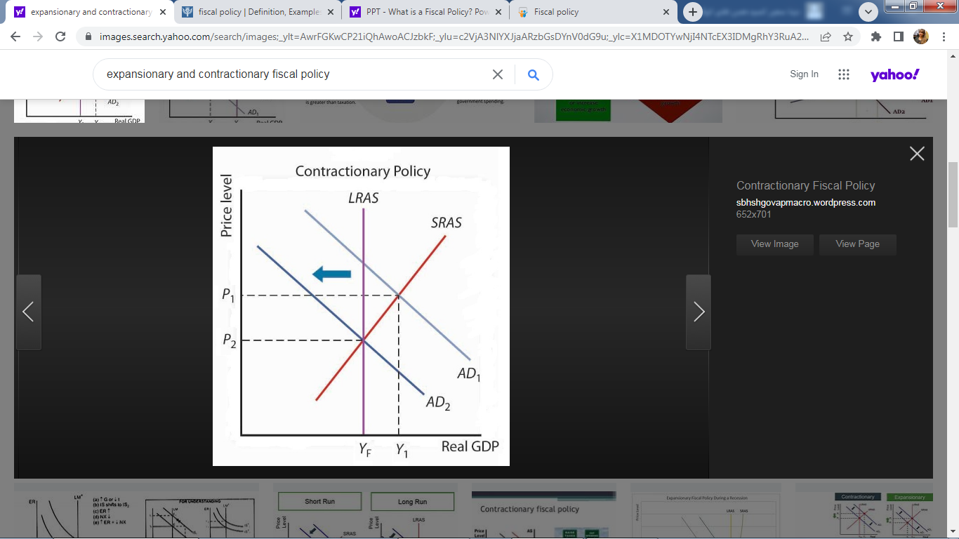
Fiscal Policy
Chapter
08
2) Contractionary FP
www.midocean.ae

Slide 31
Think
Chapter
08
v
------ is known as the policies that fiscal authorities adopt
Public policy
Fiscal policy
Government policies
None of the above
Fiscal policy is defined as the policy under which
The government uses instruments of taxation
The government uses instruments of Government spending
Government has a predetermined purpose of economic policy
All of the above
www.midocean.ae

Slide 32
Think
Chapter
08
v
Which of the following are the tools of fiscal policy?
Taxation
Government research
Government borrowing
None of the above
Which of the following objectives are achieved by fiscal policy?
Economic stability
Achieving high level of employment
Accelerating economic growth
All of the above
www.midocean.ae

Slide 33
Think
Chapter
08
v
Budget is an instrument of
Monetary policy of the government
Commercial policy of the government
Fiscal policy of the government
Money-saving policy of the government
Fiscal policy creates a surplus, when the total--------
Expenditure and total receipts same
Receipts more than Expenditure
Expenditure over Receipts
Receipts and total Expenditure very low
When the governments total revenue is less than the planned expenditure, it is called----
Revenue deficit
Budget shortfall
Fiscal deficit
Deficit financing
www.midocean.ae

Slide 34
Summary outlines
Chapter
08
v
Monetary policy (definition, tools, expansionary, and monetary policy)
Fiscal policy (definition, tools, expansionary, and fiscal policy)
www.midocean.ae

Slide 35


Thank You

