Slide 1



Business law
Lecture 5
MGM412
Business law
Prepared by
Dr. Fatma Abdalla

Slide 2

Lecture goals
.1- Quick revision of the previous lecture
2- Our educational goals today
3- Conclusion
4- References

Slide 3

1- quick revision of the previous lecture
remaining features of juristic person
The extinction of the juristic personality
Definition, kinds and sources of obligation

Slide 4

2- educational goal today
Part 4: sources of obligation:
1- tort
2- unjust enrichment.
3- law as a direct source of obligation
4- unilateral declaration.
5- contract

Slide 5
PART 4 : sources of pecuniary obligation
C- sources of obligation:
If you go to the court and claimed that another person is obliged to do certain act to you, the first thing that you need to present before the judge is the source of such obligation.
Sources of obligation: means legal reasons for the existence of an obligation. some of these sources are voluntary ( impose the obligation on the obliged by his will), namely the contract and the unilateral undertaking, while the others are involuntary (imposed on the obliged without his will), namely the enrichment without just cause , tort and law. Accordingly there are 5 sources of obligations we shall discuss each in the following:

Slide 6
Exclusive sources of pecuniary obligation
Voluntary sources
contract
Unilateral act
Involuntary sources
Law as a direct source
tort
Unjust enrichment

Slide 7
1- Unlawful acts (torts)
Torts that cause harm to other persons raise the liability to compensate the harmed person. Torts have three cases:
I- Liability arising from personal acts.
II- Liability arising from the acts of another person.
III- Liability arising from things which need special care.

Slide 8
.I- Liability arising from personal acts:
The general rule: Is that any person commits a fault causing harm to another must compensate the injured.
To claim damages, and win the case. The claimant must assure that the other party actually committed a fault and that fault was the direct cause for the harm sustained by the claimant.
Conditions of damages
Fault of the defendant
Harm sustained by the claiment
That harm is directly caused by the fault

Slide 9
If the fault is not the direct cause for the harm sustained by the injured person, the wrongdoer will not compensate the injured person.
Accordingly, if “A” drives a car without a license, then he hits “B” causing him serious injury. Here “A” committed a fault which is driving a car without a license, and “ B” sustained harm due to the accident.
But if it was proved that the accident happened due to fault of the injured person, for example he passed suddenly in front of “A”’s car.
So A is not liable as his liability is released by an external cause, which is the fault of the injured person, so the fault was found.

Slide 10
Tortuous personal tort is a deviation from the conduct of reasonable man in same circumstances.” Which means that the judge in evaluating the existence of fault use the objective criterion ( evaluate it based on majority conduct)
It is to be noted that: all crimes an violations to mandatory rules are certainly personal tortuous faults but civil fault has wider scope: it shouldn’t necessarily amount to a crime or a violation of law, it is enough to constitute deviation from the normal person conduct.
So if someone put plant pots on the balcony Edge without any precautions to prevent falling, this act does not violate law, but certainly this is against normal person conduct.
So if any of these pots fall on any car in this street, the owner of this pot should compensate any harm caused by it.

Slide 11
Exceptionally, No responsibility (the doer won’t compensate injured person) in the following cases:
- acts out of will of the doer or what is called foreign cause: A person is not liable to make reparation, if he proves that the injury resulted from a cause beyond his control, such as, force majeure, the fault of the victim or of a third party.
- legitimate defense : A person who causes an injury to another in the legitimate defense of his person or property, or of the person or property of a third party, is not responsible, provided that he does not exceed the measures necessary for his defense, otherwise he will be liable to damages assessed in accordance with the principles of equity.

Slide 12
- Case of urgency or necessity: A person will not be liable for faults injuring another even if the fault is intentionally done, if such fault is committed to avoid greater injury to the doer or third party.
For example: the driver who suddenly finds a child running in front of his car and smash another car while trying to avoid hitting the child will not be responsible for the harm caused to the smashed car.

Slide 13
II- Liability arising from the acts of another person
A person may be liable for torts committed by other persons in two cases:
The first: The person entrusted with the supervision of other Persons by reason of their minority, mental. Is liable for torts committed by supervised persons unless the supervisor proves that he has performed the duty of supervision with due care or that the damage would have inevitably occurred even if he had performed this duty with due care.
The second: The employer is liable for the torts of his employee committed while performing his work or because of this work, on condition that the principal has actual authority to supervise the employee, even if the principal is not free to choose his subordinate.
III- Liability arising from things which need special care:
Also a person may be responsible for positive movements harming others and made by his animals, machines, destruction of buildings in his custody.

Slide 14
2- Enrichment without just cause:
A person, who without just cause enriches himself to the detriment of another person, is liable, to the extent of his profit, to compensate such other person.
Applications (examples) of enrichment without just cause:
- Payment not due: In this case anyone who receives by mistake a payment, which is not owing to him, is bound to return it. For Example: the employee who receives by mistake sum of money exceeding his legal salary, must return the excess sum.

Slide 15
Voluntary agency: if due t urgency circumstances one person of his own assumes the management of another person’s business or property without on that person’s behalf without being bound to do so.
For example: When a person fixes the broken gate of his absent neighbor's house, he is entitled to get the fixed cost.
Another example would be the interference of the shipper to repackage products which are about to be damaged due to unexpected seizure of the ship in a foreign port. In this case the shipper will be entitled to any loss he sustained due to conducting this sale, for example expenses of buying extra packaging to these products.

Slide 16
3- the law as a direct source of obligation:
Obligations resulting directly from the text of law.
Ex: Obligation stated in the law imposing on the father to pay alimony to his children

Slide 17
4- unilateral undertakings
They are legal acts made by the unilateral will of one person.
Ex: wills and promise to the public of a reward: a person who makes a promise to the public of a reward in exchange for a specified service is bound to pay the reward to the person who performs the service , even if he acted without thought of the promise of reward ,or without knowledge thereof .

Slide 18

Contract is the first voluntary source of pecuniary obligation; it is also the most used source.
I- Definition of contract: It is the exchange of promises ( offer and acceptance) between two parties or more with intent to create or modify or extinguish legal obligations”. It is to be noted that acceptance should be exactly matching the offer to conclude contrat.This is called Mirror Image Rule
Contract may be made verbally, in writing, by electronic means, or By inference from the conduct of the parties and the circumstances of the case.
However, the law in certain cases may provide that a contract should be concluded only in writing or it will be void, such contract such contract of partnership.
5- Contract

Slide 19
II-requirements for the validity of contracts.
1- the existence of a valid consent
The existence of consent (offer and acceptance)
The validity of consent offeree and offeror has ( full capacity and their will are free from vices of consent)
2- the existence of a valid object
The existence of object
Ex: in sale contract: defining sold thing
The validity of object (lawful).
Ex: not sale of illegal drugs
3- the existence of a valid consideration
The existence of consideration ( existence of price or any thing else in exchange of the sold thing)
The validity of consideration (lawful)
Ex: sale contract is not made as a kind of bribe.

Slide 20
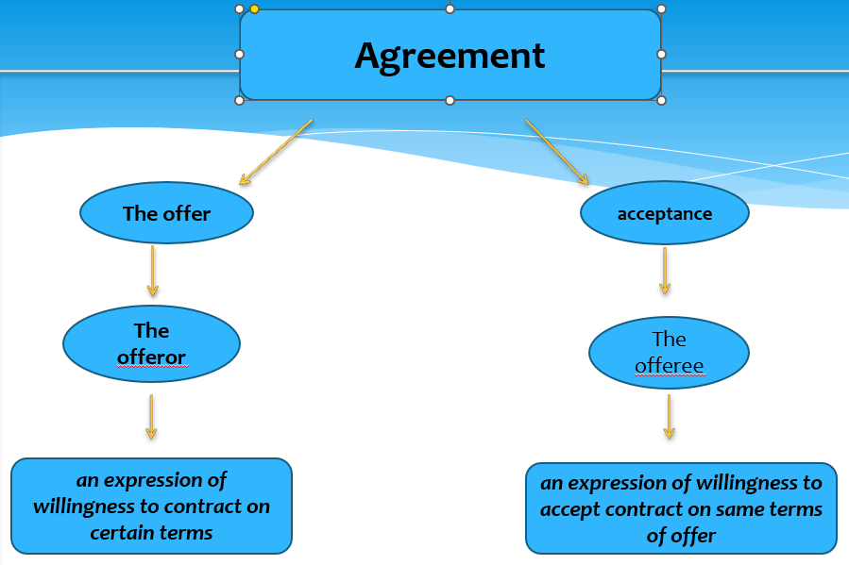
First requirement: the existence of a valid consent:
It exists by the exchange of mutual promises between parties of the contract. Offer from the first party called the offeror and matchingg acceptance from the other party from the offeree.

Slide 21
Termination of the offer: ( offer may not be accepted after it termination)
If the offer terminated before acceptance by any of the following ways the contract will not be concluded even if the offeree issued his acceptance later on.
a- revocation of the offer:
The offeror may withdraw his offer at any time before acceptance unless it is time limited offer, but if the acceptance was issued first he will be bound by the terms of the contract. revocation must be communicated to offeree to be effective.
Termination of offer
Revocation
Lapse of time
Rejection
death
Non fulfillment of condition

Slide 22
b- non-fulfillment of a conditional offer:
Ex: If “A” offers to transfer 10% of his company to the company’s manager “B” if “B” succeeded to double the company profit. If “A” doesn’t fulfill the condition, offer will be terminated and no contract could be concluded.
c- passage of time: in the following circumstances:
(a) if offer is time limited – ex: offer for a week - and the acceptance is not made during the period defined by the offer.
(b) if there is no period prescribed, offer terminate by the lapse of reasonable period (depends on circumstances of the case).
d- the death of a party: before the issuance of acceptance.

Slide 23
e- rejection of the offer:
an offeree who rejected an offer can not accept it latter.
- Rejection may express: written or oral.
- Rejection may also be implied: where the offeree makes a counter- offer. It means modifying at least one of the terms of the offer, for example changing the price mentioned in the offer.

Slide 24

On 1-5- 2024 AMCO company for paper industries sent an email to FLT company offering the following: “ 70 gram white papers with certain qualifications in exchange of certain price”.
On 6-5-2024 FLT company sent an email to titled offer accepted. In this email the company accepts this offer but for 80 grams white papers with the same offered qualifications and price. And required deliverance of the offered quantity by the next week.
On 10-5-2024 AMCO sent an email to revoke the offer stating that they don’t have the ability to supply the papers by the next week. But FLT refused this revocation and said that contract is already concluded when it expressly accepted the offer on 6-5-2024. do you think that contract is actually concluded?

Slide 25
Actually, contract is not concluded on 6-5-2024, because FLT company didn’t accept the offer because the email sent didn’t include matching acceptance that include the exact terms of the offer. Instead, it rejected the offer implicitly by sending a counteroffer modifying the weight stated in the original offer.

Slide 26

Second requirement: The existence of a lawful object of contract.
- object of contract: is the object of the main obligation in the contract for example in car sale contract, car is the main object of such contract
Object of contract should be determined or determinable and it should be lawful.
For example: if a legal decision is issued to prevent importing luxuries is for three months So an agreement between A ( Egyptian) and B ( Chinese ) to import some luxury during these months is invalid because its illegal

Slide 27
Third requirement: The existence of a lawful cause of contract:
Once the offer has been accepted there is now an agreement.
But there is no contract unless there is consideration (benefit) from one party to another, unless it is a gratuitous contract.
Consideration must be of a value, but doesn’t need to be adequate .
The consideration must be possible and legal.

Slide 28
III- assuring the validity of the will of the contracting party:
both the offeree and the offeror should have full capacity and their will should be free from vices of consent. But what do mean by full capacity and vices of consent ??
As to capacity: It means that the contracting party attained the age of majority at the time of concluding the contract.. ( 18 years in the Saudi law. 21 years in the Egyptian law)
As to vices of consent: There are four vices of consent if any of them vitiated the will of the offeror or the offeree, the contract will be voidable, namely: mistake, fraud, duress and exploitation.

Slide 29
a-Mistake as a vice of consent
- Definition of mistake: “ it is imagining something that is not true regarding the facts surrounding contract or the law” . To be able to annul a contract based on mistake as a vice of consent.
* This false imagination should be bilateral or the other party know about it , or could have easily detected the mistake.
This condition is to protect the innocent party of the contract, to be surprised by this sanction "the nullity", and to protect the stability and security of transaction.
* Mistake must be substantial: The error is substantial if the mistaken party will not conclude the contract, if he has not committed such mistake.

Slide 30
In one of the leading cases company “A” which is specialized in food products mainly meat sausages “ MINO SAUSAGE” sent an email to all client restaurant to inform them with their new product tiny sausage “CHINO SAUSAGE” which was actually “ chicken sausage”. This was accompanied with different new offers on both meat and chicken sausage under the title “ new launch equal prices ”.
One of the client restaurant known for his excellent meat sausage sandwich which used to take hundreds of kilos of meat sausage every month sent the company an email congratulating and huge quantity to benefit from the offer asking 10000 kilos of the new launch.
After few days the company delivered the products, received the price. Few hours after deliverance , the client called them and said he wants to annul the agreement as he falsely thought the new product differs from the old one in size only not in kind too. Especially that he doesn’t sell chicken suausage in his restaurant and would never buy it if he knew its true kind. The company said the kind is written on all cans and they didn’t expect this mistake.

Slide 31
Do you think that the restaurant has the right to annul the contract or not?
yes, the restaurant has this right because this mistake was caused because the company didn’t inform him individually that the tiny sausage is different kind , and it could easily be detected that he wont buy this huge quantity of a new product that he doesn’t currently use in his sandwiches, also mistake here is essential.

Slide 32
* Annulment must not be contrary to good faith: contract may not be annulled if the other party shows that he is willing to perform the contract as the mistaken party wanted in the first place.
So if “A” bought a candle stick thinking that it is made of silver because he bought it from silvery antiques shop, then he discovered that it silver plated not made of silver. This is a mistake that may enable “ A” to annul the contract.
if the seller provided the buyer with a real silver plated candle stick there would be no reason for insisting on the annulment instead of asking the exact performance of the contract, as asking annulment would be against good faith.

Slide 33
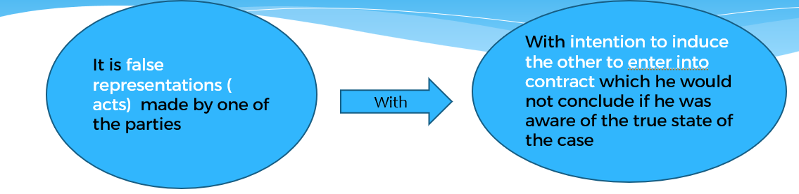
b- Fraud (misrepresentation)
For example if “A” used false formal document to convence “B” that sold machines are made in Germany while infact they are made in chine

Slide 34

It is considered fraud to deliberately remain silent in order to conceal a matter that the deceived person would not have concluded the contract had he known about it.
Also fraud should be essential- same as mistake- to annul the contract.

Slide 35

C- Duress:
as a vice of consent: Duress could be defined as The stress of justifiable fear on one party of the contract resulted in serious and imminent danger surrounding himself or his property or honor.
For example: if a husband threatened his wife to sell him her house otherwise, he would kill her. This sale even if signed by the wife is voidable if she proved such duress.

Slide 36
D- Exploitation:
If one of the contracting parties exploits an apparent weakness or urgent need in the other contracting party, to conclude a contract from which he has been extremely inproportionate - decreasing the consideration to an amount that is outside the usual custom - then the court, based on the request of the exploited contracting party and taking into account the circumstances of the case, may reduce his obligations or increase the obligations of the other contracting party or nullify the contract.

Slide 37
IV-Valid, void and voidable contracts:
valid contract : meets all the essential elements to establish a contract, it produces all its intended legal effect and no one can annul it.
void contract: has no legal effect. It is as if no contract had ever been created. A contract to commit a crime or the contract of donation given by minor under the age of majority are void.
if a contract is void then neither party is obligated to perform the contract and neither party can enforce the contract. Any interested person can claim its annulment ang judge can annul it without being asked to do so.

Slide 38
voidable contract: voidable contract are producing their legal effects unless annulled . So it is a contract in which one or both parties have the option to void their contractual obligation. If a contract is voided, both parties are released from their contractual obligations. If the party with the option chooses to ratify the contract, both parties must fully perform their obligations.
such as sale contract concluded by a 17 years old minor, or by a person acting under duress , fraud or mutual mistake.

Slide 39
V- Breach of contract:
Where a party fails to perform his contractual obligation or in case of late or defected performance.
A breach of one party gives the other a right of action against him.
The usual remedy is compensating the other party for all the loss he sustained.
In some cases the court may order the specific performance instead of damages.

Slide 40

3- Conclusion

Slide 41
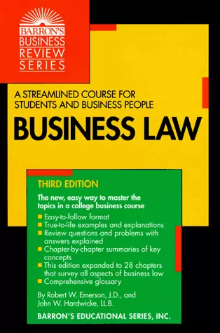
4- References
Business Law (Barron's Business Review) by Robert W. Emerson J.D.

Slide 42



Thank You

