Slide 1


Accounting for Managers
Prepared by Dr. Emad Zaher
Assistant Professor of Accounting
MGM341
Lecture (5)
Cost – volume – profit Analysis
(Break even point)

Slide 2

Learning outcomes
  LO 1 Prepare a CVP income statement to determine contribution margin.
  LO 2 Compute the break-even point.
  LO 3 Determine the sales required to earn target net income and determine margin of safety.

Slide 3
Cost-Volume-Profit Analysis
Cost-volume-profit (CVP) analysis is the study of the effects of changes in costs and volume on a company’s profits.
Important in profit planning.
Critical factor in management decisions as
  Setting selling prices,
  Determining product mix
  Maximizing use of production facilities.
Prepared by Dr. Emad Zaher

Slide 4

Cost-Volume-Profit Analysis
Basic Components
ILLUSTRATION 22.10
Components of CVP analysis

Slide 5
Basic Components
Assumptions
Behavior of both costs and revenues is linear throughout the relevant range of the activity index.
Costs can be classified accurately as either variable or fixed.
Changes in activity are the only factors that affect costs.
All units produced are sold.
When more than one type of product is sold, the sales mix will remain constant.
Prepared by Dr. Emad Zaher

Slide 6
CVP Income Statement
Sales (Selling price per unit x Sold units). | xx
Less | ( - )
Variable cost (Variable cost per unit x Sold units). | (xx)
Contribution Margin (C.M) | Xx
Less | ( - )
Fixed Cost | (xx)
Net Income | x
Prepared by Dr. Emad Zaher

Slide 7
Cost-Volume-Profit Analysis
CVP Income Statement
A statement for internal use.
Classifies costs and expenses as fixed or variable.
Reports contribution margin in body of statement.
  Contribution margin – amount of revenue remaining after deducting variable costs.
Reports same net income as a traditional income statement.
Prepared by Dr. Emad Zaher

Slide 8
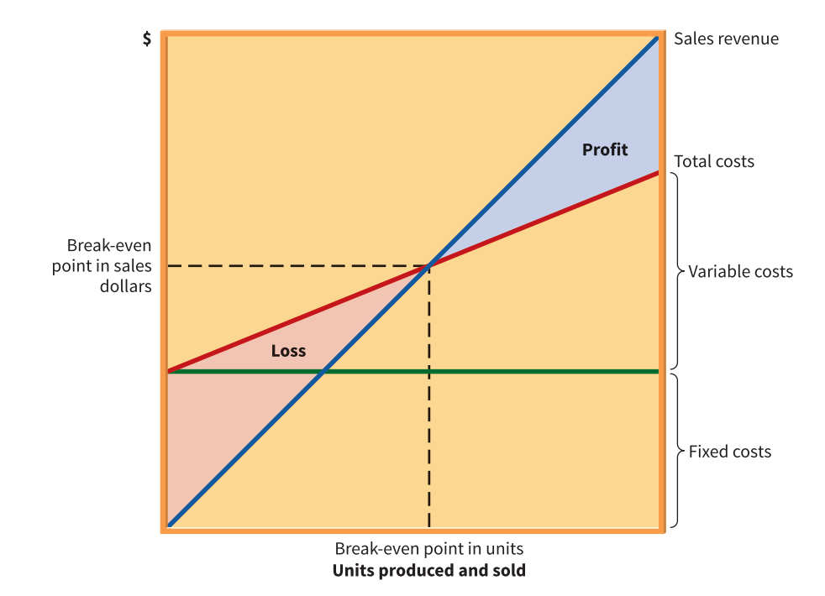
Graphic Presentation

Slide 9
Computing Break-Even Analysis
Prepared by Dr. Emad Zaher

Slide 10
CVP Income Statement
Illustration: Fandi Electronics produces cell phones. Relevant data for the cell phones sold by this company in June 2020 are as follows.
Unit selling price of cell phone | €500
Unit variable costs | €300
Total monthly fixed costs | €200,000
Units sold | 1,600
Prepared by Dr. Emad Zaher

Slide 11
CVP Income Statement
Illustration shows CVP income statement for Fandi in case of selling 1600 cell phones.
Fandi Electronics CVP Income Statement For the Month Ended June 30, 2020
 | Total | Per Unit
Sales (1,600 cell phones) | €800,000 | €500
Variable costs | 480,000 | 300
Contribution margin | 320,000 | €200
Fixed Costs | 200,000
Net income | €120,000
Prepared by Dr. Emad Zaher

Slide 12
CVP Income Statement
Unit Contribution Margin
Contribution margin is available to cover fixed costs and to contribute to income
Formula for unit contribution margin and the computation for Fandi Electronics are:
Unit Selling Price | - | Unit Variable Costs | = | Unit Contribution Margin
€500 | - | €300 | = | €200

Slide 13
Fandi’s CVP income statement assuming a zero net income in case of selling 1000 cell phones.
Fandi Electronics CVP Income Statement For the Month Ended June 30, 2020
 | Total |  | Per Unit
Sales (1,000 cell phones) | €500,000 |  | €500
Variable costs | 300,000 |  | 300
Contribution margin | 200,000 |  | €200
Fixed Costs | 200,000
Net income | € 0

Slide 14
Assume that Fandi sold one more cell phone, for a total of 1,001 cell phones sold.
Fandi Electronics CVP Income Statement For the Month Ended June 30, 2020
 | Total |  | Per Unit
Sales (1,001 cell phones) | €500,500 |  | €500
Variable costs | 300,300 |  | 300
Contribution margin | 200,200 |  | €200
Fixed Costs | 200,000
Net income | € 200

Slide 15
Contribution Margin Ratio
Shows the percentage of sales available to apply toward fixed costs and profits.
Formula for contribution margin ratio and the computation for Fandi Electronics are:
Unit Contribution Margin | ÷ | Unit Selling Costs | = | Contribution Margin Ratio
€200 | ÷ | €500 | = | 40%

Slide 16
CVP income statement, with net income and percent of sales data.
Fandi Electronics CVP Income Statement For the Month Ended June 30, 2020
 | Total |  | Percent of Sales
Sales (1,001 cell phones) | €500,500 |  | 100%
Variable costs | 300,300 |  | 60
Contribution margin | 200,200 |  | 40%
Fixed costs | 200,000
Net income | € 200

Slide 17
Contribution margin:
Is revenue remaining after deducting variable costs.
May be expressed as unit contribution margin.
Is selling price less cost of goods sold.
Both (a) and (b) above.

Slide 18
DO IT! 3 CVP Income Statement
Khor Industries produces and sells a cell phone-operated thermostat. Information regarding the costs and sales of thermostats during September 2020 are provided below.
Unit selling price of thermostat $2,550
Unit variable costs $960
Total monthly fixed costs $5,700,000
Units sold 4,000
Prepare a CVP income statement for Khor Industries for the month of September. Provide per unit values and total values.

Slide 19
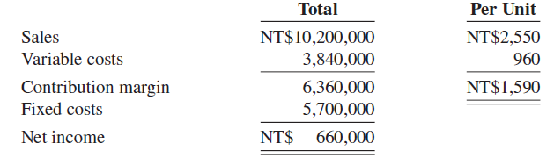
DO IT! 3 CVP Income Statement
Prepare a CVP income statement for Khor Industries for the month of September. Provide per unit values and total values.
Khor Industries
CVP Income Statement
For the Month Ended September 30, 2020

Slide 20
Break-Even Analysis
Process of finding break-even point level of activity at which total revenues equal total costs (both fixed and variable)
Can be computed or derived
  by using contribution margin, or
  from a cost-volume-profit (CVP) graph.
Expressed either in units or in sales
Prepared by Dr. Emad Zaher

Slide 21
DO IT! 4 Break-Even Analysis
Yunxuan Group has a unit selling price of $400, variable costs per unit of $240, and fixed costs of $180,000. Compute the break-even point in units
Fixed Costs | ÷ | Unit Contribution Margin | = | Break-Even Point in Units
$180,000 | ÷ | $160 | = | 1,125 units

Slide 22
Target Net Income
To determine required units for Fandi Electronics:
Yunxuan Group has a unit selling price of $400, variable costs per unit of $200, and fixed costs of $200,000. Compute sales to achieve target income $120000
(Fixed Costs + Target Net Income) | ÷ | Unit Contribution Margin | = | Required Units
($200,000 + €120,000) | ÷ | $200 | = | 1,600 units

Slide 23
Target Net Income
To determine required sales value :
(Fixed Costs + Target Net Income) | ÷ | Contribution Margin Ratio | = | Required Sales
(€200,000 + €120,000) | ÷ | 50% | = | €640,000

Slide 24
Margin of Safety
Difference between actual or expected sales and sales at break-even point
Measures “cushion” that a particular level of sales provides
May be expressed in sales or as a ratio
Assuming actual/expected sales are $750,000 and break even point is $500,000:
Actual (Expected) Sales | ̶̶ | Break-Even Sales | = | Margin of Safety
$750,000 | ̶ | $500,000 | = | $250,000

Slide 25
Margin of Safety Ratio
Computed by dividing margin of safety by actual (or expected) sales
The higher the sales percentage, greater margin of safety
Assuming actual/expected sales are €750,000:
Margin of Safety | ÷ | Actual (Expected) Sales | = | Margin of Safety Ratio
$250,000 | ÷ | $750,000 | = | 33%

Slide 26
DO IT! 5 Break-Even, Margin of Safety, and Target Net Income
Praveen Ltd. makes travel bags that sell for $3,920 each. For the coming year, management expects fixed costs to total $22,400,000 and variable costs to be $2,940 per unit. Compute the break-even point in sales using the contribution margin (CM) ratio.
Contribution margin ratio = [($3,920 – $2,940) ÷ $3,920] = 25%
Break-even point in sales = $22,400,000 ÷ 25% = $89,600,000

Slide 27
DO IT! 5 Break-Even, Margin of Safety, and Target Net Income
  Praveen Ltd. makes travel bags that sell for $3,920 each. For the coming year, management expects fixed costs to total $22,400,000 and variable costs to be $ 2,940 per unit. Compute the margin of safety and margin of safety ratio assuming actual sales are $96,768,000.
Margin of safety = $96,768,000 – $89,600,000 = $7,168,000
Margin of safety ratio = $7,168,000 ÷ $96,768,000 = 7.4%

Slide 28
DO IT! 5 Break-Even, Margin of Safety, and Target Net Income
  Praveen Ltd. makes travel bags that sell for $3,920 each. For the coming year, management expects fixed costs to total $22,400,000 and variable costs to be $2,940 per unit. Compute the sales required to earn net income of $28,700,000.
Required sales =
($22,400,000 + $28,700,000) ÷ 25% = $204,400,000

Slide 29
Additional Examples

Slide 30
1. Ahmed Company has a unit contribution margin of L.E. 120 and a contribution margin ratio of 40%. What is the unit selling price?
a) L.E. 200 | b ) L.E. 300 | C) L.E. 48 | D ) Cannot be determined.
Answer
CM Ratio = | Contribution margin per unit
 | Selling price
40% = | L.E. 120
 | Selling price
Selling price = (120/40%) = L.E 300
Prepared by Dr. Emad Zaher

Slide 31
2. If the Sales are L.E. 500,000 and variable costs are L.E. 330,000. What is the contribution margin ratio?
a) 52% | b ) 34% | C) 66%
D ) Cannot be determined because amounts are not expressed per unit.
Answer
CM Ratio = | Sales – Variable cost
 | Sales
= | L.E. 500,000 - L.E. 330,000 | =34%
 | L.E.500,000
Prepared by Dr. Emad Zaher

Slide 32
3. If the Company has a product with a selling price per unit of L.E. 200, the unit variable cost is L.E. 110, and the total fixed costs are L.E. 300,000. How much is Compony 's contribution margin ratio?
a) 45 % | b) 55 % | C) 150 % | D ) 182%
Answer
CM Ratio = | Selling price – Variable cost/unit
 | Selling price
= | L.E. 200 - L.E. 110
 | L.E.200
= 45%
Prepared by Dr. Emad Zaher

Slide 33
4. If the Compony has a unit contribution margin of L.E. 30 and a contribution margin ratio of 60%. How much is the selling price of each unit?
a) L.E. 50 | b) L.E. 75 | C) L.E. 18
D ) Cannot be determined without more information
Answer
CM Ratio = | Contribution margin per unit
 | Selling price
60% = | L.E. 30
 | Selling price
Selling price = (30/60%) = L.E 50
Prepared by Dr. Emad Zaher

Slide 34
5.If Fixed costs are L.E. 900,000 and the variable costs are 75% of the unit selling price. What is the break-even point in pounds?
a) L.E. 2,100,000 | b) L.E. 2,700,000. | C) L.E. 3,600,000 | D ) L.E. 1,200,000
Answer
CM ratio = sales ratio – Variable cost ratio
CM ratio= 100%- 75% = 25%
Break even point (Value) = | Fixed cost
 | CM Ratio
= | L.E. 900,000
 | 25%
= L.E 3600,000
Prepared by Dr. Emad Zaher

Slide 35
6.Ahmed Company sells product (A) for L.E. 60 each. Variable costs are L.E. 40 per unit, and fixed costs total L.E. 120,000. How many product (A) must Company sell to earn net income of L.E. 280,000?
a) 20000 | b) 7000 | C) 5000 | D ) 6000
Answer
Sales to achieve target income= | Fixed costs +Target income
 | Selling price – V.C/unit
BEP = | 120,000+280,000
 | 60 – 40
= 20000 units
Prepared by Dr. Emad Zaher

Slide 36
7.If the Compony has actual sales of L.E. 800,000 and a break-even point of L.E. 520,000. How much is its margin of safety ratio?
a) 35 % | b) 46 % | C) 54 % | D ) 65 %
Answer
Margin of safety ratio = | Actual sales -BEP
 | Actual sales
Margin of safety ratio = | 800,000 -520,000
 | 800,000
=35%
Prepared by Dr. Emad Zaher

Slide 37



Thank You

