Slide 1

AI-Based Nowcasting of National CO₂ Emissions Using Satellite-Derived Indicators: A Hybrid Framework for GCC Countries

Slide 2
Problem (timeliness gap)
Official national Territorial CO₂ inventories are the basis for climate policy.
However, they are published with a significant 1- to 2-year delay.
This forces decision-makers to rely on outdated information, hindering timely responses.
Goal: Bridge this information gap using near-real-time satellite data.

Slide 3
Research Questions

Slide 4


Related Work & Gap
What prior work has done
Economic/inventory-driven models achieve high accuracy but with significant time lags.
Satellite-based proxies offer timely data but are less validated at the national level.
What remains missing (the gap)
A national-level estimation framework specifically tailored and validated for the GCC region.
An explicit quantification of the trade-off between model accuracy and data timeliness.
This thesis contribution
This research develops a hybrid framework to nowcast national GCC emissions, directly
addressing the need for timely, regionally-validated monitoring.

Slide 5
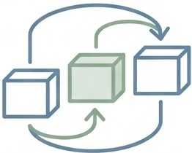

Key Contributions
₋-₋
Novel GCC Dataset
A new multi-source panel dataset (2000-2023), integrating five satellite products for the region.
Comparative Framework
A three-model design to rigorously benchmark performance (Economic vs. Hybrid vs.
Satellite-only).
Quantified Trade-off
The first explicit quantification of the accuracy-for-timeliness trade-off for GCC
emissions .
Interpretable Model
An interpretable model where feature importance aligns with physical drivers like cooling demand.

Slide 6
Study Area (GCC)
Countries: Saudi Arabia, UAE, Qatar, Kuwait, Oman, Bahrain.
A compelling case study due to a unique combination of factors:
Hot, arid climate drives extreme electricity demand for cooling.
Economies are major oil and gas producers.
Among the world's highest per-capita CO2 emissions.

Slide 7
End-to-End Data Collection Pipeline
Notes:
All features are aggregated to annual, country-level values to ensure direct comparability with target emissions data.
The shorter temporal record for Sentinel-5P NO₂ (post-2018) is handled consistently as detailed in the methodology.

Slide 8
Unified Panel Dataset
Target (y): Annual Territorial CO₂ Emissions (Source: Global Carbon Project/ OWID).
Economic Predictors (x): GDP, population, energy consumption (for Model A).
Satellite Predictors (x): LST, NDVI, Night-time Lights, AOD, NO₂ (for Models B/C).
Scope: 6 countries over 24 years (2000-2023), creating a balanced panel.
Total Size: 144 country-year observations.

Slide 9
Satellite Indicators as Emission Proxies
Variable | Satellite Product | Physical Meaning | Coverage
LST | MODIS MOD11A2 | Thermal emission ➔ cooling demand | 2000-present
NDVI | MODIS MOD13A2 | Vegetation greenness ➔ agricultural activity | 2000-present
NTL | DMSP-OLS / VIIRS | Artificial light ➔ urbanization, economic activity | 1992-present
AOD | MERRA-2 | Aerosol loading➔ combustion+ dust | 1980-present
NO₂ | Sentinel-5P TROPOMI | Tropospheric NO₂ ➔ combustion tracer | 2019-present

Slide 10
GEE extraction workflow
Leveraged Google Earth Engine (GEE) for scalable, cloud-based data processing.
Developed an automated and reproducible workflow for all 144 observations.
Process Overview:
  Filter image collections by country and time.
  Apply quality assurance (QA) masks to remove clouds/artifacts.
  Aggregate temporally (e.g., seasonal or annual means).
  Aggregate spatially over country boundaries.
  Export clean, analysis-ready data.

Slide 11
Data preparation

Slide 12
Experimental design (3 models)

Slide 13
Validation strategy (temporal split)
A temporal split is crucial to prevent data leakage and test true predictive power on unseen
future data.
Training Set: 2000-2018 (114 observations).
Test Set: 2019-2023 (30
observations, completely held out).
The model must predict the future based only on patterns learned from the past.

Slide 14
Results summary table

Slide 15
Trade-off slide (latency vs R²)

Slide 16
Feature importance (drivers)
Summer LST (34%): The single most important feature, directly reflecting
cooling demand.
Winter LST (22%):Important as a baseline and for industrial/commercial activity.
Night-time Lights (22%): A strong proxy for economic activity and electricity use.
Population Density (13%): Accounts for the urban concentration of emissions.
NDVI and AOD play minor roles, consistent with the GCC's arid environment and dust.

Slide 17
Diagnostic: Model Fit
Model B captures the overall trend and scale of emissions across the GCC.
The model performs well for mid-to-high emitters like the UAE and Kuwait.
Absolute errors scale with emission magnitude (Saudi Arabia has the largest range).
Errors are roughly centered; dispersion increases at higher emissions (scale effect).
This pattern is expected in country-level annual totals with a wide emission range

Slide 18
Performance by country
The model's effectiveness differs slightly by country, reflecting different emission scales and dynamics.
Highest R²: Saudi Arabia (0.72), where large emission variations provide a strong signal.
Lowest R²: Bahrain (0.61), where the smaller, less variable emission range is harder to model precisely.
Performance is robust across UAE, Qatar, Kuwait, and Oman (R² from 0.64 to 0.68).

Slide 19
Implications / Use cases
Satellite-based nowcasting cannot replace official inventories, which remain the gold standard.
However, it is a powerful complementary tool for use between official reporting cycles.
Practical Use Cases:
This framework offers a low-cost, scalable approach for enhancing national monitoring systems.

Slide 20
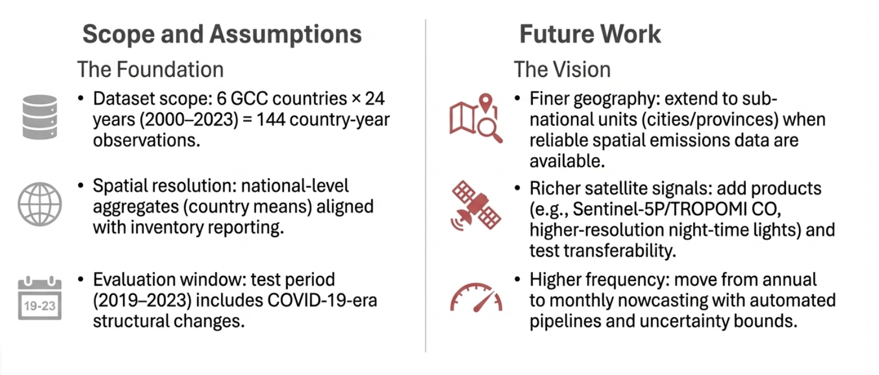
Scope & Future work

Slide 21
Conclusion
The 1-2 year lag in CO₂ reporting is a significant barrier to effective climate policy.
This thesis successfully developed a hybrid AI framework that uses satellite data to nowcast GCC national emissions in near-real-time.
The framework achieves a useful balance, retaining over 70% of the accuracy of economic models while reducing data latency by ~99%.
The model is interpretable and grounded in the physical drivers of the region's emissions, particularly cooling demand.

Slide 22
Appendix: XGBoost Hyperparameter Configuration
A conservative hyperparameter set was used to prevent overfitting on the limited dataset.
The same configuration was applied to all three models for a fair comparison.
Parameters were chosen to favor generalization over maximizing in-sample training performance.

