Slide 1

The Cultures of New Media (DGM 715)
Prepared by
Dr. Mohamed Owies
Lecture No.9
The Cultures of New Media (DGM 715)

Slide 2


Lecture 9
The content of Lecture 9
The lecture 9 sheds light on a number of important topics, including the following:
Authority in Online Tribes
Cyberchiefs and Charisma
New media vs New cultures
What is Digital Media Software?
Algorithms in Social Media Platforms
How do algorithms work?
How algorithms influence the spread of culture in society?

Slide 3
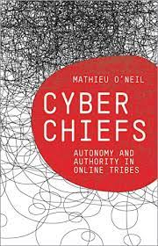
Lecture 9
Authority in Online Tribes
Digital communications researcher Mathieu O’Neil is among those who claim that the internet is in fact full of hierarchies.
O’Neil (2009) says, authority is a hugely important element of the social interaction in digital online networks.

Slide 4
Lecture 9
Authority in Online Tribes
First, in order to be able to organise and express themselves, participants need to exercise some sort of quality control over what they are doing, and organize their activities. in other words, that online organization is impossible without some sort of hierarchy emerging.

Slide 5
Lecture 9
Authority in Online Tribes
Second, there is the issue of trust and reliability, It is O’Neil’s view that for online self-expression and organisation to work, participants also need to be able to somehow determine who is reliable and who is not, and understand which contributions are relevant and important.

Slide 6
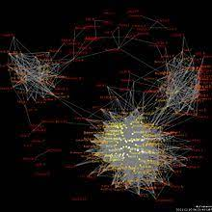
Lecture 9
Authority in Online Tribes
Third, he argues, the building of trust will in turn decide who should be part of the group, as issues of inclusion and exclusion need to be dealt with. O’Neil’s explanation of how authority emerges online, in spite of the ‘stateless’ character of the internet, lies in his notion of online tribes.

Slide 7
Lecture 9
Authority in Online Tribes
Such tribes are online formations based on direct forms of grassroots interaction, and on a feeling of closeness to others. But, because of the reasons presented above, authority is still an important dimension of such tribes.

Slide 8
Lecture 9
Authority in Online Tribes
O’Neil draws here on the classic sociology of Max Weber, whose view was that authority is a fundamental feature of all complex systems of human relationships —such as the internet. In Weber’s view, the authority of a person is the result of other people agreeing that this person has a legitimate right to exercise power.

Slide 9
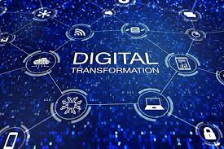
Lecture 9
Cyberchiefs and Charisma
O’Neil (2009) makes the argument that whatever utopian hopes we might have for the internet and social media, groups will always need or have leaders of some sort. These are the cyber chiefs of the online tribes.

Slide 10
Lecture 9
Cyberchiefs and Charisma
So, while online projects (ranging from full-on activist campaigns to other social ‘projects’, such as a hashtag or a single discussion thread in a forum) centre around charismatic leaders, who affect many and inspire them to follow, they still manage to maintain a formal equality between participants. Furthermore, digital society in O’Neil’s view is marked by ‘permanent conflictuality’, a recurring sequence of action that proceeds in this way: a claim is made, the facts are examined, deliberation ensues.

Slide 11

Lecture 9
Cyberchiefs and Charisma
So, when it comes to power and dominance in a digital society, it is unavoidable that leaders and authorities emerge, even though some have optimistically imagined otherwise. But in fact, it is all but unexpected that digital media can support this timeless social form.

Slide 12
Lecture 9
Cyberchiefs and Charisma
Some sort of power structure or leadership is unavoidable. When writing of the forms of the social, Simmel argued that ‘a group upon reaching a certain size must develop forms and organs which serve its maintenance and promotion’, and furthermore that ‘the structure of the group requires a certain quota of its members for leadership’ (Simmel 1950: 87 and 107).

Slide 13
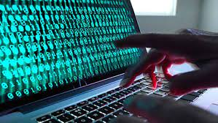
Lecture 9
Cyber typing and Binary Switch
In mainstream research and theorising about digital society there is often a lack of acknowledgment of the significant differences in uses that take form at the intersection of gender, race, ethnicity, and so on.

Slide 14
Lecture 9
Cyber typing and Binary Switch
This risks that the way in which we view the digital may in fact conceal existing inequalities. Sociologists Eileen Green and Carrie Singleton (2013: 36) argue that rather than becoming dazzled by the shiny new vista that the digital age appears to open up, one must focus on the broader structural inequalities and the localised differences in how the digital works.

Slide 15
Lecture 9
Cyber typing and Binary Switch
Instead of repeating that things like gender and race do not matter in the digital age, we must look at how such things matter, in potentially new ways. According to the theory about the social shaping of technology, technology is (re-)shaped by the social while the social is (re-)shaped by technology (Williams & Edge 1996).

Slide 16
Lecture 9
Cyber typing and Binary Switch
It is from such a perspective, Green and Singleton argue, that we must look closer at the gendering of digital society, or the racialisation of digital society, and so on.
Digital tools and platforms are socially contextualised and shaped by interaction and relations. This is as applicable to their design and development, as to their utilisation and
domestication. Some of the platforms may indeed allow for engagement in what cultural theorist Lisa Nakamura (2002: 14) calls identity tourism.

Slide 17
Lecture 9
Cyber typing and Binary Switch
This is a process whereby one can temporarily appropriate identities different from one’s own in online settings (in games, for example). Nakamura says, however, that such tourism is not really about honouring diversity, but rather about playing with identities as ‘amusing prostheses to be donned ’ without any real consequences.

Slide 18
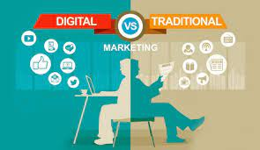
Lecture 9
New media vs New cultures
New media are forms of media that are native to computers, computational and relying on computers for redistribution. Some examples of new media are telephones, computers, virtual worlds, single media, website games, human-computer interface, computer animation and interactive computer installations.

Slide 19
Lecture 9
New media vs New cultures
Although there are several ways that New Media may be described, Lev Manovich, in an introduction to The New Media Reader, defines New Media by using six propositions:
1. New Media versus Cyberculture – Cyberculture is the various social phenomena that are associated with the Internet and network communications (blogs, online multi-player gaming), whereas New Media is concerned more with cultural objects and paradigms (digital to analog television, iPhones).

Slide 20

Lecture 9
New media vs New cultures
2. New Media as Computer Technology Used as a Distribution Platform – New Media are the cultural objects which use digital computer technology for distribution and exhibition. e.g. (at least for now) Internet, Web sites, computer multimedia.. etc. The problem with this is that the definition must be revised every few years. The term "new media" will not be "new" anymore, as most forms of culture will be distributed through computers.

Slide 21
Lecture 9
New media vs New cultures
3. New Media as Digital Data Controlled by Software – The language of New Media is based on the assumption that, in fact, all cultural objects that rely on digital representation and computer-based delivery do share a number of common qualities. New media is reduced to digital data that can be manipulated by software as any other data. Now media operations can create several versions of the same object. An example is an image stored as matrix data which can be manipulated and altered according to the additional algorithms implemented, such as color inversion, gray-scaling, sharpening, rasterizing, etc.

Slide 22
Lecture 9
New media vs New cultures
4. New Media as the Mix Between Existing Cultural Conventions and the Conventions of Software – New Media today can be understood as the mix between older cultural conventions for data representation, access, and manipulation and newer conventions of data representation, access, and manipulation. The "old" data are representations of visual reality and human experience, and the "new" data is numerical data. The computer is kept out of the key "creative" decisions, and is delegated to the position of a technician. e.g. In film, software is used in some areas of production, in others are created using computer animation.

Slide 23
Lecture 9
New media vs New cultures
5. New Media as the Aesthetics that Accompanies the Early Stage of Every New Modern Media and Communication Technology. instead, we would have to develop a much more comprehensive analysis which would correlate the history of technology with social, political, and economical histories or the modern period.

Slide 24
Lecture 9
New media vs New cultures
6. New Media as Faster Execution of Algorithms Previously Executed Manually or through Other Technologies – Computers are a huge speed-up of what were previously manual techniques. e.g. calculators. Dramatically speeding up the execution makes possible previously non-existent representational technique. This also makes possible of many new forms of media art such as interactive multimedia and video games. On one level, a modern digital computer is just a faster calculator, we should not ignore its other identity: that of a cybernetic control device.

Slide 25
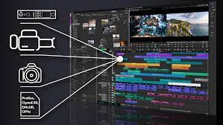
Lecture 9
What is Digital Media Software?
Digital media software refers to computer application programs that allow a user the flexibility to manipulate and control many aspects of digital media files. The three discrete components of digital media are audio, photographs, and video. With digital media software, a creator can combine the various constituent elements of digital media into one unified production and easily share it with others.

Slide 26
Lecture 9
What is Digital Media Software?
Digital, as opposed to analog, media is created by digitizing the underlying data into a binary format that computers can readily interpret. Modern personal computers, equipped with powerful processors as well as large hard drive storage capacities, can now manage the billions of bits of data that comprise digital images, sound, and video. Digital media software provides the necessary tools as well as a graphical user interface to accomplish these tasks.

Slide 27
Lecture 9
What is Digital Media Software?
By using the various tools provided in digital media software, the underlying attributes of each type of digital media can be adjusted or manipulated with great precision at the user’s discretion. Photographs can be color corrected, for example; exposure, brightness, and contrast each can be modified. Blemishes and other unsightly imperfections can be removed entirely.

Slide 28
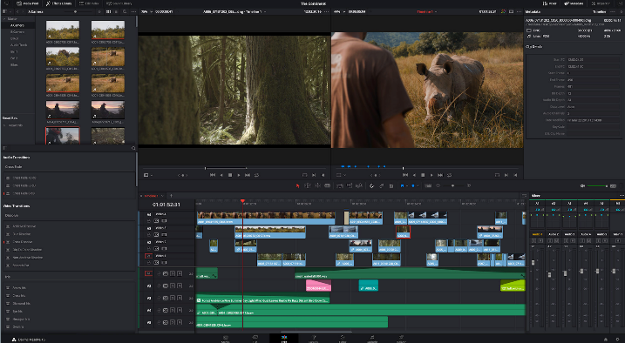
Lecture 9
What is Digital Media Software?
The variable characteristic of digitized sound or audio files can be similarly altered. Portions of audio can be cut, copied, and pasted, and the discrete parts can then be combined into one continuous recording. Amplitude and volume can be adjusted and controlled as well, at any point in the audio track. Fade in and fade out of songs or audio recordings can be achieved easily by adjusting the volume curve from within the software application program.

Slide 29
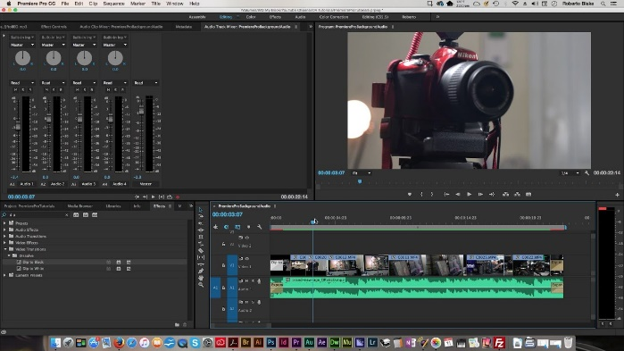
Lecture 9
What is Digital Media Software?
Digital video editing software can be used to place video clips imported from a video camera onto a graphical timeline, where they can be shortened, cut, and rearranged in any sequence in order to achieve a desired effect. Sound and other audio files can be imported and added to the timeline and arranged to play at any point in the production. Still photographs can be added to the timeline and interspersed between video clips to create a montage effect.

Slide 30
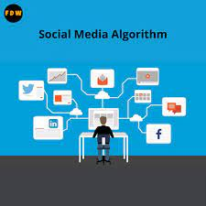
Lecture 9
Algorithms in Social Media Platforms
Algorithms in social media platforms can be defined as technical means of sorting posts based on relevancy instead of publish time, in order to prioritize which content an user sees first according to the likelihood that they will actually engage with such content. For example, the posts which are recommended to you when you scroll through your Instagram feed, or the stories of your friends that appear first on the dashboard, are determined by algorithms.

Slide 31
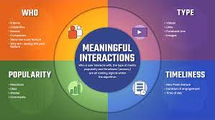
Lecture 9
Algorithms in Social Media Platforms
Algorithms can be written by coders who make use of machine learning. “Machine learning” means that algorithms “learn” how to carry out tasks under various levels of human oversight. Algorithms manage several tasks which would be tedious for humans to carry out, such as managing flows of content through active recommendations as well as negative shadow bans and mediating interaction with information through likes and comments to improve content discoverability. In addition, algorithms rank and filter information in ways that create incentives and conditions of interaction for content creators that are similar to markets.

Slide 32
Lecture 9
The function of an algorithm
The function of an algorithm is to deliver relevant content to users. The reason why social media platforms use algorithms is to more organically filter through the large amount of content that is available on each platform. Algorithms do the work of delivering content that is potentially more “interesting” for a user to the detriment of posts which are deemed irrelevant or low-quality - either in general, or to a specific user.

Slide 33
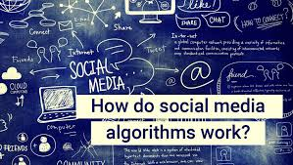
Lecture 9
The function of an algorithm
Regarding the criteria based on which algorithms deliver content, sometimes social media platforms explicitly specify which content they consider as high-quality and therefore promote on their platform.

Slide 34
Lecture 9
The function of an algorithm
It must be further kept in mind that social media platforms are actual businesses, which make part of their revenue from marketing. This may include marketing of a brand or content that public pages want to promote by paying a fee to the social media in order to have the algorithms promote them.

Slide 35
Lecture 9
How do algorithms work?
Algorithms are designed in a way that takes into account different aspects. Some of these aspects are content-based, meaning that this kind of algorithmic design seeks to match a user’s taste, based on their profile, to specific posts that the system guesses the user will like. Once users show interest in a specific tag or category, they are directed to other items in the same category.

Slide 36
Lecture 9
How do algorithms work?
Moreover, algorithms can operate in a collaborative way. Collaborative filtering consists in matching users to other users who seem to share similar interests; this way, a person is directed to posts or videos that they might want to see based on the fact that a user with a similar profile searched for that specific source. Algorithms can be context-aware, in the sense that they can individuate personal data such as a user’s exact geographic location in order to include it in the algorithmic calculations.

Slide 37
Lecture 9
How do algorithms work?
Finally, machine learning uses computers to simulate human learning, which allows them to identify and acquire knowledge from the real world, and improve performance of some tasks, such as recommendations through algorithms, based on this new knowledge.

Slide 38
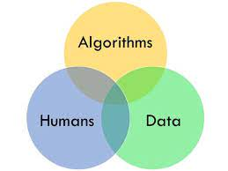
Lecture 9
How algorithms influence the spread of culture in society
These different approaches to algorithmic design have consequences when processing cultural content. For example, when engineers set computers through machine learning to create algorithms based on the geographic location of users, they limit - or at least direct - the spread of a particular form of art or of information to that specific area. The effects of algorithmic design can be considered both positive or negative. Often algorithms may be created with the aim of increasing awareness or interest in the digital society on a specific matter, some users may suddenly see in their feed an increase of posts concerning nutrition and diet, or foreign cinema, or politics.

Slide 39
Lecture 9
How algorithms influence the spread of culture in society
However, the negative implications that algorithmic design may have are often the object of heated discussions on the controversies that surround algorithms. Such controversies often concern privacy issues: algorithms work with the personal data of the social media user, in order to “know” how to display the content on the social media platform (for example, algorithms make use of sensitive data such as the geographical location of the user, the friends and acquaintances they interact the most with, the pages and hashtags that they often search for, et cetera). Similarly, there are also considerations about how algorithms influence the opinion and interests of social media users and, consequently, of the digital society.

Slide 40
Lecture 9
Thank You

