Slide 1



Overview of Intrusion Prevention
Lecture 8
HCIA-Security
Prepared by
Dr. Abdelrhman Ahmed

Slide 2
Chapter
08
Forward
• Currently, malware is the most common form of security threat, while the impact of greyware is increasing and security threats correlated to crimes have been critical to network security.
• Instead of dealing with only virus attacks, users now have to fend off combinations of network threats, including viruses, hacker intrusions, Trojan horses, botnets, and spyware. Current defense mechanisms struggle to mitigate such attacks.
• This course explains what intrusion is and describes to what degree Huawei USG products support intrusion prevention.

Slide 3
Chapter
08
Objectives
• Upon completion of this course, you will be able to:
□ Describe the different types of intrusion prevention.
□ Deploy network antivirus policies.

Slide 4
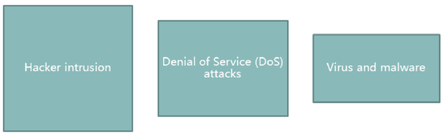
Chapter
08
Network Threats in Today’s Networks
• Network threats, such as viruses, no longer only target computer systems. Instead, they are also used for financial gain, etc. This is causing conventional computer viruses and other network threats to evolve into interest-driven, all-round network threats.
• Malware is the most common security threat, and includes viruses, worms, botnets, rootkits, Trojans, backdoor programs, vulnerability exploit programs, and wap malicious programs. Besides malware, the impact of greyware is increasing and security threats correlated to crimes have been critical to network security.
• Instead of facing only virus attacks, users now have to fend off combinations of network threats, including viruses, hacker intrusions, Trojan horses, botnets, and spyware. Current defense mechanisms struggle to mitigate such attacks.

Slide 5
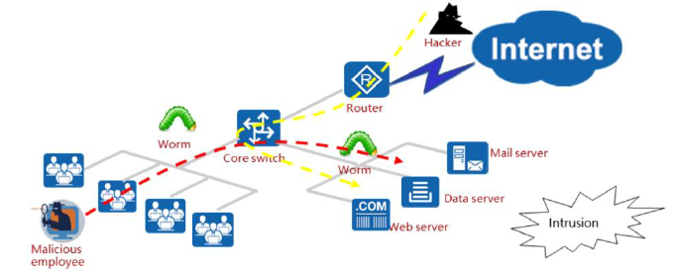
Chapter
08
Intrusions by Hackers
Hackers and malicious employees may exploit system and software vulnerabilities to intrude into servers, putting the security of data from key services at risk.
• Vulnerabilities lead to severe security risks:
□ Application software running on the enterprise intranet may have vulnerabilities.
□ The Internet helps vulnerabilities in application software spread rapidly.
□ Worms spread by exploiting application software vulnerabilities, consuming network bandwidth and damaging important data.
□ Hackers and malicious employees target vulnerabilities to intrude into enterprise servers and tamper with, destroy, or steal confidential information.

Slide 6
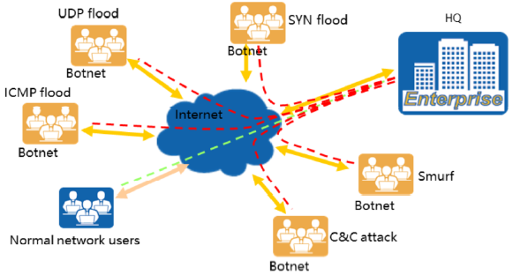
Chapter
DDoS Attacks
08
DDoS attacks launched for financial gain continuously disrupt the normal operation of enterprises, and these attacks are becoming increasingly harmful.

Slide 7
Chapter
08
DDoS Attacks
• DDoS attacks:
□ There is now a global black industry chain based on DDoS attacks that has the aim of financial gain. Also, there is a huge number of botnets on networks.
□ DDoS attacks may be launched for blackmail or disrupting competitors.
□ DDoS attacks will occupy bandwidth to bring the network down and exhaust server resources to prevent the server from responding to user requests or to crash the system, ultimately causing services to fail.

Slide 8
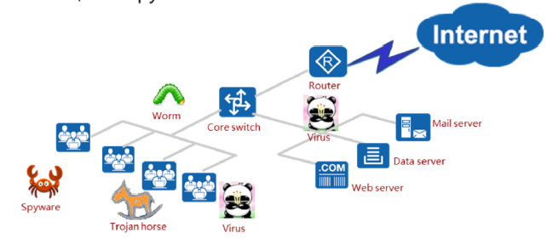
Chapter
Viruses and Malware
08
• An increasing number of enterprise service applications depend on the IT information system. The operation of services is under threat from viruses, Trojan horses, and spyware.
• A virus is a type of malicious code that infects or attaches to application programs or files and spreads through protocols, such as email or file sharing protocols, threatening the security of user hosts and networks.
• Viruses perform various types of harmful activities on infected hosts, such as exhausting host resources, occupying network bandwidth, controlling host permissions, stealing user data, and even corrupting host hardware.
• Virus and malware:
□ Viruses, Trojan horses, and spyware invade an intranet mainly through web browsing and mail transmission.
□ Viruses can crash computer systems and tamper with or destroy service data.
□ Trojan horses enable hackers to steal key information on computers as well as crash them. Spyware collects, uses, and transmits sensitive information on enterprise employees, disturbing normal services.
□It’s difficult for desktop antivirus software to globally prevent the outbreak of viruses.

Slide 9
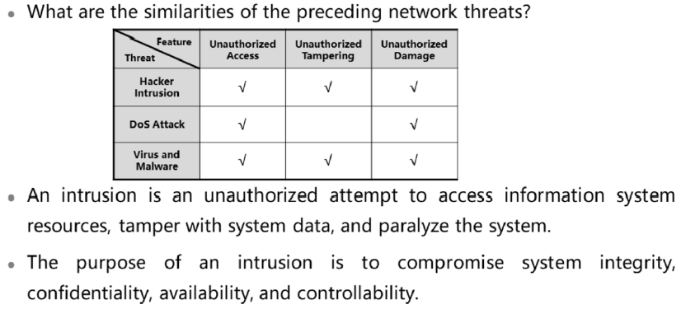
Chapter
08
What is an Intrusion?

Slide 10
Chapter
08
What is an Intrusion?
• Typical intrusions:
□ Tampering with web pages
□ Cracking system passwords
□ Copying and viewing sensitive data
□ Obtaining user passwords using network sniffing tools
□ Accessing servers without authorization
□ Obtaining raw packets with special hardware
□ Implanting Trojan horses in hosts

Slide 11
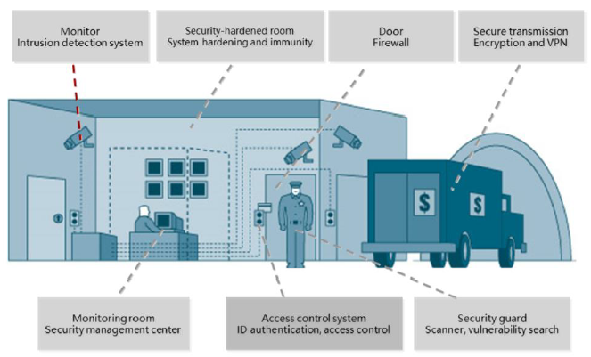
Chapter
08
Positions of Security Devices in a Security System

Slide 12
Chapter
08
Positions of Security Devices in a Security System
• In the security system, the intrusion detection system (IDS) takes on the same role as a surveillance camera. It monitors and analyzes traffic across key nodes in the information system and learns of ongoing security events. The system administrator can use the IDS to obtain and analyze the traffic of key nodes for discovering and reporting anomalies and suspicious network behaviors.
• Intrusion detection inspects various operations as well as analyzing and auditing data and phenomena to detect intrusion behaviors in real time. It is a proactive and dynamic security defense technology that covers various authorized and unauthorized intrusion behaviors.
• The IDS can immediately start relevant security mechanisms once detecting security policy violation behaviors or evidence that the system is being attacked.
• Firewalls and IDS:
□ Firewalls are usually deployed in serial mode and are capable of rapid forwarding but not in-depth detection.
□ Firewalls can neither correctly analyze malicious code in application data flows nor detect malicious operations or mis operations of intranet users.
□ Firewalls perform coarse-grained access control, whereas the IDS provides fine­ grained detection, allowing the administrator to monitor the live network even more accurately.
□ The IDS can interwork with a firewall and switch to serve as a helpful assistant of the firewall for controlling interzone access.
□ The IDS can be manually or automatically updated, and its policies can be easily configured.

Slide 13
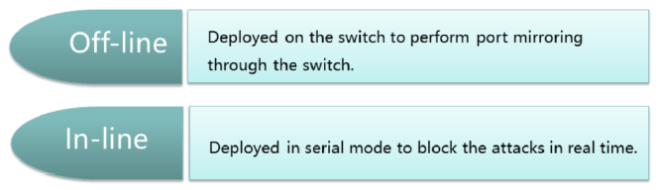
Chapter
08
Intrusion Prevention System
• The intrusion prevention system (IPS) is an intelligent intrusion detection and prevention product. As well as detecting intrusions, it also prevents and terminates intrusion behaviors using certain ways of responding, protecting the information system in real time against substantial attacks.
• The IPS can be deployed in the following modes:

Slide 14
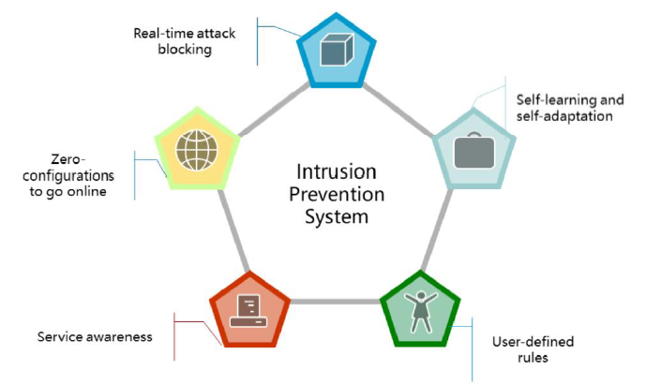
Chapter
08
Technical Feature of the IPS

Slide 15
Chapter
08
Technical Features of the IPS
• The IPS has the following technical features:
□ Real-time blocking: The IPS detects and blocks network attacks in real time, whereas the IDS can only detect attacks. Therefore, the IPS improves system security to the maximum extent.
□ Self-learning and self-adaptation: The IPS minimizes the rate of false negatives and false positives through self-learning and self-adaptation to reduce the impact on services.
□ User-defined rules: The IPS supports the customization of intrusion prevention rules to give the best possible response to the latest threats.
□ Service awareness: The IPS can detect exceptions or attacks at the application layer.
□ Zero-configurations to go online: The system provides a default intrusion prevention security profile that can be directly referenced.

Slide 16
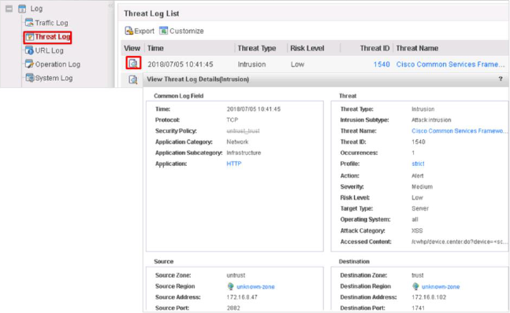
Chapter
08
Viewing Intrusion & Prevention Behaviors

Slide 17
Chapter
08
Viewing Intrusion & Prevention Behaviors
• Intrusion log information includes virtual system, hit security policy, source and destination addresses, source and destination ports, source and destination Zones, user, protocol, application, hit intrusion prevention security profile, signature name, signature sequence number, event count, intrusion target, intrusion severity, operating system, signature category, and signature action. Of these, the following are particularly important:
□ Profile: Hit intrusion security profile.
□ Threat name: IPS signatures describe attack behavior features. The firewall compares the features of packets with the signatures to detect and defend against attacks.
□ Event count: The field is used for merging logs. Whether logs are merged is determined by the merge frequency and conditions. The value is 1 if logs are not merged.
□ Intrusion target: Indicates the attack target of a packet detected based on the signature, which can be:
■ server: The attack target is the server.
■ client: The attack target is the client.
■ both: The attack targets are the server and client.

Slide 18
Chapter
08
NAT Server – Internal Server
□ Intrusion severity: Indicates the severity of the attack caused by the packet detected based on the signature, which can be:
■ Information
■ Low
■ Medium
■ High
□ Operating system: Indicates the operating system attacked by the packet detected based on the signature, which can be:
■ All: all systems
■ Android - iOS
■ Unix-like
■ Windows
■ Other: other systems
□ Signature category: Indicates the threat category to which the packet attack detected based on the signature belongs.
• Signature action, which can be:
□ Alert
□ Block

Slide 19
Chapter
Overview of Computer Viruses & Malicious Code
08
• Computer virus
□ A computer virus is a set of self-replicable instructions or program code compiled independently or embedded in computer programs to adversely affect a computer's use by damaging its functions or data.
• Malicious code
□ Malicious code is a program that covertly inlays code into another program to run intrusive or disruptive programs and damage the security and integrity of the data on an infected computer.
• Ways of categorizing computer viruses:
□ By functions of malicious code: virus, worm, and Trojan horse
□ By transmission mechanisms: mobile media, network sharing, network scanning, email, and P2P network
□ By infected objects: operating system, application, and device
□ By carriers: executable file, script, macro, and boot area

Slide 20
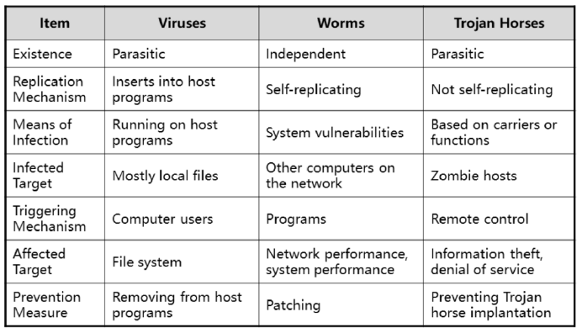
Chapter
08
Viruses, Worms & Trojan Horses

Slide 21
Chapter
08
Viruses, Worms & Trojan Horses
• The relationships between viruses, worms, and Trojan horses are as follows:
□ A virus is a segment of malicious code that is parasitic on a normal program. When a user enables the normal program, the virus is also started, damaging the system's file system.
□ A worm is a variant of the virus. It is an independent entity that does not need to be parasitic. It can replicate itself and spread by exploiting system or intentional vulnerabilities, impacting the performance of the entire network and the computer system even more severely.
□ A Trojan horse is a kind of malicious code that is parasitic by nature and is extremely covert. Hackers can usually control a host through a Trojan horse and make the host become a zombie. In addition, a Trojan horse can be used to monitor and obtain key information of a victim, such as a bank account password.
• When we talk about using an antivirus, we are referring to the mitigation of malicious code.

Slide 22
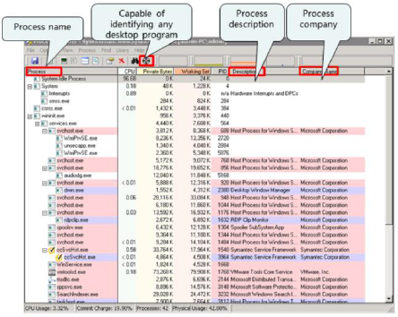
Chapter
08
Antivirus Technologies
• Based on Zones, there are two types of antivirus technology:
□ Single device antivirus
□ Network antivirus
• Single-device antivirus can be implemented by installing antivirus software or professional antivirus tools. Virus detection tools detect malicious code, such as viruses, Trojan horses, and worms. Some detection tools can also provide the recovery function. Norton Antivirus from Symantec is a common antivirus software program, and the Process Explorer (see figure) is a professional antivirus tool.
• Network antivirus technology refers to deploying antivirus policies on a security gateway.

Slide 23
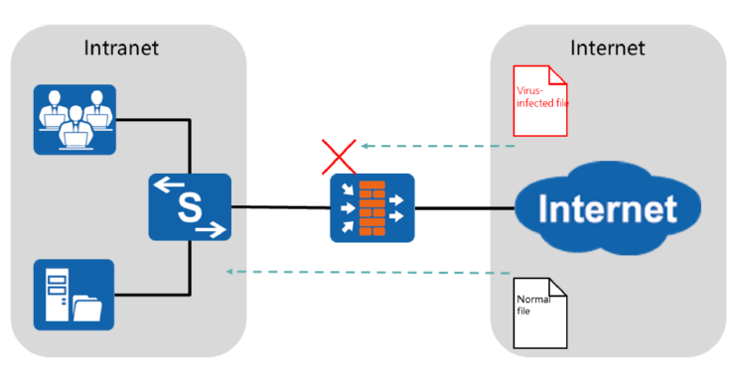
Chapter
08
Network Antivirus Application Scenario
• Antivirus is used for network security in the following scenarios:
□ Intranet users can access the Internet and need to frequently download files from the Internet
□ Servers deployed on the intranet need to frequently receive files uploaded by Internet users.
• As shown in the figure, the NIP serves as a gateway device that isolates the intranet from the Internet There are user PCs and a server on the intranet. Intranet users can download files from the Internet, and Internet users can upload files to the intranet server. To secure the files to be uploaded or downloaded, the antivirus function should be configured on the NIP.
• After the antivirus function is configured, the NIP only permits secure files to be transferred into the intranet. If a virus is detected in a file, the NIP applies the action, such as block or alert, to the file.

Slide 24
Chapter
08
Modes for Implementing Gateway Antivirus
• Proxy scanning mode
□ All data packets passing through the gateway that require virus detection are transparently transmitted to the gateway's protocol stack for caching and then sent to the virus detection engine.
• Flow scanning mode
□ File signatures are extracted for matching against the local signature database. This mode relies on stateful inspection and protocol parsing technologies.
• Currently, device vendors (including UTM and AVG) provide two antivirus scanning modes: proxy scanning and flow scanning.
□ A proxy antivirus gateway performs more advanced operations, such as decompression and unpacking, with a high detection rate. However, performance and system overheads are large because all files are cached.
□ A flow antivirus gateway has high performance and low system overhead but low detection rate, failing to cope with shelled and compressed files.

Slide 25
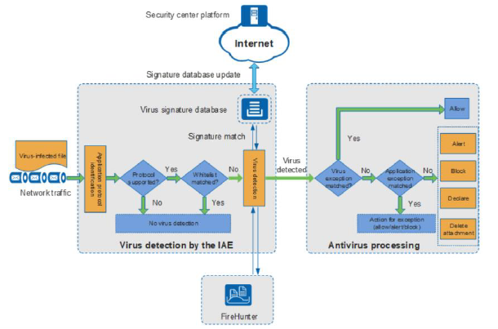
Chapter
08
How Does Firewall Antivirus Work?

Slide 26
Chapter
08
Antivirus Response Actions
• Actions taken by the firewall when a virus is detected:
□ Alert: The device permits the virus-infected file and generates a virus log.
□ Block: The device blocks the virus-infected file and generates a virus log.
□ Declare: For a virus-infected email message, the device permits it but adds information to the email body to announce the detection of viruses and generates a virus log. This action applies only to SMTP and POP3.
□ Delete Attachment: The device deletes malicious attachments in the infected email message, permits the message, generates a log, and adds information to the email body to announce the detection of viruses and deletion of attachments. This action applies only to SMTP and POP3.

Slide 27
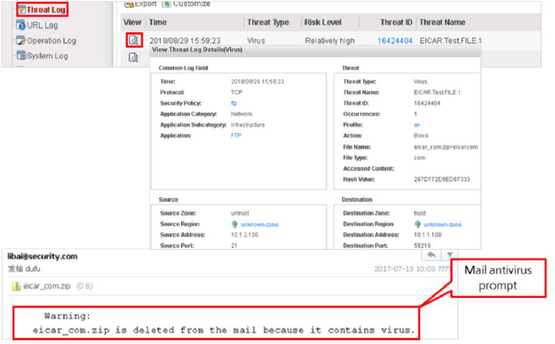
Chapter
08
Checking the Firewall Antivirus Results
• After a virus is detected by the firewall, you can view the detailed antivirus results in the service log.
• After antivirus for HTTP and email protocol is configured, you can view relevant information in the access page or email body.

Slide 28



Thank You

