Slide 1


Strategic Brand Management
Prepared by Dr. Perihan Salah
MKT733
CHOOSING Brand Elements to build Brand Equity
Lecture 5

Slide 2



Strategic Brand Management
Lecture 5
MKT733
CHOOSING Brand Elements to build Brand Equity
Prepared by
Dr. Perihan Salah
www.midocean.ae

Slide 3


Chapter
05
LEARNING OBJECTIVES
Identify the different types of brand elements
List the general criteria for choosing brand elements
Describe key tactics in choosing different brand elements
Explain the rationale for “mixing and matching” brand elements
Highlight some of the legal issues surrounding brand elements
www.midocean.ae

Slide 4
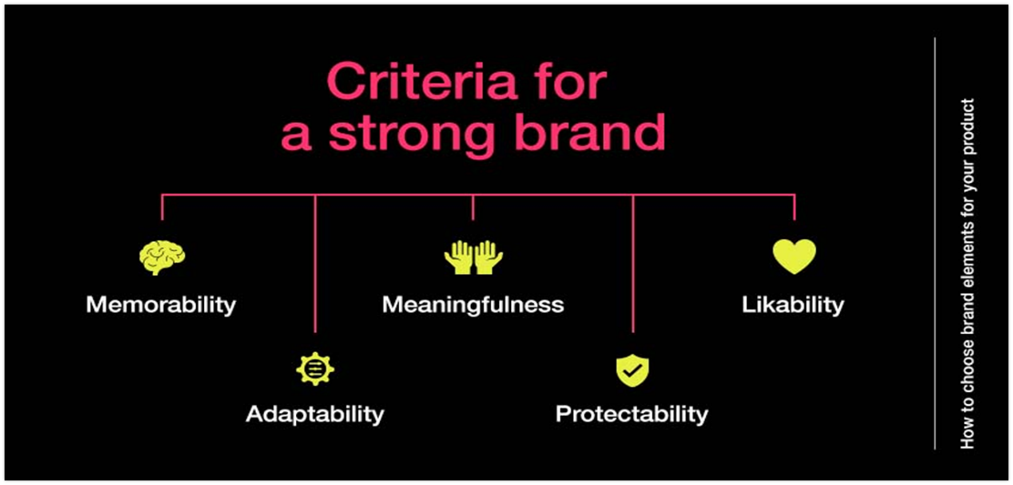
Brands Resonance and the Brand Value Chain
www.midocean.ae

Slide 5
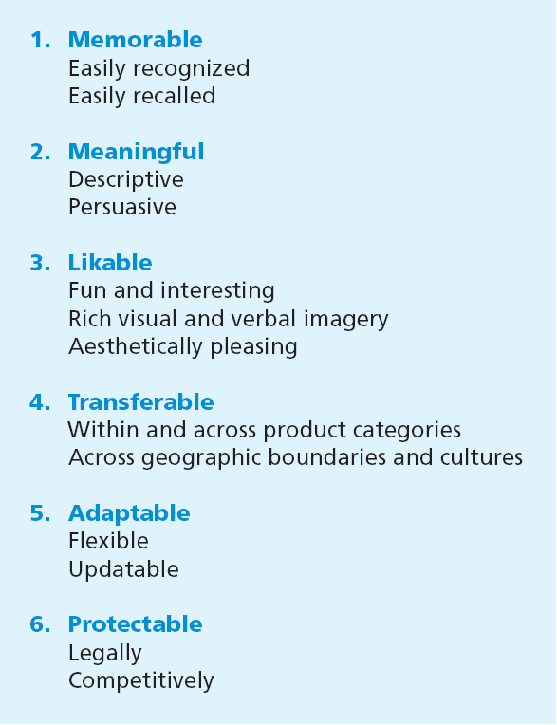

Criteria for Choosing Brand Elements
www.midocean.ae

Slide 6

Criteria for choosing brand elements
There are six criteria for brand elements:
The first three criteria—memorability, meaningfulness, and likability—are the marketer’s offensive strategy and build brand equity.
The latter three, however, play a defensive role for leveraging and maintaining brand equity in the face of different opportunities and constraints.
www.midocean.ae

Slide 7
Criteria for choosing brand elements
Memorability:
A necessary condition for building brand equity is achieving a high level of brand awareness.
Brand elements that promote that goal are inherently memorable and attention-getting and therefore facilitate recall or recognition in purchase or consumption settings
www.midocean.ae

Slide 8
Criteria for choosing brand elements
Meaningfulness:
Brand elements may take on all kinds of meaning, with either descriptive or persuasive content.
General information about the function of the product or service: Does the brand element have descriptive meaning and suggest something about the product category, the needs satisfied, or benefits supplied?
Specific information about particular attributes and benefits of the brand: Does the brand element have persuasive meaning and suggest something about the particular kind of product, or its key points-of-difference attributes or benefits?
www.midocean.ae

Slide 9
Criteria for choosing brand elements
Likability:
Independent of its memorability and meaningfulness, do customers and the brand element aesthetically appealing?
Is it likable visually, verbally, and in other ways? Brand elements can be rich in imagery and inherently fun and interesting, even if not always directly related to the product.
www.midocean.ae

Slide 10
Criteria for choosing brand elements
Transferability:
Measures the extent to which the brand element adds to the brand
equity for new products or in new markets for the brand.
How useful is the brand element for line or category extensions? In general, the less specific the name, the more easily it can be transferred connotes a massive South American river and therefore as a brand across categories. For example, Amazon can be appropriate for a variety of different types of products
To what extent does the brand element add to brand equity across geographic boundaries and market segments? To a large extent this depends on the cultural content and linguistic qualities of the brand element. One of the main advantages of nonmeaningful, synthetic names like Exxon is that they transfer well into other languages.
www.midocean.ae

Slide 11
Criteria for choosing brand elements
Adaptability:
The other consideration for brand elements is their adaptability over time.
Because of changes in consumer values and opinions, or simply because of a need to remain contemporary, most brand elements must be updated.
The more adaptable and flexible the brand element, the easier it is to update it.
For example, logos and characters can be given a new look or a new design to make them appear more modern and relevant.
www.midocean.ae

Slide 12
Criteria for choosing brand elements
Protectability:
Another consideration is the extent to which the brand element is protectable—both in a legal and a competitive sense.
Marketers should (1) choose brand elements that can be legally protected internationally, (2) formally register them with the appropriate legal bodies, and (3) vigorously defend trademarks from unauthorized competitive infringement.
www.midocean.ae

Slide 13


Slide 14
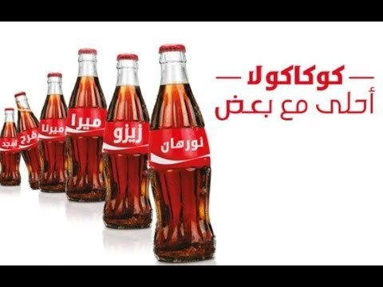

Slide 15
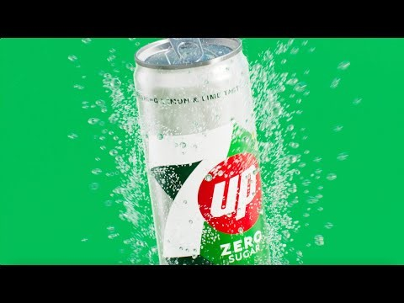

Slide 16


Slide 17


Slide 18
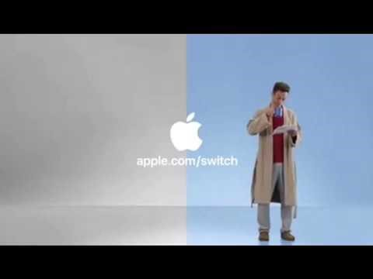

Slide 19

www.midocean.ae

Slide 20
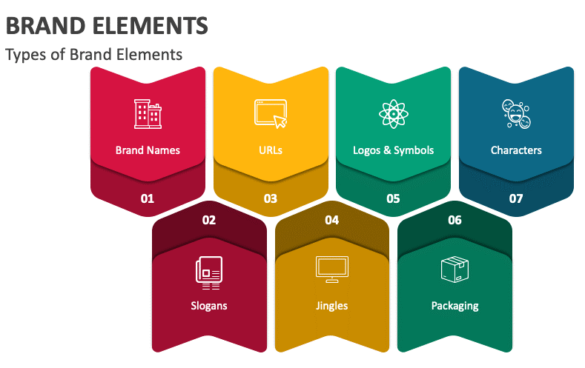
Types of Brand Elements
www.midocean.ae

Slide 21
Brand Names
Captures the central theme or key associations of a product in a very compact and economical fashion
Most difficult element for marketers to change
  Closely tied to the product in the minds of consumers
www.midocean.ae

Slide 22
Brand Names
Naming guidelines: brand awareness (simplicity and ease of pronounce, therefore marketers can shorten longer names to make it easier to recall (Chevrolet Chevy and Coca-Cola Coke) however, the way a brand is pronounced can affect its meaning, beside familiarity, differentiated, distinctive and unique such as Toys are us became R Us).
www.midocean.ae

Slide 23
Brand Names
Naming guidelines
  Simplicity and ease of pronunciation and spelling.
  Familiarity and meaningfulness.
  Differentiated, distinctive, and unique.
  Brand associations:
    Morpheme: Smallest linguistic unit having meaning.
    Plosives: The letters b, c, d, g, k, p, and t.
    Sibilants: Sounds like s and soft c.
www.midocean.ae

Slide 24
Brand Names
Marketers generally devise made-up brand names
systematically, basing words on combinations of morphemes.
A morpheme is the smallest linguistic unit having meaning.
There are 7,000 morphemes in the English language, including real words like “man” and prefixes, suffixes, or roots.
For example, Nissan’s Sentra automobile is a combination of two morphemes suggesting “central” and “sentry” (sentinella).
By combining carefully chose n morphemes, marketers can construct brand names that actually have some relatively easily inferred or implicit meaning.
www.midocean.ae

Slide 25
Brand Names
Brand names raise a number of interesting linguistic issues
The letter X became popular (e.g., ESPN’s X Games and Nissan’s Xterra SUV) because X represents “extreme,” “on the edge,” and “youth
The sounds of letters can take on meaning as well
Some words begin with phonemic elements called plosives, like the letters b, c, d, g, k, p, and t, whereas others use sibilants, which are sounds like s and soft c.
www.midocean.ae

Slide 26
Brand Names
Plosives escape from the mouth more quickly than sibilants and are harsher and more direct. Consequently, they are thought to make names more specific and less abstract, and to be more easily recognized and recalled.
On the other hand, because sibilants have a softer sound, they tend to conjure up romantic, serene images and are often found in the names of products such as perfumes—think of Chanel, Ciara (by Revlon), and Shalimar and Samsara (Guerlin).
www.midocean.ae

Slide 27
Brand Names
Naming procedures: (define objectives, generate names, screen and study initial candidates, and select the final name which maximizes the company’s branding and marketing objectives)
www.midocean.ae

Slide 28
Brand Names
Naming procedure
  Define objectives
  Generate names
  Screen initial candidates
  Study candidate names
  Research the final candidates
  Select the final name
www.midocean.ae

Slide 29


Slide 30
Uniform Resource Locators (URLs)
Specify locations of pages on the Web known as domain names in order to protect their brands from an authorised use in other domain names.
Protect the brands from unauthorized use in other domain names
www.midocean.ae

Slide 31
Uniform Resource Locators (URLs)
Domain squatting is defined by government low and Registered. Also brand recall is critical for URL because it increases the likelihood that consumers easily to remember URL to get to the site.
  The top areas of legal activity initiated by companies' biotechnology and pharmaceuticals
www.midocean.ae

Slide 32


www.midocean.ae

Slide 33
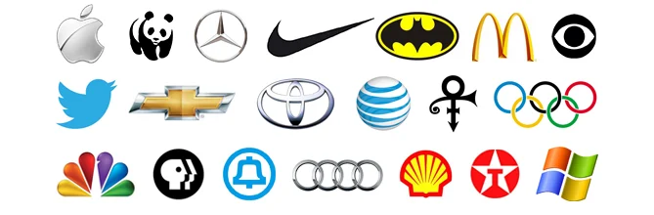
Logos and Symbols
Indicate origin, ownership, or association
Range from corporate names or trademarks written in a distinctive form, to abstract designs that may:
  Be completely unrelated to the corporate name or activities.
  Logos can be distinctive and recognizable.
  Because logos are often non-verbal they transfer well across cultures.
  Some logos may lack the inherent meaning and consumers may not understand what the logo is intended to represent.
  Also the consumers might perceive and evaluate logos differently depending on the shape.
www.midocean.ae

Slide 34
Logos and Symbols
Benefits:
  Easily recognized and can be a valuable way to identify products.
  Versatile.
  Abstract logos offer advantages when the full brand name is difficult to use for any reason.
  Unlike brand names, logos can be easily adapted over time to achieve a more contemporary look.
www.midocean.ae

Slide 35


Slide 36


Slide 37
Characters
Special type of brand symbol
  One that takes on human or real-life characteristics
Introduced through advertising and can play a central role in ad campaigns and package designs.
Brand characters tend to be attention getting and useful for creating brand awareness.
Also, the human element of brand characters can enhance likeability and help to create perceptions, fun and interesting.
Because brand characters do not have direct product meaning, they may be transferred to across product categories
www.midocean.ae

Slide 38
Characters
Benefits:
Tend to be attention getting and quite useful for creating brand awareness.
Help brands break through marketplace clutter as well as help communicate a key product benefit.
The human element of brand characters can enhance likeability and help create perceptions of the brand as fun and interesting.
A consumer may more easily form a relationship with a brand when the brand literally has a human or other character presence.
Brand characters do not typically have direct product meaning, therefore they can be transferred relatively easily across product categories.
www.midocean.ae

Slide 39
Characters
Cautions:
Can be so attention getting and well liked that they dominate other brand elements and actually dampen brand awareness.
Must be updated over time so that their image and personality remain relevant to the target market.
www.midocean.ae

Slide 40
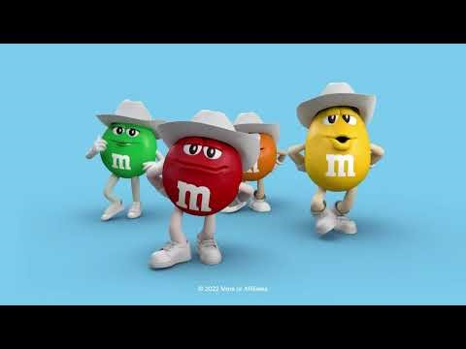

Slide 41


Slide 42
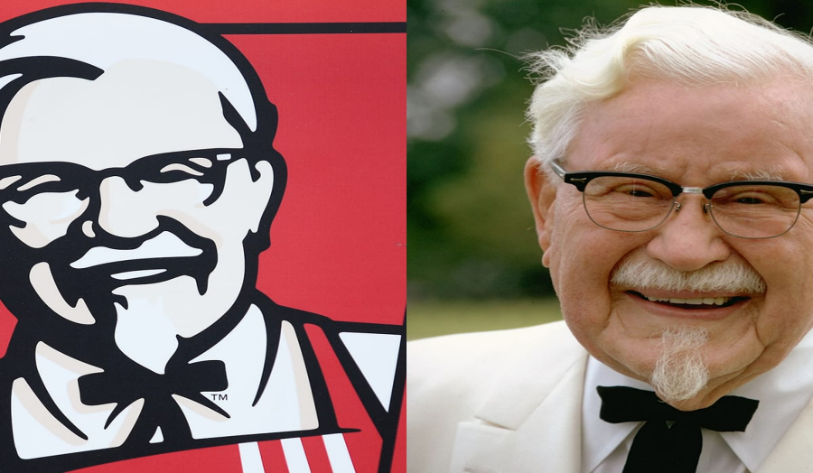
www.midocean.ae

Slide 43
Slogans
Short phrases that communicate descriptive or persuasive information about the brand.
Indispensable means of summarizing and translating the intent of a marketing program. Some slogans help build brand awareness and reinforce the brand positioning and some slogans might be very powerful for enhancing brand equity.
Examples ( City Never Sleeps, lower prices- better life, Prepare for Battle (Nike), which express performance. Benetton has strong slogan represents it global clothing style (United Colours of Benetton)
www.midocean.ae

Slide 44
Slogans
Benefits:
Help build brand awareness by making strong links between the brand and the corresponding product category.
May serve as tag lines to summarize the descriptive or persuasive information conveyed in the ads.
www.midocean.ae

Slide 45
Slogans
Designing slogans
  Slogans should be designed in such a way that they contribute to brand equity in multiple ways.
  Slogans also can contain product-related messages and other meanings.
www.midocean.ae

Slide 46
Slogans
Updating slogans
In updating slogans marketers should:
Recognize how the slogan is contributing to brand equity, if at all, through enhanced awareness or image.
Decide how much of this equity enhancement, if any, is still needed.
Retain the needed or desired equities still residing in the slogan as much as possible while providing whatever new twists of meaning are necessary to contribute to equity in other ways.
www.midocean.ae

Slide 47







www.midocean.ae

Slide 48
Jingles
Musical messages written around the brand
Have catchy hooks and that become permanently registered in the minds of listeners
Enhance brand awareness by repeating the brand name in clever and amusing ways. Even consumers are likely to mentally rehearse or repeat catchy jingles after the ad is over, providing more encoding opportunities and increasing memorability.
www.midocean.ae

Slide 49


Slide 50


Slide 51


Slide 52
Packaging
Activity of designing and producing containers or wrappers
From the perspective of both the firm and consumers, packaging must:
  Identify the brand
  Convey descriptive and persuasive information
  Facilitate product transportation and protection
  Assist in at-home storage
www.midocean.ae

Slide 53
Packaging
From the perspective of both the firm and consumers, packaging must:
  Aid product consumption. Packaging play a significant role at the point of purchase, with package design and innovation. Packaging innovations can create a point of difference and can capture new market segments.
  One of the major packaging trends of recent years is to make bigger and smaller packaged versions of products to appeal to new market segments. Jumbo sizes have been successfully introduced for Pizzas, frozen dinners.
www.midocean.ae

Slide 54
Packaging
Benefits:
  Structural packaging innovations can create a point of difference that permits a higher margin.
  New packages can also expand a market and capture new market segments.
  Packaging changes can have immediate impact on customer shopping behavior and sales.
www.midocean.ae

Slide 55
Packaging
Packaging at the point of purchase
Many consumers may first encounter a new brand on the supermarket shelf or in the store therefore right packaging can create strong appeal on the store shelf and help products stand out from the clutter.
When few product differences exist in some categories, packaging innovations can provide at least a temporary edge on competition.
www.midocean.ae

Slide 56
Packaging
Packaging innovations
  Can both lower costs and/or improve demand
  Manufacturers can redesign packages and employ more recyclable materials to lower the use of paper and plastic.
  In mature markets, package innovations can provide a short-term sales boost.
www.midocean.ae

Slide 57
Packaging
Package designing
  Integral part of product development and launch.
  Specialized package designers bring artistic techniques and scientific skills to package design in an attempt to meet the marketing objectives for a brand.
  Packaging color affect consumers’ perceptions of the product itself.
www.midocean.ae

Slide 58
Packaging
Packaging changes
  Firms change their packaging:
  To signal a higher price, or to more effectively sell products through new or shifting distribution channels.
  When a significant product line expansion would benefit from a common look.
  To accompany a new product innovation to signal changes to consumers.
  When the old package looks outdated.
www.midocean.ae

Slide 59

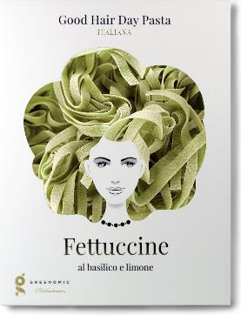


www.midocean.ae

Slide 60
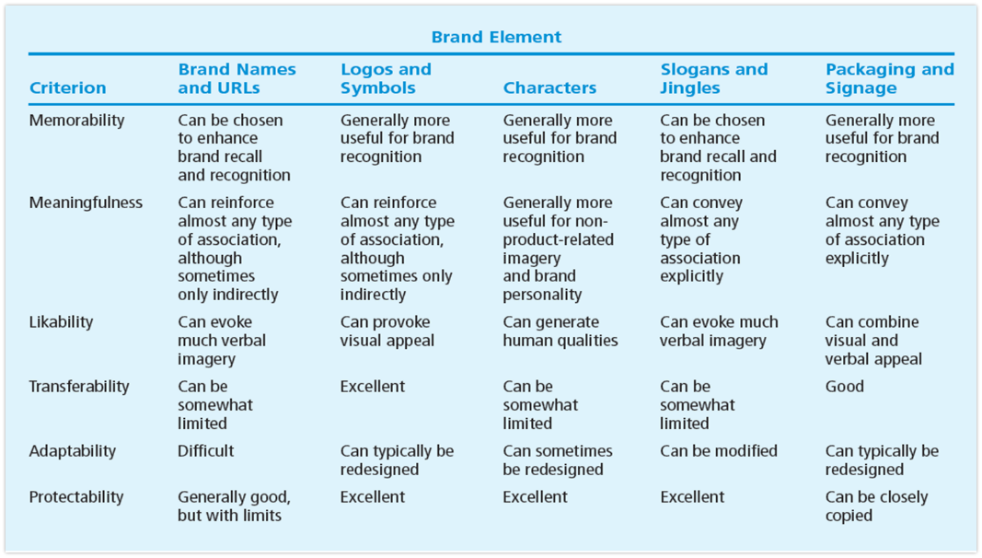
Critique of Brand Element Options

Slide 61

www.midocean.ae
Identify the different types of brand elements
List the general criteria for choosing brand elements
Describe key tactics in choosing different brand elements
Explain the rationale for “mixing and matching” brand elements
Highlight some of the legal issues surrounding brand elements
Chapter
05
To Sum Up…

Slide 62



Thank You

