Slide 1



Writing and presenting your project report
Prepared by Associate Professor:
Ahmed Rageh Ismail
ENT 636
Research Project
Lecture 10

Slide 2


Learning outcomes
Chapter
10
By the end of this chapter you should:
Understand writing as a continuous process, not a final step
Use AI tools ethically and effectively in research writing
Evaluate and select appropriate report structures
Differentiate between academic and consultancy reports
Write in a clear, accessible style for multiple audiences
Meet modern assessment criteria including AI transparency
Plan digital-first presentations (slides, posters, dashboards)
Avoid common AI pitfalls (hallucinations, bias, generic text)
www.midocean.ae

Slide 3
Introduction
Chapter
10
Writing should never be left until the end.
It is a continuous process throughout your research.
Your report is something you develop over time, not write in a panic.
The best way to learn is to teach. Writing forces you to understand thoroughly before explaining. Your reader knows little about your topic – you must guide them.
www.midocean.ae

Slide 4
Introduction
Chapter
10
5 years ago: Writing = final stage, supervisor = only reader, paper only.
Now: Writing = iterative, AI = assistant, readers = humans + AI detectors.
You are still the author. AI is a tool..
www.midocean.ae

Slide 5
Undertaking writing
Chapter
10
Create time for your writing
Writing is not an activity that can be allocated an odd half-hour whenever it is convenient. It requires sustained effort and concentration. Some people prefer to write all day until they drop from exhaustion! Others like to set a strict timetable where a few hours a day are devoted to writing.
You may find it helpful to set aside a particular period each day to write. Writing on successive days will also help to ensure the continuity of your ideas and avoid having to keep ‘thinking your way back’ into your research.
www.midocean.ae

Slide 6
Undertaking writing
Chapter
10
Write when your mind is fresh
Writing is a creative process so it is important to write at the time of day when your mind is at its freshest. All of us have jobs to do that require little or no creativity so arrange your day to do uncreative jobs when you are at your least mentally alert.
www.midocean.ae

Slide 7

Undertaking writing
Chapter
10
Find a regular writing place
Writing is often best undertaken in the same place. This may be because you are psychologically comfortable in a particular space. It may be for more practical reasons. If that space is your own room you will already be familiar with the need to make sure you do not disturb yourself or allow others to do this.
Switching off all distractions such as your mobile phone, social media and television and putting a ‘do not disturb’ sign on the door may allow you to work undisturbed in your own room. However, if this doesn't work, you may be able to concentrate better if you find a neutral space, such as an area in your university's library, where you can write without your possessions or your friends being able to distract you! What is important is to know what distrac^{w}ts^{w}y^{w}o^{.m}u and to remove those distractions.

Slide 8
Undertaking writing
Chapter
10
Create a structure for your writing
Writing requires structure. Your research project is likely to be one of the largest pieces of written work you undertake. It is important to think about what you want a chapter to contain before you attempt to write it. As you work though the material you have assembled to write a chapter and jot down ideas that flow from this, you will start to work out how your ideas and this material may be grouped and how such groupings may be related to one another.
www.midocean.ae

Slide 9
Undertaking Writing: Use AI to Generate Structure
Chapter
10
Prompt example:
"What sections should be in the Discussion chapter of a qualitative case study?" Use AI output as a checklist, not a first draft.
You decide the final structure based on your data.

Slide 10
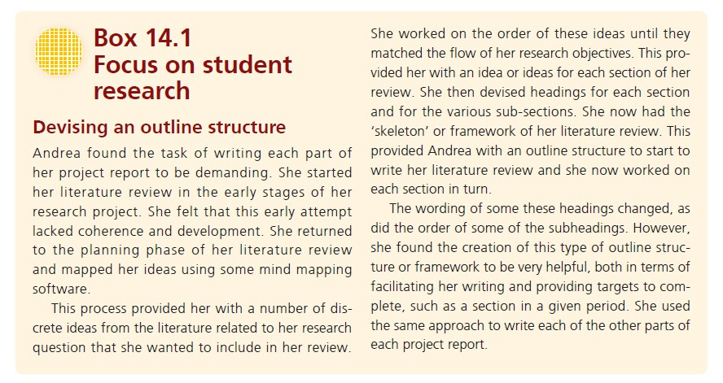

Slide 11
Undertaking writing
Chapter
10
Set goals and achieve them
Writing may involve goal or target setting. You may decide to set yourself the goal to write a section of a chapter in a given period, or to target writing a number of words.
This can be helpful where you have allocated yourself a certain amount of time to write the chapter on which you are working, to be able to judge if you are ‘on time’. However, it is important to be realistic about these goals. If you are too ambitious the quality of your work may suffer as you rush to meet your target.

Slide 12
Undertaking writing
Chapter
10
Finish a writing session on a high point and provide a link to a new session
Writing is about ideas. Many writers prefer to get to the end of a section before they finish writing so that they do not lose any ideas they develop during that session.
This also allows them to tidy up one set of materials and possibly to lay out those for the next session of writing. The worst thing you can do is to leave a complex section half completed as it will be difficult to pick up your thoughts and ideas.

Slide 13
Undertaking writing
Chapter
10
2026 tools:
Google Docs, Notion, Obsidian, Scrivener. Cloud + auto-save + version history.

Slide 14
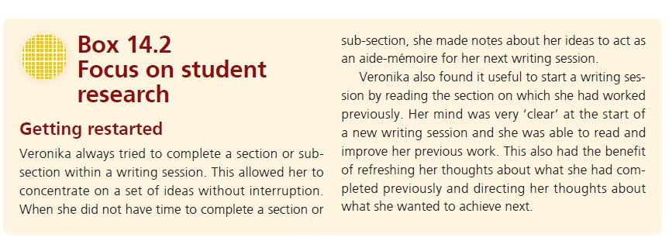

Slide 15
Undertaking writing
Chapter
10
Commence a new writing session by reviewing your previous session
It is helpful to commence a new writing session by reviewing and revising what we wrote in the previous session. If you do this it should provide you with two benefits. Firstly, it will allow you to review what you wrote previously with a fresh mind.
This will allow you to revise what you wrote previously.
Secondly, it will allow you to think yourself back into the ideas that you were working with previously. This should help you to progress your writing in this new writing session.

Slide 16
Undertaking writing
Chapter
10
Get friends to read your work
Writing is creative and exciting, but checking our work may not be! The importance of getting someone else to read through your material cannot be overemphasized.
Your project supervisor should not be the first person who reads your report, even in its draft form. Ask a friend to be constructively critical. Your friend must be prepared to tell you about things in the text that are not easy to understand – to point out omissions, spelling, punctuation and grammatical errors.
Overall, your friend must tell you whether the piece of writing makes sense and achieves its purpose. This is not an easy process for you or your critical friend. Most of us are sensitive to criticism, particularly when the consequence of it is the necessity to do a lot more work.

Slide 17
Get AI to Read Too
Chapter
10
Undertaking writing - Get AI to Read Too
Use Grammarly, ProWritingAid, or LanguageTool.
Ask ChatGPT: "What is unclear in this paragraph?"
But AI misses context – human readers are still essential.

Slide 18
Structuring your project report
Chapter
10
Before you consider different ways to structure your project report, it is important to realize the structure you use will emphasize (or reflect) certain aspects of your research.
Five underlying ‘reporting approaches’ , potentially, be suitable for your project report. They are: linear-analytic; comparative; chronological; theory building; and suspense.

Slide 19
Structuring your project report
Chapter
10
Linear-analytic approach
In a linear-analytic approach a project report is structured logically to reflect the research process. The traditional way to structure a project report is essentially a linear-analytic approach. It is well suited to a deductive, theory-testing approach but is also adaptable to other research approaches.

Slide 20
Structuring your project report
Chapter
10
Comparative approach
In a comparative approach the emphasis is placed on devising a structure that allows analytical comparisons to be made. Different types of comparisons may be made. In one type of comparative approach, the structure used will reflect the fact that the same set of data is analyzed more than once using different analytical perspectives to allow the results of these analyses to then be compared.
In another type of comparative approach, the structure will reflect the fact that different but related data sets are analyzed so that the results of these may then be compared.

Slide 21
Structuring your project report
Chapter
10
Chronological approach
In a chronological approach a structure is devised that allows the emphasis to be placed on the sequence of events evident in the data set. At its simplest, this is essentially an historical account, where it is important to use a structure that allows the data to be reported in a chronological way to understand how the order of events and contextual factors produce cause-and effect sequences.

Slide 22
Structuring your project report
Chapter
10
Theory-building approach
In a theory-building approach a structure is devised that allows the emphasis to be placed on the emergence and refinement of research ideas and the development of themes, relationships and explanations as data are collected. Whereas the linear- analytic approach presents the research process in a logical, rational and ‘sanitized’ way, the theory-building approach is likely to present research as an emergent and messy process but which ultimately produces a convincing story and compelling theoretical explanation. This approach may resemble a chronological approach, albeit that it reports how a theory is developed rather than documenting the sequential development of explanations.

Slide 23
Structuring your project report
Chapter
10
Suspense approach
In a suspense approach, the emphasis is placed on devising a structure that allows the reader to understand how an explanation has been built. It is suggested that the explanation or answer to the research question is presented in the introduction.
The structure of the project report is then devoted to exploring alternative explanations of the phenomenon being studied to be able to evaluate why the chosen explanation is the most convincing.

Slide 24
Structuring your project report
Chapter
10
How might these underlying structural types affect your choice of report structure?
These reporting approaches should help you to evaluate what type of structure will best suit your project report. They should prompt you to ask yourself the following questions:
How does my research design affect the way I might structure my project report?
How does the way I analyzed my data affect the way I might structure my project report?
How does the purpose of my research affect the way I might structure my project report?

Slide 25
Characteristics of the traditional structure
Chapter
10
The traditional structure generally contains the following parts:
Abstract
Introduction
Literature Review
Method
Findings/Results
Discussion
Conclusions
References
Appendices

Slide 26
Characteristics of the traditional structure
Chapter
10
The substantive parts in between these are likely to vary when you use an alternative structure in relation to an inductive research strategy such as
Action Research, Case Study, Ethnography,
Grounded Theory
or Narrative Inquiry.

Slide 27
Abstract
Chapter
10
The Abstract is a short summary of the complete content of the project report. It often contains four short paragraphs with the answers to the following questions:
What were my research questions and why were these important?
How did I go about answering the research questions?
What did I find out in response to my research questions?
What conclusions do I draw regarding my research questions?
A good Abstract should be short (generally between 200 and 300 words); selfcontained; a reflection of the report's content; adequate to inform your reader about the report; objective, precise and easy to read.

Slide 28
Abstract
Chapter
10
The academic publisher, Emerald, gives advice to potential academic authors on how to compile an abstract. Although referring to academic journal articles (papers), it is useful to consider in terms of preparation of your research report.
Writing a good abstract is difficult. The obvious thing to do is to write it after you have finished the report. It is suggested that you draft it at the start of your writing so that you have got your storyline abundantly clear in your mind. You can then amend the draft when you have finished the report.

Slide 29
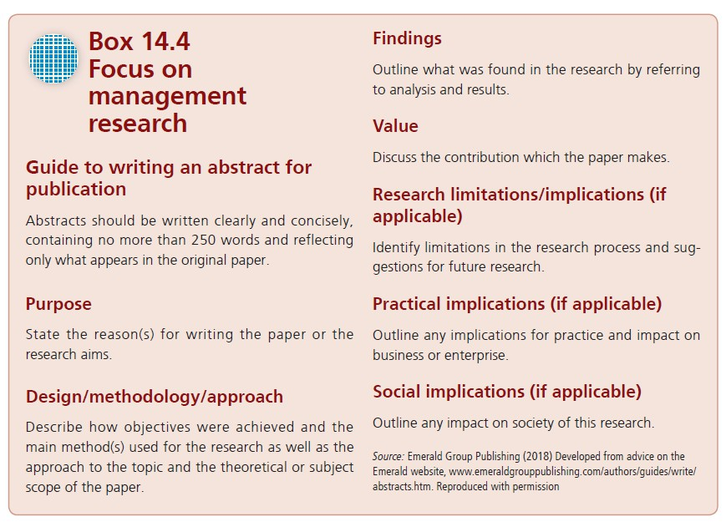

Slide 30
Introduction
Chapter
10
The Introduction should give the reader a clear idea about the central issue of concern in your research and why you thought that this was worth studying. It should also include a full statement of your research question(s), research aim and research objectives.
If your research is based in an organization, we think that it is a good idea to include some brief details about the organization, such as its history, size, products and services. This may be a general background to the more specific detail on the research setting you include in the method chapter.

Slide 31
Introduction
Chapter
10
It is also important to include a ‘route map’ to guide the reader through the rest of the report. This will give brief details of the content of each chapter and present an overview of how your storyline unfolds.
You will probably find it helpful to write the Introduction after drafting the rest of your report to ensure that it accurately represents the report's content.

Slide 32
Use AI to find papers (Elicit, Scite, Consensus, Connected Papers). Use AI to summarize debates. You must synthesize – compare, contrast, critique. AI suggests themes → you verify.
Chapter
10
Literature review
The main purpose of your Literature Review is to set your study within its wider, theoretical context so the reader understands how your study relates to the work that has already been done on your topic.
The Literature Review will directly inform your research questions and any specific hypotheses or propositions that your research is designed to test. These hypotheses or propositions will also suggest a particular research approach, strategy and data collection techniques.

Slide 33
Use AI to find papers (Elicit, Scite, Consensus, Connected Papers). Use AI to summarize debates. You must synthesize – compare, contrast, critique. AI suggests themes → you verify.
Chapter
10
Literature review – 2026 Approach
Use AI to find papers (Elicit, Scite, Consensus, Connected Papers).
Use AI to summarize debates.
You must synthesize – compare, contrast, critique.
AI suggests themes → you verify.

Slide 34


Use AI to find papers (Elicit, Scite, Consensus, Connected Papers). Use AI to summarize debates. You must synthesize – compare, contrast, critique. AI suggests themes → you verify.
Chapter
10
Literature review – What NOT to do?
Do not ask AI to "write a literature review on X“
Do not paste AI-generated text without verification
Do not use hallucinated references
Do: Ask AI to "summarize key debates about X from 2020-2026"

Slide 35
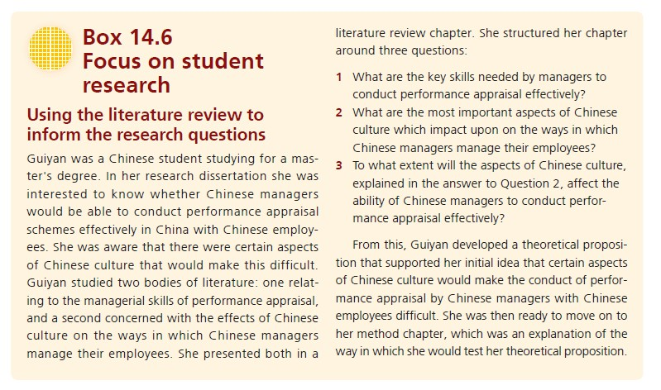

Slide 36
Method
Chapter
10
This should be a detailed and transparent chapter giving the reader sufficient information to understand why you chose the method you used, to assess the reliability and validity of the procedures you used, and to evaluate the trustworthiness of your findings.
You must state:
What AI tools were used
How they were used (brainstorming, coding, editing, etc.)
Any limitations or risks. Example: "ChatGPT-4 generated initial code categories. All codes were reviewed by the researcher.

Slide 37
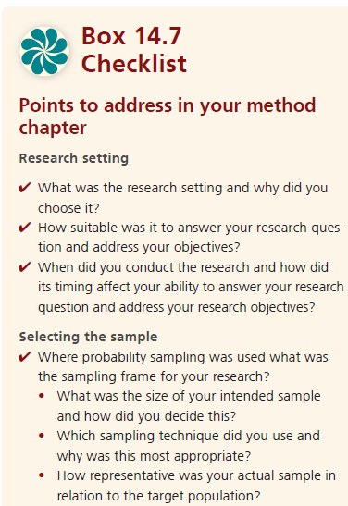

Slide 38
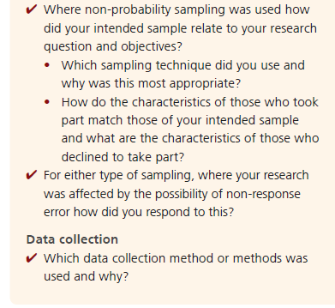

Slide 39
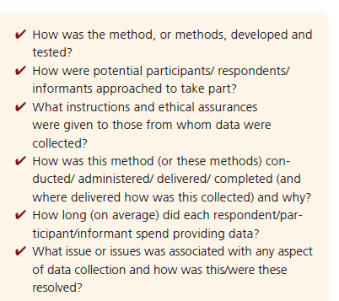

Slide 40
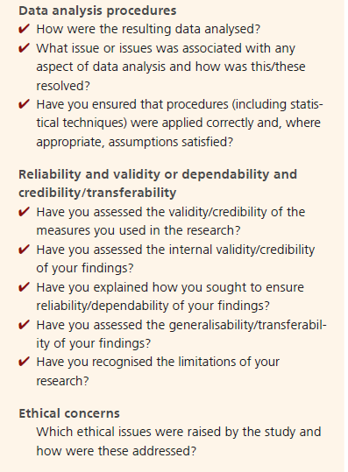

Slide 41
Findings/Results
Chapter
10
This provides you with the opportunity to report your results and is probably the most straightforward part of your report to write.
Where you have analyzed your data quantitatively, you will include the results of your statistical analyses and use tables and graphs to illustrate your findings (do not put these in the appendices if they are important to your argument).
Where data are analyzed qualitatively you are likely to include illustrative quotations to convey the richness of your data and offer insights.

Slide 42
Findings/Results
Chapter
10
There are two important points to bear in mind when writing about your findings.
The first is to stress that the purpose is to present the results of your data analysis. It is normally not appropriate in this chapter to discuss these results. This is the purpose of the Discussion and Conclusions chapters.
Many of us become confused about the difference between findings and discussion. One way of overcoming any confusion is to draw up a table with two columns. The first should be headed ‘What I found out’ and the second ‘What judgements I have formed on the basis of what I found out’. The first list will be based on your data analysis and therefore the content of your Findings/Results. The second list will be your judgements based on what you found out and therefore the content of your Discussion chapter.

Slide 43
Findings/Results
Chapter
10
The second point links to the first. Drawing up a table will lead you to a consideration of the way in which you present your findings. The purpose of your project report is to communicate the answer to your research question in as clear a manner as possible to your readers. Therefore you should structure your findings in a clear, logical and easily understood manner.
There are many ways of doing this. One of the simplest is to return to the research objectives and let these dictate the order in which you present your findings.
Alternatively, you may prefer to report your findings thematically. You could present the themes in descending order of importance. Whichever method you choose should be obvious to the reader.

Slide 44
Discussion
Chapter
10
Findings presented without thought run the risk of your reader asking ‘so what?’: what meaning do these findings have for me?; for my organization?; for professional practice?; for the development of theory?
So the main focus of the Discussion is to interpret the results you presented in the previous chapter. You should state the relation of the findings to the research questions or objectives discussed in the Introduction.
In addition, the Discussion should discuss the implications of your research for the relevant theories which you detailed in your Literature Review. It is usual to discuss the strengths, weaknesses and limitations of your study. However, it is not a good idea to be too modest here and draw attention to aspects of your research which you may consider to be a limitation but that t^{w}h^{w}e ^{w}re^{.m}ad^{id}eºr^{ce}is^{an}u.n^{ae}likely to notice!

Slide 45
Discussion
Chapter
10
The Discussion is where you have the opportunity to shine. It will show the degree of insight that you exhibit in reaching your conclusions. However, it is the part of the report that most of us find difficult. It is the second major opportunity in the research process to demonstrate real originality of thought (the first time being at the stage where you choose the research topic).
Because of that, we urge you to pay due attention to the Discussion. Crucially, here you are making judgements rather than reporting results, so this is where your maturity of understanding can shine through.

Slide 46
Discussion - Advanced 2026 Technique
Chapter
10
Use AI to generate alternative explanations for your findings.
Prompt: "What are three alternative interpretations of these results?“
Then refute or integrate them into your discussion.
This shows critical depth.

Slide 47
Conclusion
Chapter
10
This chapter should not be used to present any new material and should be a conclusion to the whole project (not just the research findings).
Check your Conclusions using the questions in box below.
You may find that the clearest way to present your Conclusions is to follow a similar structure to the one used in your Findings/Results. If that structure reflects the research

Slide 48
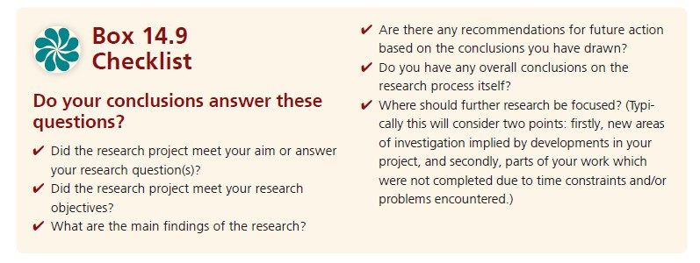

Slide 49
References
Chapter
10
A range of conventions are used to reference other writers' material that you have cited in your text. (Three of the most popular of these, the Harvard, footnotes and American Psychological Association (APA) systems.).
It is a good idea to start your references section at the beginning of the writing process and add to it as you go along. It will be a tedious and time-consuming task if left until you have completed the main body of the text. If you do leave it until the end, the time spent on compiling the reference section is time that would have been better spent on checking and amending your report.

Slide 50
Appendices
Chapter
10
In general, appendices should be kept to the minimum. If the material in an appendix is crucial to your reader's understanding, then it should be included in the main body of your report. If, on the other hand, the material is ‘interesting to know’ rather than ‘essential to know’ then it should be in the appendices.
Often students feel tempted to include appendices to ‘pad out’ a project report. Resist this temptation. Your readers will not be reading your report for relaxation. They will be pressed for time and will probably not look at your appendices. Your project report will stand or fall on the quality of the main text.

Slide 51
Appendices
Chapter
10
However, your appendices should include a blank copy of your questionnaire, interview or observation schedule, or participant diary.
Where these have been conducted in a language different from that in which you write your submitted project report you will need to submit both this version and the translation.
In addition some universities also require you to include a copy of your ethical review approval as an appendix.

Slide 52
Recommendations
Chapter
10
In the typical management report or consultancy report recommendations may be the most important section. The hard-pressed executive reading your report may
turn to your recommendations first to see what action needs to be taken to tackle the issue.
If you are doing exploratory research you may well write recommendations, among which will be suggestions for the pursuit of further research. However, if your research is designed to explain or describe, recommendations are less likely.

Slide 53
Recommendations
Chapter
10
For example, the research question ‘Why do small companies in the Egypt reinvest less of their profits in their businesses than their Saudi counterparts?’ may imply clear points for action.
However, strictly speaking, recommendations are outside the scope of the research question, which is to discover ‘Why?’ not ‘What can be done about it?’ The message is clear. If you want your research to change the situation that you are researching, then include the need to develop recommendations in your research objectives.

Slide 54
Chapter
10
Making the report's content clear and accessible
Choosing a title
A good title is one that has the minimum possible number of words while describing the content of the report accurately.
Try choosing a title and then ask a colleague who knows your subject what they think the title describes.
If their description matches your content then keep the title.

Slide 55
Chapter
10
Making the report's content clear and accessible
Tell a clear story
Be prepared for your project supervisor to ask you ‘What's your main storyline?’ Your storyline (your central argument or thesis) should be clear, simple and straightforward.
It should be so clear that you can stop the next person you see walking towards you and tell that person what your project report's storyline is and he or she will say ‘Yes, I understand that’. This is where writing the abstract helps. It forces you to think clearly about the storyline because you have to summarise it in so few words.

Slide 56

Chapter
10
Making the report's content clear and accessible
Another way of checking to see whether your storyline is clear is to ‘reason
backwards’. An example of this is a project report that ends in clear conclusions. Start by explaining your conclusions to your supervisor. This invites the question from that supervisor: ‘On what basis do you draw these conclusions?’ Here your answer is, of course, on the findings that you established.
The next question asked by the supervisor is: ‘How did you arrive at these findings?’ in response to which you explain your method. The supervisor may counter by asking you why she should take any notice of your findings. The response to this is that you took care to design a research strategy that would lead to valid and reliable findings.
Moreover, that research strategy is based on a clear research question and objectives and a detailed review of the relevant literature. Such ‘reasoning backwards’ is a useful check to see not only whether your ^{w}st^{w}o^{w}ry^{.m}li^{i}n^{d}e^{oc}i^{e}sªc^{n}l^{.a}e^{e}ar but also that it stands up to

Slide 57
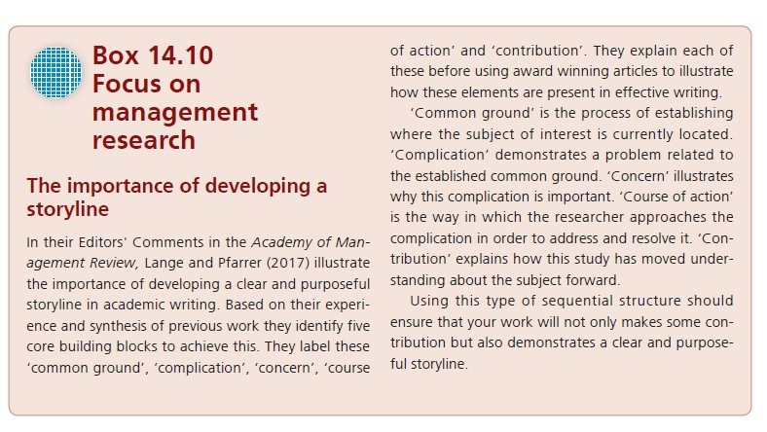

Slide 58
Helping the reader to get all the information out that they need
Chapter
10
Dividing your work
Divide your work in such a way that it is easy for readers to find their way round it and for them always to be clear where they are, where they have come from, and where they are going.

Slide 59
Helping the reader to get all the information out that they need
Chapter
10
Previewing and summarizing chapters
A further way in which you can signpost your work is to ‘top and tail’ each chapter. This is to include a few words of introduction at the beginning of the chapter that provide a description of how the chapter is structured in relation to answering the research question and the key aspects that are covered in the chapter.
At the end of each chapter it is useful to provide a brief summary of the content of the chapter and a very brief indication of how this content links to the following chapter.
This may seem like repetition. However, it helps the reader on her or his journey through your report and ensures that you, the writer, are on the correct road.

Slide 60
Helping the reader to get all the information out that they need
Chapter
10
Visualization
As we introduced earlier, your reader will find your project report more accessible and easier to read if you present some of your data and ideas in tables and figures. It is not only numerical data that can be presented in tables and diagrams. You can also present ideas that can be easily compared.
Do not be tempted to put your tables in the appendices. They will probably be some of your most important data. Include them and comment on them in the text. Your commentary should note the significant aspects of the data in the tables. It should not simply describe the table's contents. A final note of caution: to avoid confusing your reader, do make sure that, wherever possible, you have introduced the table or figure before it appears in the text.

Slide 61
Developing an appropriate writing style
Chapter
10
Write simple sentences
A common source of lack of clarity is the confusing sentence. This is often
because it is too long. A simple rule to adopt is: one idea – one sentence. Try reading your work out loud. If your sentences are too long, you will run out of breath!

Slide 62
Developing an appropriate writing style
Chapter
10
Avoid jargon
Jargon should not be confused with technical terminology. Some technical terms are unavoidable. To assist your reader, it is best to put a glossary of such terms in the appendices. However, do not assume that your reader will have such a full knowledge as you of the subject and, in particular, the context. Here, and in all cases, try to put yourself in the position of the reader.
What can be avoided is the sort of jargon that The Free Dictionary (2018) defines as ‘gibberish’. You will know the sort of phrases: ‘ongoing situation’; ‘going down the route of’; ‘at the end of the day’; ‘the bottom line’; ‘at this moment in time’. It is not just that they are ugly but they are not clear and simple. For example, ‘now’ is much clearer and simpler than ‘at this mo^{w}m^{w}e^{w}n.t^{m}in^{ido}ti^{c}m^{ea}e^{n}’..^{ae}

Slide 63
Developing an appropriate writing style
Chapter
10
Beware of using large numbers of quotations from the literature
We believe that quotations from the literature should be used infrequently in your project report. In addition, by using quotations in this way the student's line of argument tends to become disjointed and less easy to follow.
It is therefore usually better to explain other people's ideas in your own words.
That is not to say that you should never use quotations. Rather we would advise you to use them sparingly to create maximum impact in supporting your storyline.

Slide 64
Developing an appropriate writing style
Chapter
10
Check your spelling and grammar
Spelling is still a problem for many of us, in spite of spellcheckers. A spellchecker will not correct your ‘moral’ when you wished to say ‘morale’ or sort out when you should write ‘practise’ rather than ‘practice’. This is where the friend who is reading your draft can help, provided that friend is a competent speller.
Supervisor tend to be more patient with errors of this kind than those that reflect carelessness. However, the point remains that spelling errors detract from the quality of your presentation and the authority of your ideas.

Slide 65



Thank You

